Slide 1
Integrating and Aligning Academic Data, Practices and Systems
Strand 2: December 2021

Slide 2
VTSS Implementation Components
Aligned Organizational Structure
Data-informed Decision Making
Evidence-based Practices
Family, School, Community Partnerships
Monitoring Student Progress
Evaluation of Process
Source: VTSS Implementation Matrix

Slide 3
Supporting Improvements in Behavioral Competence, Academic Achievement and Social-Emotional Wellness
OUTCOMES
Supporting
Staff
Supporting
Decision
Making
SYSTEMS
DATA
PRACTICES
Supporting
Students

Slide 4
October 2021
Learning Intentions
Review the responsibilities of the Division Leadership Team to align all supports within a VTSS structure.
Understand the process of developing an assessment inventory.
Understand the use of a Universal Screening process within a tiered system, including purpose, selection, and importance for evaluating overall academic health; the use of an Early Warning System will also be explored.

Slide 5
River Valley County Public Schools
River Valley County Public Schools is a division comprised of five schools: 3 elementary schools, one middle school and one high school.
The DLT members include the building level principals, the Director of Special Education and Student Services, the Director of Instruction and Federal Programs, a Technology Specialist, and the Superintendent.
The VTSS team is attending the VTSS S2S Strand 2: Academic Alignment this year.

Slide 6
Today’s Learning Intentions
Develop a process to create a written description of the expectations for quality Tier 1 academic instruction and a system for communicating the expectations to stakeholders. (IM Feature 3A)
Examine existing evidence-based Tier 1 practices to create a continuum of supports that is culturally responsive and is utilized to provide an instructional match to meet learner needs (IM Feature 3C)
Develop a plan for implementing Tier 1 data meeting structures at the school and division level and determine how to measure the fidelity and effectiveness of the meeting structures. (IM Feature 2C)

Slide 7
Success...
Our team can define quality core instruction and understands the importance of creating a communication system for our division stakeholders.
Our team will create a continuum of supports that is culturally responsive and works for ALL students.
Our team will develop a plan for Tier 1 data meeting structures at the school and division level.

Slide 8
QUALITY CORE INSTRUCTION
Evidence-Based Practices

Slide 9
Supporting Improvements in Behavioral Competence, Academic Achievement and Social-Emotional Wellness
OUTCOMES
Supporting
Staff
Supporting
Decision
Making
SYSTEMS
DATA
PRACTICES
Supporting
Students

Slide 10
Fall data sources
VDOE Fall Growth Assessments (grades 3-8)
PALS (grades PreK-3)
VKRP
Commercial screening tools (e.g., DIBELS, FastBridge, I-Ready)
Early Warning Systems (for some)
Classroom data (e.g., running records, benchmark assessments)

Slide 11
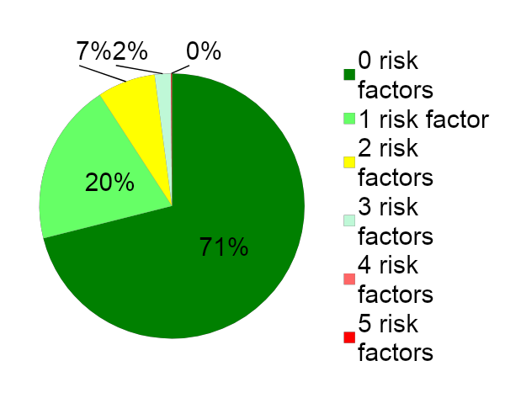
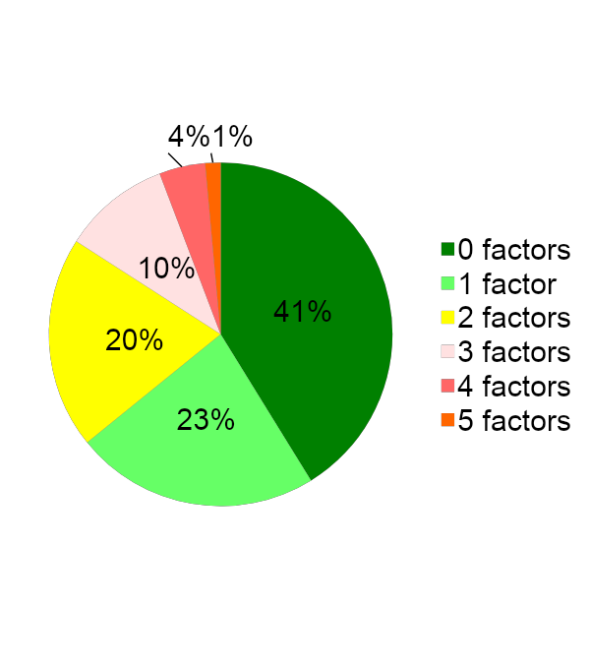
A good screening tool aids decision making
The data can be compared across schools
The data can be displayed graphically

Slide 12
Supporting Improvements in Behavioral Competence, Academic Achievement and Social-Emotional Wellness
OUTCOMES
Supporting
Staff
Supporting
Decision
Making
SYSTEMS
DATA
PRACTICES
Supporting
Students

Slide 13
Evidence-based Practices
Develop a process to create a written description of the expectations for quality Tier 1 academic instruction and a system for communicating the expectations to stakeholders. (Feature 3A)

Slide 14
Evidence-Based Practices:
Feature 3.A

Slide 15
Alignment
“...the degree to which expectations and assessments are in agreement and service in conjunction with one another to guide the system toward students learning what they are expected to know and do.”
Written Curriculum
Taught Curriculum
Tested
Curriculum
Source: Virginia Department of Education

Slide 16
Quality core instruction…
How is it defined?
What is taught?
How it is taught?
Aligned to the standards
Standards unpacked
Pacing guides
Evidence-based practices in the classroom
Providing experiences in the 5Cs
Critical thinking
Creative thinking
Communication
Collaboration
Citizenship

Slide 17
Quality Instruction:
What is the foundation for our division?

Slide 18
IES Resources
Source: https://ies.ed.gov/

Slide 19
Based upon your data,
what is the foundation for our division?

Slide 20
Based upon your data,
what is the foundation for our division

Slide 21
Based upon your data,
what is the foundation for our division

Slide 22
Document, Document, Document!

Slide 23
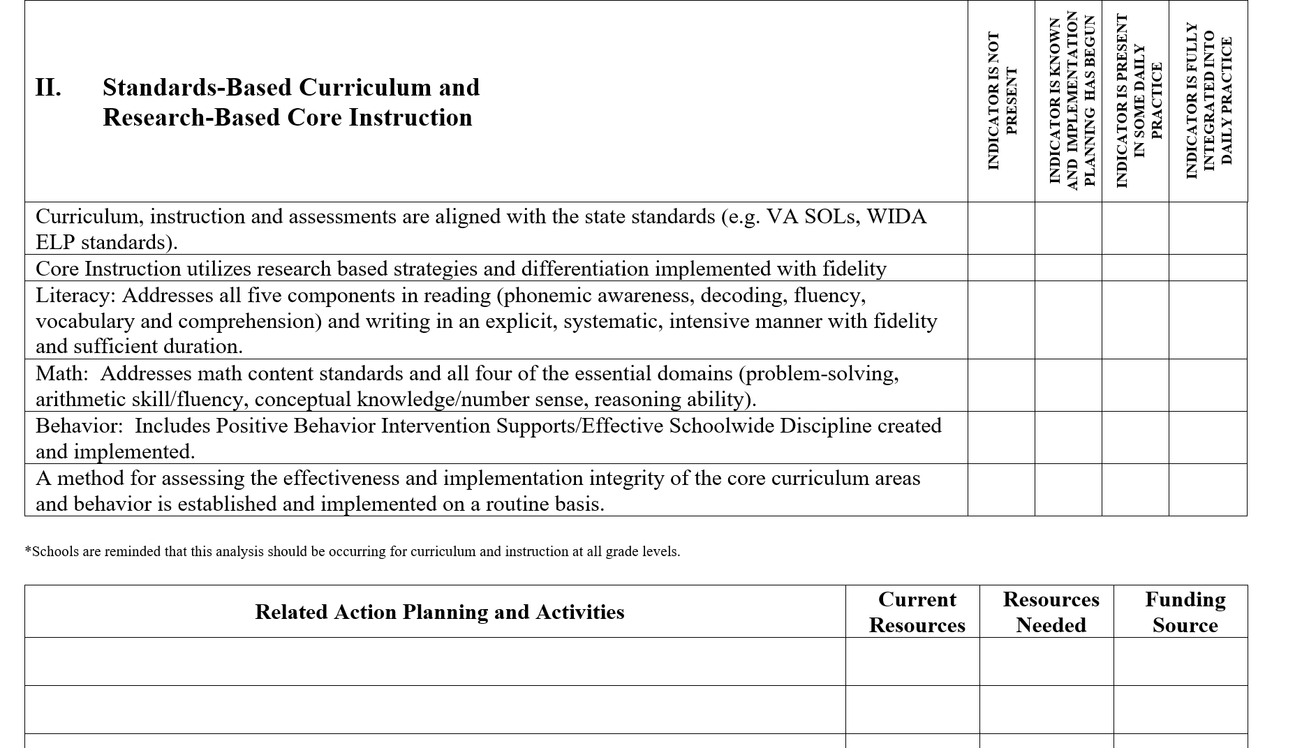
Prince William County Blueprint

Slide 24
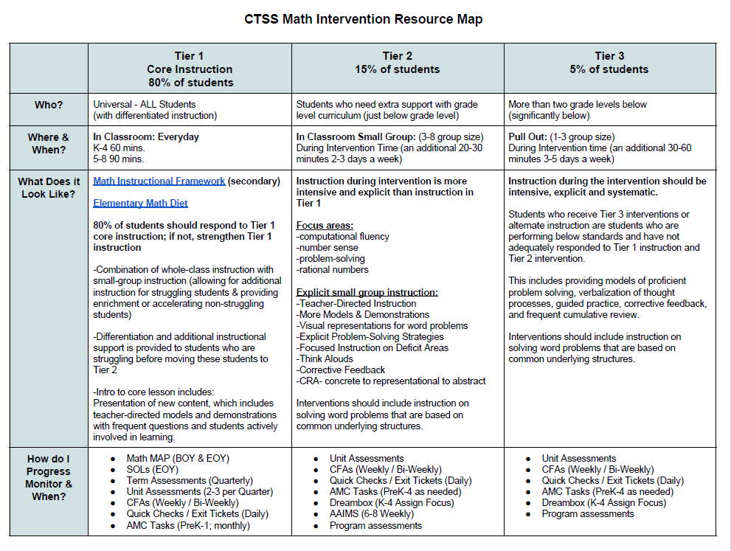
Charlottesville Examples

Slide 25
Develop a Shared Understanding
Learning walks
Instructional rounds
Tandem walkthroughs
Video reviews
Other ways…

Slide 26
Partnership Buy-in
Internal
Instructional leaders
Building Administrators
Teachers
Paraprofessionals
Others

Slide 27
How do you communicate with external stakeholders?
Internal
External
Instructional leaders
Building Administrators
Teachers
Paraprofessionals
Others
Families
Community
Others

Slide 28
The Warren County Journey to Defining a Vision of Quality Instruction

Slide 29
Supporting Improvements in Behavioral Competence, Academic Achievement and Social- Emotional Wellness
OUTCOMES
Supporting
Staff
Supporting
Decision
Making
SYSTEMS
DATA
PRACTICES
Supporting
Students

Slide 30
CONTINUUM OF SUPPORTS THAT IS CULTURALLY RESPONSIVE
Aligned Organizational Structure

Slide 31
Evidence-based Practices
Develop a process to create a written description of the expectations for quality Tier 1 academic instruction and a system for communicating the expectations to stakeholders. (IM Feature 3A)
Examine existing evidence-based Tier 1 practices to create a continuum of supports that is culturally responsive and is utilized to provide an instructional match to meet learner needs. (IM Feature 3C)

Slide 32
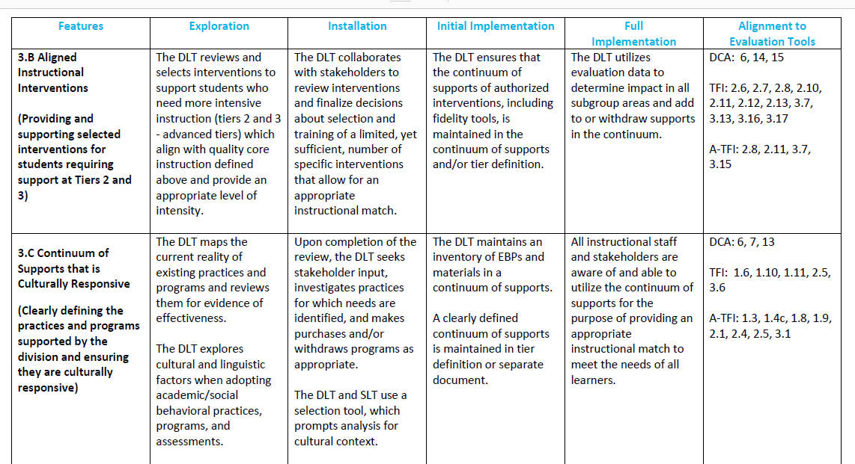
Evidence-Based Practices: Feature 3.C

Slide 33
Big ideas
Has the division team clearly
defined the programs and
practices in use at all tiers?
Is there a process for
review for effectiveness and cultural
responsiveness?
Are the practices understood and used at the school/classroom level?

Slide 34
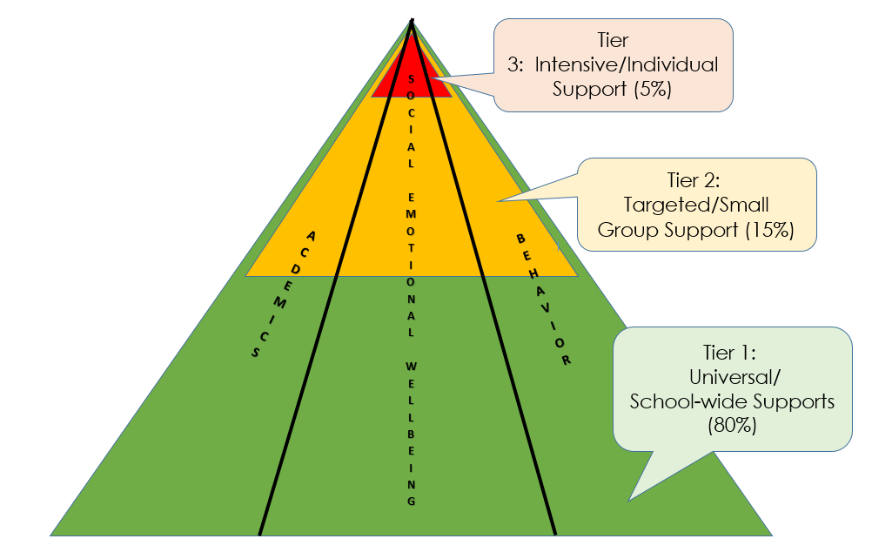
Continuum of Supports for
ALL Students

Slide 35
What is in use now?:
Division Initiative Map (IM)
What programs and/or practices is the division supporting?
Does data support the continued use? If not, is the practice implemented with fidelity? Is the practice supported with adequate resources?
Which programs and/or practices need to be abandoned?
Lastly, what gaps remain and need to be filled?

Slide 36
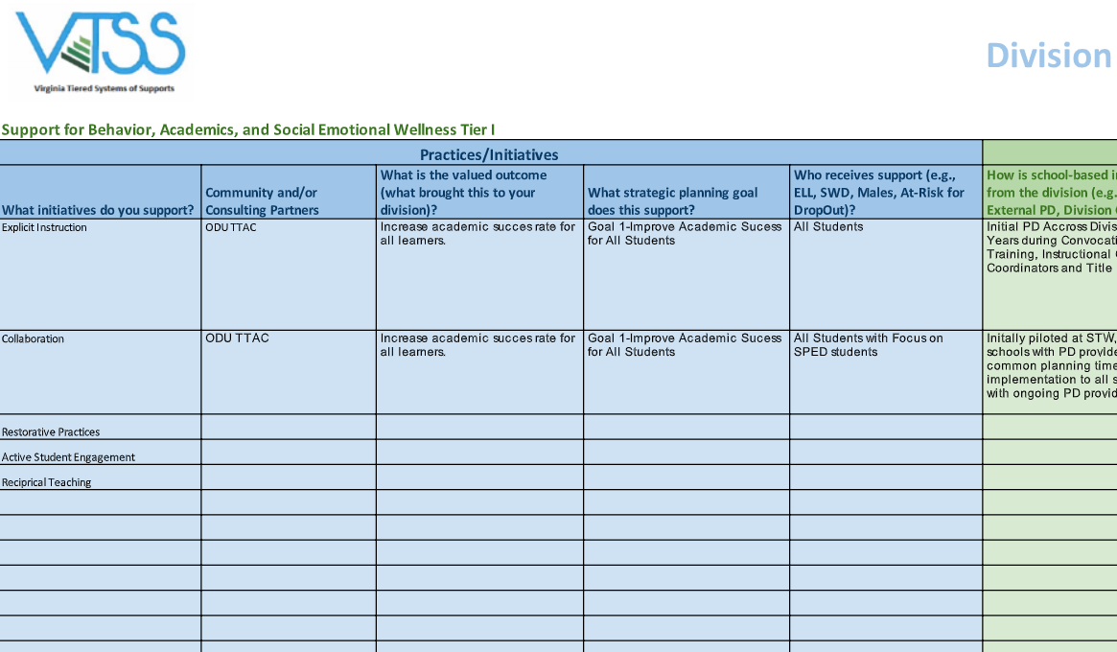
Initiative Map
Practices

Slide 37
System

Slide 38
Data

Slide 39
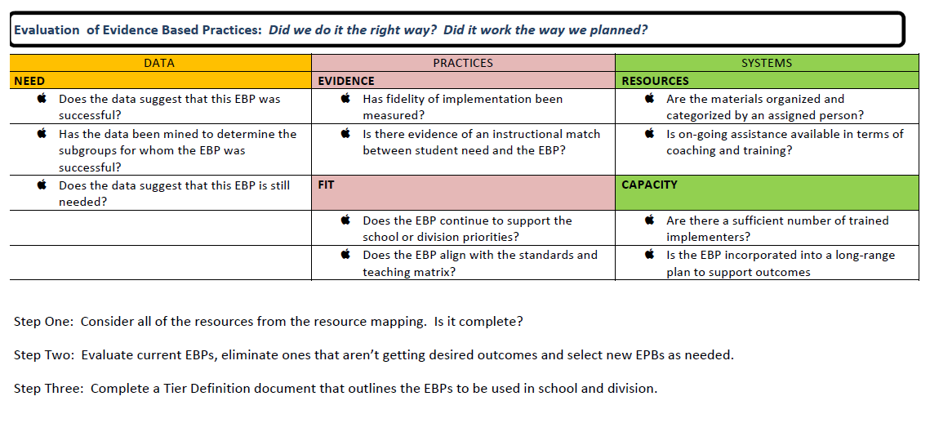
Selection of
Evidence-based Practices: Side 2

Slide 40
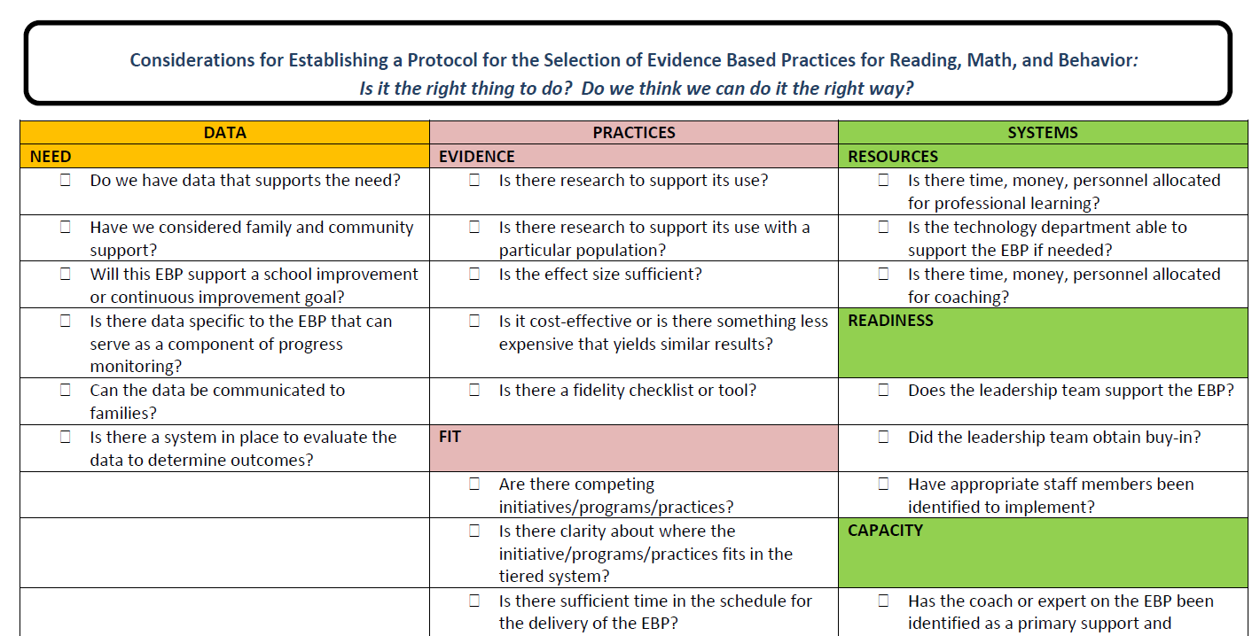
Selection of
Evidence-based Practices: Side 1

Slide 41
Questions to Consider: Data
Selection Tool
Equity Audit Tool
Do we have the data that supports the need?
Are data regularly analyzed and disaggregated data by student groups? (p.3)
Is there a system in place to evaluate the data to determine outcomes?
Have we established a process to identify and communicate equity gaps? (p.3)
Navigating Equity (VDOE) p.31

Slide 42
Questions to Consider: Practices
Selection Tool
Equity Audit Tool
Is there research to support its use with a particular population? Is the effect size sufficient?
How do we know the practices we are selecting are effective for the identified group(s) of students?

Slide 43
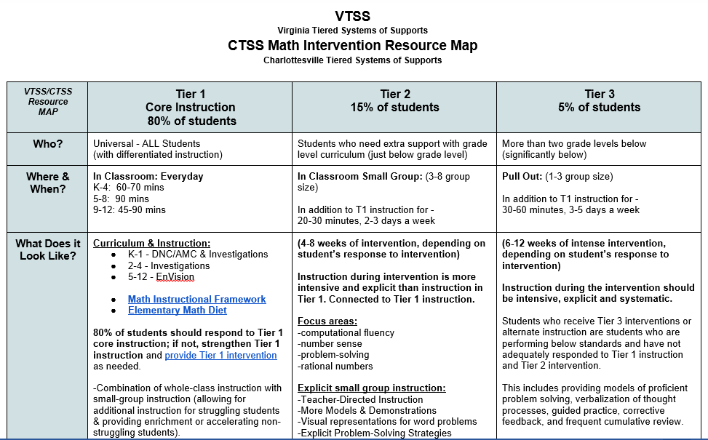
Charlottesville City Schools
A Continuum of Supports

Slide 44
A Continuum of Supports

Slide 45
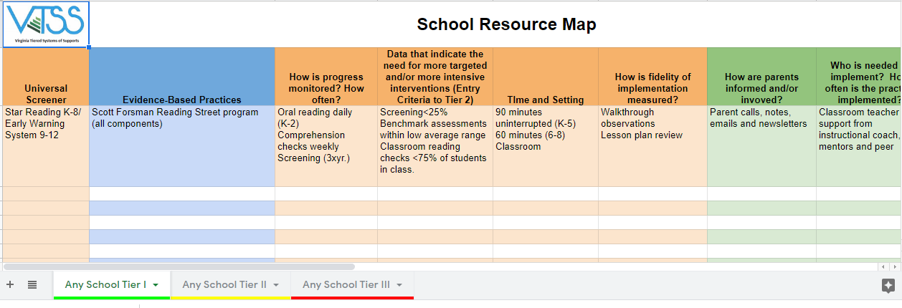
VTSS School Resource Map: English

Slide 46
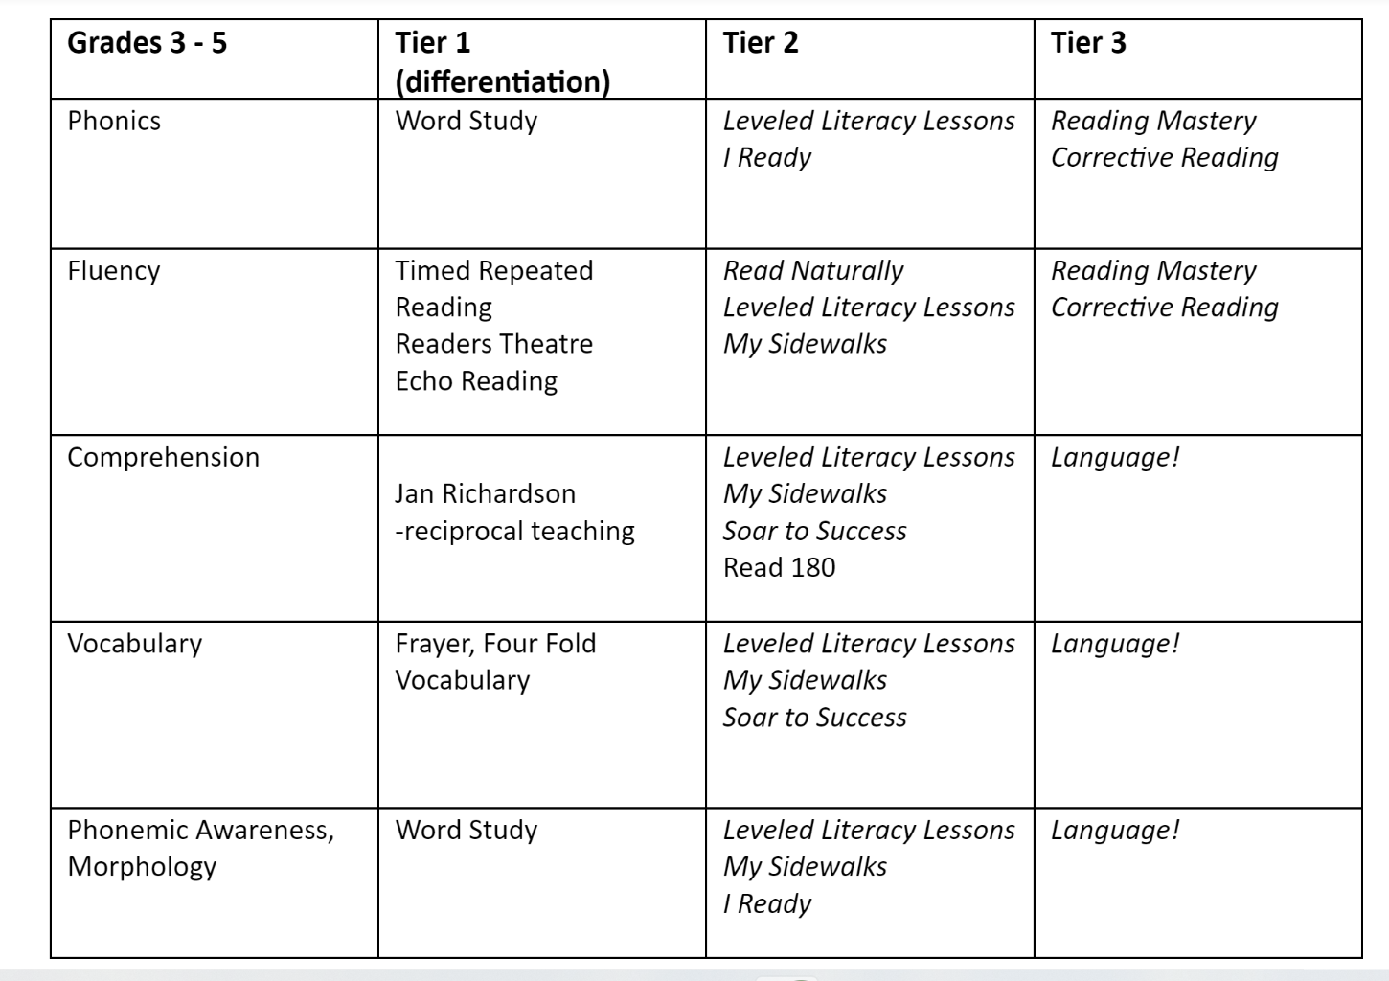
Matching the intervention
to the need

Slide 47
Curriculum Reframing
Navigating Equity (VDOE) p. 25

Slide 48
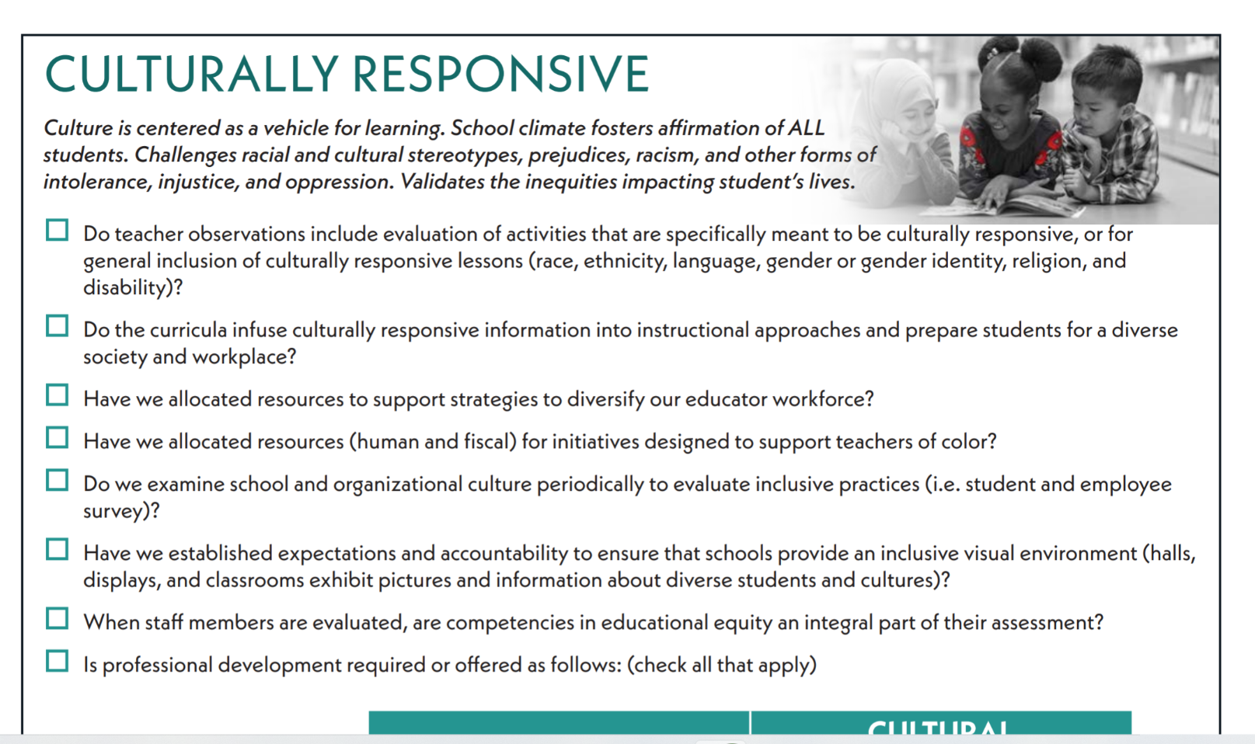
A useful checklist
Navigating Equity (VDOE) p. 39

Slide 49
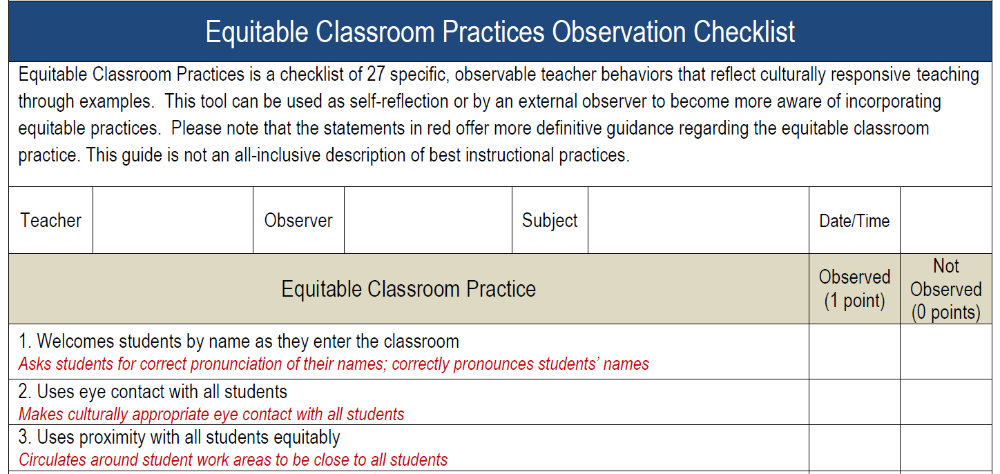
Resources to consider

Slide 50
MEETING STRUCTURES FOR DATA-INFORMED DECISION MAKING (TIER 1)
Data-informed Decision Making

Slide 51
Academic Alignment
Develop a process to create a written description of the expectations for quality Tier 1 academic instruction and a system for communicating the expectations to stakeholders. (IM Feature 3A)
Examine existing evidence-based Tier 1 practices to create a continuum of supports that is culturally responsive and is utilized to provide an instructional match to meet learner needs. (IM Feature 3C)
Develop a plan for implementing Tier 1 data meeting structures at the school and division level and determine how to measure the fidelity and effectiveness of the meeting structures. (IM Feature 2C)

Slide 52
Data Informed Decision Making:
Feature 2.C

Slide 53
The DIDM Process
Step 6: Monitor and Evaluate Results
Step 5: What do teachers need to implement/sustain?
Step 1: What does the data say? (Analyze strengths and opportunities for growth)
SYSTEMS:
Support Staff Behavior
DATA:
Drives Decision Making
Step 4: Create success criteria (for strategy/practice)
PRACTICES:
Support Student Behavior
Step 2: Set Goal
(SMART)
Step 3:What strategies/practices will we select? (Supporting student academic and social behavior)

Slide 54
One example of a division tool

Slide 55
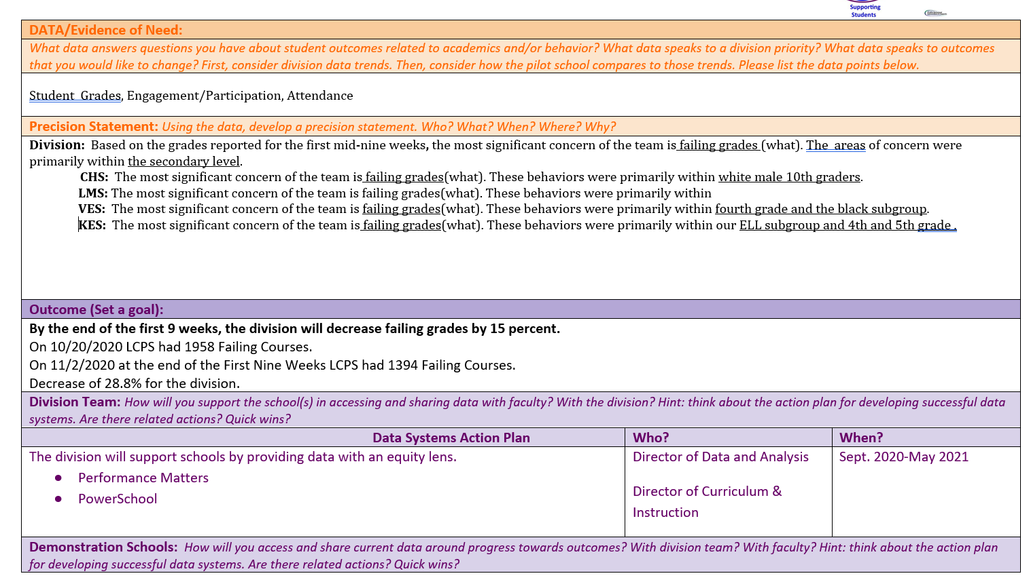
Setting goals with school leaders

Slide 56
Types of Data Driven Discussions
1. Universal Screening (Tier 1)
2. Grade Level/Content Area Performance (Tier 1)
3. Individual Student Data and Intervention Efficacy (Tier 2/Tier 3)
4. Individual Student Problem Solving and Intervention Planning (Tier 2/Tier 3)

Slide 57
Types of Data Driven Discussions
#1
Universal Screening

Slide 58
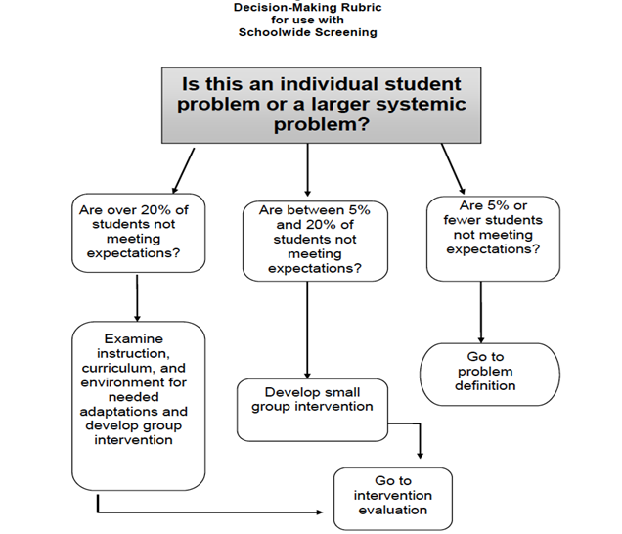
Your data will tell you where to focus!

Slide 59
How are school teams discussing universal screening data?
Is the core instruction sufficient (is it working) and is it improving (i.e., health of the curriculum)?
For whom is it working/not working?
What are the root causes?
Is there a priority skill?
What is the goal for the next screening?
What are our next steps (e.g., instructional adjustments, reviewing lesson plans)?

Slide 60
Prepare for the meeting-Elementary

Slide 61
Prepare for the meeting-Secondary

Slide 62
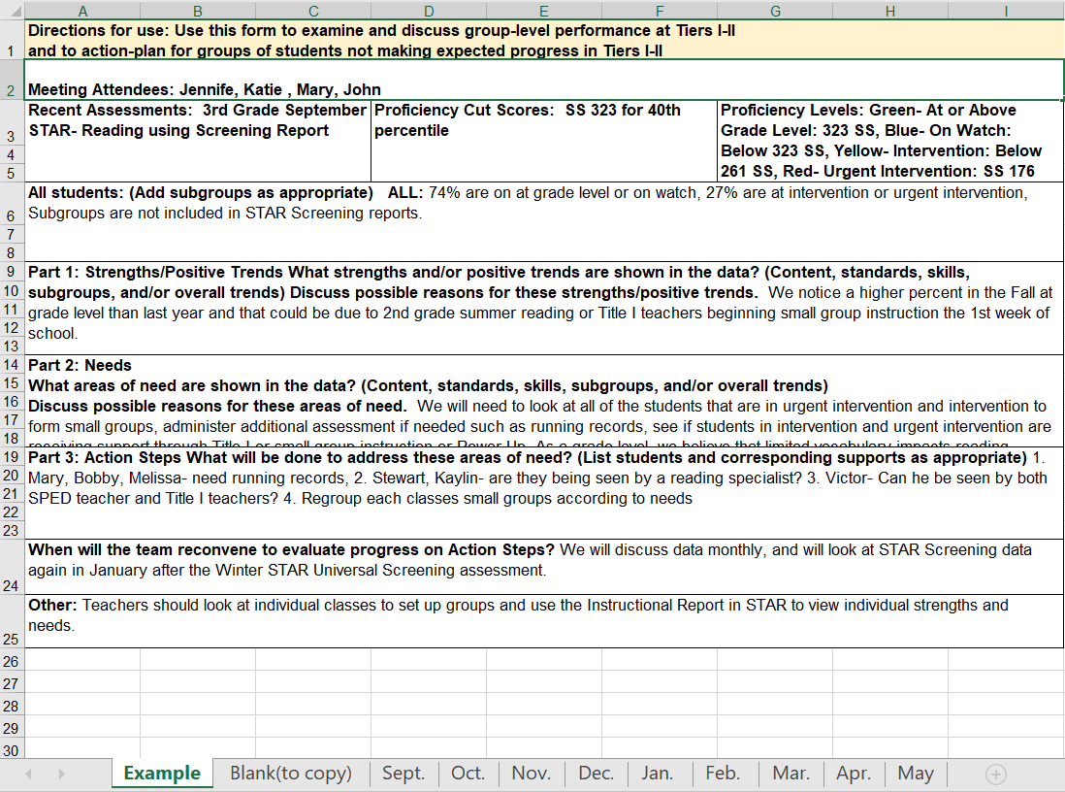
DLT Supporting Schools in Data Analysis: Elementary Reading

Slide 63
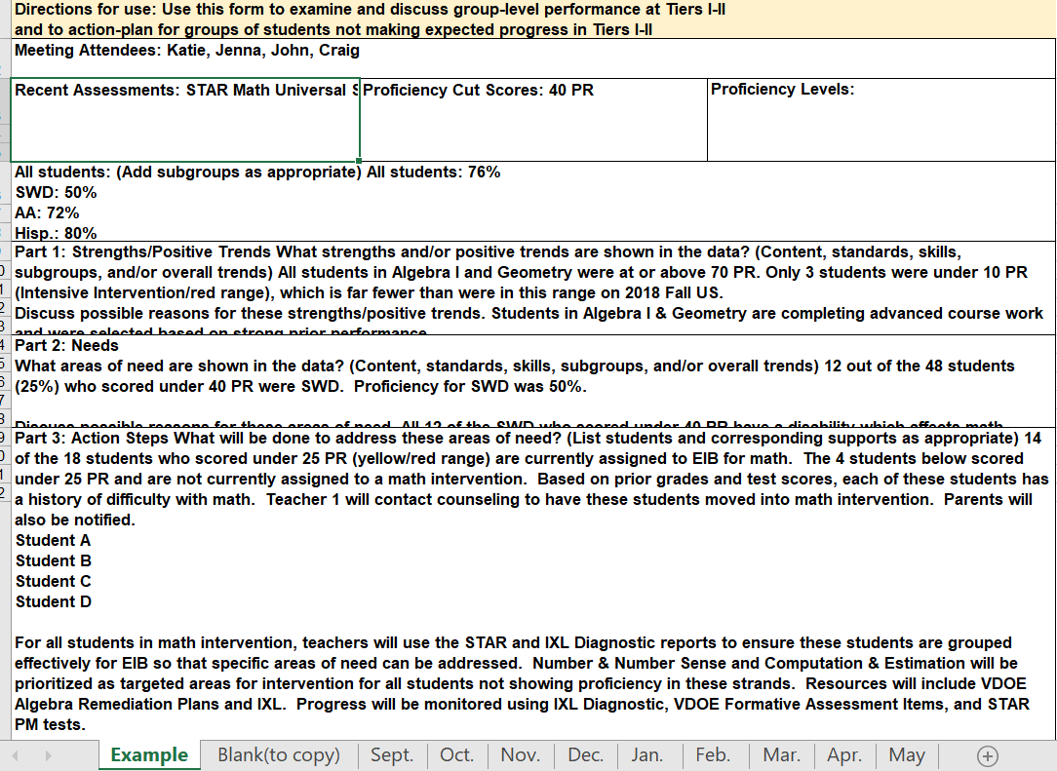
DLT Supporting Schools in Data Analysis: Secondary Math

Slide 64
After the universal screening data meeting...
The school can assess strengths and weaknesses in their core curriculum
After making adjustments to the core curriculum individual student's needs can easily examined using your decision rules
Well organized data helps this process to be quick and efficient across all areas including academics

Slide 65
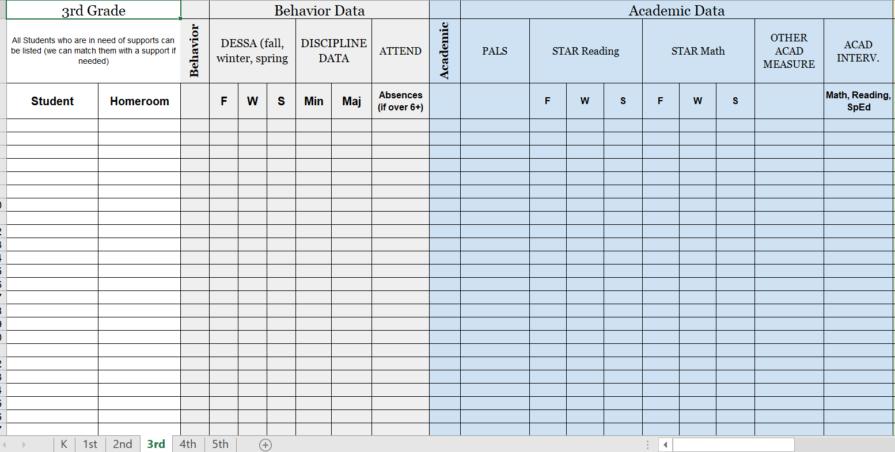
Good forms help make the process flow better

Slide 66
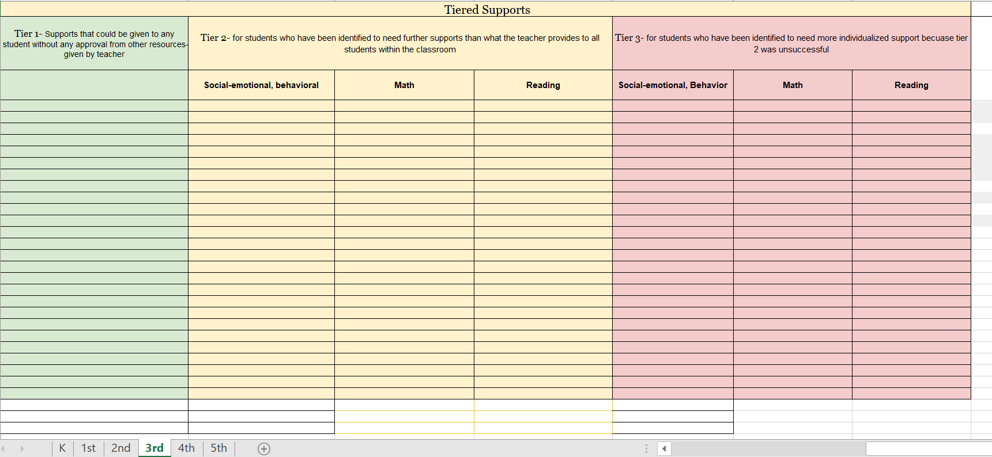
From their data the tiered supports for students are identified

Slide 67
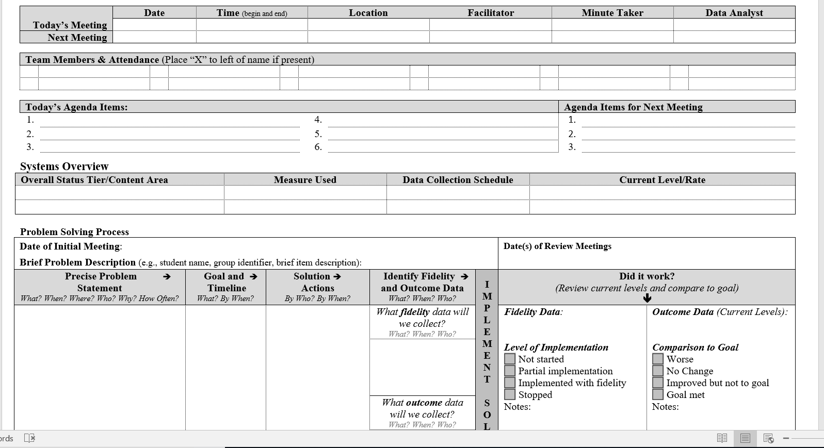
Agenda with DIDM Embedded

Slide 68
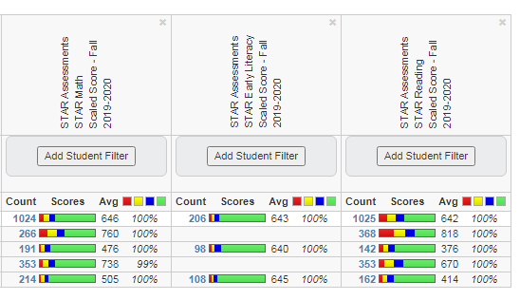
Performance Matters Score Board

Slide 69
Types of Data Driven Discussions
#2
Grade Level/Content Area Performance

Slide 70
Grade Level/Content Level Performance Discussions
Tier 1
We taught it!
Did they get it?
For academics, these are the Virginia standards. For behavior, this is the schoolwide matrix.
Often, this meeting is referred to as a PLC or whatever name the school or division calls it (it needs a name).

Slide 71
What are the root causes for concerns? (Elementary)

Slide 72
What are the root causes for concerns? (Secondary)

Slide 73
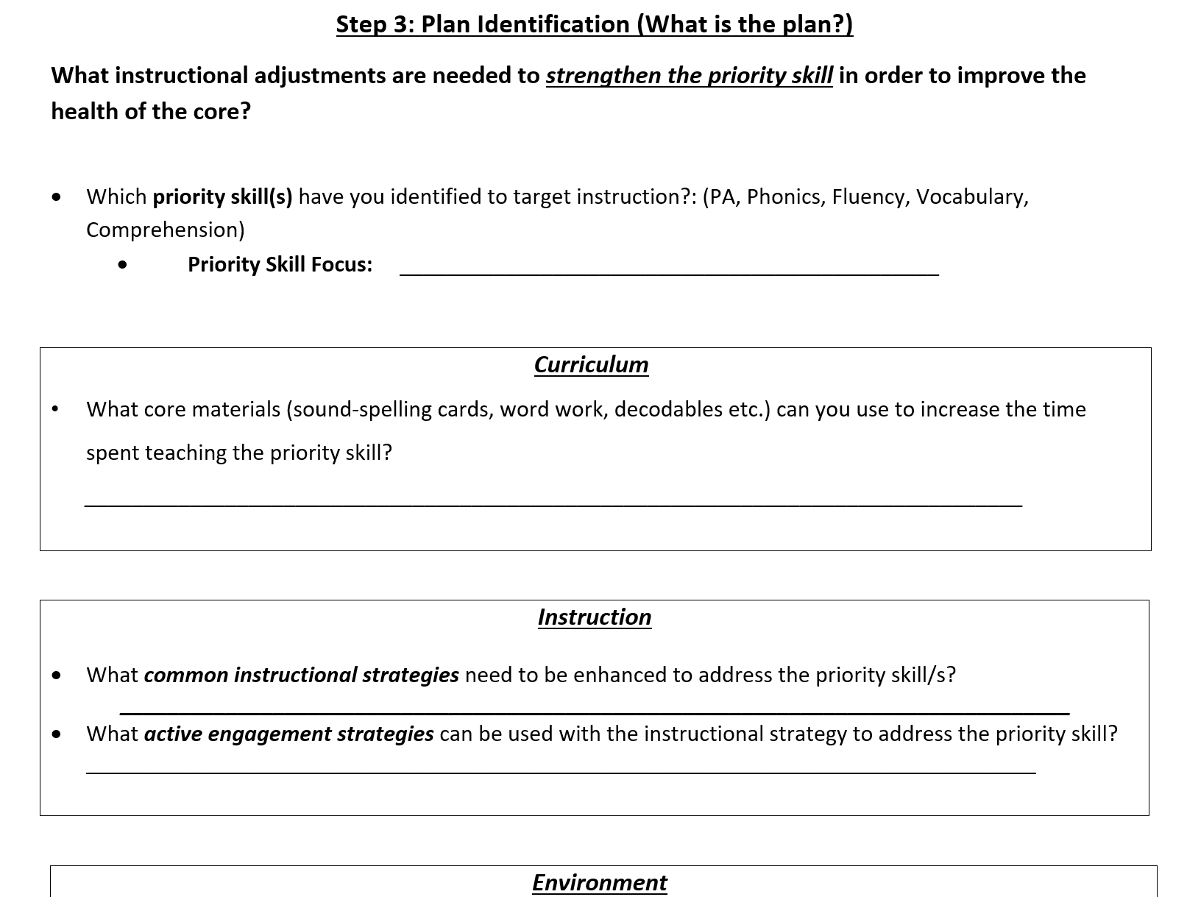
Instructional Adjustments (Elementary)

Slide 74
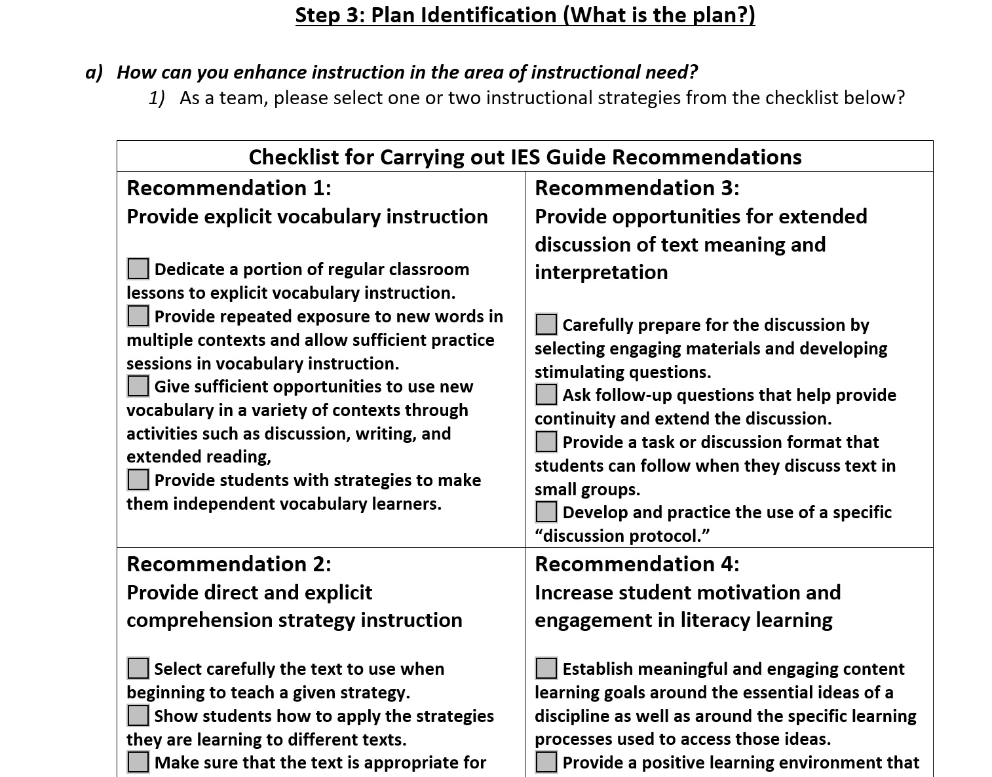
Instructional Adjustments (Secondary)

Slide 75
Avoid meeting overload!!
Problem solving does not need to be drawn out. Good decision rules (cut scores or level of use) and continuum of supports should make initial placement in interventions quick and easy.
Time is saved when data is entered in the agenda and resources are assembled prior to the meeting.

Slide 76
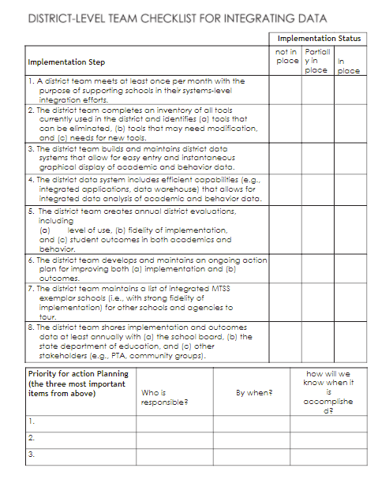
Checklist for
District Data Meetings

Slide 77
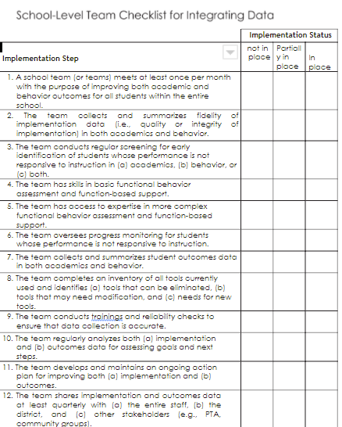
Checklist for
School Data Meetings

Slide 78
Today’s Learning Intentions
Develop a process to create a written description of the expectations for quality Tier 1 academic instruction and a system for communicating the expectations to stakeholders. (IM Feature 3A)
Examine existing evidence-based Tier 1 practices to create a continuum of supports that is culturally responsive and is utilized to provide an instructional match to meet learner needs (IM Feature 3C)
Develop a plan for implementing Tier 1 data meeting structures at the school and division level and determine how to measure the fidelity and effectiveness of the meeting structures. (IM Feature 2C)

Slide 79
Success...
Our team can define quality core instruction and understands the importance of creating a communication system for our division stakeholders.
Our team will create a continuum of supports that is culturally responsive and works for ALL students.
Our team will develop a plan for Tier 1 data meeting structures at the school and division level.

