Slide 1
Integrating and Aligning Academic Data, Practices and Systems
Strand 2: March 2022

Slide 2
VTSS Implementation Components
Aligned Organizational Structure
Data-informed Decision Making
Evidence-based Practices
Family, School, Community Partnerships
Monitoring Student Progress
Evaluation of Process
Source: VTSS Implementation Matrix

Slide 3
River Valley County Public Schools
River Valley County Public Schools is a division comprised of five schools: 3 elementary schools, one middle school and one high school.
The DLT members include the building level principals, the Director of Special Education and Student Services, the Director of Instruction and Federal Programs, a Technology Specialist, and the Superintendent.
The VTSS team is attending the VTSS S2S Strand 2: Academic Alignment this year.

Slide 4
River Valley County Public Schools
After reflecting upon the content from Session B and their discussion about possible next steps, the team members decided to focus their efforts on Quality Core Instruction (Feature 3.A on the Implementation Matrix). They plan to share the session information with the full DLT at their next meeting. They will explain why they think the division needs to review its written description for quality core instruction to see if it needs to be updated/revised. Do the walkthrough documents need to be reviewed to ensure alignment? And, they will discuss how the division’s definition of quality core instruction is communicated to internal and external stakeholders, asking for the perspective of the new family members on the team.

Slide 5
VTSS Implementation Components
Aligned Organizational Structure
Data-informed Decision Making
Evidence-based Practices
Family, School, Community Partnerships
Monitoring Student Progress
Evaluation of Process
Source: VTSS Implementation Matrix

Slide 6
Supporting Improvements in Behavioral Competence, Academic Achievement and Social-Emotional Wellness
OUTCOMES
Supporting
Staff
Supporting
Decision
Making
SYSTEMS
DATA
PRACTICES
Supporting
Students

Slide 7
Today’s Learning Intentions
Develop a plan to monitor fidelity of implementation of evidence-based practices. Matrix 3D
Understand the elements of progress monitoring at Tier 1 and ensure a plan exists for utilizing these data. Matrix 5D
Explore the use of the Academic Tiered Fidelity Inventory as a tool to monitor the fidelity of implementation of essential Tier 1 academic features at the school level.

Slide 8
Success…
Our team can evaluate if evidence-based practices are implemented with fidelity.
Our team understands how to gather and use fidelity data.
Our team can describe three ways to monitor progress at Tier 1.
Our team can describe the purpose of the Academic Tiered Fidelity Inventory (A-TFI).

Slide 9
Evidence-based Practices
FIDELITY OF PRACTICES

Slide 10
Evidence-based Practices
Develop a plan to monitor fidelity of implementation of evidence-based practices. Matrix 3D

Slide 11
Evidence-based Practices
Feature 3.D
Practices used and observable
Components of the instructional tool
Evidence-based programs taught as designed
Alignment!

Slide 12
Revisiting Warren County

Slide 13
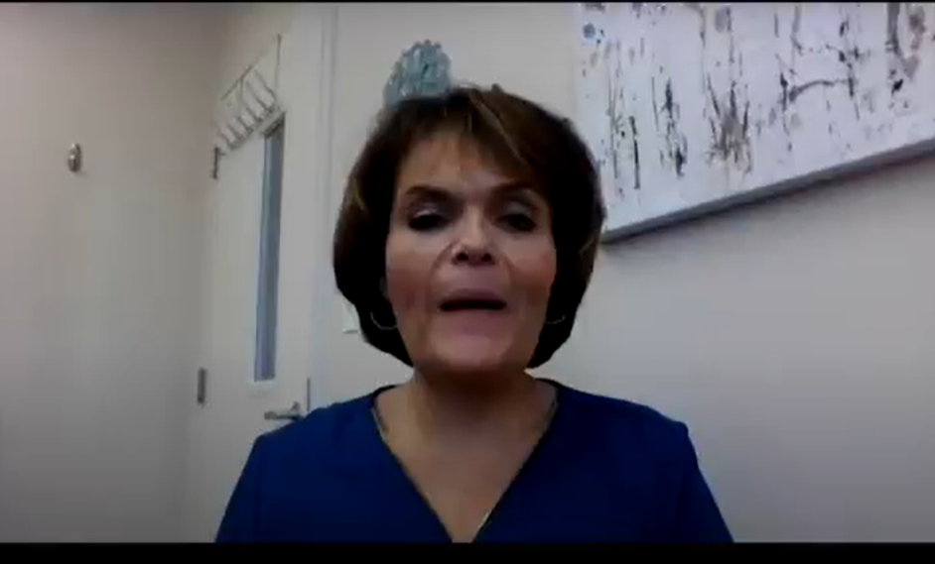
Warren County System of Fidelity

Slide 14
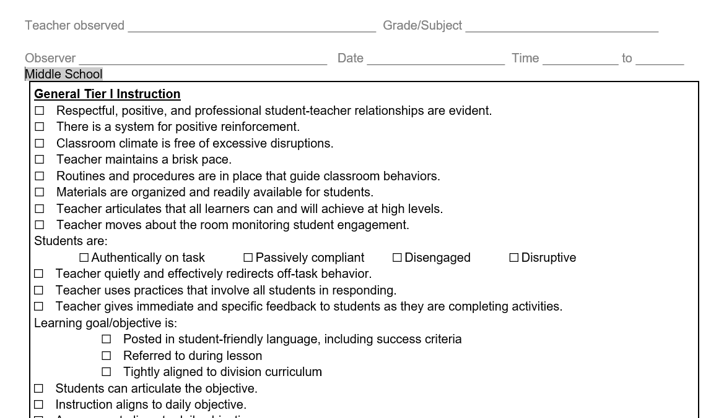
Warren County
Walkthrough Forms

Slide 15
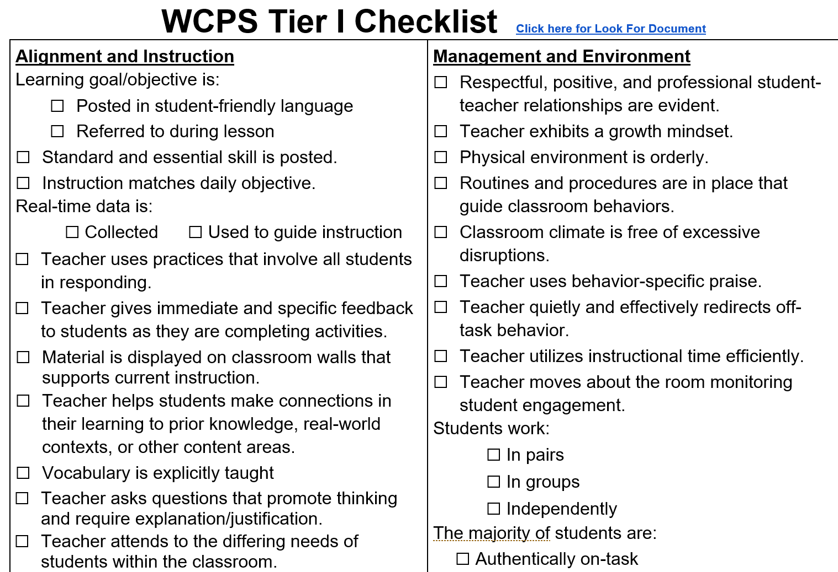
Effective practices….are they observable?

Slide 16
Example: Walkthrough Observation Data

Slide 17
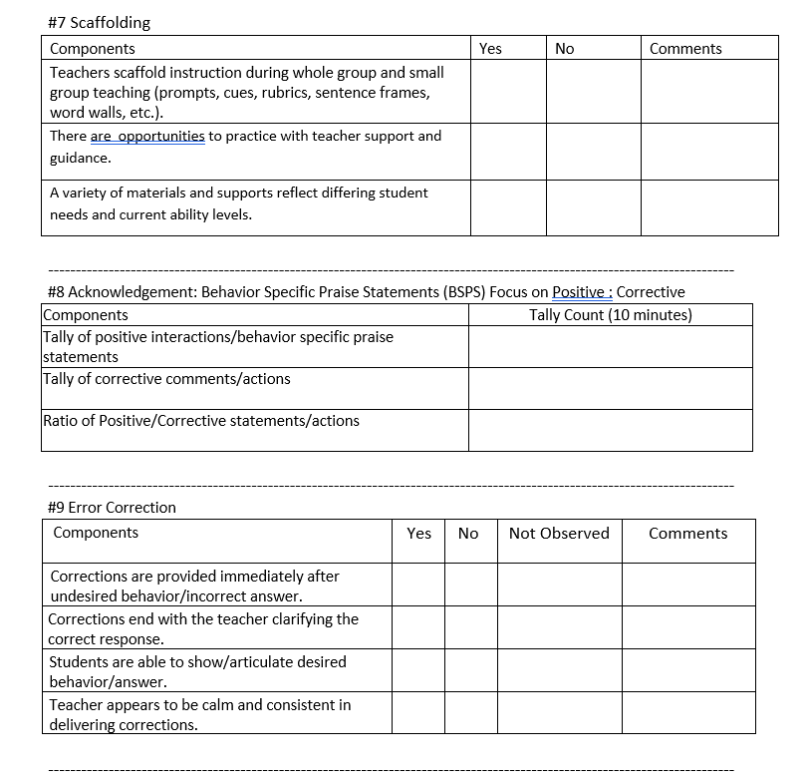
Effective Classroom Systems Walkthrough Tools

Slide 18
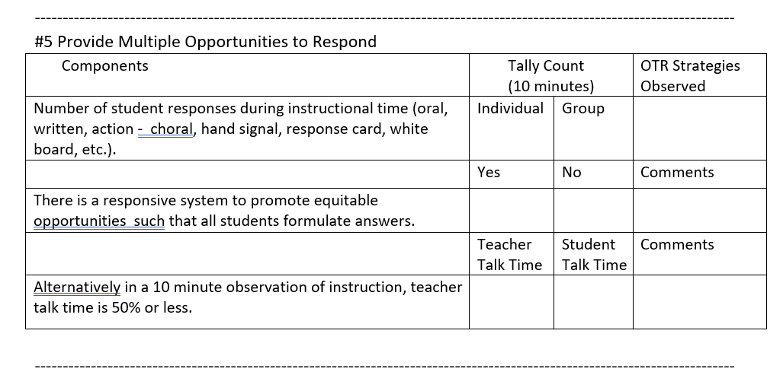
Narrow the focus to one practice

Slide 19
Building fidelity of your implementation
How do you go from VTSS training on Effective Classroom Systems to classroom implementation in your division?
How do you make sure that these practices are being implemented in classrooms with fidelity?
How do you target needed areas for professional development and follow-up?

Slide 20
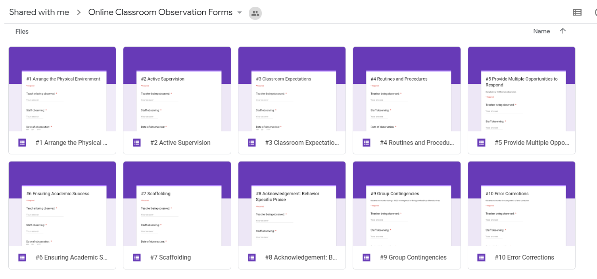
Google Forms from Effective Classroom Systems

Slide 21
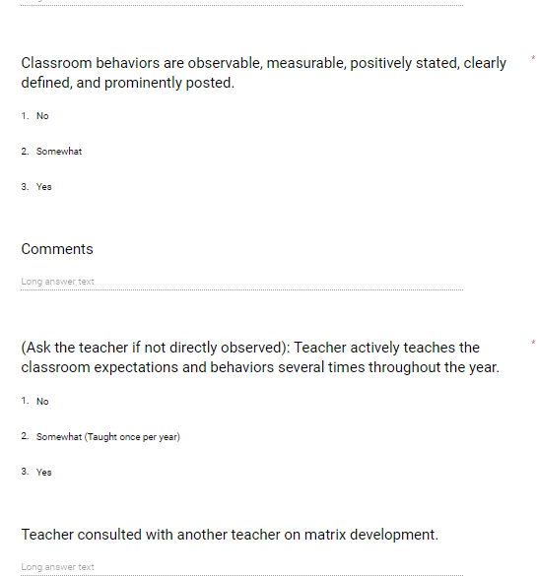
Using Google Forms to Create Forms for Brief Walkthroughs

Slide 22
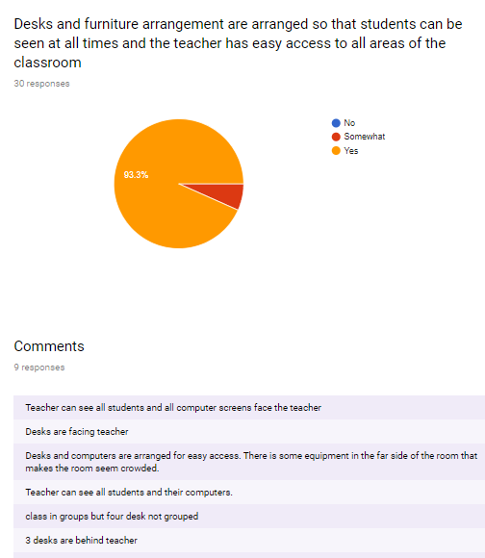
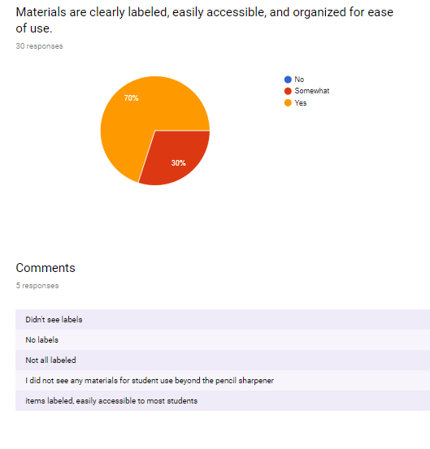
Data is compiled for the school and DLT

Slide 23
Gloucester LETRS/Science of Reading Implementation with Fidelity
DIDM Goal to have all students reading on grade level by third grade with data specified and update
Begin training teachers in LETRS
Develop an implementation plan which includes tracking implementation and student outcomes
Developing curriculum resources and guides and start a literacy plan

Slide 24
Gloucester LETRS/Science of Reading Implementation
Update reading resource maps for the schools and division to identify gaps
Evaluate current practices and LETRS/SOR implementation using the Reading League Curriculum Evaluation Tool at monthly reading specialist support meetings
Track implementation progress in the written plan which is updated on an ongoing basis
Conduct informal walkthrough observations and follow up with the Elementary Specialist and Principals to examine classroom reading instructional and current practices

Slide 25
Next Steps: Gloucester LETRS/ Science of Reading Implementation
Continue LETRS training to assure all K-3 teachers, reading specialist and special education teacher have the training
Conduct a book study with building and division leadership on improving reading achievement within a VTSS framework
Develop walkthrough tools for principals to use independently to assess fidelity of implementation
Use STAR Reading and other measures to determine if student reading achievement is improving (Data outlined in in division DIDM goal)

Slide 26
River City County Schools
From Data to Instruction: Fidelity
The DLT works with school leaders to provide a guidance document for vocabulary instruction during reading
They develop a walkthrough tool to look at the implementation of an evidence-based vocabulary instructional program
The DLT trains school administrators and reading specialists on use of the tool
School administrators and the reading specialist conduct walkthroughs and gather data
The DLT and VTSS school teams begin to look at initial data to determine professional development needs for staff by grade level and teacher

Slide 27
Monitoring Student Progress
PROGRESS MONITORING AT TIER 1

Slide 28
Monitoring Student Progress
Understand the elements of progress monitoring at Tier 1 and ensure a plan for utilizing these data exists. (Matrix 5.D)

Slide 29
Monitoring Student Progress
Feature 5.D

Slide 30
Big Ideas about Progress Monitoring at Tier 1
Evaluate the progress of ALL students at least three times a year (Universal Screening). Are the needs of 80% of students being met?
Evaluate the effectiveness of Tier I instruction (every 4-6 weeks).
Continually evaluate the progress of all students through the use of formative assessment.

Slide 31
Big Idea#1
Screening
What adjustments to curriculum, pacing or instruction need to be made?
Mid-year review of screening data was particularly important this year.
Topic: Screening | National Center on Improving Literacy

Slide 32
Tier 1 progress monitoring in 2022
Screening data in 2021 resulted in students needing intervention support in Tier 1.
Below Benchmark 60%-80%

Slide 33
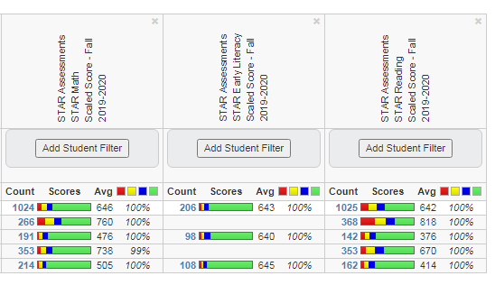
Buy-in: Screening data is useless without a plan for review

Slide 34
Promoting equity-using data

Slide 35
Mid-Year checkup-Discuss
If your primary tool for fall screening was the growth assessment, what was used for mid-year assessment?
How have teachers identified the skills to prioritize?
How have teachers identified students needing extra attention?
How did teachers adjust curriculum, pacing, instructional practices, etc. to meet student needs?

Slide 36
Big Idea #2:Evaluate the effectiveness of Tier 1 instruction
We taught it….did they get it?
Which students were successful?
Which students were not? Is there a pattern?
Collective teacher efficacy
Looking at data
Reflecting on one’s practices within a trusted group
Setting common goals and celebrating accomplishments

Slide 37
Tier 1 progress monitoring in 2022
Check in every two to three weeks on students who were unable to access interventions because of numbers.
Below Benchmark 60%-80%

Slide 38
Explore and discuss
Take a few minutes to explore these resources in the folder.
How could some of these help with supporting school teams in intensifying Tier 1 instruction?
Tips for Intensifying Instruction at Tier 1
Team Data Reflection sheet (example)
Looking at Data Protocol
5.D Progress Monitoring at Tier 1

Slide 39
Big Idea #3: Continuous evaluation using formative assessment

Slide 40
The 5 strategies of formative assessment
Clarify, share, and understand learning intentions and success criteria
Find out what students have learned
Provide feedback that moves learning forward
Activate students as instructional resources for one another
Activate students as owners of their own learning
Wiliam, D. (2011). Embedded Formative Assessment

Slide 41
Valuable tools for math instructions from VDOE
VDOE Quick Checks:
A tool for accelerating learning by checking to determine what skills are already in place.
Just in Time – Mathematics Quick Checks
Bridging for Math Strength website

Slide 42
Coaching/Professional Learning
Effective Classroom Systems
A-TFI for school teams
VDOE resources

Slide 43
Support schools in creating decision rules

Slide 44
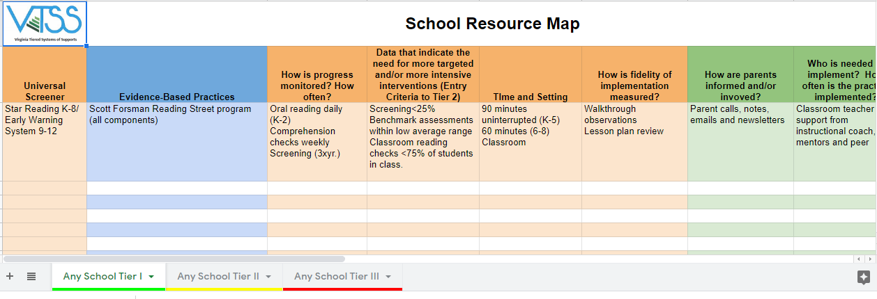
Make decisions easier and meetings more efficient

Slide 45
Tier 1 progress monitoring in 2022
Are we growing the green?
Below Benchmark 30%-50%

Slide 46
Full implementation

Slide 47
River Valley
The River Valley division team had decided to investigate and select a math screener for K-2. Using the tool provided in December, they selected a few screeners, then solicited input from stakeholders. Once a screener was chosen, the team began to set up professional learning schedules for each of the schools and set a screening schedule for the next school year.

Slide 48
CONNECTION TO THE ACADEMIC TIERED FIDELITY INVENTORY

Slide 50
Purpose of the A-TFI
The purpose of the Academic - Tiered Fidelity Inventory is to (a) measure fidelity of implementation of the essential academic components of an integrated, multi-tiered system and (b) provide a road map for school teams to action plan and monitor for continuous improvement.
The Academic - Tiered Fidelity Inventory (A-TFI) is intended to complement and align with the Tiered Fidelity Inventory.

Slide 51
Academic Tiered Fidelity Inventory Features
Implementation
1.3 | Aligned Curricula
1.4a | Evidence-Based Practices
1.4b | Lesson Plans
1.4c | Relevant Objectives
1.5 | Performance Measures
1.6a | Formative Assessment
1.6b | Instructional Adjustment
1.7a | Professional Learning
1.7b | Coaching
1.7c | Collaborative Planning
1.8 | Instructional Practices
1.9 | Student Involvement
1.10 | Collective Teacher Efficacy
1.11 | Family and Community Engagement
Teaming
1.1 | Team Composition
1.2a | Team Alignment
1.2b | Team Operating Procedures
Evaluation
1.12a | Data Alignment
1.12b | Universal Screening
1.13 1.14 1.15a 1.15b | Data-informed Decision Making Fidelity Data Outcome Data Annual Evaluation

Slide 52
Teaming
Implementation Matrix
1.B Teaming
1.C Planning
A-TFI
1.2a Team Alignment
1.2b Team Operating Procedures

Slide 53
Assessment
Implementation Matrix
5.A Assessment Mapping for Student Growth
5.B Screening Tools and Data
5.C Screening Process
A-TFI
1.6a Formative Assessment
1.12a Data Alignment
1.12b Universal Screening
1.13 Data-informed Decision Making

Slide 54
Quality Core Instruction
Implementation Matrix
3.A Quality Core Instruction
3.C Continuum of Supports that is Culturally Responsive
A-TFI
1.3 Aligned Curricula
1.4a Evidence-based Practices
1.4b Lesson Plans
1.4c Relevant Objectives
1.8 Instructional Practices

Slide 55
Data
Implementation Matrix
2.C Meeting Structures for Data-informed Decision Making
3.D Fidelity of Practices
5.D Progress Monitoring at Tier 1
A-TFI
1.5 Performance Measures
1.9 Student Involvement
1.13 Data-informed Decision Making (Strand 1)
1.14 Fidelity Data

Slide 56
Success…
Our team can evaluate if evidence-based practices are implemented with fidelity.
Our team understands how to gather and use fidelity data.
Our team can describe three ways to monitor progress at Tier 1.
Our team can describe the purpose of the Academic Tiered Fidelity Inventory (A-TFI).

