Slide 1
Optimizing the Aligned and Integrated Systems of VTSS
Strand 3 December 2019
Roanoke
Williamsburg

Slide 2
Community Norms
Be Responsible | Take care of your needs Share your questions with the group
Be Respectful | Turn volume/sound off on cell phones Listen to others attentively Follow up and complete assigned tasks
Be Engaged | Ask what you need to know to understand and contribute Share your expertise, information and ideas

Slide 3
Making Connections

Slide 4
When Last We Met…
Advanced Tiers
Core Features
Common Language
Screening and Assessment Inventory
Data Audit
Data Informed Decision Making
Precision Statements
Decision Rules
Resource Mapping

Slide 5
Bell Ringer

Slide 6
Core Features Quick Check
Tier 2 Core Features
TFI 2.6
Adapted from Horner & Sugai (2016)

Slide 7
Tier 2 Core Features
Increased Structure & Prompts
Increased Intensity of Data Collection
Increased
Regular Feedback
Increased Family Engagement
Additional Instruction on Skills (prosocial, emotional, academic)
Tier 2 Core Features
TFI 2.6
Efficient system for access and delivery of intervention
Adapted from Horner & Sugai (2016)

Slide 8
Today’s Learning Intentions
Build on Data-Informed Decision-Making to make instructional decisions and ways to adopt and support interventions for students requiring support at Tiers 2 and 3 (Matrix 2.B, 3.B)
Create and/or analyze clearly defined continuum of supports that is culturally responsive and utilized to ensure an instructional match for all learners (Matrix 1.F, 3.C)
Define advanced tiers and how schools will be supported to analyze data to determine the impact of interventions and make decisions to change the level of support (Matrix 2.C, 5.E)
Integrate and align professional learning based on need (Matrix 1.G)

Slide 9
Materials Walk
https://vtss-ric.org/event/starting-to-sustaining-session-b-2019-december-3/
https://vtss-ric.org/event/starting-to-sustaining-session-b-2019-december-5/
Password: vtss

Slide 10
Loudoun County Public Schools
Implementation Story
Advanced Tiers Resource Map

Slide 11
A little about LCPS
84,000 Students
94 schools (57 Elementary, 17 Middle, 17 High, 3 special facilities)
52% Minority
19% Economically Disadvantaged
17% English Language Learners (EL)
12% IEP

Slide 12
Three Integrated Frameworks
RTI (Academics)
PBIS (Behavior)
Mental Health

Slide 13
Integrated MTSS Team
MTSS Supervisor
RTI
Coordinator
PBIS Coordinator
Social Emotional Learning Specialist
RTI Consulting Teacher (FY20)
PBIS Consulting Teacher

Slide 14
Our RTI Journey

Slide 15
RTI Renewal (2016-2019)
Integrate instructional initiatives
Reduce duplicate efforts and competition
Integrate with School Improvement Planning
Improve collaboration for systemic implementation

Slide 17
LCPS RTI Core Components
Leadership
Data for Student Success
Includes universal screening and progress monitoring
Targeted Instruction
High quality core instruction at Tier 1
Strategic intervention at Tier 2
Intensive intervention at Tier 3
Data-Driven Decision Making
Evaluation
Fidelity and Student Outcomes
Anchors: Structures – Processes & Procedures – Professional Development

Slide 18
MISSION IMPOSSIBLE
Reduce time spent on assessment
Increase time spent on instruction
Increase effective data-driven decision making across the division

Slide 19
Our “Crew”
RTI Coordinator
Supervisor, Elem. Reading
Supervisor, Secondary Reading
Supervisor, Specialized Reading Instruction
Lead Educational Diagnostician
Systems Logic
Core Content
Core Content
Evidenced Based Reading Intervention
Assessment

Slide 20
Create Effective Efficiencies
Identifying students in need of tiered reading support
Diagnosing root of students’ reading difficulties
Matching evidenced-based interventions to specific student needs (Just Right Fit)
Monitoring effectiveness of match and student growth

Slide 21
Critical Decision Points
Map Resources
Evaluate Effectiveness
Select Assessments & Define Logic
Provide Professional Development
Establish Criteria for Additional Assessment
Match EBIs to Specific Deficit Areas
Create Decision Tree

Slide 22
Map Resources
What assessments do we have? For what? Who is trained to give them?
What EBIs can we provide with fidelity? Who is trained to implement them? How much time is required?
What’s missing? What do we need? What is the cost, required training, and implementation time?

Slide 23
Select Assessments
MAP Growth
Reading Comprehension
FAST
Phonological Awareness Fluency, Phonics Fluency, Oral Reading Fluency
Developmental Spelling (DSA)
Words Their Way Inventories
Orton-Gillingham Phonics Inventory
Phonics

Slide 24
Define Assessment Logic
Universal - ALL
PALS (Grades K-1)
MAP Growth (Grades 2-8)
Supplemental- SOME
Formative Assessment System for Teachers (FAST)
Developmental Reading Assessment (DRA-2)
Diagnostic - FEW
Phonics Inventories

Slide 25
Establish Criteria for Additional Assessment
PALS (Grades K-1)
Students who don’t meet the fall benchmark
Students who meet the fall benchmark but team still has concerns
MAP Growth (Grades 2-8)
Grade 2 = Students whose score falls below the 40%tile –OR- are not on DRA grade level
Grades 6-8 = Students whose score fall below the 40%ile –OR- are not predicted to pass the VASOL English per the Class Breakdown by Proficiency Report

Slide 26
Advanced Tiers Resource Map
Let’s Practice!

Slide 27
Resource Mapping

Slide 28
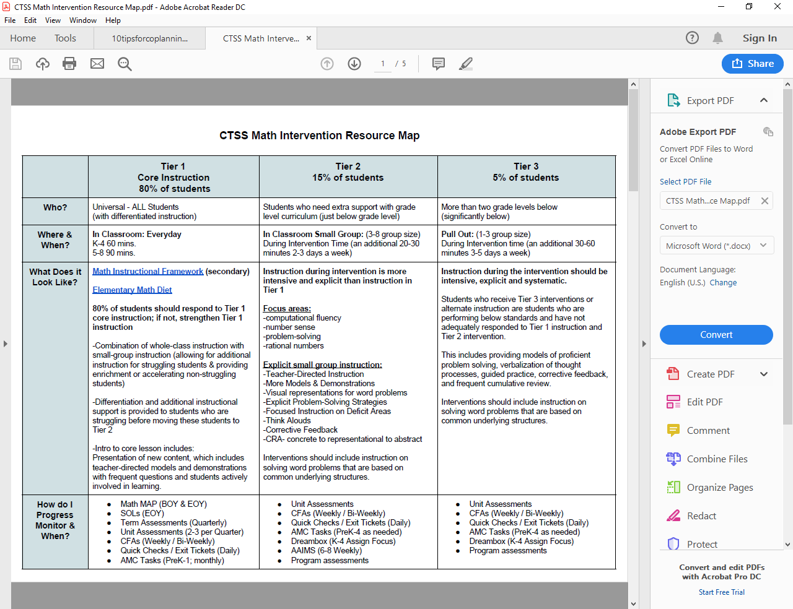
Advanced Tiers
Resource Map Example

Slide 29
Advanced Tiers Decision Rules

Slide 30
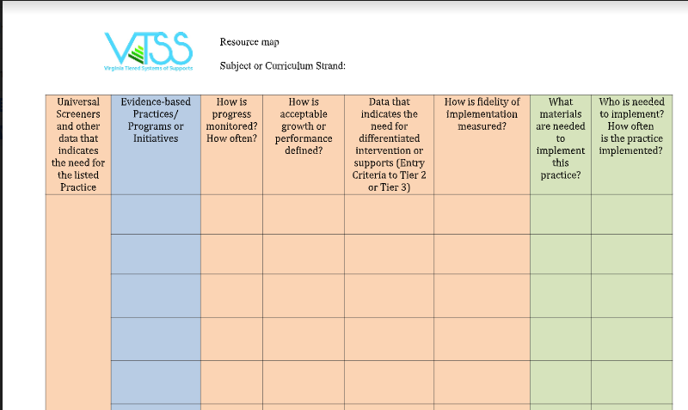
Your Turn
Advanced Tiers Resource Mapping:
Choose a domain
Complete what you can across the row
screeners/data points
EBIs/EBPs

Slide 31
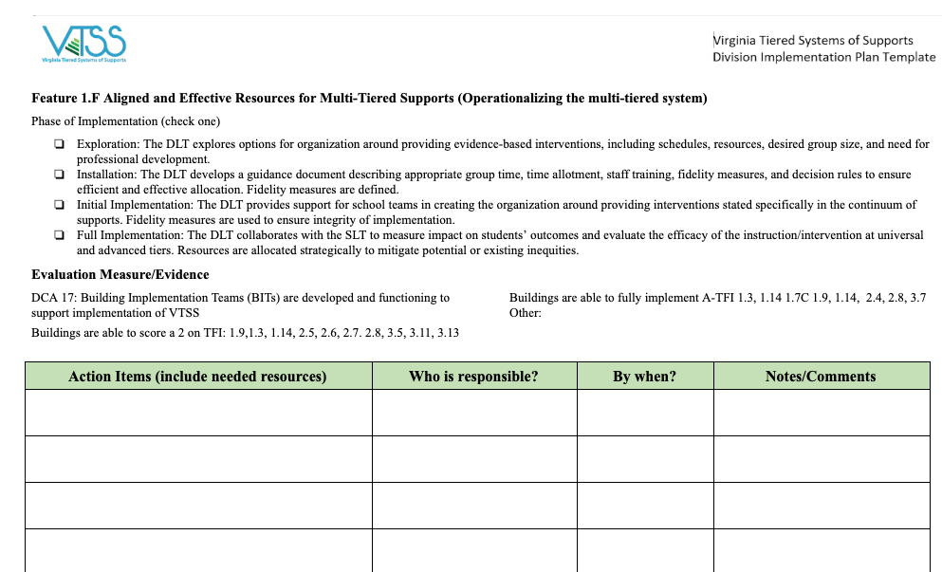
Matrix 1.F/3.C
Action Planning

Slide 32
Lunch
Digest and Process...

Slide 33
Loudoun County Public Schools:
Our Implementation Story
Advanced Tiers Decision Rules

Slide 34
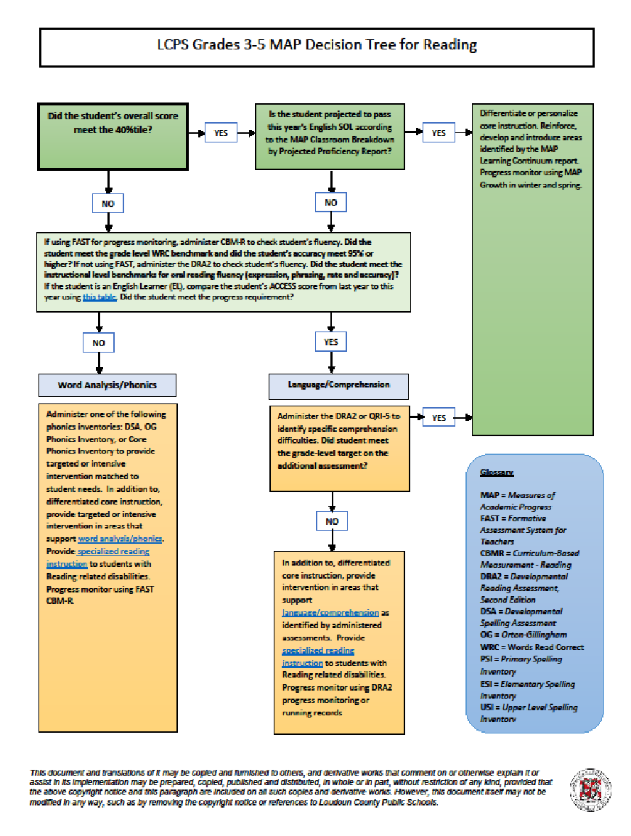
Create Decision Tree
Created using Microsoft Word
Converted to .pdf
Saved in Google drive

Slide 35
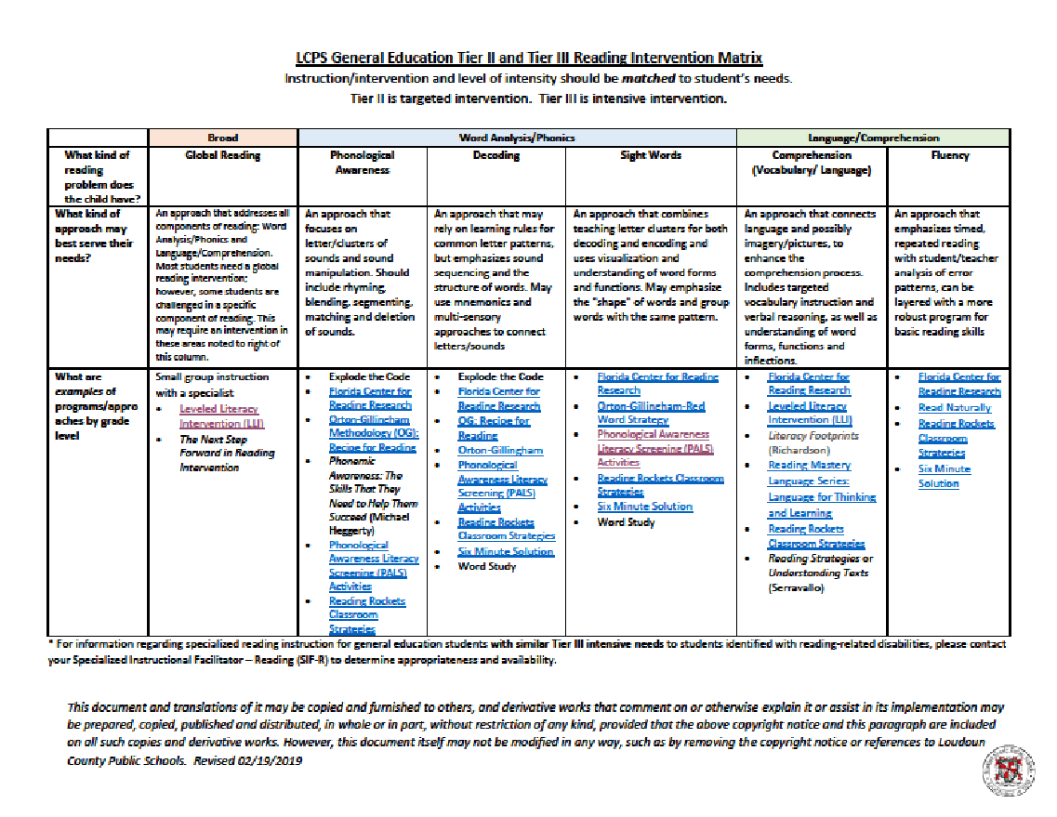
Match EBIs to Specific Deficit Areas

Slide 36
Create a Professional Development Plan
Make it sustainable and cost-effective
Appeal to several learning styles
Provide follow Up sessions
Evaluate effectiveness and use results to make
improvements
Revise plan annually

Slide 37
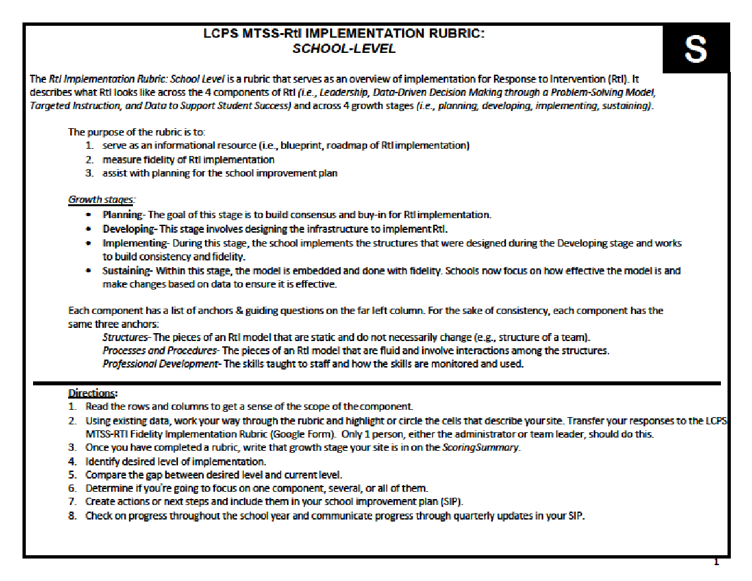
LCPS RTI Implementation Rubric

Slide 38
Evaluate Effectiveness - Implementation
Fall 2018 |  | Spring 2019 |  | GROWTH
LEADERSHIP | 2.54 | LEADERSHIP | 2.93 | 0.39
DATA DRIVEN DECISIONS | 2.34 | DATA DRIVEN DECISIONS | 2.91 | 0.57
TARGETED INSTRUCTION | 2.57 | TARGETED INSTRUCTION | 3.05 | 0.48
DATA TO SUPPORT STUDENT SUCCESS | 2.57 | DATA TO SUPPORT STUDENT SUCCESS | 2.93 | 0.36
STRUCTURES | 2.55 | STRUCTURES | 2.94 | 0.39
PROCESSES AND PROCEDURES | 2.55 | PROCESSES AND PROCEDURES | 3.00 | 0.45
PROFESSIONAL DEVELOPMENT | 2.42 | PROFESSIONAL DEVELOPMENT | 2.91 | 0.49

Slide 39
Evaluate Effectiveness - Outcomes
Data pending. Will add.

Slide 40
Next Steps
VKRP as K math screener (Fall 2019)
Grade 1 universal math screener (Fall 2019)
Specialized Math Instruction (Fall 2019)
Math Decision Trees (Fall 2019)
EL and Dually Identified (2020)
Expand implementation to middle and high schools (2020-2023)

Slide 41
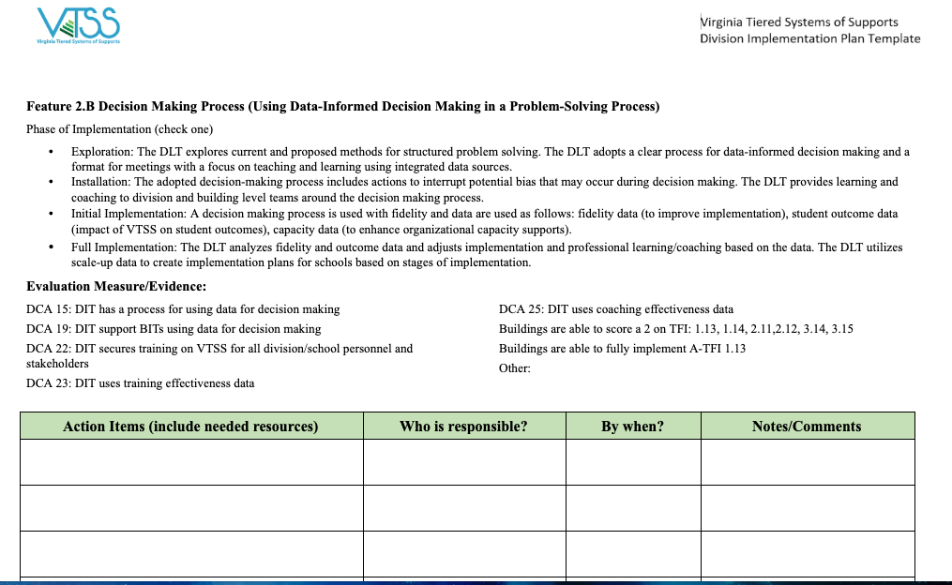
Matrix 2.B/3.B
Action Planning

Slide 42
Practices Deep Dive
Station Rotations

Slide 43
Station Rotations
Evidence-Based Practice Selection and Match
Progress Monitoring
Scheduling
Travel with Team
40-45 minutes at each station
Action plan as you go
Return to whole group for closure

Slide 44
Evidence-Based Selection Tool and Matching Interventions
Station Rotation

Slide 45
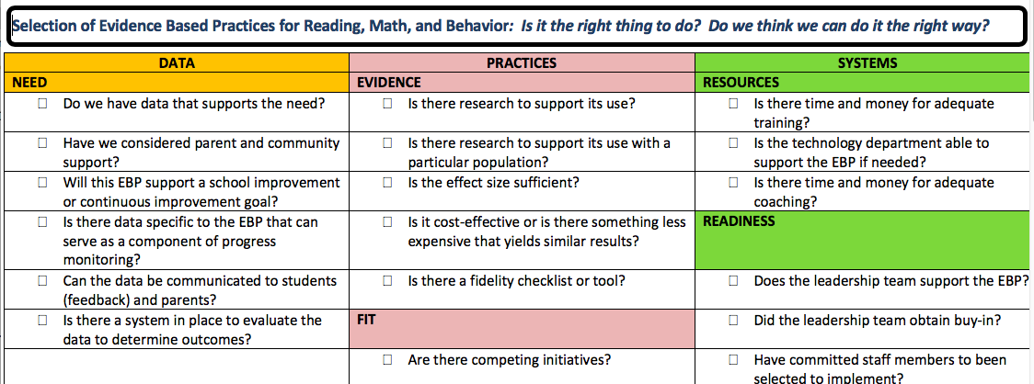
Evidence-Based Selection Tool

Slide 46
Evidence Based Practices Evaluation

Slide 47
Finding Evidence Based Practices

Slide 48
Evidence-based Practices
National Center on Intensive Intervention https://charts.intensiveintervention.org/chart/behavioral-intervention-chart
Behavior Intervention Tools Chart
Academic Intervention Tools Chart
What Works Clearinghouse
https://ies.ed.gov/ncee/wwc/FWW
Behavior Intervention Tools Chart
Academic Intervention Tools Chart

Slide 49
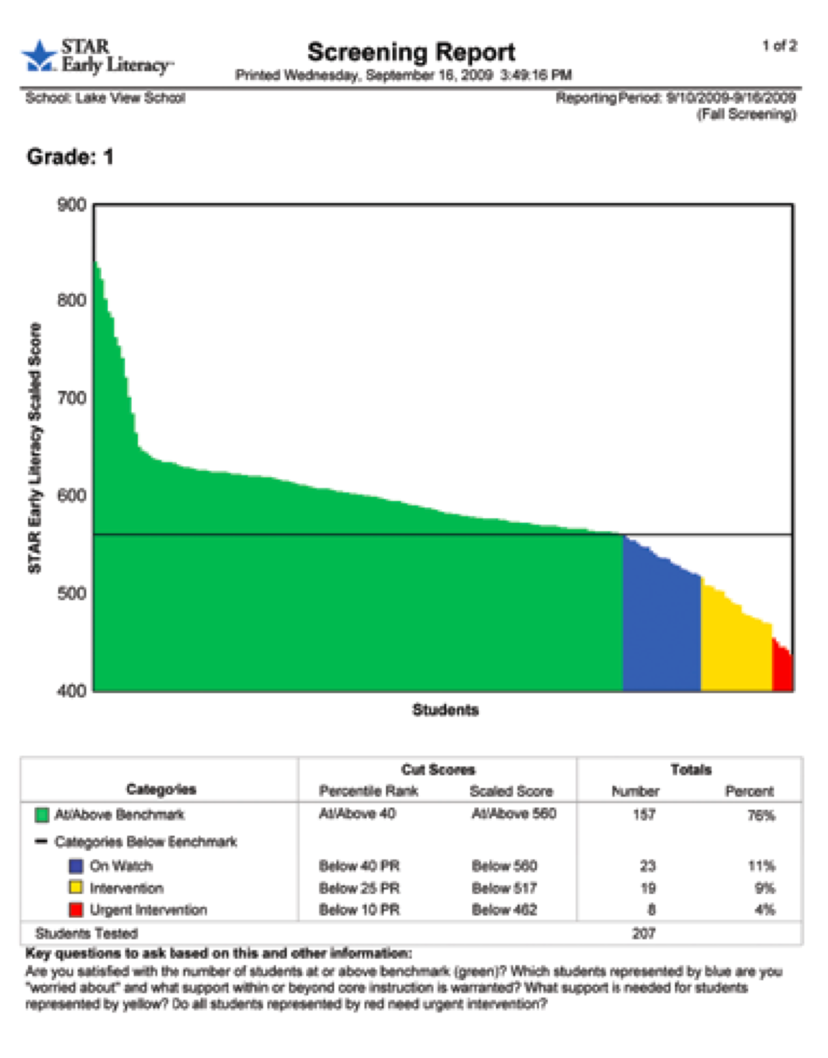
Your Turn!
Let’s Practice!
Use the sample set of data to determine possible evidence-based interventions.

Slide 50
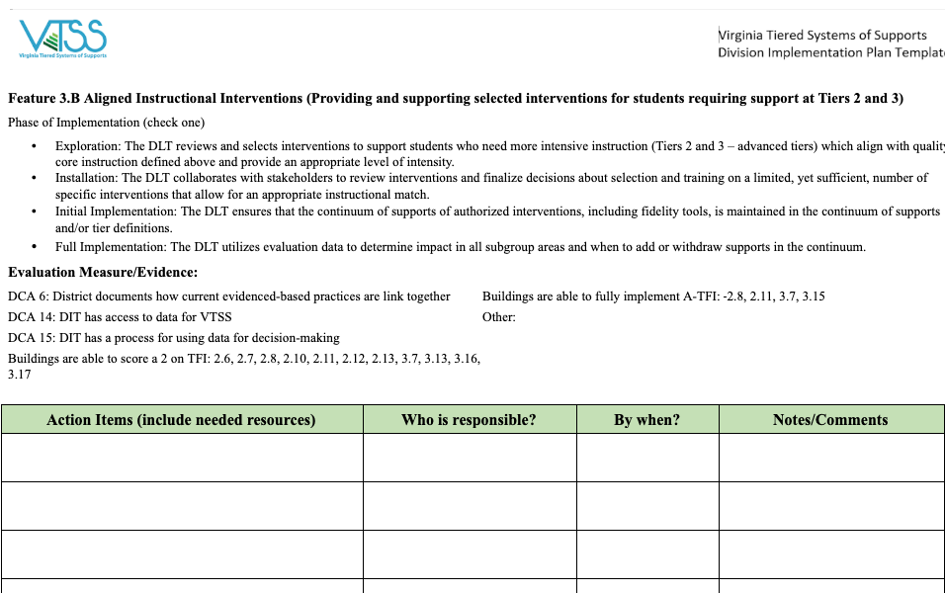
Matrix 2.B/ 3.B
Action Planning

Slide 51
Progress Monitoring
Station Rotation

Slide 52
Measurement Tools
It Is Not “Either/Or”
Curriculum-based measurements (CBMs) are standardized assessments, including specific scoring guidelines, usually timed, criterion based. For example, fluency measures serve as a proxy for overall literacy development
Curriculum-based assessments (CBAs) are tools developed by teachers that align with the content they have taught. CBAs involve “direct observation and recording of a students performance in the local curriculum…” (Deno, 1987)
*Definition adapted from Hattie, Fisher, Frey (2016)

Slide 53
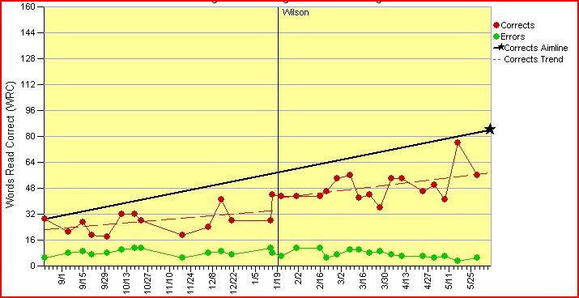
The RATE and LEVEL of Learning

Slide 54
General Indicators: The Medical Analogy
Think About Starting with Screening Tools:
Height
Weight
Temperature
Blood Pressure
Pulse
1

Slide 55
Blood Pressure Is An Indicator
It is considered to be an indicator of overall health; not a complete picture
It isn’t the only indicator of overall health, and it is used with some other measures
It is brief and reliable
It is a “flag” that there may be risk factors
2

Slide 56
Blood Pressure As A General Indicator Uses Decision Rules
What is the data that suggests
“at risk?
What happens if the screener isn’t
Administered with fidelity? How will it
impact the fidelity of progress monitoring?
3

Slide 57
The Indicator Guides Other Decisions
What might you consider if someone is mildly at risk?
4

Slide 58
Mr. Smith: Flagged As “At Risk”
Social History Reveals:
Family history of high blood pressure
Exercises on an inconsistent basis
Business travel prevents him from eating healthy meals on a regular basis
Has a demanding work week
5

Slide 59
Other Diagnostic Tests Are Ordered
Blood values
Stress test
Mr. Smith has to visit a specialist for some of these tests, while some are administered at the office.
(Does this sound like diagnosing the problem in order to make a good Instructional match?)
6

Slide 60
The Team Meets Again With the Results And A New Team Member
THE PLAN
Daily exercise routine with trainer – heart rate monitored each session
Low sodium diet; journal of food intake
Plot blood pressure on a graph each week
Blood pressure medication – common and generic
7

Slide 61
Monitoring Begins
5 data points have been collected of the systolic pressure:
170
177
172
172
180

Slide 62
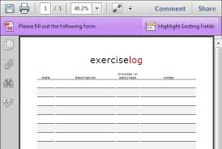
Change The Intervention? How?
Suppose you discovered that Mr. James could not lay off the chips, and it turns out that his trainer had a family emergency and was only able to meet with him for 60% of the scheduled appointments. Would you make a change to the prescription medicine?
9

Slide 63
TIP #1
The first thing you do if the “dots aren’t going in the right direction” is to check the fidelity of assessment and implementation.
10

Slide 64
Tip# 2
Consider having all the reasons for lack of success categorized to make the problem solving process easier:
Was the instruction at all tiers delivered with fidelity?
Was it a correct instructional match? Was there consistent programming? Is the dosage sufficient?
Is attendance an issue? (Consider attendance of student and adults.)
Is attention the reason the student is not performing well?
Is motivation and engagement an issue? (Consider the engagement of peers as well.)
Are there certain behaviors (disruptions, defiance, etc.)that impede learning?
Are there social-emotional and wellness issues that are the barrier to learning?
11

Slide 65
Improvement! But Will He Reach His Goal?
Aim is 125
Next 5 systolic readings:
170
165
160
162
158

Slide 66
Now Our Decision May Change
Eating Healthy
Exercising Daily
13

Slide 67
An Iterative Process of Problem Solving
Aim is 125
Next 5 systolic readings:
150
152
145
130
135

Slide 68
Implementation Matrix 2.C
What the division needs
What the school needs
A way to know the percent of students successful in intervention
A time to discuss intervention data with links to universal data
A time and process to determining if the intervention is working for individual students
A time and process to utilize this data to determine success level in the intervention
A time and process to communicate data to the division

Slide 69
Complete Resource Map

Slide 70
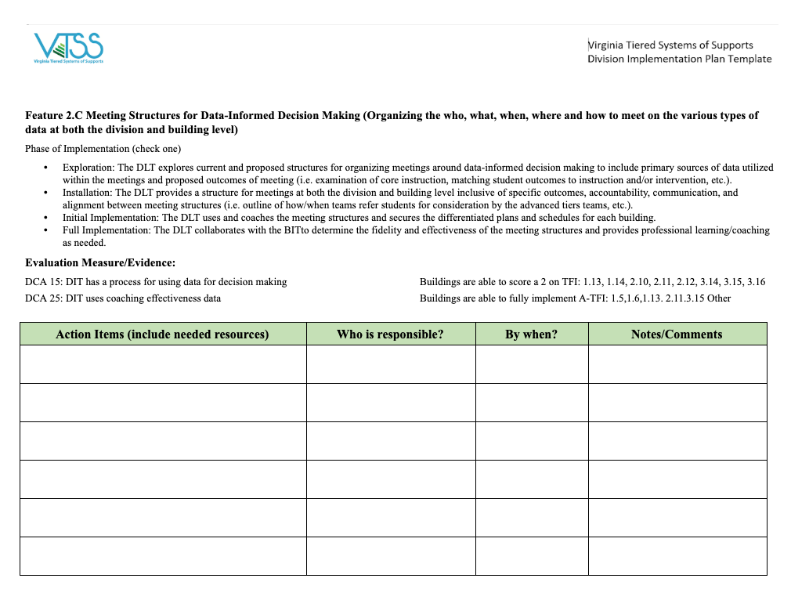
Matrix 2.C/ 5.E Action Planning

Slide 71
Scheduling for Advanced Tier Effectiveness
Station Rotation

Slide 72
Scheduling Intensive Intervention
Instruction
Engagement
Instructional Time
Data-based Individualization
Modify Instruction Delivery
Change Learning Environment to promote attention and engagement
Change dosage or time
Cognitive processing
(Vaughn et al., 2013)
http://www.centeroninstruction.org/files/Intensive%20Interventions%20for%20Students%20Struggling%20in%20Reading%20%26%20Math.pdf.

Slide 73
Strategies for Adding Intervention Time
Double dip
Single intervention block vs intervention at different times during the day (e.g., 20 min in the morning and 20 min the afternoon rather than a single 40 min session) (Gersten et al., 2008; Vaughn et al., 2012).
Use entry or exit routines
Provide independent or peer-mediated practice opportunities for students to minimize wait time and allow multiple small groups to run at once.
Reinforce groups for working independently
Allows for multiple groups running simultaneously

Slide 74
Scheduling Resource
https://intensiveintervention.org/sites/default/files/NCII-Scheduling-508.pdf

Slide 75
Scheduling Treasure Jigsaw
Number off 1-3
Join group
Read highlight
Share findings
Prioritize top 3 to share out with group
Share scheduling gems with whole group

Slide 76
Enough Is Enough?
Pair with a learning partner
Confer and record a guess
Reveal on signal
Erase and prepare for next question!

Slide 77
Questions
What is the suggested duration of intensive intervention?
2. Who does the research say needs more intensive intervention time, younger or older students?

Slide 78
More time questions
3. What is the recommended range of time per day for intensive intervention?
4. What is an important consideration to determine length and frequency of intervention?

Slide 79
Methods for Increasing Quantity of Instruction
Minutes per day
Minutes per session
Sessions per week
Total number of sessions

Slide 80
What is the suggested duration of intensive intervention?
Consider:
Students further behind need more intervention time.
Students provided less appropriate Tier I instruction need more intervention time.
Older students will likely need more time in intervention than younger students.
* Research on the number of sessions varies, but at least 8-16 weeks, often longer (Vaughn et al., 2012)

Slide 81
What are the suggested length and frequency of intensive intervention?
Consider:
How far the student is below grade-level
The length and frequency of the previous interventions
The complexity of the learning tasks
Student stamina and attention span
* Evidence suggests that students with intensive needs may benefit from 60-120 min of intervention per day.

Slide 82
Increase Time = Increase PRACTICE
Even more time for additional learning
(i.e.,120 min/per x 16 weeks)
More time for additional learning (i.e.,60 min/per x 8 weeks)
Typical routines for practice

Slide 83
Evaluate Learning Time
How much time do you have for an instructional
activity?
Identify “Time Killers” - Student disruptions,
visitors, announcements, transitions
“Disciplinary Time Killers” – waiting for
compliance, individual corrections, redirections
2. So how much time do you really have?
(Allotted time) – (Time killers) = Instructional time
3. How much of your instructional time is spent in
Lecture? Guided practice? Independent practice?
4. How many students are engaged during instructional
time?

Slide 84
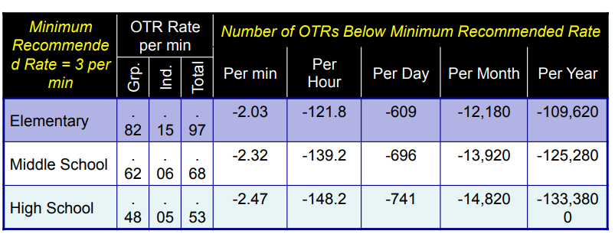
What’s Typical Rate of Practice?
Scott (2015)

Slide 85
Intensifying Practice Opportunities
Targeted practice and repetition based on errors in responding
Focused opportunities to respond
Typical routines for practice

Slide 86
Your Turn!
Explore and Discuss
Individually:
explore sample schedules
http://www.schoolschedulingassociates.com/
Team Share:
what you noticed
questions
take-aways

Slide 87
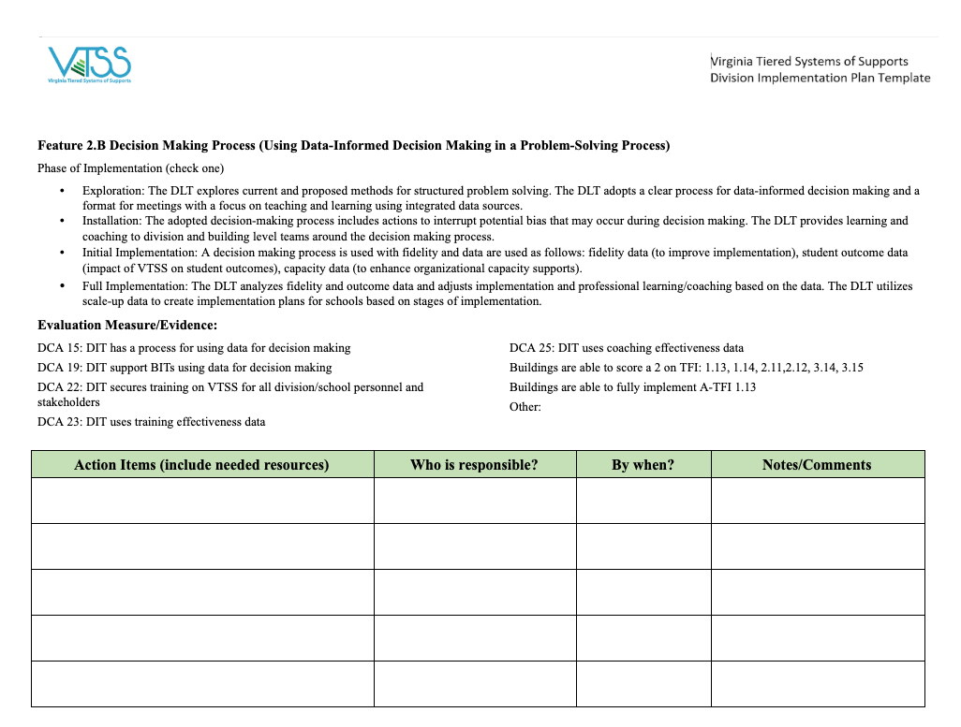
Matrix 2.B/ 3.B/ 1.G Action Planning

Slide 88
Assessing Today’s Learning Intentions
Build on Data-Informed Decision-Making to make instructional decisions and ways to adopt and support interventions for students requiring support at Tiers 2 and 3 (Matrix 2.B, 3.B)
Create and/or analyze clearly defined continuum of supports that is culturally responsive and utilized to ensure an instructional match for all learners (Matrix 1.F, 3.C)
Define advanced tiers and how schools will be supported to analyze data to determine the impact of interventions and make decisions to change the level of support (Matrix 2.C, 5.E)
Integrate and align professional learning based on need (Matrix 1.G)

