Slide 1
Implementing Advanced Tiers
Strand 3 October 2019

Slide 2
Welcome
Strand 3 Team
Located at...
Regina Pierce RIC
Rick Bowmaster RIC
Kelley Neubert TTAC at VCU
Karen Berlin TTAC at GMU
Kandy Grant TTAC at JMU

Slide 3
Community Norms
Take care of your needs
Share your questions with the group
Turn volume/sound off on cell phones
Listen to others attentively
Follow up and complete assigned tasks
Ask what you need to know to understand and contribute
Share your expertise, information and ideas
Be Responsible
Be Respectful
Be Engaged

Slide 4
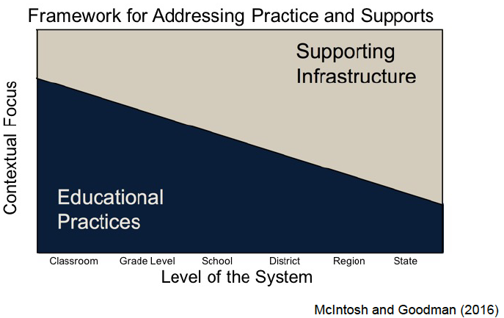
The Division’s Role
Practices
Supports

Slide 5
Today’s Learning Intentions
Identify enhancements to data dashboards to include data related to advanced tier instruction, inclusive of mental wellness (Matrix 2A)
Establish communication loops to connect faculty and staff with advanced tier implementation, as appropriate (Matrix 1D and 2C)
Apply the data-informed decision-making process to complex concerns so that the DLT and SLT position solutions accurately to maximize the efficient use of resources (Matrix 2B)

Slide 6
Implementation at Advanced Tiers
OUTCOMES
SYSTEMS
DATA
PRACTICES
Leadership Team Established: Support the vision of a sustainable implementation of a tiered system through effective communication, common language, infrastructure planning, consensus and commitment building and a communication plan.
Notes:
Thought we should put this in to review the big picture.
We are going back through this now with the notion of advanced tiers: who do we need to add to leadership? How do we add initiatives for students who need additional supports
Do we need to move the Initiative and Resource Mapping Boxes to the appropriate place in the presentation?

Slide 7
Implementation at Advanced Tiers (continued)
INITIATIVE MAP
Used at the division level to describe initiatives that the division expects every school to implement, along with the data and systems necessary to implement those practices with fidelity.
OUTCOMES
SYSTEMS
DATA
PRACTICES
RESOURCE MAP
Used at the school level to describes the specific practices in use at each tier along with the data and systems necessary to implement those practices with fidelity.
Notes:
Thought we should put this in to review the big picture.
We are going back through this now with the notion of advanced tiers: who do we need to add to leadership? How do we add initiatives for students who need additional supports
Do we need to move the Initiative and Resource Mapping Boxes to the appropriate place in the presentation?

Slide 8
Implementation at Advanced Tiers Also Includes…
Set up a system of decision rules and clarity around tiered support (tier definitions).
OUTCOMES
Start with universal data and other multiple measures to set goals.
SYSTEMS
DATA
PRACTICES
Build a continuum of supports that includes culturally responsive evidence based practices, at all 3 tiers, for academics, behavior and mental wellness with a scheduled time and resources for delivery.
Notes:
Thought we should put this in to review the big picture.
We are going back through this now with the notion of advanced tiers: who do we need to add to leadership? How do we add initiatives for students who need additional supports
Do we need to move the Initiative and Resource Mapping Boxes to the appropriate place in the presentation?

Slide 9
Data Informed Decision Making Process
Provide professional development to support staff with improving outcomes and meeting goals. Determine how to include and keep families informed.
Progress monitor all 3 tiers systematically using assessments defined in tier definitions.
OUTCOMES
SYSTEMS
DATA
PRACTICES
Notes:
Thought we should put this in to review the big picture.
We are going back through this now with the notion of advanced tiers: who do we need to add to leadership? How do we add initiatives for students who need additional supports

Slide 10
Outcomes
OUTCOMES
SYSTEMS
DATA
PRACTICES
Examine OUTCOMES: Were the desired outcomes achieved? Were the evidence based and culturally responsive instruction, interventions and support implemented with fidelity?
Notes:
Thought we should put this in to review the big picture.
We are going back through this now with the notion of advanced tiers: who do we need to add to leadership? How do we add initiatives for students who need additional supports

Slide 11
Aligning Language and Common Understanding
Laying the Foundation

Slide 12
VTSS Implementation Matrix 1D
1.D Communication: The team communicates the work of implementation with each other and also with stakeholders
At full implementation the DLT utilizes the communication plan to report policy relevant information (with feedback loops) for all stakeholders including the school board.
Stakeholders report the communication plan has been effective

Slide 13
Stations
Vocabulary
What Do We Mean When We Say…?
Six Core Features
What Distinguishes Advanced Tiers?
Screening and Referral
How do we give guidance?

Slide 14
Common Vocabulary

Slide 15
Jargon Buster
Accommodations
Modifications
Remediation
Intervention
Strategy
As a team, write a definition for each of these terms

Slide 16
Accommodations
Changes that remove
barriers to learning
Change how kids learn,
Not what they learn
Presentation
Response
Setting
Timing and scheduling
Don’t lower
expectations

Slide 17
Modifications
Not expected to learn
the same material
as their classmates
Only available to
students with an
IEP or 504 plan
Changes what a student is taught or expected to learn
Can result in learning less,
and over time could
be a disadvantage

Slide 18
Remediation
Basic skills development for
students needing more support
Assist in achieving
expected competencies
in core academic skills
Rectify, improve or
remedy something
Guided opportunity to internalize
cognitive strategies

Slide 19
Strategy
Strategically matched to the specific type of knowledge being taught
Enhances effort to
improve performance
Tool used to accomplish
a task
Structure, system, method
technique, procedure and
process used to assist
student learning

Slide 20
Intervention
Intentional; aimed at a
particular weakness
Child’s progress
is monitored
Specific and formalized;
reviewed at set intervals
Not an informal,
untracked strategy

Slide 21
Tier 2 Core Features
Advanced Tiers

Slide 22
Core Features
Additional Instruction on skills
Increased regular feedback
Increased structures and prompts
Increased intensity of data collection
Increased family engagement
Efficient system for access and delivery of intervention

Slide 23
Screening and Referral Data
Advanced Tier

Slide 24
Data Collection: Mapping

Slide 25
Websites for screening tools
National Center on Intensive Intervention
(intensiveintervention.org)
Comprehensive, Integrated Three-tiered Model of Prevention (ci3t.org)

Slide 26
Why universal screening?
Division
School
Is the core instruction sufficient and is it improving?
For which groups (gaps, schools, grade levels) is it working/not working?
What is the efficacy of the tiered interventions?
Is the core instruction sufficient and is it improving?
For which groups (gaps, grade levels, classrooms) is it working/not working?
What is the efficacy of the tiered interventions?
What is the individual growth of our students?

Slide 27
Screening in All Domains: Behavior
Sample Behavior Screening
(from preschool to high school):
BASC 2- Behavioral and Emotional Screening System (PK-12)
SRSS: Student Risk Screening Scale (K-6)
SSBD: Systematic Screening for Behavior Disorders (K-6)
Strengths and Difficulties Questionnaire (ages 3-17)
SSIS: Social Skills Improvement System (PK-12)

Slide 28
Screening in All Domains: Social-Emotional Learning
Behavioral and Emotional Rating Scale
Measures strengths and competencies ages 5-18
Devereux Student Strengths Assessment
Designed to screen, assess, guide K-8 intervention
Strengths and Difficulties Questionnaire (SDQ) - Elementary School
Global Appraisal of Individual Needs- Short Screener (GAIN-SS) - Middle and High School

Slide 29
Screening in All Domains: Academics
Examples:
Measures of Academic Progress
Aimsweb, FAST, DIBELS
PALS
I-Ready Diagnostics
I-Station

Slide 30
Division Guidance for Selection Criteria
ODRs, OSS, ISS
Minors
Attendance
Tardies
Early warning systems
Academic data
Mental health screeners
Lost instructional time (eg. any time out of room)
Nurse/counselor visits

Slide 31
Division Guidance for Nomination/Referral Process
What is process for teacher/family student nomination?I
Nomination Process Considerations
Staff training
Decision rules
Number of teachers requesting support exceeds resources
Staff notification of students receiving support
Timeline for nomination decision
Timeline for providing supports to students
Family notification if child is nominated

Slide 32
Common Errors to Pre-Correct
Staff are not trained, or held accountable for their part in intervention
Selection: “Wrong” students on the “wrong” intervention
Not attending to specific types of need
Not attending to intensity of needs
Individualizing for every kid
Over-specialization: 1-2 staff trying to sustain system

Slide 33
Matrix 1D: Action Planning
1.D Communication: The team communicates the work of implementation with each other and also with stakeholders
At full implementation the DLT utilizes the communication plan to report policy relevant information (with feedback loops) for all stakeholders including the school board.
Stakeholders report the communication plan has been effective

Slide 34
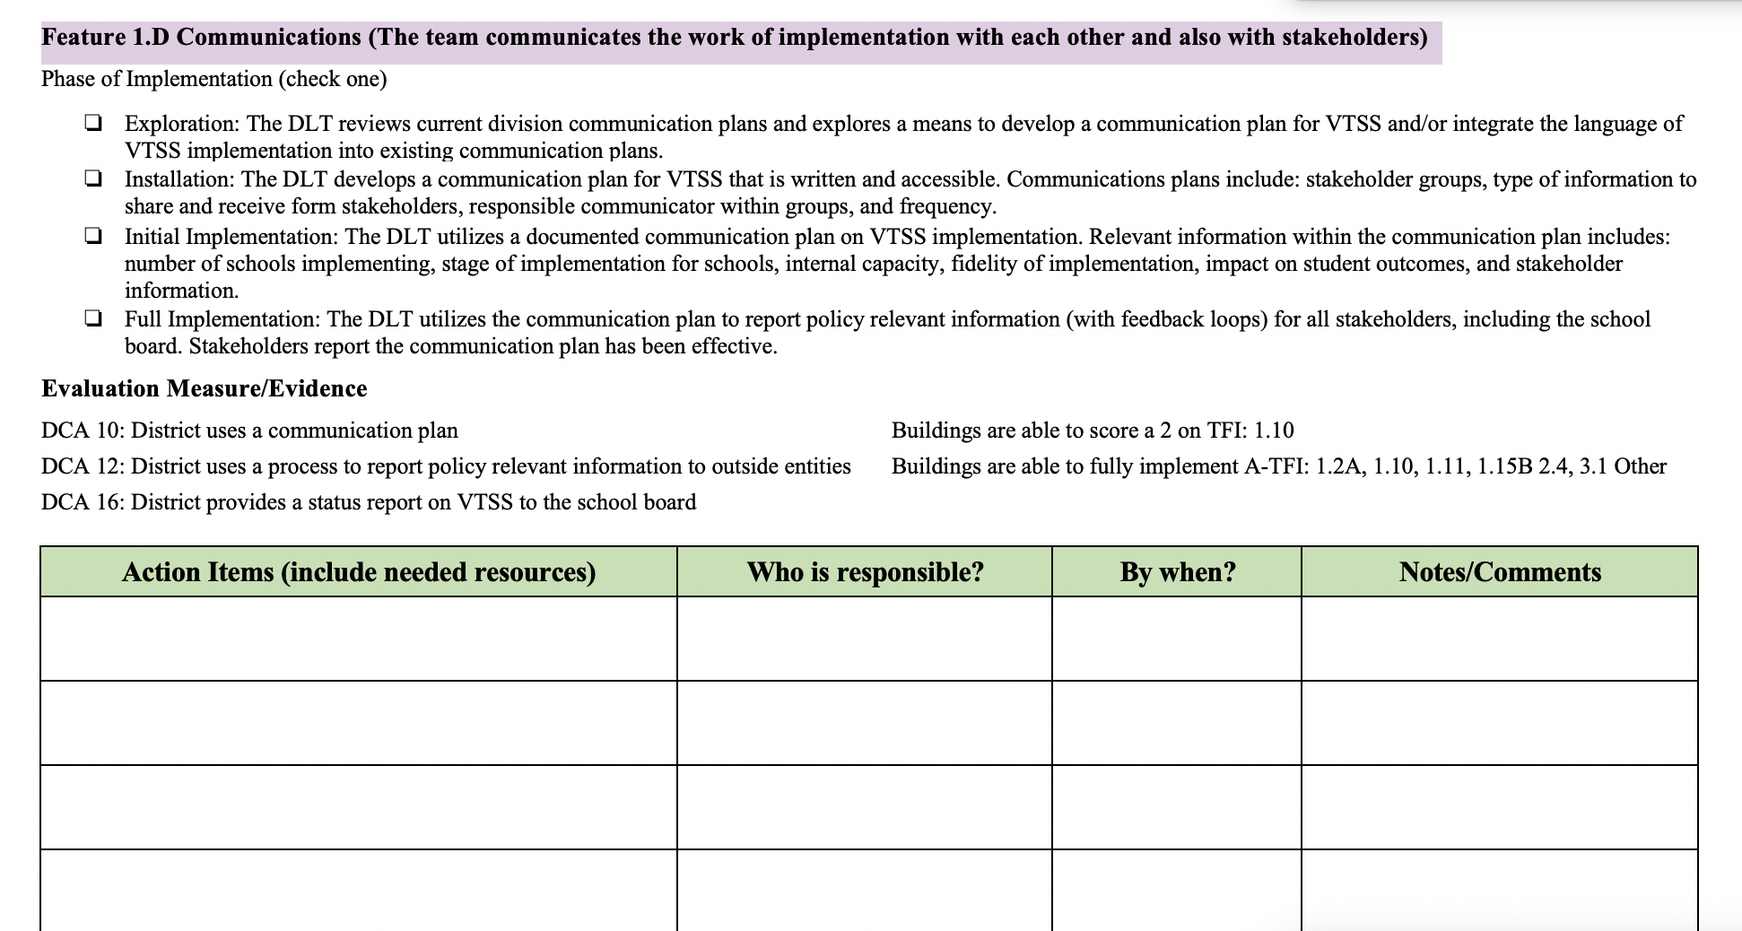
Action Planner 1.D

Slide 35
Advanced Tiers Teaming

Slide 36
Implementation Matrix 2C
2.C Meeting Structures for Data Informed Decision Making: Organizing the who, what, when, where and how to meet on the various types of data at both the division and building level
At full implementation the DLT collaborates with the SLT to determine the fidelity and effectiveness of the meeting structures and provides professional learning/coaching as needed

Slide 37
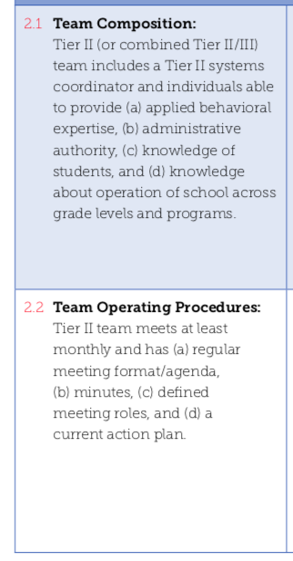
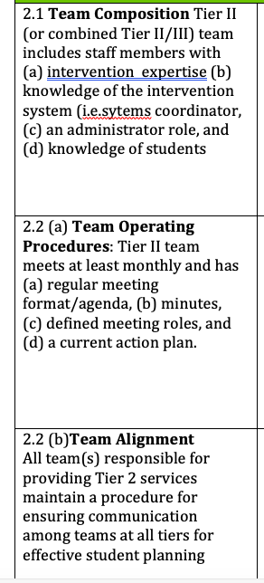
TFI School Road Maps
Notes:
As a division team, your role would be to ensure that schools have the capacity to do this. Are they using agendas, do they have the people that have the knowledge and skills and how can you help them access that? Do they align with other teams? What is that communication process to ensure consistency among teams. Do your schools have a tier 2 team???

Slide 38
Division Supports School Teams
Guidance for team membership at each tier
Distinction guidance between Tier 1, 2, and 3 team functions, conversations and responsibilities
Communication tools, meeting process structures and and supports

Slide 39
Advanced Tiers Division Leadership
Explore data and “look” for students in need
Establish decision rules for access to interventions
Link interventions directly to the academic, SEL and behavior goals
Select and maintain interventions that are always available to students
Collect and analyze data of students in intervention
Provide ongoing support and feedback to staff

Slide 40
Consistent Team Structures
Who is on the school Tier 2 team?
Administrator
Instructional specialists
Behavior specialists
School psychologist
School counselor
School social worker
Teachers
Who else?

Slide 41
Sample Tier 2 Teaming Structure
Tier 2 Core Members: Administrator, Coach(es), Intervention Coordinators
Intervention Coordinator CICO
Intervention Coordinator CICO-M
Intervention Coordinator SAIG
Intervention Coordinator Read 180
Each then work with facilitators

Slide 42
Team Conversations 1
Tier 1/ Universal
Tier 2/ Targeted
Tier 3/ Tertiary
Uses data to provide schoolwide and classroom supports
Uses data to determine overall intervention effectiveness
Problem solves to determine or refine intervention match
Uses data to determine overall intervention effectiveness
Examples:
CICO
CICO-M
Academic
Examples:
Brief FBA/BIP
Diagnostic Review
Example: Schoolwide Lessons;
Screeners
Complex FBA/BIP
WRAP RENEW

Slide 43
Data-Informed Decision Making and Team Problem Solving
Problem Solving
Decision Making
Identify students
Teachers and families invited
Communicate with all stakeholders
Match student needs to intervention
Analyze individual student progress
Identify staff professional learning needs

Slide 44
Team Conversations 2
Tier 1/ Universal
Tier 2/ Targeted
Tier 3/ Tertiary
Uses data to provide schoolwide and classroom supports
Uses data to determine overall intervention effectiveness
Problem solves to determine or refine intervention match
Uses data to determine overall intervention effectiveness
Examples:
CICO
CICO-M
Academic
Examples:
Brief FBA/BIP
Diagnostic Review
Example: Schoolwide Lessons;
Screeners
Complex FBA/BIP
WRAP RENEW

Slide 45
Intervention Effectiveness
Intervention Monitoring
Progress Monitoring
Monitor effectiveness of tier 2 interventions
Review data to make decisions on improvements to intervention fidelity
Focus on trends to assess how groups of students are responding
# of students making/not making progress
# of students who have met their goal

Slide 46
Advanced Tier Team Sample Guidance
Team meets 1-2 times per month
Team processes Requests for Assistance Forms and examines screening data
Team monitors progress of students receiving Tier II supports
Team uses meeting agenda format

Slide 47
Which Team Is It?
Hold up a color response card to indicate if the statement on the screen represents: Green: Tier One Meeting
Yellow: Tier Two Meeting
Red: Tier Three Meeting

Slide 48
Name that Team
School-wide representation
Specialist representation
Meets monthly
Meets 2x/month
Family representation
Community Partner representation

Slide 49
Design Interventions for Who?
Designs positive interventions for all students with goal of 80-90% of students meet expectations
Designs positive interventions for individuals, about 1-5% of students
Designs positive interventions for small groups, about 10-15% of students

Slide 50
Progress Monitor What?
Student outcome and intervention fidelity data
School-wide data for all students
Analyzes data for small groups of students
Behavior Intervention Plan

Slide 51
Share What?
Professional learning and wrap around intervention support
Professional learning and core instruction support
Professional learning and targeted instruction support
Intervention data and outcomes with staff and stakeholders
School-wide data and outcomes

Slide 52
Tier 2 Team Meeting
https://www.youtube.com/watch?v=z6MtVtRSXMs

Slide 53
Teaming Alignment
Do you know what teams are having what conversations at your your schools?
Is there overlap?
Is there an opportunity for integration?
What can you do do to help school teams work smarter, not harder?

Slide 54
Working Smarter

Slide 55
Assessment
Tier 2 team members who serve on tier one teams should retain the same roles and responsibilities.
Tier 2 teams coordinate the data, systems, and practices by are not necessarily the implementers.
Tier 2 teams plan supports for staff implementing tier 2 practices.

Slide 56
Assessment (continued)
4. Tier 2 teams have two kinds of conversations: problem solving and intervention effectiveness.
5. Tier 2 teams should never share intervention data and outcomes with stakeholders to avoid breaking confidentiality.
6. Tier 2 teams problem solve for individual students.

Slide 57
Reflection: Division Team Composition
We have everyone we need to be effective and efficient moving into advance tiers
We may need to think about adding someone else
We need to reflect on this with our larger team

Slide 58
Reflection: Knowledge of School Team Composition
We have tier 2/3 teams in schools
We know how our teams communicate with one another
We have staff with needed expertise on our advanced tier teams
We need to go put on our action plan to go back and look at exactly how this works in our schools

Slide 59
Matrix 2C: Action Planning
2.C Meeting Structures for Data Informed Decision Making: Organizing the who, what, when, where and how to meet on the various types of data at both the division and building level
At full implementation the DLT collaborates with the SLT to determine the fidelity and effectiveness of the meeting structures and provides professional learning/coaching as needed

Slide 60
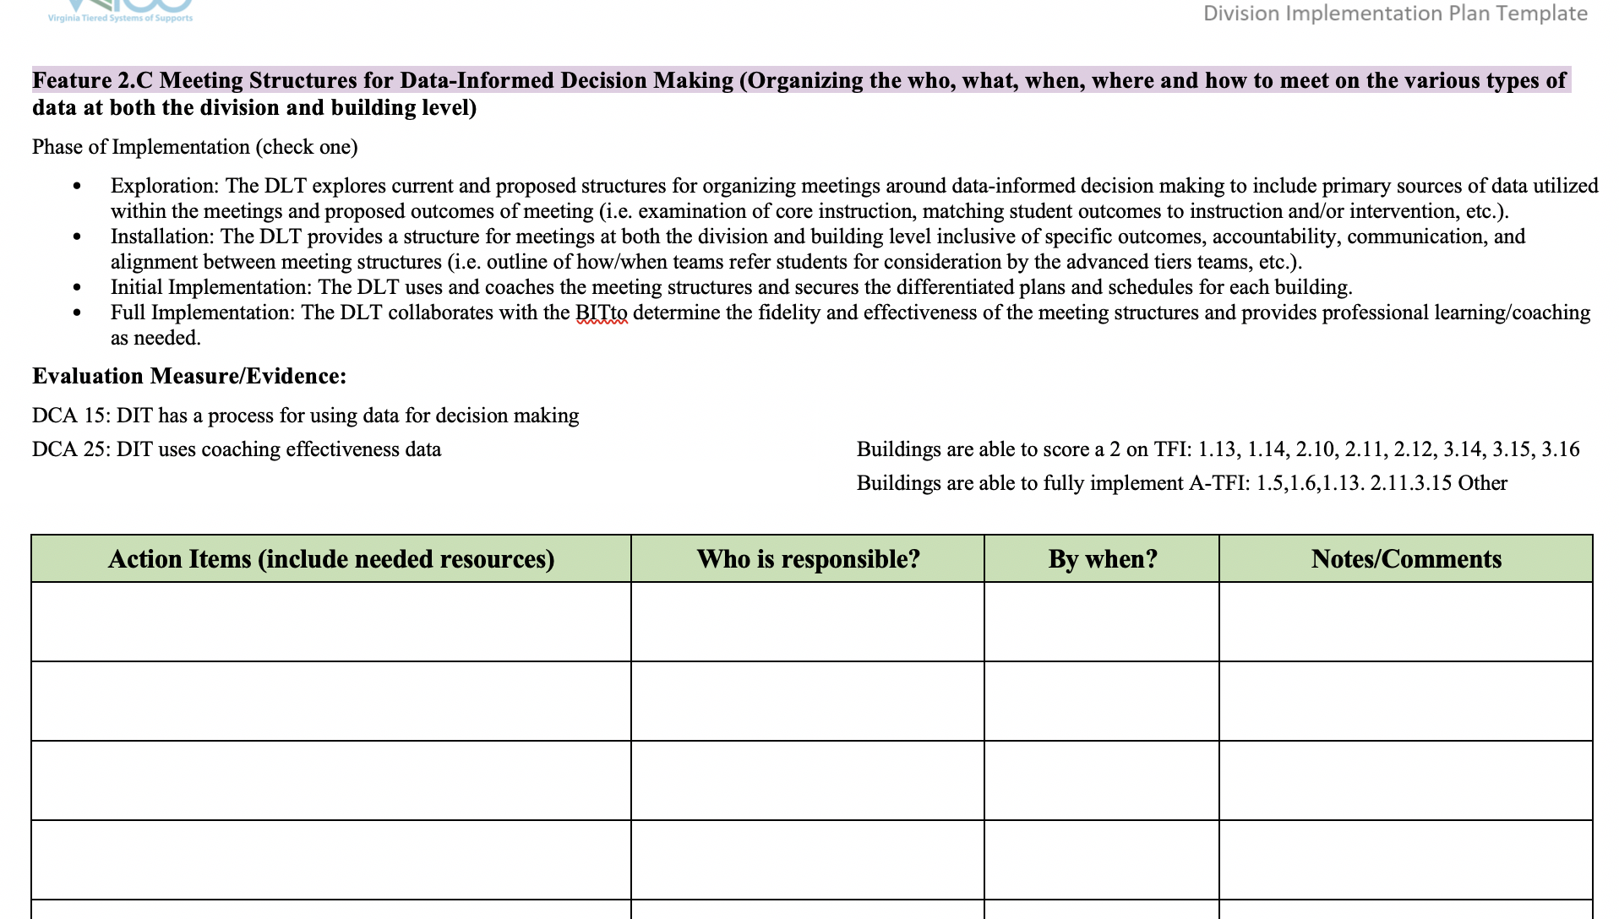
Action Planner

Slide 61
Data Informed Decision Making

Slide 62
VTSS Implementation Matrix 2A
2.A Data Systems: Managing the data effectively and efficiently at all levels
At full implementation the DLT maintains a process to ensure fidelity of usage and evaluation of the effectiveness of the data systems

Slide 63
VTSS Implementation Matrix 2B
2.B Decision Making Process: Using Data Driven Decision Making in a problem solving process
At full implementation the DLT utilizes the fidelity evidence outcome data and adjusts the guidelines and professional learning/coaching based on the data.
The DLT utilizes scale-up data to create implementation plans for schools based on stages of implementation

Slide 64
WHERE ARE WE IN THE TRIANGLE?
Academic Systems
Behavioral Systems
Tier 3/Tertiary Interventions 1-5%
Individual students
Assessment-based
High intensity
1-5% Tier 3/Tertiary Interventions
Individual students
Assessment-based
Intense, durable procedures
Tier 2/Targeted Interventions 5-15%
Some students (at-risk)
High efficiency
Rapid response
Small group interventions
Some individualizing
5-15% Tier 2/Targeted Interventions
Some students (at-risk)
High efficiency
Rapid response
Small group interventions
Some individualizing
Tier I/Universal Interventions 80-90%
All students
Preventive, proactive
80- 90% Tier I/Universal Interventions
All settings, all students
Preventive, proactive
Notes:
64
64

Slide 65
Data-Informed Decision Making:
Systems or Student Issue?
80-90% of total population needs are met by Tier I alone
5-15% total population expected to need and be supported by Tier 2 interventions
1-5% total population expected to need and be supported by Tier 3 interventions

Slide 66
Quick Math
What is your total student enrollment? (*If you need numbers, check your your school profile page)
What is 10% of your total enrollment?
+ ½ that number
Write this number down
This is the number of students in your division you will likely be supporting in academic, behavior, SEL (or combination thereof) intervention at any given time

Slide 67
Framework Health Assessment
Do we have too many students in advanced tier interventions?

Slide 68
Data Divisions Want to Know
What percent of students are making adequate progress in advanced tiers
70% of students are making progress if intervention is effective
Remember: Tier 2 supports that are used too little (1%) or too much (20%) are not sustainable

Slide 69
DLT Assures Schools Can...
gather accurate and reliable data
correctly interpret and validate data
use the data to make meaningful instructional changes for students
establish and manage increasingly intensive tiers of support
evaluate the process at all tiers to ensure the system is working

Slide 70
Station Groups
Data Audit
Looking at intervention data through a division lens
Precision Statements
Telling the story through data
Decision Rules
Creating consistency

Slide 71
Data Audit
Station 1

Slide 72
Division Dashboard/System
How does your division look at intervention data in the aggregate?
Is it on a dashboard?

Slide 73
VTSS Cohort 1 Example
Powhatan
https://docs.google.com/spreadsheets/d/1JwWxDybfALDskFK_0abmeHvTrzt3dYdO/edit#gid=1933465988

Slide 74
Data Audit of Systems

Slide 75
Expanding the View Gather Division Data

Slide 76
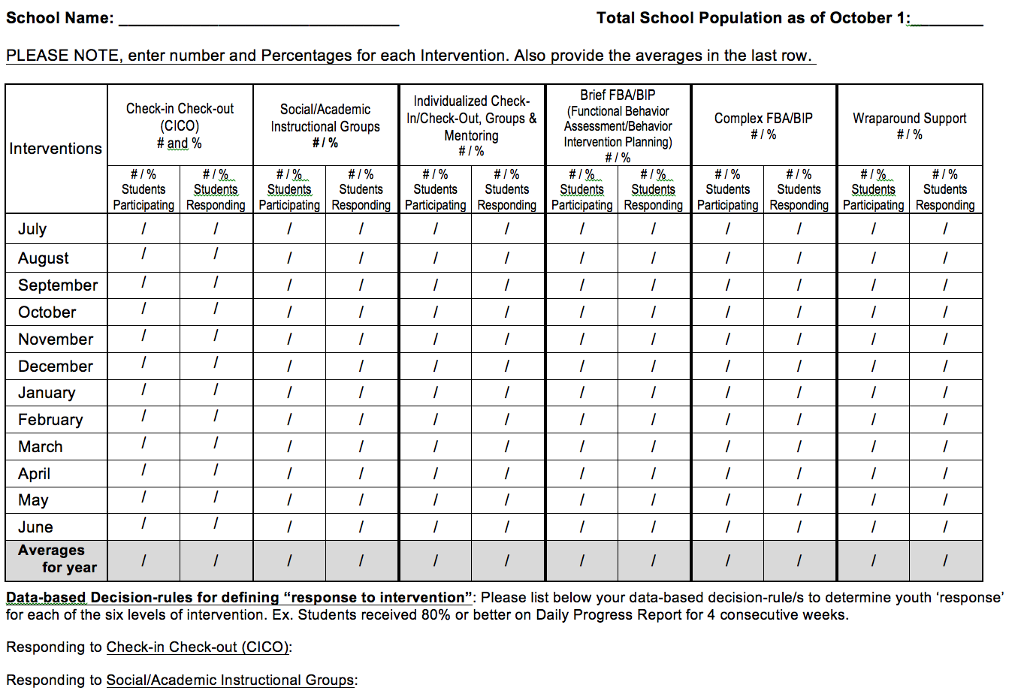
Intervention Tracking Tool
Notes:
76

Slide 77
Precision Statements for Team Problem Solving

Slide 78
Tell the Story

Slide 79
Division Data Dig
Examine your division’s 2018-19 TFI data
What advanced tier implementation trends do you notice across the division?

Slide 80
Division Professional Learning Plan
What does the division leadership team need to do to be sure school teams are proficient in data informed decision-making?

Slide 81
Data Informed Decision Rules

Slide 82
Creating Decision Rules
Decision rules: data sets consistent for all students that determine which students would receive support in an advanced tier or are ready to move to a lower tier.
Making these decisions based on common data sets provides equity in selection.
Make sure there are multiple methods
Nominations – not just teachers
Existing data
Screeners

Slide 83
Creating Decision Rules, cont’d
Decision rules may be a division decision, or they may be a school decision, but the division establishes and documents the process

Slide 84
Academic Example: Decision Rules for Tier 2
Below 25% on universal screener
Below 70% on benchmark assessments
Did not meet PALS benchmark
Did not pass prior year’s SOL
Did not achieve course credit

Slide 85
Behavior Example: Decision Rules for Tier 2
More than 2 ODRs (Office Disciplinary Referrals)
3-5 classroom managed referrals
Nominations
Screener cut scores will be embedded in the tools

Slide 86
Mental Wellness Example: Decision Rules for Tier 2
5+ visits to the nurse or school counselor per month
3-5 absences per month
2-4 tardies and/or early dismissals
Nominations

Slide 87
Document the Process
Make Sure They Belong There
Who Is “IN”

Slide 88
Matrix 2.A and 2.B Action Planning

