Slide 1
Optimizing the Aligned and Integrated Systems of VTSS
Strand 3 March 2020
Implementation Matrix: 6A, 6B, 1G, 1H

Slide 2
Community Norms
Be Responsible | Take care of your needs Share your questions with the group
Be Respectful | Turn volume/sound off on cell phones Listen to others attentively Follow up and complete assigned tasks
Be Engaged | Ask what you need to know to understand and contribute Share your expertise, information and ideas

Slide 3
Learning Intentions
Apply outcome evaluation data to problem solving(6.A)
Implement fidelity measures for data informed decision making (6.B)
Develop professional learning and coaching supports for effective advanced tiers implementation (1.G; 1.H)

Slide 4
Agenda
11:00 -12:00 Division Networking: Advanced
Tiers Implementation
12:00 - 1:00 Lunch
1:00- 2:00 Teaming / Fidelity Measures
2:00 - 2:15 Break
2:15 -3:15 Professional Learning/Coaching
3:15 - 4:00 Action Planning and Closing

Slide 5
Mix and Share
First:
Move to the chart paper that lists the continuum of supports your team is seeking to build
Then:
Share responses with one another to the implementation questions provided

Slide 6
What We Want to Know
Questions that Remain and

Slide 7
LUNCH

Slide 8
Matrix 6.A
Using Outcome Data for Problem Solving
Meeting Structures for Team Effectiveness

Slide 9
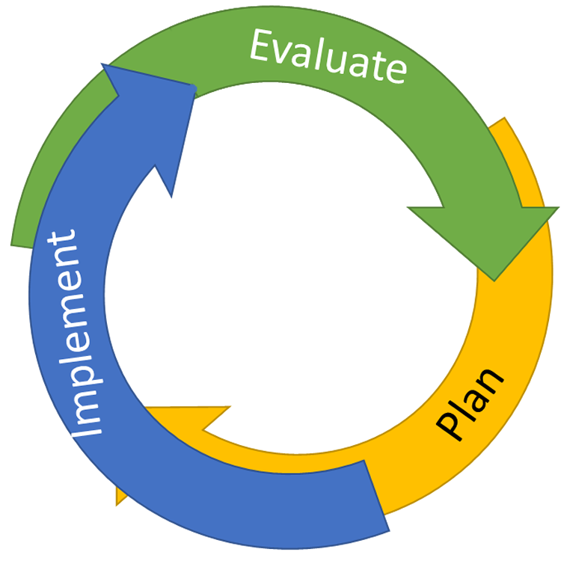
Continuous Quality Improvement
Reassess and revise intervention(s) as needed
Identify problems with precision
Monitor outcomes and compare
to goal(s)
Establish goal(s)
Develop solution(s)
Select
Interventions
Implement interventions with integrity and fidelity

Slide 10
Team Evaluation Tasks
Fidelity of Interventions
Impact of Interventions
“Did we do what we said we were going to do in the way we said we would do it?”
tools
frequency
who and how
communication
“Did it work?”
Better
Same
Worse
Continue?
Fade?
Change?

Slide 11
Varied Forms of Teaming
We are a small school. Our Tier I, Tier II & III teams are the same people
PBIS Team meets monthly, and VTSS integrated Team meets every other week
We meet every week for 30 minutes for each Tier

Slide 12
Advanced Tier Team Distinctions
What is the same?
What is different?
Tier 1
Tier 2

Slide 13
Who is on Advanced Tier Teams?
Tier 2 Core Members: Administrator, Coach(es), Intervention Coordinators
Intervention Coordinator CICO
Intervention Coordinator
Math
Intervention Coordinator Leveled Literacy

Slide 14
Team Conversations
Tier 1/ Universal
Tier 2/ Targeted
Tier 3/ Tertiary
Uses data to provide schoolwide and classroom supports
Uses data to determine overall intervention effectiveness
Problem solves to determine or refine intervention match
Uses data to determine overall intervention effectiveness
Schoolwide Lessons;
Screeners
Behavior
Academic
Brief
Diagnostic Review
Complex FBA/BIP
WRAP RENEW

Slide 15
Sample Division Guidance
Team meets 1-2 times per month
Team processes requests for assistance forms and examines screening data
Team uses meeting agenda format
Team monitors and reports progress of students receiving Tier II supports
Team monitors and reports intervention fidelity data

Slide 16
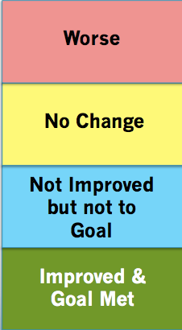
Meeting Structures that Guide Conversation
X
.17/day

Slide 17
Sample Advanced Tiers
Agenda Items
Coordinator/data analyst report for each intervention
New referrals to team
Fading and graduation
System updates and communication
Problem solving and action planning

Slide 18
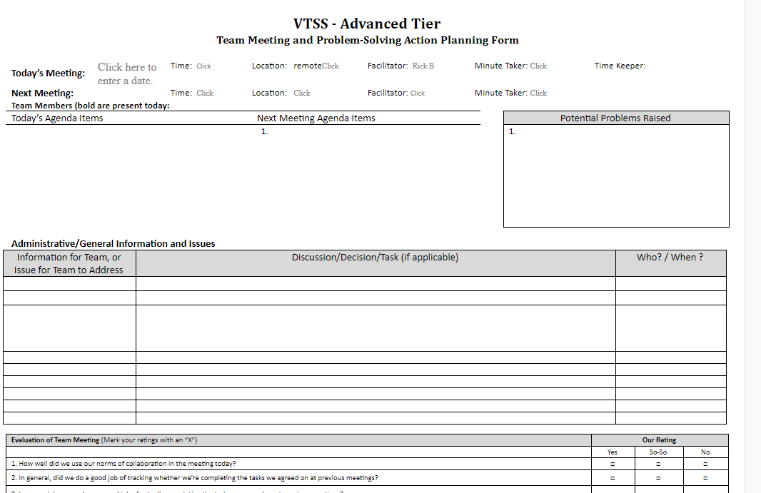
“What’s My Line?”

Slide 19
What Do We Do Next?
Modify the intervention
Monitor fidelity and/or feasibility
Revisit the problem-solving process
Revise the precision problem statement
Revise the goal
Change the intervention
Stop the intervention

Slide 20
Intervention Effectiveness
Intervention Monitoring
IN, ON, OUT
Monitor effectiveness of tier 2 interventions
Review data to make decisions on improvements to intervention fidelity
Focus on trends to assess how groups of students are responding
Students making/not making progress
Students who have met their goal

Slide 21
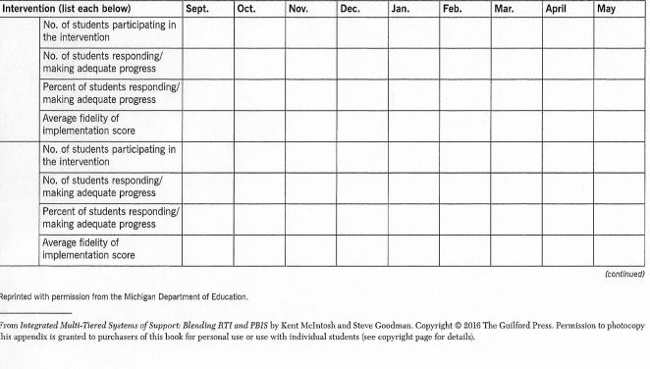
Sample Intervention Tracker

Slide 22
Assessment
School division leadership teams provide guidance and tools for advanced tiers meetings at the school level.
The most important function of the advanced tier team is problem solving for individual students.
It saves time when the same people serve on tier one and advanced tier teams because the conversations are so similar.
Division leadership teams develop a system to provide professional learning and coaching to sustain effective advanced tiers teaming structures and data-informed decision making.

Slide 23
Implement fidelity measures for data informed decision making (6.B)
Did we do what we said we would do?

Slide 24
Checklist Manifesto
https://www.youtube.com/watch?v=1ufwtP36id8

Slide 25
Fidelity
Implementation
Instruction
Assessment

Slide 26
Fidelity Tools
TFI = Tiered Fidelity Inventory
ATFI = Academic Tiered Fidelity Inventory

Slide 27
Implementation Matrix
VTSS IMPLEMENTATION AT A GLANCE for Divisions
Aligned Organizational Structure: The elements of a tiered system exist at the division, school, and classroom levels and are compatible.
Leadership: Getting a functional team together and helping schools to do the same.
Teaming: Making sure the team is knowledgeable and fits with other teams.
Planning: The team now aligns the work for implementation.
Communication: The team communicates the work of implementation with each other and also with stakeholders.
Aligned Definitions of Multi-tiered Supports: Establishing the data, practices, and systems across all three tiers.
Aligned and Effective Resources for Multi-Tiered Supports: Operationalizing the multi-tiered system.
Professional Learning: Integrating and aligning all professional learning based on need.
Coaching: Developing coaching plans and processes to support data, practices, and systems.

Slide 28
Considerations
Clearly defined outcomes
People responsible for implementation
Specific decision rules
Data Dashboard
Use of TFI & ATFI

Slide 29
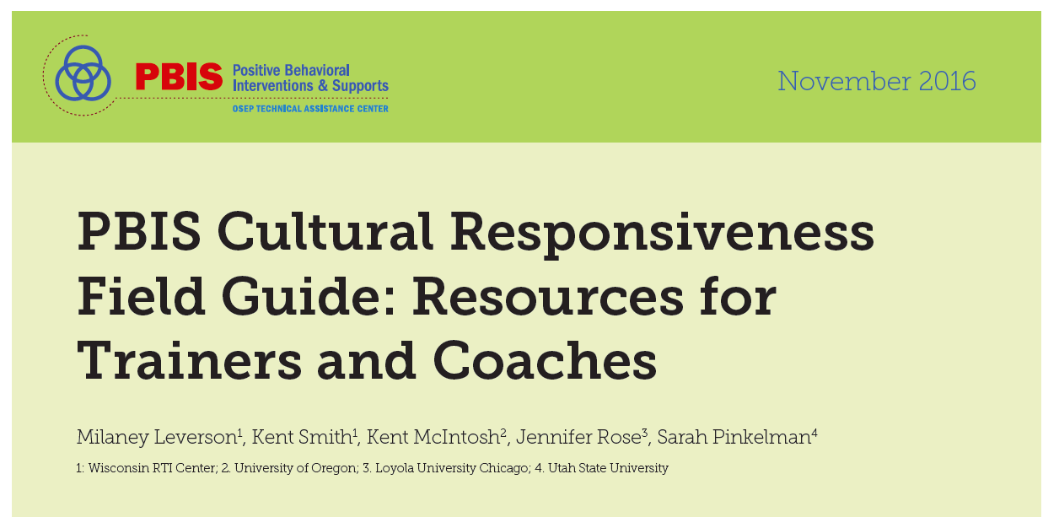
Fidelity of Implementation

Slide 30
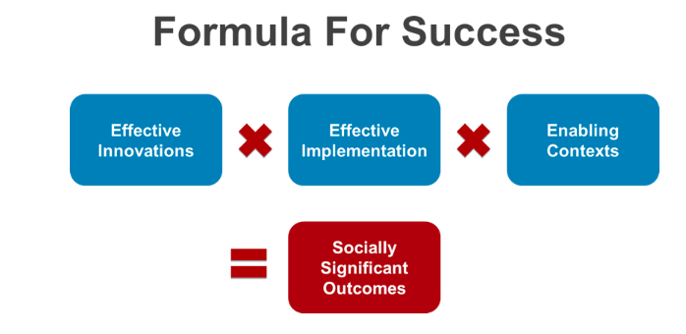
Power of Fidelity
National Implementation Research Network

Slide 31
Fidelity of Assessment

Slide 32
Fidelity of Instruction

Slide 33
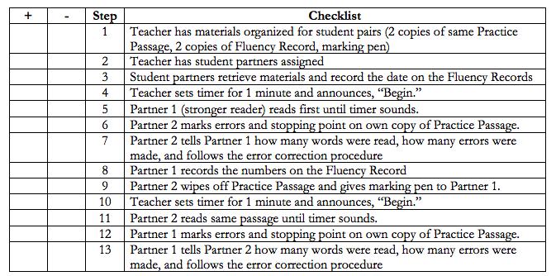
Programs
(Example only)

Slide 34
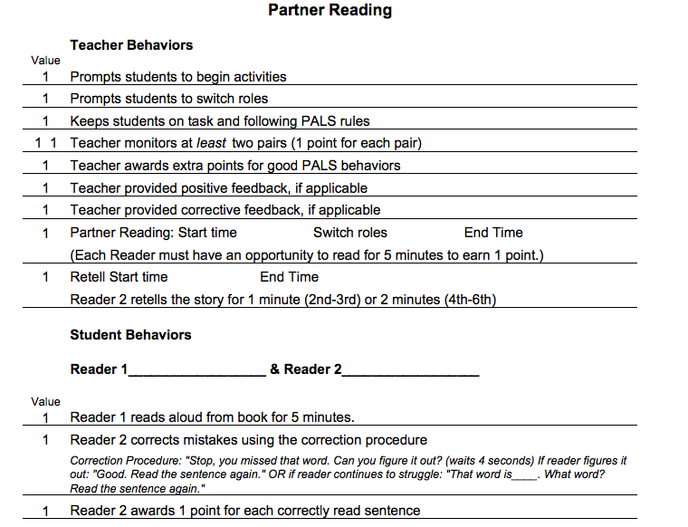
Strategies

Slide 35
One More Resource

Slide 36
Your Division Manifestos
“Did we do what we said we were going to do in the way we said we would do it?”
Thinking back on the intervention(s) you discussed in the morning mixer, what will be your fidelity measures?
tools
frequency
who and how
communication

Slide 37
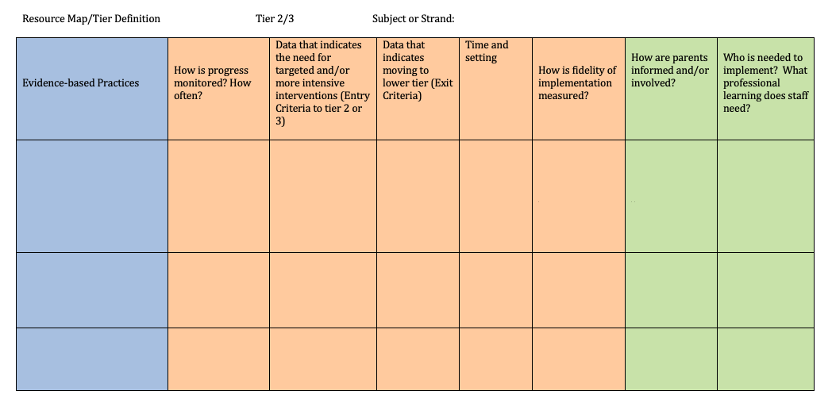
Fidelity on
Tier Definition/Resource Map
What is the professional learning and coaching needed for the person delivering the intervention to be able to teach with fidelity?

Slide 38
Matrix 1.G:
Professional Learning
Integrate and Align Learning Based on Need

Slide 39
1.6 - Professional Learning

Slide 40
Something to Consider
We give schools strategies and systems for improving practice and outcomes, but implementation is not accurate, consistent, or durable, and desired outcomes aren’t realized. School personnel and teams need more than exposure, practice, and enthusiasm.
George Sugai, OSEP Center on PBIS, Center for Behavioral Education and Research, University of Connecticut

Slide 41
Common Language
PROFESSIONAL DEVELOPMENT: a single event such as face-to-face training
PROFESSIONAL LEARNING: a systematic process of support for everyone

Slide 42
Professional Learning is…
A process of continuous improvement
Focused on achieving learning goals
Not an event defined by a predetermined number of hours

Slide 43
Professional Learning Examples
Standard | Qualities | Team’s Role
Learning Communities | occurs within learning communities committed to continuous improvement, collective responsibility, and goal alignment. | creates a network of ongoing learning for evidence based practices embedded in PBIS
Resources | requires prioritizing, monitoring, and coordinating resources for educator learning. | identifies resource needs and determine how to meet them
Learning Designs | integrates theories, research, and models of human learning to achieve its intended outcomes. | brings the learning design to the faculty…provides well designed training and time to discuss
Leadership | requires skillful leaders who develop capacity, advocate, and create support systems for professional learning. | .
Data | uses a variety of sources and types of student, educator, and system data to plan, assess, and evaluate professional learning. | shares and analyzes data
Implementation | applies research on change and sustains support for implementation of professional learning for long term change. | makes implementation plans
Outcomes | aligns its outcomes with educator performance and student curriculum standards. | measures fidelity and outcomes.

Slide 44
The Teacher Professional Learning Process - Division Process
Define quality instruction for all levels and tiers
(Workbook p. 8)
Analyze data from fidelity tool to create a coaching plan
Develop a professional learning plan for instructional leaders and staff
Division supports school implementation
Create a fidelity measure (walkthrough tool)

Slide 45
Check: The Teacher Professional Learning Process - Division Process
Define quality ____________ for all levels and tiers
Analyze data from fidelity tool to create a ________ plan
Develop a P______ L_________ plan for instructional leaders and staff
___________ supports school implementation
Create a __________ measure (walkthrough tool)

Slide 46
Teacher Professional Learning Process – School Process
(Workbook p. 8)
Presentation of Theory and Research
Coaching and Follow up
Demonstration of the Strategy or Skill
Practice and Feedback

Slide 47
Developing a Plan
Based on data, identify the need to be addressed
What is the desired outcome?
What practices do teachers need to know and be able to do to reach that outcome?
What systems are needed to support staff growth?

Slide 48
Implementation with Fidelity
Implementation with fidelity is better achieved when…
OUTCOMES
Systems
How will we train on and implement a new resource?
Data
What does the data tell us is an area of concern?
Practices
What resource can address this areas of concern?

Slide 49
Supporting Our Teachers
Source:Simonson et al, 2013
Tier 3
Intensive PD
Tier 2
Targeted PD
Tier 1
Universal PD

Slide 50
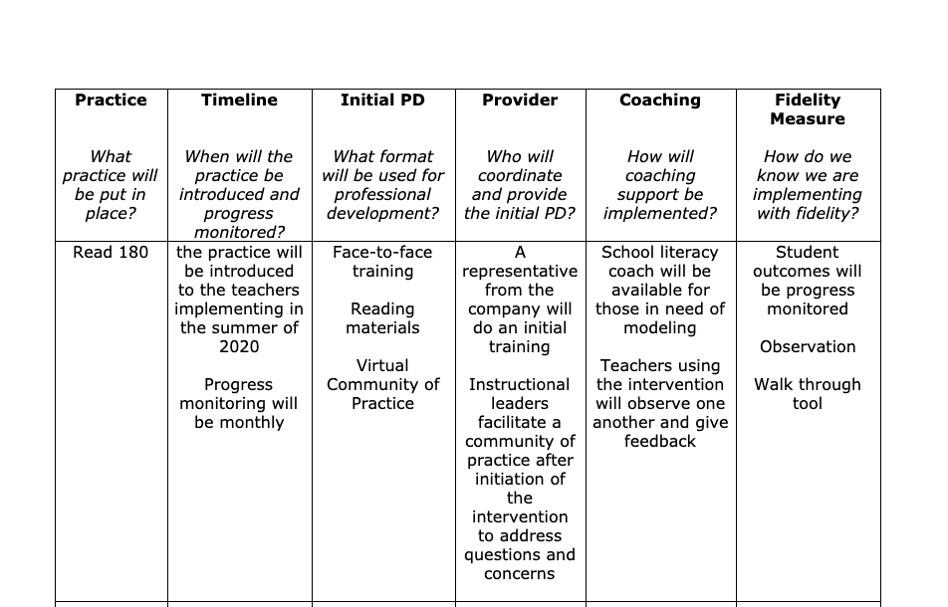
Something like this…

Slide 51
Professional Learning
Tier Definition/Resource Map
What is the professional learning and coaching needed for the person delivering the intervention to be able to teach with fidelity?

Slide 52
Matrix 1.H:
Coaching
Develop coaching plans and processes to support data, practices and systems

Slide 53
Professional Learning Impact

Slide 54
Coaching in VTSS:
Think Verb, Not Noun
Systems Coaching Institutes:
The vision of VTSS is to build capacity within school divisions for a sustained tiered system of academic, behavioral, mental wellness supports responsive to the needs of all students. VTSS Systems Coaching Institutes are designed to develop a set of coaching skills or facilitation capacity within a team of individuals in order to raise a system’s ability to organize personnel and resources for prompting and encouraging local school training and implementation efforts.

Slide 55
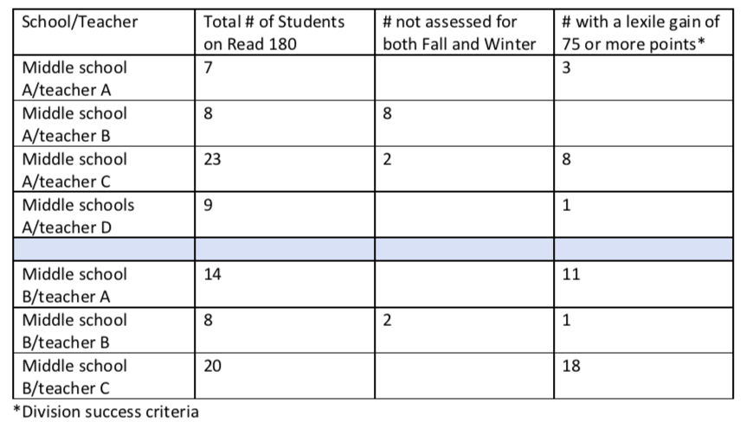
Example and Non-Example

Slide 56
Network around ways to have coaching available
How can this be accomplished?

Slide 57
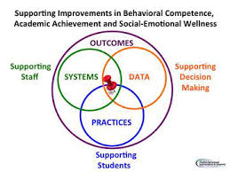
1.H Examining the Matrix: Using an Advanced Tiers Lens

Slide 58
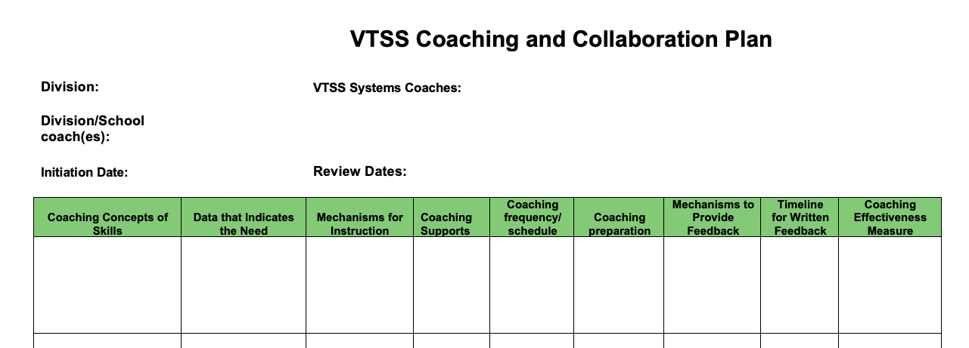
Coaching Plans

Slide 59
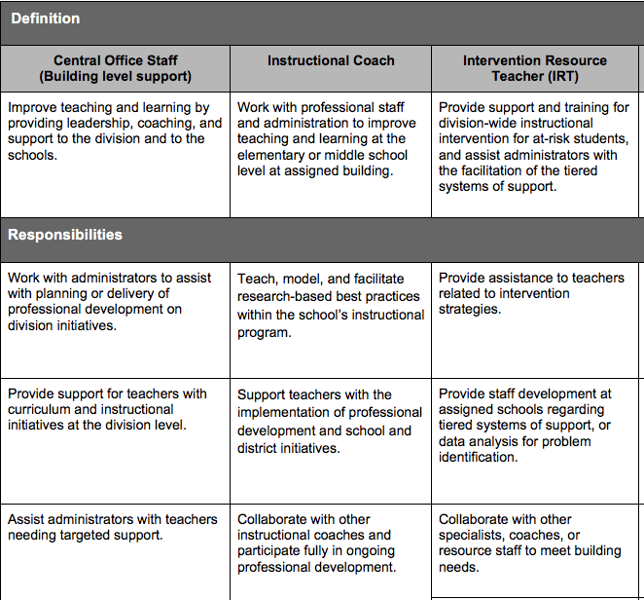
Example of Responsibilities

Slide 60
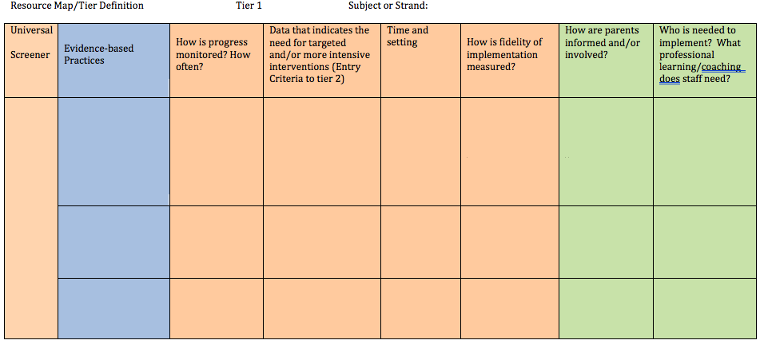
Adding to
Tier Definition/Resource Map
What is the professional learning and coaching needed for the person delivering the intervention to be able to teach with fidelity?

Slide 61
The Big Ideas:
Thinking Through Our Day
Determine Impact of data, systems, practices
Determine professional learning requirements
Initiate coaching according to need
Implement practices with fidelity
Evaluate fidelity of implementation

Slide 62
Spiraling Back and Moving Forward:
Building Data, Systems, Practices
Determine Advanced Tiers teams
Evaluate Tier 1 using universal screening data
Make decision rules about access and exit to Advanced Tiers supports
Ensure a continuum of evidence based practices at Advanced Tiers (6 core features, selection process)
Ensure a system for matching intervention to student need
Determine the progress monitoring data to be collected
Ensure coaching (, training, and fidelity checks
Determine meeting structures with agendas utilizing problem solving process
when do we discuss intervention data?
when do we discuss individual student data?

Slide 63
Closing
Action planning and interactive group activity

