Slide 1
Strand 3 Advanced Tiers
Building A System
Supporting Schools

Slide 2
Greetings from the VDOE

Slide 3
Today’s Agenda
9:00 - 10:30
Intro & Connections
Advanced Tiers Overview
Teaming
Data-Informed Decision Making
10:30 - 10:40: Quick Break
10:40 - 11:30
Decision Rules
Team Time Guidance
11:30 -12:15: Team Time Breakout Rooms
12:15- 12:30: Review & Preview

Slide 4
Welcome!
Let’s meet one another!
Please tell us:
Your name
Your role in your division
Something that has “fallen” into place recently either personally or professionally

Slide 5
Poll: Where Are You?
Top Ten for Advanced Tiers
Answer:
“in place”
“in progress”
“unsure”
...reflecting your knowledge of the stated item.

Slide 6
Navigating ZOOM!
CHAT
MUTE YOUR MICROPHONE
HIDE YOUR VIDEO CAMERA
SHARE YOUR SCREEN

Slide 7
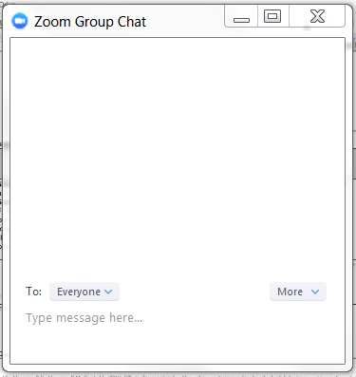
Chat Box Feature

Slide 8
Virtual Norms
Be Engaged | Unmute to share ideas/questions. Participate in virtual activities
Be Respectful | Eliminate distractions like cell phones, email, social media, and background noise Give others time to talk and share Be committed to attend the full session
Be Prepared | Download materials prior to session Set dates/times with your team to continue action planning after sessions

Slide 9
Learning Intentions for Session 1
Participants apply the Data Informed Decision- Making Process for Advanced Tiers implementation (Matrix 2.B).
Participants coordinate collaboration with school teams to ensure fidelity and effectiveness of the meeting structures used for data informed decision making (2.C).
Participants analyze current definitions of each tier and design aligned operational definitions for multi-tiered supports across domains for efficient implementation (Matrix 1.F).

Slide 10
Success Criteria
My division team will provide school teams with:
Documented meeting structure guidance for efficient and effective advanced tiers meetings
Documented guidance for regularly occurring advanced tier data-informed decision making (DIDM) about intervention level of use, student performance, and fidelity of implementation
Documented guidance to create and/or revise advanced tiers decision rules

Slide 11
Advanced Tiers Foundations
“The Elite Eight”
Teaming
Professional Learning and Coaching
Screening and Request for Assistance
Data-
Informed Decision Making
Decision Rules
Progress Monitoring
Continuum of Support
Alignment

Slide 12
What is Advanced Tiers? VTSS Tier 2
Targeted support for students not successful with Tier 1 alone
Small group intervention
Provided in addition to universal, Tier 1 and aligned with student needs
For students who may be struggling or who need more challenge

Slide 13
What is Advanced Tiers? VTSS Tier 3
Frequent, intensive, and individualized intervention
Intensive support for students not responding to Tier 2 support or need more intensive support
Individualized intervention
Different than special education

Slide 14
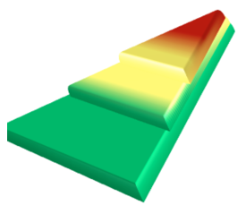
Where Are We in the Triangle?
Tier 3 for a Few: Intensive, Individualized
Tier 2 for Some: Targeted for Small Groups
Tier I for All: Core/Universal
1 - 5%
5 - 15%
80 - 90%

Slide 15
Moving In and Out of Tiers
How are students’ experiences in a multi-tiered system of supports similar to a lava lamp?

Slide 16
What is your Data Story?
What does your triangle currently look like?
If your Tier 1 foundation is not strong enough, too many students will require more intensive instruction

Slide 17
What goes into Advanced Tiers?
Determine the available interventions (academics, behavior, mental wellness, attendance)
Teams meet and evaluate early warning (EWS) and screening data
Develop and respond to a Request for Assistance
Determine what the intervention will be for specific students
Make an instructional match based on available data
Set goals for students!
How will teams determine movement in and out of different levels of support?

Slide 18
What goes into Advanced Tiers (cont.)
Track the efficacy of each intervention and monitor fidelity
Monitor progress of students receiving intervention and respond accordingly
Align with Student Support/Special Education/Tier 1 instruction
Communicate and engage with school/stakeholders/families

Slide 19
Social Competence & Academic Achievement
OUTCOMES
What we use to make decisions; Progress Monitoring, Fidelity
SYSTEMS
DATA
What we do to support adults to implement the practices
PRACTICES
What we do to
support students
Notes:
19

Slide 20
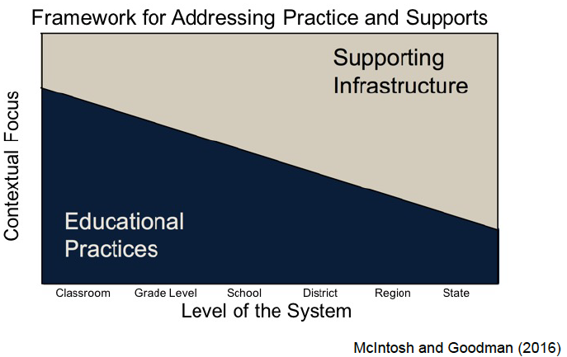
The Division’s Role
Practices
Supports

Slide 21
Advanced Tiers Foundations
Today’s Agenda
Teaming
Professional Learning and Coaching
Screening and Request for Assistance
Data-
Informed Decision Making
Decision Rules
Progress Monitoring
Continuum of Support
Alignment

Slide 22
Teaming
Teaming
Professional Learning and Coaching
Screening and Request for Assistance
Data-
Informed Decision Making
Decision Rules
Progress Monitoring
Continuum of Support
Alignment

Slide 23
Implementation Matrix
Meeting Structures

Slide 24
VTSS Division Leadership
Division provides schools guidance at each tier for:
Team Membership and Responsibilities
Alignment and guidance for team meeting structures
Data Conversations and Decisions
Communication
Professional Learning

Slide 25
Advanced Tier Team Meetings
Occur more frequently (2x month)
Process referrals:
Screening data and Requests for Assistance
Make Data-Informed Intervention Decisions
Monitor student progress and intervention effectiveness data
Communicate with staff and stakeholders

Slide 26
How Does This Look at Various Sites?
We are a small school. Our Tier I, Tier II & III teams are the same people
Our Team meets monthly, and our Tier II Team meets every other week
We meet every week for 30 minutes for each Tier

Slide 27
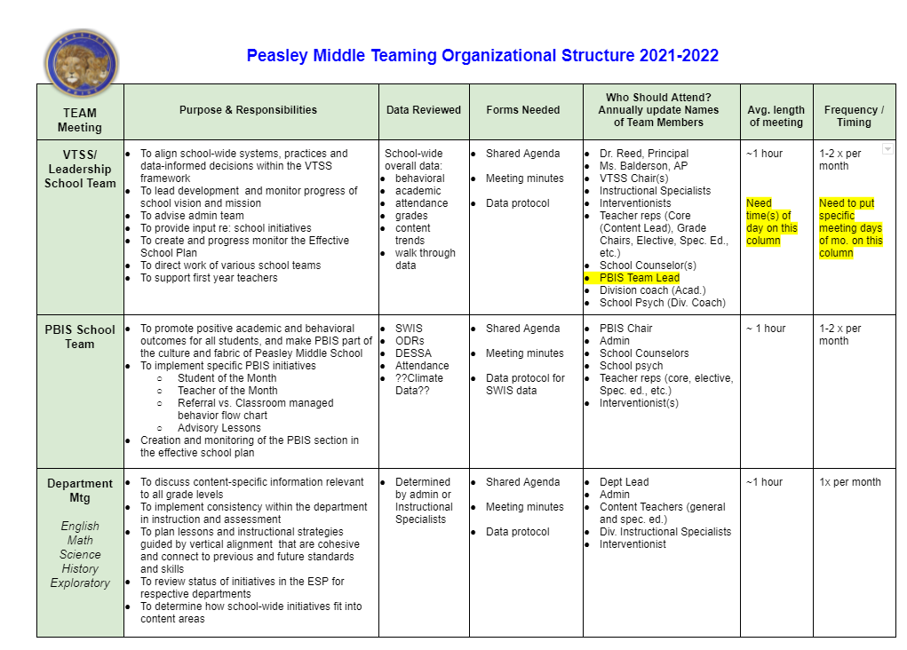
Sample from The Field

Slide 28
Team Data Conversations
Tier 1/ Universal
Tier 2/
Targeted
Tier 3/ Tertiary
Student referral and progress monitoring
Intensified individual student progress monitoring
Intervention level of use and % of students making progress
Schoolwide and classroom
Increased progress monitoring, fidelity measures and family engagement

Slide 29
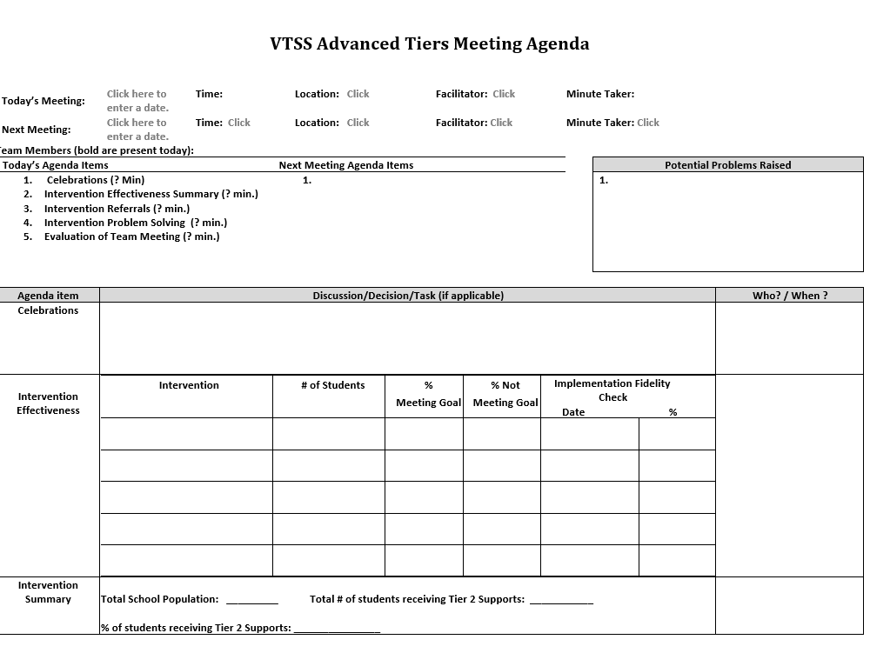
Advanced Tier Sample Meeting Agenda

Slide 30
Advanced Tiers Standing Agenda Items
Intervention Effectiveness
# of students
# meeting goal
# not meeting goal
Level of Use
Total school population
# of students receiving intervention
Fidelity
Intervention Referrals and Decision Rules
Team Problem Solving

Slide 31
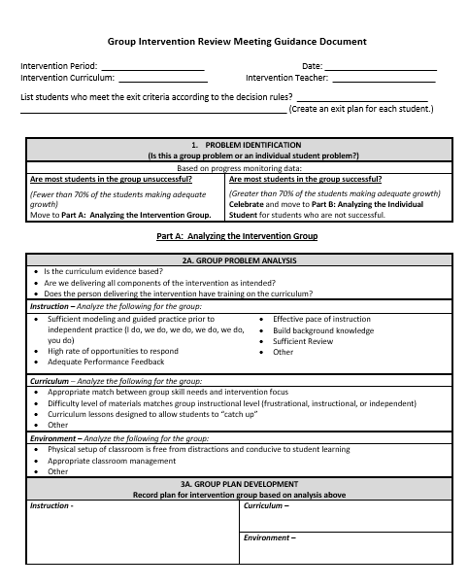
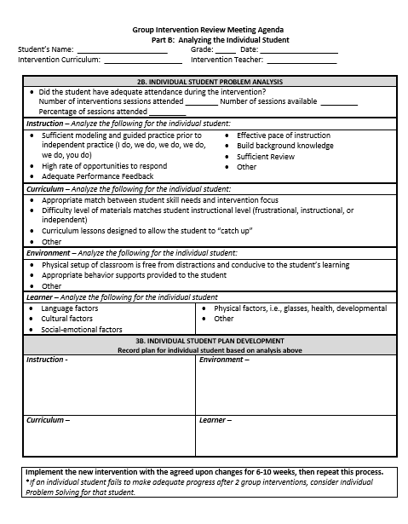
Different Forms,
Same Discussions!
retrieved from http://www.oregonrti.org/resources

Slide 32
Communication with Staff
Share student progress graphs in CLTs and grade level meetings
Include Tier 2 graphs in school-to-home communication
Builds commitment to Tier 2 interventions
Increases awareness of interventions
Create and maintain a clear communication plan to share information and decisions across teams

Slide 33
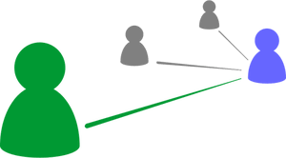
Continue the Conversation!
What guidance does or could your division provide to school teams as they support core instruction and advanced tiers interventions this school year?

Slide 34
Stretch Break
Stand, stretch, refocus your eyes

Slide 35
Data Informed Decision Making
Teaming
Professional Learning and Coaching
Screening and Request for Assistance
Data-
Informed Decision Making
Decision Rules
Progress Monitoring
Continuum of Support
Alignment

Slide 36
VTSS Implementation Matrix
Decision Making Process

Slide 37
Division Data Dashboard
Division data dashboard includes:
% of students receiving interventions
% of students are making adequate progress in interventions
70% of students are making progress if intervention is effective
Tier 2 interventions used too little (1% or too much (20%) are not sustainable

Slide 38
Division Data Conversations
VTSS division leadership teams use data to make decisions about:
Level of use
Intervention effectiveness
Student growth and progress
Intervention fidelity

Slide 39
DLT School Support
Division Leadership ensures school teams can:
gather accurate and reliable data
correctly interpret and analyze data
use the data to make meaningful instructional decisions for students
use the data to evaluate health of the multi-tiered framework at their school
identify and provide professional learning and coaching needs for intervention implementation fidelity

Slide 40
LEVEL OF USE and EFFECTIVENESS DATA

Slide 41
Level of Use Team Discussions
Level of use data are necessary to answer important questions:
Is access to intervention proportionate to school population?
Is the intervention effective for most of the students receiving the intervention?
Is there disparity across students receiving intervention?

Slide 42
Tier 2 Enrollment Rates
5-15% of students receive Tier 2 supports
Tier 2 supports that are used too little (1%) or too much (20% >) are not sustainable

Slide 43
Academic Data
Level of Use Decision
IF
THEN?
Screening data indicates more than 50% of 5th grade students are in need of math intervention
Tier 2 group intervention
Tier 1 Core instruction
Tier 3 individual intervention

Slide 44
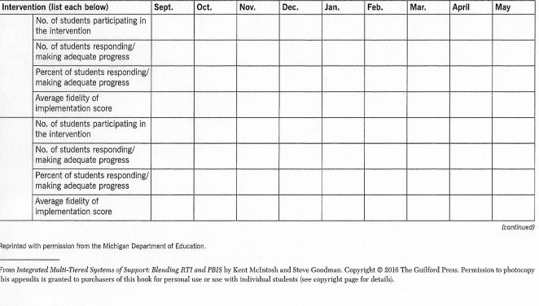
Intervention Effectiveness Data

Slide 45
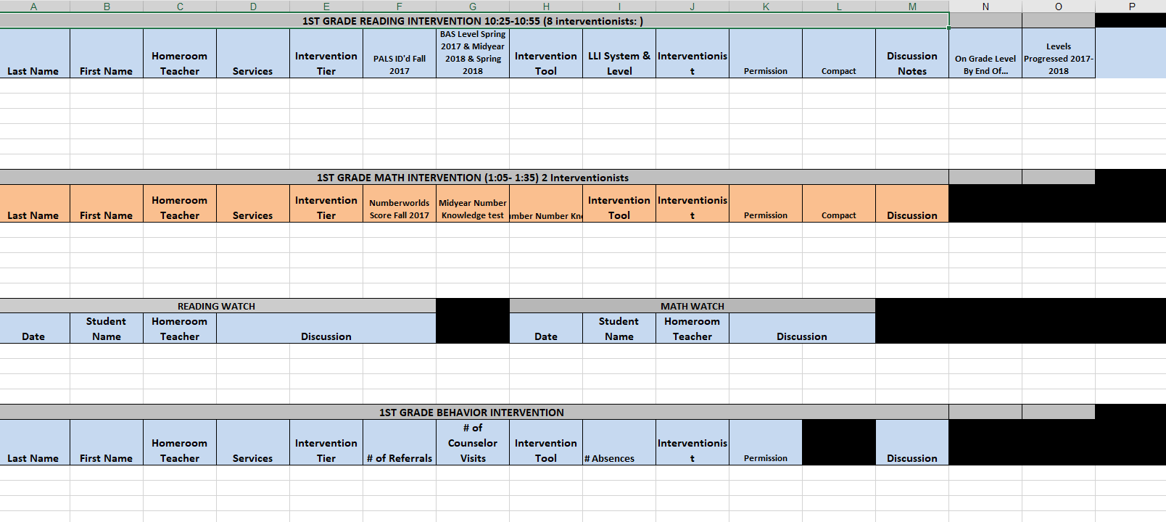
Powhatan Sample Tracking Tool

Slide 46
Insert Powhatan Video Clip here
Powhatan County Public Schools Presentation

Slide 47
STUDENT PERFORMANCE DATA

Slide 48
Student Performance Data
Self-Check
Tier II team tracks proportion and % of students experiencing success AND uses Tier II intervention outcomes data and decision rules for progress monitoring and intervention modification
0 = Student data not monitored
1 = Student data monitored/no data decision rules to alter support
2 = Student data monitored and used at least monthly, with data decision rules established

Slide 49
Coordinator Report Example
Student Intervention Data Meeting Grade ____
Name:______________
Date:____ Reading____Math____Behavior MW_____
Intervention Data:
Goal ROI/Trend ROI ___/___ for reading
Progress Monitoring Data:
Other indicators impacting performance
Is the progress: ____Good ____Questionable ___Poor
Decision:
__exit (goal met) ____modify ___increase
__continue (satisfactory progress
___schedule individual problem solving

Slide 50
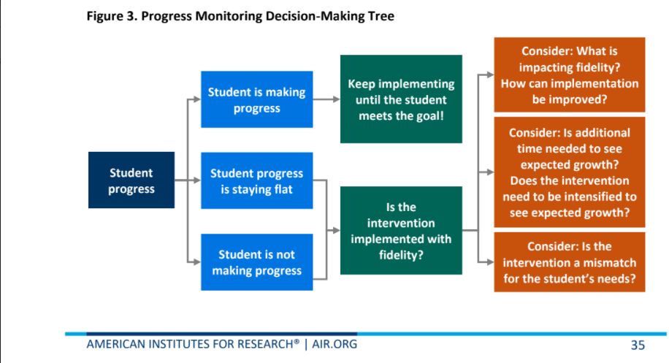
Progress Monitoring
Decision Tree Example

Slide 51
What Do We Do Next?
Modify the intervention
Change the intervention
Fade the intervention
Monitor fidelity
Revisit the problem-solving process
Revise the precision problem statement
Revise the goal

Slide 52
FIDELITY DATA

Slide 53
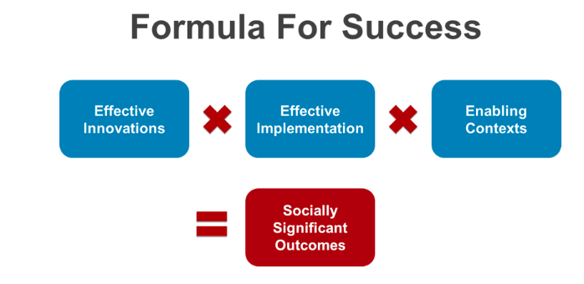
Power of Fidelity
National Implementation Research Network

Slide 54
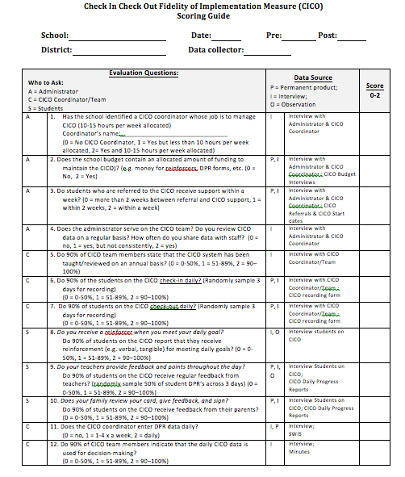
Behavior Intervention Fidelity Checklist Example
Notes:
54

Slide 55
Quick Check for Understanding
_____ _______ are important because they prevent teams from misplaced problem solving when the problem is the intervention and not the student.
A) Decision Rules
B) Effectiveness and Efficiency
C) Fidelity Measures

Slide 56
Assessment Continued
Level of use data help determine:
1) Health of multi-tiered framework
2) If disparity exists across students receiving the intervention
3) intervention effectiveness

Slide 57
Data Discussion
What new or additional supports can your division leadership team provide school teams to ensure regular review of level of use, intervention effectiveness, student performance and fidelity data?

Slide 58
Screening and Request for Assistance
Teaming
Professional Learning and Coaching
Screening and Request for Assistance
Data-
Informed Decision Making
Decision Rules
Progress Monitoring
Continuum of Support
Alignment

Slide 59
Implementation Matrix
Screening Tools, Data, Process
Screening and Request for Assistance

Slide 60
Universal Screeners
ACADEMIC National Center on Intensive Intervention RAND Education Assessment Finder | BEHAVIOR National Center on Intensive Interventions Center on PBIS | SOCIAL EMOTIONAL CASEL Assessment Guide RAND Education Assessment Finder Ohio Department of Education

Slide 61
Steps to Universal Screener Implementation
Establish Clear Roles/Responsibilities
Identify Stakeholders
Determine the frequency/timelines
Communicate the Purpose
Ensure Accessibility of ALL and elimination of potential bias
Provide/Participate in Professional Development of Assessment Tools

Slide 62
Integrated Screening
INFORMAL
FORMAL
Nominations/ Requests for Assistance
Existing Data Sets
Universal Screeners

Slide 63
Nominations/ Request for Assistance
Designed for quick response
Staff (Teacher, Support Staff, Administration), Caregiver and/or Student may make a nomination.
Should identify students with not only externalizing (interpersonal) risk characteristics but those with internalizing (intrapersonal) risk characteristics as well.
Scheduled to occur at designated points across the school year.

Slide 64
Data Informed Decision Rules
Teaming
Professional Learning and Coaching
Screening and Request for Assistance
Data-
Informed Decision Making
Decision Rules
Progress Monitoring
Continuum of Support
Alignment

Slide 65
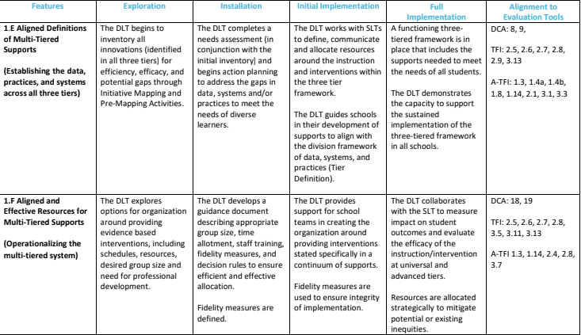
Implementation Matrix
Aligned Definitions & Resources
Decision Rules

Slide 66
Going Beyond Tier 1
*Grab the reading specialist in the hall and ask if she can add one more to the group.
*Tell the high school counselor Johnny just got on your last nerve and he/she needs to see him during your class period for social skills.
*Email the school psychologist and everyone else you know because Susie seriously interferes with learning in the classroom and please come or send the behavior specialist (who is serving Tier 3 only at this time).

Slide 67
Decision Rules
1.Decision rules, or “entry and exit criteria” allow for more equitable decisions on who receives support.
2. Clear criteria to return to Tier 1.
3. There needs to be a uniform method to refer students to advanced tiers.

Slide 68
Creating Decision Rules
Make sure there are multiple methods
Nominations – not just teachers
Existing data
Screeners
Decision rules may be a division decision, or they may be a school decision, but the division establishes and documents the process

Slide 69
Example: Academic
Decision Rules for Tier 2
Below 25% on universal screener
Below 70% on benchmark assessments
Did not meet PALS benchmark
Did not pass prior year’s SOL
Did not achieve course credit

Slide 70
Example: Behavior
Decision Rules for Tier 2
2-5 ODR’s
1 Suspension
> ? minutes missed instruction
> ? days unexcused absences
Incomplete classwork/homework
Tardies
Student, family, staff nomination

Slide 71
Example: Mental Wellness
Decision Rules for Tier 2
5+ visits to the nurse/school counselor per month
3-5 absences per month
2-4 tardies and/or early dismissals
Student, family, staff nomination
Mental Wellness Screener

Slide 72
Sample Decision Rules
Measure | Proficient Score | At-Risk | High Risk
Classroom Managed | 0-4 | 5 or more | 15 or more
ODR | 0-1 | 2-5 | 6 or more
Absences | <5 / trimester | 5+ / trimester | 10 / trimester
Tardy | <4 / trimester | 4+ / trimester | 10 / trimester
ISS | 0-1 | 2 | 4 or more
OSS | 0 | 1 | 2
Reading Virginia Growth Assessment | scores red or higher | scores fall between purple and red | scores fall below purple
Math Virginia Growth Assessment | scores red or higher | scores fall between purple and red | scores fall below purple
Writing Assessment | 3 or 4 | 2 | NS; 1
Nurse (non-medication) | 0-1 (no pattern) | 2-5 (patterns of regular visits) | 6 or more (patterns of regular visits)
*Ensure schools are looking at more than one data point to determine intervention need(s)*

Slide 73
TEAM TIME

Slide 74
Advanced Tiers Foundations
“The Elite Eight” Team Time
Teaming
Professional Learning and Coaching
Screening and Request for Assistance
Data-
Informed Decision Making
Decision Rules
Progress Monitoring
Continuum of Support
Alignment

Slide 75
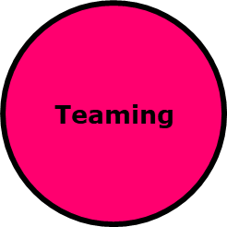
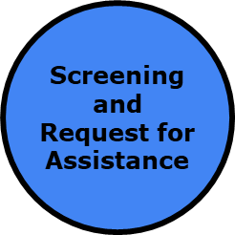
Division Leadership Team
Guiding Questions
What documentation and/or guidance do we need to provide school teams about:
Effective and consistent advanced tiers meeting structures
Level of use, intervention effectiveness, fidelity, and student performance data-informed decision making
Screening and request for assistance procedures
Decision rules, advanced tiers entry/exit criteria
What do we already have in place? What do we need to create or revise at this time?

Slide 76
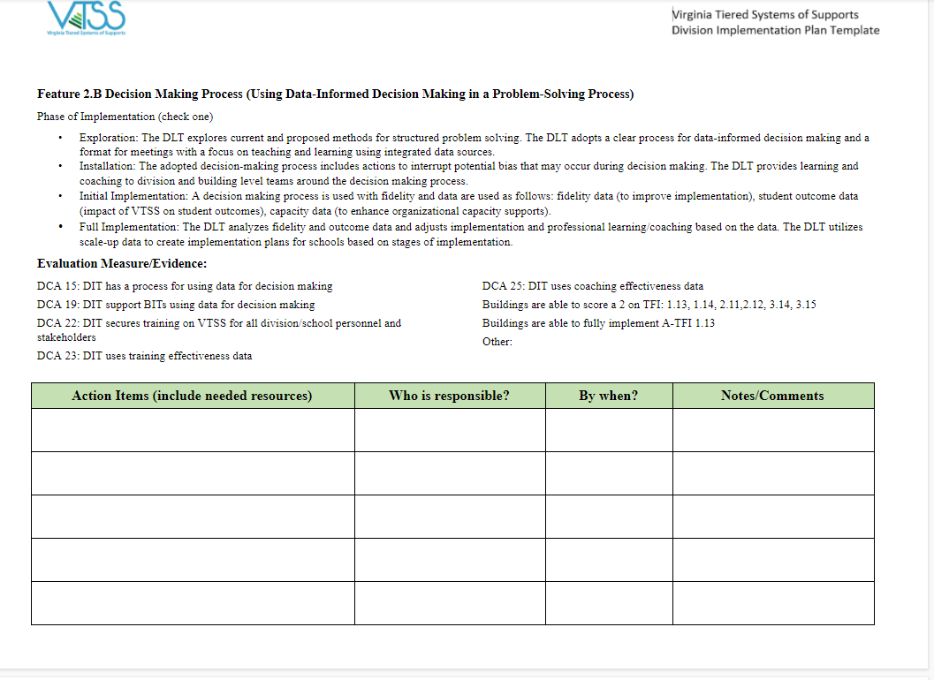
Action Planning

Slide 77
Sharing of Discussions
Select a reporter who will share your thoughts and ideas.
Thanks for sharing and helping everyone move forward!

Slide 78
COMING IN DECEMBER!
A Double Feature to Amaze You!
Continuum of Supports - The Story of Evidence-Based Intervention Selection
Progress Monitoring - The story of how plans are used to assess whether students are making adequate growth.

Slide 79
EVALUATION
How did today’s session measure up with you? Please complete our evaluation to help ensure we meet your needs.
Thanks!

