Slide 1
Strand 3 Advanced Tiers
Building A System
Supporting Schools

Slide 2
Welcome to Strand 3
Advanced Tiers
Building A System
Supporting Schools

Slide 3
VDOE Update

Slide 4
Today’s Agenda
9:00 - 9:20 Intro & Connections
9:20 - 9:55 Evidenced-Based Intervention Selection
9:55 - 10:35 Continuum of Supports
10:35 - 10:40 Quick Break
10:40 - 11:25 Progress Monitoring
11:25 - 11:30 Break
11:30 - 11:40 Review and Preview
11:40 - 12:30 Breakout Rooms

Slide 5
Welcome Activity
Think, think, think…
What television show, movie, book, or song best describes where in advanced tiers implementation your team is currently? Why?
Be Creative!

Slide 6
Navigating ZOOM!
CHAT
MUTE YOUR MICROPHONE
HIDE YOUR VIDEO CAMERA
SHARE YOUR SCREEN

Slide 7
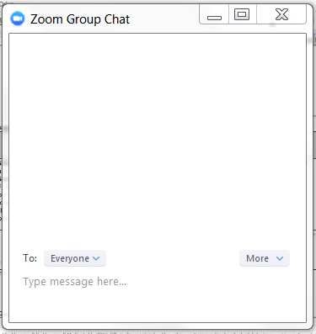
Chat Box Feature

Slide 8
Virtual Norms
Be Engaged | Unmute to share ideas/questions. Participate in virtual activities
Be Respectful | Eliminate distractions like cell phones, email, social media, and background noise Give others time to talk and share Be committed to attend the full session
Be Prepared | Download materials prior to session Set dates/times with your team to continue action planning after sessions

Slide 9
Learning Intentions for Session 2
Participants will provide school teams guidance for evidenced-based selection of advanced tiers interventions.
Participants will create or enhance division continuum of supports with culturally responsive interventions matched to student instruction needs.
Participants will define how schools will be supported to analyze progress monitoring data to determine the impact of interventions and to make decisions to change the level of support.
VTSS Implementation Matrix 1E, 1F, 3B, 3C and 5E

Slide 10
Success Criteria
My division team will:
Select contextually fit evidence-based practices utilizing an evidence-based selection tool
Create a continuum of supports that ensures advanced tiers interventions are culturally responsive and matched to student needs.
Provide advanced tiers progress monitoring guidance to schools.

Slide 11
Advanced Tiers Foundations
“The Elite Eight”
Teaming
Professional Learning and Coaching
Screening and Request for Assistance
Data-
Informed Decision Making
Decision Rules
Progress Monitoring
Continuum of Support
Alignment

Slide 12
Building on What We Learned
Last Time:
This Time:
The Elite 8 Circle
Teaming
Data-informed decision-making
Screening and requests for assistance
Decision rules
Evidence based practice selection
Continuum of supports
Progress monitoring

Slide 13
The Start of Our Work
Teaming and Meeting Structures for Tier 2 & Tier 3 teams
How do our teams consistently function?
Data-informed decision making process to problem solve around student data.
What data do we have and how to we use it to guide our work?
Universal screeners and request for assistance guidance.
How do we know who is and is not responding to universal instruction?
Decision-making rules for movement in within tiers of support.
What is our criteria to know who requires additional support, no longer requires additional support, and how do we ensure consistency across the division?

Slide 14
Building on Our Learning
Continuum of supports provided across the division.
What is currently being provided for each tier of support across the division? What are we missing? What can we remove?
Identifying evidence-based practices / interventions within our continuum.
What criteria do we use to ensure practices and interventions are a good fit?
Monitoring progress to determine if the identified intervention is effective.
How do we systematically monitor progress to know the student is making progress towards their goal/ expectation with the targeted/intensive intervention?

Slide 15
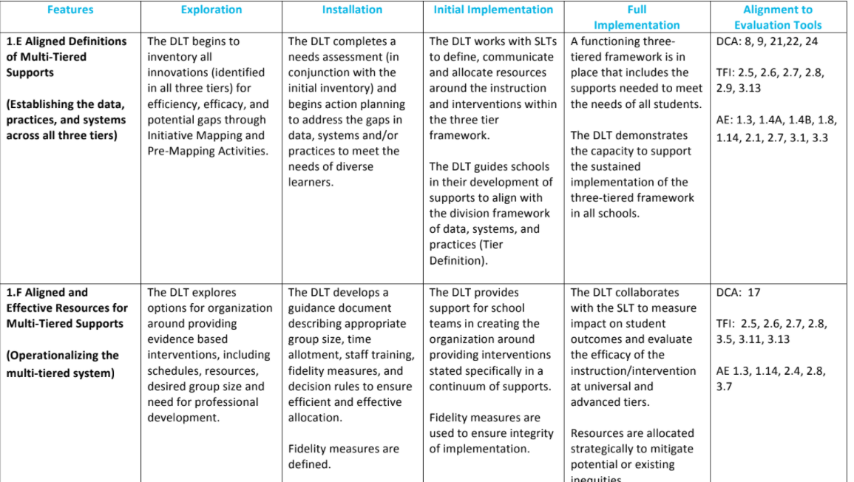
VTSS Implementation Matrix
Aligned Definitions and Resources

Slide 16
Advanced Tier Intervention Core Features
Increased Structure & Prompts
Increased Intensity of Data Collection
Increased
Regular Feedback
Increased Family Engagement
Additional Instruction on Skills (prosocial, emotional, academic)
Tier 2 Core Features
TFI 2.6
Efficient system for access and delivery of intervention
Adapted from Horner & Sugai (2016)

Slide 17
Core Features Quick Check
Tier 2 Core Features
TFI 2.6
Adapted from Horner & Sugai (2016)

Slide 18
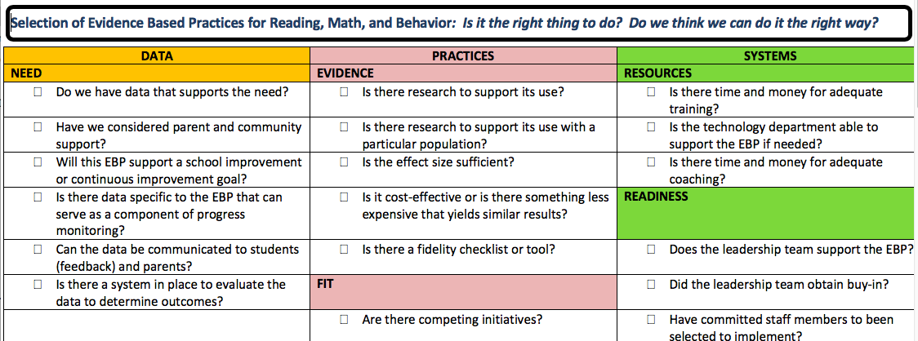
Evidence-Based Selection Tool

Slide 19
Evidence Based Practices Evaluation

Slide 20
Finding Evidence Based Practices

Slide 21
Evidence-based Practices
National Center on Intensive Intervention https://charts.intensiveintervention.org/chart/behavioral-intervention-chart
Behavior Intervention Tools Chart
Academic Intervention Tools Chart
What Works Clearinghouse
https://ies.ed.gov/ncee/wwc/FWW
Behavior Intervention Tools Chart
Academic Intervention Tools Chart
CASEL Program Guide
https://pg.casel.org/
Review Program Lists

Slide 22
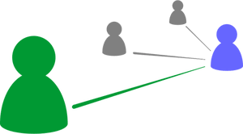
Break-out Room Discussion
How does your DLT ensure advanced tier interventions provided include 6 core features?
What do you find most helpful on the VTSS EBP selection tool? How might a tool like this assist selection of evidence-based practices?

Slide 23
Stretch Break
Stand, stretch, refocus your eyes

Slide 24
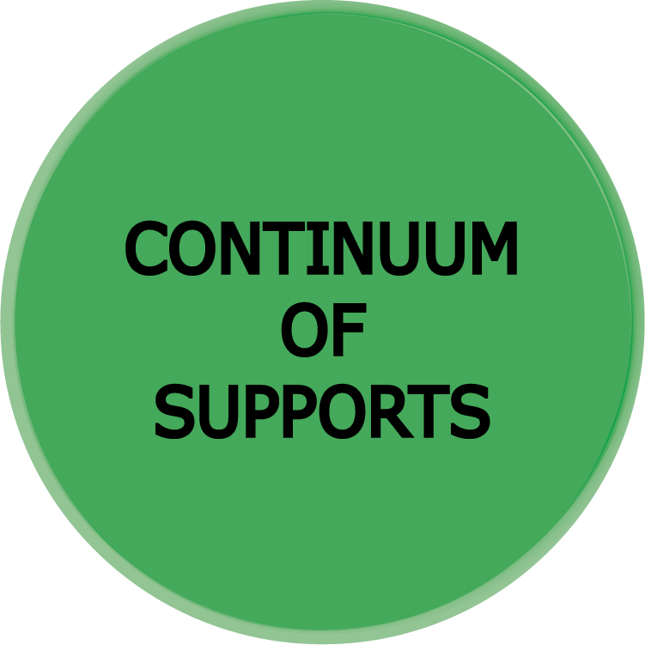
Building a Continuum of Supports

Slide 25
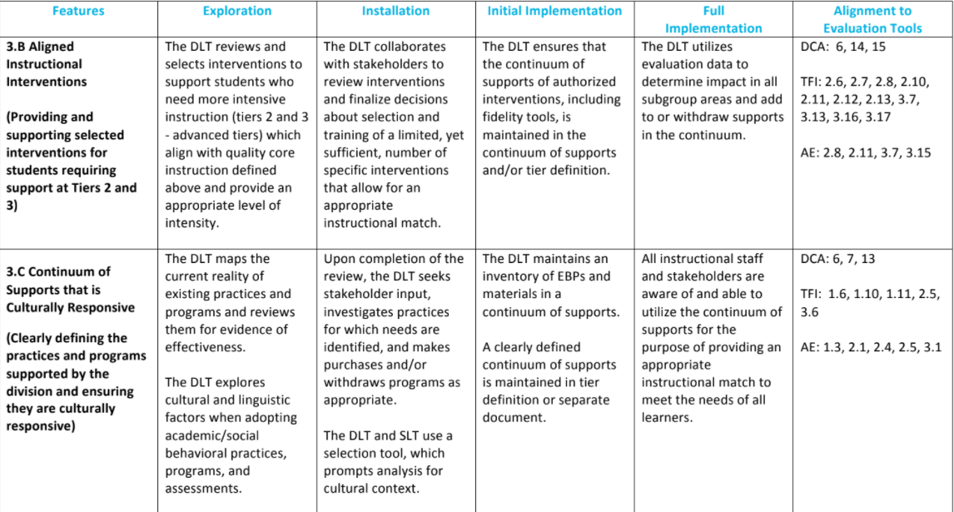
VTSS Implementation Matrix
Aligned Interventions and Continuum of Supports

Slide 26
Three Integrated Frameworks
RTI (Academics)
PBIS (Behavior)
Mental Health

Slide 27
LCPS RTI Core Components
Leadership
Data for Student Success
Includes universal screening and progress monitoring
Targeted Instruction
High quality core instruction at Tier 1
Strategic intervention at Tier 2
Intensive intervention at Tier 3
Data-Driven Decision Making
Evaluation
Fidelity and Student Outcomes
Anchors: Structures – Processes & Procedures – Professional Development

Slide 28
MISSION IMPOSSIBLE
Reduce time spent on assessment.
Increase time spent on instruction.
Increase effective data-driven decision making across the division

Slide 29
Create Effective Efficiencies
Identifying students in need of tiered reading support
Diagnosing root of students’ reading difficulties
Matching evidenced-based interventions to specific student needs (Just Right Fit)
Monitoring effectiveness of match and student growth

Slide 30
Map Resources
What assessments do we have? For what? Who is trained to give them?
What EBIs can we provide with fidelity? Who is trained to implement them? How much time is required?
What’s missing? What do we need? What is the cost, required training, and implementation time?

Slide 31
Select Assessments
MAP Growth
Reading Comprehension
FAST
Phonological Awareness Fluency, Phonics Fluency, Oral Reading Fluency
Developmental Spelling (DSA)
Words Their Way Inventories
Orton-Gillingham Phonics Inventory
Phonics

Slide 32
Define Assessment Logic
Universal - ALL
PALS (Grades K-1)
MAP Growth (Grades 2-8)
Supplemental- SOME
Formative Assessment System for Teachers (FAST)
Developmental Reading Assessment (DRA-2)
Diagnostic - FEW
Phonics Inventories

Slide 33
Establish Criteria for Additional Assessment
PALS (Grades K-1)
Students who don’t meet the fall benchmark
Students who meet the fall benchmark but team still has concerns
MAP Growth (Grades 2-8)
Grade 2 = Students whose score falls below the 40%tile –OR- are not on DRA grade level
Grades 6-8 = Students whose score fall below the 40%ile –OR- are not predicted to pass the VA SOL English per the Class Breakdown by Proficiency Report

Slide 34
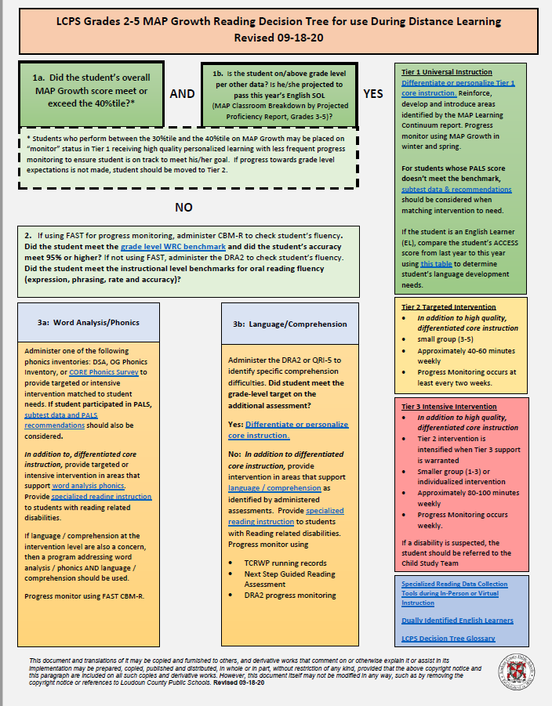
Create Decision Tree
Created using Microsoft Word
Converted to .pdf
Saved in Google drive

Slide 35
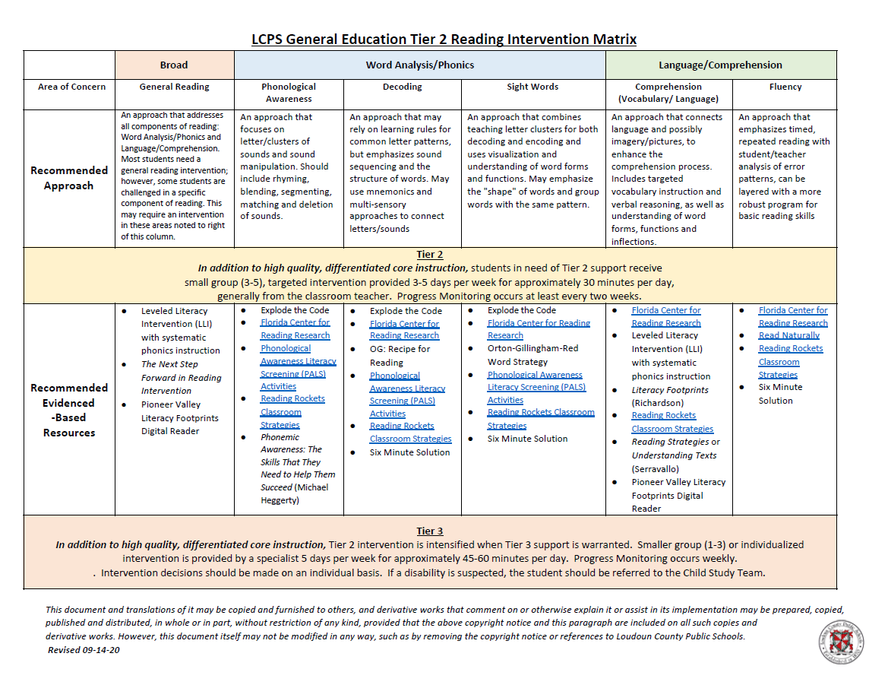
Match EBIs to Specific Deficit Areas

Slide 36
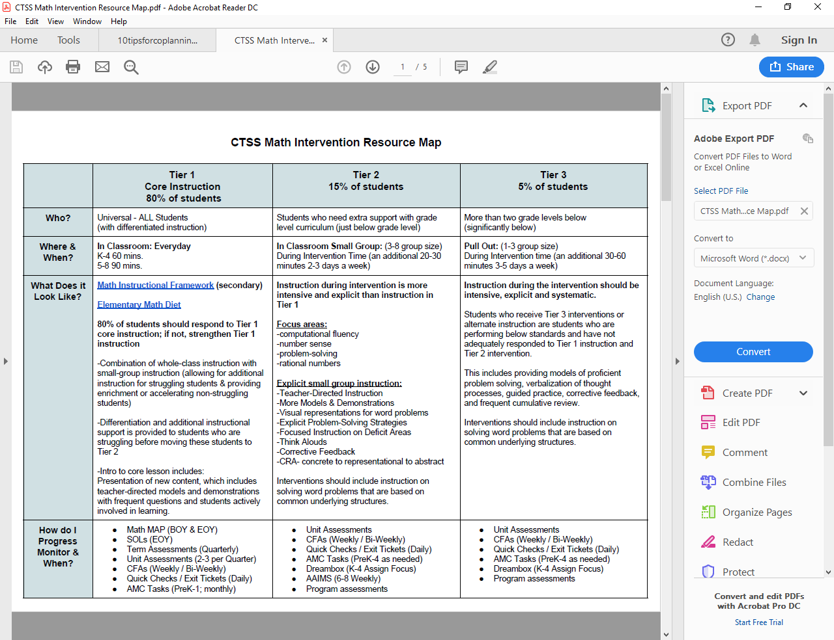
Advanced Tiers
Resource Map Example

Slide 37
Advanced Tiers Decision Rules

Slide 38
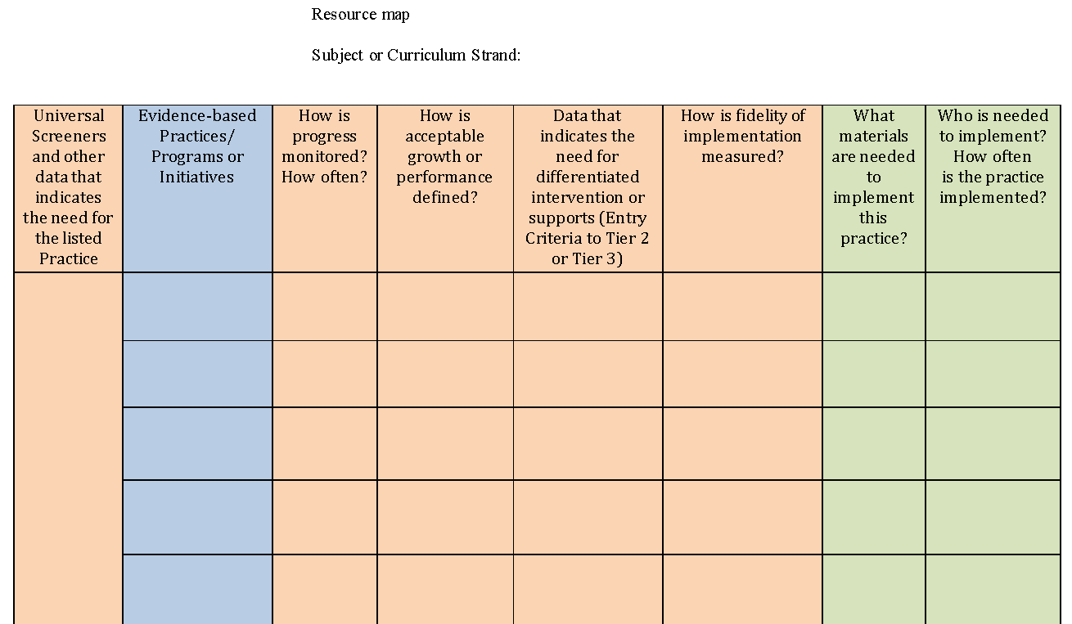
Your Turn! Resource Map

Slide 39
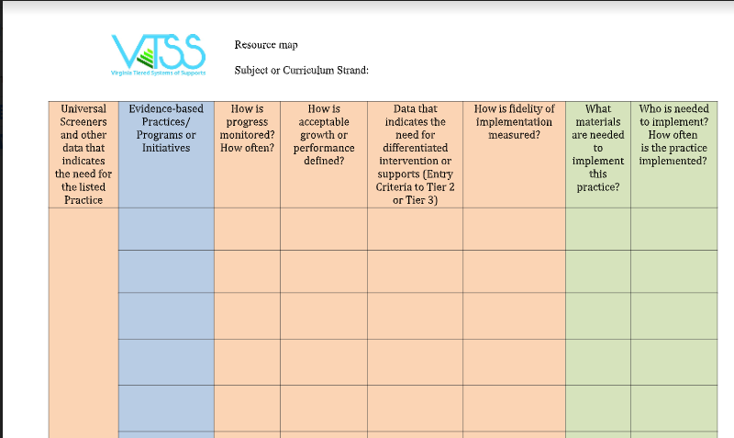
Break-out Rooms
Choose a domain and analyze what information your division has and has not mapped
How can a completed resource map and decision trees help your DLT?

Slide 40
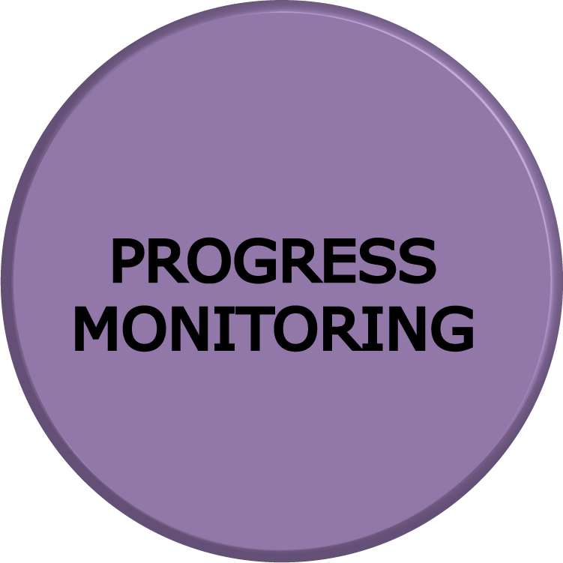
Progress Monitoring
How to Tell if Students are Making Adequate Progress

Slide 41
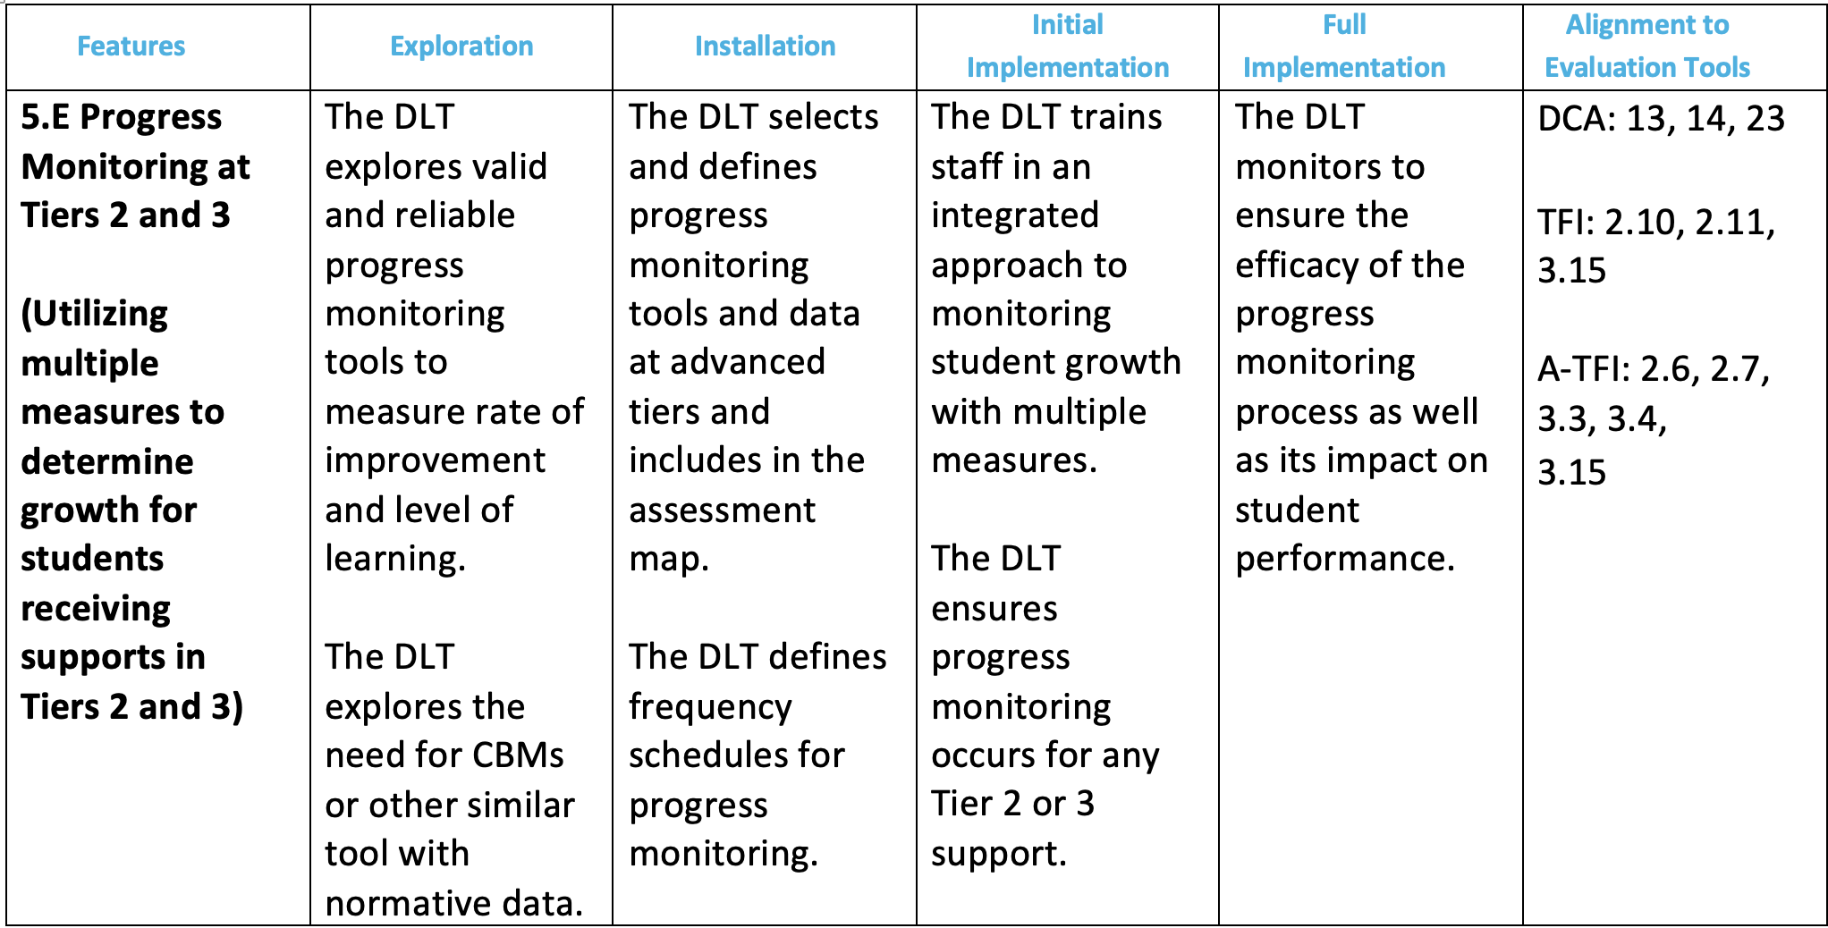
VTSS Matrix 5E Progress Monitoring at Tiers 2 & 3

Slide 42
True ⭐️ or False❌
Progress monitoring only happens at tiers two and three.
Progress monitoring is primarily used to track student progress.
Curriculum-based measurements are standardized.

Slide 43
Where Does it Fit?

Slide 44
Definition
“…is used to assess student progress or performance in those areas in which they were identified by universal screening as being at-risk for failure (e.g., reading, mathematics, social behavior). It is the method by which teachers or other school personnel determine if students are benefitting appropriately from the typical (e.g., grade level, locally determined, etc.) instructional program, identify students who are not making adequate progress, and help guide the construction of effective intervention programs for students who are not profiting from typical instruction” (paragraph 2).
Source: RTI Action Network

Slide 45
Important Components of Progress Monitoring
Selecting evidence-based tools
Implementing the assessment well
Considering students’ language barriers and special needs
Recognizing students’ strengths
Renaissance https://www.renaissance.com/edwords/progress-monitoring/

Slide 46
Why is it Important?
Data should be used to help
individual students make
significant growth toward
educational goals by redirecting
instruction when needed

Slide 47
Example
A child may have a reading intervention goal that is stated in terms of the number of words per minute expected
The intervention begins and the child's progress toward meeting the goal is measured at set intervals.
Each probe has the same level of difficulty, so they can reflect the child's rate of progress accurately.
With each test, comparisons are made as to how much the child is expected to have learned to the child's actual rate of learning.

Slide 48
Measurement Tools
Curriculum-based measurements (CBMs) are standardized assessments, including specific scoring guidelines, usually timed, criterion based. For example, fluency measures serve as a proxy for overall literacy development
Curriculum-based assessments (CBAs) are tools developed by teachers that align with the content they have taught. CBAs involve “direct observation and recording of a students performance in the local curriculum…” (Deno, 1987)
*Definition adapted from Hattie, Fisher, Frey (2016)

Slide 49
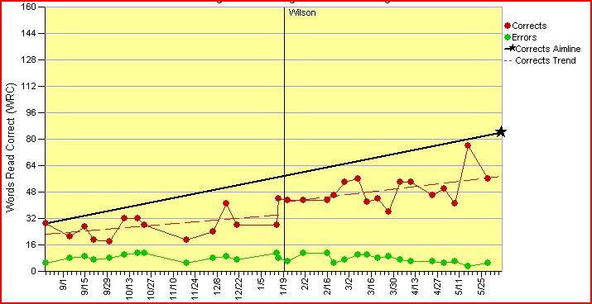
The RATE and LEVEL of Learning

Slide 50
Student Graph:
Student Data and Aim/Goal Line
Image Source:
Progress Monitoring Brief Series, National Center on Response to Intervention

Slide 51
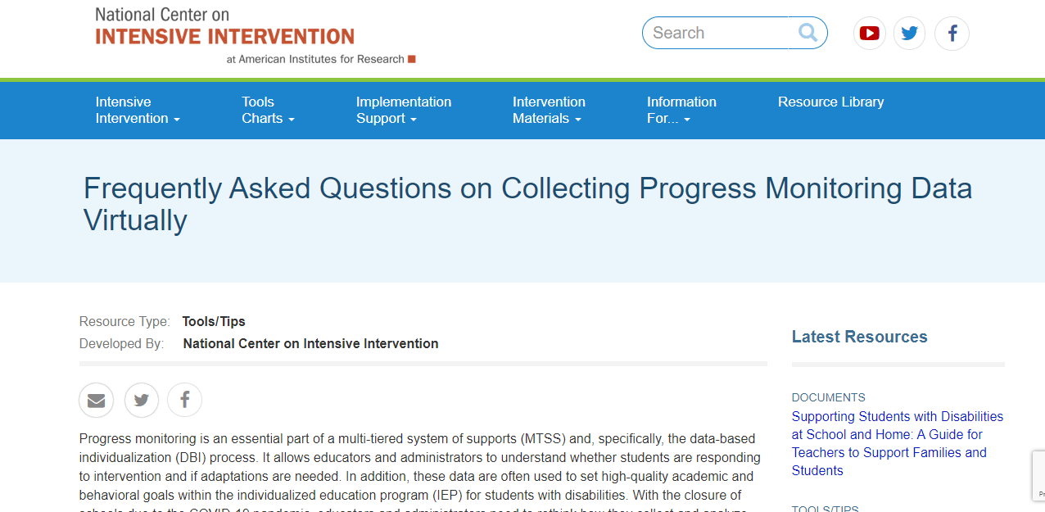
National Center on Intensive Intervention
https://intensiveintervention.org/resource/academic-progress-monitoring-tools-chart

Slide 52
Return to the Assessment Inventory:
Progress Monitoring of Core Instruction
and Intervention

Slide 53
Math Intervention Resource Map

Slide 54
Progress Monitoring
How to Tell if Students are Making Adequate Progress

Slide 55
Social Competence & Academic Achievement
OUTCOMES
How will schools know that students are responding to the intervention and making progress towards their goal?
SYSTEMS
DATA
What we do to support adults to implement the practices?
PRACTICES
What we do to
support students?
Notes:
55

Slide 56
VTSS Implementation Matrix Progress Monitoring at Tiers 2 & 3

Slide 57
Formal Definition
“…is used to assess student progress or performance in those areas in which they were identified by universal screening as being at-risk for failure (e.g., reading, mathematics, social behavior). It is the method by which teachers or other school personnel determine if students are benefitting appropriately from the typical (e.g., grade level, locally determined, etc.) instructional program, identify students who are not making adequate progress, and help guide the construction of effective intervention programs for students who are not profiting from typical instruction” (paragraph 2).
Source: RTI Action Network

Slide 58
Progress Monitoring is...
“a form of assessment in which student learning is evaluated on a regular basis (e.g., weekly, every two weeks) to provide useful feedback about performance to both students and teachers” (iris.peabody.vanderbilt.edu)
Two Types
Mastery Monitoring: assessment of the mastery of a sequence of skills, with one skill being assessed to mastery before moving to the next skill
Curriculum-Based Measurement: standardized evaluative tool that targets specific skills or abilities covered within a curriculum

Slide 59
Progress Monitoring is...
Tier 1: Universal screening of all students to determine who is and is not, responding to universal instruction
Tier 2: Assess response to Tier 2 intervention
Tier 3: Assess response to intensive, Tier 3 intervention and use data to modify individualized instruction, as needed

Slide 60
Progress Monitoring at Tier 2 & 3
Determine if, with a given intervention, students are making expected progress towards a goal
Based on data, not opinion
Assess the effectiveness of different instructional practices
Intensity of progress monitoring increases with intensity of the intervention
Ex. A student receiving 15 minutes of intervention each day may have progress monitored once a week, whereas a student receiving 15 minutes 3 times a week may only be progress monitored once every 2 weeks

Slide 61
True ⭐️ or False❌
Progress monitoring only happens at tiers two and three.
Progress monitoring is primarily used to track student progress.
Curriculum-based measurements are standardized.

Slide 62
Where Does It Fit?

Slide 63
Some Considerations
for Progress Monitoring
Progress is measured at equal intervals from baseline throughout the intervention.
Each probe has the same level of difficulty (stays consistent), so probe data can reflect the child's rate of progress accurately.
With each probe, comparisons are made as to how much the child is expected to have learned, the individual goal, and to the child's actual rate of learning.
A change in the intervention is considered if the rate of progress is not showing student will meet the goal.

Slide 64
Progress Monitoring Data is Graphed
Baseline: where the student is performing prior to intervention
Goal: where the student is expected to be performing by a given date (this may be to meet a benchmark or based on expected rate of progress)
Goal Line/ Aim Line: line connecting the baseline to the goal. If the student’s progress follows this line, they will meet their goal
Phase Line: line that separates changes to the intervention
Trendline: the current trend of the data *If the student continues to make progress as they currently are, this is the trajectory of their progress
Note: trendline should be analyzed only within the current phase of intervention, data from prior interventions should not be used to determine the current data trend

Slide 65
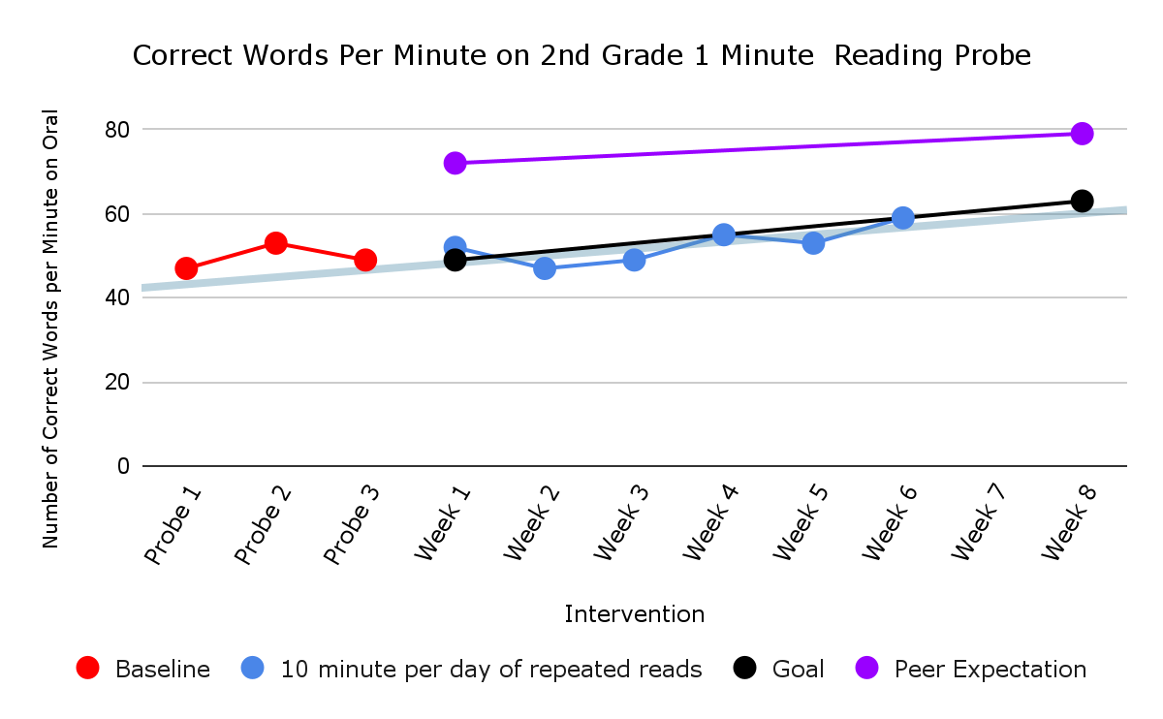
Importance of Graphing
Baseline
Intervention

Slide 66
National Center on Intensive Intervention
https://intensiveintervention.org/resource/academic-progress-monitoring-tools-chart

Slide 67
Return to the Assessment Inventory:
Progress Monitoring of Core Instruction
and Intervention

Slide 68
How it Fits Together - Example

Slide 69
Future Steps for the DLT
Explore and identify progress monitoring tools
All Tier 2 and Tier 3 interventions should have ways to monitor progress towards individual student goals
Reliable, Valid, and Quick to Administer
What is the process for training staff?
What will be consistent across the division?
What will be decided on within individual schools?
Identify how you will monitor that progress monitoring is occurring at all levels and student’s are making progress?

Slide 70
TEAM TIME

Slide 71
Our Work Thus Far
Teaming
Professional Learning and Coaching
Screening and Request for Assistance
Data-
Informed Decision Making
Decision Rules
Progress Monitoring
Continuum of Support
Alignment

Slide 72
Role of the Division Team
A successful Tier 2 implementation requires a systems approach to coordinate the purpose, components, and key actions that help ensure success for the school and for the students.
rtinetwork.org

Slide 73
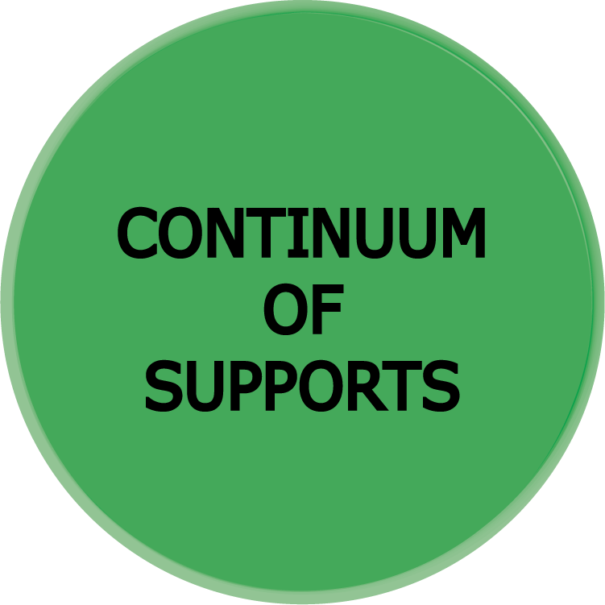
Division Leadership Team
Guiding Questions
What documentation and/or guidance do we need to provide school teams about:
Using an Evidence-Based Selection Tool for data-informed decision making
Using our continuum of supports that ensures advanced tiers interventions are culturally responsive and matched to student needs
Tools for providing advanced tiers progress monitoring guidance
What do we already have in place? What do we need to create or revise at this time?

Slide 74
Sharing of Discussions
Select a reporter who will share your thoughts and ideas.
Thanks for sharing and helping everyone move forward!

Slide 75
Complete Resource Map

Slide 76
COMING IN MARCH!
A Wednesday Matinee!
How The System Grew a Teacher! (Ok, it is really Professional Learning)
The Chiropractor’s Nightmare! (Don’t be scared, it’s just Alignment)

Slide 77
EVALUATION
How did today’s session measure up with you? Please complete our evaluation to help ensure we meet your needs.
Thanks!

