Slide 1
Statewide Division PD
Strand 4 – Session B
Equity / Cultural Responsiveness

Slide 2
Guiding Questions
How does awareness, knowledge, and understanding of one’s own racial and cultural identity influence effective teaching, leading, and learning?
How does awareness, knowledge, and understanding of the racial and cultural identity of students and staff promote effective teaching, leading, and learning?
How do we design systems and practices to establish learning environments that are conscious of race and culture to ensure implementation of culturally responsive practices, policies and procedures?
Notes:
Guiding questions for all VTSS Equity work

Slide 3
NORMS
Speak your truth and respect the truth of others
Listen with respect and remain open to different perspectives
Lean into discomfort and push your growing edge
Keep it confidential (What’s said in here, stays in here. What’s learned in here, leaves here.)
Accept non-closure
Notes:
Key Points:
-How did these work last time? How did we do (as a group and individually)? Where there any that you felt were difficult (for yourself or others)?
- To push your growing edge means that when you hit a point (or various points) in the workshop that forces you to reflect on your beliefs and practices, recognize that moment and challenge it rather than allowing it to wear you down and make you feel helpless (or defensive).

Slide 4
Mirror vs. Window
Notes:
Key Points –
Remember, when we work on equity we must focus both on how we as an individual are participating in the work (with consideration toward how our own identities and belief are shaping our perception, thinking, actions) - MIRRORS and look outward to the systems that are shaping everyone’s experiences - WINDOWS.
Today we’re focusing a lot on WINDOW work. However, if at an moment we feel challenged, uncomfortable, or pushed, then let’s lean into that and do some mirror work. What was said? What was my internal response? Why might I have felt that way?
Jot these moments down on your mirror card to reflect on when you’re ready.

Slide 5
Day 2 Learning Intentions
Develop Division and/or team definition of equity
Review data calculations from October session
Prioritize areas of concern in order to focus further analysis
Analyze an Equity Audit as a potential tool to facilitate Gap/Root Cause Analysis
Examine the experience of a VTSS Division currently working to implement equitable practices for all of their students.

Slide 6
VTSS Matrix Connection
Most of the work today will be directly connected to:
3.C Continuum of Supports that is Culturally Responsive
Clearly defining the practices and programs supported by the division and ensuring they are culturally responsive
Notes:
We’ll be doing this through the equity audits.

Slide 7
Biased Based Beliefs Scenario
Pick a case scenario from your table.
Read the scenario and consider the questions at the end.
Find the other people in the room who have the same scenario (hint: they’re color coded).
Discuss – What biased based belief(s) do you see playing out in this scenario?
Notes:
Ice Breaker Activity:
Participant should choose a scenario, read it and consider:
What are the beliefs, assumptions, biases held by those in this scenario?
Whose background/identity is benefiting in this scenario?
What identities were made socially deficit (marginalized) in this example?
How could this inequity be addressed? Who has been harmed? What needs to happen to restore trust and limit the likelihood of this happening again?
- They should then find the other people in the room who have the same scenario and discuss: What biases based belief(s) do you see playing out in this scenario?
- If they have time, they can discuss the other questions as well.

Slide 8
How are they linked?
We know from prior research that teacher ideologies and beliefs about the student population they serve can have a positive or negative effect on the student outcomes via the actions and behaviors teachers choose to employ in the classroom.
Madon, Jussim, Eccles, 1997; Madon et. al., 1998; Madon et al., 2001;Proctor, 1984
Notes:
Key Points: When our biases move from just thoughts and feelings into actions, then they begin to have a direct impact on our actions. Those actions are felt by those who witness or are affected by those actions. Once those actions become our way of work, they become systems that marginalized people have to work within.

Slide 9
Microagressions
Brief and common daily verbal, behavioral, and environmental communications, whether intentional or unintentional, that transmit hostile, derogatory, or negative messages to a target person because they belong to a stigmatized group.
Microaggressions are the physical manifestation of biases.
Notes:
Key Points:
So, the case scenarios we just looked are were all examples of micro (and some maco) aggressions – when biases manifest themselves into words and actions. For example, in the scenario where the young woman is dress coded for wearing leggings the bias is that tight fitting clothing for females promotes sexuality and is distracting to males. The microaggression was telling Kate her leggings were making others uncomfortable and making her change her clothes.
The insidiousness of microaggressions, is that the more marginalized identities one connects with, the more microaggressions they are bombarded with.

Slide 10
Question:
How might students’ response to microaggressions lead to black students having a 3.1 risk ration for being chronically absent or a 2.7 risk ratio for # of ODRs?
Notes:
Possible ways to pair up and discuss:
High five three people and talk to the third.
Touch five chairs and talk to next person you see.
Find someone who shares a wardrobe similarity (both wearing ties, ring on middle finger, etc.)

Slide 11
VTSS Implementation Matrix
Notes:
The VTSS implementation logic helps us to stay focused on our systems work rather than on specific students or practices. The systems work is where we should focus our efforts.

Slide 12
Data Informed Decision Making
Notes:
Remember that we showed this tool in October and anyone who has attended the Data Informed Decision-Making training has seen it and practices using it. The content from the rest of today will help your team to fill in the “Precision Statement” box as well as look at the Systems and Practices in place in your divisions that may be impacting your data.
Considering the systems piece will lead to the action items

Slide 13
Data Point(s) of Concern
If educational equity is what you’d like to achieve, where does your data tell you you’re meeting / not meeting the mark?
What are your top three data points of concern?
Notes:
Activity:
Teams were asked to disaggregate their OSS, attendance, and SOL pass rate data from the last session. They should look at their risk ratios and consider:
Are any of your risk ratios higher for some identity groups than others? Is it consistent amongst all of the data points or just in one or two? What
are you most concerned about?
Teams should write the top data points their concerned about (no more than 3) on a sheet of chart paper.
When teams share out with group, remind them that this is not about who is doing it right or wrong and that were working within a structure we did not create. However, we do have the power to DO something about the structure. Looking at our data isn’t about feeling good or bad, but rather what do we want / need to focus on.

Slide 14
Sample Risk Ratios
Subgroups by data points
 | American Indian | Asian | Black | Hispanic | Native Hawaiian | White | Two or More Races
ODRs | > | 0.45 | 2.33 | 1.89 | > | 0.78 | 1.65
Chronic Absence | > | 0.88 | 1.63 | 2.46 | > | 1.02 | 1.93
SOL Failure | > | 0.63 | 2.56 | 1.96 | > | 0.83 | 2.02
Notes:
Ask participants to consider how they could include this sample data in their DIDM Precise Problem Statement Worksheet.
What additional information would they want in order to fill in the additional boxes.

Slide 15
Data Point(s) of Concern (cont.)
If educational equity is what you’d like to achieve, where does your data tell you you’re meeting / not meeting the mark?
What are your top three data points of concern?
Notes:
Activity:
Teams were asked to disaggregate their OSS, attendance, and SOL pass rate data from the last session. They should look at their risk ratios and consider:
Are any of your risk ratios higher for some identity groups than others? Is it consistent amongst all of the data points or just in one or two? What
are you most concerned about?
Teams should write the top data points their concerned about (no more than 3) on a sheet of chart paper.
When teams share out with group, remind them that this is not about who is doing it right or wrong and that were working within a structure we did not create. However, we do have the power to DO something about the structure. Looking at our data isn’t about feeling good or bad, but rather what do we want / need to focus on.

Slide 16
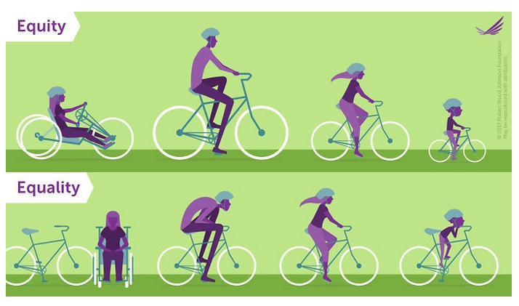
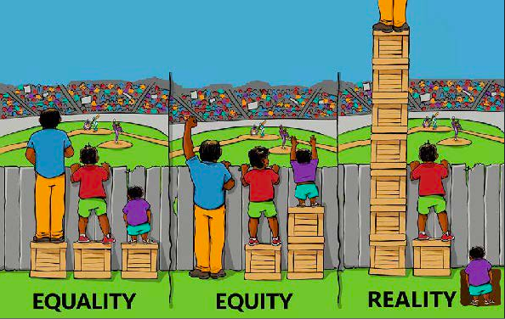
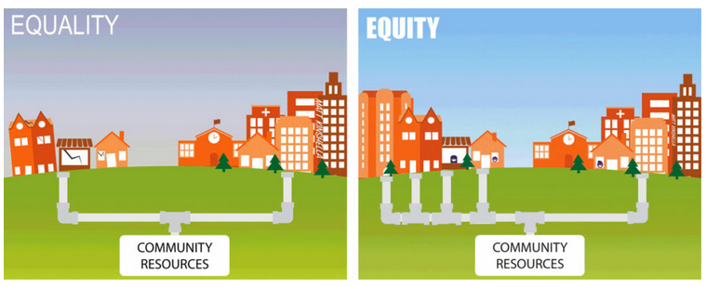
Which one of these images do you think best represents EDUCATIONAL EQUITY?
Notes:
Key Points:
- So to address our data points of concern, we have to look closely at the systems and practices that are driving them. We have to look critically at those systems and practices for evidence of inequity (bias, prejudice, -isms). But before we can do that, we have to all be on the same page with what we mean by EDUCATIONAL EQUITY.
One of the major stumbling blocks folks have when engaging in equity work is that they often confuse equality (everyone getting the same thing) with equity (getting the things you need to be successful).
This is often tied to people’s belief about what is fair. But as we discussed last time, due to bias and systemic inequity, people do not start off or operate from a level playing field. Some identities are priviledged and others are marginalized.
Activity:
Choose the poster that best represents your feelings / understanding of educational equity.
Go stand by that poster.
With the other people standing by your poster, describe why that visual resonated / aligned best with your thoughts and feelings about educational equity. Why was it more appropriate than the others?
Ask each group to share out with the room the key points that were discussed.

Slide 17
Educational Equity Definition
As a team, begin to construct a school / division wide definition of EDUCATIONAL EQUITY..
Questions to consider:
What IS educational equity?
What is it NOT?
Write your working definition on a piece of chart paper and be prepared to share it with the group.
Notes:
Considerations:
Some groups may already have a definition. If so, ask them to think about whether their definition encompasses all of the points they just talked about during the image activity.
Do any of the images fit with their definition?
Would they want to use or modify any of these images to help others understand their definition? If none of them work, ask them to think about an
appropriate design.
- Point participants to handouts – NEP Definition of Educational Equity and Defining Educational Equity - Views on Equity
These an be used as possible models or to jump start conversation.

Slide 18
Ways to Engage!
National Equity Project
Equity 101: Starting the Equity Conversation
National Equity Project
Notes:
Talking Points:
There are other activities that you might use to get your division/school talking about their own definition of educational equity, before trying to craft a school or division wide one. One such activity is in Dr. Fergus’s book, which has participants start with ways leaders in educational equity have defined the term.
National Equity Project Equity 101: Starting the Equity Conversation
https://youtu.be/s0bJ91aFQ-g

Slide 19
Action Plan
By Whom? By When?
Action item: Develop a division or school wide definition of educational equity.
Who needs to be involved?
How will you get input? What information needs to be shared or pre-thinking needs to happen before you construct your definition?
How, when, and by whom will that happen?
Notes:
Key Points:
Remind teams that an action planning worksheet was provided last time that the can use to capture their to do’s, or just continue adding to their division planner.

Slide 20
Equity Audit
If structural discrimination doesn't require conscious racists or sexists, how can school leaders recognize it and work to counter it?
Sarah Sparks, Education Week 2017
Notes:
Ask participants to consider the quote and talk at their tables about how school/division leaders can address the question.
Direct them to review Equity Audit article in their workbook.

Slide 21
Conditions for reviewing process /systems
Team members with understanding of process / system
Manage personnell and practice
Documents of practice/process
Notes:
When doing equity audit, who do we need in the room? What's the thing we're measuring (should have some type of documentation)? And how do we make this conversation about the process/practices/system and NOT individuals (we're not looking to BLAME)?
Breadth of process competency: you need folks in the room that understand the process and not folks who are guessing how it happens.
Documents of practice: ensure to have documents readily available to review
Manage personal and practice: establish perimeters on what it means to review practice and not attacking individuals who are charged with specific practice.

Slide 22
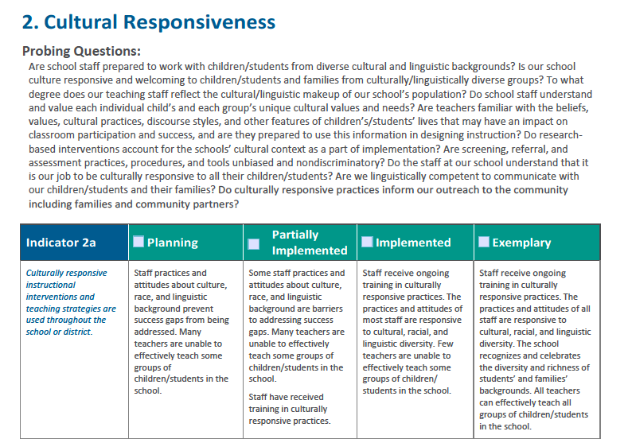
IDEA Addressing Success Gaps
Notes:
This Equity Audit is used in Virginia as part of the CCEIS process for divisions with disproportionality in identification of SWDs or discipline dispro within their SWD population.
It is the only Equity Audit currently being used by VDOE, but can be overwhelming for teams to use.
Direct participants to review the full document (Equity Audit – IDEA) t in the workbook.

Slide 23
IDEA Audit Drill Down
In the workbook, there is a Word document titled “IDEA Equity Audit Drill Down”.
We have broken down the questions into more manageable pieces.
We completed a sample of the activity for Indicator 1: Data-based Decision Making
Notes:
Direct participants to the document in their materials and ask them to look at Part 1.

Slide 24
IDEA Audit Drill Down Sample
Question(s): Does our school or district identify data elements or quality indicators that are tracked over time to measure school effectiveness? What are those data elements? Are the data valid and reliable?
How do you know? What data help answer the questions? Longitudinal data for students in the division over several years; tracking benchmark, referral/suspension, and attendance data to assess growth/improvement over a school year; specific policies or use of data programs that insure regular data entry and facilitate data analysis.
What criteria would you consider to determine a score for Indicator 1? Meeting minutes, presentations to the School Board, press releases and other communications showing how data was considered in decision-making.
Notes:
For each of the sets of questions, we have provided a structure to help in determining a score
How do you know? What data help answer the questions?
What criteria would you consider to determine a score for the indicator?
At their tables, ask participants to consider the sample that has been developed. What data/examples are missing? What additional criteria might be used to determine a score?

Slide 25
Drill Down Group Work
In mixed groups, work through your assigned set of questions from Indicator 2: Cultural Responsiveness.
Determine what data and indicators might be part of the discussion.
When you return to your Division Team, you will share out as the expert for that set of questions.
Notes:
Divide the participants into 6 groups and assign each group a set of questions.
Encourage them to think of as many examples as possible to fill in the boxes. For some questions, there may not be a specific connection to one of the Indicators (2A, 2B, or 2C) tell participants it’s okay if they do not have information for each indicator as long as they’re filling in as much as they can.
After the mixed groups have completed their sections, have participants return to their division team and share out (like a Jigsaw)

Slide 26
Choosing an Equity Audit
SYSTEMS, PRACTICES, and BELIEFS
ALL levels and areas – Human Resources, Beliefs and Values, Facilities, Budgeting, Staff, School Board, Instruction, Curriculum, Policies, etc.
Multiple Identities (Race, Gender, Ability, etc.)
Will this audit help us drill down enough (ask the right questions) so we have a better, clearer picture of what is happening in our division?
Notes:
Key Points:
- A good equity audit is going to help you closely examine both your SYSTEMS and your PRACTICES on the division, school, and classroom level

Slide 27
Loudoun County

Slide 28
Loudoun County Debrief
Based on the information you just heard, what are some “Lessons Learned” that you can apply to the Equity work you will be doing in your Division?
What additional resources might be necessary for you to really dig into your Divison policies and practices?

Slide 29
Division Team Homework for March
Watch National Equity Project webinar (National Equity Project Webinar) for possible ways to engage others in pre-thinking prior to defining educational equity work.
Construct a division wide definition of education equity.
Preview multiple equity audits and choose the one that would best meet your division’s need.

Slide 30
Possible Mirror Homework for March
Continue to explore your WHY. WHY is this work important to you? Select an object / quote / song that reminds you of your WHY.
Conduct your own equity / cultural competency self-audit. What are areas you’d like to grow / focus on? Decide on two action steps to help you move forward in that area.
Go back to your mirror card and consider: What was said? What was my internal response? Why might I have felt that way?

Slide 31
Thanks for participating today!
Don’t forget:
Please complete the PD evaluation that is emailed to you. We could really use your feedback!
Take your recertification certificate.

