Slide 1
VTSS Starting to Sustaining
Strand 4
Equity / Cultural Responsiveness

Slide 2
Guiding Questions
How do awareness, knowledge, and understanding of one’s own racial and cultural identity influence effective teaching, leading, and learning?
How do awareness, knowledge, and understanding of the racial and cultural identity of students and staff promote effective teaching, leading, and learning?
How do we design systems and practices to establish learning environments that are conscious of race and culture to ensure implementation of culturally responsive practices, policies and procedures?
Notes:
Guiding questions for all VTSS Equity work

Slide 3
NORMS
Speak your truth and respect the truth of others
Listen with respect and remain open to different perspectives
Lean into discomfort and push your growing edge
Keep it confidential (What’s said in here, stays in here. What’s learned in here, leaves here.)
Accept non-closure
Notes:
Key Points:
-How did these work last time? How did we do (as a group and individually)? Where there any that you felt were difficult (for yourself or others)?
- To push your growing edge means that when you hit a point (or various points) in the workshop that forces you to reflect on your beliefs and practices, recognize that moment and challenge it rather than allowing it to wear you down and make you feel helpless (or defensive).

Slide 4
Day 3 Learning Intentions
Create a plan for completing an Equity Audit that includes:
Choosing an equity audit that aligns with division's vision of educational equity.
Determining possible data sources to provide evidence of implementation of equitable practices and systems within school division.
Identifying when and how the audit will be conducted and how that process will be communicated to appropriate stakeholders/participants.
Notes:
Briefly review learning intentions for the day.

Slide 5
Day 3 Learning Intentions con’t
Analyze current policies and practices through an equity lens by utilizing the PBIS Cultural Responsiveness Field Guide.
Determine division support to assist schools in addressing found inequities.
Develop a plan to communicate and seek buy-in for implementing equitable practices from division leadership and community stakeholders.
Notes:
Briefly review learning intentions for the day.
Remember – True learning is when we process information and make new discoveries. We’ve given you some things to do and think about, but your growth will come from you applying knowledge to address an issue/problem.

Slide 6
Mirror v. Window
Notes:
Equity work always involves the mirror and the window.
Mirror - To do equity work effectively, we have to constantly be checking on where WE are (how might our biases, stereotypes, the racist structure in which we live, ect. be shaping our thoughts and reactions?). We’re going to do a couple activities to check our mirror. Use the mirror card to jot some notes / wonderings / emotional moments through out the day that you might want to come back to.
Window – Use discussions today to collect more window information. What did I learn and how did the speaker’s background shape their thoughts / words? Is that perspective similar to one I’ve heard before? What can I take away from that?

Slide 7
What’s been catching your attention lately?
Notes:
Ask participants to consider what they’ve been thinking about lately. Explain that we’re going to run through a series of headlines that might resonate or jog their memory.
** These headline slides may change depending on current events surround presentation.

Slide 8
Current Events and Articles
Amid tight security, Virginia gun rally draws thousands of supporters.
Student will be barred from graduation unless he cuts his dreadlocks, school says.
Virginia school board refuses to ban confederate flag from the dress code. “I am not through until I get this done, “ said the school board’s only black member.
Confederate flag allowed in dress code at Franklin county schools.

Slide 9
Current Events and Articles cont’d.
Tennessee governor signs anti-gay adoption bill. The controversial measure allows faith-based foster care and adoption agencies to use taxpayer money even if they exclude prospective LGBT! Parents.
Oscars 2020: Women scored record 31% of nominations overall despite female director snub
Supreme Court could be headed to a major unraveling of public school funding
The Supreme Court could force taxpayers to subsidize religious schools

Slide 10
What’s been on your heart and mind?
Notes:
Jot down your feelings from these images and/or what’s been on your heart and mind lately (provide a few minutes for participants think/write).
Turn to the person / people next to you and discuss what’s been on your heart and mind lately? Pay special attention to how you’re listening.
Be present
Withhold judgement
Remind participants that it is important to bring your whole self into this work; use that that emotional connection to reconnect with your why.
In order to keep at it, it’s important to constantly reconnect with our why.

Slide 11
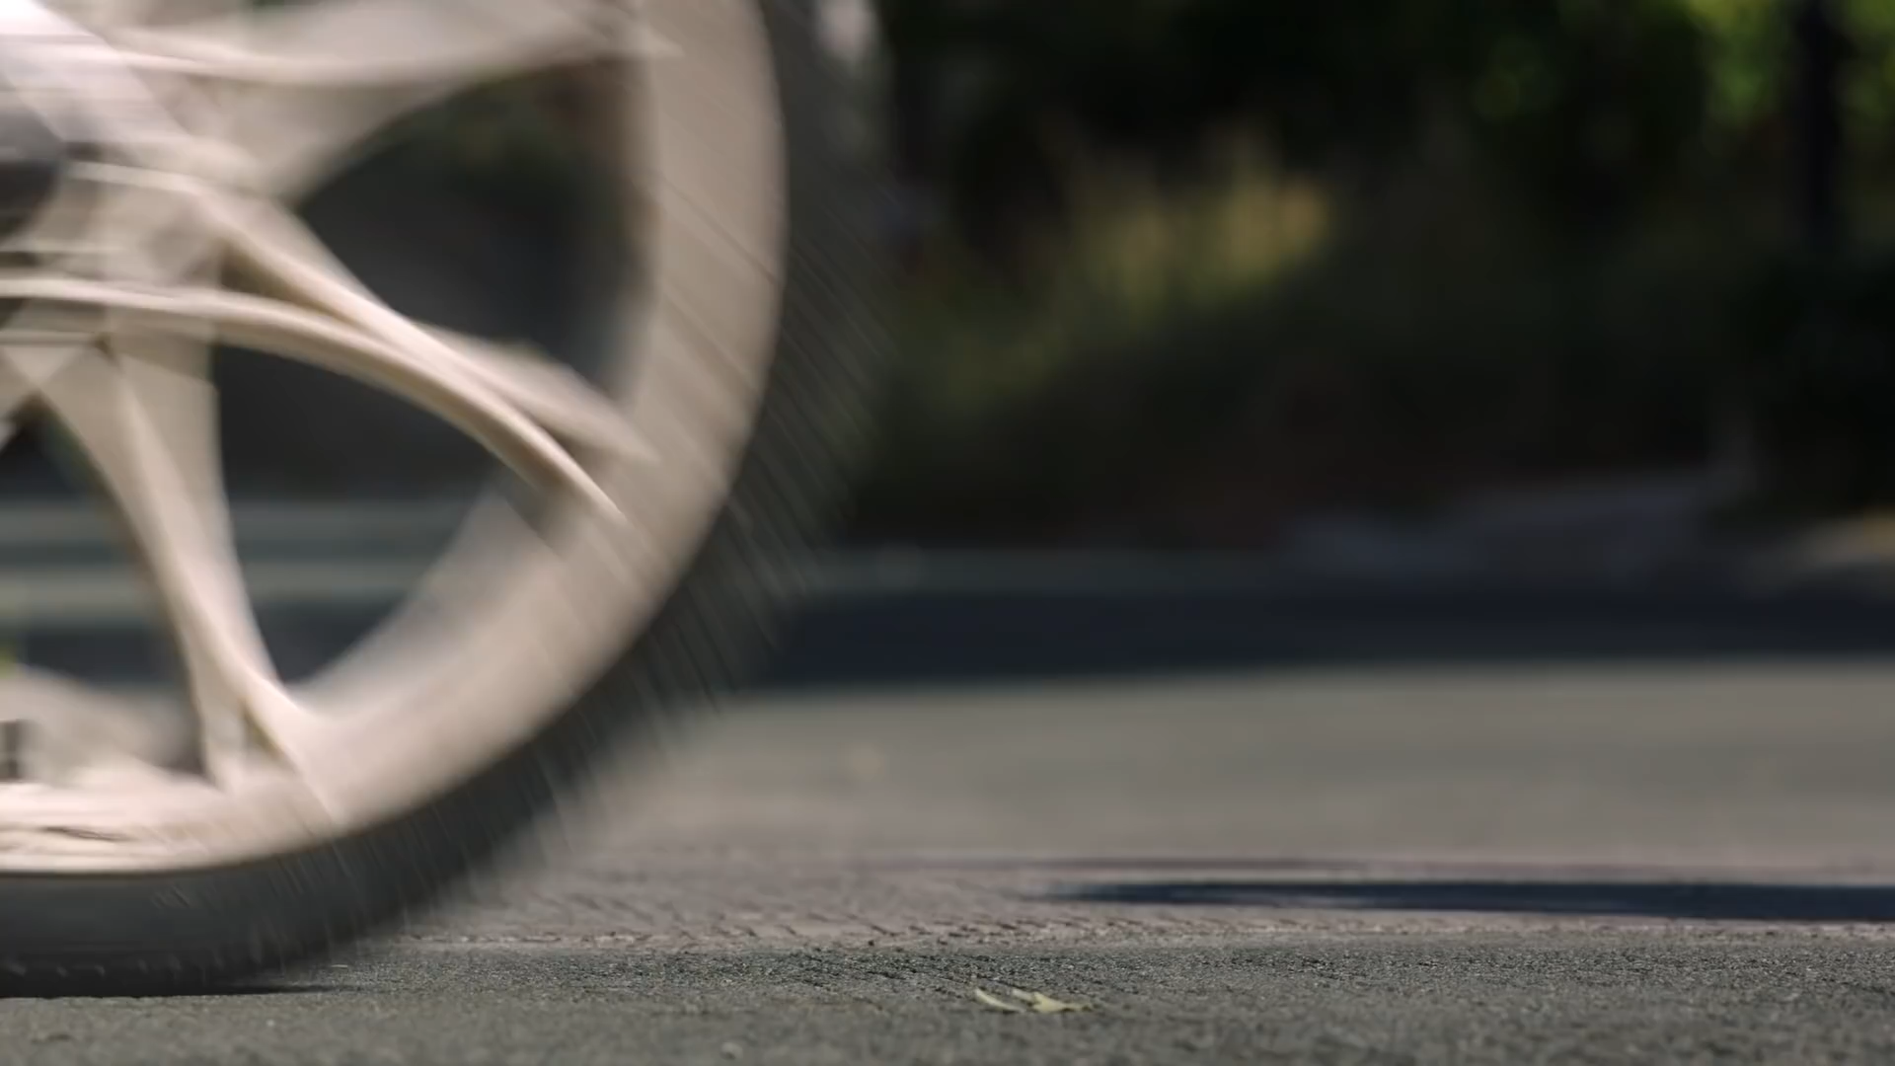
For ALL
Notes:
Our WHY usually comes from an emotional response. We do this work, b/c it makes us fell joyful / angry / powerful / etc. when humans we care about feel _________________ (frightened, included, empowered). “You can’t teach a kid you don’t like.” Rita Pearson.
Connect folks with that emotional component stemming from their why. As a team, it also helps to have a shared why and a shared understanding of what this work looks like when we get there. Videos are a great way to do that.
Does this video connect to your why? If so, how?
Feeling included, empowered?
Community?
Shared joy/excitement/wonder
If there’s time, have folks discuss the video’s connection to their why with someone from another table.
A Star Wars Experience For ALL of Us
https://www.youtube.com/watch?v=V90pqyZ3cU8

Slide 12
Equity Statement
What does EDUCATIONAL EQUITY look like in your division?
SAMPLE: Montgomery County, MD.
We will advance racial justice and cultural proficiency by interrupting systems of bias (implicit and explicit), oppression, and inequity in our policies, practices and procedures by challenging every MCPS employee to be courageous, persistent and effective in confronting and resolving racial and cultural issues that impact everyone but disproportionately impact the academic and social emotional success of students of color.
Notes:
Last time we talked about the importance of having common language/understanding around educational equity.
Whole group:
Did anyone watch the NEP webinar? Did any of the activities in the webinar speak to you and why?
Did anyone work on forming a shared definition? What worked? What was difficult?
Once you have a common understanding of what educational equity IS, you need to build a vision around what it LOOKS / SOUNDS LIKE in your division. If we are striving toward education equity are we DOING?
As we look at the these examples of equity statements, make a mental not or write down the VERBS.
Ex.
INTERUPTING systems of bias, oppression and inequity
CHALLENGING employees to be be courageous
CONFRONTING and RESOLVING racial and cultural issues

Slide 13
Removing Predictability
Designing Agendas for Equity Work – National Equity Project
Designing Agendas for Equity Work
Notes:
Next three slides from National Equity Porject:
Designing Agendas for Equity Work – National Equity Project
https://www.youtube.com/watch?v=6QO_Es6Lz1E&feature=youtu.be
REMOVING predictability
If time, stop and discuss…
What part of our systems are contributing to the predictability and can we have a real conversation about the root causes
What tangible action step might that look like?

Slide 14
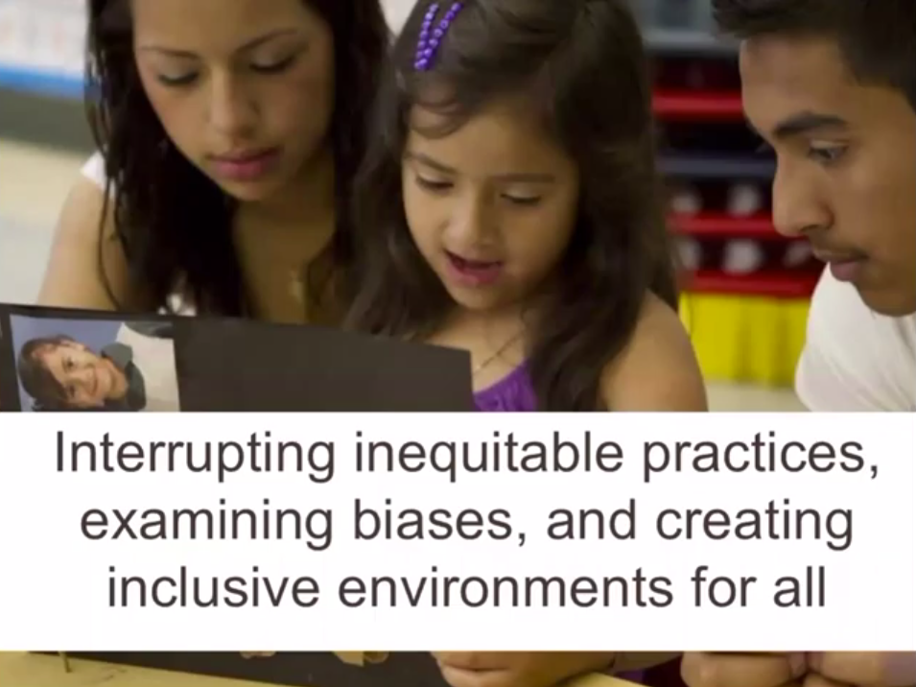
Interrupting Inequitable Practices
Designing Agendas for Equity Work – National Equity Project
Designing Agendas for Equity Work
Notes:
INTERUPTING inequitable practices
EXAMINING biases
CREATING inclusive environments
If time, stop and discuss…
What part of our systems are contributing to this and can we have a real conversation about the root causes?
What tangible action step might that look like?

Slide 15
Discovering Unique Gifts
Designing Agendas for Equity Work – National Equity Project
Designing Agendas for Equity Work
Notes:
DISCOVERING and CULTIVATING unigue gifts
If time, stop and discuss…
What part of our systems are getting in the way of this?
What tangible action step might that look like?

Slide 16
Next Steps
1. Each team member choose a different mission / vison statement.
2. Read through your sample equity mission / vision statement.
3. Highlight the piece(s) that resonate with you and your why.
4. Review the your big areas of concern from our last session.
Do any of the pieces that resonated with you begin to address your areas of concern?
5. As a team, write down the your VERB statements.
What will you DO as a division?
Notes:
Find posters
NEXT STEP – When they return to their divisions, they will need to flush out their verb statements into their equity mission / vision. This is what they are committing to do to achieve educational equity.

Slide 17
This is Equity
Notes:
As you develop your mission/vision statement, consider…
Whose feedback have you gotten?
Whose voice is included???
Californians Dedicated to Education Foundation
This is Equity
https://www.youtube.com/watch?v=tcPGacPFt6E
Who do you need to include to construct your division’s statement about educational equity?
Those who have been marginalized know when they’ve ben marginalized. Most are willing to share if they do not fear repercussion.
Whose voice are you hearing??

Slide 18
IDEA Audit Drill Down
In the workbook, there is a Word document titled “IDEA Equity Audit Drill Down”.
We have broken down all of the questions into more manageable pieces.

Slide 19
Equity Audit
Review all indicators from data audit.
What data do you already have to answer these questions?
What data will you need to collect to answer these questions?
Do you want to focus on the entire audit, or just the pieces that most closely aligned with your priorities?
Who, how and when will you administer your audit?
Notes:
As a division think through the following process questions. Some divisions may begin to go through the equity audits and choose questions. Some may come up with a time line of implementation. After the allotted work time, divisions should record all of the next steps to implement an equity audit on their action plan.

Slide 20
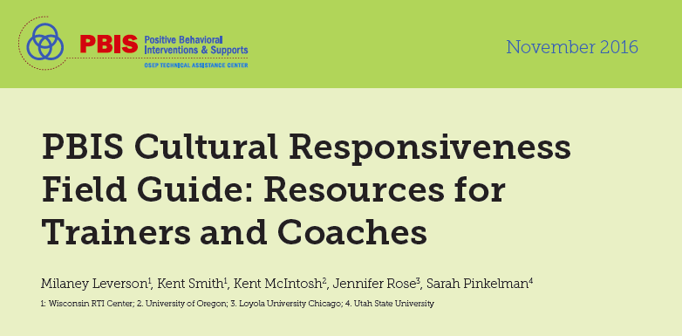
Using PBIS Systems and Structures to Address Inequities

Slide 21
Imagine…
Notes:
Imagine a a group of folks coming together this summer to work on equity – school team, divison team, etc.
What do you want to see this group doing together to focus on equity?
What would it look like?
What would it sound like?
Introduce barriers and supports worksheet.
In order to be successful, we need to understand the dynamics of that group. What do they need to be successful? That’s where we need YOU! What can you help them do PRIOR to the training to get them ready to tackle these big issues?

Slide 22
Components of Cultural Responsiveness
Identity
Voice
Supportive environment
Situational appropriateness
Data for equity
Notes:
These are the five areas components of cultural responsiveness that are areas we can address through our PBIS work and systems.

Slide 23
Data For Equity
Level 1: Outcome Data
Define the magnitude, timing, and/or location of outcome pattern
Level 2: Process Data
Define the practice and policy artifacts and the manner of their operation.
Define the gaps in practices and policies
Level 3: Name the Root Causes
Define the connections between gaps in process data and outcome data
Notes:
Just like we did with you all (divisions teams), we take schools through looking at their data with an equity lens (dissagregating data by subgroups, looking at data across behavior/academics/mental health, figuring out if the data tells us we have a problem, gathering data to define the gaps and root causes).

Slide 24
Identity
What mirror work are you doing as a school / division?
Book Groups
White Fragility by Robin DiAngelo
The Person You Mean to Be by Dolly Chugh
How to Be an Antiracist by Ibram Kendi
PLCs
Courageous Conversations About Race by Glen Singleton
“Teachers Go to School on Racial Bias” The Hechinger Report
Teaching While White – blog / podcast
Teaching While White
Notes:
This summer we will discuss with school teams the importance of understand where we, as individuals, are with our thinking on equity. These are some suggestions on how others have engaged their staff on thinking about their identity, their biases, and the larger systems that effect how others see them and how they see others.
“Teachers Go to School on Racial Bias” The Hechinger Report
https://hechingerreport.org/teachers-go-to-school-on-racial-bias/
Teaching While White – blog / podcast
https://teachingwhilewhite.org/about-teaching-while-whhite
Choose a blog post (A Letter to White Teachers of My Black Children is especially good!) and/or podcase each meeting to discuss.

Slide 25
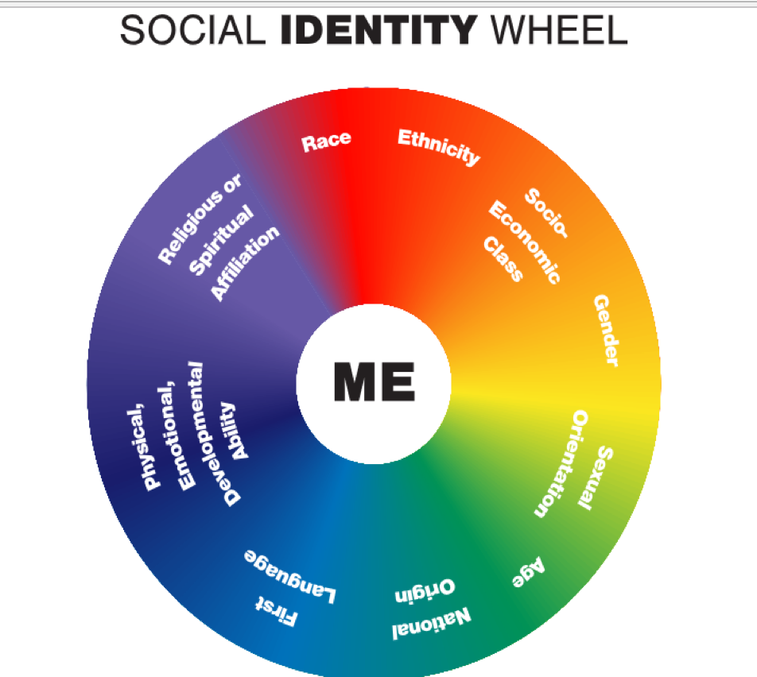
Voice
Notes:
Whose voice is present in our team? Whose is not?
Whose voice is present in constructing our expectations, lessons, acknowledgement systems, behavior process, etc.? Whose is not?

Slide 26
Supportive Environment
“Problems arise when appropriateness is judged by schools in a way that favors certain ethnicities and races.” Controlling the Student Body Teaching Tolerance 2017
School’s rules or expectations determine what is appropriate within the school.
In what way might a school rule favor certain ethnicities/races/identities?
In what way might a school rule make a student feel invalidated or unwelcome?
Notes:
We spend time thinking about what might the consequence of feeling excluded or not part of our school be? How might our rules play into others feeling excluded or invalidated?

Slide 27
Matrix and Expectations Equity Review
Step 1. Identify Any Existing Expectations or Matrices
Step 2. Assess Existing Expectations Based on Fit with Values and Needs of Students, Families, and the Community
Step 3. Revise Expectations and Matrix Based on Feedback
Step 4. Assess New Options for Expectations and Matrix Based on Critical Features of Effective Practices
Notes:
This is a big activity we walk school teams through.
Field Guide pgs 32-33

Slide 28
Situational Appropriateness
Negative or Deficit | Neutral | Positive Plus Validation and Affirmation
Should, ought to, wrong, value-based terms, fix it, correctly, right way, our way, your way, or the only way. | Understand, tolerate, allow, another chance, consequence-based terms, this time or next time. | Appreciate, honor, value, love, respect, inspire, move, affirm, connect, empathize, can relate or am grateful.
Notes:
We need to move from blaming and tolerating, to affirming and honoring.

Slide 29
Personal Matrix
School-wide Expectation | At SCHOOL as a professional … It looks like... | At HOME at an extended family gathering… It looks like... | Out with my friends… It looks like...
Be Safe
Be Respectful
Be Responsible
Notes:
Understand the differences and similarities.

Slide 30
Example
School-wide Expectation | At SCHOOL It looks like... | At HOME It looks like... | In my NEIGHBORHOOD It looks like...
Be Safe | Keep hands and feet to self Tell an adult if there is a problem | Protect your friends and family Don’t talk back | Stick up for your friends Don’t back down Look the other way
Be Respectful | Treat others how you want to be treated Include others Listen to adults | Do exactly what adults tell you to do Don’t stand out Don’t bring shame | Text back within 30 seconds Be nice to friends’ parents share food
Be Responsible | Do my own work Personal best Follow directions Clean up messes | Help your family out first Own your mistakes Share credit for successes | Have each other’s backs Own your mistakes check in about what to do
Notes:
Here’s what it might look like.

Slide 31
Lesson Plan Review
After we validate, then we teach the WHY WE’RE DOING IT DIFFERENTLY AT SCHOOL.
What other venues might require a similar expectation?
Notes:
Once we recognize that the behaviors might look different and validate/affirm that’s okay, then how do we use lesson plans to build and bridge. What is the behavior? Why might we do it differently in this setting under these circumstance?

Slide 32
Feedback, Neutralizing Routines, and Situationally Appropriate Behavior
How able are you / your faculty to notice positive behavior?
How often do you / your faculty recognize the positive behavior (either verbally or written) to students?
What behaviors trigger you? Do you recognize when you’ve been triggered? What do you do to stop, gather information, and consider assumptions / perspectives / biases before reacting?
What are some common misunderstandings of behaviors that you or your faculty have?
Notes:
When the behaviors don’t align, what do we do to see the gap and respond to promote learning?

Slide 33
Communication
Who do you need to communicate (or sell!) your equity work to? Decided on your audience.
Slide 1 – What is educational equity (include your division’s definition)? | Slide 2 – WHY is educational equity important to your division. Create an emotional connection to your WHY. Image Story
Notes:
Time permitting, allow teams time to construct their pitch. Each slide should have specific talking points.

Slide 34
Communication, cont’d
Who do you need to communicate (or sell!) your equity work to? Decided on your audience.
Slide 3 – Where are you on your journey toward achieving educational equity? - Share your equity data story | Slide 4 – What are three things you’re committing to do in the next year to work towards educational equity?
Notes:
Time permitting, allow teams time to construct their pitch. Each slide should have specific talking points.

Slide 35
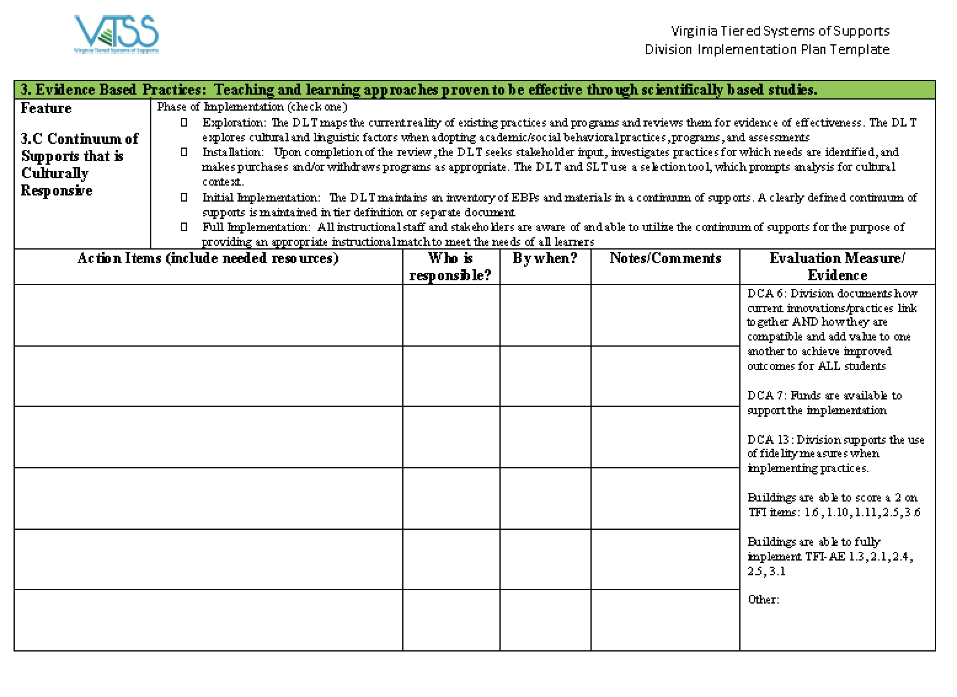
Action Planning By Whom? By When?
Notes:
What needs to happen?
Who is going to do it?
By when?

Slide 36
What are the tensions?
Personal: what is your personal tension about discussing race/ethnicity, language, and gender based issues?
Structural: what is your organization’s tension in discussing race/ethnicity, language, and gender based issues?
Strategies: what is a tension of your school’s academic or behavioral program/strategy related to race/ethnicity, language, and gender issues?
Personal
Structural
Strategies
Notes:
Using the post-it notes on your table, answer the following questions and then place on chart paper around the room:

