Slide 1
Division Workspace - Strand 4 Equity
DLT members working on this design
ABOUT THIS DESIGN SPACE:
These slides are your division’s design board for your work during the three Starting to Sustaining session. Use the post-its to write your ideas. You can resize the post-its by clicking to select, hovering over the corner, clicking and dragging. You can resize, bold or italics the text in your post-its using the top bar. Please also feel free to use the shapes and arrows and lines tools, import other images, etc.
Additional workspace slides will be added at each session.
Make the space your own! Experiment! You can create new slides, import slides or images, take photos, etc. The goal is use this for liberatory collaboration to make progress on your equity challenge.
Directions for many of the activities are located in the speaker notes section of each slide.

Slide 2
Notes
Notes:
Welcome video from Michael (or someone).

Slide 3
Guiding Questions
How does awareness, knowledge, and understanding of one’s own racial and cultural identity influence effective teaching, leading, and learning?
How does awareness, knowledge, and understanding of the racial and cultural identity of students and staff promote effective teaching, leading, and learning?
How do we design systems and practices to establish learning environments that are conscious of race and culture to ensure implementation of culturally responsive practices, policies and procedures?

Slide 4
BEHAVIORS THAT HELP TAKE CONVERSATION TO A DEEPER REALM:
We acknowledge one another as equals.
We try to stay curious about each other.
We recognize that we need each other's help to become better listeners.
We slow down so we have time to think and reflect.
We remember that conversation is the natural way humans think together.
We expect it to get messy sometimes.
The Art of Conversation (adapted from Margaret Wheatley)
Notes:
Presenter Notes:
Building on those assumptions we make, let’s take a look at some actions/behaviors we may expect of each other.
These come from The Art of Conversation (adapted from Margaret Wheatley)

Slide 5
Notes:
Presenter Notes:
For additional information, see Dr. Lane’s presentation on the VA roadmap to equity: VDOE Roadmap to Equity
In the summer of 2020, Virginia Department of Education launched their 5 Cs of Educational Equity. These are areas of focus that charge educators with these internal/external, individual/institution actions. These 5 calls to action become the work that we must do to design equitable outcomes in schools and communities.

Slide 6
Problem Solving for Equity
How do you usually realize you have an equity problem?
Something goes wrong / blows up
See it in our data
Someone from a marginalized group speaks up
What process (if any) do you use to address the equity problem?
What do you feel is successful about your process?
What are some of the challenges with your process?

Slide 7
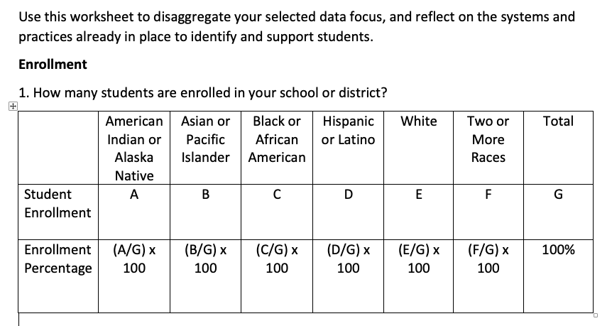
Calculating Equity Measures
Notes / observations:
Notes:
Adapted from Fergus, E. (2017). Solving Disproportionality and Achieving Equity: A Leader’s Guide to Using Data to Change Hearts and Minds. Thousand Oaks, California: Corwin.

Slide 8
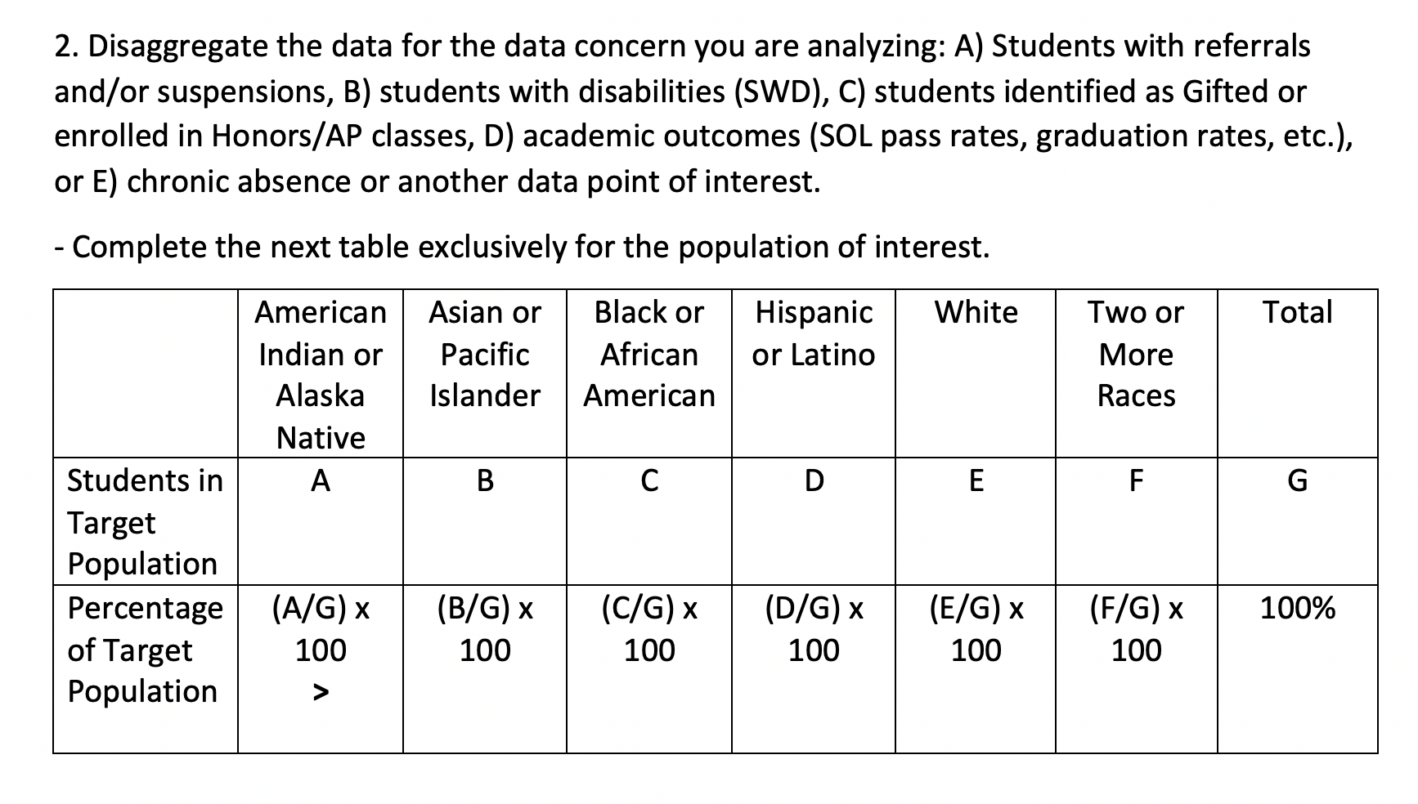
Notes / observations:
Notes:
Adapted from Fergus, E. (2017). Solving Disproportionality and Achieving Equity: A Leader’s Guide to Using Data to Change Hearts and Minds. Thousand Oaks, California: Corwin.

Slide 9
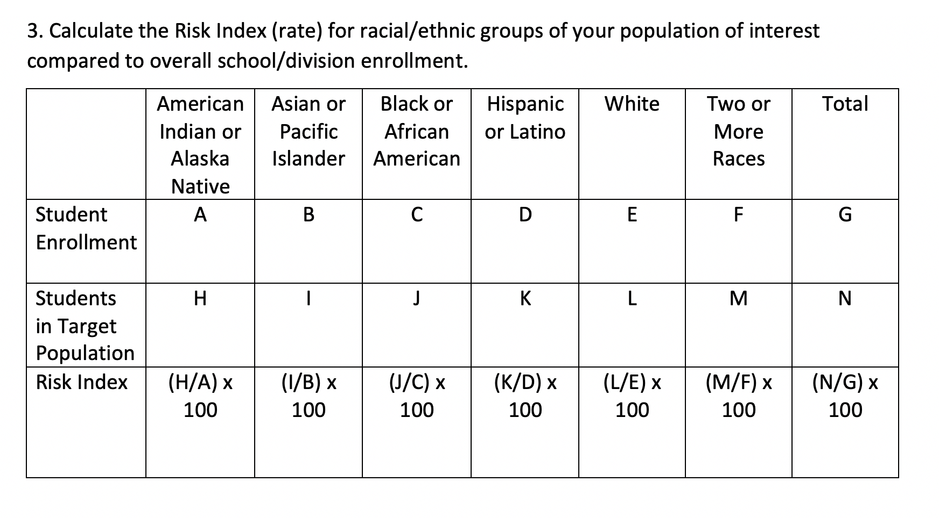
Notes / observations:
Notes:
Adapted from Fergus, E. (2017). Solving Disproportionality and Achieving Equity: A Leader’s Guide to Using Data to Change Hearts and Minds. Thousand Oaks, California: Corwin.

Slide 10
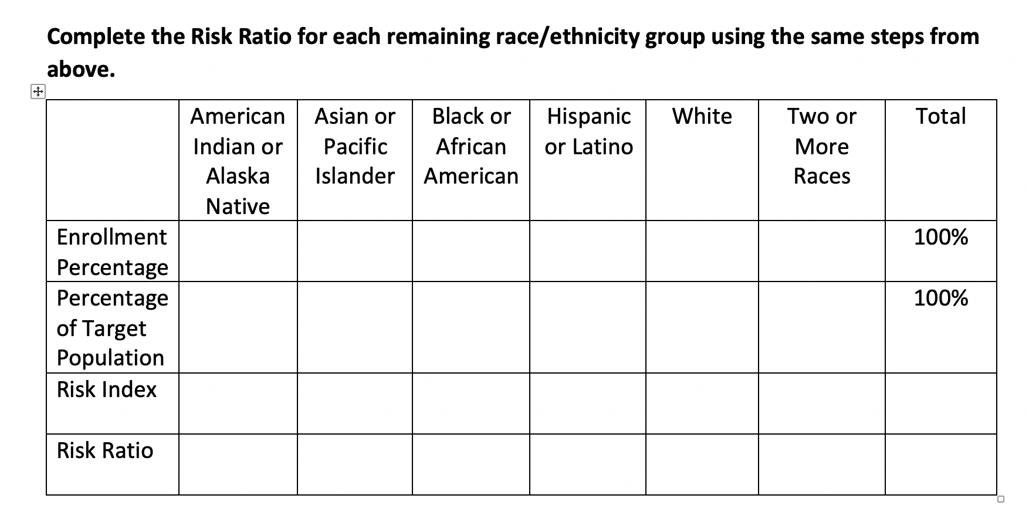
Risk Ratios
For White Students
Calculate the total number of non-white students (Total Population – White Population)
Calculate the Target Population (TP) number of non-white students (Total TP – White TP)
Calculate the Risk Index for TP of non-white students (Non-white TP / Total non-white)
Calculate the Risk Ratio for white TP (Risk Index of White TP / Risk Index of non-white TP)
For Black Students
Calculate the total number of non-black students (Total Population – Black Population)
Calculate the Target Population (TP) number of non-black students (Total TP – Black TP)
Calculate the Risk Index for TP of non-black students (Non-black TP / Total non-black)
Calculate the Risk Ratio for Black TP (Risk Index of Black TP / Risk Index of non-black TP)
Notes:
Risk Ratio Spreadsheet (make yourself a copy): https://drive.google.com/file/d/1_pJW1gtOZmHYwHifr8FhsWosGIonvfWb/view?usp=sharing
Risk Ratio Instructions:
https://drive.google.com/file/d/1NAj44sjpk7G7wbUKVXTywit6iAXnOVGQ/view?usp=sharing
Adapted from Fergus, E. (2017). Solving Disproportionality and Achieving Equity: A Leader’s Guide to Using Data to Change Hearts and Minds. Thousand Oaks, California: Corwin.

Slide 11
Color Blindness
Deficit Thinking
Poverty Disciplining
I try not to notice a child’s race or skin color in the classroom setting.
They need to pull up their pants; otherwise they won’t get a job.
Latino students who speak English should refrain from speaking Spanish at school so they don’t alienate other students of teachers.
Poor kids are not exposed to the type of grit necessary to be successful in school
Students of color from disadvantaged homes just seem to show a lack of initiative.
The values and beliefs
share by those in poor
neighborhoods tend to go
against school values and
beliefs about what makes
good education.
Poor people don’t know the value of education and need to be educated about its value.
Discipline is an important tool when working with poor kids.
Low SES students generally do not have the abilities necessary to succeed in the classroom.
Sometimes I wonder why we can’t see each other as individuals instead of race always being an issue.
It is important that students of color assimilate so that they can succeed in mainstream American culture.
I try to ignore skin color in order to view students as individuals.
Notes:
WORKSPACE
Colorblindness: denial of racial differences by emphasizing sameness; denial of racism by emphasizing equal opportunities
Deficit Thinking: the notion that students (particularly those of low income, racial/ethnic minority background) fail in school because such students and their families have internal defects (deficits) that thwart the learning process
Poverty Disciplining: the assumption that poverty itself is a kind of “culture,” characterized by dysfunctional behaviors that prevent success in school
Directions:
Read the statements in the boxes at the bottom.
Decide if you think they’re an example of color blindness, deficit thinking or poverty disciplining.
Pull the box under the bias based belief in which you think the comment falls.
Be prepared to discuss why you categorized the statements the way you did.

Slide 12
Step 1:
Use your BIG DATA to help you narrow in on your equity challenge.
Start by disaggregating your academic and behavior data by race, ability, gender, and socio economic status. Who is what you’re doing working for? Who is it not?
What inequities (patterns of outcomes and experiences) are happening?
Do we have an equity problem/challenge?
Compare your subgroups with...
your entire student population and/or that of the dominant group.
the same subgroups within your region, the state and/or nationally.
regional / state / national preferred/expected status.

Slide 13
Step 2:
Once you know WHO it’s not working for, brainstorm all of the factors that might be contributing to WHY it’s not working.
What structures could be contributing to these outcomes? What could be the root cause?
Biased based beliefs that are influencing: adult/student relationships, instructional methods and practices, student self-efficacy?
Structural inequities within our policies, systems, and/or way of work?
What structures could be contributing to these outcomes? What could be the root cause?

Slide 14
Step 3:
Explore the different tools you might use to explore the WHYs.
-Empathy interviews
-Equity audits (curriculum, policies, budget, etc.)
-Focus groups
-Observations
-Surveys
Empathy Interviews
Interview for Empathy
Empathy Interview - How to do it and why it matters.
Equity Audits (curriculum, policies, budget, etc.)
VDOE Equity Audit Tool
Equity Self-Audit - teaching.pdf
Equity Audit - National Equity Project .pdf
Equity Audit - MAEC.pdf
Equity Audit - IDEA.pdf
Equity Audit - Fergus.pdf
Equity Audit - Fisher Frey Smith Pumpian.pdf
Cultural Competency Self-Audit.pdf
Cultural Competency Self-Audit Mental Health and Human Service Providers.pdf
Focus Groups
How can we design focus groups that give us the best information possible?
NAPE Basics of Conducting Focus Groups
Listening to Students: Sample Focus Group and Survey Materials
Observations
Equitable Classroom Practices Observation Check List
A Resource for Equitable Classroom Practices
Surveys
ICCSD School Climate Survey
CA Safe Schools Survey (teachers and staff)
NASSP - Equity in School Culture
NAPE Building Survey
Notes:
For descriptions and considerations for each of these tools, please see Inquiry: Assessing Your Current Reality / Empathy Approaches in Liberatory Design in Complex Systems (pgs 47-48)

Slide 15
Identify the
equity challenge
Notice
-Who are we as a team, relative to those whose needs we’re designing for?
-How are we seeing power here?
-What emotions are up for us in this design situation?
-What mindsets feel important now?
See System
Empathize
-How did we experience this process?
-What cultural norms and biases may have been at play?
-What do we want to adjust?
Reflect
Notes:
WORKSPACE
Make sure you plan individually and as a team to come back to NOTICE and REFLECT on the process and your place in it. Try to do this at least one time before we meet again in December. Use this workspace to capture your thoughts and questions.

Slide 16
3. Evidence Based Practices: Teaching and learning approaches proven to be effective through scientifically based studies.
Feature 3.C Continuum of Supports that is Culturally Responsive | Phase of Implementation (check one) • Exploration: The DLT maps the current reality of existing practices and programs and reviews them for evidence of effectiveness. The DLT explores cultural and linguistic factors when adopting academic/social behavioral practices, programs, and assessments • Installation: Upon completion of the review, the DLT seeks stakeholder input, investigates practices for which needs are identified, and makes purchases and/or withdraws programs as appropriate. The DLT and SLT use a selection tool, which prompts analysis for cultural context. • Initial Implementation: The DLT maintains an inventory of EBPs and materials in a continuum of supports. A clearly defined continuum of supports is maintained in tier definition or separate document • Full Implementation: All instructional staff and stakeholders are aware of and able to utilize the continuum of supports for the purpose of providing an appropriate instructional match to meet the needs of all learners
Evaluation Measure/ Evidence
DCA 6: Division documents how current innovations/practices link together AND how they are compatible and add value to one another to achieve improved outcomes for ALL students DCA 7: Funds are available to support the implementation DCA 13: Division supports the use of fidelity measures when implementing practices. Buildings are able to score a 2 on TFI items: 1.6, 1.10, 1.11, 2.5, 3.6 Buildings are able to fully implement TFI-AE 1.3, 2.1, 2.4, 2.5, 3.1 Other:
Step 4:
Determine HOW you’re going to gather more information to tell you whether the WHYs are really making an impact and in what way.
-What tool are you going to use?
-Who are your going to use the tool with?
-Who will be a gathering the data with the tool?
-When are they going to do that?
-When are you going to get back together to look at the new data you’ve collected?
ACTION ITEM / NOTES | Who is responsible? | By when?
Notes:
WORKSPACE
Action Planner to record next steps.

Slide 17
Notes:
Mindset cards: https://www.nationalequityproject.org/tools/liberatory-design-card-deck

