Slide 1
From Starting to Sustaining
Strand 4 Equity
October 13, 2021
Notes:
Welcome!

Slide 2
As everyone is signing in, please change your name to: name - division (ex. Tracy - Radford).
To do this…
Click on PARTICIPANTS on the bottom bar.
Go to your name and click MORE.
Select RENAME from the drop down menu.
Type in your name - division.
Notes:
Daria

Slide 3
Workbook and Workspace
Your workbook is your own and no one will be able to access it unless you share the link with them. Click on the WORKBOOK link in the chat box and MAKE A COPY of the slide deck.
Your workspace is a community virtual space for you to work collectively with your division. Click on the WORKSPACE link in the chat box that corresponds with your division. No need to make a copy, you should be able to type directly in each page.
Notes:
Daria
Workbook is individual and will need to make a copy for themselves.
Workspace is for the team to access and use throughout this work.

Slide 4
Welcome!
Notes:
Welcome video?

Slide 5
Who Are We?
Division Level Equity Director or Coordinator | Division Leadership Team (DLT) Member | Division Equity Team Member
School Leadership Team (SLT) Member | Behavior or Instructional Coach/Teacher | Other
Notes:
Daria
Participants will use annotation tool to place a stamp in the box that best describes their role.

Slide 6
Poll Everywhere - Daria

Slide 7
Why Strand 4?
We are currently implementing an equity system in our division/school.
2. We are exploring implementing an equity system in
our division/school.
3. We are not doing much equity work in my
division/school, but I am interested in this work.
4. I was voluntold to attend this strand.
Notes:
Charlome
poll

Slide 8
What Are We Doing?
1. We have an office of equity/equity team with a
director/coordinator leading equity work in
our division.
2. Our division/school leaders provide us with
some equity work, but I am not aware of a
formal committee/team and/or a
director/coordinator.
3. We talk about equity in our school/division, but
not in a formal way.
4. I am not aware of any equity work in my
division/school.
Notes:
Charlome
poll

Slide 9
Self-Assessment
Feelings
Turn slides 5-8 into a POLL EVERYWHERE
Notes:
Daria

Slide 10
Learning Intentions
Begin to recognize and investigate equity challenges in current systems.
Examine The VDOE definition of educational equity and the Equity 5 C’s.
Identify disproportionality in division data.
Build understanding of how individual experiences and biases impact decision-making.
Notes:
Daria

Slide 11
This is what we’re addressing…

Slide 12
Assumptions
We are all well-intentioned good people who want to see all of our children succeed in school.
No one of us has all of the answers to the many complex questions about difference in a multi-racial, ethnic, and linguistic society.
Some of us would much rather not talk about cultural differences such as race, but we agree to enter into this conversation under the agreement of trust and good will.
Seeking safety in equity dialogues involves being heard, discussing our uncomfortable topics, making room to not know and seek understanding.
We must embrace the inherent risk within the conversations and actions to address disparity.
(Fergus, 2019)
Notes:
Daria
Instead of beginning with establishing ‘norms’ for working together, let’s start with a few assumptions we can make about how we show up for this work together. Reflect on your beliefs and actions and the intent/impact these may have. You will see these again in the afternoon
Engagement: Refer to the workbook page 3 to assess how you are feeling within each of these assumptions.
We are all well-intentioned, good people who want to see all of our children succeed in school.
No one of us has all of the answers to the many complex questions about race in a multi-racial, multi-ethnic society.
Some of us would much rather not talk about race, but we agree to enter into this conversation under the agreement of trust and good will.
Race Matters. Almost every indicator of well-being shows troubling disparities/disproportionalities by race.
Disparities are often created and maintained inadvertently through policies and practices that contain barriers to opportunity.
It is possible – and only possible – to close equity gaps by using strategies determined through an intentional focus on race.
If opportunities in all key areas of well-being are equitable, then equitable results will follow.
Given the right message, analysis, and tools, people will work toward racial equity.

Slide 13
BEHAVIORS THAT HELP TAKE CONVERSATION TO A DEEPER REALM:
We acknowledge one another as equals.
We try to stay curious about each other.
We recognize that we need each other's help to become better listeners.
We slow down so we have time to think and reflect.
We remember that conversation is the natural way humans think together.
We expect it to get messy sometimes.
The Art of Conversation (adapted from Margaret Wheatley)
Notes:
Sharon
Presenter Notes:
Building on those assumptions we make, let’s take a look at some actions/behaviors we may expect of each other.
These come from The Art of Conversation (adapted from Margaret Wheatley)
We need to create an environment that can serve as a Brave Space (not just a safe space) in order to have dialogue and open conversations about where we are as an individual, as a group, as a society. Instead of norming ourselves which tend to prioritize the dominant culture, let’s lean into courageous conversations so that they can be fuller, deeper, and richer.
Engagement: What do you feel are your strengths? weaknesses? What will you pay close attention to during our work today? There is a space for reflection on workbook page 4.
Included in your resources, there is additional information related to norming best practices. Please take time to read this and reflect on workbook page 5.

Slide 14
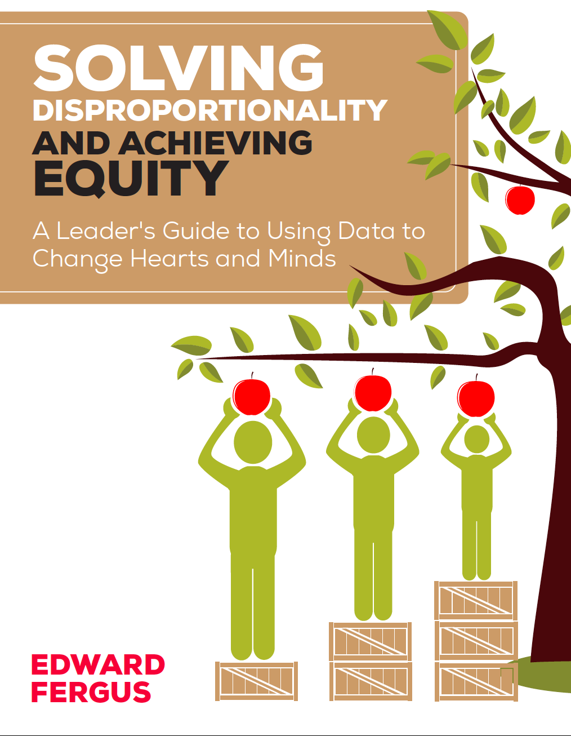
Notes:
Presenter Notes:
Throughout our work together, we will lean on the experts in the field in order to bring you the latest research and information on educational equity. We will share those resources along the way, however, know that Dr. Edward Fergus of Temple University and author of this book as well as the National Equity Project, both have an influence on this work.
These links can be found in the workbook page 6 as well.
https://www.nationalequityproject.org/
https://education.temple.edu/about/faculty-staff/edward-fergus-tuh42458

Slide 15
Notes:
Presenter Notes:
The Virginia Department of Education is also providing a lot of resources for teachers and administrators to explore educational equity in schools. The focus is on ‘eliminating the predictability of student outcomes’ based on race, gender, zip code, ability, socioeconomic status or languages spoken at home.
IF time:: (Chat Box or Break out Room)
Pause and reflect. What does that mean: Eliminating the predictability of student outcomes? What are some barriers to doing this? How do we overcome these?

Slide 16
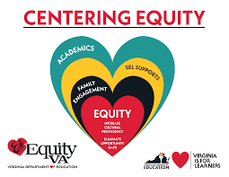
Virginia’s Equity 5Cs
Courageous Leadership
Curriculum Reframing
Compassionate Student & Family Engagement
Continuous Reflection
Culturally Responsive Teaching
Notes:
Presenter Notes:
For additional information, see Dr. Lane’s presentation on the VA roadmap to equity: VDOE Roadmap to Equity
In the summer of 2020, Virginia Department of Education launched their 5 Cs of Educational Equity. These are areas of focus that charge educators with these internal/external, individual/institution actions. These 5 calls to action become the work that we must do to design equitable outcomes in schools and communities.
Refer back to workbook page 7. Review the examples of the 5 Cs. Where do we see the 5 Cs in the liberatory map? Crosswalk the 5 Cs post it notes and lay them onto the liberatory map.

Slide 17
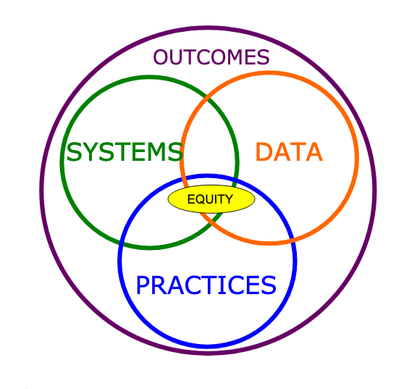
Centering Equity
Supporting
Staff
Supporting
Decision
Making
Supporting
Students

Slide 18
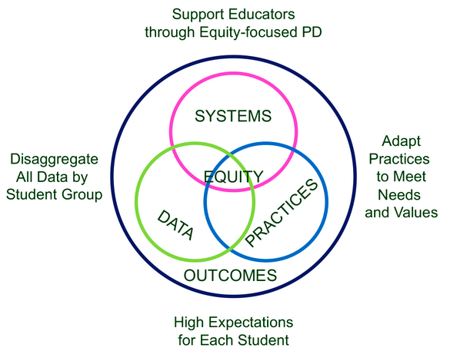
Notes:
https://www.pbis.org/topics/equity

Slide 19
VTSS Matrix Connections
3.C Continuum of Supports that is Culturally Responsive (Clearly defining the practices and programs supported by the division and ensuring they are culturally responsive) | The DLT maps the current reality of existing practices and programs and reviews them for evidence of effectiveness. The DLT explores cultural and linguistic factors when adopting academic/social behavioral practices, programs, and assessments. | Upon completion of the review, the DLT seeks stakeholder input, investigates practices for which needs are identified, and makes purchases and/or withdraws programs as appropriate. The DLT and SLT use a selection tool, which prompts analysis for cultural context. | The DLT maintains an inventory of EBPs and materials in a continuum of supports. A clearly defined continuum of supports is maintained in tier definition or separate document. | All instructional staff and stakeholders are aware of and able to utilize the continuum of supports for the purpose of providing an appropriate instructional match to meet the needs of all learners. | DCA: 6, 7 TFI: 1.6, 1.10, 1.11, 2.5, 3.6 A‐TFI: 1.3, 1.4c, 1.8, 1.9, 2.1, 2.4, 2.5, 3.1
Equity applies throughout the VTSS Matrix: 1B, 1C, 1D, 1F, 2A, 2B, 3A, 3B, 3C, 3D, 3E, 4B, 6A, 6B.
You can also find it in the DCA Items: 5, 6, 10, 11, 14, 15, 18, 19, 21
Notes:
Presenter Notes:
This work is always grounded in the VTSS Implementation Matrix can be found throughout the components.

Slide 20
Guiding Questions
How does awareness, knowledge, and understanding of one’s own racial and cultural identity influence effective teaching, leading, and learning?
How does awareness, knowledge, and understanding of the racial and cultural identity of students and staff promote effective teaching, leading, and learning?
How do we design systems and practices to establish learning environments that are conscious of race and culture to ensure implementation of culturally responsive practices, policies and procedures?
Notes:
Charlome
Presenter Notes: Review guiding questions.
Outcomes from NEP workshop:
Learning Outcomes
Develop and use Equity, Complexity and Design “lenses” in service of more accurate problem-identification, effective decision-making, and taking productive, liberatory action in your system.
Apply these three lenses to an equity challenge in your system. Use these lenses to expand how you see, engage and take action within your sphere of influence.
Identify your next actions. Apply the liberatory design cycle methods and mindsets to design ways to empathize and probe in your system in order to better understand your challenge and determine a direction for your work.
Questions for another time:
I am wondering if potentially better guiding questions would be taking the learning outcomes in the notes of this slide and changing them to the how questions: How do we apply the equity, complexity, and design lenses to an equity challenge in our system? etc...

Slide 21
A “map” of Systemic Oppression
Blindness to the reality of systemic oppression...
INDIVIDUAL
SYSTEMIC
Identity & difference
Biased policies & practices
Reproductive discourse (discourse 1)
Advantage & disadvantage
Institutional
Microaggressions
Individual
Racist interactions
Disproportional (e.g. racialized) outcomes
Explicit Bias
Interpersonal
Systems of Advantage & Disadvantage
Implicit Bias
Transferred oppression
Stereotype Threat
Structural
Internalized oppression
Opportunity structures
Notes:
Presenter Notes:
This map of Systemic Oppression is courtesy of the National Equity Project.
While this is very full of information and examples, the big picture we must recognize is that we are individuals who show up with different identities, advantages, and biases, but we all must interact within a larger institution. This system has institutional and structural forces in place that include disproportion of different outcomes, policies and practices that are not equitable and different opportunities for individuals. Where the individual and ways of a system influence and intersect is often where our students find themselves dealing with microaggressions, racism, systemic oppression. There is often a blindness to the reality of this.

Slide 22
A(partial) “map” of Liberation...
Awareness of the reality of systemic oppression - and agency to interrupt it...
INTERNAL
EXTERNAL
Recognizing identity & difference
Discourse 2
Equity-centered policies & practices
Community Agreements
Institutional
Individual
Interpersonal
Equity-centered design & learning
Recognizing and owning our privilege & disadvantage
Equitable outcomes
Alliances (across & within difference)
Organizing & Protest
Reflection & Self-inquiry
Constructivist Listening
Structural
Systems of oppression
Learning (read, watch, talk)
Notes:
Presenter Notes:
Again this image and concept is courtesy of the National Equity Project.
This image illustrates what happens when there is an awareness of the way the individual and institution intersect and there is the motivation and agency to change it. When an individual is able to reflect on their identity and belief systems and recognize their own privilege (internal/mirror work); and when the individual can clearly look at the system and see the ways in which policies and practices, ways of organizing and protest and actual designs of systems can impact equitable outcomes (external/window work). Where these two overlap, provides the opportunities for growth, for listening, for alliances and agreements that benefit all.

Slide 23
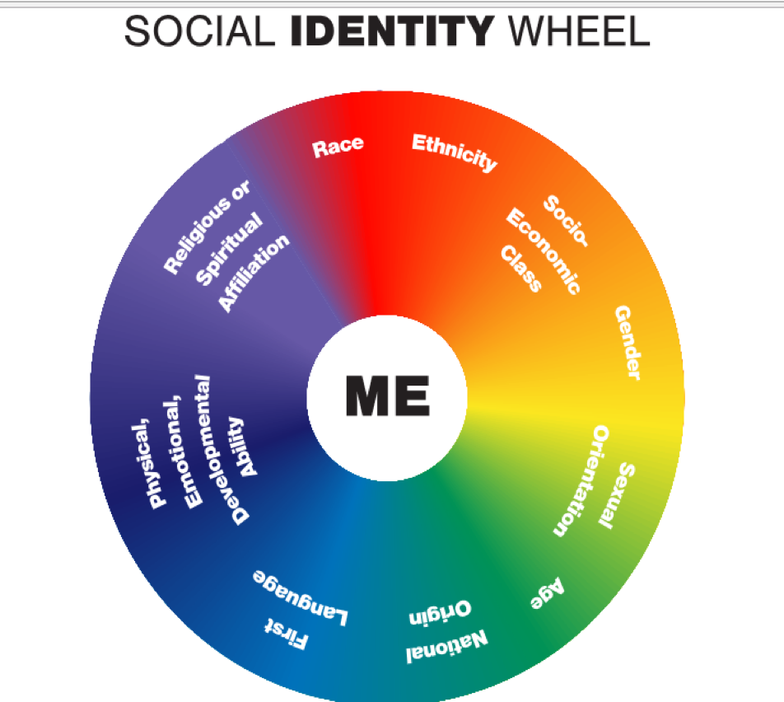
Culture / Beliefs = IDENTITY
Notes:
Daria
Presenter Notes:
To begin this work, we start by looking in the mirror. We all identify in many different ways across many different categories. Some of these identifiers are with us from the beginning, some change or are challenged over time through experiences/belief systems. We do not fit into boxes easily and each part of our identities are important and essential.

Slide 24
Our identities are the sum of our experiences. They shape our beliefs and our ways of viewing the world.
How do your deep cultural beliefs around school, learning, and success have the potential to impact
the design process of the educational system?
Workbook - Slide 9 and 10
PBIS Field Guide Activity: Appendix H pg. 45
Notes:
Daria
Presenter Notes:
PBIS Field Guide Activity: Appendix H: pg. 45
Ask participants to look at the chart on slide 10 in the workbook.
Choose 2-3 of the elements of culture. When thinking about your values growing up, think about:
How did you come to those beliefs?
What messages did you get about why people succeed or not? Were those beliefs tied identity groups? Ex. Always open doors for physically challenged people b/c they couldn’t do it for themselves.
How about holding doors for women? Often couched in “respect” but what was the underlying reason?
What did your culture teach you about intelligence? Ability?
Do columns 1-5 independently. Pair and share. TOGETHER generate possibilities for column 6 (How this difference can create conflict)
Purpose:To engage staff in reflecting on their own values and culture, how they change over time, and how the school culture may engage or disengage students and families.

Slide 25
Ideologies and beliefs about the student population they serve can have a positive or negative effect on student outcomes via the actions they choose to employ in the classroom.
(e.g., Madon, Jussin, & Eccles, 1997; Madon et al., 1998; Madon et al., 2001; Proctor, 1984).
Notes:
Daria
Presenter Notes:
Knowing that beliefs about students can have a positive or negative impact on outcomes, how might these show up in daily actions in the classrooms?

Slide 26
We ALL Have Biases
A bias is a tendency, inclination, or prejudice toward or against something or someone.
Implicit bias - biases formed from lifelong societal input that escape conscious detection
Notes:
Daria
egocentric bias
Presenter Notes:
We as humans, group and classify based on physical attributes we can see. We use these to assign labels. When we assign negative labels, that’s when we need to be looking at biases and prejudice.
As designers, we have to remember that We make generalizations.
We have to be aware of these and understand the impacts that this could have on data, on practices and on our systems.
Blindspots: Areas of concern or problem that we are not individually been aware of because they have not been a part of our own personal or cultural experience. If we do not interrogate what we as individuals might not know, we could miss important considerations of the cause(s) of our precise problems.

Slide 27
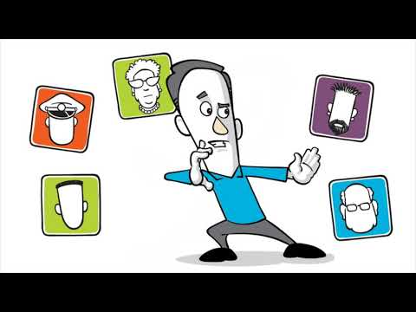
Notes:
An Introduction to Unconscious Bias
https://www.youtube.com/watch?v=KCgIRGKAbfc
A whiteboard video produced for Hemsley Fraser in Washington, D.C., explaining unconscious bias and how to avoid it, script provided by client.

Slide 28
Notes:
Daria
Presenter Notes:
Check Our Bias To Wreck Our Bias
https://www.youtube.com/watch?v=b8ZFDqzAmEE

Slide 29
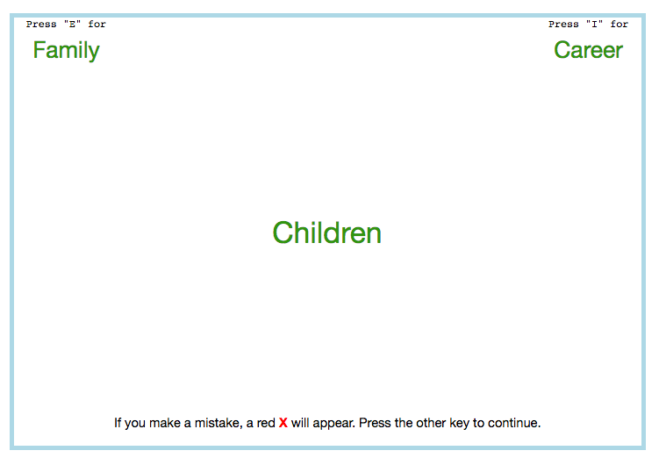
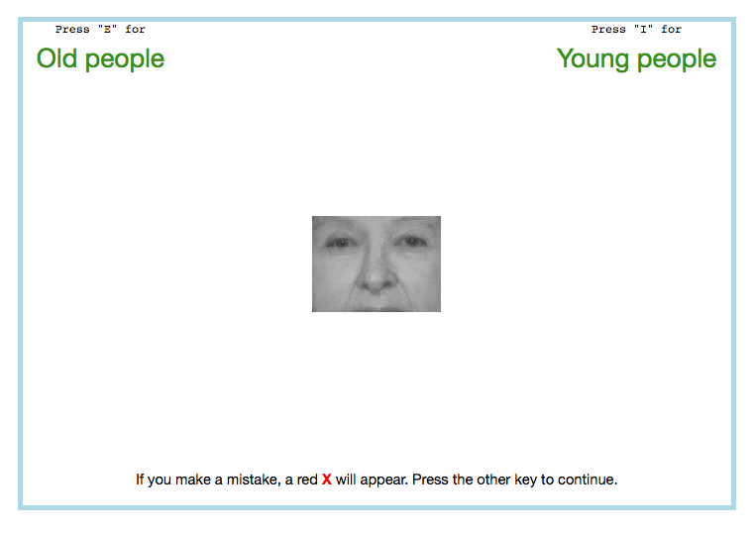
Harvard Implicit Bias Test
https://implicit.harvard.edu/implicit/takeatest.html
Notes:
Daria
Presenter Notes:
We have to be aware of our biases; to make the invisible visible.
Another resource is the Harvard Implicit Bias Test. This is an excellent resource that allows individuals to be reflective.
https://implicit.harvard.edu/implicit/takeatest.html

Slide 30
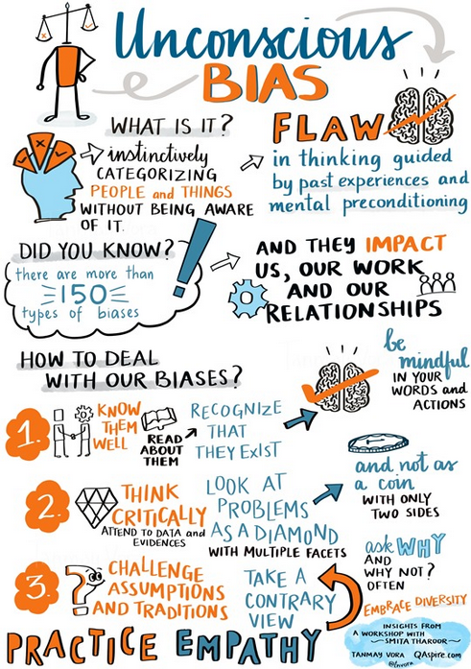
“Biases are often based on stereotypes, rather than actual knowledge of an individual or circumstance. Whether positive or negative, such cognitive shortcuts can result in prejudgments that lead to rash decisions or discriminatory practices.”
(Psychology Today 2019)
Notes:
Daria
Presenter Notes:
We all implicit, unconscious biases. But it is when they lead to action/decisions that marginalize others is when have to be careful.
Emphasize that when our individual biases act collectively with others who have similar biases and beliefs, this often results in inequitable systems that privilege some and marginalize others and shows up as dispro in our data.
https://www.psychologytoday.com/us/basics/bias

Slide 31
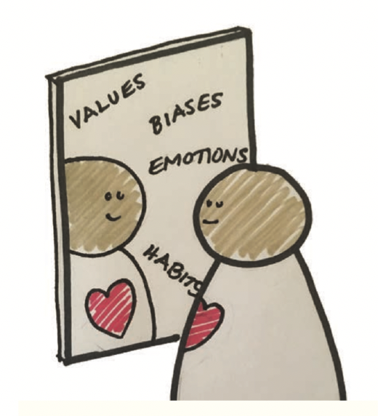
Practice Self Awareness
We design from who we are. So we need a clear “mirror” to better see how who we are shapes what we see, how we relate, and how we design.
Notes:
Break afterwards
Tracy
Presenter Notes:
Introduce Liberatory Mindsets. By exercising these mindsets, we build our muscles - our equity centered creative agency.
What are some sterotypes or biases you already know you hold? What do you do help change them?
Ex. Linda Sue Park is reading only books by black author’s this year
I name the confirmation bias and force myself to remember a time when that wasn’t the case (Asian women; Linie).
Why?
Liberatory Design requires that we minimize the harmful effects of our blind spots and maximize the potential for non-oppressive partnerships. Liberatory Design has the potential to change us to the extent we work with humility, curiosity, and courage.
How
- Ask yourself “How am I positioned (relative to privilege and/or oppression) in all aspects of my identities (e.g. race, class, gender, language)?”
Ask yourself, “How might these identities impact people and out process?”
Surface what you don’t know. Ask yourself, “What is unfamiliar to me here?”
Challenge your assumptions.
Expand your equity consciousness by seeking out new information about privilege and oppression.

Slide 32
Stretch Break

Slide 33
social awareness

Slide 34
A(partial) “map” of Liberation...
Awareness of the reality of systemic oppression - and agency to interrupt it...
INTERNAL
EXTERNAL
Recognizing identity & difference
Discourse 2
Equity-centered policies & practices
Community Agreements
Institutional
Individual
Interpersonal
Equity-centered design & learning
Recognizing and owning our privilege & disadvantage
Equitable outcomes
Alliances (across & within difference)
Organizing & Protest
Reflection & Self-inquiry
Constructivist Listening
Structural
Systems of oppression
Learning (read, watch, talk)
Notes:
Tracy - arrow and tie to reflection

Slide 35
Notes:
Tracy
Presenter Notes:
Systemic Racism Explained
https://www.youtube.com/watch?v=YrHIQIO_bdQ&vl=en

Slide 36
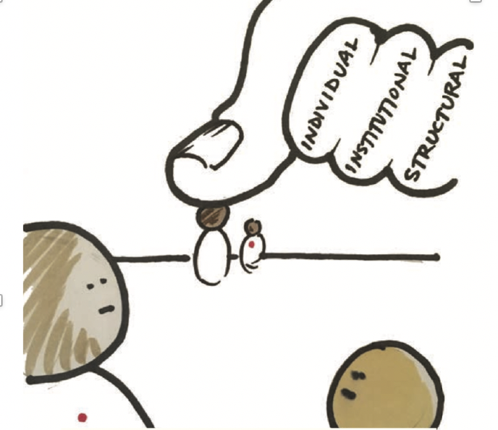
Recognize Oppression
Our designs depend on how we frame a challenge. So we need a clear “window” to see how oppression may be at play in our context.
Notes:
Tracy
Presenter Notes:
Systemic inequities, just like biases, are a form of oppression - they keep or make it harder for some people to get things that others are just provided.
Wkbk pg. 15
What are examples of systemic inequity you and/or your students navigate or deal with regularly?
Do you think people recognize the inequity?
Why does it exist?
Why?
The people we are designing with and the challenges they face do not sit in a vacuum. If we are able to see root causes and systemic inequities more clearly, our design work has the potential address deeper needs. Our design process should build our capacity to recognize oppression at play at individual, institutional, and structural levels.
How
- Ask “What identity-related patterns and inequities are we seeing in this context?”
Ask yourself, “How might these identities impact people and out process?”
Ask, “What barriers are in the way of achieving equitable outcomes?”
Ask, “What is this community’s experience with ‘design’ and how does that affect how we do this work?”
Ask, “How are relationships and power differentials affecting the truth that is told here?”

Slide 37
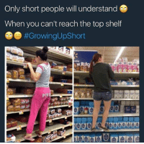
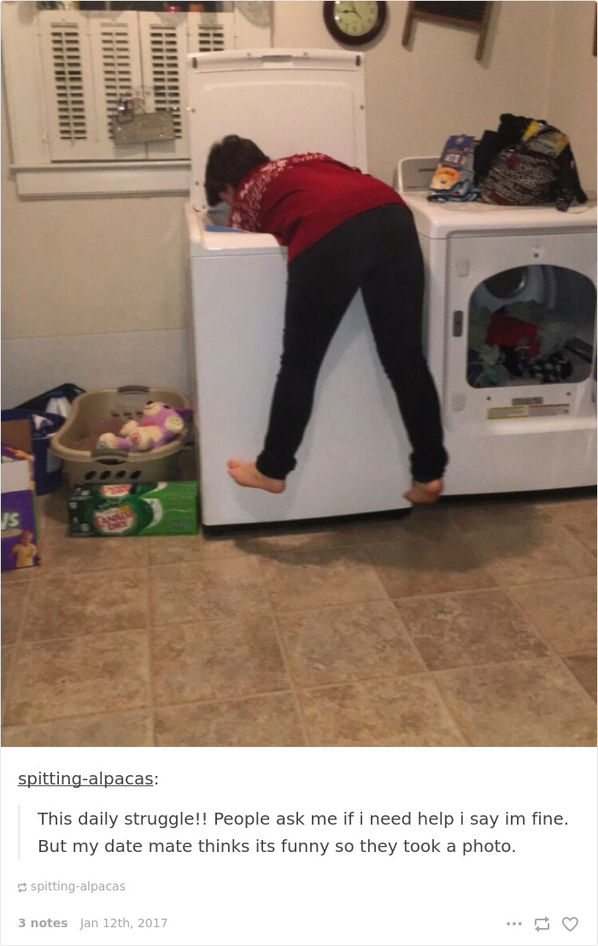
Advantage / Disadvantage
Notes:
Right handed vs. left handedness
Let’s go ahead and talk about the word that sometimes makes people wiggle in their seats-privilege. Sometimes we have privileges we did not even know we have. If we engage in courageous reflection we can probably identify some privileges we have AND some ways we may have been marginalized. For example, on a light note-the height is not a privilege I possess. Which is a benefit in a mean game of limbo, but certainly not a benefit when I am trying to reach items in the grocery store from the top shelf (sidenote- now amount of praising me for my effort to jump up and grab that can of soup is going to effectively help me).
As you watch the video, please take a moment to reflect on the power dynamics that may be existing.

Slide 38
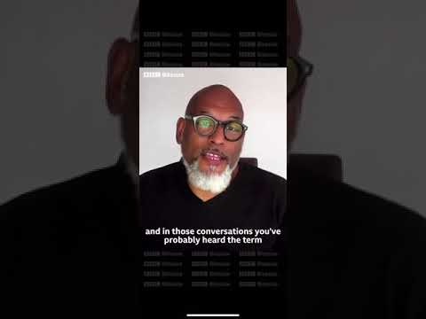
Systemic inequities will limit some groups of people, while making things easier for others
= PRIVILEGE
Notes:
Tracy
Presenter Notes:
John Amaechi summarizes white privilege in this video.
Privilege is the absence of inconvenience.
wkbk pg. 13
Answer on their own and discuss: How am I positioned (relative to privilege and/or oppression) in all of my identities (e.g. race, class, gender, language, ability)?
Discuss as a group: How might these identities impact people and our process?
https://www.pinknews.co.uk/2020/08/06/white-privilege-explained-racism-race-john-amaechi-video/
White Privilege Explained John Amaechi

Slide 39
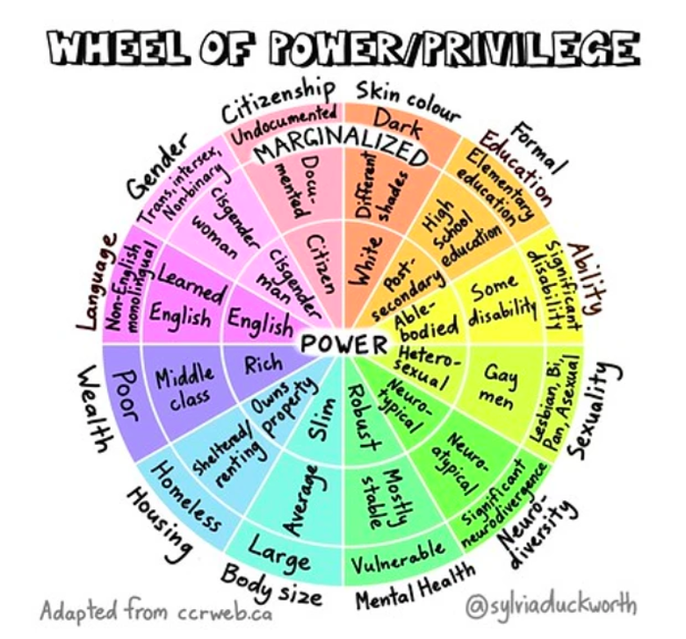
Notes:
adapted from ccweb.ca

Slide 40
Notice and Reflect
Practice self-awareness (own identity, values, emotions, bias, power, assumptions)
Collectively build situational awareness (context, people, power, history, current state)
Pause midstream to reflect on actions, impact, emotions, relationship
Adjust our intentions, presence, direction
National Equity Project - Liberatory Design in Challenging Times Webinar
Notes:
Tracy

Slide 41
Notice and Reflect
Identity: Who am I/we? Who are our “users”?
Power: How are we respectively situated (relative to opportunity, institutional power?
Context: What is our situation, our equity challenge?
Partnership: Given the above, how can we create a partnership that is liberating for all in the process?
What evidence do I have that I am becoming more self aware and self correcting as an equity leader?
How is my emotional state affecting how I show up with my team? How can I share or release those emotions with my team?
Liberatory Design in Complex Systems Resource Guide pg. 33 and 36
Notes:
Tracy

Slide 42
Problem Solving for Equity
How do you usually realize you have an equity problem?
Something goes wrong / blows up
See it in our data
Someone from a marginalized group speaks up
2. What process (if any) do you use to address the equity problem?
3. What do you feel is successful about your process?
4. What are some of the challenges with your process?
Notes:
Discuss and record answers on slide 6 of their workbook.

Slide 43
VTSS Data-Informed Decision Making
Notes:
Tracy

Slide 44
Visual Representation of VTSS Data Informed Decision Making Process
Identify data / evidence of need
Create progress monitoring plan
Develop a precision statement
Collect and Use Data
Identify key systems for adults
Set a goal based on student outcome data
Identify key practices for students

Slide 45
Equity Lens
The metaphor of a lens allows us to see our contexts in new and revealing ways.
POLICIES
OUTCOMES
POWER
RELATIONSHIPS
SOLUTIONS
Notes:
Tracy
Presenter Notes:
How might we design with intention to eliminate inequity? We will be asking your team to apply an equity lens to use of the VTSS DIDM process.
This is courtesy of the National Equity Project.
Without this lens, we are definitely going to miss important things that are not immediately obvious--like policies, outcomes, power, relationships and equitable solutions.
Contribution from Reina Cabezas at Oakland Unified School District
“Whenever I arrive on a real location, I have to move around and work out what the
best angles are going to be. When I was moving around with the lens, I discovered
things that the naked eye would not have.” – filmmaker Pedro Almodovar

Slide 46
Identify data / evidence of need
Create progress monitoring plan
Develop a precision statement
Collect and Use Data
Identify key systems for adults
Set a goal based on student outcome data
Identify key practices for students
Notes:
We start in the same place - with data.

Slide 47
Equity Challenge: Initial Thoughts
What have you and/or your division already identified as your equity challenge?
What “big” data indicates this area of need?
Examples of big data:
Overall Reading and Math SOL scores
SOL scores for specific student groups
Discipline data (starting with discipline referrals and suspension/expulsion)
Chronic Absenteeism
Notes:
Daria
Presenter Notes:
You may already have an equity challenge that your team or division has identified. If so, briefly share the data with your team that indicates the need.
If you do not already have an identified equity concern, take a look at the overall “big” data for your division and discuss what you see.
We are going to show you some additional data tools to support analysis of your “big” data and identify more specific areas of concern

Slide 48
Calculating Dispro:
The Why
1.Disproportionality represents one of the most significant problems in education today (Gregory, Skiba, & Noguera, 2010; U.S. Government Accountability Office, 2013).
2. Disproportionality in exclusionary discipline blocks us from the overall objective of promoting positive outcomes for ALL students.
3. You can examine dispro to promote equity in many areas: academics, students enrolled in AP classes, chronic absenteeism, discipline, etc.
4. Evidence of disproportionality is an indicator of the need for system or individual (adult) change.
Notes:
Daria
Presenter Notes:
Disproportionality represents one of the most significant problems in education today (Gregory, Skiba, & Noguera, 2010; U.S. Government Accountability Office, 2013). The results of decades of research consistently show that students of color, particularly African American students (and even more so for those with disabilities), are at significantly increased risk for exposure to exclusionary discipline practices, including office discipline referrals and suspensions (e.g., Fabelo et al., 2011; Losen & Gillespie, 2012; Shaw & Braden, 1990).
Educators must address this issue by identifying rates of discipline disproportionality, taking steps to reduce it, and monitoring the effects of intervention on disproportionality.
Disproportionality, in most cases, is caused my unequal enforcement of discipline policies, and/or a mismatch of policies with the skills of students. Dispro does NOT indicate that there is something wrong with a group of student. Dispro indicates that the adults need to do something differently.

Slide 49
Calculating Dispro:
The What
Typically calculated as a risk ratio
Risk ratios represent the likelihood of the outcome (e.g., ODRs) for one group in relation to a comparison group.
Frequently used for interpretation:
1.0 - 1.9 = low risk
2.0 - 2.9 = moderate
3.0 and above = significant
Notes:
Daria
Presenter Notes:
A really important point is that “moderate” may make you think it isn’t that bad, but even moderate means that you do have concerns in the building. The goal should be to get a close to 1.0 as possible for all groups of students.
Can give example , such as ODRs for students with disabilities compared to all

Slide 50
Post Session Work-
Calculating Dispro: “The How”
In your materials, you have an Excel document called “Risk Ratio Spreadsheet” and a document with instructions for using it.
In your team work time later today, or at a later time, please calculate Risk Ratios for your divisions for suspensions, chronic absenteeism, and SOL Proficiency.
Notes:
Daria
Breakout Division Teams - What data do they have and in what form is it in?
Presenter Notes:
To be completed in team work time

Slide 51
Next Steps
Use your BIG DATA to help you narrow in on your equity challenge.
Start by disaggregating your academic and behavior data by race, ability, gender, and socio economic status. Who is what you’re doing working for? Who is it not? View the VoiceThread that will be sent to you to assist this process.
Ex. Our students with disabilities are passing their SOL examines at a much lower rate than their non-disabled peers.
Notes:
Tracy
Presenter Notes:
Step by step.

Slide 52
Lead India video

Slide 53
Let’s reflect...
Notes:
google form to reflect

Slide 54
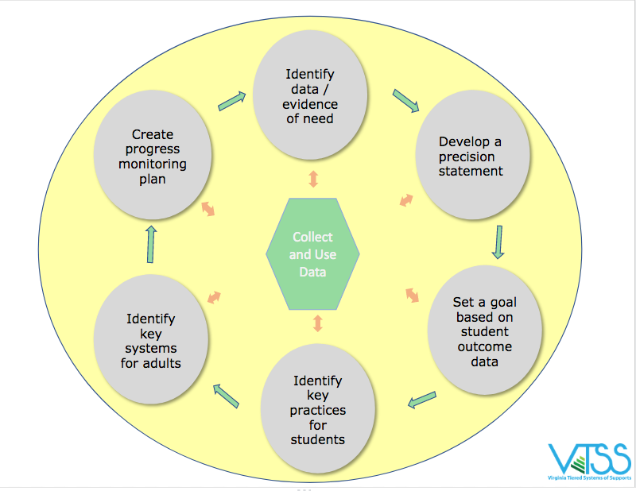
DATA/Evidence of Need: Do we have an equity problem/challenge? Compare your subgroups with... your entire student population and/or that of the dominant group. the same subgroups within your region, the state and/or nationally. regional / state / national preferred/expected status.
Identify data / evidence of need
What inequities (patterns of outcomes and experiences) are happening?
Notes:
Workspace slide 12

Slide 55
DATA/Evidence of Need: If an equity problem/challenge is identified, then ask... What structures could be contributing to these outcomes? What could be the root cause? Biased based beliefs that are influencing: adult/student relationships, instructional methods and practices, student self-efficacy? Structural inequities within our policies, systems, and/or way of work?
Identify data / evidence of need
Hint: It is NOT the kids or their families.
Notes:
Workspace slide 13

Slide 56
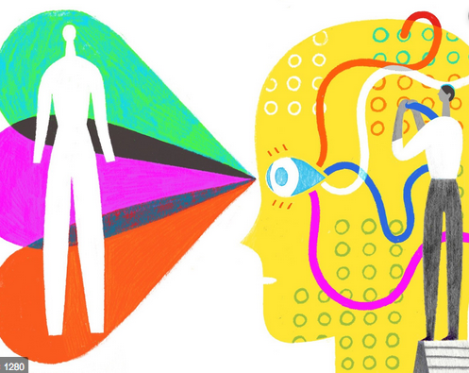
What gets in the way of educational equity?
Color Blindness
Biased Based Beliefs
Deficit Thinking
Poverty Disciplining
Notes:
DEFICIT THINKING and COLOR BLINDNESS
More on day 2…
If you’re blaming someone other than your divisions (instruction, policy, relationships, etc.)
Tracy
TIme Permitting
Presenter Notes:
After a break:
Examples of systemic inequity

Slide 57
Color Blindness: “I don’t see race or difference.”
“The Discourse of Individualism does more than posit that opportunity is equal and people arrive at their achievements through hard work alone, thus positioning dominant group members in a favorable light; it simultaneously obscures structural barriers and positions members of social groups who have achieved less in an unfavorable light”
(DiAngelo, 2010)
Notes:
Tracy
TIme Permitting
Presenter Notes:

Slide 58
Deficit Thinking Ideology
Discounts the presence of systemic inequities as the result of race-based processes, practices, and policies
Blames a group for the conditions they find themselves experiencing
Notes:
Tracy
TIme Permitting
Presenter Notes:

Slide 59
To truly understand the problem/challenge we have to gain insight from those affected by the problem/challenge.
They can help us understand:
What does this problem look/sound/feel like for them?
Who is this problem affecting and in what way?
When is this problem affecting them more? the least?
Where do they experience this problem the most?
Why do they think this problem is occuring?
Identify data / evidence of need

Slide 60
What are the underlying factors influencing why our data looks the way it does?
How are those being affected by the problem experiencing it?
Tools we could use to figure it out…
Empathy interviews
2. Equity audits (curriculum, policies, budget, etc.)
3. Focus groups
4. Observations
5. Surveys
Notes:
Workspace slide 14
Tracy
ADA compliant
Presenter Notes:
With the design thinking process, you must spend time empathizing with those involved. This requires us to look at the underlying factors that influence the data. We do this through gathering first-person information. Explanation and examples of these tools are located within your workspace.

Slide 61
Notice and Reflect
-Who are we as a team, relative to those whose needs we’re designing for?
-How are we seeing power here?
-What emotions are up for us in this design situation?
-What mindsets feel important now?
-How did we experience this process?
-What cultural norms and biases may have been at play?
-What do we want to adjust?
Notes:
Workspace slide 15

Slide 62
Step 2
Once you know WHO it’s not working for, brainstorm all of the factors that might be contributing to WHY it’s not working.
Ex.
SWD...
attend school less regularly.
are often out of class (sent out for disciplinary reasons, missing due to illness, cut class, pulled out for additional instruction, etc.) and are missing a lot of tier 1 instructional time.
do not feel successful school, which leads to having negative feelings about school
do not have strong, positive relationships with their general education teachers
Notes:
Tracy
Presenter Notes:
Step 2.

Slide 63
Step 3
Explore the different tools you might use to explore the WHYs.
Empathy interviews
Equity audits (curriculum, policies, budget, etc.)
Focus groups
Observations
Surveys
Notes:
Tracy
Presenter Notes:
Step 3. Examples of these equity audits are available in the workbook.

Slide 64
Step 4
Determine HOW you’re going to gather more information to tell you whether the WHYs are really making an impact and in what way.
- What tool are you going to use?
- Who are your going to use the tool with?
- Who will be a gathering the data with the tool?
- When are they going to do that?
- When are you going to get back together to look at the new data you’ve collected?
Ex. Conducting a school climate survey for students and parents to see how they feel about school. Include what they think is working / not working. Work with schools to figure out the best time and way to give surveys. Get results back by mid-October and review as a team at November meeting.
Notes:
Workspace slide 16
Presenter Notes:
step 4

