Slide 1
Workbook
From Starting to Sustaining
Strand 4 - Equity (Day 1)
October 13, 2021

Slide 2
Notes / Thoughts / Reflections

Slide 3
Fergus 2019
Where do you feel like you fall within each of these assumptions? What do you think your strengths and challenges are with:
Wanting all of our children to succeed
Having answers
Talking about cultural differences
Seeking safety in equity dialogues
Embracing inherent risk

Slide 4
Reflections and commitments:

Slide 5
Indeed, the unanticipated discomfort and difficulty many agent group members experience as a result of participation in a social justice learning activity can also lead to resistance and denial. Here, the truth of how power and privilege have moved in one’s life is rejected and energy is redirected toward critiquing the activity (rather than the content) as the source of her or his discomfort or explaining away others’ experiences as springing not from oppression, but from some other more benign source, disconnected from oneself. In this manner the language of safety may actually encourage entrenchment in privilege, which we may be able to curtail more effectively by building conditions in which agent group members understand and expect from the outset the challenge is forthcoming.
From Safe Spaces to Brave Spaces
Arao and Clemens, 2013
Entire chapter can be found on slides 21-36.
How do you think this passage relates to norm setting?
Why do Arao and Clemens argue that we should be focusing less on making everyone feel safe and more on creating spaces where participants can learn about differences and engage in respectful, civil discourse.

Slide 6
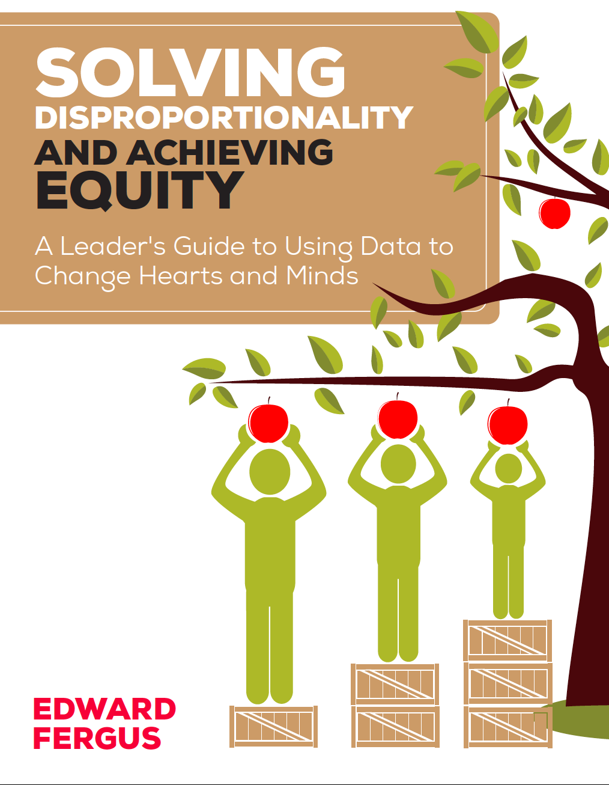
National Equity Project
Edward Fergus
Solving Disproportionality and Achieving Equity | Corwin
Presentation By Dr. Lane and Ms. Walker: https://www.youtube.com/watch?v=kT7HtzkZ74o&list=PLRTyI0-OTuVMiCuRJItbRubhQUCDGd4nk&index=6
Slides: NAVIGATING EdEquityVA:
Notes:
Throughout our work together, we will lean on the experts in the field in order to bring you the latest research and information on educational equity. We will share those resources along the way, however, know that Dr. Edward Fergus of Temple University and author of this book as well as the National Equity Project, both have an influence on this work.

Slide 7
Virginia’s Equity 5Cs
Courageous Leadership
Anti Racism and Equity Policy is explicitly stated and published.
Equity Audit is conducted annually with published results.
School division leaders promote Diversity & Cultivate Responsibility for Equity.
Equity goals are explicitly stated in Strategic Planning.
Resource Allocation advances equity goals.
Curriculum Reframing
Embeds student voice
Audited for cultural and ethnic inclusivity
Culturally relevant content and pedagogy
Deeper learning aligned
High quality instructional resources
Culturally Responsive Teaching
Culture is centered as a vehicle for learning.
Instruction is tailored to meet student needs.
School climate fosters affirmation of ALL students.
Power imbalances based on race, culture, ethnicity, and class are mitigated.
Staff communicates high expectations for ALL students.
Compassionate Family and Student Engagement
Social Emotional Learning (SEL)
Student supports
Restorative practices
Asset-based interventions
Trauma informed
Continuous Reflection
Data Driven Decision Making-Culturally relevant data guides the decisions
Equity dashboard for data is published on the website
Accountability mechanisms
Examine implicit biases
Engage students, families, and stakeholders
Requires self awareness through self assessment

Slide 8
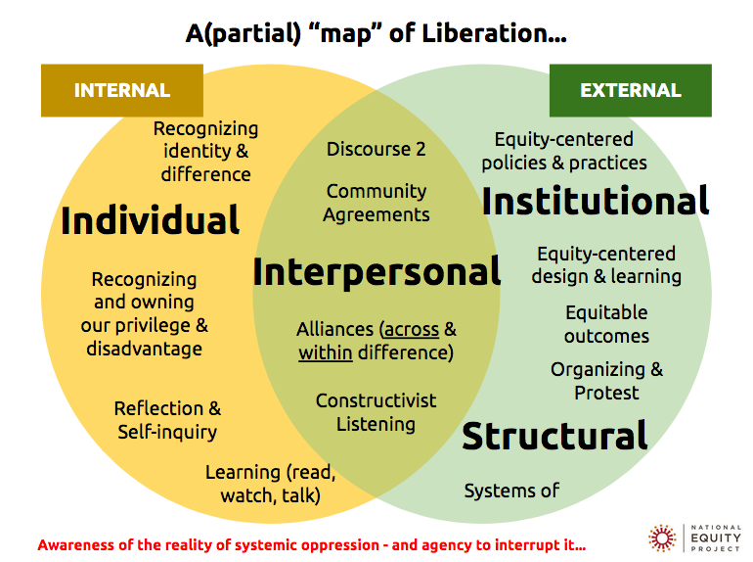
Courageous Leadership
Curriculum Reframing
Compassionate Student & Family Engagement
Continuous Reflection
Culturally Responsive Teaching
Notes:
Directions: Move the box with one of the 5 Equity C’s to where you think it aligns with the Liberation Map. If you believe it shows up in multiple places, copy the box and put the duplicates where you think they belong.

Slide 9
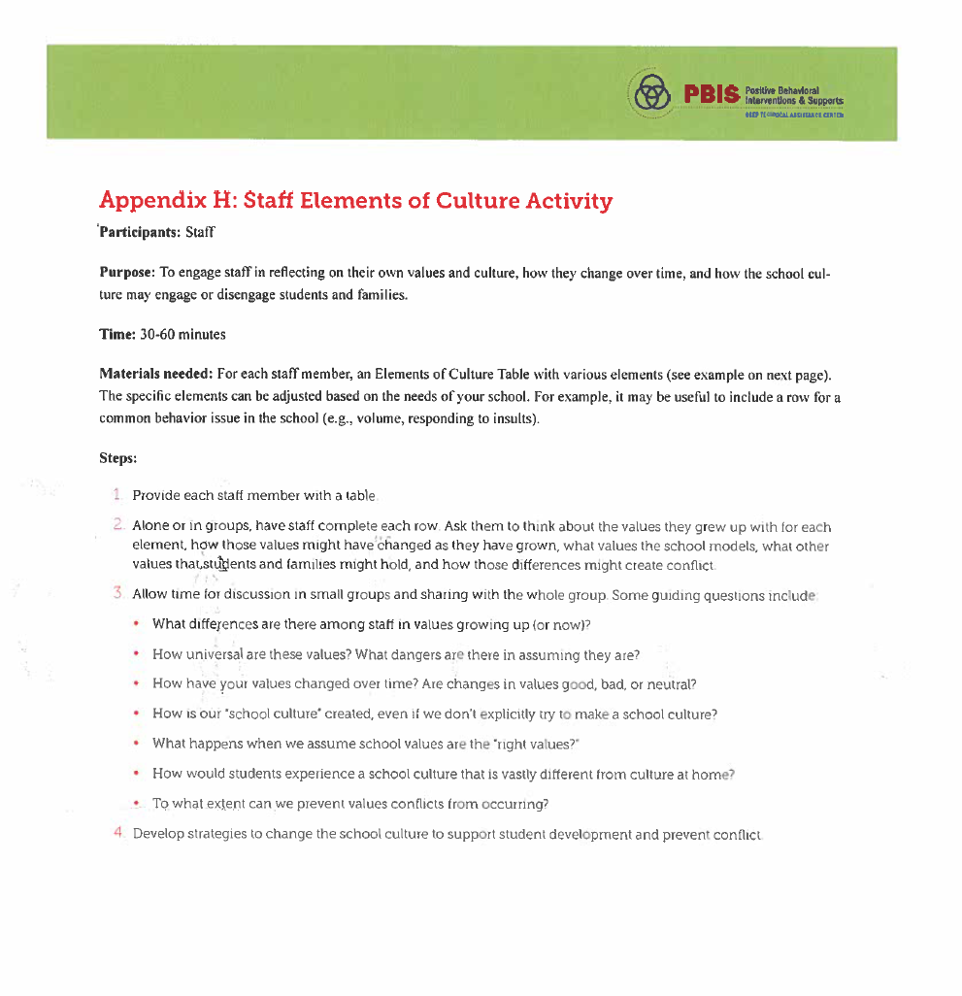

Slide 10
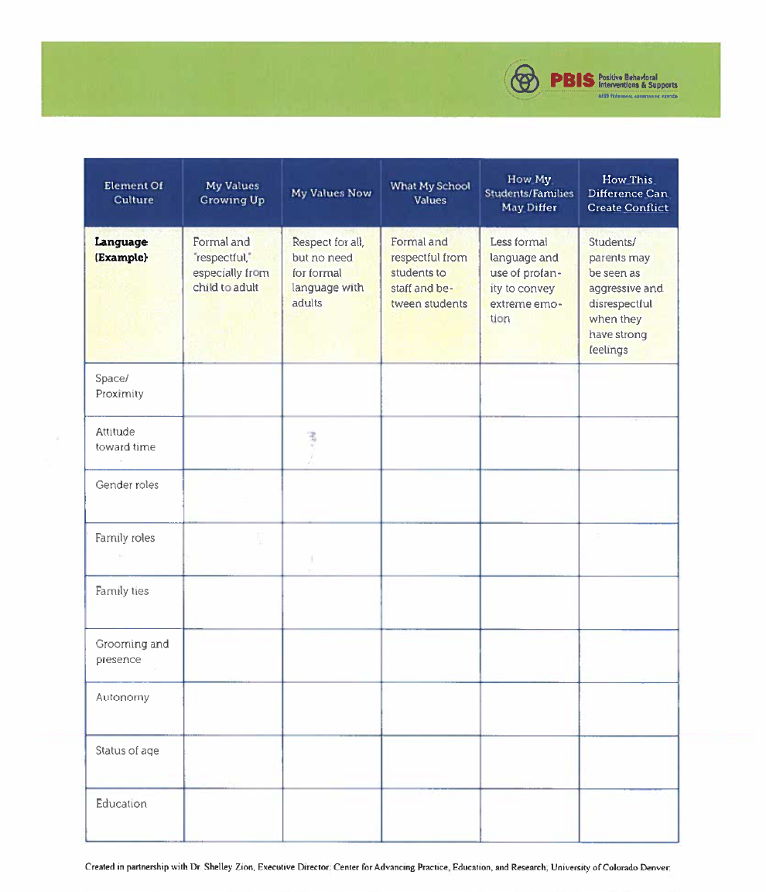

Slide 11
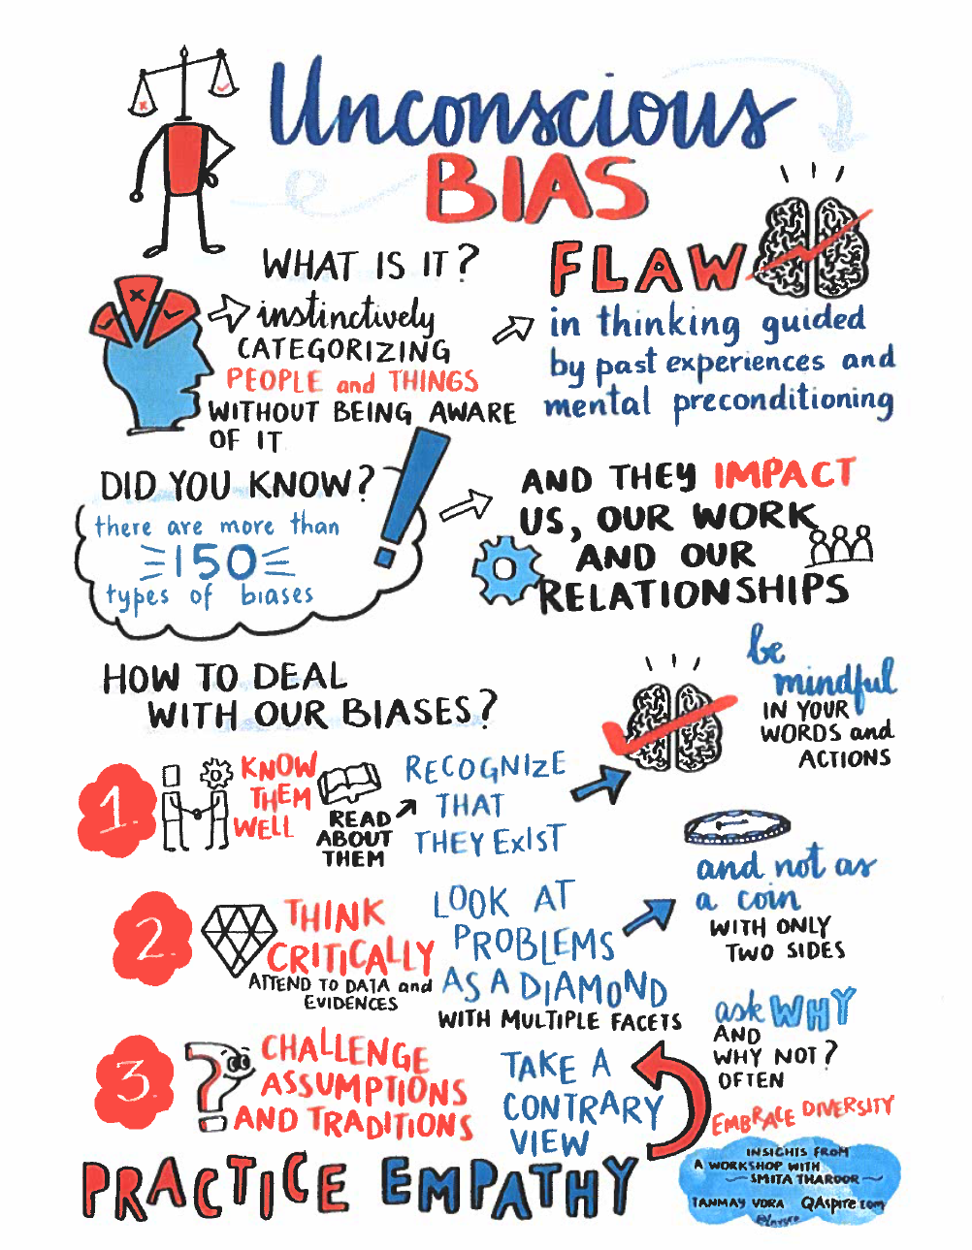
What are some stereotypes or biases you already know you hold? What do you do change/challenge them?

Slide 12
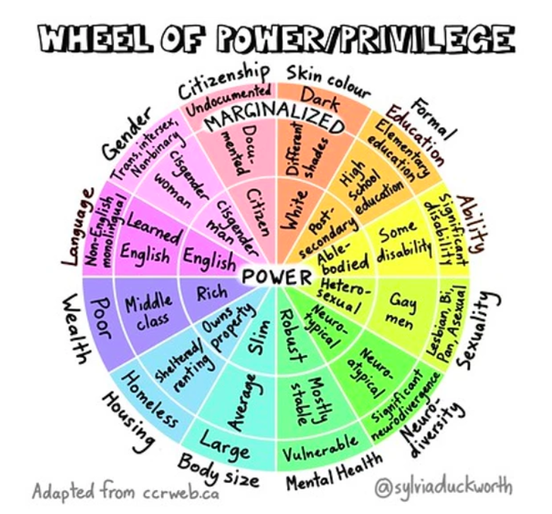
Where do you feel like your identities sometimes privilege you? What does that look like / sound like?

Slide 13
Liberatory Design Card Deck — National Equity Project
Notes:
Liberatory Mindset Cards: Liberatory Design Card Deck — National Equity Project

Slide 14
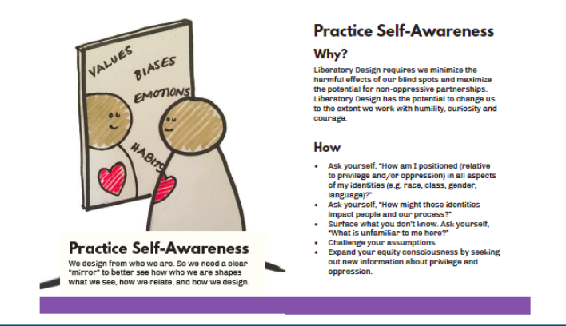
How am I positioned (relative to privilege and/or oppression) in all of my identities (e.g. race, class, gender, language, ability)?
race | class | gender | language | ability
How might these identities impact people and our process?
Notes:
Reflection

Slide 15
What are examples of systemic inequity you and/or your students navigate or deal with regularly?
Do you think people recognize the inequity?
Why does it exist?

Slide 16
How will we make others PART of this DESIGN PROCESS? How will we: stay connected, honor what is shared with us, and engage in collective sense-making?
Is this different/similar than how we’ve worked with stakeholders before? Are there methods that work that we could utilize or tap into? Are there stakeholders we’ll need to build trust with first?

Slide 17
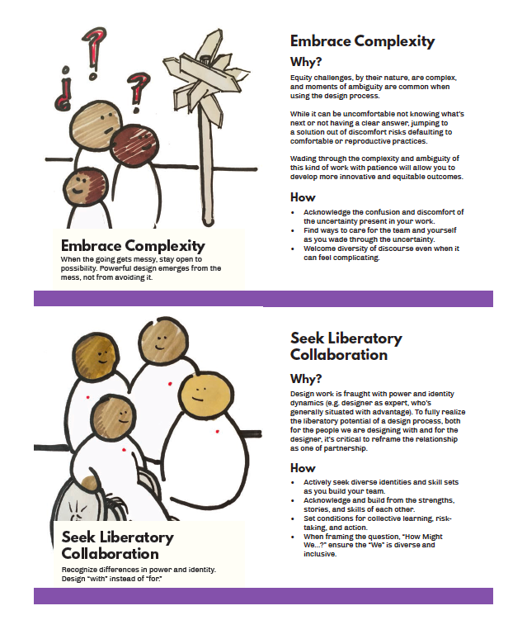

Slide 18
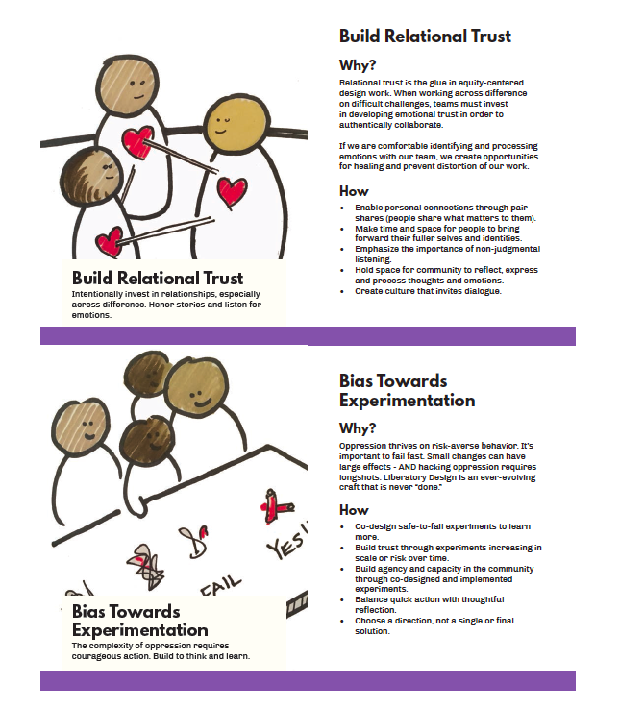

Slide 19
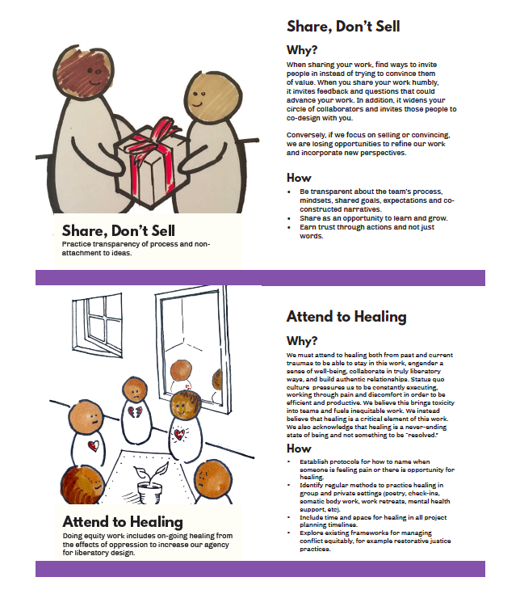

Slide 20
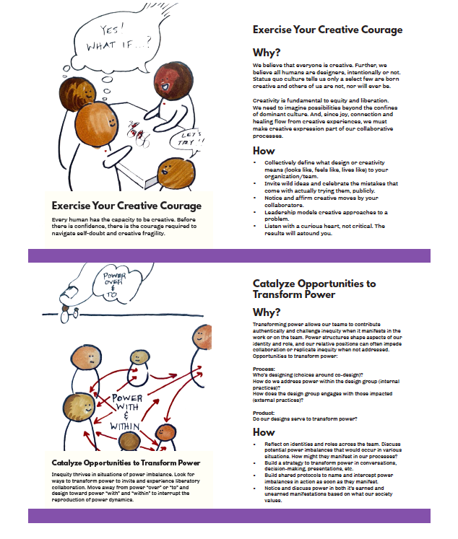

Slide 21
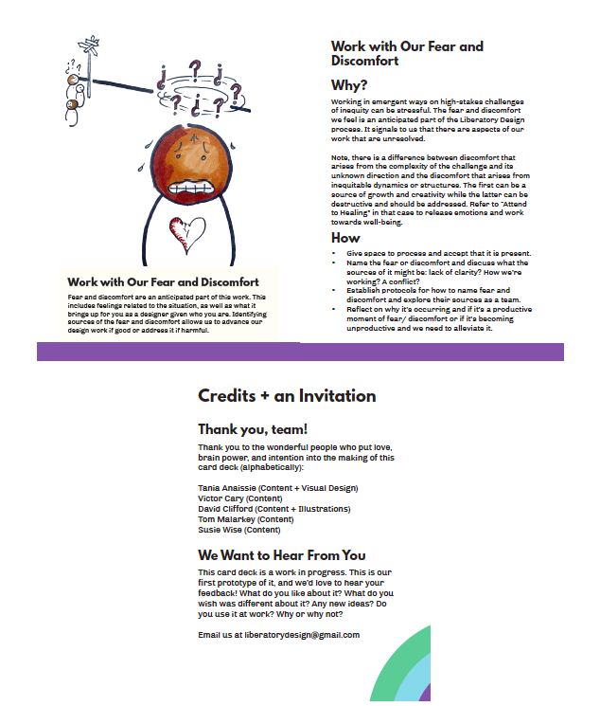

Slide 22
Day 1 - Reflection
What resonates and what feels challenging about what you’ve learned and experienced today?
In what ways do you think your identity (race, class, gender identity, sexual identity, role, etc.) affects what you’re able to see and do in your organization?
Please take a second to fill out the evaluation form emailed to you by VTSS. We would appreciate knowing what worked for you as a learner / practitioner in this work today and what challenges / barriers you ran into.
Thank you for being present and bringing your voice to this important conversation!

Slide 23
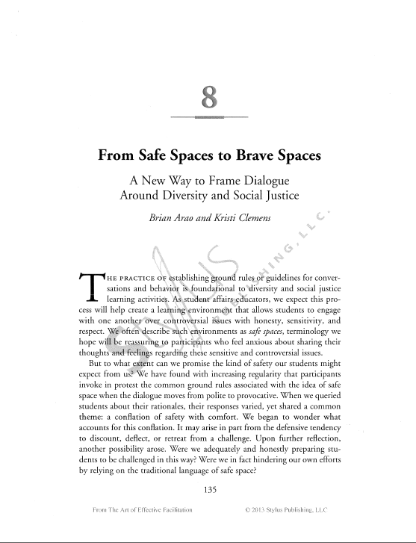
Notes:
Link to PDF of From Safe Spaces to Brave Spaces by Arao and Clemens: from-safe-spaces-to-brave-spaces.pdf

Slide 24
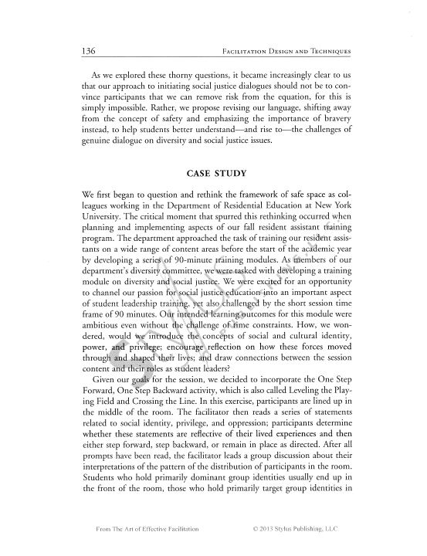
Notes:
Link to PDF of From Safe Spaces to Brave Spaces by Arao and Clemens: https://drive.google.com/file/d/1IKT431tVTs1tB5oHu-X-BKmkTvvPg5hl/view?usp=sharing

Slide 25
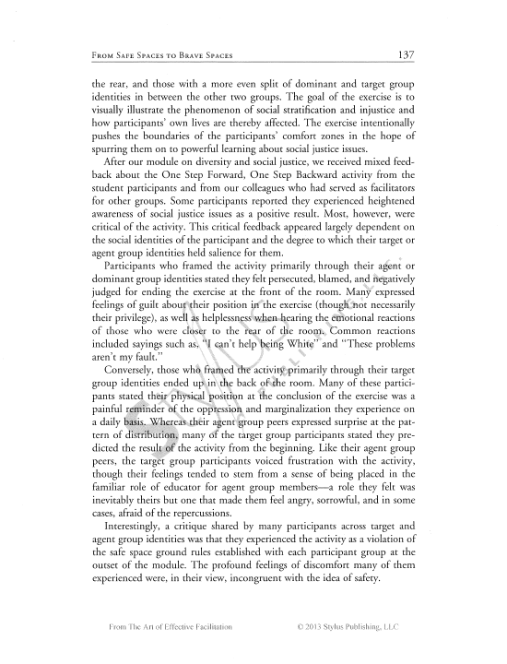
Notes:
Link to PDF of From Safe Spaces to Brave Spaces by Arao and Clemens: https://drive.google.com/file/d/1IKT431tVTs1tB5oHu-X-BKmkTvvPg5hl/view?usp=sharing

Slide 26
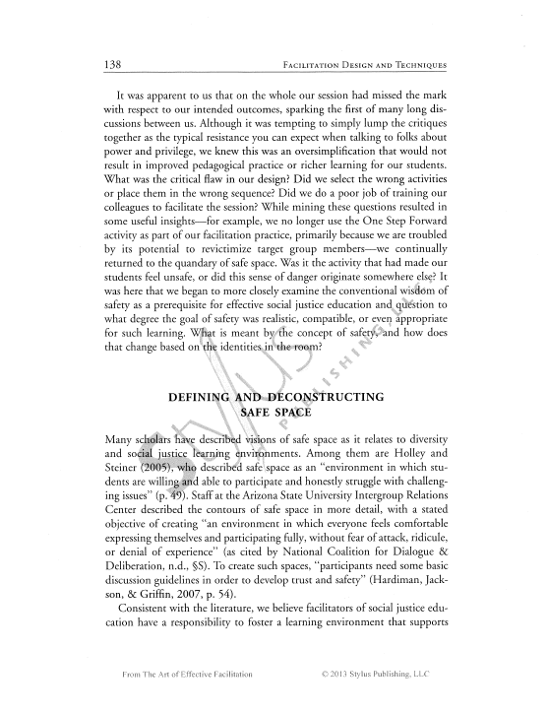
Notes:
Link to PDF of From Safe Spaces to Brave Spaces by Arao and Clemens: https://drive.google.com/file/d/1IKT431tVTs1tB5oHu-X-BKmkTvvPg5hl/view?usp=sharing

Slide 27
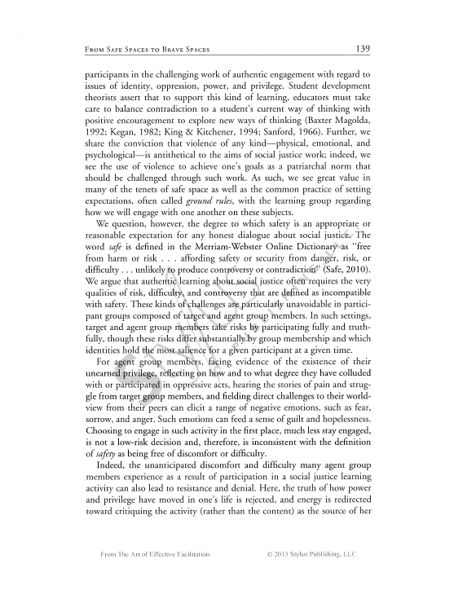
Notes:
Link to PDF of From Safe Spaces to Brave Spaces by Arao and Clemens: https://drive.google.com/file/d/1IKT431tVTs1tB5oHu-X-BKmkTvvPg5hl/view?usp=sharing

Slide 28
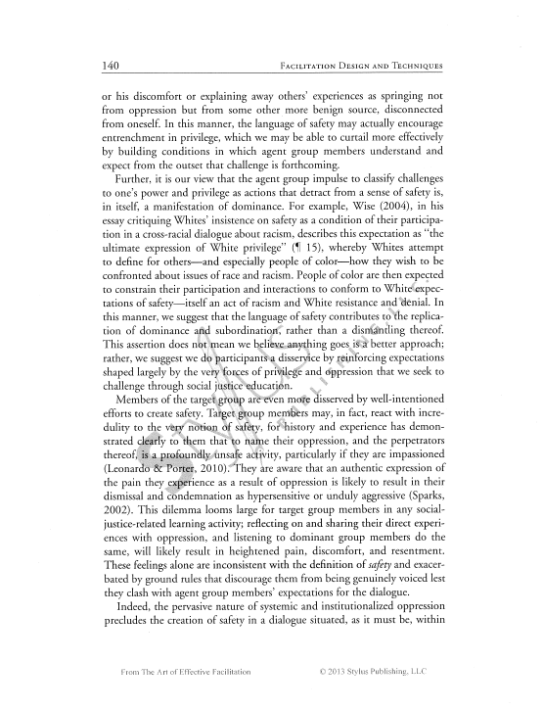
Notes:
Link to PDF of From Safe Spaces to Brave Spaces by Arao and Clemens: https://drive.google.com/file/d/1IKT431tVTs1tB5oHu-X-BKmkTvvPg5hl/view?usp=sharing

Slide 29
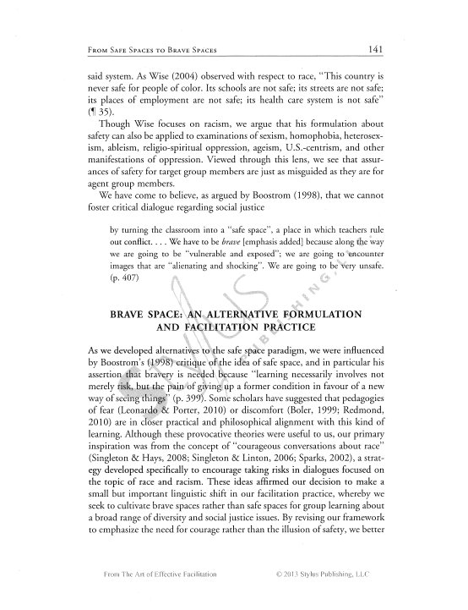
Notes:
Link to PDF of From Safe Spaces to Brave Spaces by Arao and Clemens: https://drive.google.com/file/d/1IKT431tVTs1tB5oHu-X-BKmkTvvPg5hl/view?usp=sharing

Slide 30
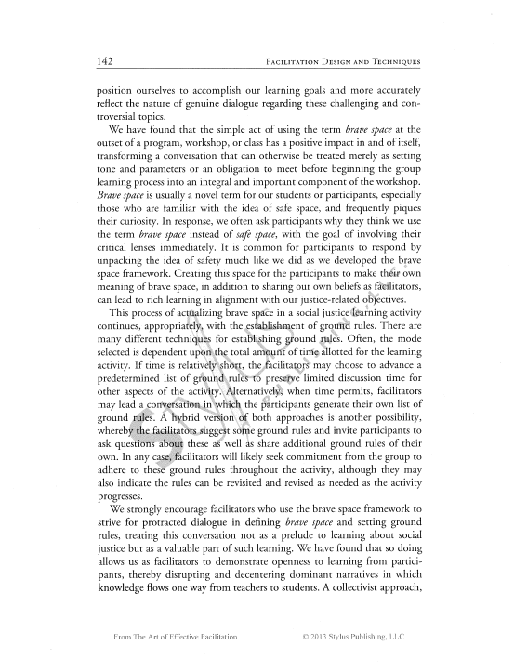
Notes:
Link to PDF of From Safe Spaces to Brave Spaces by Arao and Clemens: https://drive.google.com/file/d/1IKT431tVTs1tB5oHu-X-BKmkTvvPg5hl/view?usp=sharing

Slide 31
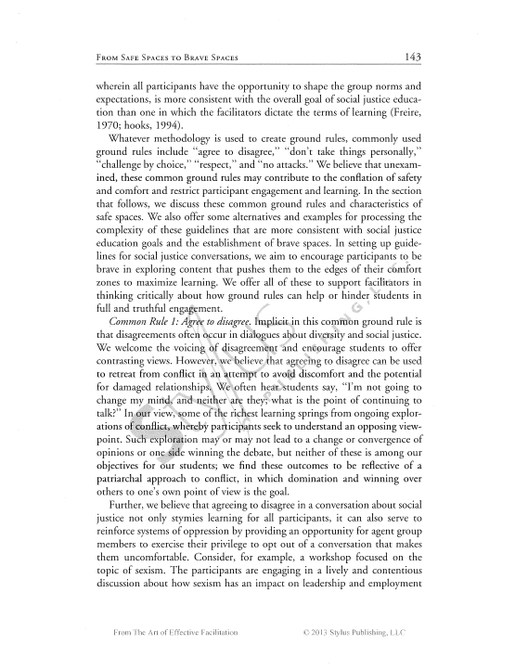
Notes:
Link to PDF of From Safe Spaces to Brave Spaces by Arao and Clemens: https://drive.google.com/file/d/1IKT431tVTs1tB5oHu-X-BKmkTvvPg5hl/view?usp=sharing

Slide 32
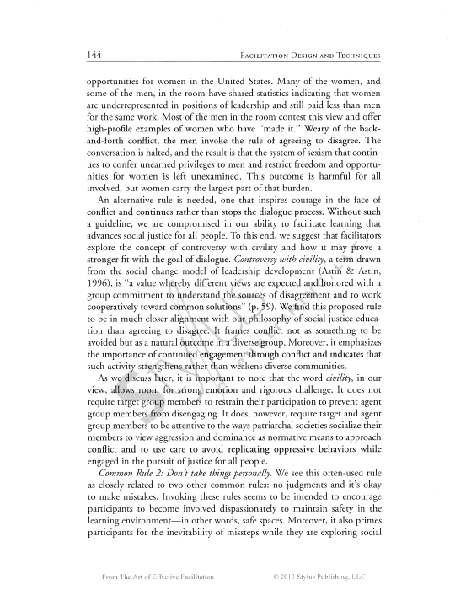
Notes:
Link to PDF of From Safe Spaces to Brave Spaces by Arao and Clemens: https://drive.google.com/file/d/1IKT431tVTs1tB5oHu-X-BKmkTvvPg5hl/view?usp=sharing

Slide 33
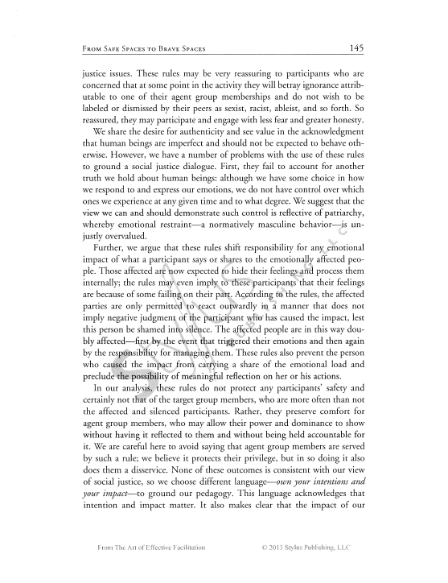

Slide 34
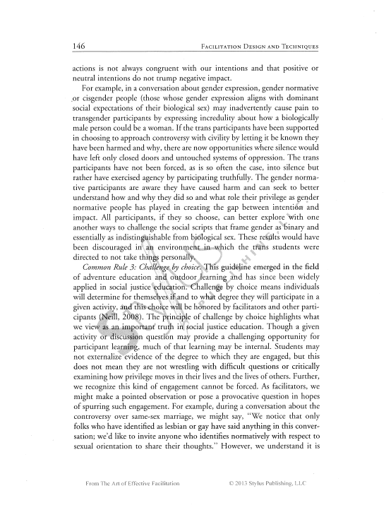
Notes:
Link to PDF of From Safe Spaces to Brave Spaces by Arao and Clemens: https://drive.google.com/file/d/1IKT431tVTs1tB5oHu-X-BKmkTvvPg5hl/view?usp=sharing

Slide 35
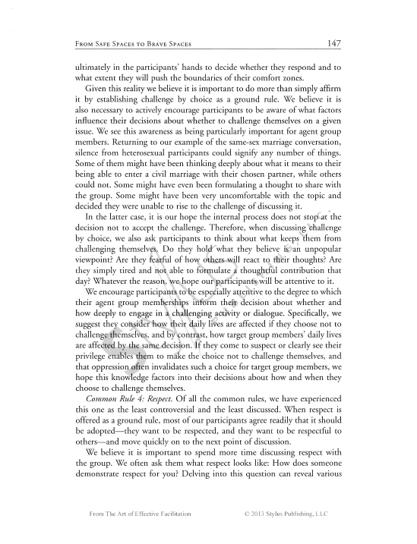
Notes:
Link to PDF of From Safe Spaces to Brave Spaces by Arao and Clemens: https://drive.google.com/file/d/1IKT431tVTs1tB5oHu-X-BKmkTvvPg5hl/view?usp=sharing

Slide 36
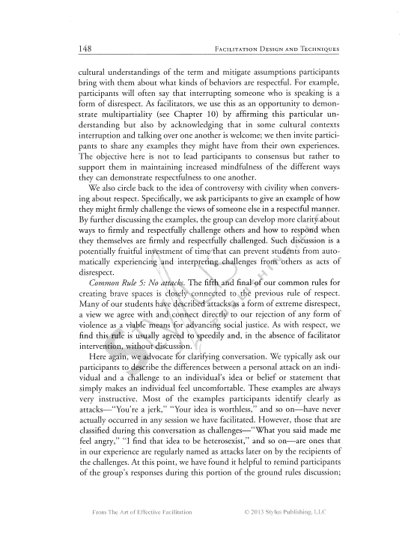
Notes:
Link to PDF of From Safe Spaces to Brave Spaces by Arao and Clemens: https://drive.google.com/file/d/1IKT431tVTs1tB5oHu-X-BKmkTvvPg5hl/view?usp=sharing

Slide 37
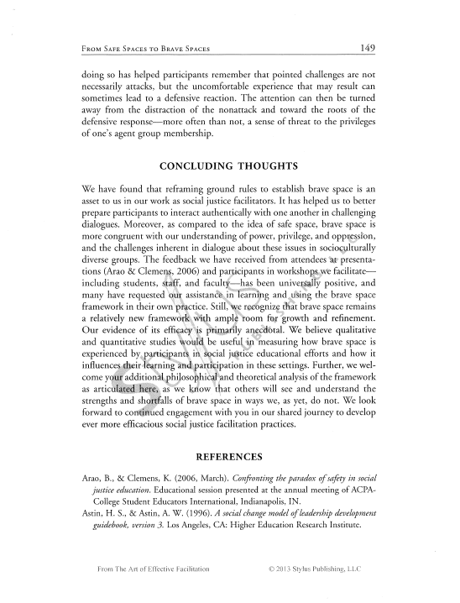
Notes:
Link to PDF of From Safe Spaces to Brave Spaces by Arao and Clemens: https://drive.google.com/file/d/1IKT431tVTs1tB5oHu-X-BKmkTvvPg5hl/view?usp=sharing

Slide 38
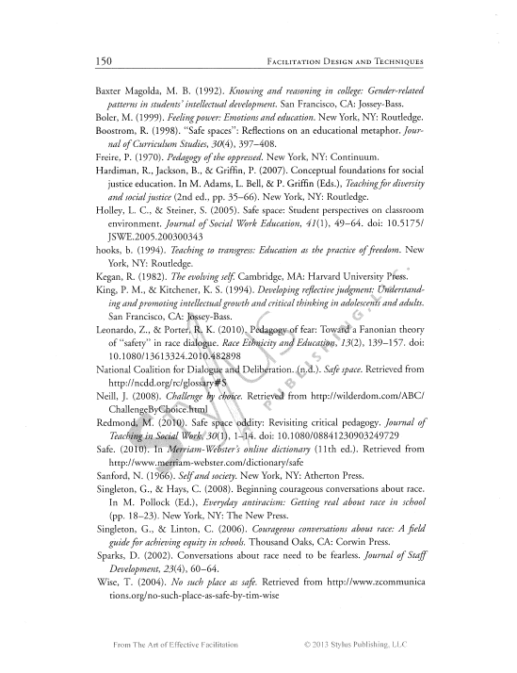
Notes:
Link to PDF of From Safe Spaces to Brave Spaces by Arao and Clemens: https://drive.google.com/file/d/1IKT431tVTs1tB5oHu-X-BKmkTvvPg5hl/view?usp=sharing

Slide 39
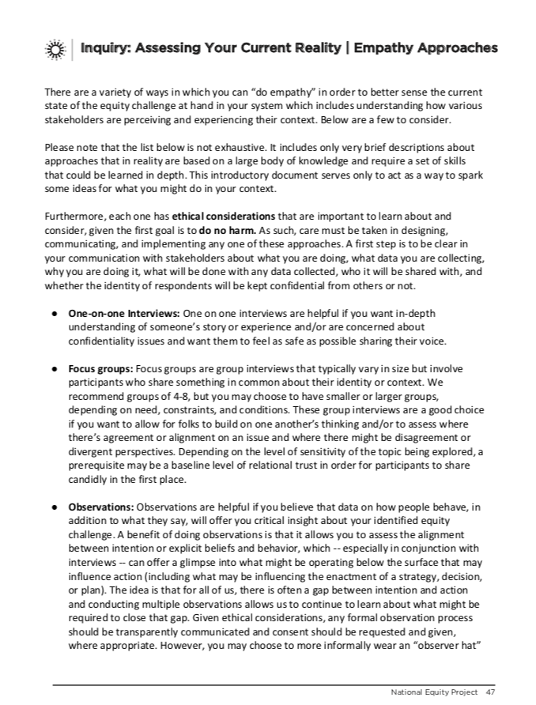
Notes:
Liberatory Design in Complex Systems

Slide 40
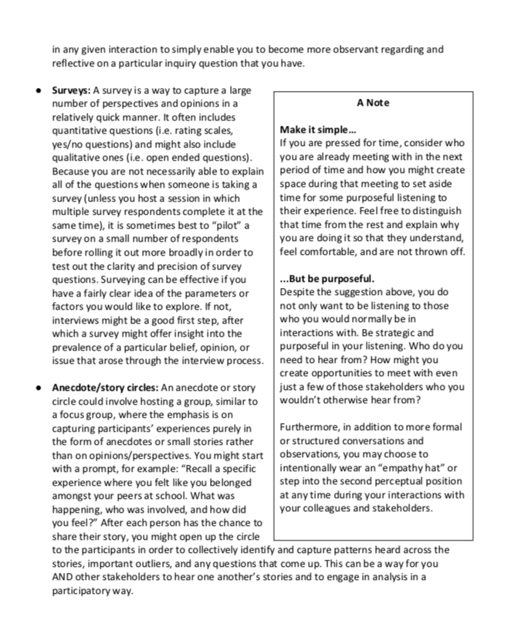
Notes:
Liberatory Design in Complex Systems

