Slide 1
From Starting to Sustaining
Strand 4 Equity
December 1, 2021

Slide 2
As everyone is signing in, please change your name to: division - name (ex. Radford - Tracy).
To do this…
Click on PARTICIPANTS on the bottom bar.
Go to your name and click MORE.
Select RENAME from the drop down menu.
Type in your name - division.

Slide 3
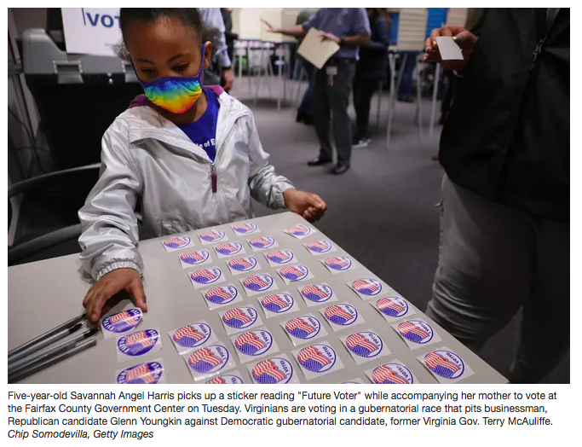
Heart and Mind
Introduce yourself! Share your name, division/school, and position.
Jot down your partner’s name, as they will be your CHAT PARTNER throughout today’s session.
3. Briefly discuss what’s on your heart and mind. There’s a lot going on in the world and in your life. What’s front and center for you right now? (WB 2)

Slide 4
Guiding Questions for Equity Strand
How does awareness, knowledge, and understanding of one’s own racial and cultural identity influence effective teaching, leading, and learning?
How does awareness, knowledge, and understanding of the racial and cultural identity of students and staff promote effective teaching, leading, and learning?
How do we design systems and practices to establish learning environments that are conscious of race and culture to ensure implementation of culturally responsive practices, policies and procedures?

Slide 5
Learning Intentions for Session B
- Continue building understanding of how individual
and collective experiences and biases impact decision-making and outcomes.
- Build consensus around division’s equity challenge
- Identify potential strategies and tools to explore initial
understanding of the equity challenge and refine the areas of need as necessary.

Slide 6
You Spoke, We Listened
More Time | We have built in more time with your teams to discuss and plan. Details on VTSS Community Conversations coming soon!
Explicit Instruction for Breakout Rooms | Slides 2, 13
CRT- How to talk about? | Slides 7-9
Examples from other Divisions | Slides 42-43

Slide 7
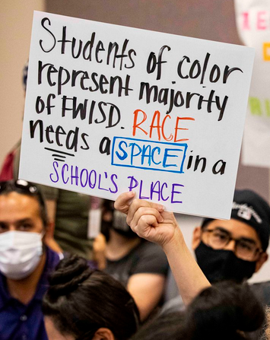
CRT and CRT:How Do We Manage ?
Know the difference between Critical Race Theory and Culturally Responsive Teaching
Critical Race Theory (CRT) is an academic concept that is more than 40 years old. The core idea is that race is a social construct, and that racism is not merely the product of individual bias or prejudice, but also something embedded in legal systems and policies.
(Education Week May, 2021)

Slide 8
CRT and CRT
Culturally Responsive Teaching (CRT) is about improving instruction and helping students of color who've historically been deprived due to structural inequities in our education system become better learners. ( Z. Hammond Nov 1, 2019)
What are you doing where you work? Are you really teaching Critical Race Theory or are you providing culturally responsive instruction? Are the naysayers playing on the acronyms and causing confusion about what is really happening in classrooms?
Knowledge is Power

Slide 9
Workbook and Workspace
Your workspace is a community virtual space for you to work collectively with your division. Click on the WORKSPACE link in the chat box that corresponds with your division. No need to make a copy, you should be able to type directly in each page.

Slide 10
Assumptions
We are all well-intentioned good people who want to see all of our children succeed in school.
No one of us has all of the answers to the many complex questions about difference in a multi-racial, ethnic, and linguistic society.
Some of us would much rather not talk about cultural differences such as race, but we agree to enter into this conversation under the agreement of trust and good will.
Seeking safety in equity dialogues involves being heard, discussing our uncomfortable topics, making room to not know and seek understanding.
We must embrace the inherent risk within the conversations and actions to address disparity.
Workbook Slide 3
(Fergus, 2019)

Slide 11
BEHAVIORS THAT HELP TAKE CONVERSATION TO A DEEPER REALM:
We acknowledge one another as equals.
We try to stay curious about each other.
We recognize that we need each other's help to become better listeners.
We slow down so we have time to think and reflect.
We remember that conversation is the natural way humans think together.
We expect it to get messy sometimes.
The Art of Conversation (adapted from Margaret Wheatley)

Slide 12
VTSS Matrix Connections
3.C Continuum of Supports that is Culturally Responsive (Clearly defining the practices and programs supported by the division and ensuring they are culturally responsive) | The DLT maps the current reality of existing practices and programs and reviews them for evidence of effectiveness. The DLT explores cultural and linguistic factors when adopting academic/social behavioral practices, programs, and assessments. | Upon completion of the review, the DLT seeks stakeholder input, investigates practices for which needs are identified, and makes purchases and/or withdraws programs as appropriate. The DLT and SLT use a selection tool, which prompts analysis for cultural context. | The DLT maintains an inventory of EBPs and materials in a continuum of supports. A clearly defined continuum of supports is maintained in tier definition or separate document. | All instructional staff and stakeholders are aware of and able to utilize the continuum of supports for the purpose of providing an appropriate instructional match to meet the needs of all learners. | DCA: 6, 7 TFI: 1.6, 1.10, 1.11, 2.5, 3.6 A‐TFI: 1.3, 1.4c, 1.8, 1.9, 2.1, 2.4, 2.5, 3.1
Equity applies throughout the VTSS Matrix: 1B, 1C, 1D, 1F, 2A, 2B, 3A, 3B, 3C, 3D, 3E, 4B, 6A, 6B.
You can also find it in the DCA Items: 5, 6, 10, 11, 14, 15, 18, 19, 21

Slide 13
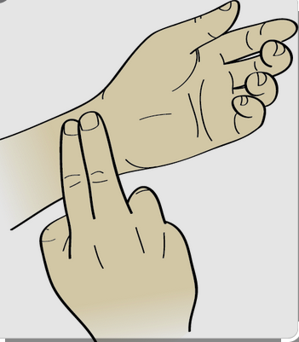
Pulse Check
What is the current climate regarding equity within your division? Schools? Community?
What CAN you do right now? What are some of the limitations you have right now?
Directions on Workspace Page

Slide 14
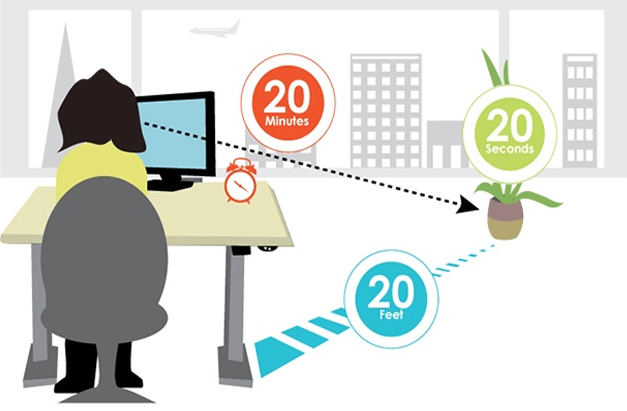
Remember the 20/20/20
We tried to time our breakouts about 20 minutes apart. Before joining the breakout rooms today, practice the 20/20/20 eye care practice.

Slide 15
Headlines

Slide 16
Education Equity in Virginia

Slide 17
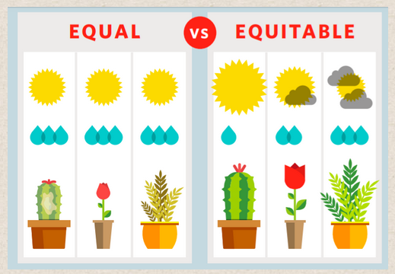
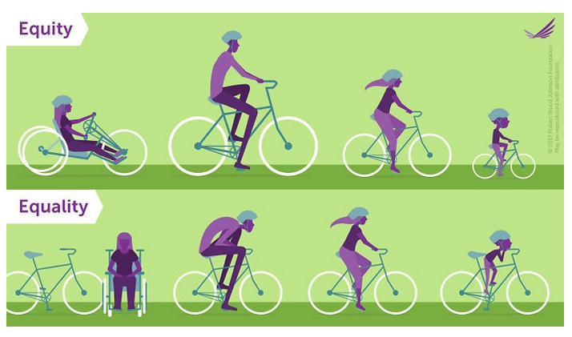
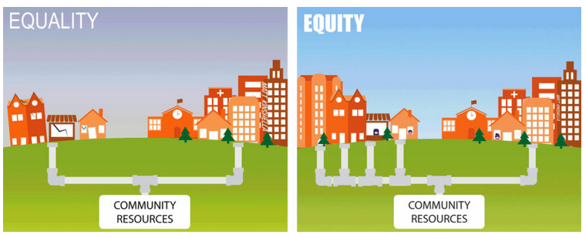
Equality vs Equity
Which one of these images (if any) do you think best represents your understanding of educational equity? How about your division’s vision of educational equity?

Slide 18
Believe
Directions on Workspace Page

Slide 19
EdEquity Audit
EdEquity Audit
Do we have a mission that clearly articulates our equity goal?
Does our mission statement articulate equitable outcomes for all students regardless of race/ethnicity, gender, native language, ability/disability, gender identity, sexual orientation, and socioeconomic status?
Is the mission statement shared regularly with: Staff? Students? Families? Community Stakeholders?
Did all component groups (the staff, parents, students, and community stakeholders) participate in the development of the mission statement?
EdEquity VA - Equity Audit Tool

Slide 20
National Equity Project’s (partial) “map” of Liberation...
Awareness of the reality of systemic oppression - and agency to interrupt it...
INTERNAL
EXTERNAL
Recognizing identity & difference
Discourse 2
Equity-centered policies & practices
Community Agreements
Institutional
Individual
Interpersonal
Equity-centered design & learning
Recognizing and owning our privilege & disadvantage
Equitable outcomes
Alliances (across & within difference)
Organizing & Protest
Reflection & Self-inquiry
Constructivist Listening
Structural
Systems of government
Learning (read, watch, talk)
Notes:
Workbook slide 24 for reference.

Slide 21
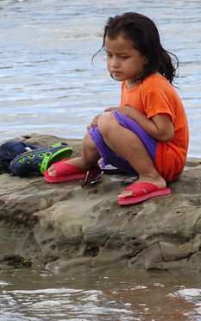
Notice and Reflect
Practice self-awareness (own identity, values, emotions, bias, power, assumptions)
Collectively build situational awareness (context, people, power, history, current state)
Pause midstream to reflect on actions, impact, emotions, relationship
Adjust our intentions, presence, direction
National Equity Project - Liberatory Design in Challenging Times Webinar

Slide 22
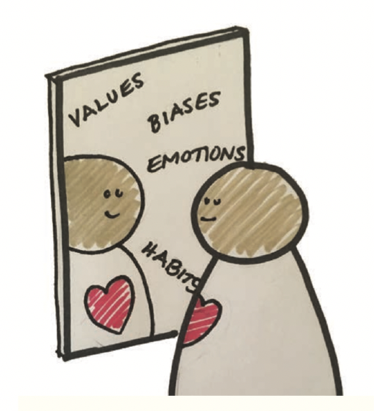
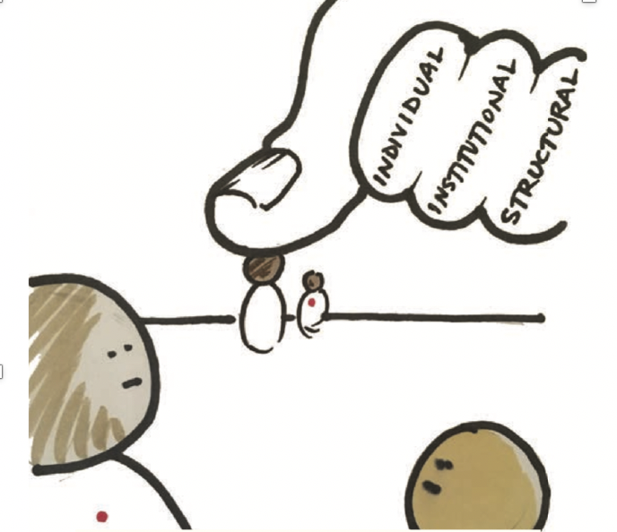
Mindsets to Be Aware of...
Practice Self Awareness
who we are shapes what we see, how we relate, and how we design
Recognize Oppression
we need a clear “window” to see how oppression may be at play in our context
National Equity Project - Liberatory Design Resource Guide

Slide 23
VTSS Data-Informed Decision Making

Slide 24
Visual Representation of VTSS Data Informed Decision Making Process
Visual Representation of VTSS Data Informed Decision Making Process
Identify data / evidence of need
Create progress monitoring plan
Develop a precision statement
Collect and Use Data
Identify key systems for adults
Set a goal based on student outcome data
Identify key practices for students

Slide 25
Identify data / evidence of need
Identify data / evidence of need
Create progress monitoring plan
Develop a precision statement
Collect and Use Data
Identify key systems for adults
Set a goal based on student outcome data
Identify key practices for students

Slide 26
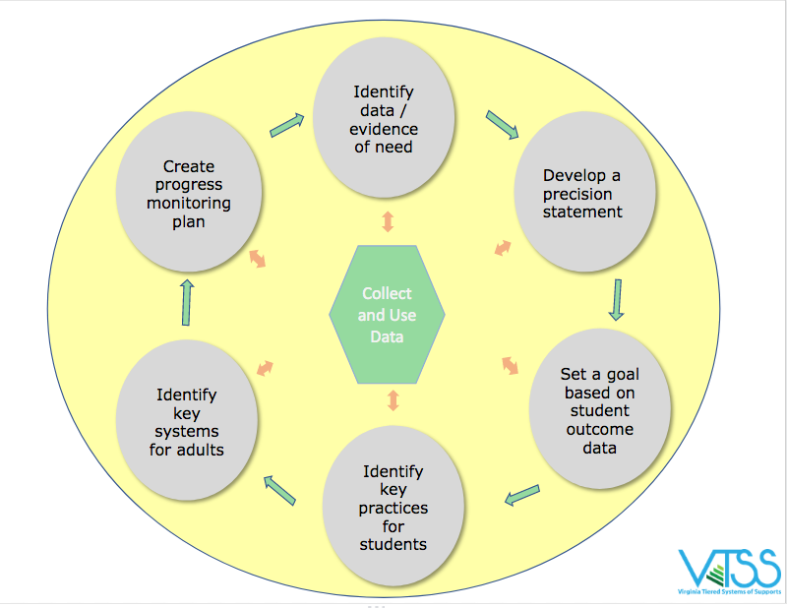
What equity challenges did your big data reveal?
DATA/Evidence of Need:
Do we have an equity problem/challenge?
Compare your subgroups with...
your entire student population and/or that of the dominant group.
the same subgroups within your region, the state and/or nationally.
regional / state / national preferred/expected status.
Identify data / evidence of need
What equity challenges did your big data reveal?
What inequities (patterns of outcomes and experiences) are happening?

Slide 27
DATA/Evidence of Need
DATA/Evidence of Need:
Do we have an equity problem/challenge?
Compare your subgroups with...
your entire student population and/or that of the dominant group.
the same subgroups within your region, the state and/or nationally.
regional / state / national preferred/expected status.
Identify data / evidence of need
Hint: It is NOT the kids or their families.

Slide 28
What gets in the way of educational equity?
What gets in the way of educational equity?
Color Blindness
Biased Based Beliefs
Deficit Thinking
Poverty Disciplining

Slide 29
Color Blindness
racial “colorblindness” — the idea that ignoring or overlooking racial and ethnic differences promotes racial harmony
does not recognize the systemic inequities that hinder students of color
assumes an equal playing field
Scruggs 2009

Slide 30
Deficit Thinking Ideology
Discounts the presence of systemic inequities as the result of race-based processes, practices, and policies
Blames a group for the conditions they find themselves experiencing

Slide 31
Poverty Disciplining
Assuming that students and families from low socio economic backgrounds lack the motivation, desire, and social emotional skills to change their financial situation.
Discounts the systemic barriers that impede them obtaining financial solvency.

Slide 32
What are examples of biased based beliefs
What are examples of biased based beliefs (color blindness, deficit thinking, poverty disciplining) that you’ve seen or heard in your school / district?
Directions on Workspace Page

Slide 33
How are they linked?
We know from prior research that teacher ideologies and beliefs about the student population they serve can have a positive or negative effect on the student outcomes via the actions and behaviors teachers choose to employ in the classroom.
Madon, Jussim, & Eccles, 1997;
Madon et al., 1998; Madon et al., 2001; Proctor, 1984

Slide 34
Microaggressions
Microaggressions:
Brief and common daily verbal, behavioral, and environmental communications, whether intentional or unintentional, that transmit hostile, derogatory, or negative messages to a target person because they belong to a stigmatized group.
Microaggressions are the physical manifestation of biases.

Slide 35
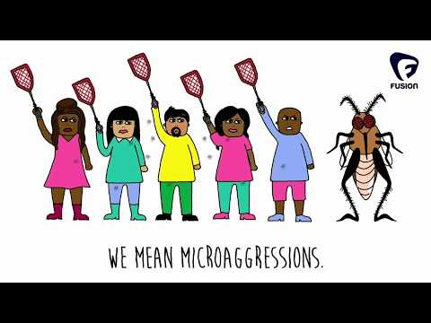
Microaggressions Example

Slide 36
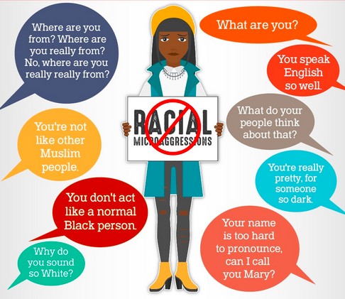
students’ responses to microaggressions
How might students’ responses to microaggressions lead to black students having a 3.1 risk ratio for being chronically absent or a 2.7 risk ratio for # of ODRs?

Slide 37
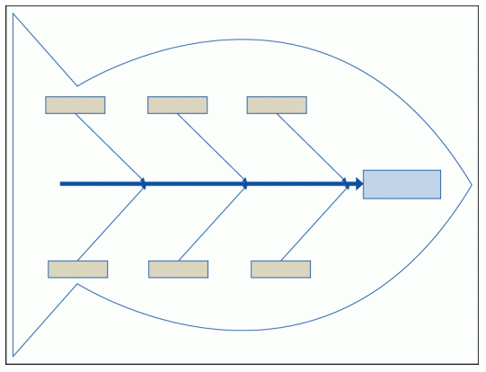
Fishbone Diagram

Slide 38
House Bill 2305
Requires BOE to provide guidance to assist Academic-Year Governor’s Schools (AYGS) to increase access for historically underserved students.
Passed in House on January 19, 2021
“Passed by indefinitely” in Senate on February 18, 2021

Slide 39
Applicants to Governor’s School
 | Am. Indian/ Alaska Native | Asian | Black | Hispanic | White | Multi | Total Population
Total # of students | 22 | 123 | 636 | 1290 | 4152 | 373 | 6600
% of students | .3% | 2% | 9.6% | 19.5% | 63% | 5.6
# of students who applied | 0 | 12 | 6 | 4 | 44 | 3 | 69
% of students who applied | 0 | 17% | 8.6% | 5.70% | 63.70% | 4.3%

Slide 40
Fishbone Diagram Disproportionality of Black and Latinx students applying
Awareness/Communication
Misconceptions/Perceptions/Attitudes (Positive/Negative)
Recruitment Processes
Students/peers
Parents/guardians
Parents
Misinformation/Technology
Students
Base School Teachers/Counselors
Disproportionality of Black and Latinx students applying
Why? Purpose
Work load/Time/Effort
Community/Outreach
Cultural (ethnic, religious, socio-ec) Norms
Money
Measurements
Support
Goal Setting/Value
Self/Others
Timeline
Transportation
Basic Needs,(lunch/breakfast)
Support/Process
Time (commitments)
Accessibility
Base School
Internal/External Student Barriers
Application Process

Slide 41
5 Whys
There’s a disproportionality of Black and Latinx students applying to GS.
Why?
Black and Latinx students don’t know about GS.
Why do Black and Latinx students not know about GS?
GS is only advertised in the higher level math classes, so it misses a lot of students.
Why is GC only advertised in higher level math classes?
Schools believe that only students in higher level math classes can be successful at GS.
Why do schools believe that only students in higher level math classes can be successful at GS?
Schools equate ability and desire to take higher level math classes with the same abilities and desires of GS students.
Directions on Workspace Page

Slide 42
Identify data / evidence of need II
To truly understand the problem/challenge we have to gain insight from those affected by the problem/challenge.
They can help us understand:
What does this problem look/sound/feel like for them?
Who is this problem affecting and in what way?
When is this problem affecting them more? the least?
Where do they experience this problem the most?
Why do they think this problem is occuring?
Identify data / evidence of need

Slide 43
Key Takeaways...
“I think if there had been a little more help to know the dates and reminders - I know it's great for kids to be responsible, but they're also younger, so they’re not as responsible.”
“I got some help from my English teacher for the essay. She helped to guide me through it and it was really helpful.”
“I was applying with a group of friends, so we were all editing each others papers and just kind of reading them over. So it really wasn't too bad.”
“in my French class a peer of mine was interested in applying, but he had never heard of it and by the time the application process was done, it was too late for him.”
Exposure to Governor’s School (information, connection to Governor’s School students, site visit) and having the skill to complete the application seem to be more of a determining factor of applying than the application criteria itself.

Slide 44
Key Takeaways...
“I’m the president of a club at my school, I work a job two or three days a week, I’m on the Executive Board of this international program. I think that it's fine. I've got tons of time to still be my friend. I have watched literally countless Netflix shows, so I don't think that it has gotten in my way at all. I’m still maintaining all A's.”
“It is not too much more work than similar classes at X school, but it is definitely a different experience and the environment has people that tend to be more stressed or conscious of what they need to do and get it done.”
Governor’s School is perceived by both GS students and their base school peers as a time intensive, driven, academically focused place to be, but there are a lot of supports to make it manageable (which non-GS are not aware of).

Slide 45
Governor’s School
“People think Governor’s School is only for the ‘smart kids.’ But anyone can succeed here, they just have to want to. It takes time and effort, but Governor’s School teachers will stick with you until you get.”

Slide 46
What are the underlying factors influencing why our data looks the way it does?
How are those being affected by the problem experiencing it?
Tools we could use to figure it out…
Equity audits (curriculum, policies, budget, etc.)
Empathy interviews
Focus groups
Observations
Surveys

Slide 47
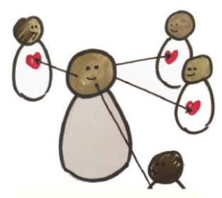
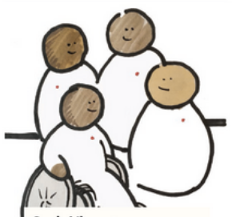
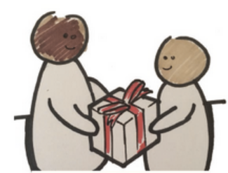
Underlying Factors
Focus on Human Values
Seek Liberatory Collaboration
Share, Don’t Sell
Seek as many ways as possible to get to know your end users including immersion, observation and co-design.
Recognize differences in power and identity. Design “with” instead of “for”.
Practice transparency of process and non-attachment to ideas.
National Equity Project - Liberatory Design Resource Guide

Slide 48
Next Steps...
Choose at least one to tool utilize to dig deeper into your problem.
Create a plan to determine:
How will the tool be utilized?
Who will be responsible for collecting data with the tool of
your choice?
When will they collect data?
When will that data be share with the group?
Complete a fishbone diagram for your potential problem. Add any additional ideas you gleaned from the data collected.
Create a plan to construct or revise an equity vision / mission / We Believe statement
Directions on Workspace Page

Slide 49
Notice and Reflect
-Who are we as a team, relative to those whose needs we’re designing for?
-How are we seeing power here?
-What emotions are up for us in this design situation?
-What mindsets feel important now?
-How did we experience this process?
-What cultural norms and biases may have been at play?
-What do we want to adjust?

Slide 50
Spotlight on Youth Voices

Slide 51
Please complete the Exit Ticket for today: https://forms.gle/wwxA6gdCcneH9sXEA
Notes:
Exit ticket - https://forms.gle/wwxA6gdCcneH9sXEA

Slide 52
References
Cary, V,. & Malarkey, T. (2020, April 17). Liberatory design in
challenging times [Webinar]. National Equity Project.
https://www.nationalequityproject.org/webinar-recordings
Feldman, J. (2019, February 10). Why it’s crucial-and really hard-to talk
about more equitable grading. MindShift.
https://www.kqed.org/mindshift/52679/why-its-crucial-and-really-hard-to-talk-about-more-equitable-grading
Fergus, E. (2017). Solving disproportionality and achieving equity: A
leader’s guide to using data to change hearts and minds. Corwin
Press.
Fergus-Arcia, E. (2019, September). Solving disproportionality and
achieving equity: Session I [PowerPoint presentation]. Presented at
the VTSS Coaches’ PLC meeting, Richmond, VA.

Slide 53
References Continued
Madon, S. J., Jussim, L., & Eccles, J. (1997). In search of the powerful
self-fulfilling prophecy. Journal of Personality and Social Psychology,
72, 791-809. https://doi.org/10.1037/0022-3514.72.4.791
Madon, S. J., Jussim, L., Keiper, S., Eccles, J., Smith, A., & Palumbo, P.
(1998). The accuracy and power of sex, social class, and ethnic
stereotypes: A naturalistic study in person perception. Personality & Social Psychology Bulletin, 24(2), 1304. https://doi.org/10.1177/01461672982412005
Madon, S. J., Smith, A., Jussim, L., Russell, D. W., Eccles, J., Palumbo,
P., & Walkiewicz., M. (2001). Am I as you see me or do you see me
as I am? Self-fulfilling prophecies and self-verification. Personality
and Social Psychology Bulletin, 27, 1214-1224.
https://doi.org/10.1177/0146167201279013

Slide 54
References Completed
National Equity Project. (2020). Resources.
https://www.nationalequityproject.org/resources
Proctor, C. P. (1984). Teacher expectations: A model for school
improvement. The Elementary School Journal, 84(4), 468-481.
https://doi.org/10.1086/461377
Scruggs, A. E. (2009). Colorblindess: The new racism? Teaching
Tolerance, 36, 45-47. https://www.tolerance.org/magazine/fall-2009/colorblindness-the-new-racism
Virginia Department of Education (2020). Navigating EdEquity
VA-Virginia’s roadmap to equity. http://www.virginiaisforlearners.virginia.gov/edequityva/

