Slide 1
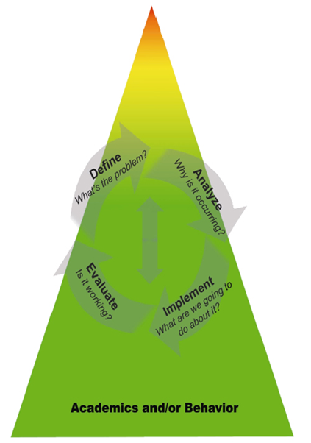
Engaging Families Throughout the Tiered Model
Efforts to Engage Families
Data about Family Engagement Efforts
Engaging Families at Tier 3:
Data about Tier 3 Efforts:
District Level
School Level
Engaging Families at Tier 2:
Data about Tier 2 Efforts:
Engaging Families at Tier 1:
Data about Tier 1 Efforts:
Responsive to Family and Student Needs
Notes:
Intent:
Talking Points: Activity- School level
Which tier is strongest for students?
Which tier is strongest for families?
Revisit their goals and results of IC: where do they want to start engaging families?
Training Activity:

