Slide 1
Strand 5: Family Engagement
March 2, 2022
9:00 - 12:30

Slide 2
Virtual Norms
Community Norms | Overall | Chat | Breakouts
Be Responsible | Use a shared action plan for your team Complete evaluation Set dates/times with your team to continue action planning | Post positive on-topic comments Post questions in the Chat Box | Take part in breakout activities and polls
Be Respectful | Limit distractions Follow up on your assigned action items Please mute your sound | Use inclusive language | Respond courageously Please unmute and share your video in breakouts
Be Safe | Take movement breaks Be aware of your stress level | Engage in productive dialogue | Ask solution oriented questions
For Presenters | Provide access to current materials | Monitor chat box to respond to participants | Provide break-out directions in chat box, once assigned

Slide 3
Resources for Today
Please see the chat box for all the materials you’ll need today!
Record your Attendance

Slide 4
It’s Read Across America Day!
How could you use Read Across America Day to encourage family engagement?

Slide 5
Strand 5
In this strand, participants will explore six essential elements of meaningful family engagement in multi-tiered systems of supports that deepen family and school commitment to collaborative and equitable partnerships while increasing specific student and family outcomes across domains.

Slide 6
Let’s Learn From Each Other!
1. Positive Relationships
2. Family Empowerment
3. Leadership
4. Multi-tiered & Multidimensional Approach
5. Data-based Goals & Outcomes
6. Collaborative Problem-Solving

Slide 7
Show and Share
family data collected, how and where shared, and how used
family collaboration successes
progress in ensuring family voice on your VTSS leadership team

Slide 8
Partnering with Families for Student Success, P. Edwards, et al.
Involving and Empowering Caretakers

Slide 9
Breakout Process for Scenario
Read context and scenario
Discuss, using guiding questions
Discuss what would be your first priority
Plan what you will share when you return to the main room

Slide 10
Break

Slide 11
Show and Share #2
family data collected, how and where shared, and how used
family collaboration successes
progress in ensuring family voice on your VTSS leadership team

Slide 12
Partnering with Families for Student Success, P. Edwards, et al. (2)
Caregivers with Complex
Job Situations

Slide 13
Breakout Process for Scenario #2
Read context and scenario
Discuss, using guiding questions
Discuss what would be your first priority
Plan what you will share when you return to the main room

Slide 14
Application to Your Work
“These scenarios help build confidence and sensitivity when interacting with caregivers and families.”

Slide 15
Break #2

Slide 16
Share out

Slide 17
Family Engagement in VTSS Videos

Slide 18
Team Time

Slide 19
Worksheet & Action Plan

Slide 20
Re-framing
From:
To:
outsiders
listen to respond
schools as sole holder of expertise
insiders
listening genuinely to understand
co-construct
equitable collaboration means first learning from families
dynamics of power are “baked in” to the conversations
Adapted from Just For Schools

Slide 21
Systems-based Co-design
recognize how positionality impacts power dynamics and trust
lean into tensions and disrupt hierarchical “business as usual”
sustain and advance the conversation over time through iterative feedback loops
Adapted from Just For Schools

Slide 22
New Rules of Engagement
“Despite an abundance of good intentions, engagement approaches largely enact a theory of change focused on ‘fixing’ marginalized parents and families.”
Adapted from Just For Schools

Slide 23
Team Action Planning
Action Plan 4: Family, School, and Community Partnerships: The collaboration of families, schools, and communities as active partners in improving learner, classroom, school, division, and state outcomes
Worksheet & Action Plan

Slide 24
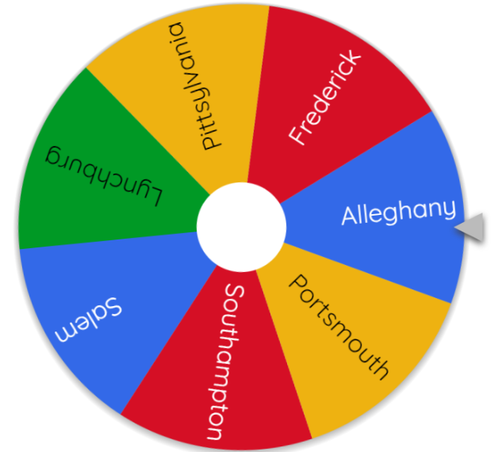
What action item have you chosen?
https://wheelofnames.com/7rb-guz

Slide 25
Thank you!

Slide 26
Help us Grow

