Slide 1
Systems Coaching Institute 101
December 2024
Virtual

Slide 2
VTSS IS WHO
WE ARE!
MTSS IS WHAT WE DO!

Slide 3
Virtual Community Agreements
Be Responsible:
Take care of your needs
Share your questions with the group
Be Respectful:
Turn volume/sound off on cell phones
Listen to others attentively
Follow up and complete assigned tasks
Be Engaged:
Please keep your video on as much as possible
Ask what you need to know to understand and contribute
Share your expertise, information and ideas

Slide 4
Systems Coaching Institute 101 Learning Intentions
Day 1
Examine, understand and apply “systems” in education, systems change, and addressing complex change
Understand how the MTSS framework can be applied to any initiative
Understand the Role & Responsibilities of a Division Systems Coach
Develop knowledge of VA’s MTSS 5 Core Components and their Features 2.0 and tools to support implementation

Slide 5
Systems Coaching Institute 101 Learning Intentions
Day 2
Continue to apply a systems coaching lens to Core Component 1 - Aligned organizational structures with a focus on Workforce Capacity- Features: Professional Learning, Routines and Procedures and Coaching
Develop conceptual understand and skill acquisition of effective communication skills and their place within aligned organizational structures
Complete a Coaches Self-Assessment (from Teaming Book, Aguilar)

Slide 6
Materials
Materials link:
https://tinyurl.com/4pp6zku3

Slide 7
Who is in the room today?
Tell us your role in your division.
How many years have you been in that position?
On a scale of 1 (a little) to 5 (got this),
how confident are you feeling today in your role in the implementation process of Multi-tiered Systems and Supports?

Slide 8
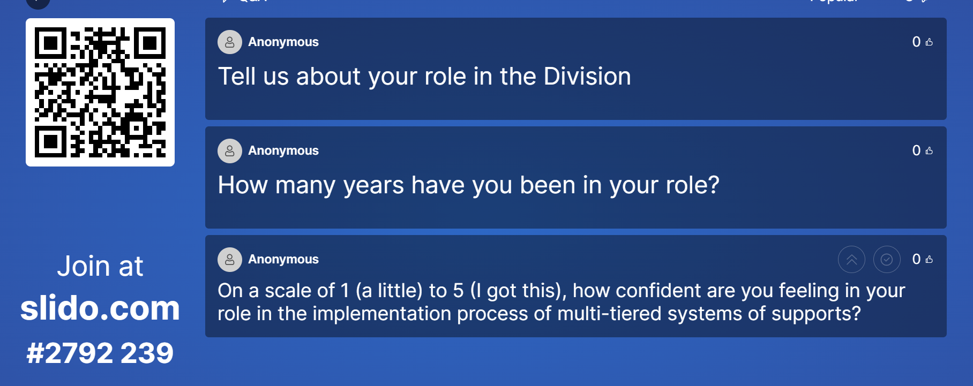
Slido Response

Slide 9
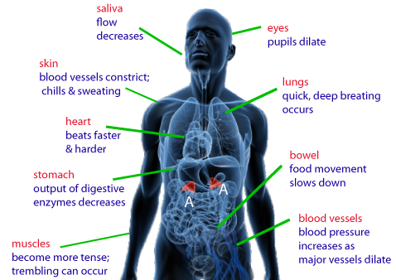
Welcome:
Systems Check

Slide 10
What is an
MTSS Systems Coach?
A Systems Coach serves as a liaison for the division leadership team (DLT) and the school’s leadership team(s) (SLT) to guide sustainable organizational change to implement MTSS and to guide systems intervention at the school level.
A systems coach facilitates systems thinking.

Slide 11
Goals of Systems Coaching
Improve Division Systems & Build Local Capacity
Improve PreK-12 classroom & school Systems & Practices
Improve Student Outcomes

Slide 12
What knowledge and skills will you need?
Expertise in systems thinking, organizational change, and implementation science
MTSS content knowledge and coaching skills for implementation of practices
Ability to build the capacity of others in the practice of reflection through data-informed decision-making and a commitment to sustainable change

Slide 13
Systems in Education
What are some systems you see in an educational system?

Slide 14
What is Systems Change?
A system is a set of interacting or interdependent component parts forming a complex/intricate whole.
Systems thinking allows us to understand that all the components of a system are related and need to be assessed to ensure they are not getting in the way of successful student outcomes.
System change aims to bring about lasting change by altering underlying structures and supporting mechanisms which make the system operate in a certain way. These can include policies & regulations, processes and procedures, relationships, resources (human, fiscal and material), power structures and values.

Slide 15
The Three Principles that Guide Systems Coaches’ Work
Principle 1: Understand the system to understand outcomes.
Principle 2: Systems-level change is an intentional and continuous process.
Principle 3: Systems-level change is an adaptive challenge.

Slide 16
Let’s Talk Principle 1
Understand the system to understand the outcomes
What do systems-level principles mean to me?
Is the idea of seeing the systems new for you, or are you familiar with the concept?
Why do you think seeing the system is important to coaching?
How would you explain the concept of a system to a team?
Coaching for Systems and Teacher Change
Jennifer Pierce; Kimberly St. Martin

Slide 17
COMPONENTS OF A SYSTEM
A constellation of parts
HUMAN RESOURCES
MATERIAL RESOURCES
Education System
FISCAL RESOURCES
$$$$$$
PROCESSES AND PROCEDURES
POLICIES AND REGULATIONS
Handout with examples
Adapted COACHING FOR SYSTEMS CHANGE-PIERCE AND ST.MARTIN 2023

Slide 18
Scenario
Reading the scenario about Greenleaf with your breakout group, pause at each question or statement.
Have a recorder write the systems component (1-5) that is the best fit.
Material Resources
Human Resources
Processes and Procedures
Policies and Regulations
Fiscal Resources

Slide 19
The “work” doesn’t work without systems
Division leadership teams with the help of division systems coaches must be aware of the multiple systems at work within the division.
They must continually analyze the health of those systems through a variety of data points.
Coaching is one of those systems!

Slide 20
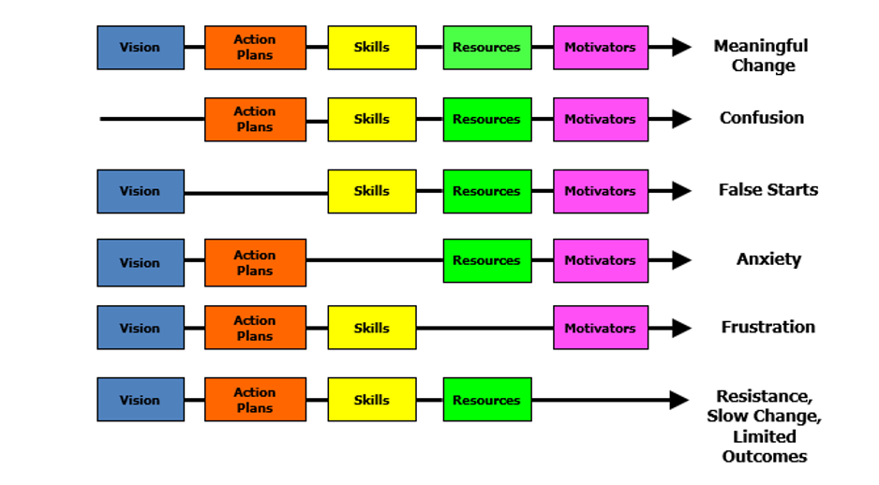
Managing Complex Change
Source: Adapted from Knoster, T., Villa R., & Thousand, J. (2000). A framework for thinking about systems change. In R. villa & J. Thousand (Eds.), Restructuring for caring and effective education: Piecing the puzzle together (pp. 93-128). Baltimore: Paul H. Brookes Publishing Co.

Slide 21
MTSS Implementation to Coaching
WHAT:
MTSS Implementation
HOW:
Coaching
Skills

Slide 22
Multi-Tiered Systems of Support (MTSS) Defined
MTSS is a systemic, data-driven approach that allows divisions and schools to provide evidence-based practices and interventions to meet the needs of their students. This is done through a clearly defined process that is implemented to fidelity by all stakeholders within the school and/or division.
(2024)

Slide 23
MTSS Framework
‹#›

Slide 24
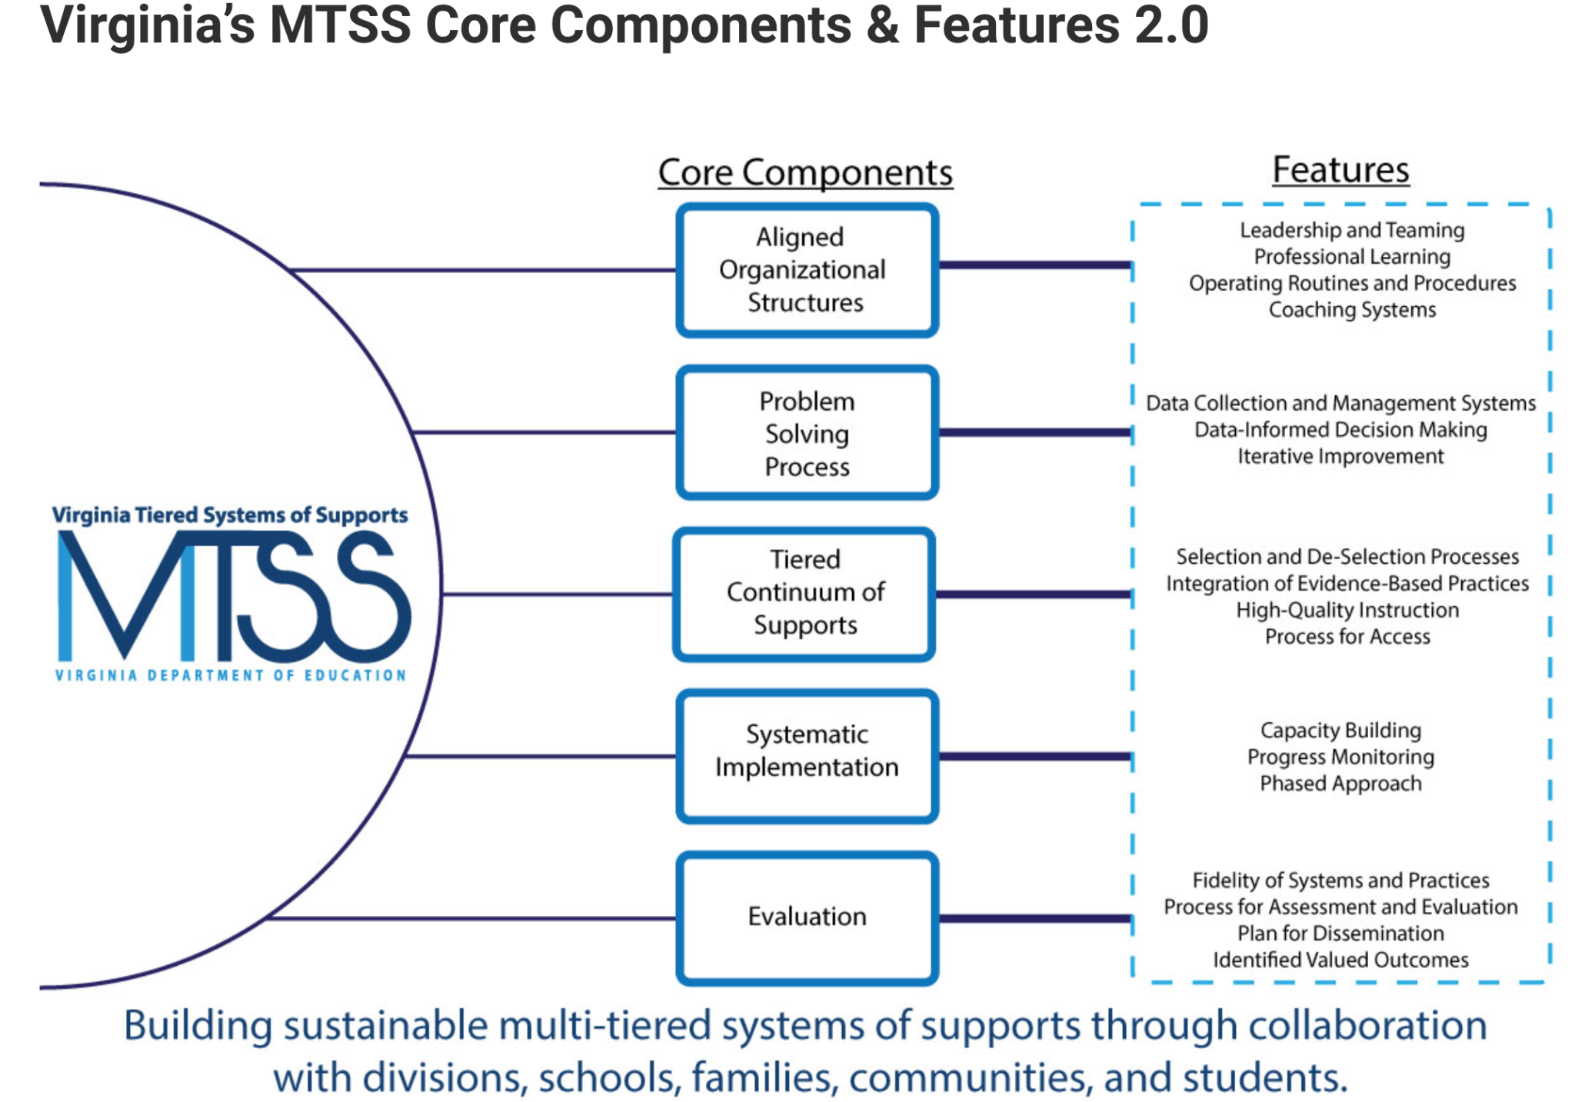
Virginia’s Five Core Components

Slide 25
MTSS is for ALL!
Growth & benefit are central. Must reflect equitable learning opportunities
Data informs decisions about screening, progress monitoring, fidelity, and equitable outcomes
Invest in Systems!!! (Leadership teams, support professional learning and coaching)
Differentiate and ensure equitable outcomes
Prioritize efficient and effective practices
(evidence, culture, context)

Slide 26
Implementation Made Simple
Your division has this THING (program, practice, intervention) that they want to do.
Your division uses the MTSS framework to organize the THING.
MTSS has these tools, strategies, activities to do THIS THING (ANY THING)
DATA tells us how much, how well we are at doing this THING.
NIRN-SISEP Center

Slide 27
Implementation Science

Slide 28
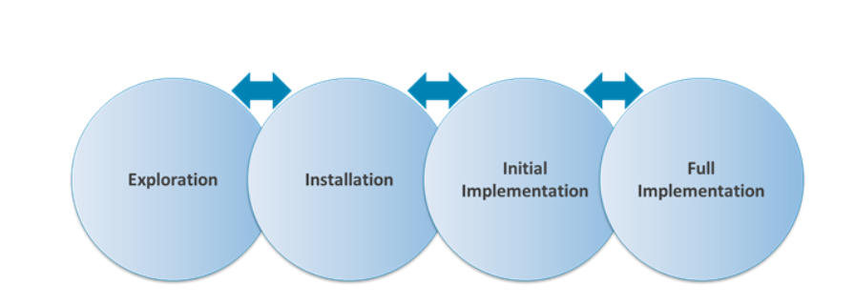
Phases of Implementation
Phase-based work helps to successfully navigate the journey.

Slide 29
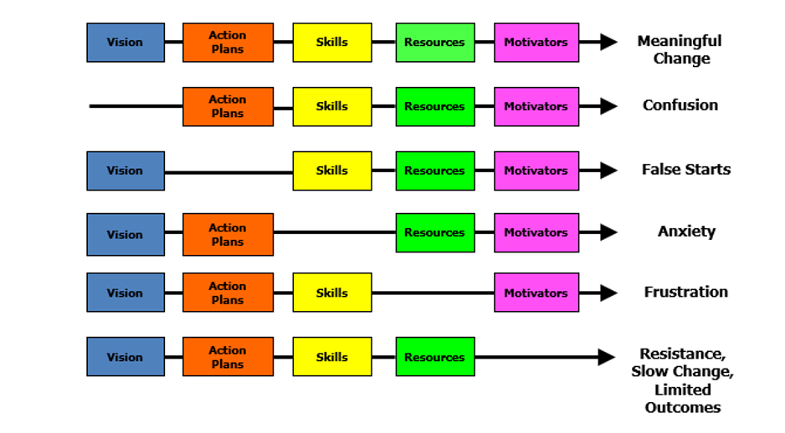
Managing Complex Change
Source: Adapted from Knoster, T., Villa R., & Thousand, J. (2000).

Slide 30
Systems Coaching Skills
WHAT
HOW

Slide 31
Coaching for Systems Change
….”VTSS systems coaching is defined as the set of skills that provides embedded, sustained professional learning (training and coaching).”
Source: VTSS Coaching Roles and Responsibilities

Slide 32
The Why behind
Systems Coaching
Through ongoing relationships and facilitating a cyclical process, systems coaching develops the capacity of division and school leadership teams to implement and align MTSS with their mission and goals (outlined in strategic plans, continuous improvement plans, OSQ plans/MOUs, SEPI CAPs) in order to enhance student outcomes.
(March and Gaunt 2013, p. 2)

Slide 33
Chunk & Chew
Take a processing pause to spend a few moments in a break out room to reflect on the last slide within this latest chunk of content
(3 minutes of silence)
Then allow each colleague share out an aha, thought or even question to consider
(5 minutes to share)

Slide 34
What it Takes
At different times, this includes:
Coaching for Individual Change: focus on skill development, support and performance feedback (content specific: academic, behavior, social/emotional health, behavioral health, wellness)
Coaching for Team/Group Change: focus on collaboration and facilitation, group dynamics
Coaching for Systems Change: focus on organizational change – removing barriers to implementation, aligning initiatives

Slide 35
Virginia’s Cascading Model of Support
National TA Support
State
Agencies
Provides guidance,
coordinates training
and technical assistance.
Creates local guidance, allocates funding, and provides training for school leaders.
Divisions
Creates guidance for implementation, provides teacher training and allocates resources.
Schools
Classrooms
Implements practices to fidelity to support all students.
Coaching
Students
Increased positive outcomes.

Slide 36
How will you do this? Context matters!
Attend DLT and SLT team meetings
Coach teams to be highly effective around data, systems, practices
Guide teams through the phases of implementation
Be a cheerleader for capacity building at all levels within the system

Slide 37
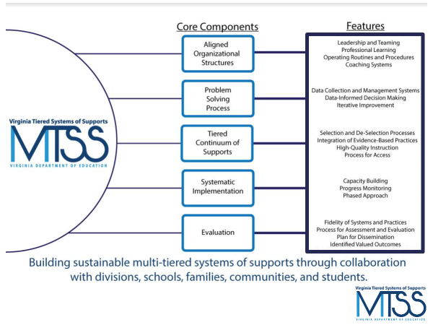
Coaching Supports
Use of the Coaching Checklist for the 5 core components, with considerations to the stages of implementation
Coaching Checklist links you to key tools used in the MTSS way of work

Slide 38
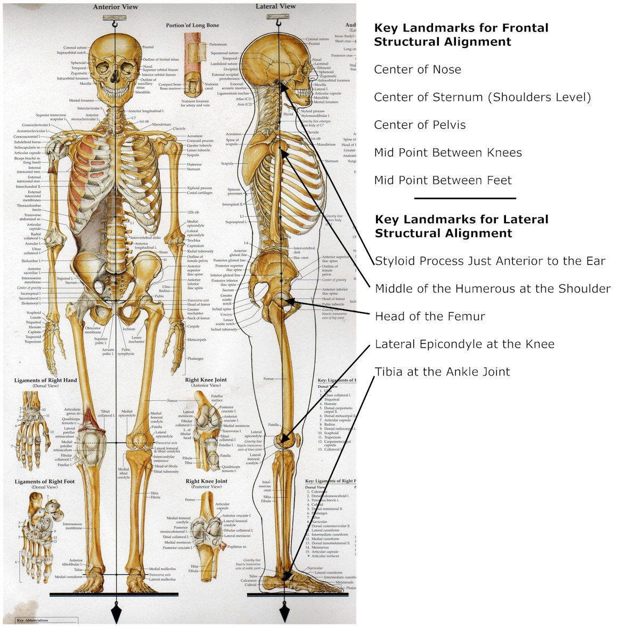
Core Component 1:
Aligned Organizational Structures
Main features of Aligned Organizational Structures:
Leadership & Teaming
Professional Learning
Operating Routines and Procedures
Coaching Systems

Slide 39
Feature 1: Leadership & Teaming
Implementation of evidence-based practices and systems are guided, coordinated and administered by a local team comprised of representation from leadership, stakeholders, implementers, consumers, and content experts. This team is responsible for ensuring high implementation fidelity, communication, management of resources, and data-based decision-making.

Slide 40
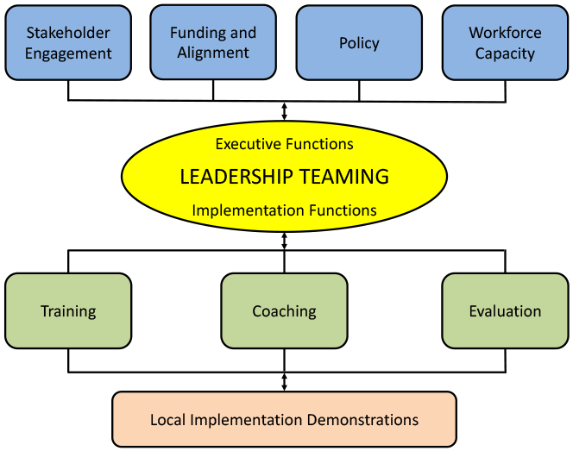
Division Leadership Team Functions
PBIS.org Implementation Blueprint and
Oregon Systems Coach Manual, 2013

Slide 41
Leadership and Teaming
The Division will get a functional team of diverse stakeholders together
Holds the vision & drives implementation
Ensures communication pathways
Defines roles/responsibilities of teams
Develops standard meeting processes
Leads results driven action planning
Creates parallel structures for schools

Slide 42
Division Roles
A Division Coordinator is named to oversee logistics and provide high-level sponsorship of the implementation effort: securing funding, allocating release time, protecting time for DLT meetings, providing leadership for alignment with existing and new initiatives, etc.
Additionally, at least one or more Division Systems Coaches are identified. That’s you!
Division Coordinator may also serve as a division coach, or share roles and tasks with a partner.

Slide 43
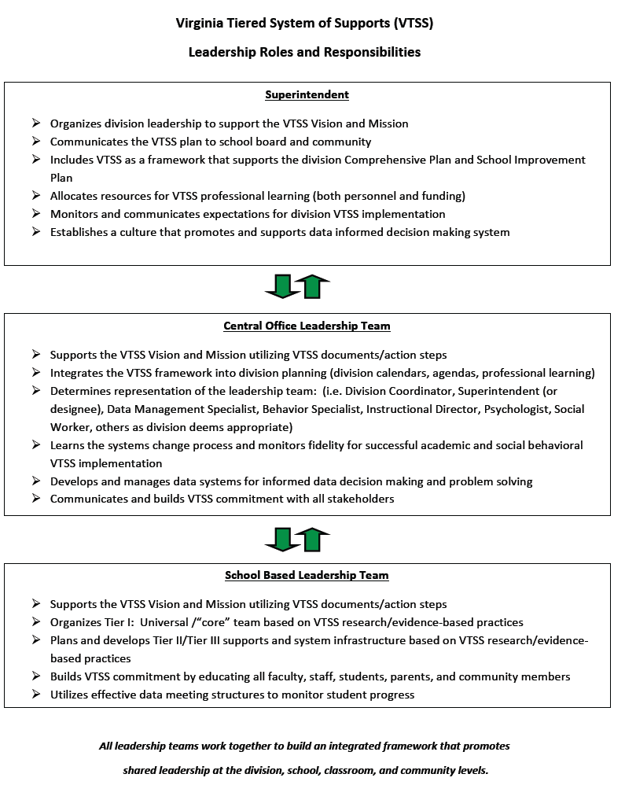
Roles and Responsibilities of Leadership

Slide 44
Coaching Teams
https://brightmorningteam.com/

Slide 45
Your focus is coaching teams!
Coaching at this level focuses on:
helping teams develop their collaboration and facilitation skills
establish team operating procedures,
understand group dynamics, and
solidify data-driven decision making processes and selection/implementation of EBPs with fidelity

Slide 46
Ever been a part of this team?

Slide 47
The “How” & Coaching Roles
Coaching
PBIS.org Implementation Blueprint and
Oregon Systems Coach Manual, 2013
Systems Coach(es)
Liaison(s) between the division and schools -
Coach Data, Practices & Systems
Communication:within & beyond groups
School Coach
Administrator
SCHOOL LEADERSHIP TEAM
School Coach
Administrator
Communication:within & beyond groups
Grade Level Teams
Department Teams
Content/Specialty Area Teams
Advanced Tier Teams
Individual Student Teams
Adapted from PBIS.org Implementation Blueprint and
Oregon Systems Coach Manual, 2013

Slide 48
Who should be on the DLT?
Division Coach and/or Division Coordinator
Superintendent / Executive authority (funding/policy)
Individuals who are able to make decisions/expertise:
Director of Instruction
Key Department Leads, e.g. Literacy, Math, CTE, etc.
Director of Student Support Services
Behavior Specialist
Director of Special Education
Data Analyst
Director of Professional Learning
Director of Family and Community Engagement
Any others who have the authority and expertise to help with implementation

Slide 49
Looking back…
Parallel structure for schools
The division will get a functional team together and will help schools do the same - create parallel structures for schools.
Diverse stakeholders
Communication pathways
Roles/responsibilities of teams
Meeting processes
Data informed decision making process & protocol
Results driven action planning
Holds the vision & drives implementation

Slide 50
Coaching Teams
Gloucester Video

Slide 51
Who should be on the SLT?
School Administrator(s)
Content area reps: Literacy, Math, CTE, etc.
Grade level leadership
Individual with Special Education expertise
Intervention providers
School Counselor
Behavior expertise
Data collector & analysis expertise
Family & Community stakeholder(s)
Student representatives - key to secondary
Not an exhaustive list; context matters

Slide 52
Other Service Providers
Is your School Psychologist, School Social Worker, School Counselor and/or School Nurse, School Resource Officers on the team?
Can community mental health providers be a member of the Tier 1 team?
Memorandum of Understanding (MOU)
Provide Tier 1 Instruction/Skills training for all students

Slide 53
Youth, Family & Community
Why include youth, family and community?
Students have higher math and reading achievement when schools engage families.
Children of school-engaged families have higher academic & social skills and lower aggressive behaviors.
Empowering families in school leadership matters!
“Family” must be inclusive of and respectful of each child’s family structure and is not limited to just parents and children in the home.
Perhaps not easy!

Slide 54
Youth, Family & Community cont.
A family member on the team may be any adult in a child’s life who has responsibility of primary care for the child or youth.
Family member should be independent (not a staff member who is also a parent); have reach to other families; and is willing and able to take on the family advocate role.
For secondary school teams, consider a student who can offer a youth voice.
Consider and clarify time commitment and access to meetings
Perhaps not easy…. but possible & essential!

Slide 55
Team membership influences decision-making
Every team member brings a unique set of experiences and perspectives.
How do we create teams who can best represent the needs of all of our students when important decisions are being made?

Slide 56
What about personality?
To understand; not develop
To give us insight so we know how to respond
To gain knowledge which increases our emotional intelligence
To celebrate the unique YOU
Source: Elena Aguilar, The Art of Coaching Teams: Building Resilient Communities that Transform Schools. Jossey-Bass, 2016.

Slide 57
Coaching Checklist 2.0

Slide 58
Coaching Core Component 1
Coaching Pause: Reflect on your current team composition and answer the following questions:
Do you have family and community voice on your teams?
Do your teams represent diversity?
Do you have the right team members on your team to accomplish your division goals?
What might be some “look fors,” and what
coaching moves might you make?

Slide 59
Teaming Structure:
Working smarter, not harder
Division Level Teams
represented on
Division Leadership Team
School Level Teams
represented on
School Leadership Team

Slide 60
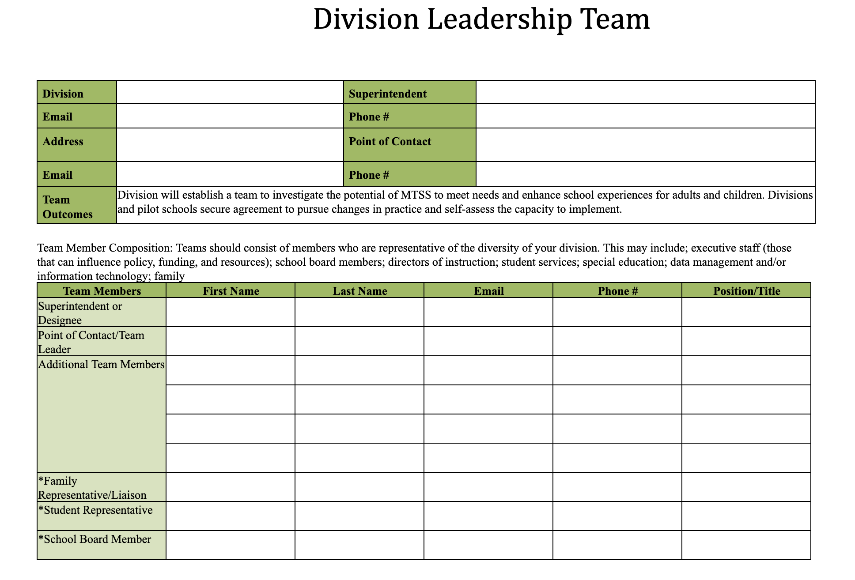
Tools for Efficiency:
Documentation of Team Members

Slide 61
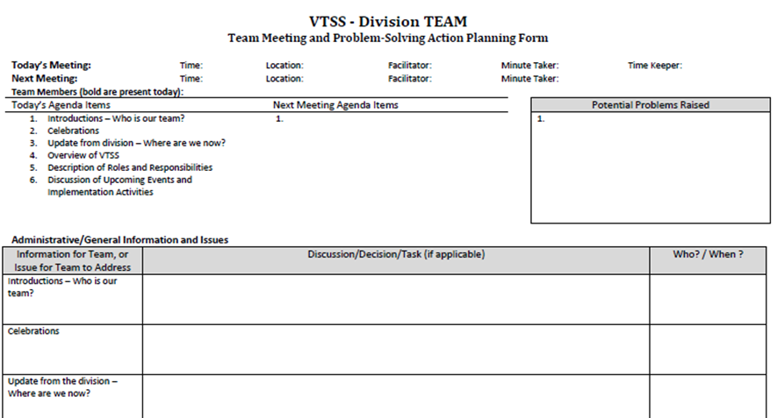
Effective and Efficient
Meeting Structure

Slide 62
Creating an Enabling & Collaborative Context
An effective coach creates a hospitable environment (culture) to support the use of skills through effective communication, collaboration, problem-solving, and shared ownership by demonstrating flexibility, supportiveness, approachability, and trustworthiness in a non-judgmental, hospital environment for individuals, teams and leaders.

Slide 63
Create a Culture of Trust
Building or rebuilding a culture of trust takes time and determination.

Slide 64
Why is trust important?
Increases levels of engagement
People are happier
More productive
Better outcomes for all
Neurological connections between trust, leadership and organizations/ team's performance and outcomes

Slide 65
Building the Enabling Context
Practice communication skills
Active listening
Asking clarifying questions
Summarizing to ensure understanding
Acknowledge strengths
Role effectiveness
Deep understanding of the work
Accomplishing tasks
Notice (not to attend to yet)
Who is speaking most, leading most, etc.
Is there balance of voice
What’s on most agendas
What are the conversations about
Are there patterns of barriers

Slide 66
NIRN Practice Profile for Coaching

Slide 67
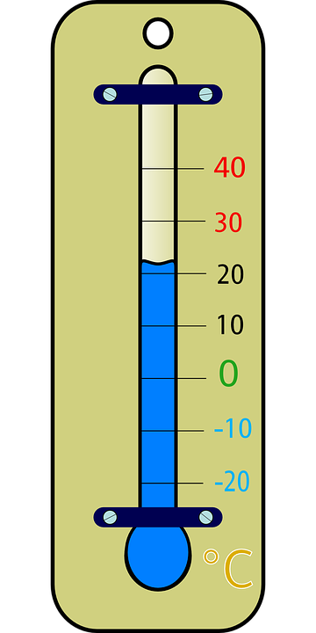
Temperature Check
Examine, understand and apply “systems” in education, systems change, and addressing complex change
Understand how the MTSS framework can be applied to any initiative
Understand the Role & Responsibilities of a Division Systems Coach
Develop knowledge of VA’s MTSS 5 Core Components and their Features 2.0 and tools to support implementation

Slide 68
Follow VTSS
Please feel free to tag us at any of our social media handles below!
Twitter - VTSS_RIC
Facebook - VTSSRIC

Slide 69
Day 2
Materials link:
https://tinyurl.com/4pp6zku3

Slide 70
Systems Coaching Institute 101 Learning Intentions
Day 2
Continue to apply a systems coaching lens to Core Component 1 - Aligned organizational structures with a focus on Workforce Capacity- Features: Professional Learning, Routines and Procedures and Coaching
Develop conceptual understanding and skill acquisition of effective communication skills and their place within aligned organizational structures
Complete a Coaches Self-Assessment (from Teaming Book, Aguilar)

Slide 71
Virtual Community Agreements
Be Responsible:
Take care of your needs
Share your questions with the group
Be Respectful:
Turn volume/sound off on cell phones
Listen to others attentively
Follow up and complete assigned tasks
Be Engaged:
Please keep your video on as much as possible
Ask what you need to know to understand and contribute
Share your expertise, information and ideas

Slide 72
Reflections from Day 1
Anything you’d like to share?
What was the biggest ‘Afterthought’ that lingered with you overnight?
Exit ticket results

Slide 73
Virginia’s Five Core Components

Slide 74
Feature 2: Professional Learning
Activities that are data-driven, content-focused, and aligned to the instructional and growth needs of all students and staff. Professional learning activities should be collaborative, purposeful, planned, sustained over time, job-embedded, classroom-focused, and aligned with VDOE's mission and vision.

Slide 75
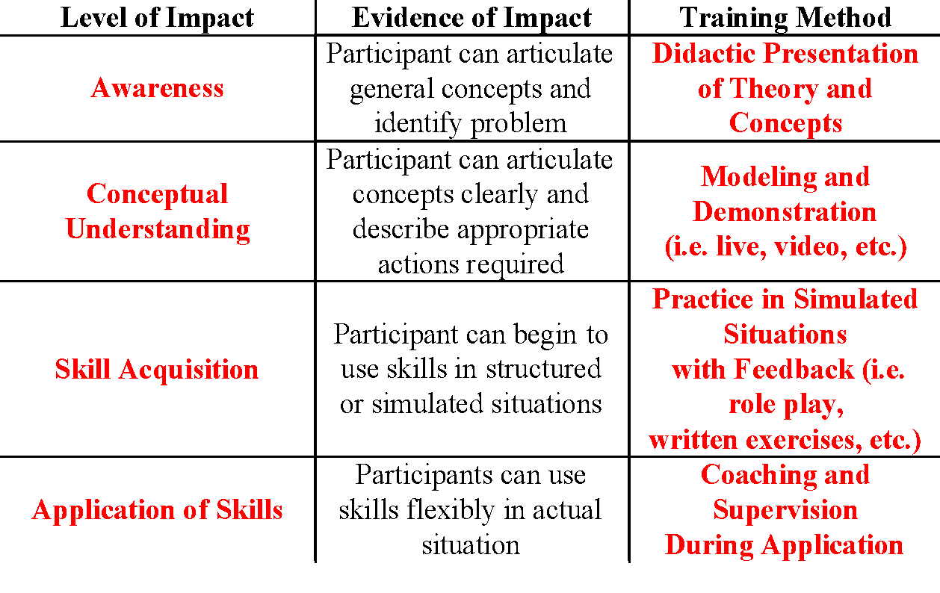
Levels of Impact and
Training Methods
KNOWING
DOING

Slide 76
Feature 3:
Operating Routines and Procedures
Detailed step-by-step explanations of procedures and standards necessary for districts and schools to be successful (e.g., communication, planning, funding, and policy).

Slide 77
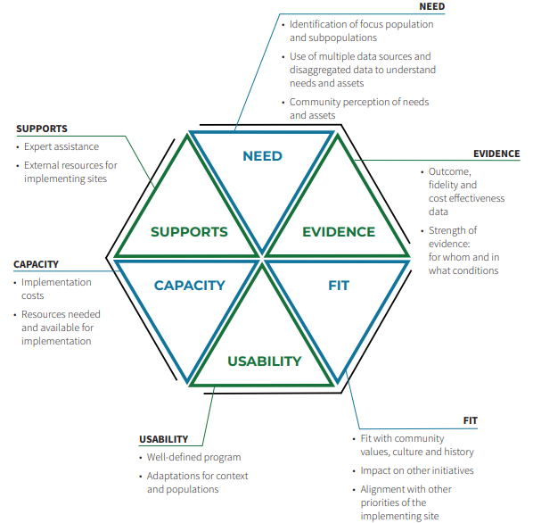
Example: Programs or practices will be selected using the Hexagon Tool
National Implementation & Research Network, 2020

Slide 78
Barriers to implementation will be addressed by this process: Communication Plans
NIRN-Communication Protocols

Slide 79
Communication System
What are all the necessary communication loops that must exist to create a robust communication system?

Slide 80
A Closer Look…
Let’s consider a school division’s communication system through the lens of MTSS:
What are its parts?
Who are the stakeholders involved?
What outcomes, data, practices and systems should be considered?
What other systems are impacted when a change is made in this system?
Where does communication begin? End?
How is it documented? DCA item 10.

Slide 81
Feature 4: Coaching Systems
Coaching for systems change involves collaborating with school and division leaders to develop, implement, and sustain an MTSS framework that emphasizes educational environments that improve student outcomes through leadership, facilitating resource allocation, fidelity of evidence-based practices, and addressing large-scale reform and whole-school organizational improvement.

Slide 82
What is coaching?
Coaching is defined as regular, job-embedded professional learning designed to help teachers and staff use an evidence-based practice or program as intended. Coaching bridges the research-to-practice gap. Training supported by ongoing coaching results in teachers implementing 80-90% of new practices.

Slide 83
Visualizing a Coaching System
Coaching
PBIS.org Implementation Blueprint and
Oregon Systems Coach Manual, 2013
Systems Coach(es)
Liaison(s) between the division and schools -
Coach Data, Practices & Systems
Communication:within & beyond groups
School Coach
Administrator
SCHOOL LEADERSHIP TEAM
School Coach
Administrator
Communication:within & beyond groups
Grade Level Teams
Department Teams
Content/Specialty Area Teams
Advanced Tier Teams
Individual Student Teams
Adapted from PBIS.org Implementation Blueprint and
Oregon Systems Coach Manual, 2013

Slide 84
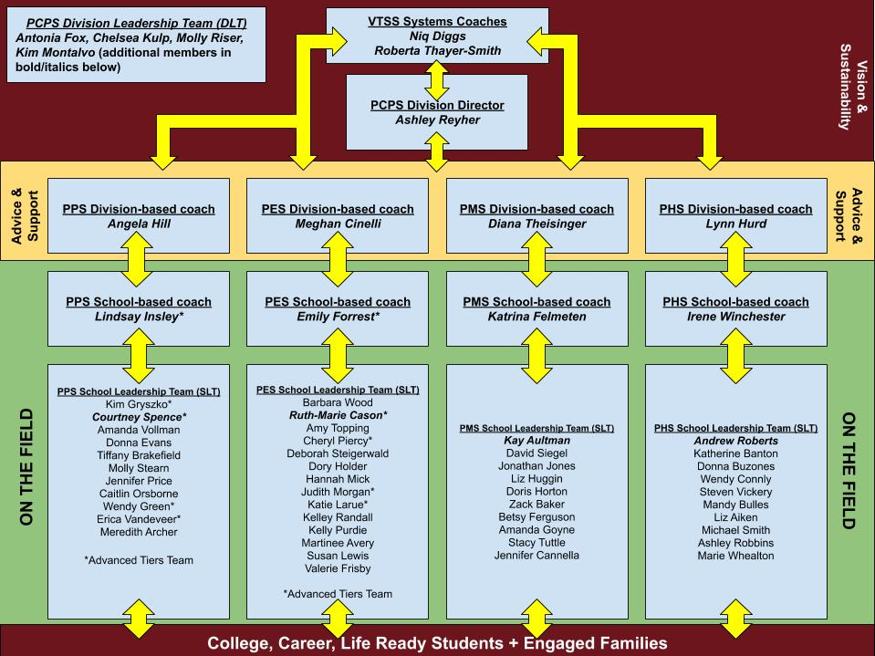
Poquoson Visual Model

Slide 85
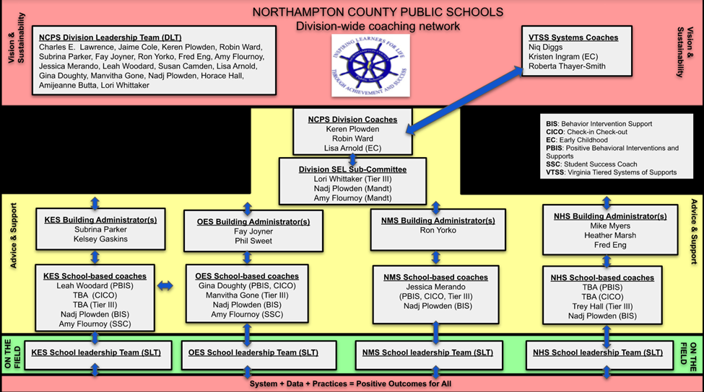

Slide 86
The Why behind a Coaching System
The coaching system is developed to ensure building level teams and school staff have equitable access to high quality coaching
Division context will inform the Coaching System in your division
Coaching will be a critical component of your division’s professional learning system
A Coaching system provides tiered learning supports for all staff
District Capacity Assessment (DCA) #25, 26, 27

Slide 87
Guide to Building a Sustainable Coaching System

Slide 88
Virginia’s Five Core Components

Slide 89
from WHAT: MTSS Implementation to HOW: Coaching
HOW:
Coaching
Skills
WHAT:
MTSS Implementation

Slide 90
Soft Skills or Core Competencies?
“They aren’t called soft skills; they are called courage-building skills.” —Brené Brown
85% of one’s success in the workplace is attributed to ‘soft skills’ and only 15% to technical skills.—Harvard Study
“I really reject the idea of soft skills. There is nothing soft about them. We have hard skills and we have human skills. We need more human skills.” —Simon Sinek

Slide 91
Top 10 Coaching Skills
Resilience
Emotional intelligence
Problem solving
Creativity
Communication
Stress management
Time management
Empathy
Collaboration
Leadership

Slide 92
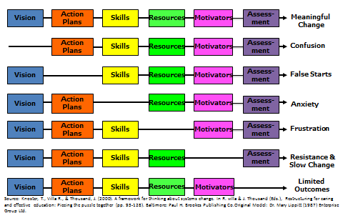
Managing Complex Change

Slide 93
Levels of Impact and
Training Methods
KNOWING
DOING

Slide 94
Quote Activity
“Coaching is the art of creating an environment, through conversation and a way of being, that facilitates the process by which a person can move toward desired goals in a fulfilling manner.”
(Tim Gallwey, 2000, p. 177)

Slide 95
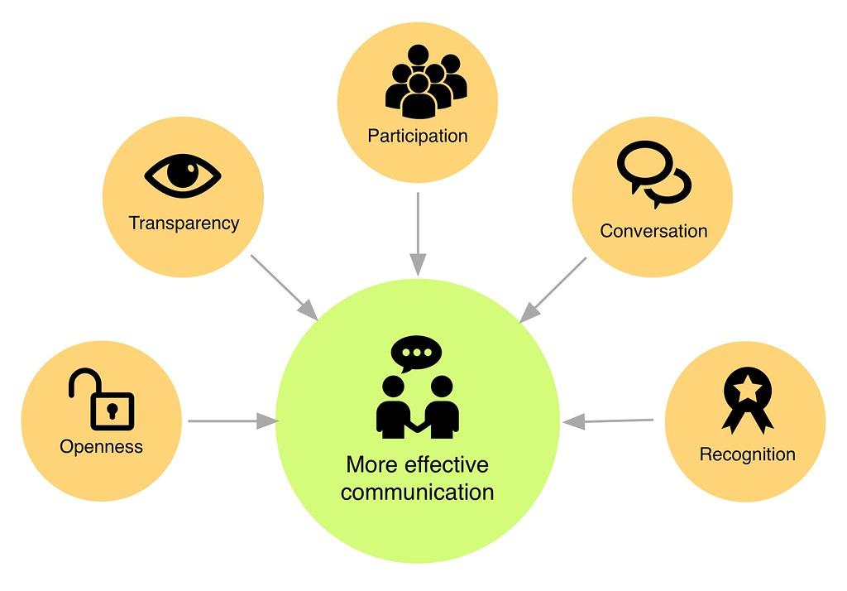
Effective communication
builds trust

Slide 96
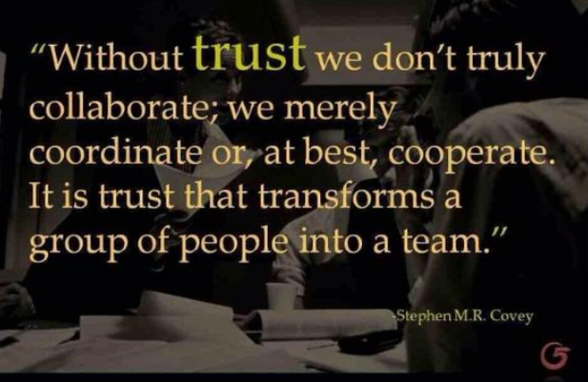
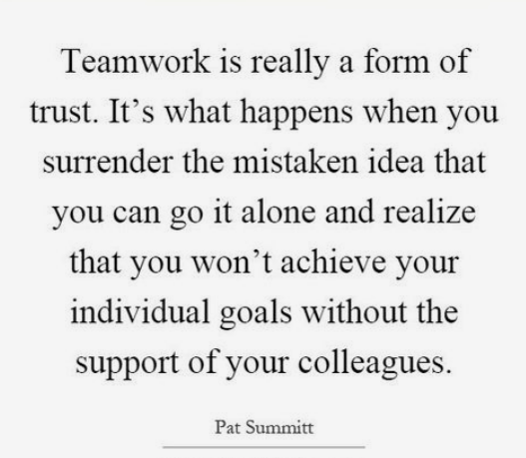
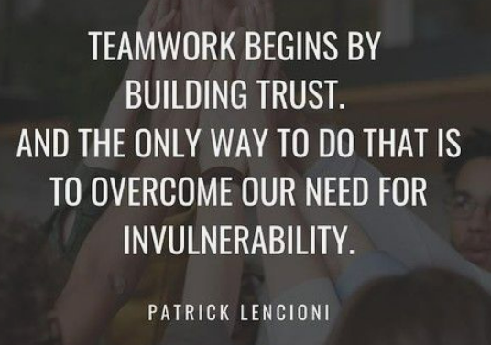
Trustworthy Communication

Slide 97
Stop and Jot
What is a recent experience you’ve had as a systems coach that was challenging for you?
Write about the experience on a scratch piece of paper, changing identifying names and locations to protect identity.
When you’re finished, tuck the paper away somewhere for safe keeping.

Slide 98
A Tool is Only as Good as the Person Holding it
TOOLS
Checklists
Observation walkthroughs
Data trackers
Lesson plan templates
Teacher interviews

Slide 99
Better Conversations

Slide 100
How do you Coach
a System?
One successful interaction at a time

Slide 101
Partnership Communication
What we believe =
How we communicate
Power vs. Leadership

Slide 102
Coaching is an
Act of Service
Coachee
Coach

Slide 103
Example...
Coach not featured

Slide 104
Belief #2 - I want to hear
what others have to say

Slide 105
When it’s no longer
about you…

Slide 106
Forced Listening - A Story

Slide 107
Belief #3 - I believe other people
should have a lot of autonomy
If you can’t say no, saying yes has no meaning.
If someone doesn’t want to do something, they’ll find a way out.
Peter Block

Slide 108
Autonomy is Crucial
The proper question is not, “how can people motivate others?” but rather, “how can people create the conditions within which others will motivate themselves?”
Deci. (1995). Why We Do What We Do: Understanding Self-Motivation

Slide 109
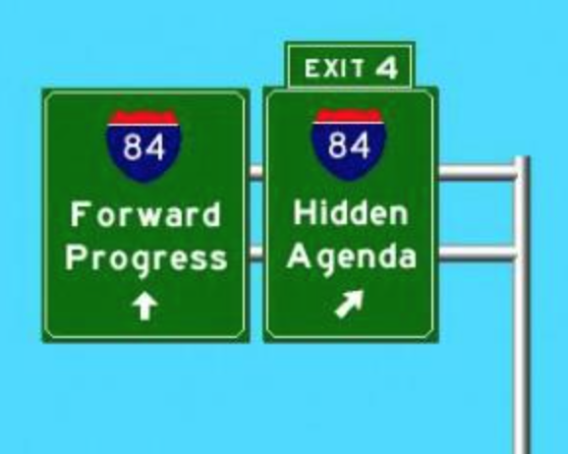
What does autonomy look like in conversations?
Release hidden agenda
Strive for the best answer, as opposed to your answer

Slide 110
Let’s talk about our beliefs…
How do you currently show those you coach that you see them as equals?
Do you spend as much time listening as you do talking during conversations? What distracts you from being fully present?
How do you feel when you are in a conversation with a person who needs to be right? Do you find yourself needing to be right in conversations?

Slide 111
You Can’t Hide Your Principles

Slide 112
Collaborative Communication Skills
“Effective interpersonal communication skills are essential whether one is coaching an individual person, a team of people, or an organization as a whole. This ability to listen, ask open-ended questions, paraphrase, summarize and synthesize information – all within a nonjudgmental climate – are especially important.”
(March & Gaunt, 2013 p. 10)

Slide 113
Collaborative Communication Skills
Paraphrasing
Restating words – as specific as possible
Offering empathy
Restating others’ feelings about a situation
Asking clarifying questions/Requesting
clarification
A question/statement that is directly related to
what has been said
Summarizing
Concise and specific wrap-up
Offering Information
Adding factual or research based information
Asking potentially relevant questions
Questions that require adding new
information to the conversation

Slide 114
Paraphrasing Stems
So what I think I’m hearing is…
Let me know if this sounds right…
Let me make sure I understand…

Slide 115
Paraphrasing Example
Speaker: “We’ve looked at our data a million times and we still can’t agree on what the priority should be as a team moving forward.”
Coach: “So what I think I hear you saying is you’ve looked at the data as a team and no one priority makes sense to the group?

Slide 116
Offering Empathy
Specific to:
- you
- them
- situation

Slide 117
Summarizing Stems
So, to pull things together…
Let me just summarize what has been said…
Here is where we are in our process…

Slide 118
When to Summarize
At the end of a coaching session (to summarize what occurred at the current session).
At the beginning of a coaching session (to summarize what occurred at a previous session).
In the middle of a coaching session when a lot of information is being shared and the coach wants to ensure that he or she understands.

Slide 119
Clarifying Questions/ Statements
What is a clarifying question?
A question that seeks a shared understanding with the speaker by using the speaker’s own words.
(Gravois, 2011)

Slide 120
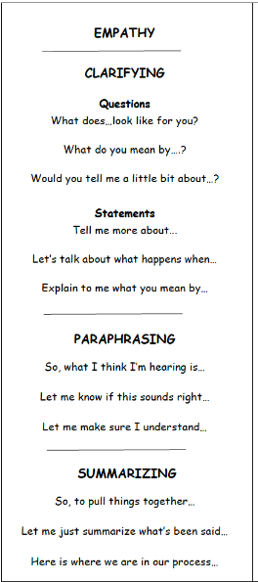
Clarifying Questions/ Statement Stems
What does…look like for you?
What do you mean by ….?
Would you tell me a little bit about…?
Tell me more about...
Let’s talk about what happens when…
Explain to me what you mean
by…

Slide 121
Example
Speaker: “When some team members talk about Tier 2 and Tier 3, they use the terms incorrectly. I’m not sure they understand what tiered interventions really are.”
Coach: “Tell me more about team members not understanding.”

Slide 122
Practice
Speaker 1: “The teachers aren’t working on any proactive behaviors with the students. It’s all about negative consequences.”
Speaker 2: “I’ve started to question my own understanding! I thought differentiation was a Tier 1 practice, but some team members say it’s not.”

Slide 123
Coaches Make Choices

Slide 124
Coaches Make Choices
Speaker: “This team just doesn’t get it! Every time we look at data, the team just talks about “these kids” and “these families”.
Coach:

Slide 125
Collaborative Communication Sort
1
2
3
Look at the coach’s statements/ questions and decide the following:
Is this a clarifying
question? (using speakers words to request more information about what’s been said)
Is this going to take you up or down the escalator?
Read the transcript from the speaker
Sort the cards accordingly

Slide 126
Speaker Transcript
Speaker: “We are having a hard time with Tier 1 expectations. We’ve been meeting several times a month and don’t seem to be making progress. Our matrix development is going terribly. Everyone argues about what should be included. One team member keeps saying that we should just make a list of all the things kids do wrong and then decide how best to create consequences. I know we should be teaching positive behaviors but it’s hard. The kids are very resistant to any of this as well. I’m constantly trying to reel them all in.”

Slide 127
Sort in workbook
Example of Clarifying |  | Non-example of Clarifying
Takes conversation in a positive direction | Takes Conversation in a negative direction

Slide 128
Levels of Impact and Training Methods

Slide 129
Observe and Record Feedback for the Coach

Slide 130
Levels of Impact and
Training Methods

Slide 131
Practice in Triads
Coachee
Coach
Observer

Slide 132
Unpacking and Processing

Slide 133
Levels of Impact and Training Methods

Slide 134
Trustworthy Communication

Slide 135
Moving forward
Use the Communication Skills bookmark (refer to workbook and resources folder).
Identify a skill or belief you would like to grow in. How will you monitor your growth?
Identify a school based coach who would benefit from learning about and practicing some of these skills. Make a plan for sharing/modeling/practice/feedback.
Watch for information about Systems Coaching 102!

Slide 136
Trustworthy Communication

Slide 137
Managing Complex Change
Source: Adapted from Knoster, T., Villa R., & Thousand, J. (2000). A framework for thinking about systems change. In R. villa & J. Thousand (Eds.), Restructuring for caring and effective education: Piecing the puzzle together (pp. 93-128). Baltimore: Paul H. Brookes Publishing Co.

Slide 138
Great skills make
great coaches!
Your job already requires critical coaching skills:
Listening
Building trust
Relationships building
Communication
Problem solving
Data analysis
Collaboration

Slide 139
Identify Your Core Competencies
(Skills)
3 components to this tool to help you identify strengths and opportunities for growth as a facilitator:
(1) skills and knowledge;
(2) emotional intelligence; and
(3) will and capacity
Complete Section 1: All 3 subsections
Team Development & Facilitation
Communication
Conflict & Commitment
Aguilar, The Art of Coaching Teams, pg. 299-300

Slide 140
Facilitator Core Competencies
Aguilar, The Art of Coaching Teams, pg. 288
Link to form

Slide 141
Evaluation
Thank you for spending time with us the past two days. Please complete the evaluation to provide us feedback to assist with our planning.
https://tinyurl.com/3xc8fm3k
Notes:
Link to evaluation: https://tinyurl.com/3xc8fm3k

Slide 142
The Art of Coaching Teams
Attendees will receive the book The Art of Coaching Teams. It will be used in Systems Coaching Institute 102 in February 2025.

Slide 143
Follow VTSS
Please feel free to tag us at any of our social media handles below!
Twitter - VTSS_RIC
Facebook - VTSSRIC

