Slide 1
Systems Coaching Institute 101
March 11 & 12, 2026

Slide 2
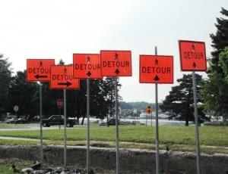
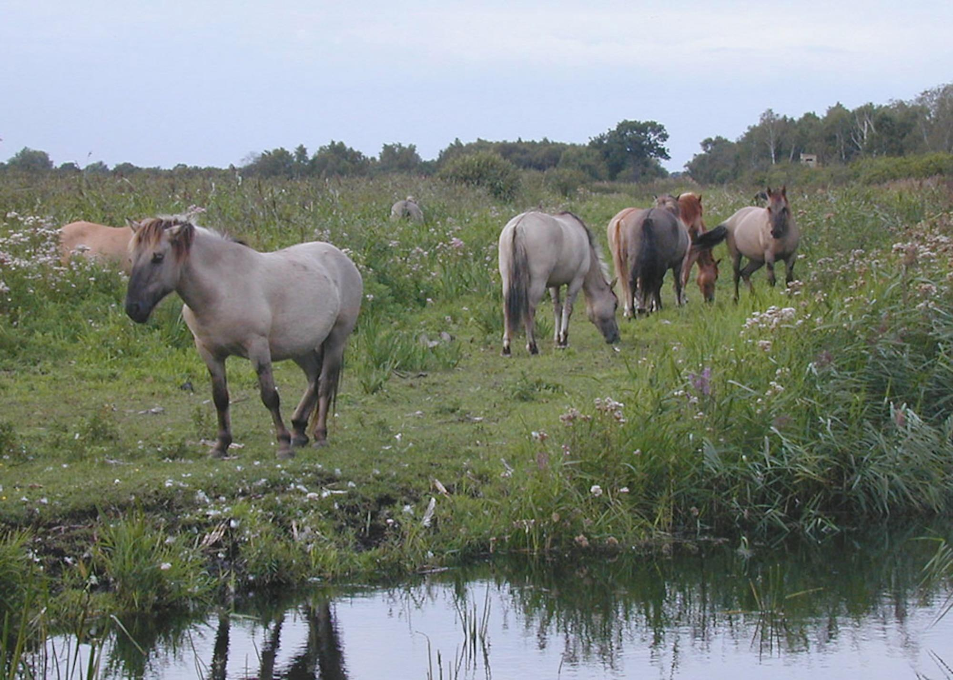



Systems Coaching is like…

Slide 3
VTSS IS WHO
WE ARE!
MTSS IS WHAT WE DO!

Slide 4
Virtual Community Agreements
Be Responsible:
Take care of your needs
Share your questions with the group
Be Respectful:
Turn volume/sound off on cell phones
Listen to others attentively
Follow up and complete assigned tasks
Be Engaged:
Please keep your video on as much as possible
Ask what you need to know to understand and contribute
Share your expertise, information and ideas

Slide 5
Systems Coaching Institute 101 Learning Intentions
Day 1
Examine, understand, and apply “systems” in education, systems change, and addressing complex change
Understand how the MTSS framework can be applied to any initiative
Understand the role and responsibilities of a Division Systems Coach
Develop knowledge of Virginia’s MTSS Core Components and their features to support implementation

Slide 6
Systems Coaching Institute 101 Learning Intentions
Day 2
Continue to apply a systems coaching lens to Core Component 1 - Aligned organizational structures with a focus on Workforce Capacity- Features: Professional Learning, Routines and Procedures and Coaching
Develop conceptual understand and skill acquisition of effective communication skills and their place within aligned organizational structures
Complete a Coaches Self-Assessment (from Teaming Book, Aguilar)

Slide 7


Materials
SCI 101 Workbook

Slide 8
Who is in the room today?
What is your role on your division’s MTSS team?
How long have you served in this role?
On a scale of 1 (a little) to 5 (got this),
how confident are you feeling today in your role in the implementation process of Multi-Tiered Systems of Supports?

Slide 9
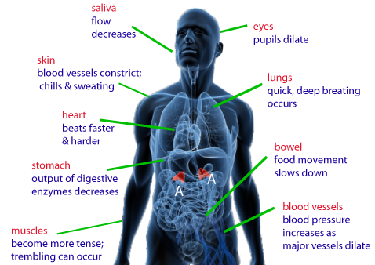
Welcome:
Systems Check

Slide 10

What is an
MTSS Systems Coach?
A Systems Coach serves as a liaison for the division leadership team (DLT) and the school’s leadership team(s) (SLT) to guide sustainable organizational change to implement MTSS and to guide systems intervention at the school level.
A Systems Coach facilitates systems thinking.

Slide 11
Goals of Systems Coaching
Improve Division Systems & Build Local Capacity
Improve PreK-12 classroom & school Systems & Practices
Improve Student Outcomes

Slide 12
What knowledge and skills will you need?
Expertise in systems thinking, organizational change, and implementation science.
MTSS content knowledge and coaching skills for implementation of practices.
Ability to build the capacity of others in the practice of reflection through data-informed decision-making and a commitment to sustainable change.

Slide 13
Systems in Education
What are some systems you see in an educational system?

Slide 14
What is Systems Change?
A system is a set of interacting or interdependent component parts forming a complex/intricate whole.
Systems thinking allows us to understand that all the components of a system are related and need to be assessed to ensure they are not getting in the way of successful student outcomes.
System change aims to bring about lasting change by altering underlying structures and supporting mechanisms which make the system operate in a certain way. These can include policies & regulations, processes and procedures, relationships, resources (human, fiscal and material), power structures and values.

Slide 15
The Three Principles that Guide Systems Coaches’ Work
Principle 1: Understand the system to understand outcomes.
Principle 2: Systems-level change is an intentional and continuous process.
Principle 3: Systems-level change is an adaptive challenge.

Slide 16
Let’s Talk Principle 1
Understand the system to understand the outcomes.
What do systems-level principles mean to me?
Is the idea of seeing the systems new for you, or are you familiar with the concept?
Why do you think seeing the system is important to coaching?
How would you explain the concept of a system to a team?
Coaching for Systems and Teacher Change
Jennifer Pierce; Kimberly St. Martin

Slide 17
Components of a System:
A constellation of parts
HUMAN RESOURCES
MATERIAL RESOURCES
Education System
FISCAL RESOURCES
$$$$$$
PROCESSES AND PROCEDURES
POLICIES AND REGULATIONS
Pgs. 7-8 in Workbook
Adapted COACHING FOR SYSTEMS CHANGE-PIERCE AND ST.MARTIN 2023

Slide 18
Scenario
Reading the scenario about Greenleaf with your breakout group, pause at each question or statement.
Have a recorder write the systems component (1-5) that is the best fit.
Material Resources
Human Resources
Processes and Procedures
Policies and Regulations
Fiscal Resources

Slide 19




The “work” doesn’t work without systems
Division leadership teams with the help of division systems coaches must be aware of the multiple systems at work within the division.
They must continually analyze the health of those systems through a variety of data points.
Coaching is one of those systems!

Slide 20
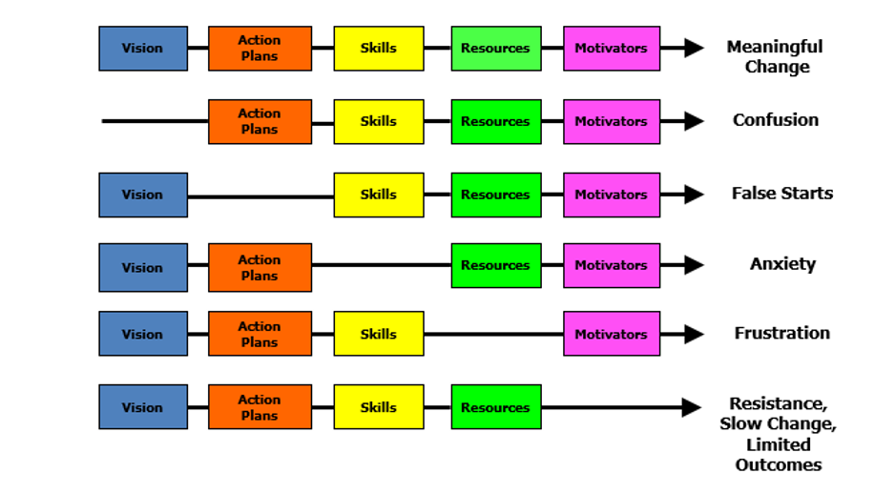
Managing Complex Change
Adapted from Knoster, Villa, & Thousand (2000). A framework for thinking about systems change.
Villa & Thousand (1999). Restructuring for caring and effective education: Piecing the puzzle together.

Slide 21

MTSS Implementation to Coaching
WHAT:
MTSS Implementation
HOW:
Coaching
Skills

Slide 22
Multi-Tiered Systems of Support (MTSS) Defined
MTSS is a systemic, data-driven approach that allows divisions and schools to provide evidence-based practices and interventions to meet the needs of their students. This is done through a clearly defined process that is implemented to fidelity by all stakeholders within the school and/or division.
(2024)

Slide 23
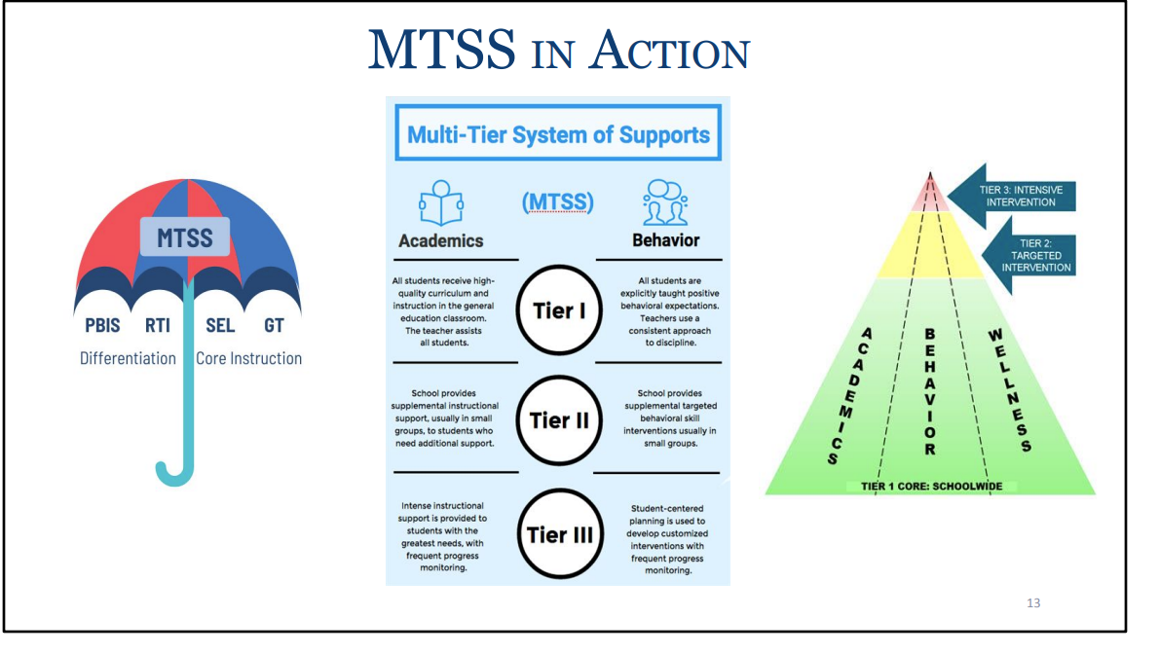
MTSS Framework
23

Slide 24
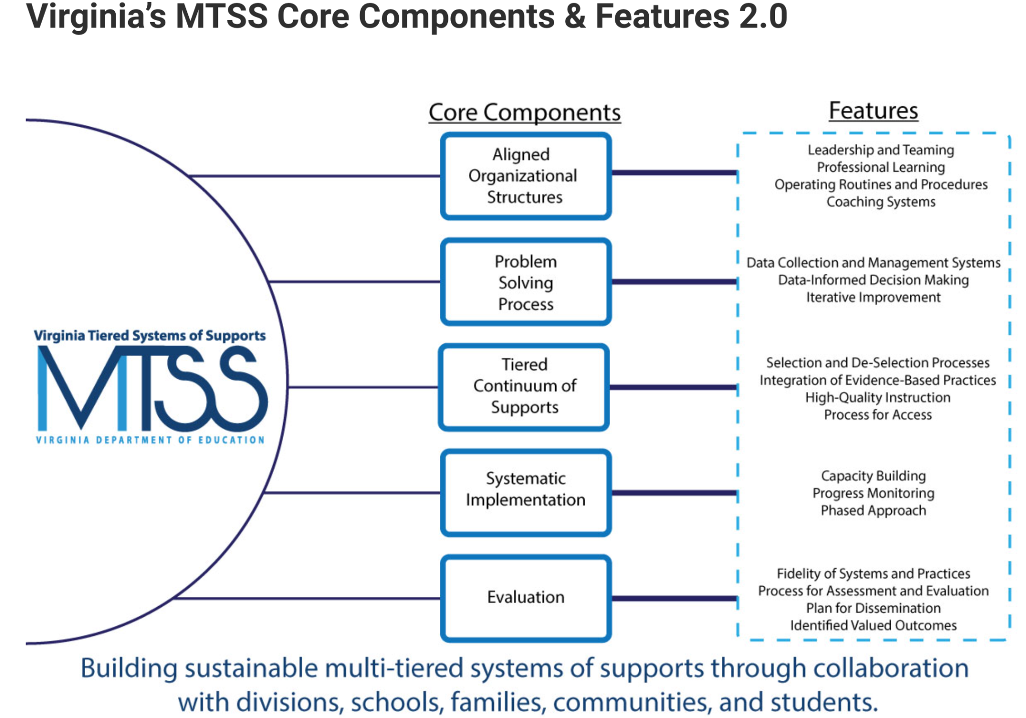
Virginia’s Five Core Components

Slide 25
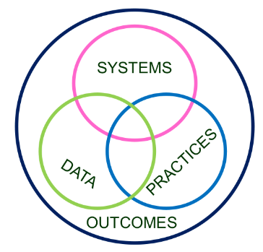
MTSS for ALL!
Invest in Systems!!! (Leadership teams, support professional learning and coaching)
Differentiate and ensure outcomes are reflective of all students.
Data informs decisions about screening, progress monitoring, fidelity, and outcomes
Prioritize efficient and effective practices
(evidence, culture, context)
Growth & benefit are central. Must reflect learning opportunities for all
25

Slide 26
Implementation Made Simple
Your division has this THING (program, practice, intervention) that they want to do.
Your division uses the MTSS framework to organize the THING.
MTSS has these tools, strategies, activities to do THIS THING (ANY THING)
DATA tells us how much, how well we are at doing this THING.
NIRN-SISEP Center

Slide 27
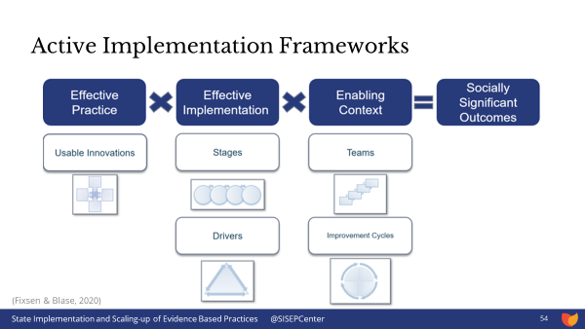
Implementation Science

Slide 28
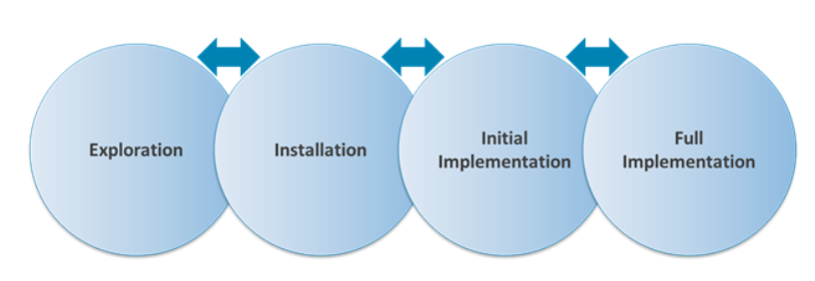

Phases of Implementation
Phase-based work helps to successfully navigate the journey.

Slide 29
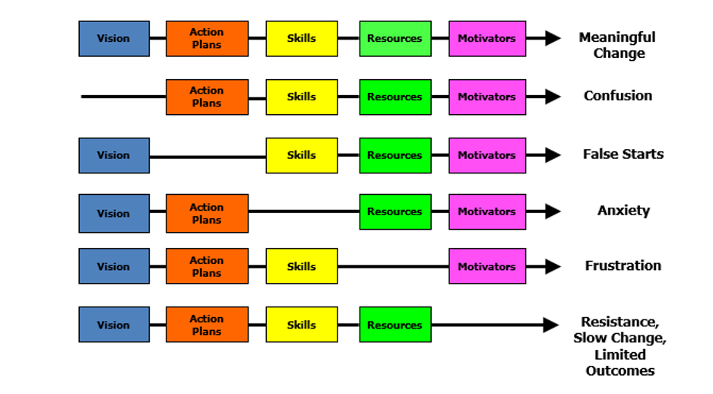
Managing Complex Change
Adapted from Knoster, T., Villa R., & Thousand, J. (2000).

Slide 30
Systems Coaching Skills
WHAT
HOW

Slide 31
Coaching for Systems Change
….”VTSS systems coaching is defined as the application of a set of skills that provides embedded, sustained professional learning (training and coaching).”
Source: VTSS Coaching Roles and Responsibilities

Slide 32
The Why behind
Systems Coaching
Through ongoing relationships and facilitating a cyclical process, systems coaching develops the capacity of division and school leadership teams to implement and align MTSS with their mission and goals (outlined in strategic plans, continuous improvement plans, OSQ plans/MOUs, SEPI CAPs) in order to enhance student outcomes.
(March and Gaunt 2013, p. 2)

Slide 33
Chunk & Chew
Take a processing pause to spend a few moments in a breakout room to reflect on the last slide within this latest chunk of content
(3 minutes of silence)
Then allow each colleague share out an aha, thought or even question to consider
(5 minutes to share)

Slide 34
What it Takes
At different times, this includes:
Coaching for Individual Change: focus on skill development, support and performance feedback (content specific: academic, behavior, social/emotional health, behavioral health, wellness)
Coaching for Team/Group Change: focus on collaboration and facilitation, group dynamics
Coaching for Systems Change: focus on organizational change – removing barriers to implementation, aligning initiatives

Slide 35
Virginia’s Cascading Model of Support
Virginia’s Cascading Model of Support
National TA Support
State
Agencies
Provides guidance,
coordinates training
and technical assistance.
Creates local guidance, allocates funding, and provides training for school leaders.
Divisions
Creates guidance for implementation, provides teacher training and allocates resources.
Schools
Classrooms
Implements practices to fidelity to support all students.
Coaching
Students
Increased positive outcomes.

Slide 36
How will you do this? Context matters!
Attend DLT and SLT team meetings
Coach teams to be highly effective around data, systems, practices
Guide teams through the phases of implementation
Be a cheerleader for capacity building at all levels within the system

Slide 37
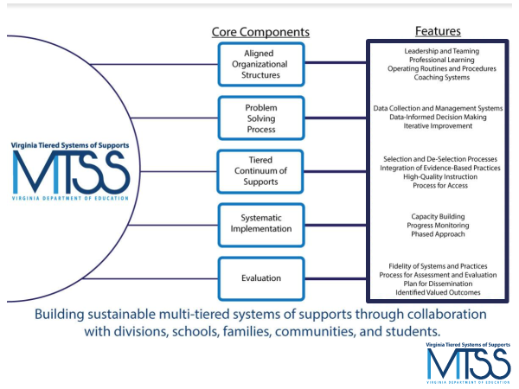
Coaching Supports
Use of the Coaching Checklist for the 5 core components, with considerations to the stages of implementation.
Coaching Checklist links you to key tools used in the MTSS way of work.

Slide 38
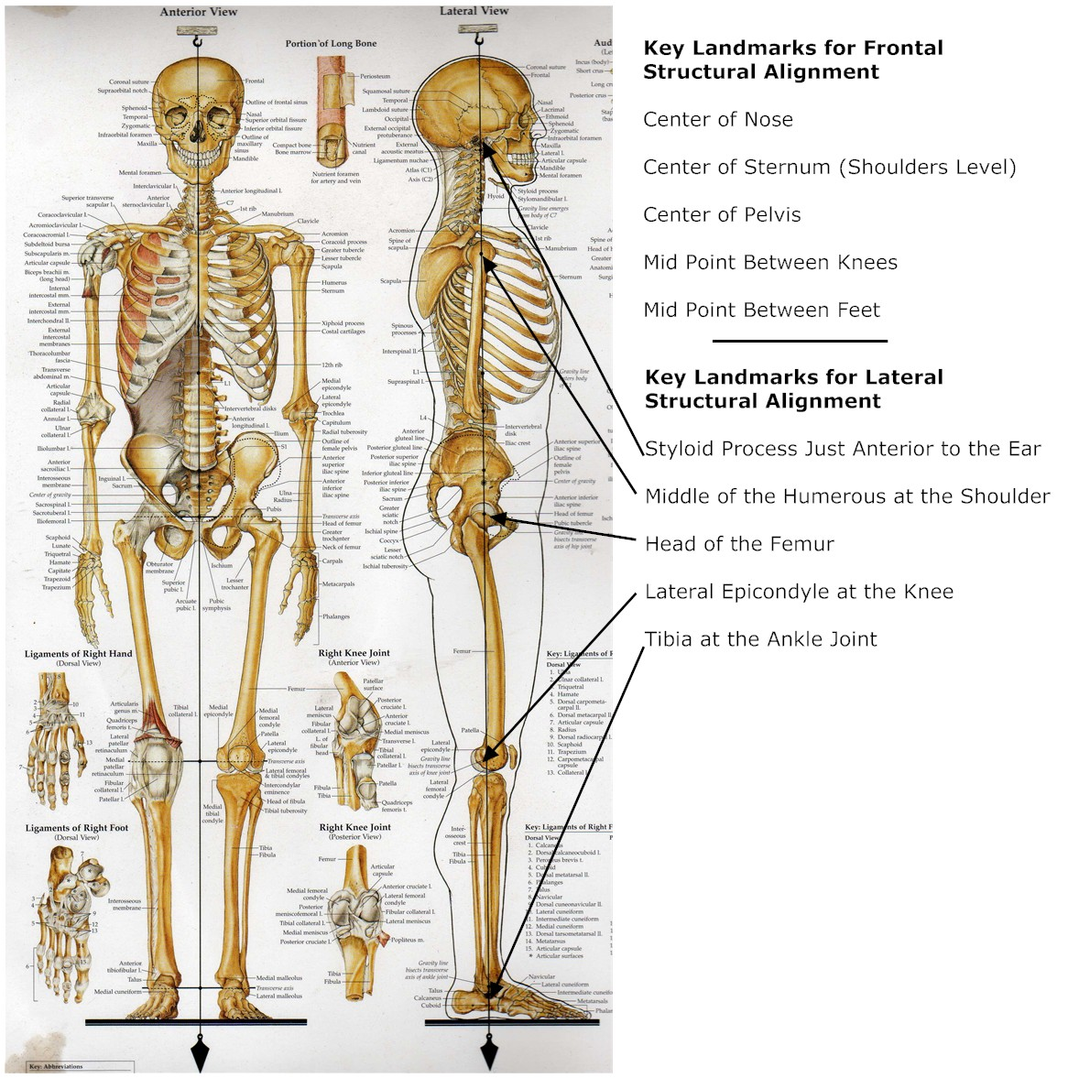
Core Component 1:
Aligned Organizational Structures
Main features of Aligned Organizational Structures:
Leadership & Teaming
Professional Learning
Operating Routines and
Procedures
Coaching Systems

Slide 39
Feature 1: Leadership & Teaming
Implementation of evidence-based practices and systems are guided, coordinated and administered by a local team comprised of representation from leadership, stakeholders, implementers, consumers, and content experts. This team is responsible for ensuring high implementation fidelity, communication, management of resources, and data-based decision-making.

Slide 40
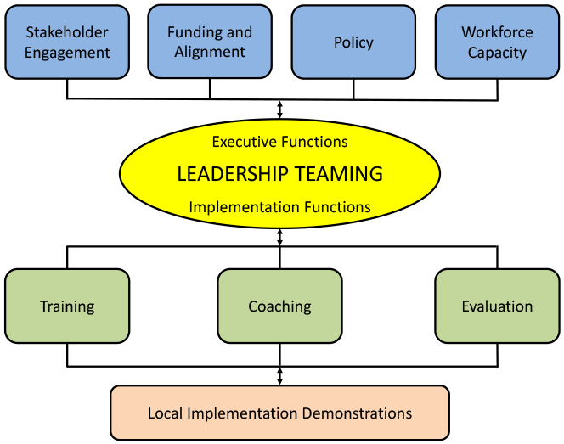
Division Leadership Team Functions
PBIS.org Implementation Blueprint and
Oregon Systems Coach Manual, 2013

Slide 41
Leadership and Teaming
The Division will get a functional team of diverse stakeholders together
Holds the vision & drives implementation
Ensures communication pathways
Defines roles/responsibilities of teams
Develops standard meeting processes
Leads results driven action planning
Creates parallel structures for schools

Slide 42
Division Roles
A Division Coordinator is named to oversee logistics and provide high-level sponsorship of the implementation effort: securing funding, allocating release time, protecting time for DLT meetings, providing leadership for alignment with existing and new initiatives, etc.
Additionally, at least one or more Division Systems Coaches are identified. That’s you!
Division Coordinator may also serve as a division coach, or share roles and tasks with a partner.

Slide 43
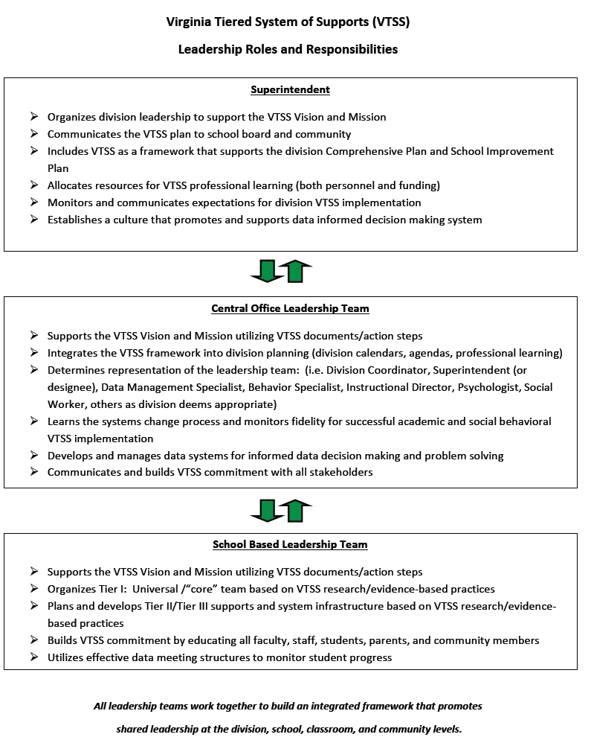
Roles and Responsibilities of Leadership

Slide 44

Coaching Teams
https://brightmorningteam.com/

Slide 45
Your focus is coaching teams!
Coaching at this level focuses on:
helping teams develop their collaboration and facilitation skills
establish team operating procedures,
understand group dynamics, and
solidify data-driven decision making processes and selection/implementation of EBPs with fidelity

Slide 46
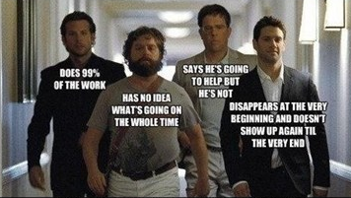
Ever been a part of this team?

Slide 47
The “How” & Coaching Roles
Coaching
PBIS.org Implementation Blueprint and
Oregon Systems Coach Manual, 2013
Systems Coach(es)
Liaison(s) between the division and schools -
Coach Data, Practices & Systems
Communication:within & beyond groups
School Coach
Administrator
SCHOOL LEADERSHIP TEAM
School Coach
Administrator
Communication:within & beyond groups
Grade Level Teams
Department Teams
Content/Specialty Area Teams
Advanced Tier Teams
Individual Student Teams
Adapted from PBIS.org Implementation Blueprint and
Oregon Systems Coach Manual, 2013

Slide 48
Who should be on the DLT?
Division Coach and/or Division Coordinator
Superintendent / Executive authority (funding/policy)
Individuals who are able to make decisions/expertise:
Director of Instruction
Key Department Leads, e.g. Literacy, Math, CTE, etc.
Director of Student Support Services
Behavior Specialist
Director of Special Education
Data Analyst
Director of Professional Learning
Director of Family and Community Engagement
Any others who have the authority and expertise to help with implementation

Slide 49
Looking back…
Parallel structure for schools
The division will get a functional team together and will help schools do the same - create parallel structures for schools.
Diverse stakeholders
Communication pathways
Roles/responsibilities of teams
Meeting processes
Data-informed decision making process & protocol
Results driven action planning
Holds the vision & drives implementation

Slide 50

Coaching Teams
Gloucester Video

Slide 51
Who should be on the SLT?
School Administrator(s)
Content area reps: Literacy, Math, CTE, etc.
Grade level leadership
Individual with Special Education expertise
Intervention providers
School Counselor
Behavior expertise
Data collector & analysis expertise
Family member(s)
Community stakeholder(s)
Student representatives - key to secondary
Not an exhaustive list; context matters

Slide 52
Other Service Providers
Is your School Psychologist, School Social Worker, School Counselor and/or School Nurse, School Resource Officers on the team?
Can community mental health providers be a member of the Tier 1 team?
Memorandum of Understanding (MOU)
Provide Tier 1 Instruction/Skills training for all students

Slide 53
Youth, Family & Community
Why include youth, family and community?
Students have higher math and reading achievement when schools engage families.
Children of school-engaged families have higher academic & social skills and lower aggressive behaviors.
Empowering families in school leadership matters!
“Family” must be inclusive of and respectful of each child’s family structure and is not limited to just parents and children in the home.
Perhaps not easy!

Slide 54
Youth, Family & Community cont.
A family member on the team may be any adult in a child’s life who has responsibility of primary care for the child or youth.
Family member should be independent (not a staff member who is also a parent); have reach to other families; and is willing and able to take on the family advocate role.
For secondary school teams, consider a student who can offer a youth voice.
Consider and clarify time commitment and access to meetings
Perhaps not easy…. but possible & essential!

Slide 55
Team membership influences decision-making
Every team member brings a unique set of experiences and perspectives.
How do we create teams who can best represent the needs of all of our students when important decisions are being made?

Slide 56
What about personality?
To understand; not develop
To give us insight so we know how to respond
To gain knowledge which increases our emotional intelligence
To celebrate the unique YOU
Source: Elena Aguilar, The Art of Coaching Teams: Building Resilient Communities that Transform Schools. Jossey-Bass, 2016.

Slide 57
Coaching Checklist 2.0

Slide 58




Coaching Core Component 1
Coaching Pause: Reflect on your current team composition and answer the following questions:
Do you have family and community voice on your teams?
Do your teams represent diversity?
Do you have the right team members on your team to accomplish your division goals?
What might be some “look fors,” and what
coaching moves might you make?

Slide 59
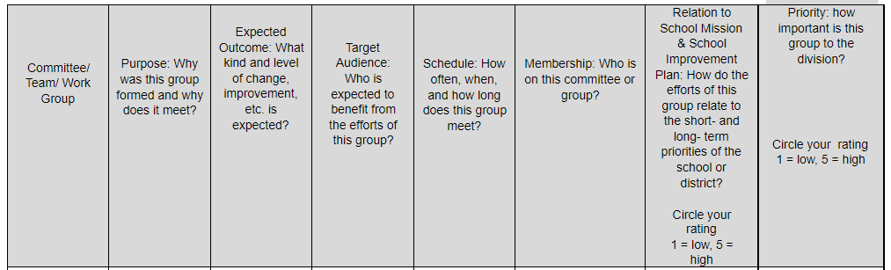
Teaming Structure:
Working smarter, not harder
Division Level Teams
represented on
Division Leadership Team
School Level Teams
represented on
School Leadership Team

Slide 60
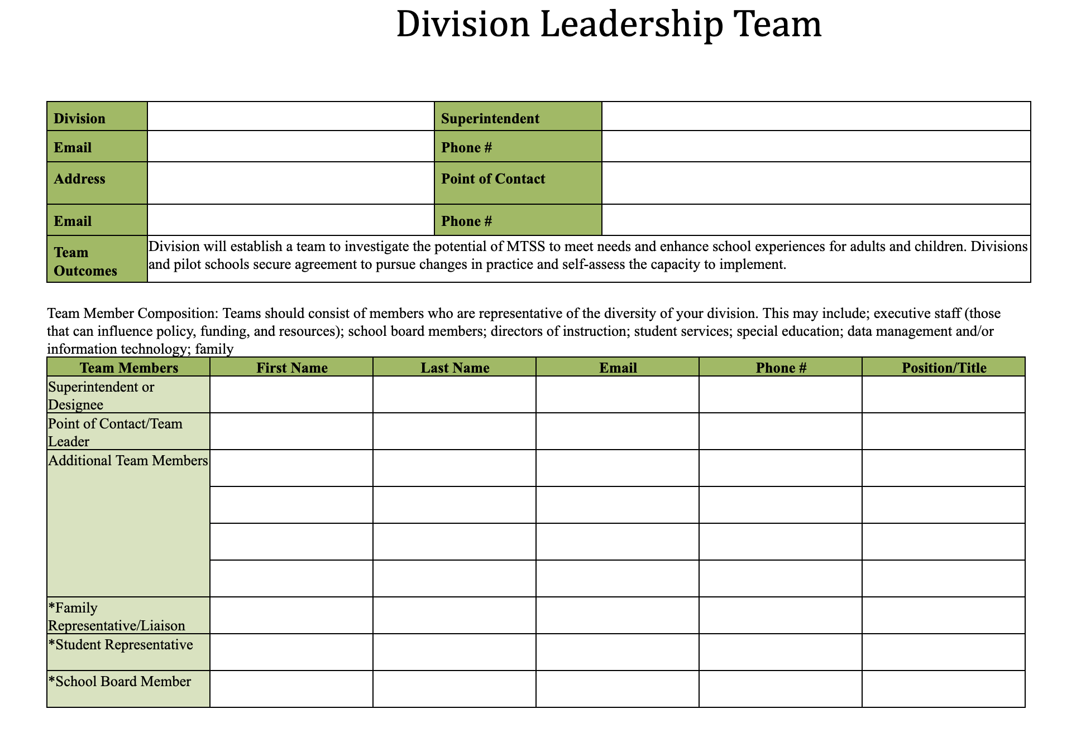
Tools for Efficiency:
Documentation of Team Members

Slide 61
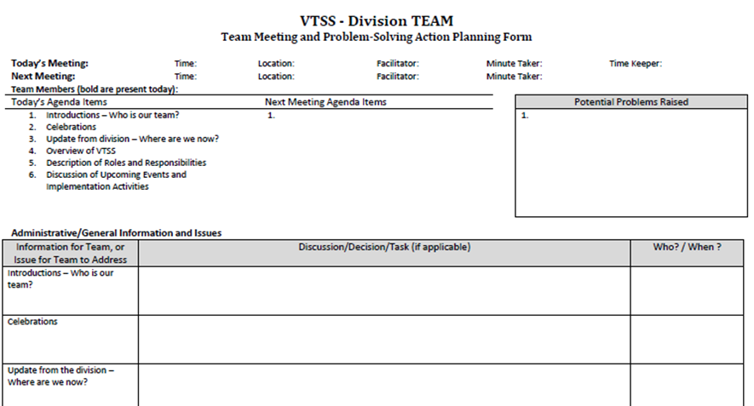
Effective and Efficient
Meeting Structure

Slide 62
Creating an Enabling & Collaborative Context
An effective coach creates a hospitable environment (culture) to support the use of skills through effective communication, collaboration, problem-solving, and shared ownership by demonstrating flexibility, supportiveness, approachability, and trustworthiness in a non-judgmental, hospital environment for individuals, teams and leaders.

Slide 63

Create a Culture of Trust
Building or rebuilding a culture of trust takes time and determination.

Slide 64
Why is trust important?
Increases levels of engagement
People are happier
More productive
Better outcomes for all
Neurological connections between trust, leadership and organizations/ team's performance and outcomes

Slide 65
Building the Enabling Context
Practice communication skills
Active listening
Asking clarifying questions
Summarizing to ensure understanding
Acknowledge strengths
Role effectiveness
Deep understanding of the work
Accomplishing tasks
Notice (not to attend to yet)
Who is speaking most, leading most, etc.
Is there balance of voice
What’s on most agendas
What are the conversations about
Are there patterns of barriers

Slide 66
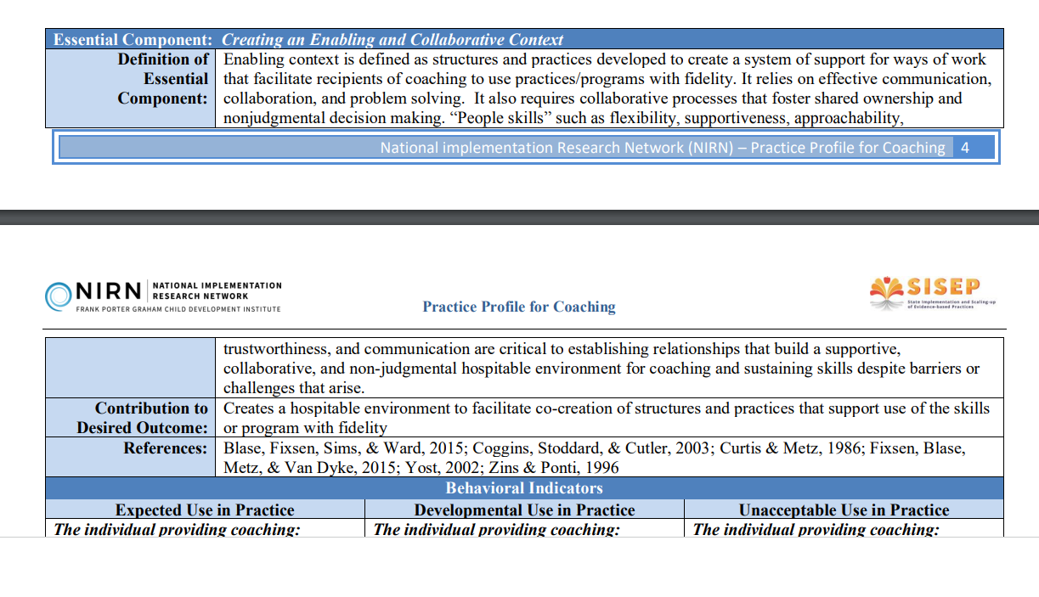
NIRN Practice Profile for Coaching

Slide 67
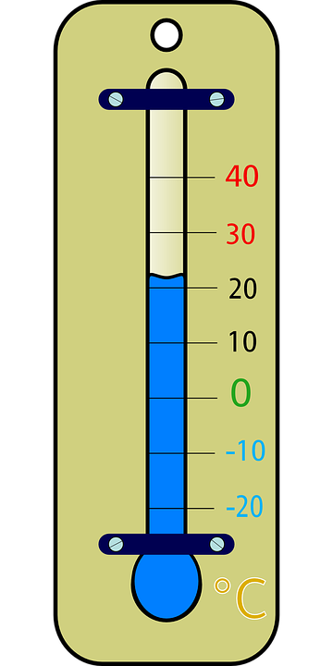
Temperature Check
Examine, understand and apply “systems” in education, systems change, and addressing complex change
Understand how the MTSS framework can be applied to any initiative
Understand the Role & Responsibilities of a Division Systems Coach
Develop knowledge of VA’s MTSS 5 Core Components and their Features 2.0 and tools to support implementation

Slide 68


Follow VTSS
Please feel free to tag us at any of our social media handles below!
Twitter - VTSS_RIC
Facebook - VTSSRIC

Slide 69
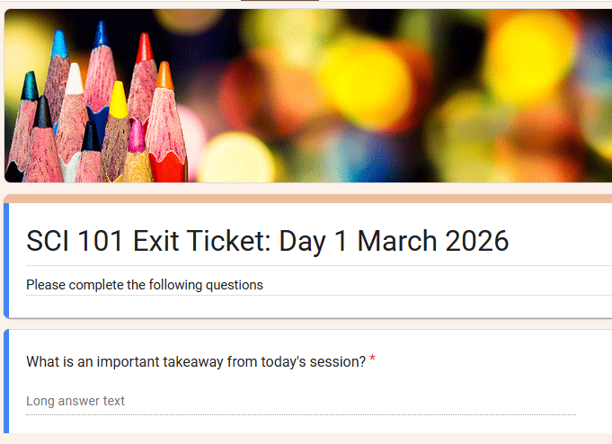

Exit Ticket
https://tinyurl.com/y5unzzd8

Slide 70

Day 2
Day 2
Materials link:

Slide 71
Systems Coaching Institute 101 Learning Intentions
Day 2
Continue to apply a systems coaching lens to Core Component 1 - Aligned Organizational Structures with a focus on these features: Professional Learning, Routines and Procedures, and Coaching
Develop conceptual understanding and skill acquisition of effective communication skills and their place within aligned organizational structures
Complete a Coaches Self-Assessment (from The Art of Coaching Teams Book, Aguilar)

Slide 72
Virtual Community Agreements
Be Responsible:
Take care of your needs
Share your questions with the group
Be Respectful:
Turn volume/sound off on cell phones
Listen to others attentively
Follow up and complete assigned tasks
Be Engaged:
Please keep your video on as much as possible
Ask what you need to know to understand and contribute
Share your expertise, information and ideas

Slide 73

Reflections from Day 1
Anything you’d like to share?
What was the biggest ‘Afterthought’ that lingered with you overnight?
Exit ticket results

Slide 74
Virginia’s Five Core Components

Slide 75
Feature 2: Professional Learning
Activities that are data-driven, content-focused, and aligned to the instructional and growth needs of all students and staff. Professional learning activities should be collaborative, purposeful, planned, sustained over time, job-embedded, classroom-focused, and aligned with VDOE's mission and vision.

Slide 76
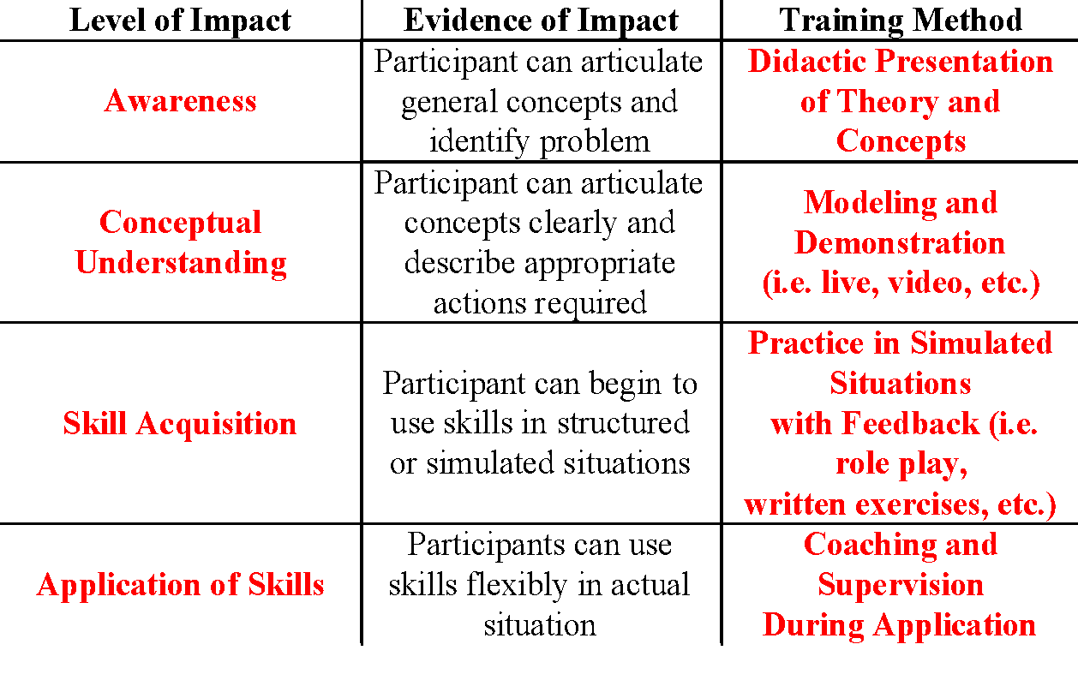
Levels of Impact and
Training Methods
KNOWING
DOING

Slide 77
Coaching Feature 2: Professional Learning
Coaching Pause: Reflect on your division’s current approach to professional learning.
Is there an aligned Professional Learning (PL) calendar for the division or is it siloed?
Do all teachers/staff get the same thing?
How do you provide PL suited to the needs and wants of teachers?
Does every presenter develop and post learning intentions and consider levels of impact?
Is PL effectiveness data collected?

Slide 78
Feature 3:
Operating Routines and Procedures
Detailed step-by-step explanations of procedures and standards necessary for districts and schools to be successful (e.g., communication, planning, funding, and policy).

Slide 79
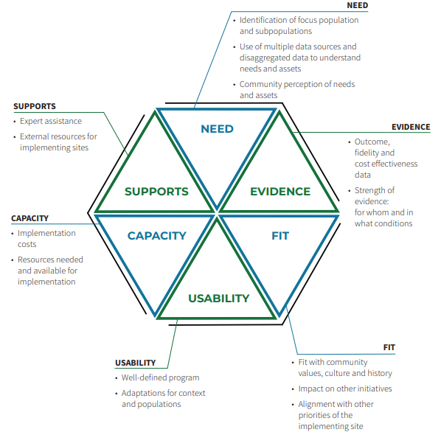
Example: Programs or practices will be selected using the Hexagon Tool
National Implementation & Research Network, 2020

Slide 80

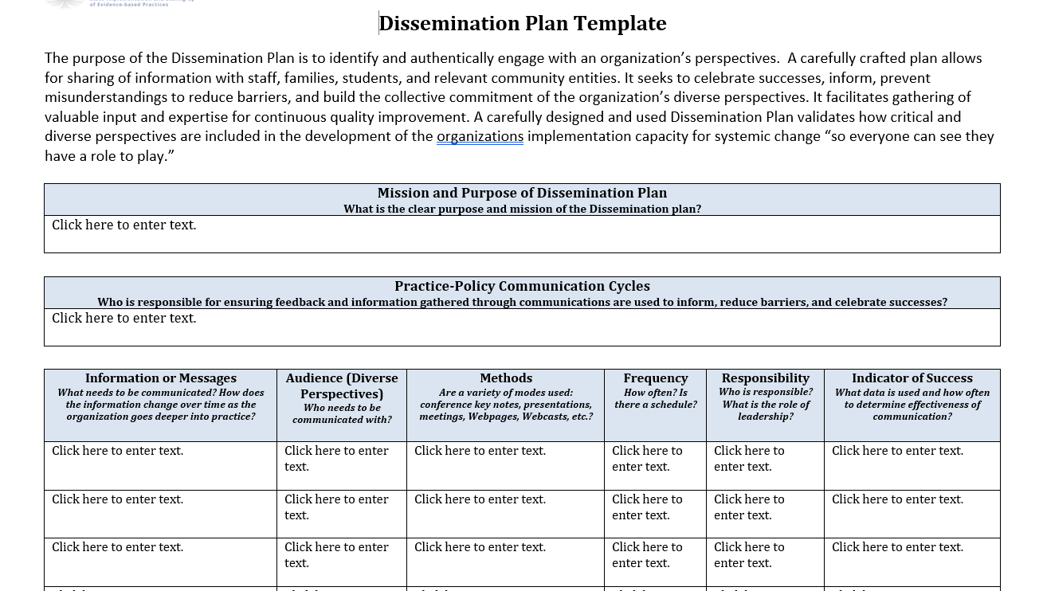
Barriers to implementation will be addressed by this process: Communication Plans
Michigan’s Communication Plan Template
NIRN Communication Protocol

Slide 81


Communication System
What are all the necessary communication loops that must exist to create a robust communication system?

Slide 82

A Closer Look…
Let’s consider a school division’s communication system through the lens of MTSS:
What are its parts?
Who are the stakeholders involved?
What outcomes, data, practices and systems should be considered?
What other systems are impacted when a change is made in this system?
Where does communication begin? End?
How is it documented? DCA item 10.

Slide 83
Feature 4: Coaching Systems
Coaching for systems change involves collaborating with school and division leaders to develop, implement, and sustain an MTSS framework that emphasizes educational environments that improve student outcomes through leadership, facilitating resource allocation, fidelity of evidence-based practices, and addressing large-scale reform and whole-school organizational improvement.

Slide 84
What is coaching?
Coaching is defined as regular, job-embedded professional learning designed to help teachers and staff use an evidence-based practice or program as intended. Coaching bridges the research-to-practice gap. Training supported by ongoing coaching results in teachers implementing 80-90% of new practices.

Slide 85
Visualizing a Coaching System
Coaching
PBIS.org Implementation Blueprint and
Oregon Systems Coach Manual, 2013
Systems Coach(es)
Liaison(s) between the division and schools -
Coach Data, Practices & Systems
Communication:within & beyond groups
School Coach
Administrator
SCHOOL LEADERSHIP TEAM
School Coach
Administrator
Communication:within & beyond groups
Grade Level Teams
Department Teams
Content/Specialty Area Teams
Advanced Tier Teams
Individual Student Teams
Adapted from PBIS.org Implementation Blueprint and
Oregon Systems Coach Manual, 2013

Slide 86
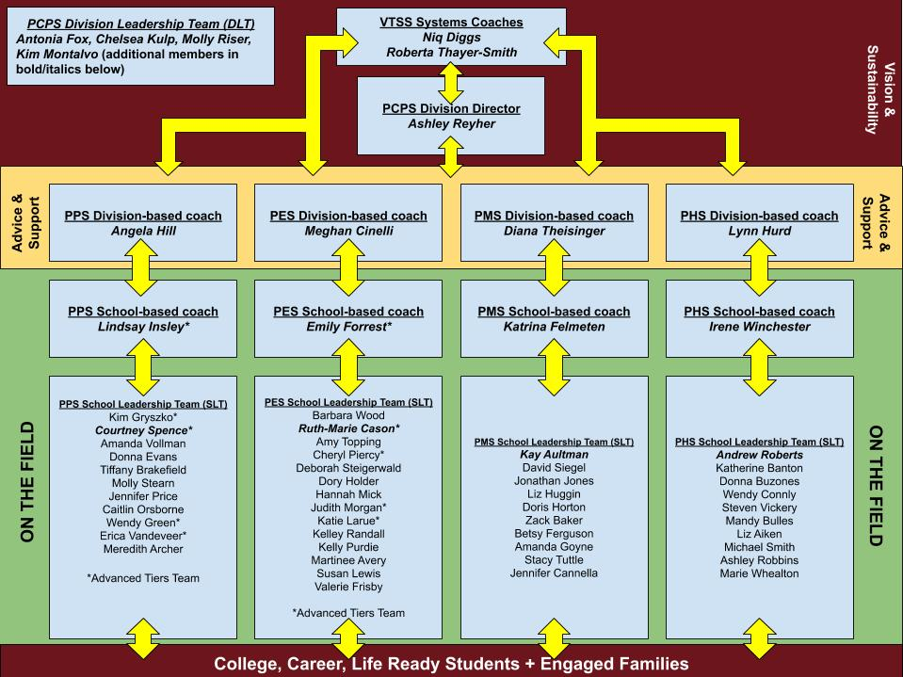
Poquoson Visual Model

Slide 87
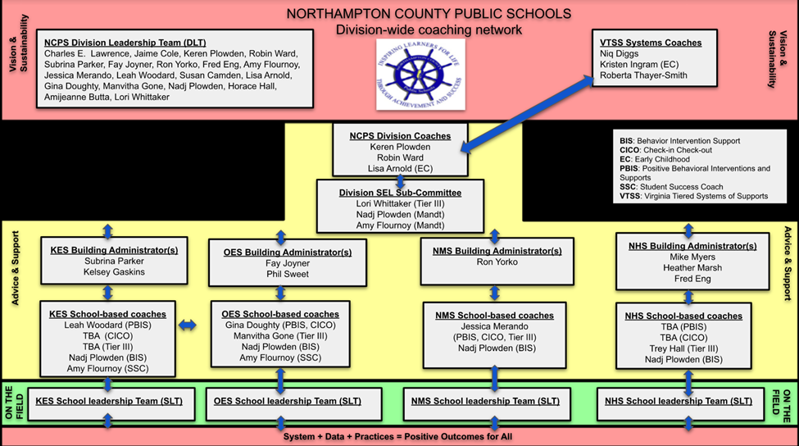
Northampton Visual Model

Slide 88
The Why behind a Coaching System
The coaching system is developed to ensure building level teams and school staff have equitable access to high quality coaching
Division context will inform the Coaching System in your division
Coaching will be a critical component of your division’s professional learning system
A Coaching system provides tiered learning supports for all staff
District Capacity Assessment (DCA) #25, 26, 27

Slide 89
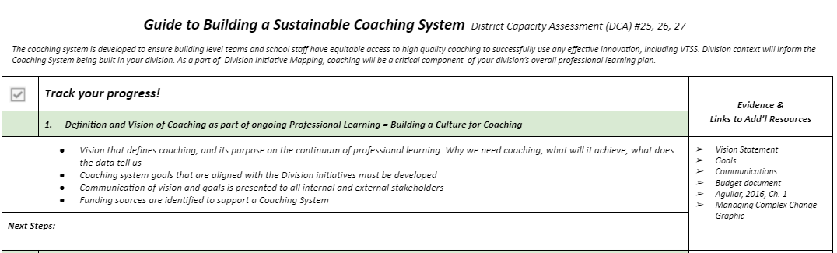
Guide to Building a Sustainable Coaching System

Slide 90
Virginia’s Five Core Components

Slide 91
From WHAT: MTSS Implementation to HOW: Coaching
HOW:
Coaching
Skills
WHAT:
MTSS Implementation

Slide 92
Soft Skills or Core Competencies?
“They aren’t called soft skills; they are called courage-building skills.” —Brené Brown
85% of one’s success in the workplace is attributed to ‘soft skills’ and only 15% to technical skills.—Harvard Study
“I really reject the idea of soft skills. There is nothing soft about them. We have hard skills and we have human skills. We need more human skills.” —Simon Sinek

Slide 93
10 Essential Coaching Skills
Resilience
Emotional intelligence
Problem solving
Creativity
Communication
Stress management
Time management
Empathy
Collaboration
Leadership

Slide 94

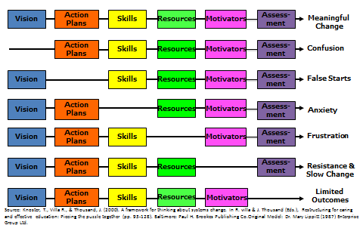
Managing Complex Change

Slide 95
Levels of Impact and
Training Methods
KNOWING
DOING

Slide 96

Quote Activity
“Coaching is the art of creating an environment, through conversation and a way of being, that facilitates the process by which a person can move toward desired goals in a fulfilling manner.”
(Tim Gallwey, 2000, p. 177)

Slide 97
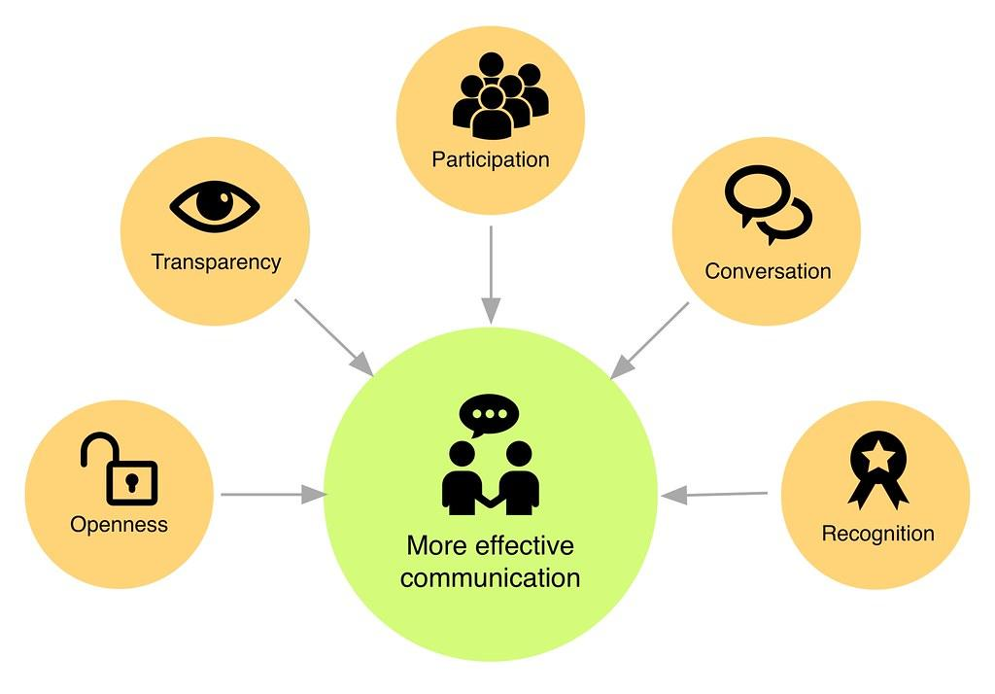
Effective communication
builds trust

Slide 98
Stop and Jot
What is a recent experience you’ve had as a systems coach that was challenging for you?
Write about the experience on a scratch piece of paper, changing identifying names and locations to protect identity.
When you’re finished, tuck the paper away somewhere for safe keeping.

Slide 99

A tool is only as good as the person holding it.
TOOLS
Checklists
Observation walkthroughs
Data trackers
Lesson plan templates
Teacher interviews

Slide 100

Better Conversations

Slide 101

How do you Coach
a System?
One successful interaction at a time.

Slide 102

Partnership Communication
What we believe =
How we communicate
Power vs. Leadership

Slide 103

Belief #1 - Coaching is an
act of service
Coachee
Coach

Slide 104

Example...
Coach not featured

Slide 105


Belief #2 - I want to hear
what others have to say.

Slide 106

When it’s no longer
about you…

Slide 107

Forced Listening - A Story

Slide 108

Belief #3 - I believe other people
should have a lot of autonomy.
If you can’t say no, saying yes has no meaning.
If someone doesn’t want to do something, they’ll find a way out.
Peter Block

Slide 109
Autonomy is Crucial
The proper question is not, “how can people motivate others?” but rather, “how can people create the conditions within which others will motivate themselves?”
Deci. (1995). Why We Do What We Do: Understanding Self-Motivation

Slide 110
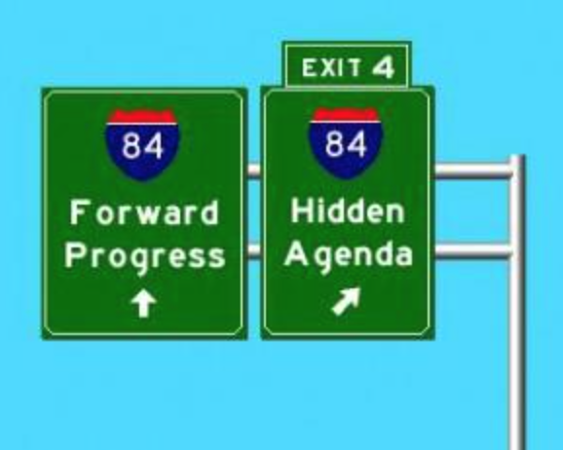
What does autonomy look like in conversations?
Release hidden agenda.
Strive for the best answer, as opposed to your answer.

Slide 111
Let’s talk about our beliefs…
How do you currently show those you coach that you see them as equals?
Do you spend as much time listening as you do talking during conversations? What distracts you from being fully present?
How do you feel when you are in a conversation with a person who needs to be right? Do you find yourself needing to be right in conversations?

Slide 112
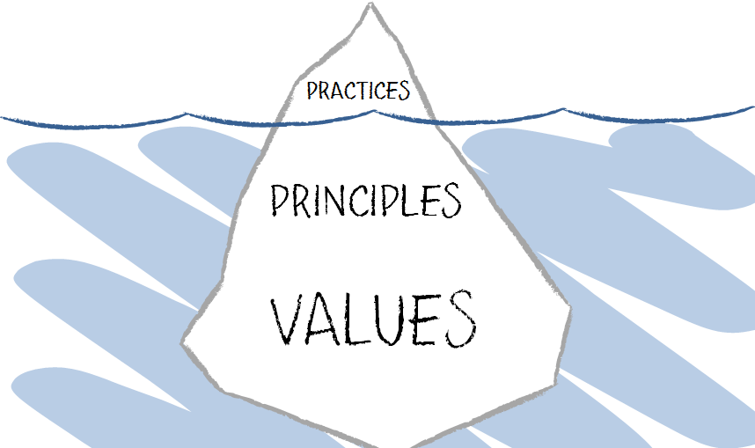
You Can’t Hide Your Principles

Slide 113
Collaborative Communication Skills
“Effective interpersonal communication skills are essential whether one is coaching an individual person, a team of people, or an organization as a whole. This ability to listen, ask open-ended questions, paraphrase, summarize and synthesize information – all within a nonjudgmental climate – are especially important.”
(March & Gaunt, 2013 p. 10)

Slide 114
Collaborative Communication Skills
Paraphrasing
Restating words – as specific as possible
Offering empathy
Restating others’ feelings about a situation
Asking clarifying questions/Requesting
clarification
A question/statement that is directly related to
what has been said
Summarizing
Concise and specific wrap-up
Offering Information
Adding factual or research based information
Asking potentially relevant questions
Questions that require adding new
information to the conversation

Slide 115
Paraphrasing Stems
So what I think I’m hearing is…
Let me know if this sounds right…
Let me make sure I understand…

Slide 116
Paraphrasing Example
Speaker: “We’ve looked at our data a million times and we still can’t agree on what the priority should be as a team moving forward.”
Coach: “So what I think I hear you saying is you’ve looked at the data as a team and no one priority makes sense to the group?

Slide 117

Offering Empathy
Specific to:
- you
- them
- situation

Slide 118
Summarizing Stems
So, to pull things together…
Let me just summarize what has been said…
Here is where we are in our process…

Slide 119
When to Summarize
At the end of a coaching session (to summarize what occurred at the current session).
At the beginning of a coaching session (to summarize what occurred at a previous session).
In the middle of a coaching session when a lot of information is being shared and the coach wants to ensure that he or she understands.

Slide 120
Clarifying Questions/ Statements
What is a clarifying question?
A question that seeks a shared understanding with the speaker by using the speaker’s own words.
(Gravois, 2011)

Slide 121
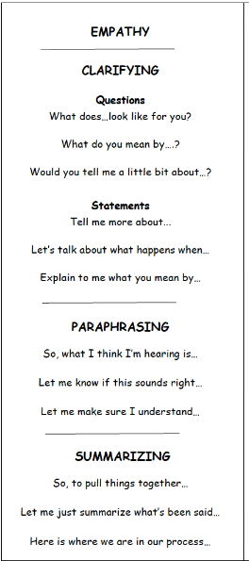
Clarifying Questions/ Statement Stems
What does…look like for you?
What do you mean by ….?
Would you tell me a little bit about…?
Tell me more about...
Let’s talk about what happens when…
Explain to me what you mean
by…

Slide 122
Example
Speaker: “When some team members talk about Tier 2 and Tier 3, they use the terms incorrectly. I’m not sure they understand what tiered interventions really are.”
Coach: “Tell me more about team members not understanding.”

Slide 123
Practice
Speaker 1: “The teachers aren’t working
on any proactive behaviors with the
students. It’s all about negative
consequences.”
Speaker 2: “I’ve started to question my
own understanding! I thought
differentiation was a Tier 1 practice, but
some team members say it’s not.”

Slide 124

Coaches Make Choices

Slide 125
Coaches Make Choices
Speaker: “This team just doesn’t get it! Every time we look at data, the team just talks about “these kids” and “these families”.
Coach:

Slide 126

Coaches Make Choices
Tell me more about the data the team is looking at.
Tell me more about “these kids” and “these families”.
Tell me more about the people you think are the worst?
Tell me more about people not knowing what to do?

Slide 127
Collaborative Communication Sort
1
2
3
Look at the coach’s statements/ questions and decide the following:
Is this a clarifying
question? (using speakers words to request more information about what’s been said)
Is this going to take you up or down the escalator?
Read the transcript from the speaker
Sort the cards accordingly

Slide 128
Speaker Transcript
Speaker: “We are having a hard time with Tier 1 expectations. We’ve been meeting several times a month and don’t seem to be making progress. Our matrix development is going terribly. Everyone argues about what should be included. One team member keeps saying that we should just make a list of all the things kids do wrong and then decide how best to create consequences. I know we should be teaching positive behaviors but it’s hard. The kids are very resistant to any of this as well. I’m constantly trying to reel them all in.”

Slide 129
Question Examples
1. Can you tell me more about what you mean by tier one expectations?
8. You’ve had over a month already to do the matrix.
15. Why are you meeting several times a week?
9. Why don’t you tell them to stop?
16. What do those meetings look like?
2. I’m concerned that you aren’t further along with your matrix. What exactly is happening with that?
10. Does the team member who wants to make the list always send their students to the office?
17. When you say the kids are resistant, what do you mean?
3. Do you think you are being effective at reeling them in?
18. I think you need to attend the coaches training.
11. Tell me more about the kids being resistant.
4. Are you also arguing?
19. Okay, so I think I hear you saying that meeting are challenging and there is some concern over an emphasis on negative behaviors. Is that correct?
12. Tell me more about your matrix. What does it look like now?
5. Let’s talk about the arguing.
6. Why is it hard to teach positive behaviors?
13. Who are the people arguing in the meetings?
7. What negative behaviors do they want to list?
14. Let’s talk about your progress.
20. That sounds very frustrating!

Slide 130
Sort in workbook
Example of Clarifying |  | Non-example of Clarifying
Takes conversation in a positive direction | Takes Conversation in a negative direction
#1 - Can you tell me more about what you mean by tier one expectations? | #5 - Let’s talk about the arguing. | #2 - I’m concerned that you aren’t further along with your matrix. What exactly is happening with that?

Slide 131
Levels of Impact and Training Methods

Slide 132

Observe and Record Feedback for the Coach

Slide 133
Levels of Impact and
Training Methods

Slide 134

Practice in Triads
Coachee
Coach
Observer

Slide 135

Unpacking and Processing

Slide 136
Levels of Impact and Training Methods

Slide 137

Trustworthy Communication

Slide 138
Moving forward
Use the Communication Skills bookmark (refer to workbook and resources folder).
Identify a skill or belief you would like to grow in. How will you monitor your growth?
Identify a school based coach who would benefit from learning about and practicing some of these skills. Make a plan for sharing/modeling/practice/feedback.
Watch for information about Systems Coaching 102!

Slide 139
Managing Complex Change
Source: Adapted from Knoster, T., Villa R., & Thousand, J. (2000). A framework for thinking about systems change. In R. villa & J. Thousand (Eds.), Restructuring for caring and effective education: Piecing the puzzle together (pp. 93-128). Baltimore: Paul H. Brookes Publishing Co.

Slide 140

Great skills make
great coaches!
Your job already requires critical coaching skills:
Listening
Building trust
Relationships building
Communication
Problem solving
Data analysis
Collaboration

Slide 141
Identify Your Core Competencies
(Skills)
3 components to this tool to help you identify strengths and opportunities for growth as a facilitator:
(1) skills and knowledge;
(2) emotional intelligence; and
(3) will and capacity
Complete Section 1: All 3 subsections
Team Development & Facilitation
Communication
Conflict & Commitment
Aguilar, The Art of Coaching Teams, pg. 299-300

Slide 142
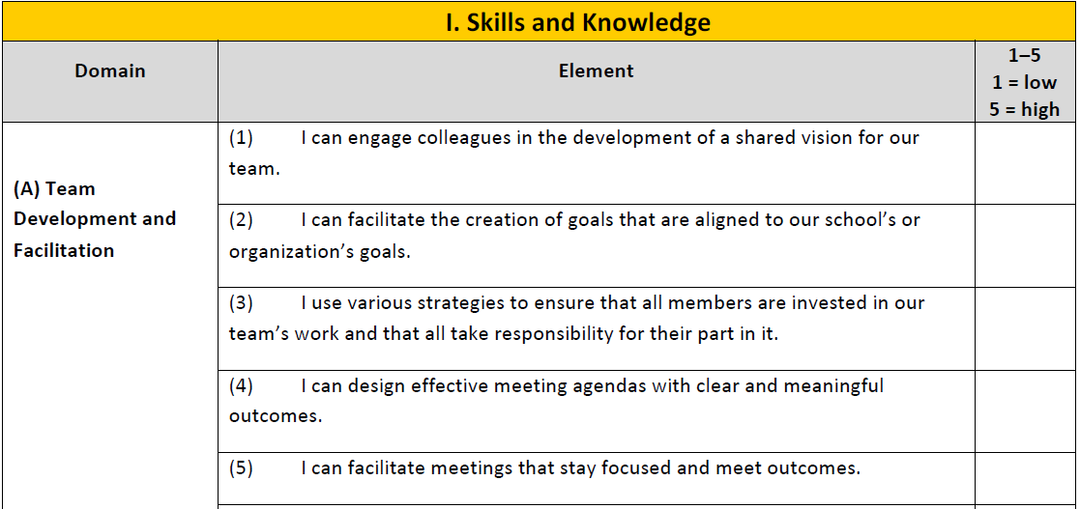
Facilitator Core Competencies
Aguilar, The Art of Coaching Teams, pg. 288
Workbook pages 63-64 - fillable

Slide 143

Evaluation Link
Evaluation
Thank you for spending time with us the past two days. Please complete the evaluation to provide us feedback to assist with our planning.
https://tinyurl.com/VTSSSCI1010

