Slide 1

Workbook
VTSS Systems Coaching Institute 101
March 2026

Slide 2
Virtual Community Agreements:
Community Agreements | Overall | Chat | Breakouts
Be Responsible | Take care of your personal needs | Post positive, on-topic comments Post questions in the Chat Box | Take part in breakout activities and polls
Be Respectful | Listen to others Please mute your sound Follow up and complete tasks | Use inclusive language | Respond courageously Please unmute and share your video in breakouts
Be Engaged | Please keep your video on as much as possible Ask what you need to know to understand and contribute | Share your expertise, information and ideas | Ask solution oriented questions
For Presenters | Provide access to current materials | Monitor chat box to respond to participants | Provide break-out directions in chat box, once assigned
What is Virginia’s Tiered System of Support (VTSS)?
Roles for your team:
Facilitator – manages the group process
Note-Taker – captures next steps in action-planner
Timekeeper – tracks time in break-outs
Communicator – reports to the larger group, if requested
Process Observer - prompts for participation of all

Slide 3
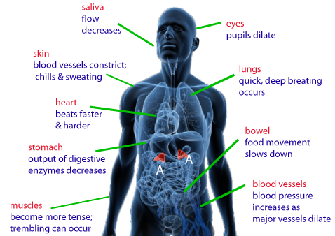
MTSS 101
First and foremost, this work is about SYSTEMS!!
Systems Analogy
Most of us have a GP - a doctor who is our biological systems manager, one that helps us achieve, maintain, prevent, and or tune-up our subsystems which make up our whole body.
Your GP has a maintenance checklist of those subsystems, they proactively request blood work to analyze health of cells, check your blood pressure, ears, send you for your colonoscopy/mammograms etc., making sure all your subsystems are working as a whole to achieve ultimate health, energy and quality of life. That is what you want your GP to do. And when something gets out of whack with one of your subsystems, such as palpitations of the heart, your GP might send you to a subsystems specialist - a heart doctor.

Slide 4
SYSTEMS COACHING
What is an MTSS Systems Coach?
A Systems Coach serves as a liaison for the division leadership team (DLT) and the school’s leadership team(s) (SLT) to guide sustainable organizational change to implement MTSS and to guide systems intervention at the school level.
A systems coach facilitates systems thinking.
Goals of Systems Coaching
Improve Division Systems & Build Local Capacity
Improve PreK-12 classroom & school Systems & Practices
Improve Student Outcomes

Slide 5
SYSTEMS COACHING
What skills and knowledge will you need?
Expertise in systems thinking, organizational change, and implementation science
MTSS content knowledge and coaching skills for implementation of practices
Ability to build the capacity of others in the practice of reflection through data-informed decision-making and a commitment to sustainable change
What is Systems Change?
A system is a set of interacting or interdependent component parts forming a complex/intricate whole.
Systems thinking allows us to understand that all the components of a system are related and need to be assessed to ensure they are not getting in the way of successful student outcomes.
Systems change aims to bring about lasting change by altering underlying structures and supporting mechanisms which make the system operate in a certain way. These can include policies & regulations, processes and procedures, relationships, resources (human, fiscal and material), power structures and values.
Name some systems you see in an educational system?

Slide 6
SYSTEMS COACHING
Three principles that guide systems coaches’ work:
Principle 1: Understand the system to understand outcomes.
Principle 2: Systems-level change is an intentional and continuous process.
Principle 3: Systems-level change is an adaptive challenge.
In breakout room, discuss the following:
Principle 1: Understand the system to understand outcomes
What do systems-level principles mean to me?
Is the idea of seeing the systems new for you, or are you familiar with the concept?
Why do you think seeing the system is important to coaching?
How would you explain the concept of a system to a team?
The “work” doesn’t work without systems!
Division leadership teams, with the help of division systems coaches, must be aware of the multiple systems at work within a division.
They must continuously analyze the health of those systems through a variety of data points.
Coaching is one of those systems!

Slide 7
Components of an Education System Handout
HUMAN RESOURCES
MATERIAL RESOURCES
Education
System
FISCAL RESOURCES
$$$$$$
PROCESSES AND PROCEDURES
POLICIES AND REGULATIONS
Reading the scenario about Greenleaf with your breakout group, pause at each question or statement.
Have a recorder write the systems component (1-5) that is the best fit.
Material Resources
Human Resources
Processes and Procedures
Policies and Regulations
Fiscal Resources

Slide 8
Greenleaf Middle School Scenarios
Scenario
Greenleaf Middle School is a large urban middle school, and a week before school is to open, 67 new students enrolled somewhat unexpectedly.
At a staff meeting prior to the new school year beginning Greenleaf Middle set a goal to improve science outcomes for 6th-grade students. They have six teachers who will be implementing the new science curriculum to meet this goal. Three weeks into implementation, three teachers have not received their new science curriculum materials and, therefore, cannot fully implement the new lessons and are using old materials.
As a result, in which system component does this best fit?
Another teacher does have the materials but does not believe that the new curriculum or lessons will improve the science outcomes like his own lessons.
In which system component does this best fit?
One teacher has received part of the curriculum with some of the materials. School procedures will not allow teachers to order materials that are needed. They must get special permission from the principal.
Which system component does this best fit?
The principal has allocated all his remaining budget to the new reading curriculum and materials associated with it because he was not anticipating an increase in enrollment.
In which system component does this best fit?
The principal at Greenleaf is hesitant to request further science and reading materials because division policies state that a principal could receive a negative (not in place) evaluation mark if she/he under-identifies the number of curriculum materials needed for the school year.
Which system component does this best fit?

Slide 9
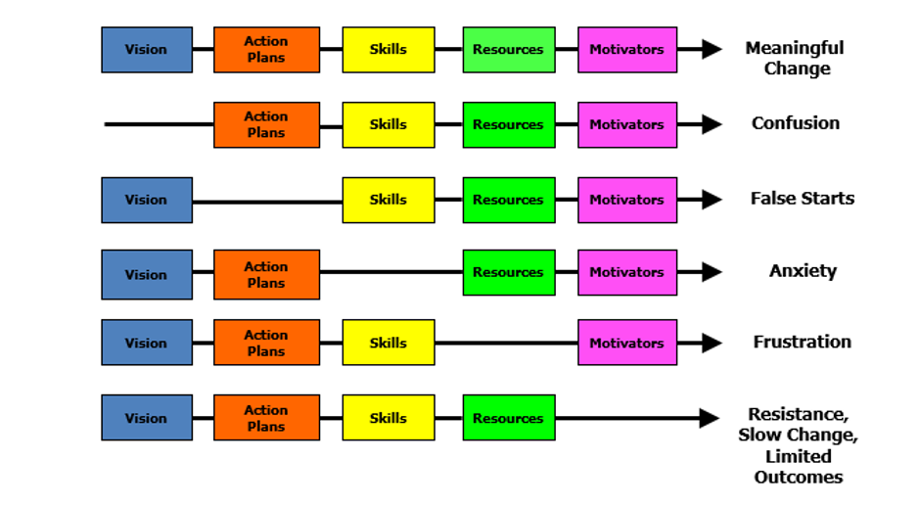
Managing Complex Change
Source: Adapted from Knoster, T., Villa R., & Thousand, J. (2000). A framework for thinking about systems change. In R. villa & J. Thousand (Eds.), Restructuring for caring and effective education: Piecing the puzzle together (pp. 93-128). Baltimore: Paul H. Brookes Publishing Co.

Slide 10
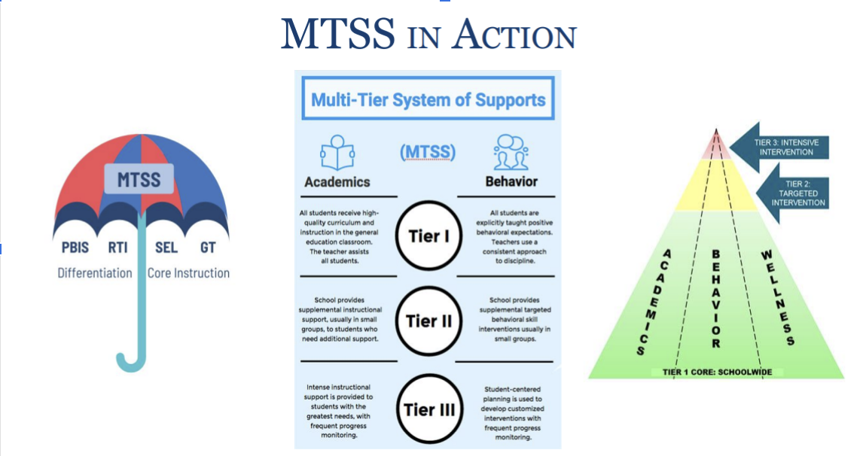
What is a Multi-Tiered System of Support (MTSS)?
What is a Multi-Tiered System of Support (MTSS)?
MTSS is a systemic, data-driven approach that allows divisions and schools to provide evidence-based practices and interventions to meet the needs of their students. This is done through a clearly defined process that is implemented to fidelity by all stakeholders within the school and/or division.

Slide 11
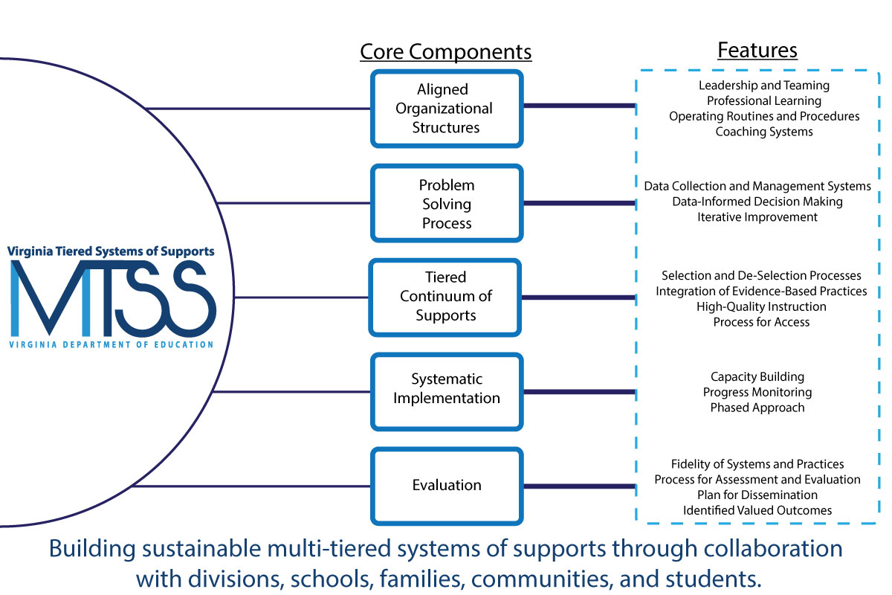
Virginia’s MTSS Five Core Components & Features 2.0
Aligned Organizational Structures: The intentional organization of a system’s processes and components that work in concert to support a common vision, mission, and set of identified goals.
Leadership and Teaming: Implementation of evidence-based practices and systems are guided, coordinated, and administered by a local team comprised of representation from leadership, stakeholders, implementers, consumers, and content experts. This team is responsible for ensuring high implementation fidelity, communication, management of resources, and data-based decision-making (PBIS Blueprint)
Professional Learning: Activities that are data-driven, content-focused, and aligned to the instructional and growth needs of all students and staff. Professional learning activities should be collaborative, purposeful, planned, sustained over time, job-embedded, classroom-focused, and aligned with VDOE's mission and vision (Michigan MTSS Practice Profile).
Operating Routines and Procedures: Detailed step-by-step explanations of procedures and standards necessary for districts and schools to be successful (e.g., communication, planning, funding, and policy).
Coaching Systems: Coaching for systems change involves collaborating with school and division leaders to develop, implement, and sustain an MTSS framework that emphasizes educational environments that improve student outcomes through leadership, facilitating resource allocation, fidelity of evidence-based practices, and addressing large-scale reform and whole-school organizational improvement (Brown et al., 2005; Fixsen et al., 2005; Fullan & Knight, 2011; March et al., 2016; Neufeld & Roper, 2003).

Slide 12
Virginia’s MTSS Five Core Components & Features 2.0
Problem-Solving Process: A process for collecting, analyzing, and evaluating data to inform educational decisions about instruction, intervention, implementation, resource allocation, policy development, and movement within a multi-tiered system.
Data Collection and Management Structures: Includes the collection, organization, storage, visual display, and reporting of data. Data systems (e.g., data collection tools and applications) promote consistent data collection and reflect a range of settings and stakeholders (e.g., community data, student and family perceptions).
Data-Informed Decision-Making: A consistently used process for analyzing and evaluating data to inform educational decisions about instruction, intervention, resource allocation, professional learning, coaching, policy development, and movement within a multi-level system to support sustainable systemic improvement and whole-child learner outcomes.
Iterative Improvement: The use of a procedure to continuously refine and evaluate practices/initiatives through regular cycles of data review and iterative action planning, which results in a closer approximation to the desired outcome.
Tiered Continuum of Supports: A three-tiered continuum of integrated academic, behavioral, and social-emotional instruction, intervention, and support that is evidence-based and responsive to the unique needs of each learner.
Selection and De-selection Processes: The explicit act of evaluating whether to select, modify, or discontinue practices, programs, and/or initiatives based on data, contextual fit, and feasibility.
Integration of Evidence-Based Practices: The strategic selection and emphasis on using teaching and learning approaches that are proven to be effective through scientifically based studies in academics, behavior, and social-emotional wellness.
High-Quality Instruction: Curricula, practices, programs, and learning environments are data-driven, aligned with standards, evidence-based, engaging, differentiated, and meet the unique needs of each individual learner.
Process for Access: Written guidelines for requests for assistance processes and the use of school-specific data-decision rules (utilizing multiple data sources) to identify how students/staff access and exit from advanced tier supports. System-wide progress monitoring occurs to track the proportion of students experiencing success and use of advanced tier supports to modify decision rules as needed (Center on Positive Behavioral Interventions and Supports, 2020).

Slide 13
Virginia’s MTSS Five Core Components & Features 2.0
Systematic Implementation: The use of an intentional process to inform, improve, and refine practices or initiatives that can be scaled and sustained over time, resulting in improvement to valued outcomes.
Capacity Building: Refers to the development of infrastructure, including the systems, activities, and resources to support the use of evidence-based interventions and strategies for adopting and sustaining innovations (Ward et al., 2015; Ward et al., 2017). More specifically, across:
  Leadership (i.e., active involvement in facilitating and sustaining systems change to support the implementation of effective practice through strategic communication, decisions, guidance, and resource allocation).
  Competency (i.e., strategies to develop, improve, and sustain educators’ abilities to use EBPs and strategies as intended in order to achieve desired outcomes).
  Organization (i.e., strategies for analyzing, communicating, and responding to data in ways that result in continuous improvement of systems and supports for educators to use EBPs and strategies with good outcomes (Ward et al., 2017)).
Progress Monitoring: Progress monitoring is used to assess students’ performance, quantify a student's rate of improvement or responsiveness to instruction or intervention, and evaluate the effectiveness of instruction using valid and reliable measures (Center on Multi-Tiered System of Supports at the American Institutes of Research, 2023). At the systems level, progress monitoring is used to assess overall intervention effectiveness and improvement.
Phased Approach: Whether programs or practices are newly selected or being scaled requires strategic planning, resources, and time. Change at the building or division level should be implemented in discernible phases (e.g., implementation science, improvement science) to explore, test, and evaluate the feasibility and effectiveness at a manageable scale and in a timely and effective manner. The systematic study of practices in such a way supports organizations to invest in creating the infrastructure necessary to scale up and sustain over time (Fixen et al., 2005).

Slide 14
Virginia’s MTSS Five Core Components & Features 2.0
Evaluation: A plan for gathering, communicating, and reporting information around key questions to monitor impact, determine potential barriers, and inform decisions related to identified valued outcomes.
Fidelity of Systems and Practices: Fidelity focuses on how well a program or practice is being implemented, including not only the person who is implementing it, but the quality of the systems in place to support its use, such as the selection, training, and coaching systems. Fidelity data informs and engages all stakeholders (e.g., division staff, instructional coaches, building administrators, and teachers) as new skills are implemented and refined. Results can be used to celebrate and reinforce progress or to provide support and guidance around organizational improvement in specific practices and skills (Active Implementation Hub, 2015).
Process for Assessment and Evaluation: At each level of implementation (i.e., division and school), assessments are clearly defined and match the uniqueness of each and every learner across academics, behavior, and social-emotional wellness. Schedules and timelines are documented and communicated. Reports are generated to build on strengths while also addressing areas of need at each level of implementation (e.g., level of use, student performance data, differentiated supports) for problem-solving and to inform practice. A range of strategies should be used to collect stakeholders'/partners' perspectives (e.g., community, family, and student) and monitored to create evaluation feedback loops.
Plan for Dissemination: Annual progress reports are designed and disseminated to inform external stakeholders/partners on the activities and outcomes related to MTSS implementation fidelity (Center on Positive Behavioral Interventions and Supports, 2020).
Identified Valued Outcomes: Valued outcomes help determine whether the initiative is having the intended impact on students, school personnel, families, and the community. The emphasis on valued outcomes directly informs decisions related to resources, scaling up, and/or improving effectiveness (Center on Positive Behavioral Interventions and Supports, 2020).

Slide 15
Virginia’s MTSS Five Core Components & Features 2.0
References
Active Implementation Hub (2023, August). AI Modules and AI lessons. https://implementation.fpg.unc.edu/resource/active-implementation-formula-framework-overviews-modules/
Brown, C. J., Stroh, H. R., Fouts, J. T., & Baker, D. B. (2005). Learning to change: School coaching for systemic reform (Report prepared for the Bill & Melinda Gates Foundation). Mill Creek, WA: Fouts & Associates, L.L.C.
Center on Positive Behavioral Interventions and Supports (2020). Positive Interventions and Supports District Systems Fidelity Inventory (DSFI) - Version 0.2. Eugene, OR: University of Oregon. Retrieved from www.pbis.org
Fallan, M. & Knight, J. (2011). Coaches as systems leaders. Educational Leadership, 69(2), 50–53.
Fixsen, D. L., Naoom, S. F., Blase, K. A., Friedman, R. M., & Wallace, F. (2005). Implementation research: A synthesis of the literature. Tampa, FL: University of South Florida, National Implementation Research Network.
March, A. L., Castillo, J. M., Batsche, G. M., & Kincaid, D. (2016). Relationship between systems coaching and problem-solving implementation fidelity in a Response-to-Intervention model. Journal of Applied School Psychology, 32(2), 147–177. https ://doi.org/10.1080/15377903.2016.1165326.
National Implementation Research Network (2020). Implementation Stages Planning Tool. Chapel Hill, NC: National Implementation Research Network, FPG Child Development Institute, University of North Carolina at Chapel Hill.
Neufeld, B., & Roper, D. (2003). Coaching: A strategy for developing instructional capacity— Promises and practicalities. Washington, DC: Aspen Institute Program on Education; Providence, RI: Annenberg Institute for School Reform.
Ward, C., Fixsen, D., & Cusumano, D. (2017). An introduction to the District Capacity Assessment (DCA): Supports for schools and teachers. Retrieved from National Implementation Research Network: University of North Carolina at Chapel Hill
Ward, C., St. Martin, K., Horner, R., Duda, M., Ingram-West, K., Tedesco, M., . . . Chaparro, E. (2015). District Capacity Assessment. Retrieved from National Implementation Research Network: University of North Carolina at Chapel Hill

Slide 16
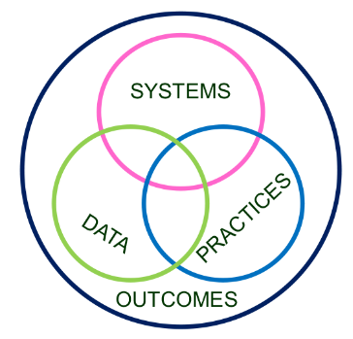
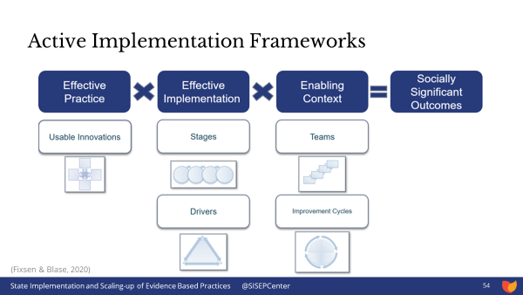
Implementation Logic
Invest in Systems!!! (Leadership teams, support professional learning and coaching)
Differentiate and ensure outcomes are reflective of all students.
Data informs decisions about screening, progress monitoring, fidelity, and equitable outcomes
Prioritize efficient and effective practices
(evidence, culture, context)
Growth & benefit are central. Must reflect equitable learning opportunities
Implementation Science

Slide 17
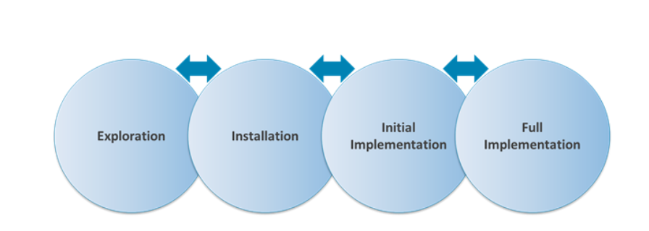
Implementation Made Simple
Your division has this THING (program, practice, intervention) that they want to do.
Your division uses the MTSS framework to organize the THING.
MTSS has these tools, strategies, activities to do THIS THING (ANY THING)
DATA tells us how much, how well we are at doing this THING.
NIRN-SISEP Center
Phases of Implementation - Phase-based work helps to successfully navigate the journey
Discuss the importance of a school/division recognizing and moving through each of the phases of implementation:

Slide 18
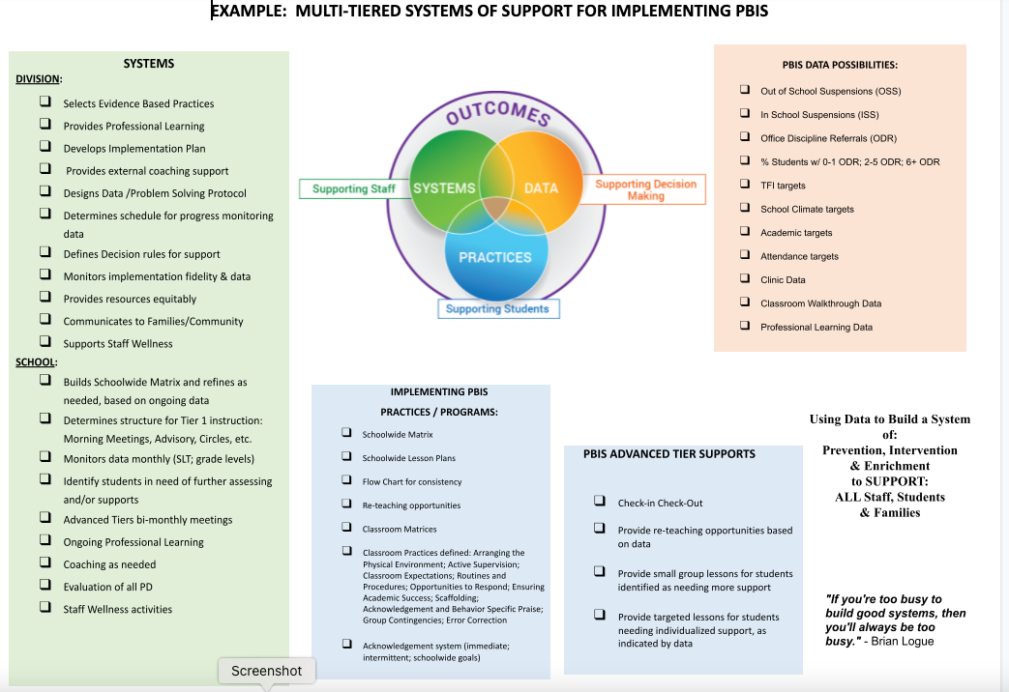
Visuals of Implementation Logic for MTSS/PBIS
Consider designing what this may look like for:
MTSS for Implementation of SEL
MTSS for Implementation of Attendance Practices
MTSS for Science of Reading Implementation
MTSS for Implementation of Restorative Practices
MTSS for Teacher Retention

Slide 19
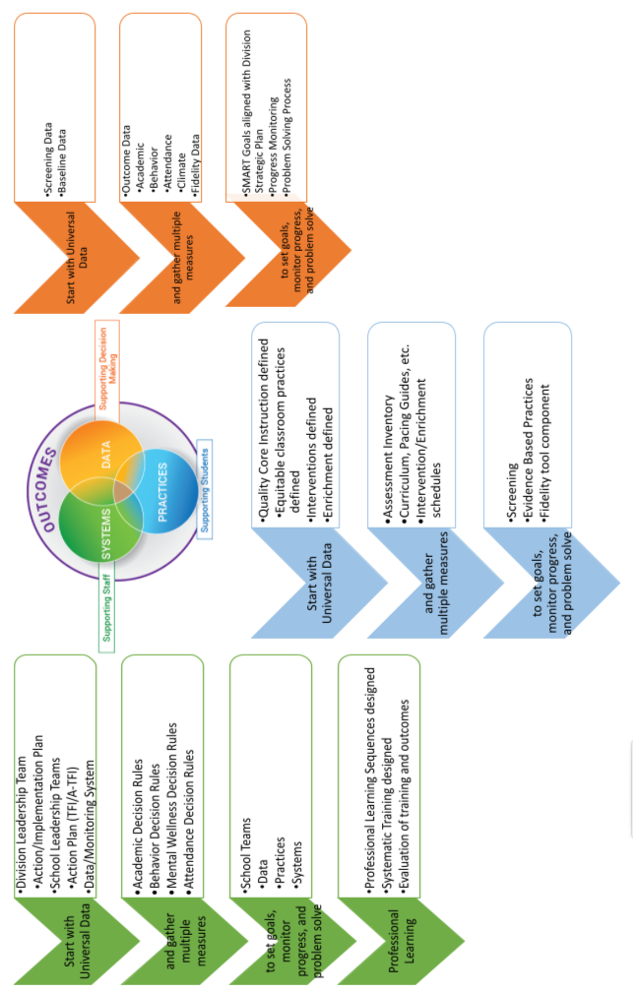
Annotated Visual of Implementation Logic

Slide 20
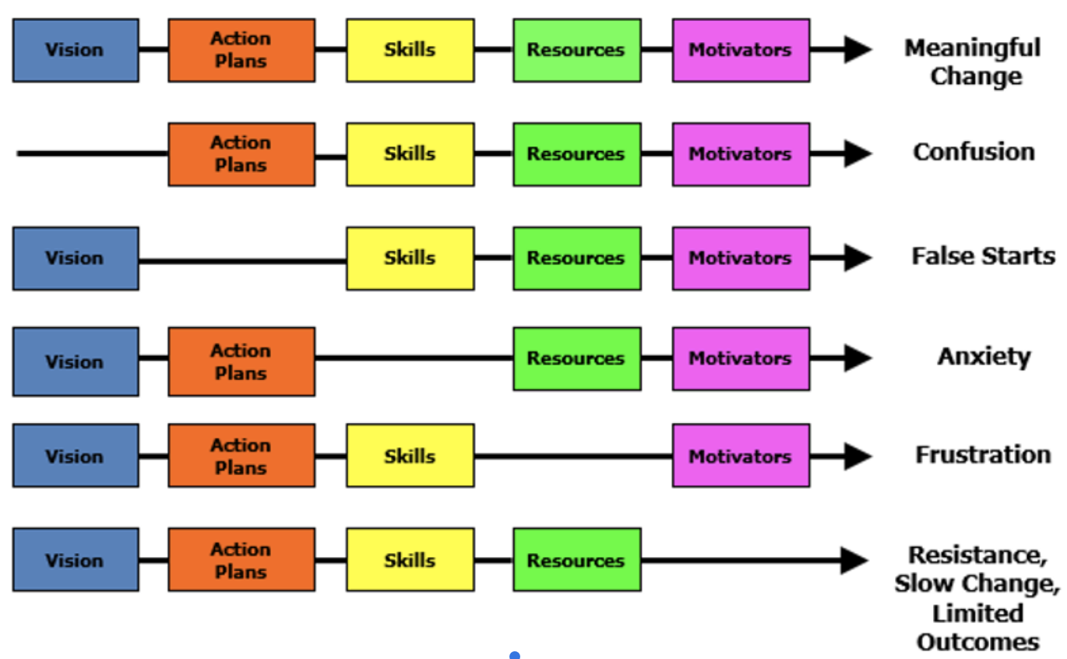
Managing Complex Change
In breakout groups, read each scenario and talk as a team about which step in managing complex change needs attention.
What were folks feeling or experiencing?
Have you experienced something similar?
Talk about what should have taken place, or what you would do differently.
Managing Complex Change Scenarios
1. Ms. Smith was the Department Chair of the English department in her high school. After a great summer off, she returned to her first week back at school with several professional learning opportunities. She was surprised to see and hear that a new curriculum was being implemented within the English department. As she took notes and gathered the resources, she kept wondering why they had chosen this curriculum and would this be the best curriculum for her students. At the division English department meeting, she asked several questions about when she would be “required” to start, if she could still use parts of the curriculum she had been using, expressing concerns if her students would “get it.”

Slide 21
Managing Complex Change Scenarios
2. Mr. Taylor is a school social worker. He has been involved in providing mental health support to his four schools that he serves. One of his schools decided to incorporate a universal approach to providing mental health support to all students using an evidenced-based program. The administration worked with the school counselors to provide a scope and sequence of rolling out the program and provided training. Mr. Taylor was not a part of the initial planning meetings due to other responsibilities at other schools he served. Ultimately, the training was excellent. Everyone understood the “why” and were so appreciative of an evidence based program to address their current needs. Once the program was implemented, many questions began to surface in regards to how and when to deliver the information and some of the support staff were confused about the steps and process of specific learning intentions.
3. For 3 years the PE teachers have been providing a specialized program on substance abuse. Through the years, folks adapted the program to meet their needs, and there was very little feedback or evaluation of the outcomes--little data was shared on fidelity of implementation. Alarmingly, there had been an increase in suspensions related to substance use, and a student death due to an overdose, which was devastating to the staff and students.
4. Mr. Jones has been implementing PBIS for two years. At first, it seemed the school was all on board and teachers seemed so excited! After two years of such dedication to the work, he’s beginning to wonder if it really matters? He often asks himself, “Am I making a difference?” “Does leadership even care about what I’m doing?” He began to think--“Why bother?!”
5. Ms. Hernandez accepted her new position as principal at ABC Elementary School. Upon arriving to the division, she was told that they had a team of teachers and staff that had began to implement a multi-tiered system of support at the school. They had just received a grant, and they were in their first year of installation. She was excited to learn more about the system of support and began digging deeper into the work with the team. They realized that the teachers were feeling more upset than excited about this new way of work. They were sharing out in the staff meetings things like, “It’s too much!” “What about training?” “How can we afford this?””This is going to take too much time out of the day.”
6. Mr. Maxwell came back from a training and shared with the staff a new book study and program called XYZ. He purchased 50 books and the license for all the teachers. The first day back at school, he quickly passed out the books with some comments and then moved on to the next agenda item. WOW! Everyone loved their shiny new book and the program seemed simple enough. After the newness wore off, Mr. Maxwell noticed that the books were collecting dust on the shelves, and that some of the teachers were not following through with some of the activities. He was pretty upset because he had spent a lot of money on this new initiative!

Slide 22
Systems Coaching within a
Multi-tiered System of Support
Coaching for Systems Change
Among other definitions and descriptions, ….”VTSS systems coaching is defined as the set of skills that provides embedded, sustained professional learning (training and coaching).”
The Why Behind Systems Coaching
Through ongoing relationships and facilitating a cyclical process, systems coaching develops the capacity of division and school leadership teams to implement and align MTSS with their mission and goals (outlined in strategic plans, continuous improvement plans, OSQ plans/MOUs, SEPI CAPs) in order to enhance student outcomes.
(March and Gaunt 2013, p. 2)
Chunk and Chew
In breakout rooms, take a processing pause to spend a few moments to reflect on the last slide within this latest chunk of content (3 minutes of silence)
Then allow each colleague share out an aha, thought or even question to consider (5 minutes to share)
Types of Activities (may include, but not limited to):
Organizing resources (Division, school, community)
Developing protocols and procedures that facilitate logistics of implementation,
Data-based planning and problem-solving;
Using data to examine fidelity and outcomes, and
Providing training and technical assistance
Being mindful of the school context, culture, and climate

Slide 23
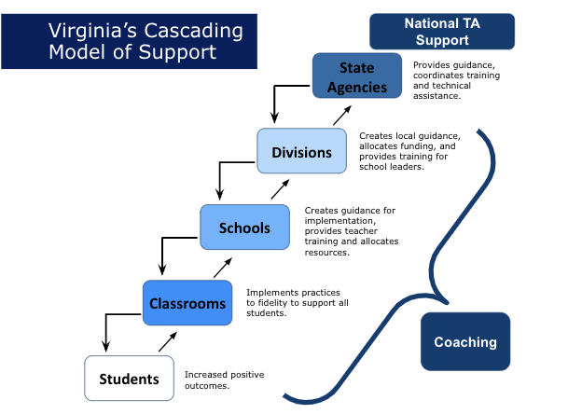
Systems Coaching within a
Multi-tiered System of Support
At different times, this includes:
Coaching for Individual Change: focus on skill development, support and performance feedback (content specific: academic, behavior, social/emotional health, behavioral health, wellness)
Coaching for Team/Group Change: focus on collaboration and facilitation, group dynamics
Coaching for Systems Change: focus on organizational change – removing barriers to implementation, aligning initiatives

Slide 24
How will Systems Coaching Occur? Context matters!
At different times, this includes:
Attend DLT and SLT meetings
Coach teams to be highly effective around data, systems and practices
Guide teams through the phases of implementation
Be a cheerleader for capacity building at all levels within the system
Coaching Supports:
Your state-level Systems Coach is there to help!
The Coaching Checklist links you to key tools used in the MTSS way of work

Slide 25
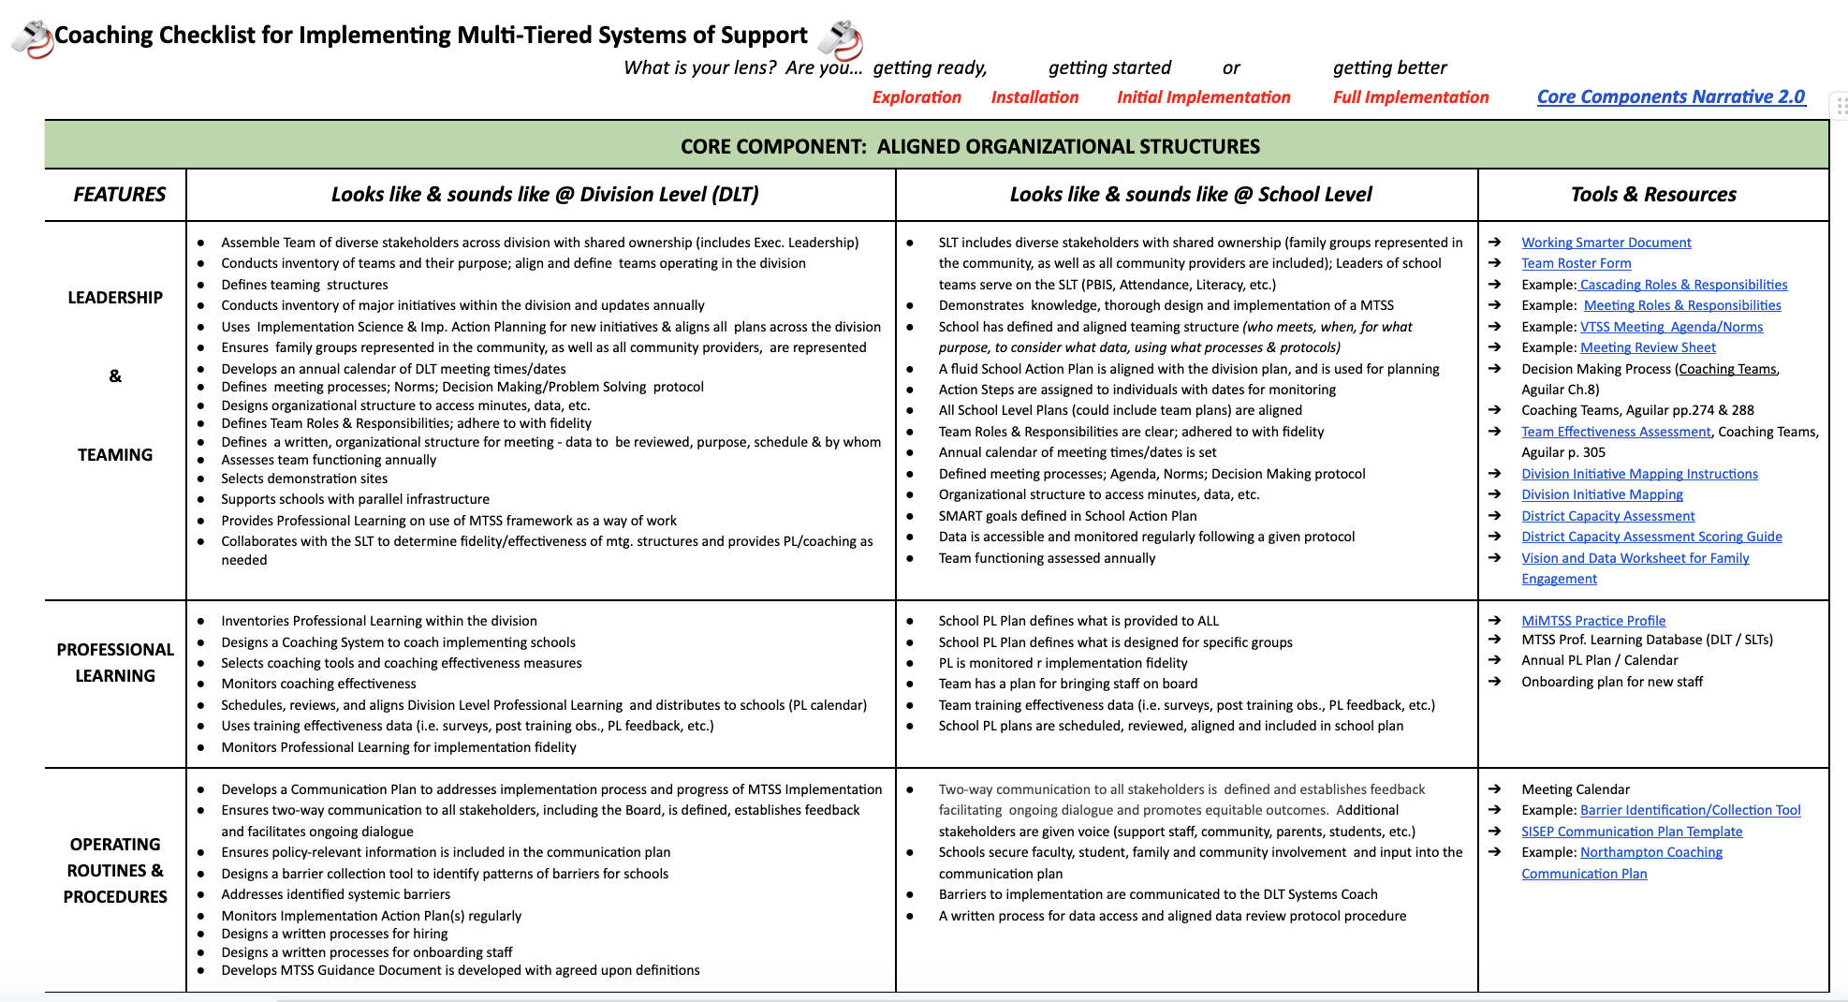
Coaching Checklist 2.0

Slide 26
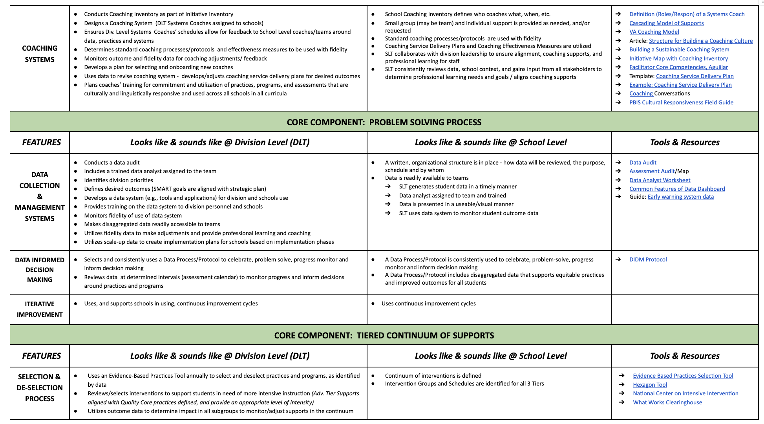

Slide 27
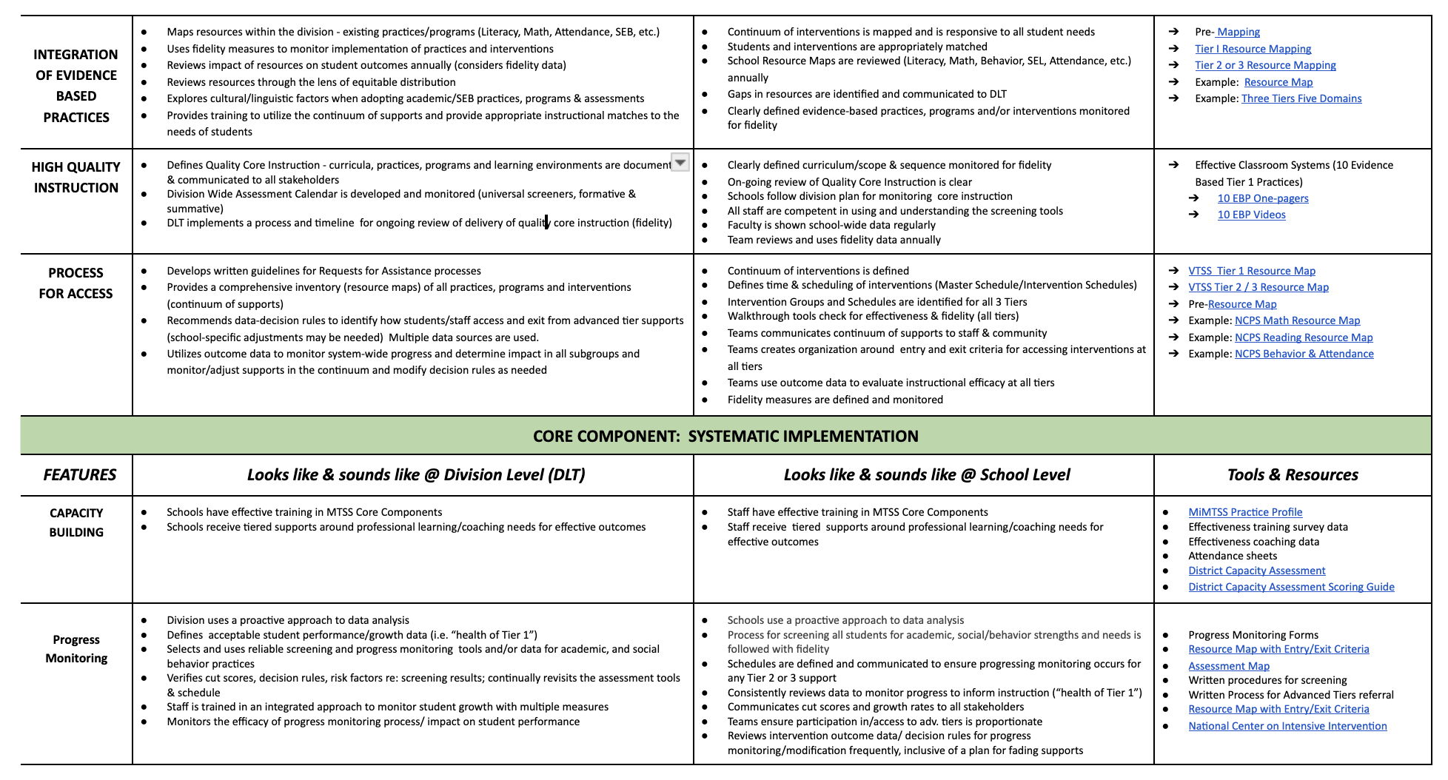

Slide 28
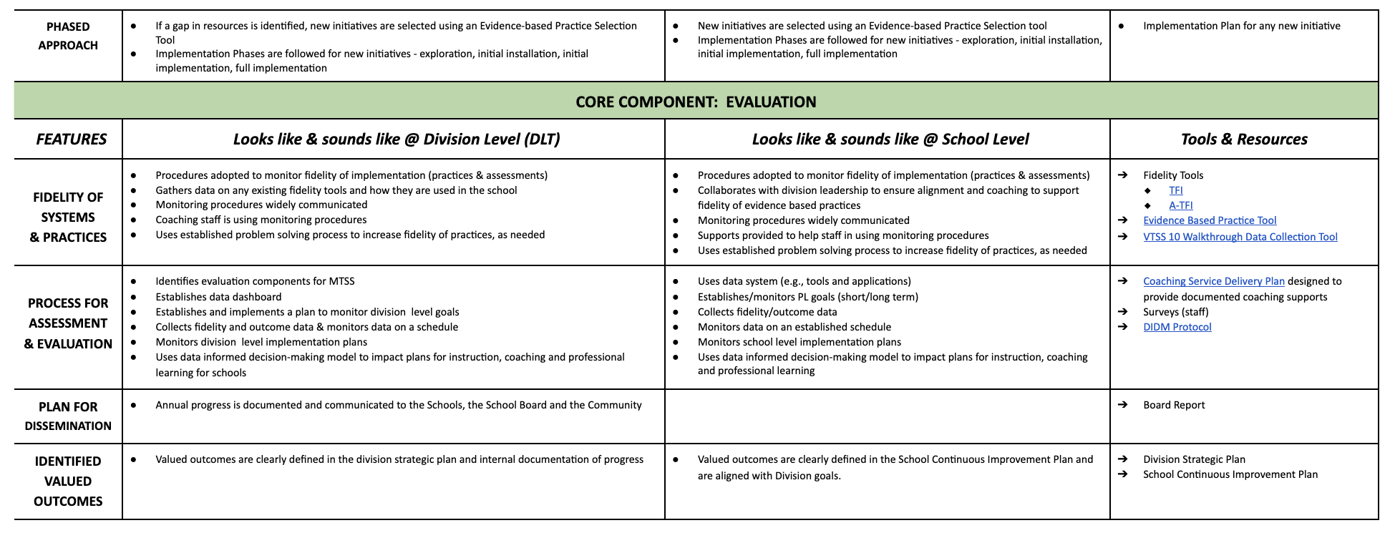

Slide 29
Notes

Slide 30
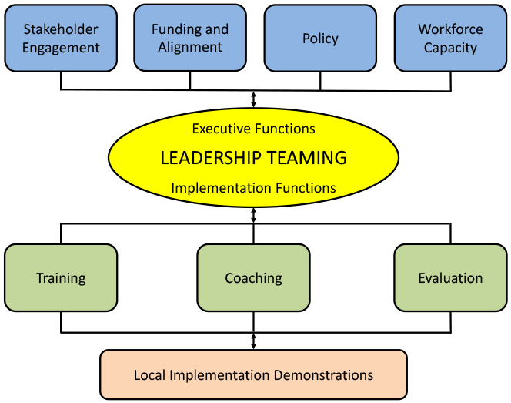
Unpacking Core Component #1 Aligned Organizational Structures
Feature 1: Leadership and Teaming
Implementation of evidence-based practices and systems are guided, coordinated and administered by a local team comprised of representation from leadership, stakeholders, implementers, consumers, and content experts. This team is responsible for ensuring high implementation fidelity, communication, management of resources, and data-based decision-making.
Functions of a Division Leadership Team
The Division will get a functional team of diverse stakeholders together
Holds the vision & drives implementation
Ensures communication pathways
Defines roles/responsibilities of teams
Develops standard meeting processes
Leads results driven action planning
Creates parallel structures for schools

Slide 31


Unpacking Core Component #1 Aligned Organizational Structures
Feature 1: Leadership and Teaming (cont.)
A Division Coordinator is named to oversee logistics and provide high-level sponsorship of the implementation effort: securing funding, allocating release time, protecting time for DLT meetings, providing leadership for alignment with existing and new initiatives, etc.
Additionally, at least one or more Division Systems Coaches are identified. That’s you!
Division Coordinator may also serve as a division coach, or share roles and tasks with a partner.
Find the sample Roles and Responsibilities link in the Coaching Checklist
REFLECTION: Review the “MTSS Roles and Responsibilities” and examine how it flows from top to bottom
Are your teams designed to serve the identified roles and responsibilities? What do you have? Where are there gaps?
Do you notice common threads across entities?
Resources to support your work: https://brightmorningteam.com/

Slide 32
MTSS Cascading Roles and Responsibilities
(SAMPLE) VTSS CASCADING ROLES & RESPONSIBILITIES
Depending on the size and needs of the Division, they may have some or all of these defined roles
EXECUTIVE LEADERSHIP TEAM (ELT):
This team is more common in larger divisions where large scale work is more distributed
Be the public presence (messaging) in support of implementation efforts (spread the vision and clear expectations for division initiatives)
Participate in Quarterly meetings for updates from DIT and assistance in addressing barriers
Support progress monitoring efforts, facilitating communication and addressing barriers as needed
DIVISION LEADERSHIP or IMPLEMENTATION TEAM (DLT or DIT)
Divisions that do not have an ELT, may choose to call this team the Division Leadership Team (DLT)
Attend monthly team meetings
Send a representative group to statewide training events that will report back to entire team
Develop and progress monitor annual division implementation plan
Progress monitor school level implementation for fidelity and alignment of division initiatives and anticipated outcomes
Design a coaching system to support school level implementation
Support systems coaches’ professional growth plan; schedule and provide space for coaches’ meetings
Ensure access to, and effectiveness of, coaching service delivery plans
Design Professional Learning plans for all staff around division initiatives
Monitor progress and fidelity to coaching plans
Design and monitor grant funds, and build sustainability within the division

Slide 33
MTSS Cascading Roles and Responsibilities (cont.)
DIVISION COORDINATOR:
Schedule and facilitate/monitor DLT (and quarterly ELT meetings)
Organize and facilitate access to funds, resources, and professional learning opportunities associated with VTSS
Organize and facilitate access to Division VTSS google drive
Ensure effective and timely communication of plans, progress, and outcomes across the division both up and down the organizational chart
Design professional growth plans for the coordinator and division level coaches to increase knowledge and skill sets required to support advancements in division implementation
DIVISION COACH:
Assess the strengths and needs of building coaches to support implementation at the building level
Communicate coaching service delivery and implementation barriers to DLT/ELT
Design and deliver bi-monthly professional learning opportunities for building coaches
Support BIT in designing and delivering professional development to staff focused on increasing understanding of PBIS/VTSS and capacity to implement related classroom practices
Participate in professional growth plan to increase knowledge and skill sets required to support advancements in division implementation

Slide 34
MTSS Cascading Roles and Responsibilities (cont.)
EXTERNAL COACHES: (Large divisions may have Cohort Coaches who serve a cluster of implementing schools)
Assess the strengths and needs of building coaches to support implementation at the building level
Communicate coaching service delivery and implementation barriers to DLT/ELT
Design and deliver monthly (or as agreed upon) professional learning opportunities for building coaches
Support BIT in designing and delivering professional development to staff focused on increasing understanding of PBIS/VTSS and capacity to implement related classroom practices (TFI 1.7-1.9)
Participate in professional growth plans to increase knowledge and skill sets required to support advancements in division implementation of initiative(s)
Assist in administration of Tiered Fidelity Inventory
BUILDING PRINCIPALS:
Participate in annual TFI administrative interview, team reflection, and action planning
Select members of BIT (TFI 1.1) to support PBIS/VTSS efforts
Principal or designated administrator attends monthly BIT meetings
Principal or designated administrator attends designated division wide Coach and Administrator meetings
Support progress monitoring efforts and facilitate communication as needed - public presence in support of implementation efforts [refer to best practices tip sheet]
Design and support systemic and sustainable professional learning (TFI 1.7)
Support systematic implementation of Effective Classroom Practices (TFI 1.8, 1.9)

Slide 35

SCI 101 Learning Intentions -
What we will know and do…
Day 1:
Examine, understand and apply “systems” in education, systems change, and addressing complex change
Understand how the MTSS framework can be applied to any initiative
Understand the Role & Responsibilities of a Division Systems Coach
Develop knowledge of VA’s MTSS 5 Core Components and their Features 2.0 and tools to support implementation
Day 2:
Continue to apply the division system coaching lens to the 5 MTSS Core Components and their Features
Develop conceptual understanding and skill acquisition of effective communication skills and their place within aligned organizational structures
Complete a Coaches Self-Assessment
MTSS Implementation to Coaching
WHAT
HOW
Additional Lenses to Consider:
Trauma informed
Culturally responsive
Diversity and Inclusion

Slide 36
MTSS Cascading Roles and Responsibilities (cont.)
BUILDING COACHES:
Schedule and facilitate monthly BIT meetings
Ensure meeting minutes, implementation artifacts, and implementation barriers are shared with DIT/DLT
Work with BIT to share data monthly with school staff
Provide professional development opportunities to staff focused on increasing understanding of PBIS/VTSS and capacity to implement related classroom practices
Work with school administration to ensure team efforts align with school improvement goals
Attend division wide coaches meetings
BUILDING IMPLEMENTATION TEAM MEMBERS:
Participate in monthly BIT meetings and fulfill meeting roles
Participate in creating, implementing, and monitoring a school wide PBIS/VTSS action plan
Assist in sharing data monthly with school staff
Provide professional development opportunities to staff focused on increasing understanding of PBIS/VTSS and capacity to implement related classroom practices
Support staff in implementation of practices and facilitate access to resources as needed
* Developed in collaboration with Accomack and Newport News Division VTSS Teams

Slide 37
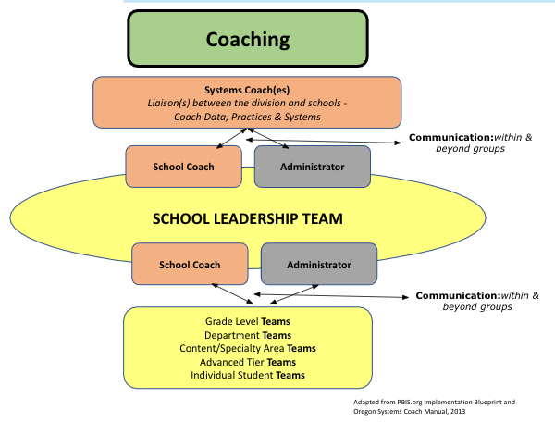
Systems Coaching within a
Multi-tiered System of Support (continued)
Why Coach?
Coaching bridges the research-to-practice gap. Training supported by on-going coaching results in teachers implementing 80-90% of new practices.
Your focus is on coaching TEAMS
Coaching at this level focuses on helping teams 1. develop their collaboration and facilitation skills, 2. establish team operating procedures, 3. understand group dynamics, and 4. solidify data-driven decision making processes.

Slide 38
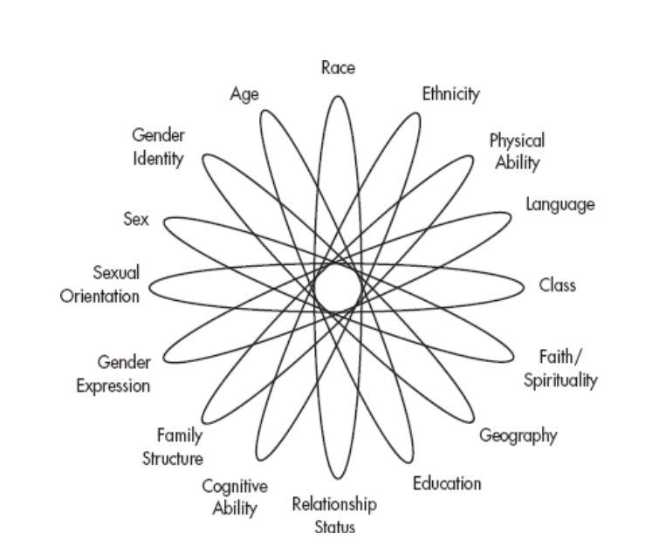
Who Should be on Your Division Leadership Team?
Division Coach and/or Division Coordinator
Superintendent / Executive authority (funding/policy)
Individuals who are able to make decisions/expertise:
  Director of Instruction
    Key Department Leads, e.g. Literacy, Math, CTE, etc.
  Director of Student Support Services
    Behavior Specialist
  Director of Special Education
  Data Analyst
  Director of Professional Learning
  Director of Family and Community Engagement
  Any others who have the authority and expertise to help with implementation
Are diverse identities represented on your team? Our identities inform and influence decisions made!
“A leader is anyone at any level who takes responsibility for finding the potential in people and processes and has the courage to develop that potential.”
-Brene’ Brown

Slide 39
Who Should be on Your School Leadership Team?
Division coach to support the team!!
School Administrator(s)
Content area reps: Literacy, Math, CTE, etc.
Grade level leadership
Individual with Special Education expertise
Intervention providers
School Counselor
Behavior expertise
Data collector & analysis expertise
Family & Community stakeholder(s)
Student representatives - key to secondary
*Not an exhaustive list; context matters
Other Considerations:
School psychologist? School nurse? School resource officer? Community mental health provider?
How will you get input from youth, family and community members?
Do you have a balance of personality/preference/work styles?
(Resources: NSEW, 16 Personalities, Strengths Finder, What’s Your Color?
Coaching Pause: Reflect on your current team composition and answer the following questions:
Do you have family and community voice on your teams?
Do your teams represent diversity?
Do you have the right team members on your team to accomplish your division goals?
What might be some “look fors,” and what
coaching moves might you make?

Slide 40
Aligned Organizational Structure
Leadership and Teaming continued
The Division will establish a highly functioning team and then guide schools to do the same. Consistent structures and processes make your work for efficient and more effective!
Teaming Structure (Division / School)
  What teams meet when
  For what purpose
  Considering what data
Team processes
  Document team members, meeting schedules
  Effective meeting agendas
  Community agreements or norms
Working Smarter Not Harder
Team/ Work group/ Committee | Purpose | Outcome | Who benefits | Schedule | Membership | How is the work related to school improvement plan? High priority?
Video resource: Team Check-ups with Gloucester & Cumberland

Slide 41
Aligned Organizational Structure
Leadership and Teaming continued
Creating an Enabling and Collaborative Context
Effective team structures and processes will free up systems coaches and team members to focus on the work. An effective coach creates a hospitable environment (culture) to support the use of skills through effective communication, collaboration, problem-solving, and shared ownership by demonstrating flexibility, supportiveness, approachability, and trustworthiness in a non-judgmental, hospital environment for individuals, teams and leaders.
Practice Communication Skills
Active listening
Paraphrasing and summarising
Asking clarifying questions
Acknowledge Strengths
Role effectiveness
Deep understandings of the work
Accomplishing tasks
Taking risks or thinking creatively
Notice
Who is speaking most, leading most?
Is there a balance of voice?
What’s on most agendas?
What are the conversations about?
Are there pattern of barriers?
NIRN Practice Profile for Coaching/Enabling Context for EBPs

Slide 42
Trust as the Foundation for Coaching
Creating an Enabling Context for Coaching - NIRN
What are some things you (can) do as a leader to build trust?
Why is trust so important?
Psychology Today - The Neuroscience of Trust: Researchers have pinpointed two brain regions associated with trust. it has more about the brain science if you’re interested!
The NIRN Practice Profile for Coaching is another excellent resource to dive deeper into coaching skills and the research behind them. We’ve also created a 1-pager of the NIRN Practice Profile for quick reference.

Slide 43
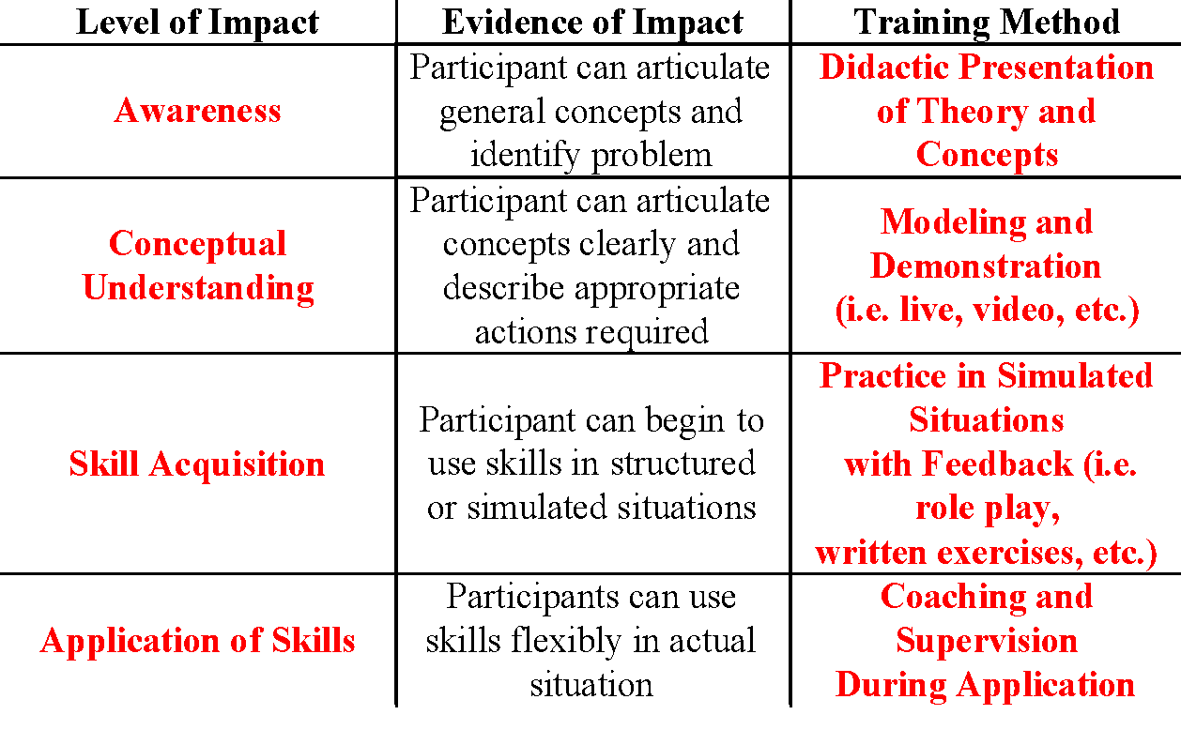
Unpacking Core Component #1 Aligned Organizational Structures (cont.)
Feature 2: Professional Learning
Activities that are data-driven, content-focused, and aligned to the instructional and growth needs of all students and staff. Professional learning activities should be collaborative, purposeful, planned, sustained over time, job-embedded, classroom-focused, and aligned with VDOE's mission and vision.
Coaching Pause: Reflect on your current team composition and answer the following questions:
Is there an aligned Professional Learning (PL) calendar for the division or is it siloed?
Do all teachers/staff get the same thing?
How do you provide PL suited to the needs and wants of teachers?
Does every presenter develop and post learning intentions and consider levels of impact?
Is PL effectiveness data collected?
How can you coach your team to move toward a strong system of Professional Learning?

Slide 44
Unpacking Core Component #1 Aligned Organizational Structures (cont.)
Feature 3: Operating Routines and Procedures
Detailed step-by-step explanations of procedures and standards necessary for districts and schools to be successful (e.g., communication, planning, funding, and policy).
Here are just a few Operating Routines and Procedures to consider and tools to support the development:
How does the division/school(s) select which Evidence-Based Practices will best fit the needs of your students and fit your context considering your capacity? What supports are need to make implementation with fidelity possible? NIRN’s Hexagon Tool might help you develop consistent “procedures” for selection.
Do you have a written Communication Protocol that explicitly describes how information is communicated from the school board to families and community and all levels of the cascade? NIRN Communication Protocol; Michigan District Communication Plan
School Board
Division
Schools
Classrooms
Students/Families/Community

Slide 45
Unpacking Core Component #1 Aligned Organizational Structures (cont.)
Feature 3: Operating Routines and Procedures (cont.)
Coaching Pause: Consider your school division’s communication system through the lens of MTSS:
What are its parts?
Who are the stakeholders involved?
What outcomes, data, practices and systems should be considered?
What other systems are impacted when a change is made in this system?
Where does communication begin? End?
How is it documented? DCA item 10.
How can you coach your team to move toward a strong system of communication?

Slide 46
Unpacking Core Component #1 Aligned Organizational Structures (cont.)
Feature 4: Coaching Systems
Coaching for systems change involves collaborating with school and division leaders to develop, implement, and sustain an MTSS framework that emphasizes educational environments that improve student outcomes through leadership, facilitating resource allocation, fidelity of evidence-based practices, and addressing large-scale reform and whole-school organizational improvement.
What is coaching?
Coaching is defined as regular, job-embedded professional learning designed to help teachers and staff use an evidence-based practice or program as intended. Coaching bridges the research-to-practice gap. Training supported by ongoing coaching results in teachers implementing 80-90% of new practices.

Slide 47
Unpacking Core Component #1 Aligned Organizational Structures (cont.)
Feature 4: Coaching Systems (cont.)
Coaching
Systems Coach(es)
Liaison(s) between the division and schools -
Coach Data, Practices & Systems
Communication: within & beyond groups
School Coach
Administrator
SCHOOL LEADERSHIP TEAM
School Coach
Administrator
Communication: within & beyond groups
Grade Level Teams
Department Teams
Content/Specialty Area Teams
Advanced Tier Teams
Individual Student Teams
A Coaching System is necessary to ensure building level teams and school staff have equitable access to high quality, tiered professional learning and coaching!
Resources:
Guide to Building a Sustainable Coaching System
Virginia’s MTSS Coaching Model

Slide 48
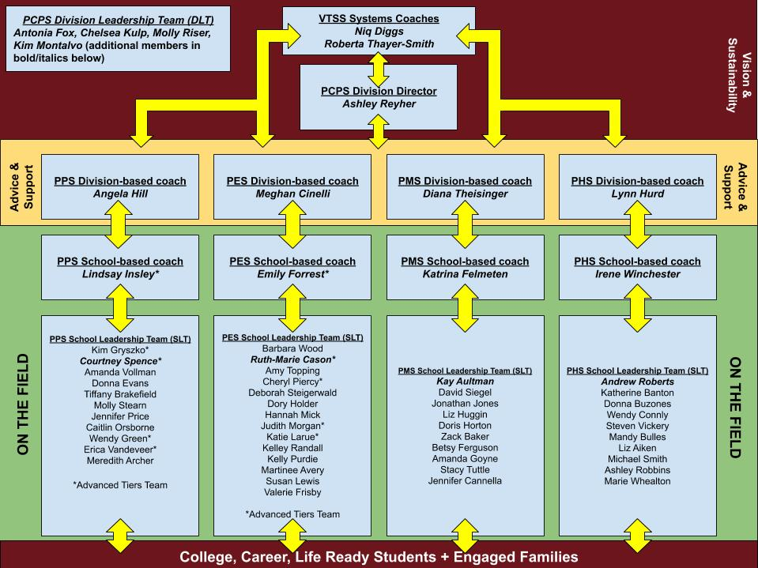
Unpacking Core Component #1 Aligned Organizational Structures (cont.)
Examples of Coaching Models/Networks:

Slide 49
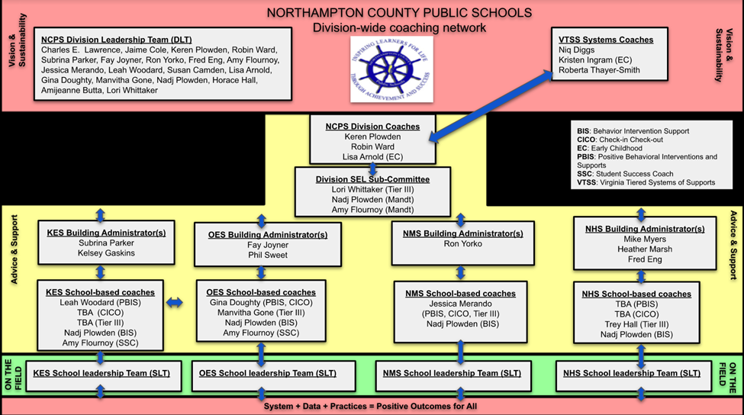
Unpacking Core Component #1 Aligned Organizational Structures (cont.)
Examples of Coaching Models/Networks:

Slide 50
Why a Coaching System?
The coaching system is developed to ensure building level teams and school staff have equitable access to high quality coaching
Division context will inform the Coaching System in your division
Coaching will be a critical component of your division’s professional learning system
A Coaching system provides tiered learning supports for all staff
District Capacity Assessment (DCA) #25, 26, 27
Temperature Check:
Does your division…
promote a culture for coaching?
encourage risk taking?
view mistakes as learning opportunities?
ensure processes and decision making are transparent?
ensure information is shared openly?
See the Guide to Building a Coaching System - pgs. 50-52

Slide 51
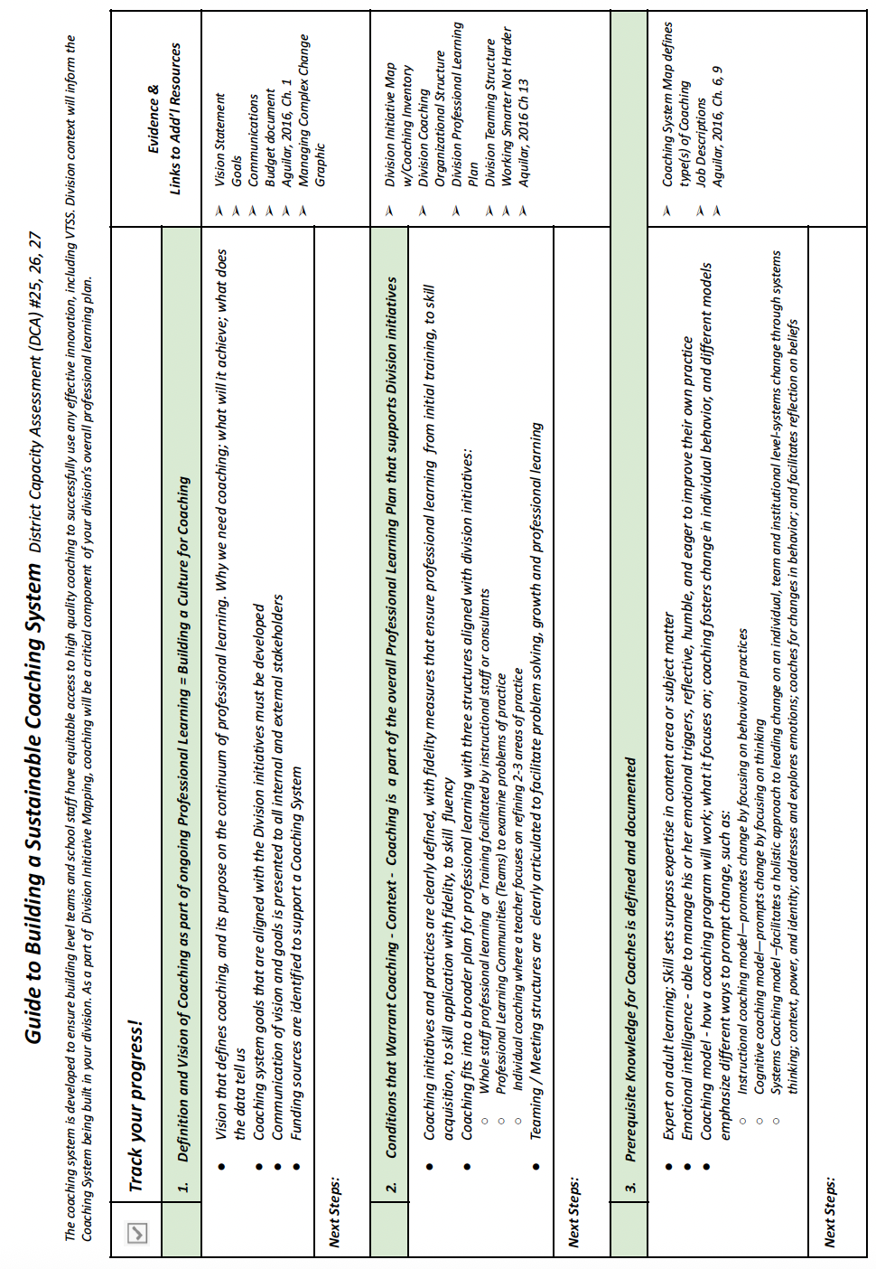

Slide 52
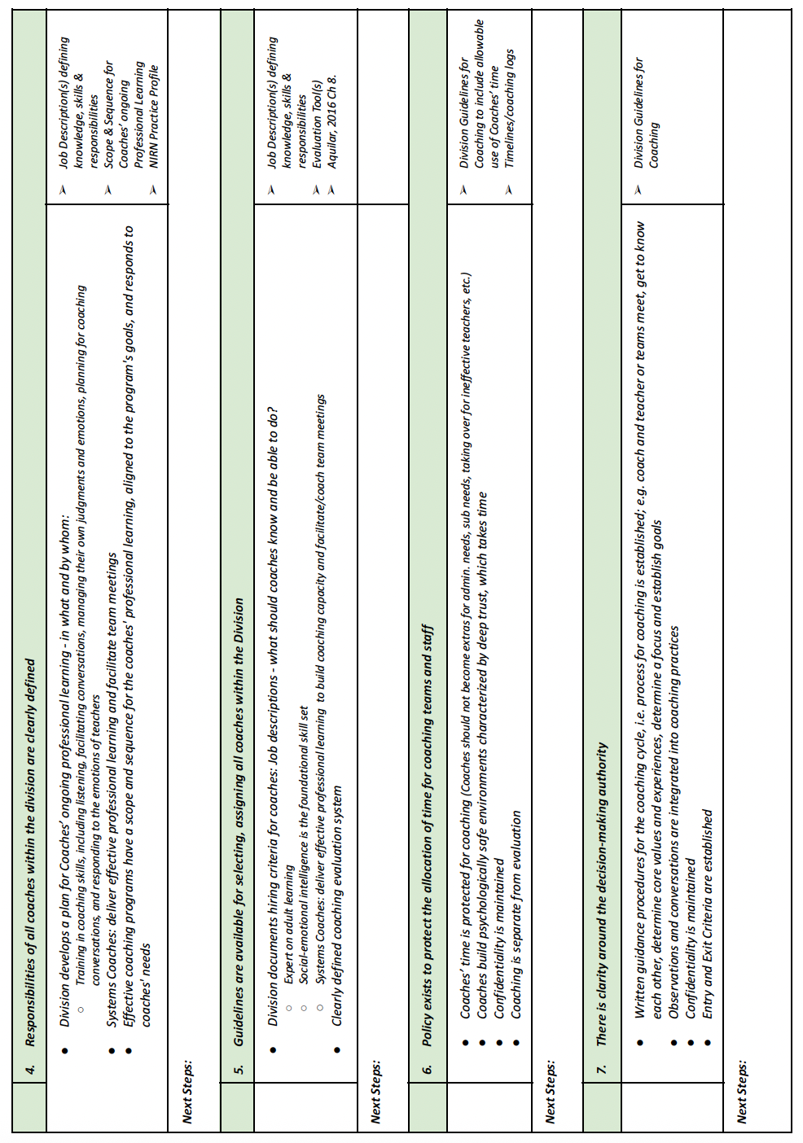

Slide 53
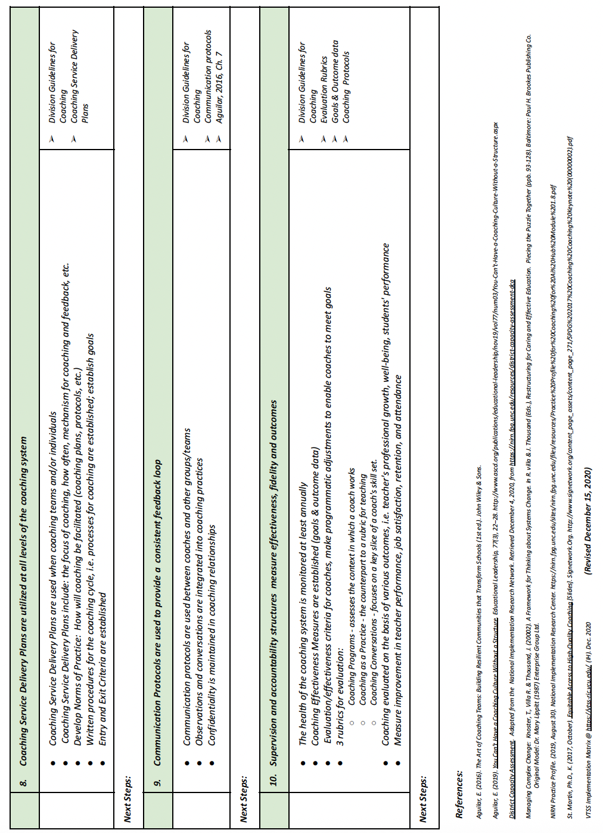

Slide 54

Soft Skills? NO! People Skills are Core Competencies!
“They aren’t called soft skills; they are called courage-building skills.”
-Brene’ Brown
85% of one’s success in the workplace is attributed to soft skills and only 15% to technical skills.
-Harvard Study
“I really reject the idea of soft skills. There is nothing soft about them. We have hard skills and we have human skills. We need more human skills.”
-Simon Sinek
Hard Skills or Human Skills video - https://youtu.be/3T71qvIPCto
Fast Facts: Why people skills matter more than ever
92% of companies say soft skills matter as much or more than hard skills
71% of employees believe soft skills will be more important in the future
84% of employees and managers believe new employees must possess soft skills
By 2030, two-thirds of all jobs will rely heavily on soft skills and grow 2.5x faster than other roles.
Sources: LinkedIn, BusinessNameGenerator, Deloitte
Don’t Forget: YOU are an AGENT of CHANGE!

Slide 55
Coaching Quotes
“The Coach’s main role deals with expanding the ability to see contexts, rather than supplying content. The person being coached then sees new ways to utilize existing skills.” (Julio Olalla)
“A Coach is someone who tells you what you don’t want to hear so that you can see what you don’t want to see so that you can be what you’ve always wanted to be.” (Tom Landry)
“Masterful coaches inspire people by helping them recognize the previously unseen possibilities that lay embedded in their existing circumstances.” (Robert Hargrove)
“Coaching is the art of creating an environment, through conversation and a way of being, that facilitates the process by which a person can move toward desired goals in a fulfilling manner.” (Tim Gallwey, 2000, p. 177)
“A Coach is someone who (1) sees what others may not see through the high quality of his or her attention or listening, (2) is in the position to step back (or invite participants to step back) from the situation so that they have enough distance from it to get some perspective, (3) helps people see the difference between their intentions and their thinking or actions, and (4) helps people cut through patterns of illusion and self-deception cause by defensive thinking and behavior.” (Robert Hargrove)
“The coach and coachee(s) relationship must be one that rests on a foundation of trust that can allow the coaching dialogue to take place.” (James M. Hunt)
“Coaches and the people they coach know that for the future to be different, we need to change the way we do things in the present…. More often, changes involve shifts in attitudes, thinking, perceptions and behavior.” (Gary Collins)
“In a dialogue, we must say what we think. However, advocacy without inquiry is anti-dialogical; it leads to a competition of wills where the lourdes or most aggressive arguer wins. Dialogue is a partnership activity in which two or more people communicate not to win, but to achieve mutual understanding.” (Jim Knight)

Slide 56
Stop and Jot: Write about a recent experience you’ve had as a systems coach that was challenging for you.
Partnership Communication
What we believe = How we communicate
I see others as equal partners in conversation
Belief 1: Coaching is an act of service
Belief 2:I want to hear what others have to say
Belief 3: I believe other people should have a lot of autonomy
Communication Belief Reflections:
Belief 1: How do you currently show those you coach that you
see them as equals?
Belief 2: Do you spend as much time listening as you do talking during conversations? What distractions keep you from being fully present?
Belief 3: How do you feel when you are in a conversation with a person who needs to be right? Do you find yourself needing to be right in conversations?

Slide 57
How Do I Listen?
Read through the kinds of listening activities listed here. Ask someone to talk for a minute or two. Notice what kinds of listening activities your mind does, and check off the boxes as you notice your mind going into these places. Alternately, listen to someone talk, watch your mind wander, and then use this tool afterward to record your observations.
Listening to find connections. Your mind thinks, “Oh, I remember when that happened to me too!”
Listening to find a story of your own to share. Your mind thinks, “I can tell her about that time that I .”
Listening but wanting to jump in and finish the speaker’s sentence.
Listening to find a point you agree or disagree with.
Listening to find something you can ask a clarifying question about after because you want more information.
Listening to understand the other person’s perspective.
Listening to ask a probing question to elicit the other person’s thinking or build their reflective capacity.
Listening to fix it—to find a way to help or solve a problem, to give advice.
Listening and empathizing with the other person.
Listening and judging the other person—finding fault with what they said or did, evaluating their thoughts.
Listening to find something you can critique or offer a rebuttal.
Listening and feeling impatient, wishing that the other person would stop talking.
Faking listening. Being bored by what the other person is saying. Occasionally nodding or ah-ha-ing but spacing out.
Listening and feeling excited, inspired, or moved by what the other person says. Listening for implicit meanings; listening between the lines.
Exhibit 7.4. © Elena Aguilar, The Art of Coaching Teams: Building Resilient Communities that Transform Schools. Jossey-Bass, 2016.

Slide 58
Collaborative Communication Skills
“Effective interpersonal communication skills are essential whether one is coaching an individual person, a team of people, or an organization as a whole. This ability to listen, ask open-ended questions, paraphrase, summarize and synthesize information – all within a nonjudgmental climate – are especially important.”
(March & Gaunt, 2013 p. 10).
Paraphrasing
Offering empathy
Asking clarifying questions/Requesting clarification
Summarizing
Offering Information
Asking potentially relevant questions

Slide 59
Notes/Reflection
Use this space to take notes on communication “Ah ha’s” as you work through the activities:
Practice Clarifying Statements
Example:
Speaker: “When some team members talk about Tier 2 and Tier 3, they use the terms incorrectly. I’m not sure they understand what tiered interventions really are.”
Practice:
Speaker 1: “The teachers aren’t working on any proactive behaviors with the students. It’s all about negative consequences.”
Speaker 2: “I’ve started to question my own understanding! I thought differentiation was a Tier 1 practice, but some team members say it’s not.”
Coaches Make Choices:
Speaker: This team just doesn’t get it! Every time we look at data, the team just talks about “these kids” and “these families.”
Coach:
Coach:

Slide 60
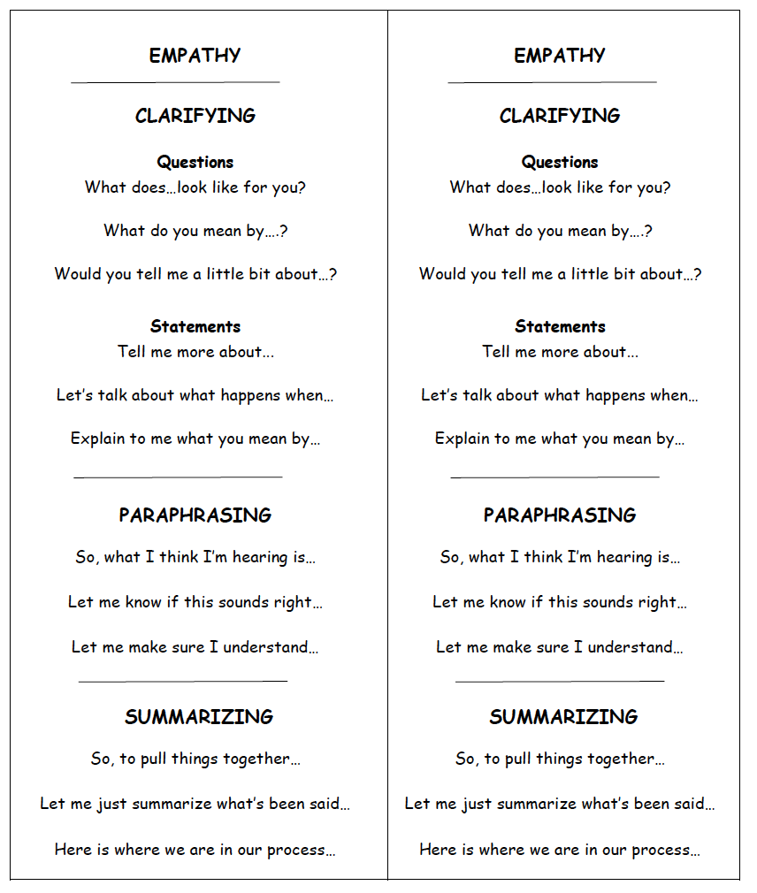
Collaborative Communication Skills Bookmarks

Slide 61
Collaborative Communication Sort
1
2
3
Look at the coach’s statements/questions and decide the following:
Is this a clarifying question?
Is this going to take you up or down the escalator?
Read the transcript from the speaker
Sort the statements accordingly
Speaker: ““We are having a hard time with tier one expectations. We’ve been meeting several times a month and don’t seem to be making progress. Our matrix development is going terribly. Everyone argues about what should be included. One team member keeps saying that we should just make a list of all the things kids do wrong and then decide how best to create consequences. I know we should be teaching positive behaviors but it’s hard. The kids are very resistant to any of this as well. I’m constantly trying to reel them all in.”
1. Can you tell me more about what you mean by tier one expectations?
8. You’ve had over a month already to do the matrix.
15. Why are you meeting several times a week?
2. I’m concerned that you aren’t further along with your matrix. What exactly is happening with that?
9. Why don’t you tell them to stop?
16. What do those meetings look like?
10. Does the team member who wants to make the list always send their students to the office?
17. When you say the kids are resistant, what do you mean?
3. Do you think you are being effective at reeling them in?
18. I think you need to attend the coaches training.
4. Are you also arguing?
11. Tell me more about the kids being resistant.
5. Let’s talk about the arguing.
12. Tell me more about your matrix. What does it look like now?
19. Okay, so I think I hear you saying that meeting are challenging and there is some concern over an emphasis on negative behaviors. Is that correct?
6. Why is it hard to teach positive behaviors?
13. Who are the people arguing in the meetings?
7. What negative behaviors do they want to list?
14. Let’s talk about your progress.
20. That sounds very frustrating!

Slide 62
Example of Clarifying |  | Non-example of Clarifying
Takes conversation in a positive direction | Takes Conversation in a negative direction
1 | 5 | 2

Slide 63
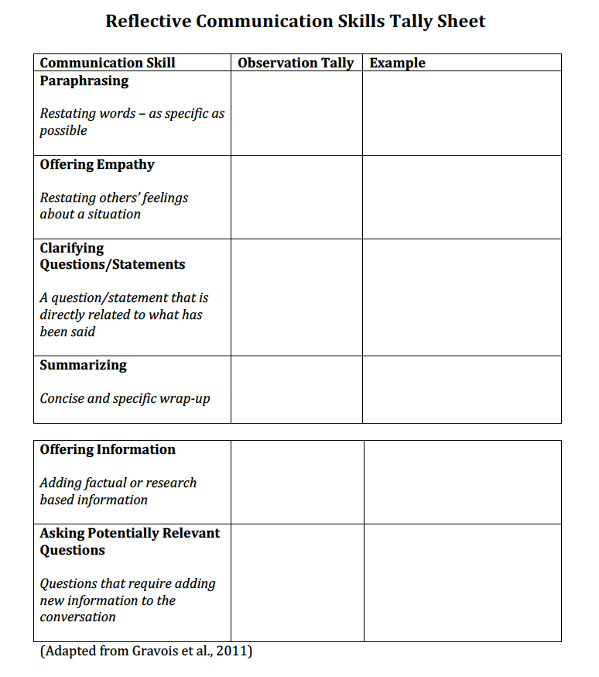
Demonstration - Using the Reflective Communication Tally Sheet below, record the communication skills observed in the demonstration provided. Capture as much of the language used as possible.

Slide 64
Practice - Time to cross the red line! As you practice in triads, each person will have a role - coach, coachee, and observer. The coachee will use the scenario they wrote down earlier in the day. The coach should try to avoid using the “bottom two” skills - it’s hard! Observer offers feedback to the coach by factually sharing what was observed including language used. Switch roles.

Slide 65
Practice - Time to cross the red line! As you practice in triads, each person will have a role - coach, coachee, and observer. The coachee will use the scenario they wrote down earlier in the day. The coach should try to avoid using the “bottom two” skills - it’s hard! Observer offers feedback to the coach by factually sharing what was observed including language used. Switch roles.

Slide 66
Moving forward:
Refer to the Communication Skills Bookmark (pg. 60 in WB and in your materials folder)
Identify a skill or belief you would like to grow and how you will monitor your progress.
Identify others on your team(s) who would benefit from learning and practicing these skills. Make a plan for sharing.
Watch for information about Systems Coaching 102.
Additional Resources:
Indicators of Trust in Schools
National Implementation and Research Network’s Philosophical Principles of Systems Coaches (beginning of Practice Profile)
NIRN Coaching Practice Profile 1-pager

Slide 67
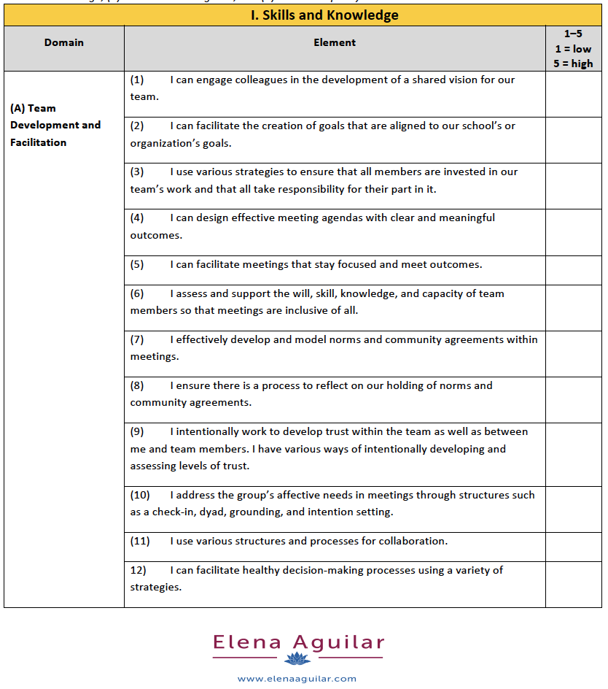
Facilitator Core Competencies
The Art of Coaching Teams, pages 299-301

Slide 68
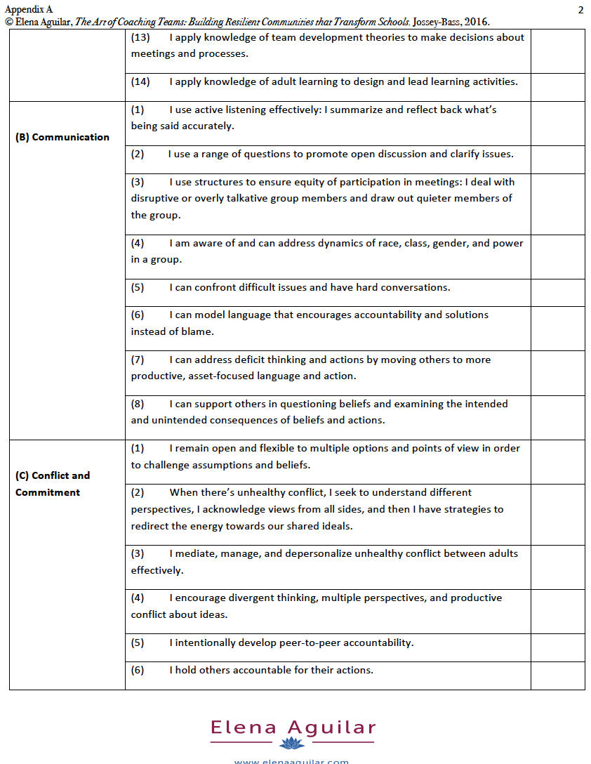
Facilitator Core Competencies (cont.)
The Art of Coaching Teams, pages 299-301

Slide 69

Suggested Reading from
The Art of Coaching Teams
You can supplement your learning from today by reading the following chapters:
Chapter 1 - Refining a Vision (all about teaming)
Chapter 2 - Knowing Ourselves as Leaders
Chapter 10 - Orchestrating Meaningful Meetings
Chapter 11 - Setting the Stage for Artful Meetings
Consider who else might benefit from some of the skills you are learning. Many divisions have used The Art of Coaching Teams successfully as a book study with colleagues! Elena Aguilar also provides a wealth of resources at Brightmorningteam.com.

Slide 70
Engaging with the Book - The Art of Coaching Teams
On pages vii-x, you will find the table of contents. Scan the chapter titles. What chapters would support your goals as a team? As a systems coach?
Consider a book study with division and school coaches.
Consider using the tools in your coaching and professional learning events.
On pages 51-52, #8, “Reflect Regularly on Team Process,” discuss how you are progressing monitoring division and school teams. How could you use the “Team Temperature Check” to assess the teams’ temperature and improve team functioning? What would this look like?
Chapter 5, page 95, “Laying a Foundation for Trust,” reviews the importance of norms with some ideas on setting norms. How can you improve communication and trust by creating and following norms as a team? (see examples on pg. 108)
Chapter 7, page 147, Cultivating Healthy Communication - Take a look at the activity as a group. How could you develop an activity or conversation using this tool to improve communication?
Where can you find more about emotional intelligence in this book? (hint: look on page 347)
Pick one emotional intelligence page(s) and share out. How can you apply the content to your coaching?

Slide 71
Coaching Institute References
VTSS RIC Website
Elena Aguilar: The Art of Coaching Teams Building Resilient Communities that Transform Schools. San Francisco, CA: Jossey-Bass, 2016.
Other Resources/Handouts for Coaching from www.elenaaguilar.com
National Implementation Research Network (NIRN): Practice Profile for Coaching for Ai Hub Module 1.8. Available: https://implementation.fpg.unc.edu/resource/coaching-practice-profile/
National Implementation Research Network (NIRN): Implementation Support Practitioner Profile, November 2020. Available: https://implementation.fpg.unc.edu/resource/implementation-support-practitioner-core-competencies/
Managing Complex Change. Source: Knoster, T., Villa R., & Thousand, J. (2000). A framework for thinking about systems change. In R. villa & J. Thousand (Eds.), Restructuring for caring and effective education: Piecing the puzzle together (pp. 93-128). Baltimore: Paul H. Brookes Publishing Co. Original Model: Dr. Mary Lippitt (1987) Enterprise Group Ltd.
Trust
Steven Covey (2006). The Speed of Trust: The One Thing that Changes Everything. Free Press: New York.
Coaching
March, A. L., & Gaunt, B. T. (2013). Systems Coaching: A model for building capacity. Tampa, FL: University of South Florida, Florida’s Multi-Tiered System of Supports Project. Retrieved from http://flpbs.fmhi.usf.edu/pdfs/SystemsCoaching.pdf
Jim Knight (2011). Unmistakable Impact: A Partnership Approach for Dramatically Improving Instruction. Corwin/Leaning Forward.
Jim Knight (2007). Instructional Coaching: A Partnership Approach for Improving Instruction. Corwin/Leaning Forward.
Jim Knight (2014). Focus on Teaching: Using Video for High-Impact Instruction. Corwin.
Jim Knight (2016). Better Conversations: Coaching Ourselves and Each Other to Be More Credible, Caring and Connected. Corwin
Peter Block (1996). Stewardship: Choosing Service over Self Interest. Berrett-Koehler: San Francisco.
Effective Conversations
Gickling, E. E., & Gravios, T. A. (2016), Instructional Assessment: An Essential Path for Guiding Reading Instruction. ICAT Publishing, LLC.

