Slide 1
Systems Coaching Institute 102
Winter 2024

Slide 2
Greetings Grid
Getting to Know You
What is true for you?
I have been in education more than more than 10 years. I make an effort to exercise everyday! I am presently reading a great book for my enjoyment! I love the beach more than the mountains. I have binge- watched something on Netflix, Amazon, etc. I have a pet.
Notes:
Stand up for true, stay seated for false. Share some book and binging titles, unique pet?

Slide 3
Welcome to
Systems Coaching 102
MTSS is a systemic, data-driven approach that allows divisions and schools to provide targeted, evidence-based interventions to meet the needs of their students. This is done through a clearly defined process that is implemented to fidelity by all stakeholders within the school and/or division.
Winter 2024

Slide 4
Our New Logo

Slide 5
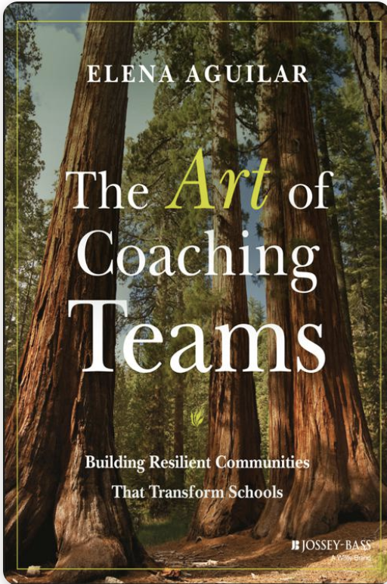
Materials
To get the most out of opportunities to work together, please decide upon the following roles for your group:
Facilitator – manages the group process
Note-Taker – captures next steps in action-planner
Timekeeper – tracks time in group activities
Communicator – reports to the larger group, if requested
Process Observer - prompts for participation of all
Notes:
Presenter:
Notes:
Encourage teams to refer to our norms - safe space

Slide 6
Community Agreements
Practice Self-Compassion | Extend patience, grace, and kindness Focus on solutions to make things easier
Practice Growth Mindset | Be open to new thoughts and ideas Embrace learning opportunities
Practice Presence | Focus on the here and now Share your expertise, information and ideas. Assign a group recorder

Slide 7
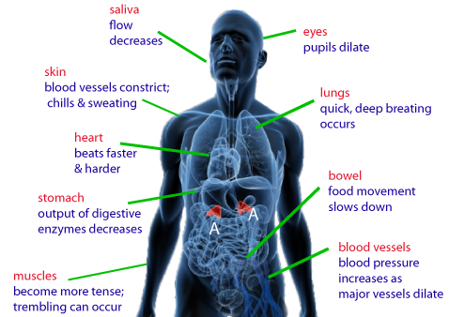
Welcome:
Systems Check
Notes:
Talking Points:
●As you engage in this work today we want you to think about this analogy:
●Most of us have a GP - a doctor who is our biological systems manager, one that helps us achieve, maintain, prevent, and or tune-up our subsystems which make up our whole body.
●Your GP has a maintenance checklist of those subsystems, they proactively requests blood work to analyze health of cells, they check your blood pressure, ears, send you for colonoscopy/mammograms etc. making sure all your subsystems are working as a whole to achieve ultimate health, energy and quality of life. That is what you want your GP to do. And when something gets out of whack with one of sub systems, palpitations of the heart, your GP might send you to a subsystems specialist-a heart Dr.
●How are your subsystems feeling today? - I invite you to do a systems check. take the next 1 minute to do a body systems check. Is there anything you need to do to get fully operational - a bottle of water, a quick restroom break, 5 deep breaths to reset, a good stretch, jot down whatever is on your mind on a sticky note to release it, and then set an intention that will allow you to be fully present and engaged today. Do what you need to do.

Slide 8
COMPONENTS OF A SYSTEM
A constellation of parts.
HUMAN RESOURCES
MATERIAL RESOURCES
Education System
FISCAL RESOURCES
$$$$$$
PROCESSES AND PROCEDURES
POLICIES AND REGULATIONS
Adapted COACHING FOR SYSTEMS CHANGE-PIERCE AND ST.MARTIN 2023
Notes:
Relate to the discussion on slide 19
Talking Points
A system can be 1 classroom, 1 school, 10 divisions, but systems have components.
Human resources: The people, their behavior, views, and beliefs (eg teacher efficacy)
Fiscal: funding sources and how they are allocated eg (towards PD and coaching)
Policies and Regulations: the formal rules, laws, and guidelines of the systems (staffing and student policies)
Processes and Procedures: hte day to day operating approaches of the system (eg how decisions are made, how barriers are removed, process or gaining access to PD opportunities)
Material resources: the physical rouces eg (curriculum and assessment materials, the school building, a classroom space)

Slide 9
Scenario
While reading the scenario about Greenleaf at your table, pause at each POLL question. Have a recorder number from 1-5 and write the component that has been highlighted.
Material Resources
Human Resources
Processes and Procedures
Policies and Regulations
Fiscal Resources
Notes:
Complete activity and debrief together.
At the end of each section you go back to look at the five items and choose which would be the correct answer (POLL 1-5). They will have numbers at their table to hold up.
Link to Greenleaf: https://docs.google.com/document/d/1AlHHtqztR82A4yNGTVVKrga0BcvrsozI/edit?usp=drive_link&ouid=102574330391338814762&rtpof=true&sd=true

Slide 10
Virginia’s Six Core Components
Leadership & Teaming
Planning
Communication
Aligned Definitions & Resources
Professional Learning & Coaching
Aligned Organizational Structure
Outcome
Fidelity
Evaluation of Process
Data Informed Decision Making
Data Systems
Decision Making Process
Meeting Structures & DIDM
Whole Child
Assessment Mapping
Screening
Progress Monitoring
Monitoring Student Progress
Evidence Based Practices
Quality Core Instruction
Aligned Instructional Interventions
Continuum of Supports
Fidelity of Practices
Capacity for Coaching & Professional Learning
Family, School, Community Partnerships
Communication
Cultural & Linguistic Responsiveness
Notes:
Notes:
VA has defined 6 core components of MTSS that are essential in all our work
Systemic Aligned Organizational structures include leadership, teaming, planning within a tiered approach
Data Informed Decision making is part of all our work
EBP begins with what does quality core instruction look like and includes Instruction as Prevention, screening
Communication to always include family, school and community voice
Progress monitoring of those practices which would include screening
We always evaluate our systems that support the work
This way of work is going to take a lot of people--henceforth change for (Students, Families, Communities, and the adults in your building/division)
MTSS is incredibly unique in that it allows schools, divisions, and states to use a framework founded on the same core components while allowing them the flexibility to make it their own based on the data defined needs and resources of their population. The core components shared across all MTSS implementation are sometimes called different things in different organizations. For example, you may hear one organization say “High quality, differentiated instruction” and one say “incorporation of evidence-based practices.” In Virginia, we identify the core components of MTSS as Aligned Organizational Structure, Data Informed Decision Making, Evidence-Based Practices, Family, School, and Community Partnerships, Monitoring Student Progress, Evaluation of Outcomes and Fidelity. You will notice that the core components are comprised of many important elements. While tiered interventions are a critical feature of MTSS, there are many other components that must be created and sustained in order to implement MTSS effectively and to support increased capacity for implementation. Don’t worry! You won’t have to jump right in to all of them, but you will need to intentionally plan for the resources necessary for successful implementation. One of your most valuable resources is also one of the most crucial resources here: time. It is important to recognize that time needs to be spent establishing a strong system and framework in order for implementation to be sustainable and successful.

Slide 11
The “work” doesn’t work without systems
Division leadership teams with the help of division systems coaches must be aware of the multiple systems at work within the division.
They must continually analyze the health of those systems through a variety of data points.
Coaching is one of those systems!
Notes:
So why do Systems Matter in Coaching? If the system is not reaching its goal of improved student outcomes in math, there are systems components getting in the way.
You have to look at the systems components and tease out the why and these components may have to change to meet the desired outcomes.
As coaches we have to understand the systems to understand why we are getting the outcomes.
Of reaching those outcome goals . the system matters because it shapes student outcomes. Note the S in Systems.
The key role and responsibility of 'systems division' coaches is to have insight into the systems at play within their division and the skills to foster systems thinking. MTSS work is the result of:
Highly effective teams Matrix items 1-2-3
An aligned communication system, Matrix item 4
Aligned Professional Learning for staff, inclusive of coaching Matrix item 7 and 8
The effectiveness of systems coaches is firstly dependent on a division’s systems thinking around a coaching system and the infrastructure needed to support.
Coaching is one of those systems
Are we being proactive or reactive within our system. What are the benefits of proactively building our systems?

Slide 12
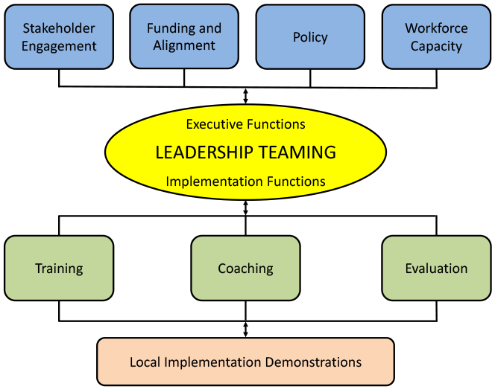
The “How To” of Coaching
Coaching
PBIS.org Implementation Blueprint and
Oregon Systems Coach Manual, 2013
Systems Coach(es)
Liaison(s) between the division and schools -
Coach Data, Practices & Systems
Communication:within & beyond groups
School Coach
Administrator
SCHOOL LEADERSHIP TEAM
School Coach
Administrator
Communication:within & beyond groups
Grade Level Teams
Department Teams
Content/Specialty Area Teams
Advanced Tier Teams
Individual Student Teams
Adapted from PBIS.org Implementation Blueprint and
Oregon Systems Coach Manual, 2013
Notes:
Talking Points:
Shown here is 1 example of what an aligned system of coaching looks like in this division.
I would like to point out a few things: it is clear what coaching supports/roles will look like and how these different roles work together to meet the coaching function of the DLT.
MTSS is about building capacity and sustainability. This is a great example of how the DLT has communicated clearly that Coaching is the way of work in a division, this is how we will build capacity and sustainability for a tiered system and how Systems Coaches will act as the liaison between the DLT and School Teams. They signified that a School coach will be designated, and the Division coach will directly support the school coach and his/her work with school based teams in implementation of MTSS. The role of the administrator is also outlined, very critical in the process, to support the Division Coach, the School based Coach/es; aligning of the various schools teams and to communicate to the DLT their successes, challenges, opportunities for growth, needs for support and barriers to implementation.

Slide 13
Learning Intentions Systems Coaching Institute 101
Develop an awareness of VA’s six core components of MTSS, as defined by the VTSS Implementation Matrix
Understand the role of a division systems coach and how to use the highlighted coaching tools: VTSS Coaching Checklist, Managing Complex Change Chart
Apply the lens of coaching to the Aligned Organizational Structure VTSS component
Explore two components of the NIRN Coaching Profile: Creating an Enabling and Collaborative Context and Performance Feedback
Begin to examine and apply communication skills through guided practice

Slide 14
LET’S
Notes:
Talking Points:
This is a formative assessment - will inform presenters how in-depth any additional review needs to be
https://docs.google.com/forms/d/1mX5P2PFR1CMvjtwgFVmOSlGiS8wKwIZY450xYa6fUIY/edit

Slide 15
Time for a…
Notes:
Complete the SCI 101 Review and take a break

Slide 16
SCI 101 Review Results
Notes:
Post results, however we want to present this is fine. Coach at the table can review results and review at the table.
https://docs.google.com/forms/d/1mX5P2PFR1CMvjtwgFVmOSlGiS8wKwIZY450xYa6fUIY/edit

Slide 17
Systems Coaching Institute 102 Learning Intentions
Understand the importance of teams in the work of systems that impact change
Understand and facilitate the development of highly effective teams
Identify, choose and implement strategies/structures for enhancing team functioning
Understand, apply and uphold concepts of emotional intelligence, accountability, engagement and collaborative decision making within a team structure
Utilize effective communication and other coaching techniques to impact systems change
Coach the development of the system and support structures
Create and utilize a Coaching Service Delivery Plan and ongoing self-reflection
Notes:
Talking Points:
3 main chunks to these learning intentions:
Highly effective teams An aligned communication system, Aligned Professional Learning for staff, inclusive of coaching

Slide 18
The Three Principles that Guide Systems Work
Understand the system to understand outcomes.
Systems-level change is an intentional and continuous process.
Systems-level change is an adaptive challenge.

Slide 19
Let’s Talk: Understand the system to understand outcomes.
Principal 1-Understanding the systems.
What do systems-level principles mean to me?
Is the idea of seeing the systems new for you, or are you familiar with the concept?
Why do you think seeing the system is important to coaching?
How would you explain the concept of a system to a team?
Coaching for Systems and Teacher Change
Jennifer Pierce; Kimberly St. Martin
Notes:
Talk at the table

Slide 20
COMPONENTS OF A SYSTEM
A constellation of parts.
HUMAN RESOURCES
MATERIAL RESOURCES
Education System
FISCAL RESOURCES
$$$$$$
PROCESSES AND PROCEDURES
POLICIES AND REGULATIONS
Adapted COACHING FOR SYSTEMS CHANGE-PIERCE AND ST.MARTIN 2023
Notes:
Relate to the discussion on slide 19
Talking Points
A system can be 1 classroom, 1 school, 10 divisions, but systems have components.
Human resources: The people, their behavior, views, and beliefs (eg teacher efficacy)
Fiscal: funding sources and how they are allocated eg (towards PD and coaching)
Policies and Regulations: the formal rules, laws, and guidelines of the systems (staffing and student policies)
Processes and Procedures: hte day to day operating approaches of the system (eg how decisions are made, how barriers are removed, process or gaining access to PD opportunities)
Material resources: the physical rouces eg (curriculum and assessment materials, the school building, a classroom space)

Slide 21
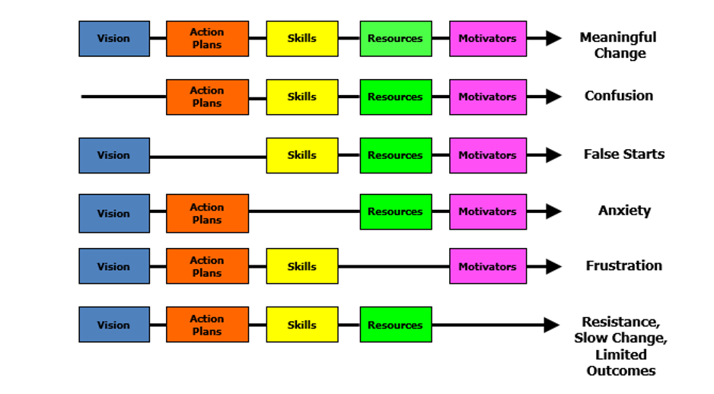
Managing Complex Change
Source: Adapted from Knoster, T., Villa R., & Thousand, J. (2000). A framework for thinking about systems change. In R. villa & J. Thousand (Eds.), Restructuring for caring and effective education: Piecing the puzzle together (pp. 93-128). Baltimore: Paul H. Brookes Publishing Co.
Notes:
Systems change take time
Talking Points:
Can’t talk about MTSS without seeing this graphic. Systems work will bring change and for some people this can be complex. Complex Change. For systems to change, somebody somewhere has to start acting differently. That is why when we say that who is on your team is important, it is. It has to be key people in the division that can change/tweek policy, deploy and align resources, etc. Kurt Lewin describes systems change as “unfreezing the existing system , changing it and refreezing it in its new and more effective configuration (NIRN 2016)
Change is hard for some people, some relish in it, others resist it. And because our work is with teams we need to be aware of but more importantly, be listening and looking for signs when initiatives or goals are not being followed through or that they are not having the anticipated outcomes we were looking for. Also think back to the phases of IMP where the activities/goals are more than there might be the capacity/skill levels to do effectively.
From NIRN: When changes are planned and initiated, we often launch into the work in a big way with lots of moving parts, communication challenges, confusion, and ‘push back’ as the result. In addition we often try to layer the work onto the existing structures with people picking up extra responsibilities. Trying to get the current system to just go faster or layer on responsibilities rarely yields results. Such approaches seldom work well because the current system is designed to achieve the current results (on purpose or unwittingly). This means that innovations are not likely to fare well in the current system. Typically, the current system exerts pressure on innovations to change to fit the status quo.
It is rare to have an existing system automatically change to support more effective education practices and frameworks. An innovation that has been altered may be a better fit with the current system but it is likely that the EBP or EII will lose its effectiveness as a result of the adaptation process.
At the beginning of a change process, leaders and Implementation Teams cannot know everything that will be required to successfully use and sustain the innovation. However, with each step forward, the next step becomes clearer. Steps forward result in discoveries about what’s working and what’s not.

Slide 22
MTSS Implementation to Coaching
WHAT
HOW
Notes:
Talking Points:
VTSS is who we are--MTSS is what we do!
As VTSS State Systems coaches, we provide direct instruction of the content and processes necessary for a division to implement a multi tiered systems of support for students. This is the WHAT- MTSS/the Educational Innovation. At the same time, we as coaches are facilitating discussions/action plans with the DLT on the HOW ---how to build a coaching system and capacity for sustainability of a MTSS, Direct instruction is directed support to DL Teams/Coordinator/Division coaches coupled with our professional learning opportunities. The direct instruction is gradually released over time.
As coaches we move back and forth across the bridge--Our phases of implementation of the what, the matrix (our road map), and the use of different tools at different times creates that movement back and forth.
But every time a division gets the what-we need to run across the bridge and ask HOW will this be sustained? How can it be ensured that schools within the division are applying/installing practices with fidelity in the schools and are using data to inform instructional decisions to ensure equitable outcomes for all students.
The question we should be asking is what PL and Coaching does the division need to provide to get the desired outcomes in schools. In part this is our CSDP, the very last column around effectiveness, how effective are the tiered interventions?
Divisions are the unit of implementation, schools are the unit of intervention, students are the unit of impact.
In a nutshell, we have dual coaching roles as a Systems Coaches 1)- to consider the continuum of coaching which initially begins with strong direct instruction around the what (VTSS) and 2) the how to build capacity and sustainability for a tiered system preK-12 within all levels in the division.

Slide 23
Moving Across the Bridge: Your Role as Coach
What is Systems Coaching?
What is the goal?.
What will you do?
Notes:
Talking Points:
YOU are a systems coach coaching teams to full implementation of a tiered system. Coaching is a necessary component for promoting team confidence and ensuring competence. Coaching is defined as regular, embedded professional development designed to help use a tiered system of support as intended.
What is a Systems Coach? A liaison for the division leadership team (DLT) and the school’s leadership team(s) (SLT) to guide systems intervention and sustainable organizational change. Systems Coaches bring informed perspectives of division and school needs (e.g., curriculum, training, coaching), and readiness for change to the division leadership team.
Goals of a Systems Coach To improve outcomes for all students using a critical eye towards improved team practice, and improving preK-12 school/grade systems. Context matters---Depending on division size and resources, this role may be served by one or more individuals.
What Does a Systems Coach Do? The Systems Coach expands the leadership or school team’s capacity to obtain identified outcomes using Virginia’s Tiered Systems of Support (VTSS) framework. Systems Coaches have the skills to guide team development, conduct effective meetings, collect, enter analyse and use data efficiently, setting a vision and goal for student improvement in school, building buy in for school implementation efforts, conducting a plan do student act cycles to continuously improve implementation efforts, use fidelity data to improve school implementation and understand the phases the implement

Slide 24
Virginia’s Six Core Components
Leadership & Teaming
Planning
Communication
Aligned Definitions & Resources
Professional Learning & Coaching
Aligned Organizational Structure
Outcome
Fidelity
Evaluation of Process
Data Informed Decision Making
Data Systems
Decision Making Process
Meeting Structures & DIDM
Whole Child
Assessment Mapping
Screening
Progress Monitoring
Monitoring Student Progress
Evidence Based Practices
Quality Core Instruction
Aligned Instructional Interventions
Continuum of Supports
Fidelity of Practices
Capacity for Coaching & Professional Learning
Family, School, Community Partnerships
Communication
Cultural & Linguistic Responsiveness
Notes:
Notes:
VA has defined 6 core components of MTSS that are essential in all our work
Systemic Aligned Organizational structures include leadership, teaming, planning within a tiered approach
Data Informed Decision making is part of all our work
EBP begins with what does quality core instruction look like and includes Instruction as Prevention, screening
Communication to always include family, school and community voice
Progress monitoring of those practices which would include screening
We always evaluate our systems that support the work
This way of work is going to take a lot of people--henceforth change for (Students, Families, Communities, and the adults in your building/division)
MTSS is incredibly unique in that it allows schools, divisions, and states to use a framework founded on the same core components while allowing them the flexibility to make it their own based on the data defined needs and resources of their population. The core components shared across all MTSS implementation are sometimes called different things in different organizations. For example, you may hear one organization say “High quality, differentiated instruction” and one say “incorporation of evidence-based practices.” In Virginia, we identify the core components of MTSS as Aligned Organizational Structure, Data Informed Decision Making, Evidence-Based Practices, Family, School, and Community Partnerships, Monitoring Student Progress, Evaluation of Outcomes and Fidelity. You will notice that the core components are comprised of many important elements. While tiered interventions are a critical feature of MTSS, there are many other components that must be created and sustained in order to implement MTSS effectively and to support increased capacity for implementation. Don’t worry! You won’t have to jump right in to all of them, but you will need to intentionally plan for the resources necessary for successful implementation. One of your most valuable resources is also one of the most crucial resources here: time. It is important to recognize that time needs to be spent establishing a strong system and framework in order for implementation to be sustainable and successful.

Slide 25
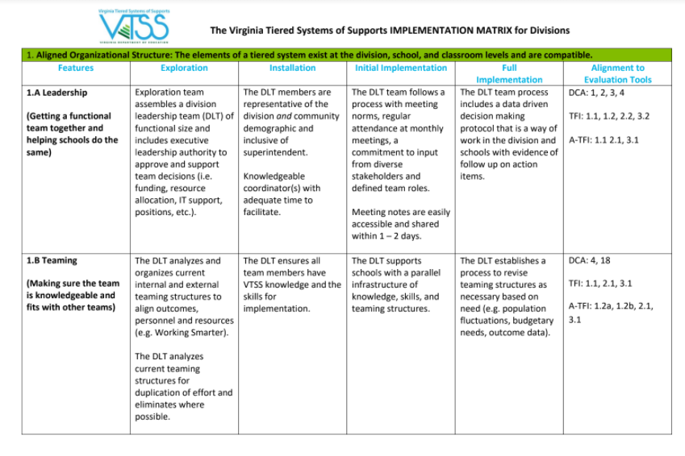
MTSS Implementation Matrix: Your Road Map!
Notes:
Talking Points:
As State and Division Coaches this is your GPS--your road map for implementation plus an emphasis on the coaching for implementation of a tiered systems of support.

Slide 26
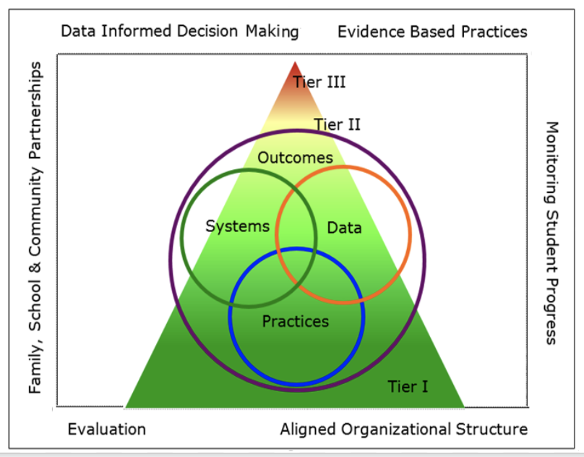
Multi-tiered Systems of Support
Notes:
Talking Points:
Here is the Big Picture. Remember this as we review the Implementation Logic
Interconnected framework contains various Systems are built upon a frame (or structure) - the body, an automobile, etc. chassy
There are six core elements of the framework that provide the structure for building Multi-tiered SystemS of Support within School Districts, AND simultaneously within their schools
The frame you see are the six core elements that provide the basis for a tiered system of implementation (how the Implementation Matrix is built)
The triangle provides the way to organize the supports/practices/internvetions for students, staff, families and our communities
The circles (Implementation Logic) help us grow and organize people, understand the data, and to provide a continuum of practices.
The goal and primary purpose of VTSS implementation is to use a tiered framework to improve outcomes for all students, using: • data informed decision making, • using evidence-based practices for whatever outcomes we are seeking, and • building systems to provide adults the structure and supports they need for implementation.
Aligned organizational structures has to where we put a lot of time and coaching energy especially when addressing equity – who will have access to the communication, how will we hear and learn from our community, equitable distribution of resources, continuum of evidence based practices - entry/ exit criteria around these, instruction matched to student need! Students are the unit of impact. In other words the 8 features under AOS will impact effectiveness and efficiency of the rest of the matrix.
These systems will include a professional learning system for staff - a support system for adults (which includes coaching as an evidence based practice), and an intervention/support system for students
●the IMP logic = holistic perspective/balcony view of what the division is doing. It stops a divison from trying to divide problems into smaller pieces and then try to solve each part. Senge--In the Fifth Discipline (which is Systems Thinking) Senge himself describes the elephant metaphor. When you split an elephant in two, you do not have two small elephants which you can take care of. You can only take care of the one complete elephant.

Slide 27
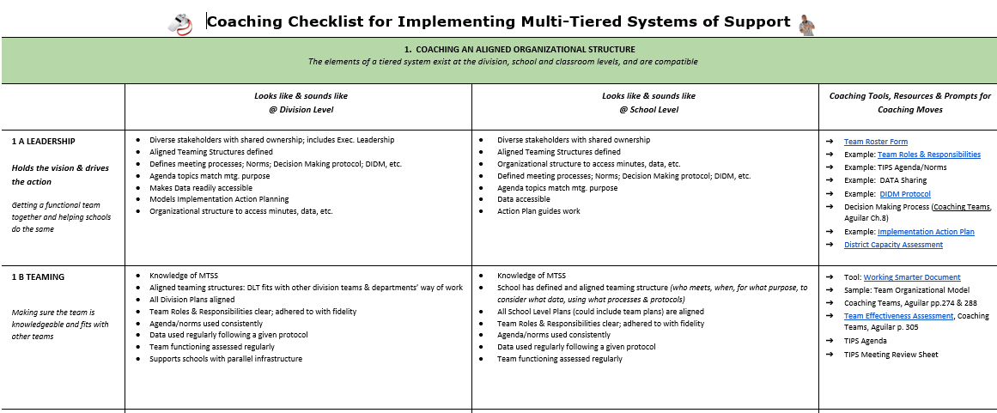
Coaching Checklist
Notes:
MOST UPDATED CHECKLIST 1-31-22 : https://docs.google.com/document/d/1NC9SrAZxkncq7lhoTwmslLo_7nurxVCn/edit#
Talking Points:
Purpose of The Coaching Institute: was created to build understanding around implementation of a tiered system, to provide cascading supports from the DOE to DLT to SLT to the classroom. The VTSS Framework is robust enough, flexible enough and responsive enough to meet any and all challenges that a division has and can provide a process to address any/all educational outcomes for students.
This work is not additional work but is THE WORK of the division and schools.
In order for a division to realize equitable outcomes for all stakeholders/to meet their strategic goals
they need to systematically document and strategically build the capacity of your their administrators/staff to create sustainability for THE work
This tool supports what FULL Implementation “looks like” and “sounds like” at the division level as well as in the schools.
It will also guide the process we will use for the rest of our time together, gaining more clarity around the WHY of the elements within the matrix, how they fit together and then how would you might coach around these elements.

Slide 28
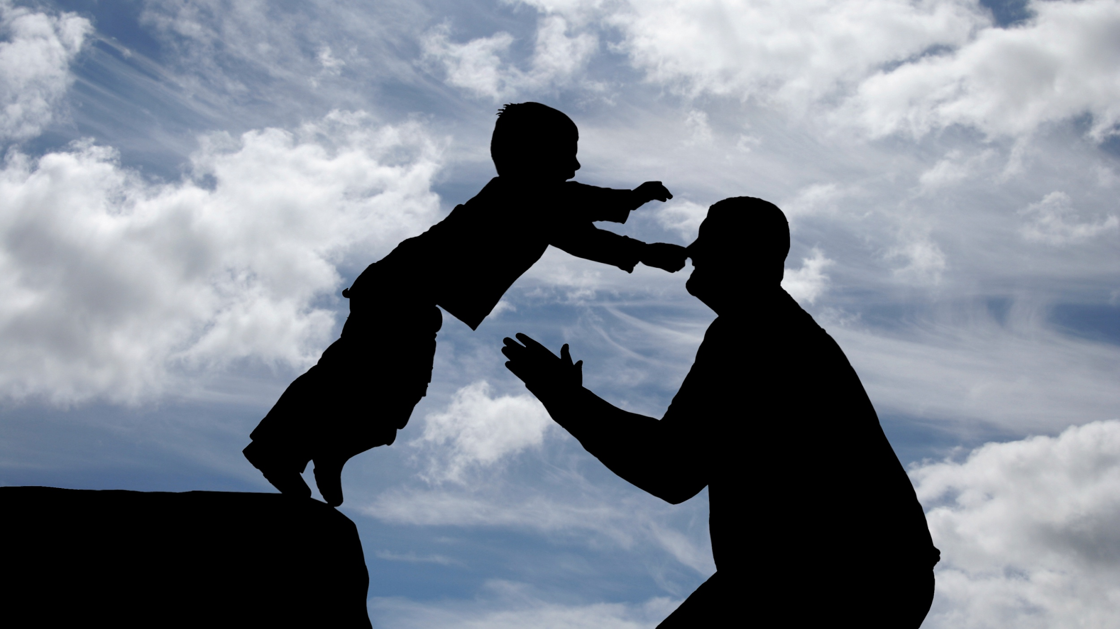
Trustworthy Communication
Notes:
Talking Points:
Activity: define relationship and alliance-what is the difference between the 2 how might that influence your role as a system coach?
The work you do for yourself has a huge impact on this VTSS way of work. Every interaction has the opportunity to change this discourse in your mind, office, school and district.
If this felt hard - good - this is not easy.
We tell our Coaches to do this - we have to be able to walk the walk. Practice. With your friends, loved ones, children. We can only work on ourselves. We need to self assess--did I try to use the “top four”? How could you collect data on your own use of these skills?

Slide 29
Collaborative Communication Skills
“Be as passionate about listening as you are about wanting to be heard.”
“Effective interpersonal communication skills are essential whether one is coaching an individual person, a team of people, or an organization as a whole.”
- Brene’ Brown
- March & Gaunt
Notes:
MOST UPDATED CHECKLIST 1-31-22 : https://docs.google.com/document/d/1NC9SrAZxkncq7lhoTwmslLo_7nurxVCn/edit#
Talking Points:
This is from the MTSS Coaches manual and similarly shows up in the NIRN Coaching Practice Profile. Statement for what’s important to be an effective coach. Take a minute to read. Other states feel this is important work.
A tool is only as good as the person holding it - communication.
What does it look and sound like?
Collaborative communication is a crucial skill set for systems coaches - which is also highlighted in the NIRN Practice Profile for Coaching: Creating an Enabling and Collaborative Context.

Slide 30
Levels of Impact
Level of Impact | Evidence of Impact | Training Method
Awareness | Participant can articulate general concepts and identify problem | Didactic Presentation of Theory and Concepts
Conceptual Understanding | Participant can articulate concepts clearly and describe appropriate actions required | Modeling and Demonstration (i.e., live, video…)
Skill Acquisition | Participant can begin to use skills in structured or simulated situations | Practice in Simulated Situations with Feedback (i.e., role play, scenarios…)
Application of Skills | Participants can use skills flexibly in actual situation | Coaching and Supervision During Application
Notes:
As a coach we are doing awareness and now we are moving into acquiring.

Slide 31
Collaborative Communication Skills
Paraphrasing: Restating words – as specific as possible
Offering empathy: Restating others’ feelings about a situation
Asking clarifying questions/Requesting clarification: A question/statement that is directly related to what has been said
Summarizing: Concise and specific wrap-up
Offering Information: Adding factual or research based information
Asking potentially relevant questions: Questions that require adding new information to the conversation
Notes:
Talking Points:
Review from 101
Jim Knight, Aguilar, Killion and others in the coaching world have done a good job of asking the coach to turn the mirror and examine their beliefs and foundational principles around communication. The problem is they stop short of helping us to understand what collaborative communication should actually look and sound like. These communication skills have been adapted from Gravois and Gickling and achieve what others haven’t.
Talk through each of the six skills and offer that they are all important. Then, the presenter asks the participants to notice the “top four” skills and the “bottom two”. Hopefully it will be fairly obvious that the top four honor the voice of the coachee, asking them to reflect on their own words while validating their experience. The bottom two are also important, but we tend to rely on those skills more when in positions of power/authority. It’s so important that we understand the coachee’s perception of reality, before we try to move them towards a different agenda.
What is paraphrasing?
We call offering empathy a “Salt and pepper skill” - offer empathy sparingingly - ask group why? We can be caught admiring the problem very quickly.
Summarizing -
Clarifying questions - what is it? Define….It’s amazing how often we insert our own words into someone else's meaning. We want to honor/validate their meaning so we’re going to spend a little time practicing.
Additional Notes: what is different about the top four skills in red and the two bottom skills? Share out; some people may say - “why isn’t listening up there?” Because listening is necessary to “do” the top four skills. We learn early on the “listening face, such as nodding, smiling, etc.” but we can’t do these skills simply by putting on our listening face.

Slide 32
Key Role of a Division Coach is systems work!
The key role and responsibility of 'systems' coaches is to facilitate the development of and to monitor multi-tiered systems for the division. MTSS work is the result of:
Highly effective teams that use data to inform their decisions
Creating communication protocols
Aligned Professional Learning for staff, inclusive of coaching
Notes:
Talking Points:
Team processes is what is what coaches aim to change first. (p.22) Changes in the team will be the conduit for improvement in the over system. For e.g. if a team becomes more endept about building buy in among educators, more education will support the implementation efforts and the overall school will be primed to kick off implementation efforts with a high degree of readiness.
What is the data system and how is it being used, what is the communication system and is it effective, and what is the PL to coaching system and is it giving us the results we want.
Schools are the unit of intervention (which are tiered) and the division are the unit of implementation.

Slide 33
Systems Change Requires…
Highly Effective Teams that use data
Why are teams so important in the work of systems change?
Who is on the team makes a difference!
How does one facilitate highly functioning and effective teams?
What is the purpose of the team?
What DATA will the team use for decision making?
What strategies/structures/meeting processes can enhance team functioning?
How will we know if our teams are being effective?
What do you bring to the table?
Notes:
Talking Points:
Why teams are important in the work of systems change
Who is on the team makes a difference. Cultural competence
How to facilitate the development of highly effective teams
Adult learning; is your division a learning one; what are the functions/purpose of each of the team
Are teams functioning well: Identify, choose and implement
strategies/structures/meeting processes for enhancing team functioning; Understand, apply and uphold concepts of emotional intelligence, accountability, engagement, cultural responsiveness and collaborative decision making within a team.
Are teams being effective?
What do you bring to the table?

Slide 34
Why are teams so important in the work of systems change?
Who is on the team makes a difference!
Systems Change Requires…
Highly Effective Teams
Notes:
Talking Points:
Implementation matrix 1- ABC
Working Smarter, Not Harder can be referenced

Slide 35
WHY teams are so important
You cannot do it alone
Creating schools into places where all children get what they need each and every day, is hard work and requires solving hard problems.
Notes:
Talking Points:
How to create equitable schools you might ask. You cannot do it alone. No individual alone can transform our schools into places where all children get what they need everyday.
Teams have a great potential for solving hard problems in challenging contexts. They bring together more skills, knowledge, and experience to work than any single individual can.
They can integrate individual members diverse contributions into a creative problem that is what is needed
“Not person dependent”

Slide 36
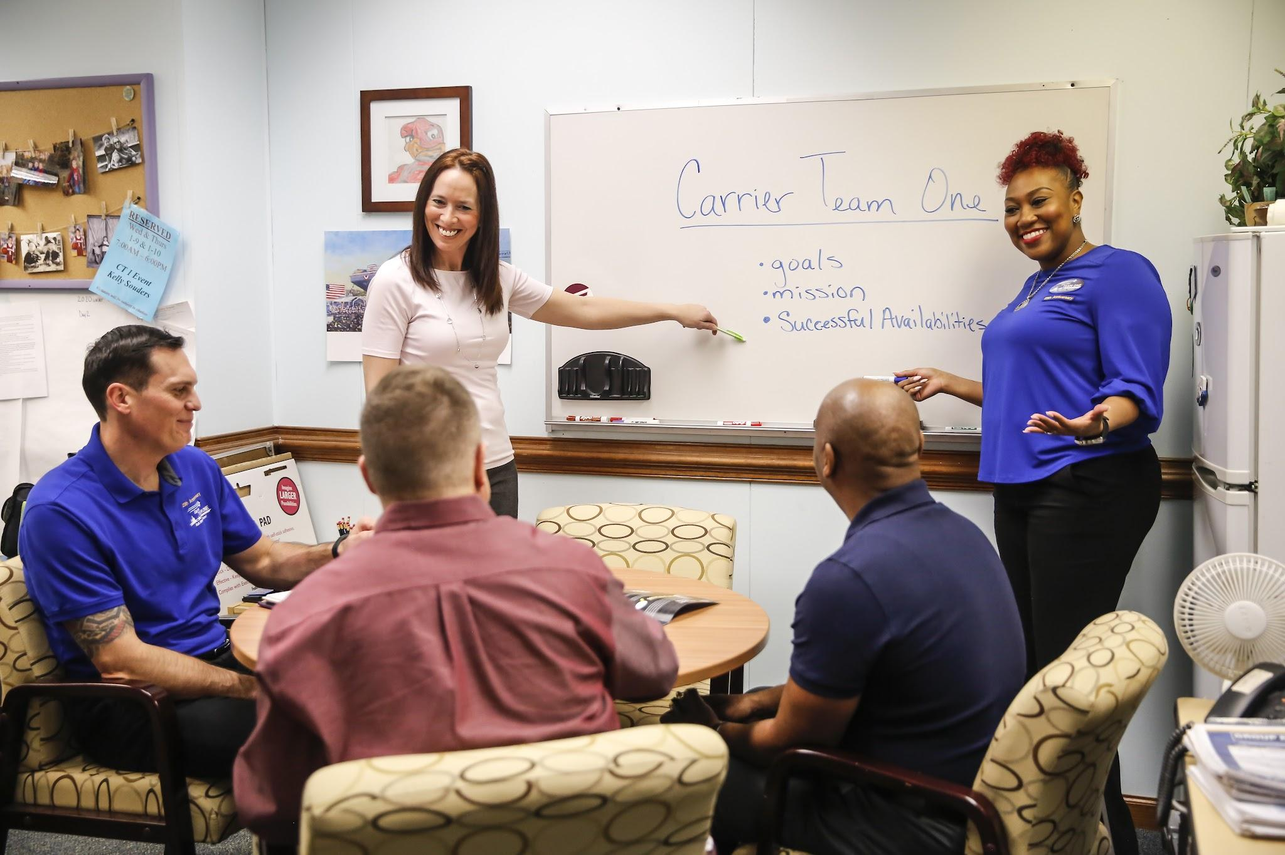
Do you have broad representation on your teams?
Notes:
Talking Points:
In teaming, it is important to look at the demographics of the organization the team supports. That may go beyond even what is on this wheel or the Federal categories out of the United States Department of Education. For example, military family members and housing challenged members may be very valuable members of division and school teams.
“Sense of belonging” and “Dignity”
Student voice, family and community voice

Slide 37
Pause and Plan
Representatives from all grade levels, departments
Roles and Responsibilities are defined and process to evaluate is included
Administrator is an active member of the school team
Team should form around the data points you want to move and your “why.”
Student representatives/voice, especially with high school
Representative/voice of families, and school community
Representative/voice from social identity wheel
Notes:
It’s okay if they are the only ones there to pause and reflect about their team.
How are they including student and family voice?

Slide 38
Systems Change Requires…
Highly Effective Teams
How does one facilitate the development of highly
effective teams?
What are the functions/purposes of each of the teams?
What data will each team use to inform their decision making?
Is your division a learning organization? Where does coaching fit?
Attend to adult learning
Notes:
Talking Points:
We have covered the why and who of highly functioning teams now how do you do it!!! The first question that comes to mind is, does my team know why they are there, what they are responsible for, what their purpose is? Does the team have access to data and do they know how they will use data and for what purpose/tier? Does my team have the willingness to learn new processes, use new tools, think about the way of work in a new way? Think about the complex change chart and without the vision for a tiered system, you will not have meaningful change.

Slide 39
Learning Organization
An organization in which everyone is learning. This not only ensures that the organization survives but also helps it thrive and generates new creations. (Senge, 2006)
The Art of Coaching Teams, pg. 185
Notes:
Talking Points:
Read this!! Generates new creations!! Those creations are could be new or improved systems that support tiered interventions for student learning.

Slide 40
Learning Organizations
Notes:
Exhibit 9.1 Indicators of a Learning Organization
https://drive.google.com/file/d/13nrmvZFZpGPrJPG_dPLgJhzeM1e-jhxA/view?usp=sharing
Talking Points:
Pg. 186 The Art of Coaching Teams has this helpful document to process your work. As a division coach you might want to ask, is your division a learning organization? Data: and how do you know?
One of the 3 NIRN drivers is Organizational Driver focused on Facilitative administration DCA ITEMs 4, 5, 6, 10, 11, 17 and the key function of that driver is to have the division building and maintain hospitable environments to support the new ways of work. These facilitative systems are accountable for creating an organizational context that support and engaged in learning and continuously improving.
Activity: Participants will be given time to complete this survey.

Slide 41
Your Time
Take 5 minutes to complete the Indicators of Learning Organizations on pg. 186 from…
YOUR PERSPECTIVE.
Think about how you can bring this back to your team for all stakeholder input and coming to consensus.
Notes:
Activity:
Give participants 5 minutes to individually complete this survey. Remember this is the beginning for you, to get familiar and then complete this and discuss outcomes with your team.

Slide 42
Time for Reflection
Which of these indicators of a learning organization are present in a team you coach? Which are absent?
What are the present barriers to becoming a learning organization?
Which practices or policies could change to become a learning organization?
What could you do to help a team become a learning organization?
How might your team be different if more willing to be a learning organization?
Notes:
Activity:
Guiding Questions on page 187. These questions will help guide reflection on which indicators show need for improvement in their school. Which priorities to focus on. Maybe policy change is needed? Consider how we can grow and support our students AND ADULTS through this process.
Ask team to identify someone to share out.

Slide 43
Leadership Team Functions
PBIS.org Implementation Blueprint and Oregon Systems Coach Manual, 2013
Notes:
Talking Points:
This slide should look familiar. The DLT has executive functions: that is all in the 4 blue boxes. It is also responsible for aligning those functions with Implementation functions
This diagram speaks to the Leadership functions of the DLT. Alignment of organizational structures is critical to the overall outcomes of implementation of VTSS-MTSS. 1B Teaming, not only applies to the DL teaming but how the DLT begins supporting schools with a parallel infrastructure of knowledge, skills and teaming structures.

Slide 44
Does your team know its Purpose?
Reflect on purpose, pg. 64
Keeping students at the center, pg. 65
Determining a team’s mission and vision, pg. 69
Notes:
Use book here.
Talking Points:
Does you tier 1 team understand what’s its purpose is?
Does your advanced tiers team know what their purpose is?
Do you have too many teams working in your schools without a clear purpose or working against each other exhausting human resources?
Working Smarter document-used to be mission aligned in all groups that work within larger units. (in folder)
Sometimes we need to circle back and look at and review our team’s purpose. We may have new members, organizational change, and the impact of external and internal events. Here are some key components when establishing a team’s purpose. Team purpose should align to the organization’s. A team is a body within a larger structure such as a school or division.
Perhaps one of your action items is to revisit these items utilizing your book.

Slide 45
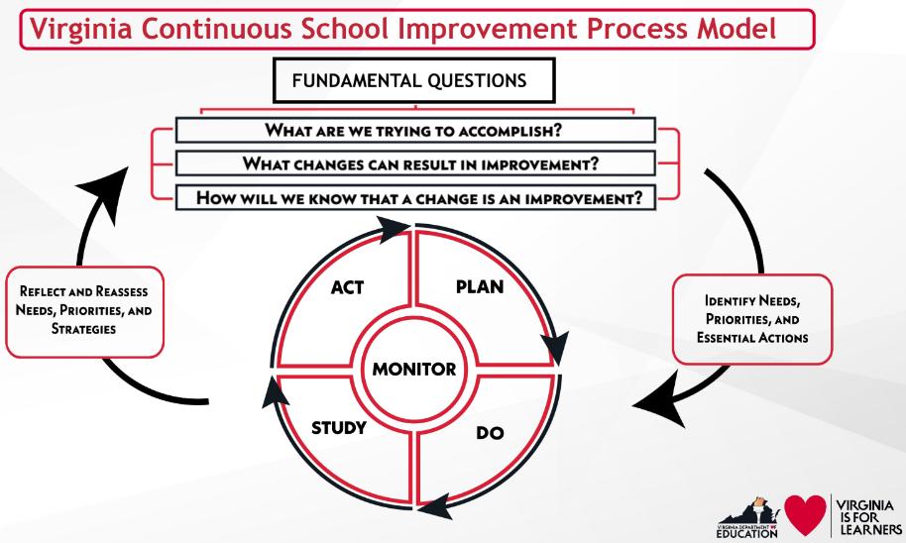
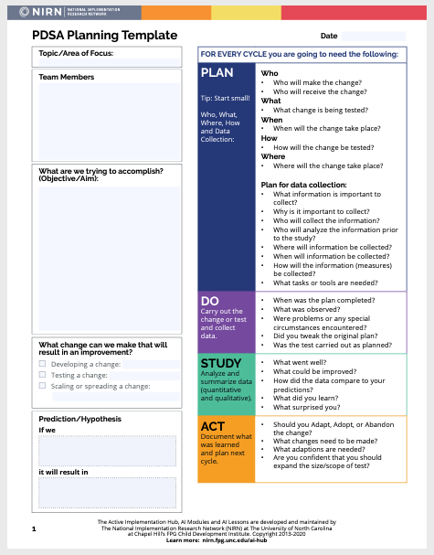
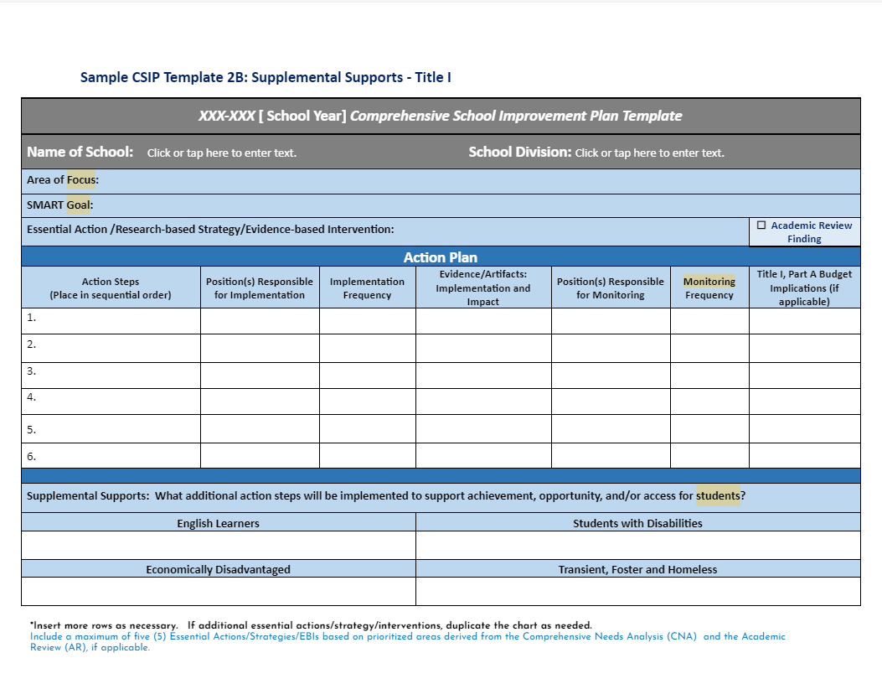
DIDM: Function Over Form
Notes:
Talking Points:
What is your division Data Informed Decision Making Process /Protocol
Here you see examples of the model used by the Office of School Quality and another used under Comprehensive School Improvement (Title I)
The importance is using a process and documenting such

Slide 46
VTSS DIDM Protocol
Notes:
Talking Points: this looks familiar
Data Informed Decision Making -
https://docs.google.com/document/d/1YWXT-ZEiylin0RG253CjnEm4yjyVldyT/edit?usp=sharing&ouid=101138290019461494780&rtpof=true&sd=true

Slide 47
Foundations for Trust and Safety:
Community agreements lay the foundation for positive culture, build trust, people feel safe.
Community Agreements
Why have Community Agreements?
Effective agreements = goals achieved.
How to develop these: Together as a team!
Ideal number is 5-7. Review every meeting.
2 types:
Procedural e.g., start and end on time, keep minutes
Behavioral e.g., offer solutions, listen to understand
Notes:
Article The Power of Setting & Sticking to Norms https://drive.google.com/file/d/1lE6kC8ctmw_Vv9LGqijlz23Yi2_DFzgA/view?usp=sharing
Article from Learning Forward on Norms: https://drive.google.com/file/d/1eWVOwr7wqmDj9E0DAhqmqAG_CWZJ8XTq/view?usp=sharing (lean into this one)
Talking Points:
Some call them “norms”, some community agreements
Remember when you looked at the learning environment questions
How will you know the norms are effective-being effective means the overall functioning and results of the team.
Discuss language around norms (Aguilar refers to) and Community Agreements
Going back to them, and using the team assessment in the book. (pg. ????)

Slide 48
Foundations for Trust and Safety Community Agreements
Clarify each agreement: Interpretations could be different. What does it sound and feel like? e.g., assume positive intent - What does that agreement mean?
TR
Visibility: on agenda and around the room
Trust
Revisit them: Are they working? What can we do to make them better?
Notes:
Talking Points:
Assume good Intent. But what is the motivation or purpose behind our action. Although our intent may be good, if it is not communicated well or the behavior that follows doesn't match it, then the outcome or the results will not go as planned.

Slide 49
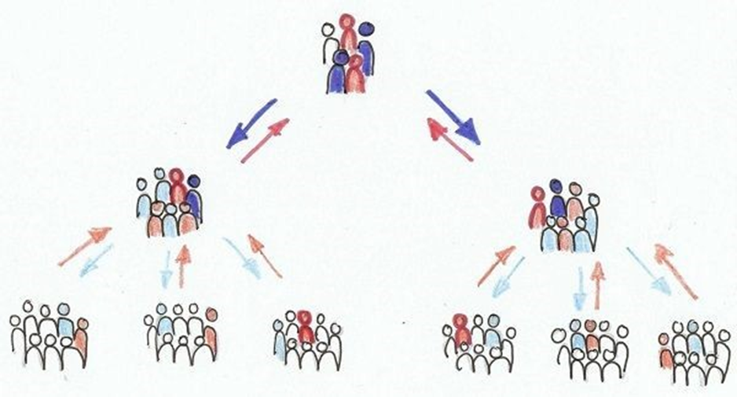
Think of a Team you are Coaching
Decision Making Systems Matter
Notes:
Talking Points:
Our work as a ‘systems coach’ is around identifying systems which work together to bring or inhibit action or outcomes. There are systems also around decision making in your division or within schools. Those systems can promote or inhibit the work being done. Think about a team that you are coaching. I have worked with teams that cannot make decisions or are hesitate to develop action steps or if they do, do not follow through with actions steps.

Slide 50
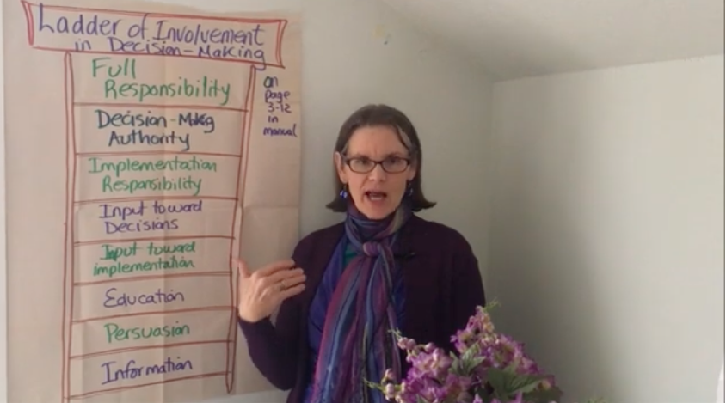
video link
Notes:
3:00 minute video.
Talking Points:
Activity: Before you watch this video I want you to think of a team that may not be functioning as you hoped. After several coaching sessions with either the division coach and/or your coaching, they keep admiring the data, seem resistant to making instructional changes, attendance at the meeting is very inconsistent, principal is not involved etc etc . Is the team functioning at a hierarchical level or is it facultative. Watch this video:
●Aguilar: Coaches using a systems-thinking approach are looking closely at context, power, and identity.
●Because Teaming is so important to a division and to a school as the unit of intervention, do SLT feel they have the power and authority to make changes? Does the DLT give power to admin?
●As Systems coaches - we need to know the level of input/this speaks to transparency/effective communication and making sure the right people with the power and authority are sitting around the table.
Activity:
Video - Decision-Making Ladder

Slide 51
Ladder of Involvement
Notes:
Time: 11:37
Presenter: Roberta
Chat Box: https://drive.google.com/file/d/12tZ7n-K9-GNrfeAmswIAWJBVXIUmQE5o/view?usp=sharing
Talking Points:
There are no wrong levels of decision making authority. They vary from being very hierarchical (Stages 1-2-3) to more facilitative with great latitude in making decisions and implementing the decision. If you want to be trusted, you will achieve best results if you are honest about what you are needing from the team. For example, do not pretend to want your team’s input on whether to make a decision when it has already been decided.
This also speaks to the Smarter Document-what is the purpose of the team/their decision making authority. Does this document help teams understand their level of authority?
Activity:

Slide 52
Are Teams Being Effective?
Cumberland Team Temperature Check
Notes:
Talking Points:
Video - https://drive.google.com/file/d/19whxSPt2rDhZk0TgSj3oXaBhUzHnftur/view

Slide 53
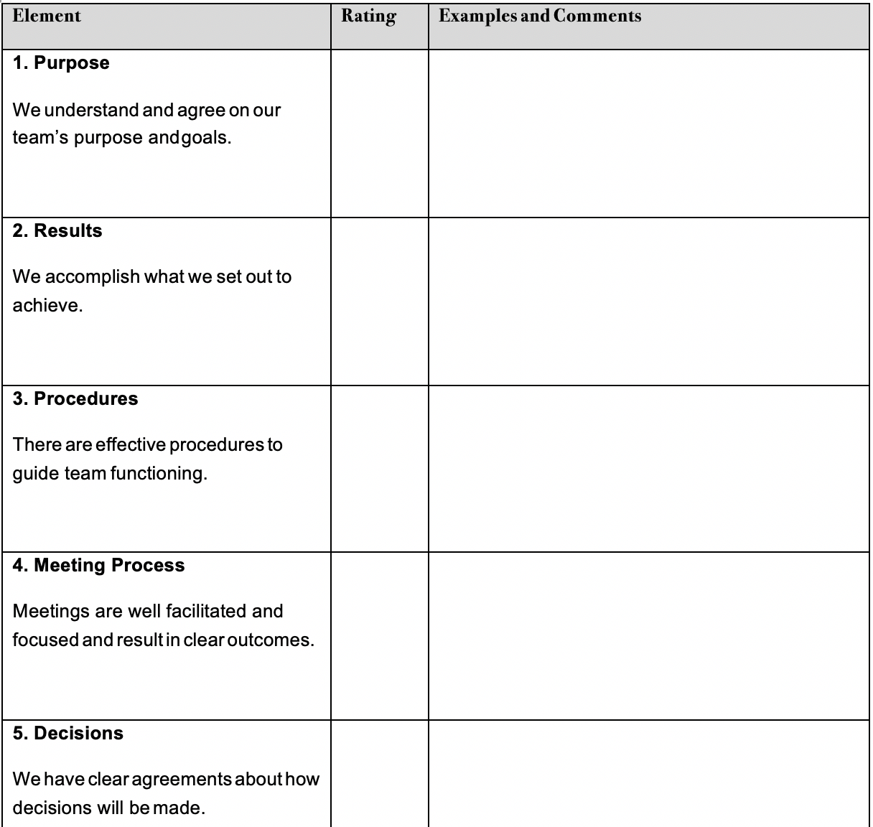
Assess Current Team Effectiveness
Reference pages 305-306 in your Aguilar book.
Notes:
https://drive.google.com/file/d/1MHMixPhzmbRQCk9cCizw8-r8OWJPUP7L/view?usp=sharing
Talking Points:
This is an opportunity to cycle back to meeting procedures/processes. Decision making, community agreements!!
Meeting norms and roles and responsibility definitions are so important in supporting effective meetings.
Team members must be active listeners as well as active participants. Each team member has important input for meetings.
Use of team members- i.e. the Encourager Role can be used to solicit feedback from each team member

Slide 54
Let’s look at your team: How will you facilitate next steps?
Brand New (We need to work on our structure, process, and procedures.)
Still Growing and/or Changing (We’ve accomplished a lot and just need to work on a few items due to change and/or growth)
Seasoned (We’ve been doing this for awhile and love to review our structure, process, and procedures).
Notes:
End of Day 1

Slide 55
Exit Ticket
http://tinyurl.com/yu3px9sa

Slide 56
Welcome back!
Notes:
Day 2

Slide 57
How are you today?

Slide 58
Systems Coaching Institute 102 Learning Intentions
Understand the importance of teams in the work of systems that impact change
Understand and facilitate the development of highly effective teams
Identify, choose and implement strategies/structures for enhancing team functioning
Understand, apply and uphold concepts of emotional intelligence, accountability, engagement and collaborative decision making within a team structure
Utilize effective communication and other coaching techniques to impact systems change
Coach the development of the system and support structures
Create and utilize a Coaching Service Delivery Plan and ongoing self-reflection
Notes:
Talking Points:
3 main chunks to these learning intentions:
Highly effective teams An aligned communication system, Aligned Professional Learning for staff, inclusive of coaching

Slide 59
The focus is on YOU!
What do you bring to the teaming table?
Notes:
Pre-work - Assessment - Need to figure out where to do this! Day 1 or beginning of Day 2
Talking Points:
Of course, a team is made up of individuals. As the coach, you set the tone for the group! As you look ahead to Day 2, try to take a little time to think about yourself and what YOU bring to the group. We’ll also be consider ways you, as the coach, can help strengthen team members skills, engagement and approaches to conflict.

Slide 60
What is your EI?
Notes:
50 Tips For Improving Your Emotional Intelligence.
Talking Points: So, my question for you today is How’s your Emotional Intelligence? Elena Aguilar really emphasizing how team leaders set the tone for your meetings. Studies have proven the link between emotional intelligence and career success, job performance, and stronger mental health.
We’re going to put you in breakout rooms again, with three different tasks. Let me give you the directions before you go, and you’ll also have written directions on the Padlet. Please assign someone to keep track of your time, a recorder and a reporter.
First, open the Jamboard and turn to the slide that corresponds to your group number. As a team read the descriptions in the orange boxes and match them to the correct EI skill in the yellow boxes. If you need help, refer to pages 16 and 17 in your book.
Second, open the 50 Tips for Improving Your EI article. Quickly scan the tips provided and each member in your room will choose 1 tip to share and why that tip resonates with you. If you have your EI self assessment nearby, look for tips in any area of growth you identified for yourself.
Training Activities:
Refer to this other resource in their folder 50 Tips For Improving Your Emotional Intelligence.
The tips are broken down by domains. Scroll through quickly and highlight a couple strategies you will use to improve the areas you identified. Talk in your group about suggestions that made you pause and why. (4 min)
Pages 35-37 really talk about the implications for team leaders who are responsible for bringing groups of folks together. (4 min)
As a leader your emotions matter the most. What does this bring up for you?
As a leader you set the emotional standard
You can intentionally spread positive feelings
When people feel good, they work at their best
The more emotionally demanding the work, the more empathetic the leader needs to be.
Leaders need to help a team build emotional intelligence
How might you use the questions on page 37 to explore your EI, particularly from a leadership lens?

Slide 61
What is your Team’s EI?
Notes:
Pages 124-126 Indicators of a Team’s Emotional Intelligence
Pages 130-131 44 ways to improve teams EI documents - links to folder
Talking Points:
As you can see, EI is fairly comprehensive and important for our own self management, but also for social management. Chances are good that, when you completed the EI self-assessment, some of you were able to identify at least one area that is weaker than others, in which you could grow your skills. So what happens when we put a group around the table? We probably all bring some skills and weaknesses. Our EI can also fluctuate from day-to-day.
Would you agree that now more than ever we are all wearing our emotions on our sleeves? Stress levels are high, tension is great and the need to be kind to one another is is at an all time high. So we’ve given you some tools to work on your own EI, but what if yours is high, but you’re sitting in a room where everyone else is, we’ll just say “lacking”? It seems worthwhile to spend a little time exploring the EI of our teams and, more importantly, how we might be able to improve it. This is not unlike the work we do in classrooms to build social emotional resilience. We all need resilience and not all of us take the time in our daily lives to “fill our buckets”, if you will. So, much like we tell teachers, pay now or pay later, taking the time to build your team will pay off in the long run.
Chapter 6 is about Developing the Emotional Intelligence of a Team
Pages 124-126 Indicators of a Team’s Emotional Intelligence
Pages 130-131 44 ways to improve teams EI documents - links to folder
Activity:
Take 2-3 minutes to read through the list of low and high indicators of a team’s EI on pages 124-126. Star or highlight indicators that resemble your MTSS leadership team.
Each participant share an EI strength of your team and an EI weakness of your team. After sharing, other participants offer suggestions based on their own experiences or by using the 44 Ways to Improve Teams EI on pages 130-131. (7 min)
Make sure each participant in your room has an opportunity to share and receive suggestions.

Slide 62
Who’s at the Table?
Elena Aguilar, The Art of Coaching Teams: Building Resilient Communities that Transform Schools. Jossey-Bass, 2016.
An awareness of one’s own cultural identity and the ability to understand others’ cultural identity and work effectively with them
Gender, age, race/ethnicity, SES, class background, sexual orientation
Region, we grew up in
Religious traditions
Notes:
Talking Points:
When we thinking about team composition, we have traditionally thought about diverse representation of grade level/content, etc. Last week we shared the VDOE resources around Cultural Competence. We also talked about intentionally creating teams that are broadly representative of all the stakeholders of you school/division/community. If we’ve invited others different from ourselves to join our team, how do we respect and honor their various identities? And Remember, it’s not just the way you talk to someone, but also they ways we talk about others, that reflects your character and your professionalism.
101--Compass Activity?

Slide 63
Intent vs Impact
Notes:
Image Reference: Phillip T. Williams (July 2020). Home [LinkedIn page]. Intent Verses Impact LinkedIn. Retrieved October 6, 2022, from https://www.linkedin.com/pulse/intent-vs-impact-phillip-t-williams-m-s-hrd/ (just a reference for the image)
Talking Points:
All of us have good intentions, we know that. But sometimes our good intentions don’t bring about the best outcomes or those good intentions impact a group of people in a negative way.
It’s not always about race, gender, etc. For example, when we make an interactive PP with words that fly in with crazy colors, it may negatively impact some individuals such as persons who are sensory sensitive. Our intent was to have an annotated and interactive presentation, but for some, our impact was that we gave them sensory overload.
Sometimes what we said is not what is received. Sometimes what we do does not yield the desired outcomes or impact. It is important to set meeting structures that allow for persons to say how they were impacted and for those who did the impacting to understand how their actions either positively or negatively impacted others. The key is to be able to say “ouch” and “oops” and to learn from the experience. Continued acknowledgement that all of us are learning and growing and that our aim is to reach a place where positive intent = positive impact.
Ouch and Oops - connections to community agreements, emotional intelligence, diversity and inclusion - how can we use the Ouch/Oops as opportunities to build inclusion and work on our EI, etc.
Do you need to revisit your community agreements? How often?
We are all learning and growing. Hopefully our intent and impact with get more aligned. And, without a structure that makes it safe for others to say “OUCH”, I don’t know if my impact was negatively received, so I don’t know how/what to change. It’s not easy to hear when my intent was good, but my impact was hurtful to someone. Honestly, my first reaction is to explain my intent. But really, most folks know my intent was not meant to harm. A much better response would be for me to say “oops!”, I’m sorry, thank you for letting me know and I’ll try to work on this.
Elena Aguilar, in The Art of Coaching, provides this amazing resources called Coaching Lenses. It is in your resource folder and offers both assumptions and coaching questions to consider in the areas of adult learning, change management, inquiry, systems thinking, emotional intelligence, and compassion.

Slide 64
What do you bring to the table? Coaching
Systems Change Requires…
Utilize effective communication and other coaching techniques to impact systems change.
Giving and receiving feedback; navigating conflict with healthy outcomes
Aligning Communication & Coaching
Notes:
Communication Bookmark
Talking Points:
As you begin thinking about communication and coaching, don’t forget the communication skills we practices in 101! You can find the Communication Bookmark in the materials folders.
Transition slide moving onto the next section
Refer the DCA items - 25. Division has a coaching system to support schools in their implementation of EIs including VTSS . IMP matrix 1D Communication
Activity: Have a group define alliance, have a group define relationships

Slide 65
Receiving and Giving Feedback
Take 4 minutes to read the article individually. While reading, highlight 1-2 points that “hit home” for both receiving and giving feedback
In your groups, 1 person shares 1 point that “hit home” for them and why. Other group members can ask up to 2 clarifying questions for the speaker to respond to.
The next person in the circle shares a different point that “hit home” for them. The process continues until each group member has been the speaker.
Adapted from National School Reform Faculty
Notes:
Giving and Receiving Feedback Article
Talking Points: Review directions. Encourage them to take notes and discuss. (no padlet for notes)
Another coaching skill that was requested at the end of 101 was some tips around feedback. To be an effective coach, feedback should be a regular occurrence! Encouraging self-reflection is always preferred BEFORE providing observational feedback. So we’re going to take a look at a very short article that is a little different because it’s focus is on both giving and receiving feedback. As lifelong learners (and human beings!), we are all in the position to receive feedback on a regular basis. How we receive feedback may well influence how we provide feedback.

Slide 66
Review: Feedback
Receiving Feedback
Giving Feedback
Be prepared; be mindful
Separate the strands: feeling, story, feedback
Contain the story
Change your vantage point
Appreciation: Validate and share concrete affirmation
Coaching: creating conditions for transformation through inquiry
Evaluation: letting someone know where they stand
Receiving and Giving Feedback by Elena Aguilar

Slide 67
Responding to Resistance
Look inward
Resistance masks fear
What looks like resistance is often the need for help
Be clear
Trust reduces resistance
Confront cynicism
Reflect on team structures
Don’t focus on the resisters
Elena Aguilar, The Art of Coaching Teams: Building Resilient Communities that Transform Schools. Jossey-Bass, 2016.
Notes:
Talking Points:
What if you’re offering feedback or trying to move the work of your team forward and the response you get is resistance?
Resistance sometimes comes when people don’t know what they are doing on the team and they think it is a waste of time. Think about the Managing Complex Change --do they know the vision, skill not will etc.
We also need to remember the role of power and choice. People who feel powerless and who are not give choices are much more likely to resist!

Slide 68
Engagement Strategies
for Teams
Every meeting should begin with identified outcomes!
Consider using structures or protocols for engagement:
Making Meaning Protocol
Consultancy Protocol
Discussion Protocols
Feedback Protocol
Chalk Talk
Dyads
Elena Aguilar, The Art of Coaching Teams: Building Resilient Communities that Transform Schools. Jossey-Bass, 2016.
Notes:
Data Driven Dialogue
Talking Points:
So, I’ve been doing this work for a while and it’s not at all uncommon to come across team(s) who aren’t engaged. Sometimes, team members are happy to let their coach take the lead, set the agenda, run the meeting and do all the work. Sometimes we find ourselves in the role of “coach” because we have a tendency to do that very thing - South, anyone??! So, how can you get your team members to be active participants in your meetings and in the work?
1st, go back to what Pat and Roberta talked about. You need an agenda, roles (rotate these so everyone gets to have a turn with each role:-), norms/community agreements - set clear expectations about the responsibilities of team members at all levels. Who brings the data? In what form? Who brings information back from schools or grade level teams? Who had an assigned task to report back on? Who gathered the staff survey results?
2nd, consider what each team member has to offer. Why were they invited to serve on the team? What information should they be bringing back to the team or taking forward to others? What specific skill/strength do they have that you might employ?
Finally when you find you’re the only one in the room talking, it’s time to break out some engagement strategies. These might look different from what you use with students, but the same ideas apply. There are many opportunities and valid reasons to have team members work in pairs, small groups or other configurations which require engagement by all.
There are many resources available including in your book, at Bright Morning and through other organizations.
One I especially like is the Data Driven Dialogue. Often teams are presented data in bits in pieces or the provider of the data presents the conclusions they have already reached. By using this protocol, folks get to examine data independently, they get to examine their own assumptions (and biases), and then work together to reach conclusions. It’s a very worthwhile process that could be used by teams or even faculties. It’s a little lengthy, but could be done over two sessions.
Pages 320 - 325 in the Art of Coaching Teams
https://www.schoolreforminitiative.org/protocols/
http://www.pz.harvard.edu/thinking-routines
https://brightmorningteam.com/coaching-team-tools/

Slide 69
Collaborative Decision Making
Multi-voting - used to whittle down from a lot of choices
Compromise - both sides may feel they’ve lost
Majority Voting - someone(s) lose
Unilateral Decisions - One person is designated to decide for the group
Consensus (using Fist to Five vote)
Consent-based - a proposal is made, clarified, modified and there are no objections (Fist to Five works here, too)
Notes:
Talking Points:
Art of Coaching Teams - Chapter 8 talks about Collaborative Decision Making. Not every decision needs to be made collaboratively!! A good leader know that, but also knows that for solid buy in, shared decision making is crucial. Similarly, good leaders surround themselves with great people, who bring a wealth of knowledge, experience and ideas.
Collaborative Decision Making can look a lot of different ways. Often time we start with brainstorming and then need to whittle down the options. Multi-voting is great for this. Maybe each person has a red, yellow and green dot to rank their first, second and third choices.
Majority Voting and even Compromise often leave some folks feeling like they lost.
A great option is (sometime called) Consensus or Consent-based Decision Making. Let’s watch a quick video.
https://www.youtube.com/watch?v=FgjgXIxHmmI?
3 minutes Fist to Five to Frodo https://www.youtube.com/watch?v=b4B7FQxND6w

Slide 70
What about conflict?
Notes:
How do you define conflict?
Summarize comments by saying that everyone defines and feels conflict in different ways and in different degrees. As a coach we need to be aware of these different behaviors.
What about conflict? How does the compass activity and what you’ve learned about feedback and emotional intelligence influence what you know about conflict resolution? We want go beyond management to resolutions! And, how you go about conflict? It’s inevitable. Yet, we are sometimes surprised by it, avoid it, or even “silently quit” because of it.
How do we see conflict as a growth opportunity that we can learn skills to manage and find resolutions. Conflict can be healthy.
Our ultimate goal is better outcomes to accomplish the tasks and build positive working relationships.

Slide 71
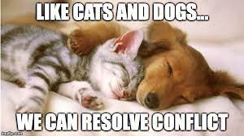
How do you feel?
Notes:
How do you feel when you are in a situation that is conflictual? Using your annotate tool or chat box and select a picture. Why did you select the picture?

Slide 72
Task vs Relational
Different opinions about how to execute a task.
More emotional; creates disconnect between people
(Prosocial: Using Evolutionary Science To Build Productive, Equitable, and Collaborative Groups; Atkins, Wilson, and Hayes)
Notes:
Presenter Notes:
When you are working with an individual or a team to explore its values and goals in relation to conflict, coaching, and providing feedback, it can be helpful to make a distinction between task conflict vs. relational conflict.
Task conflict is when team members have different opinions about how best to execute a task. This might arise because members perceive value issues differently, or because they bring different types of expertise to a task, leading them to see different perspectives and solutions. How we can decenter ourselves to gain perspective.
IMPORTANT: In some situations, task conflict can be very healthy in groups. Healthy disagreement can contribute to creativity, learning, and better solutions overall.
Pause: Think of a time when this occurred for you. When the ongoing discussion over a task, in time, brought creative thought and solutions. And, you learned from others. Remember coaching is a relationship built on mutual learning and trust. When we reflect back on our successes and positive outcomes we can build trust with the process knowing --hey I’ve been here before, this is what worked last time, this is what didn’t work.
Relationship conflict tends to be much more emotional, and it involves tension, annoyance, and animosity between people. Negative and rigid evaluations and judgments of others fuel relationship conflict. It creates disconnect between people as they avoid one another, leading to failures to transmit information and coordinate tasks and coaching. (If we do the cultural competency from the book, comments about this or circling back a bit.)
And, of course, we know that sometimes task and relationship conflicts can be intertwined. We know that significant relationship conflict can impact important tasks to be accomplished and the quality of outcomes. We find the impact more intense and difficult when we are interdependent in the outcomes (we both are impacted), the outcomes desired are important, and we both are convinced that we have the most evidence that we are right.

Slide 73
We are interdependent in the decision and outcomes.
The outcomes are viewed as important.
We are both convinced that we have the most evidence that we are right.

Slide 74
Quote
“Conflict is maintained in our heads, in the judgments of right and wrong, good and bad, justified and unjustified, and stepping into the perspective of another, seeing things from their point of view and drawing a circle that takes them in, is one of the hardest things in the world to do.”
Prosocial: Using Evolutionary Science To Build Productive, Equitable, and Collaborative Groups; Atkins, Wilson, and Hayes, pg. 177
Notes:
Notes: In psychology, there is a term called naive realism. It is human nature for us to see the world through our lens and our perspective. We have to work at, practice seeing the perspective of others.
Discuss how you experience the quote's meaning. “Conflict is maintained in our heads, in the judgments of right and wrong, good and bad, justified and unjustified, and stepping into the perspective of another, seeing things from their point of view and drawing a circle that takes them in, is one of the hardest things in the world to do.”

Slide 75
Build Interpersonal Skills
Separate people from the problem
Focus on the shared interests of both parties
Develop many options that can be used to solve the problem
Evaluate the options using objective criteria
Prosocial: Using Evolutionary Science To Build Productive, Equitable, and Collaborative Groups; Atkins, Wilson, and Hayes
Notes:
Link to How can We Make Conversations More Prosocial?
Presenter Notes:
When we begin to focus on the task we can ask questions like “What is most important to you about getting to ____________ (whatever they have stated they want)?
What matters most to you here?
What would you like to accomplish?
Authentic questions to gain perspective and understanding can be described as “conversational receptiveness” – the use of language to communicate one’s willingness to thoughtfully engage with opposing views.
When experiencing conflict, shifting to the level of interests often creates a sense of shared priorities and common ground.
How willing are we to try something new to better understand the perspective of someone else? How can we continue to ask questions for better understanding?
Research has shown that the more we are authentically curious and engaging in psychological flexibility we are more likely to create a positive work environment and bring resolutions to conflict.
We have covered ways to build positive interpersonal relationships as you coach. Consider how learning better communication skills and the activities shared today will help you and your colleagues build prosocial conversations.
In the chat box you will see a resource “How Can We Make Conversations More Prosocial?”
You’ll remember in Elena’s book, she recommends a mindfulness activity just before meeting with someone or heading into a stressful situation. Deep breathing, a quick mindfulness meditation, anything that helps you be present and open to working with others. Relaxing the mind and heart rate.
Think of your compass activity and the perspective of North, South, East, and West. Setting norms and asking how do you approach tasks and conflict.

Slide 76
Enhance Personal Skills
Prosocial: Using Evolutionary Science To Build Productive, Equitable, and Collaborative Groups; Atkins, Wilson, and Hayes
Psychological flexibility skills
Psychological flexibility – The capacity to be entirely aware and connected with the present moment while behaving in ways that promote one’s values (Biglan et al., 2013; Lloyd et al., 2013).
Perspective taking
Get up on the balcony “observing self”
Separate people from the problem (content and relationship)
Notes:
Presenter Notes:
We are all familiar with patterns of behavior that avoid and overreact to conflict. When people fear conflict, what they may fear are the emotions of anger, sadness, or shame.
Building psychological flexibility (read the definition) skills through mindfulness, reflection, and perspective taking can build the capacity to act in the direction of what really matters even when it feels uncomfortable.
Perspective Taking:
Practice “getting up on the balcony” for perspective taking. From the balcony one can see more of the dance floor. This mindfulness activity can move you from being in the middle of it all and help you see other perspectives. Most importantly, this perspective, helps you to separate people from the problem you may have rolling around in your mind and impacting progress. In every conversation there are two tracks--content and relationship--running simultaneously, each with its own level of interests. We have interests in expressing ourselves, being right, and convincing others, but we also usually have interest in preserving and enhancing relationships.
When conversations get “tricky” or difficult, particularly when there is disagreement or strong emotion, it’s easy to see the problem as lying with the other person, with their character or their identity. This escalates conflict as people see themselves being attacked or threatened.
A more helpful stance is to objectify the problem than the person, and to assume that everyone in the relationship has understandable intentions, at least from their own point of view. Segue into quote…….

Slide 77
Where is your focus?
“Play the ball, not the player.”
Notes:
A common saying in Australia, pointing to the need to focus on the task rather than playing dirty by attacking the person in a football match. How do we sometimes become so overwhelmed with the relationship and losing perspective that we lose sight of the “ball” or outcomes we desire?

Slide 78
Tools for Shifting Perspective
Prosocial: Using Evolutionary Science To Build Productive, Equitable, and Collaborative Groups; Atkins, Wilson, and Hayes)
Imagining what others might be noticing, feeling, thinking, and wanting
Actively asking others what they’re noticing, feeling, thinking, and wanting
Listening reflectively to test understanding
Reversing roles with other, perhaps what it’s like to argue for their position and interests
Empty chair; or other symbols
Notes:
Tools are not useful unless we use them and practice using them consistently and over time. One suggestion is to write down your response to the bulleted items listed here. Write down five different reasons why the other person might have behaved the way they did. Selecting reasons that the person would write or endorse. Remember perspective taking. I’ve often done this mentally when processing in the moment someone’s behavior. For example, “I remember they told me they felt overwhelmed after returning from being out with illness.” Or, “I remember that this topic is a something they are pretty passionate about and they are worried or concerned about outcomes.”
Symbols: Use a physical prop, such as an empty chair, to symbolize an alternate perspective. You can also use the empty chair to symbolize stakeholders such as families, students, staff, etc.. Are there symbols that you could use or icons to represent conflict is okay--we can work this out!

Slide 79
Perspective Taking Activity
Think of a time when you were experiencing a conflict or a challenge with another person in the professional setting.
Remember to keep the story confidential eliminating names and context.
In your pair, Partner 1 shares story, one minute.
Perspective Taking: Partner prompts the story-teller to retell the story from the other person’s perspective.
Pivot Points: Partner finds a point in the story that seems pivotal and asks, what might have gone differently? Allow them to explain what might have changed in the story.
Discuss together:
In what ways did this “perspective taking” activity open new possibilities within your coaching conversations?
Notes:
Think of a time when you were experiencing a conflict or a challenge with another person in the professional setting.
Remember to keep the story confidential in nature eliminating names and context.
In the breakout room, Partner 1 shares their story, one minute.
Perspective Taking: Partner prompts the story-teller to retell their story from the other person’s perspective.
Pivot Points: Partner finds a point in the story that seems pivotal and asks, what might have gone differently? Allow them to explain what might have changed in the story.
Discuss together:
In what ways did this “perspective taking” activity open new possibilities within your coaching conversations?

Slide 80
Coaching Conversations
A Good Conversation Process
Determine most pressing issue
Clarify the issues
Review current impact
Decide what will happen if nothing happens
Determine my own personal contribution
Describe ideal outcome
Commit to action
Receiving and Giving Feedback by Elena Aguilar
Notes:
A Good Conversation Process
How could you use the resource in the context of the story you shared? How can you use the resource in other settings?
Talking points: Main point: Conflict is healthy for all teams and for the best outcomes to complex issues/problems!!!! “We need to explore our disagreements, values, beliefs, and opinions to build strong and effective teams that will make a difference for our students.” p. 248-249
So as a coach, how do you respond to conflict on your team and or how do you identify conflict in a team setting? Make connections to EI, team effectiveness, community norms. Using the tools!
A big part of ensuring that our teams, and ourselves, are able to work through these types of challenges is investing in the skill-building ahead of time. By doing so, you build the muscle memory, confidence, and commitment to have the conversations and work towards an outcome that serves all stakeholders well.

Slide 81
Create Group level
Agreements and Processes
Principles and processes that support the work
Knowing and coaching what the processes are for conflict resolution and teaming practices
(Prosocial: Using Evolutionary Science To Build Productive, Equitable, and Collaborative Groups; Atkins, Wilson, and Hayes)
Notes:
Aside from developing personal and interpersonal skills to manage conflict effectively, having agreed-upon principles and processes that everyone can trust can greatly help the process of conflict resolution.
Making sure conflict can be resolved in a timely and fair manner.
You may have other principles such as “go to the source” first to talk it out vs. gossip or toxic communication with others.Think back to your teaming content from day 1. Your norms and way of work.
When this does not work, what processes do you have in place if things escalate or need mediation?

Slide 82
Hearing or Listening?
“An integrative, collaborative orientation does not require sacrificing one's own needs; they are just as important as anyone else’s and need to be taken into account. Being able to decenter from oneself as the center of experience, and focusing on the quality of any relationship and its workability for achieving purpose, increases the possibilities for different forms of relating and the likelihood that others involved in the conversation will engage and participate.”
Prosocial: Using Evolutionary Science To Build Productive, Equitable, and Collaborative Groups; Atkins, Wilson, and Hayes, pg. 188)
This Photo by Unknown Author is licensed under CC BY-NC-ND
Notes:
Read the quote. What words stand out to you? Are you listening or are you hearing?

Slide 83
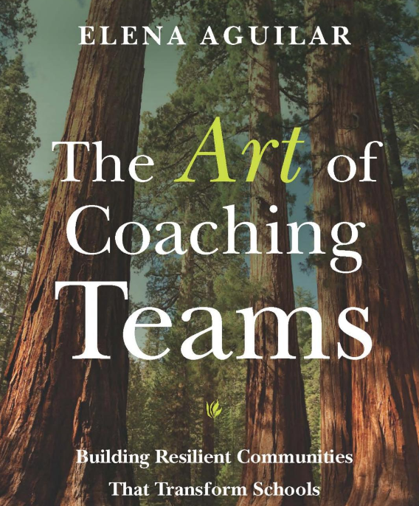
THE ART….
Notes:
Have you ever stopped to think about the title of this book? THE ART………..
Everything we are learning takes practice along with growth opportunities to sharpen our skills and develop THE ART of coaching. You are an artist, learning skills, to improve your art of coaching………..

Slide 84
MTSS Communication System Documentation
Leadership & Teaming
Planning
Communication
Aligned Definitions & Resources
Professional Learning & Coaching
Aligned Organizational Structure
Outcome
Fidelity
Evaluation of Process
Data Informed Decision Making
Data Systems
Decision Making Process
Meeting Structures & DIDM
Whole Child
Assessment Mapping
Screening
Progress Monitoring
Monitoring Student Progress
Evidence Based Practices
Quality Core Instruction
Aligned Instructional Interventions
Continuum of Supports
Fidelity of Practices
Capacity for Coaching & Professional Learning
Family, School, Community Partnerships
Communication
Cultural & Linguistic Responsiveness
Notes:
SISEP Communication Plan
NHPS Sample Communication Plan and VTSS Documentation
https://www.branchingminds.com/blog/communication-for-mtss - Example from Branching Minds
Presenter notes:
Ok, that’s a lot of information that needs to be shared and missing or failing to close any of the loops could have big consequences. And a communication system also needs to consider What outcomes, data, practices and systems should be considered? What other systems are impacted when a change is made in this system? Where does communication begin? End? How is it documented?
Here are the six core components of MTSS. Virginia’s goal is to align all our work. This work is only one piece of a much larger framework. With student impact and benefit as the ultimate outcome, there is much more to consider beyond the three tiers.
Aligned Organizational structures include leadership, teaming, planning within a tiered approach
Data Informed Decision making is part of all our work
EBP includes Instruction as Prevention, screening
We always include family, school and community voice
Progress monitoring includes screening
We always evaluate our systems that support the work
Note FOR PRESENTER/VTSS Lead - this is a graphic of the VTSS Implementation Matrix but we are NOT sharing the matrix yet.
Who else would be impacted by this way of work? (Students, Families, Communities, and the adults in your building/division)

Slide 85
A Closer Look…
Let’s consider a school division’s communication system through the lens of MTSS:
What are its parts? Who are the stakeholders involved? What outcomes, data, practices and systems should be considered? What other systems are impacted when a change is made in this system? Where does communication begin? End? How is it documented?
Notes:
One structure within an Aligned Organization Structure is around communication. So, we’re going to explore what a communication system around MTSS might need to consider. Imagine we have a DLT, they are using a DIDM process and they identify attendance as a primary area of concern for the division. They set goals and identify specific practices to help address this issue, they determine how/when they will progress monitor and how the will evaluate their plan.
DCA items 10, (6 bullets as addressed on the slide plus is it accessible and is it used) DCA 12, (process to report policy relevant info) and DCA 16 (process to communicate for using data decision making)

Slide 86
Supporting Improvements in Behavioral Competence, Academic Achievement and Social-Emotional Wellness
OUTCOMES
Communication
Supporting
Staff
Supporting
Decision
Making
SYSTEMS
DATA
PRACTICES
Supporting
Students
Notes:
These are going to fly in
Implementation Logic - Data, Practice & Systems. Imagine the Cogs in the wheel. Your division has decided that MTSS is going to be an initiative-to build its tiers of support-around behavior, academics, social-emotional wellness. MTSS.
How do you build MTS systems of support-using this logic. Data systems-data infrastructure, access, presentation, problem solving process. Why: so you can analyze and evaluate student data to inform educational decisions around PRACTICES in instruction, intervention, allocation of resources, development of policy, movement within a multi‐level system, and disability identification
Practices system - what does quality core instruction look like, practices will be selected using the hexagon tool, practices will be monitored for fidelity and intended outcomes; practices/interventions will be tiered, how/ entry and exit criteria,
Systems - how we support all adults -allocation of resources, professional learning/coaching to support teachers/bus drivers, interventionist, in implementing the practices that the division /school has decided are essential to monitor/adjust/tier for specific student outcomes. Communication is a subsystem-it supports all people in the division. Meaningful change happens when there is a vision, action plans, skills, resources, motivers, and assessment of process. How will MTSS be communicated.

Slide 87
Communication System
What are all the necessary communication loops that must exist to create a robust communication system?
Notes:
Robust Communication system are vital. Sink or swim/ essential for sustainability of MTSS. DCA items 10, (6 bullets as addressed on the slide plus is it accessible and is it used) The plan is written and accessible to all staff -ANDThe plan includes: • List of internal and external stakeholder groups (e.g., internal staff represented in the organizational chart, necessary outside agencies, families) • Person(s) responsible for communication with each group • Frequency of communication (e.g., following each monthly team meeting) • Type of information to disseminate and gather from identified stakeholders • Methods of communication (e.g., regularly scheduled meeting, email) • Communication effectiveness survey and timelines for gathering communication survey data -AND Plan is consistently used -AND Stakeholders report that communication has been effective
Some division are in the process of creating a MTSS guidance document.
Anticipated answers:
Division-level data from IT
Inform and seek approval of plan from executive leadership (if not present)
DLT implementation plan communicated with BLT, building administrator, school staff
Are policy modifications necessary? School Board need to be notified?
School level data from administrators to create school-level plan
Inform parents of any new practices, expectations, etc.
Inform students of priority, expectations, incentives, etc.
Other community members? Churches? PR?
School data to team for PM
School data to DLT to report on progress

Slide 88
The “How” and Coaching Roles
Coaching
PBIS.org Implementation Blueprint and
Oregon Systems Coach Manual, 2013
Systems Coach(es)
Liaison(s) between the division and schools -
Coach Data, Practices & Systems
Communication:within & beyond groups
School Coach
Administrator
SCHOOL LEADERSHIP TEAM
School Coach
Administrator
Communication:within & beyond groups
Grade Level Teams
Department Teams
Content/Specialty Area Teams
Advanced Tier Teams
Individual Student Teams
Adapted from PBIS.org Implementation Blueprint and
Oregon Systems Coach Manual, 2013
Notes:
Talking Points: You’ve seen this before when we discussed the priority of coaching in the division and how everyone has roles/responsibilities. This also speaks to the Coaching System
Shown here is 1 example of what an aligned system of coaching looks like in a division.
It is clear what coaching supports/roles will look like and how these different roles work together to meet the coaching function of the DLT.
MTSS is about building capacity and sustainability. This is a great example of how the DLT has communicated clearly that the division has a Coaching System --to support any initiative in the division. This is how we will build capacity and sustainability for a tiered system and how Systems Coaches will act as the liaison between the DLT and School Teams.

Slide 89
Coaching Systems
The coaching system is developed to ensure building level teams and school staff have equitable access to high quality coaching.
Division context will inform the Coaching System in your division.
Coaching will be a critical component of your division’s professional learning plan.
District Capacity Assessment (DCA) #25, 26, 27
Notes:
Talking Points: Let participants read to themselves.
Start with Coaching Systems before we move to CSDPs. Continuous professional learning, planning ahead and finding time our the division calendar is imperative.

Slide 90
VA Beach Visual Model
Department of Teaching and Learning
Chief Academic Officer
Elementary T&L
Ex. Director
Secondary T&L
Ex. Director
Student Support Svs Exec Director
Prgms for Excep. Children Exec. Dir.
Title 1 Director
Tech & Career Ed. Director
Instr. Tech
K-12 & Gifted
Opp. & Ach.
Student Svs Director
Compliance & Sped Dir.
Family Engagement Liaisons
Instructional Coaches
Program Compliance Support Ts
Notes:
Talking Points: Here is a division example of cascading support. Think about the communication systems and that department will support the division in coaching.
The coaches in VB fall where you see the PBIS logo. The Director of Student Services, along with the Coordinator of Psychological Services, provides oversight of the team with the PBIS Specialist leading that team of coaches.

Slide 91
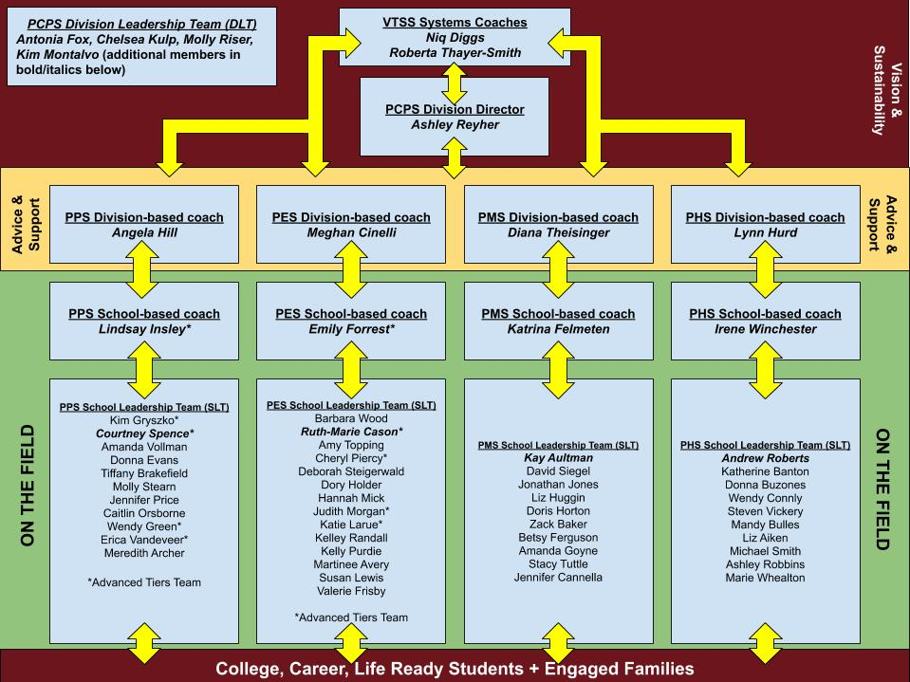
Poquoson Visual Model

Slide 92
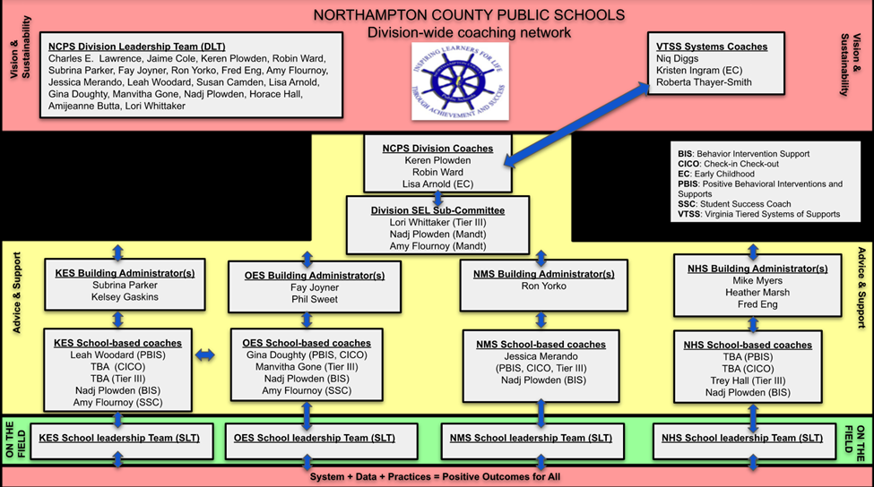
example

Slide 93
What is a VTSS Systems Coach?
A Systems Coach serves as a liaison for the division leadership team (DLT) and the school’s leadership team(s) (SLT) to guide sustainable organizational change to implement MTSS and to guide systems intervention at the school level.
A systems coach facilitates systems thinking.
Notes:
Capacity and Sustainability
The division builds the system based on resources, staff strengths, etc.
The division coaches support the schools, their PD and their initiatives.
Remember that the Division is the unit of implementation and the school are the unit of intervention.
The key role and responsibility of 'systems' coaches is to facilitate the development and monitoring of multi-tiered systems for the division through systems thinking. MTSS work is the result of:
Highly effective teams that use data to inform their decisions
An aligned communication system
Aligned Professional Learning for staff, inclusive of coaching

Slide 94
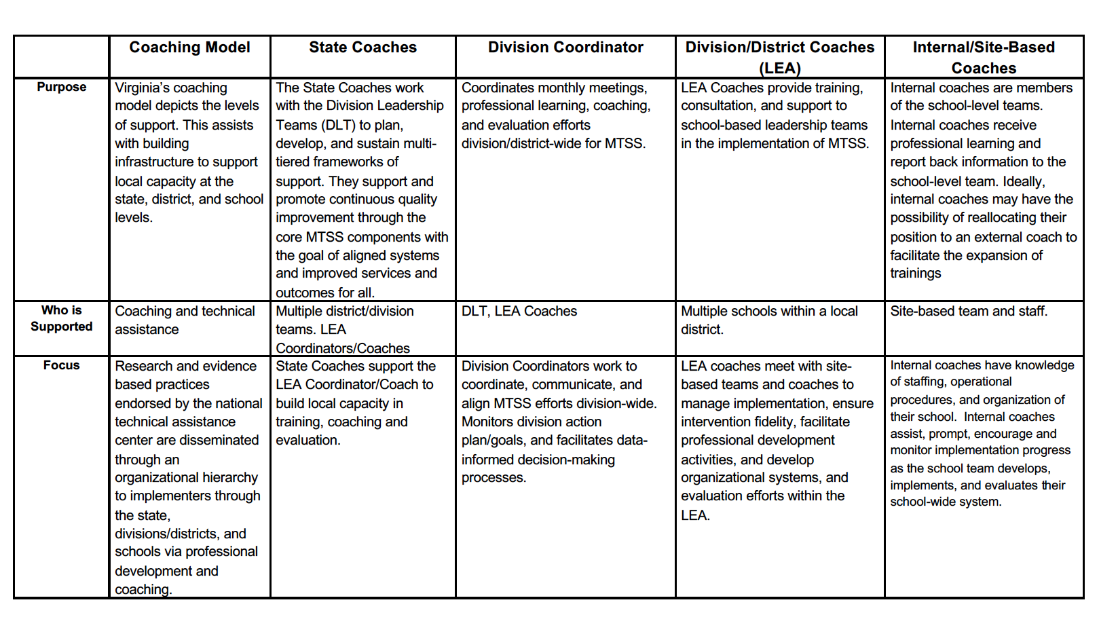
Virginia’s Coaching Model

Slide 95
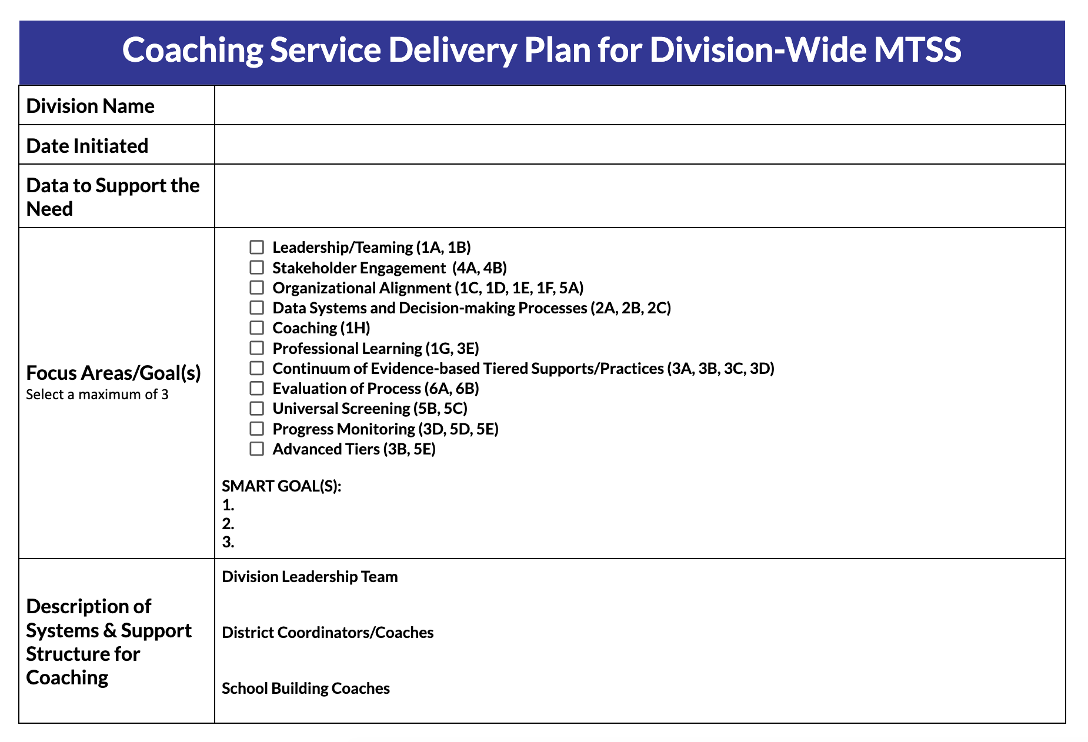
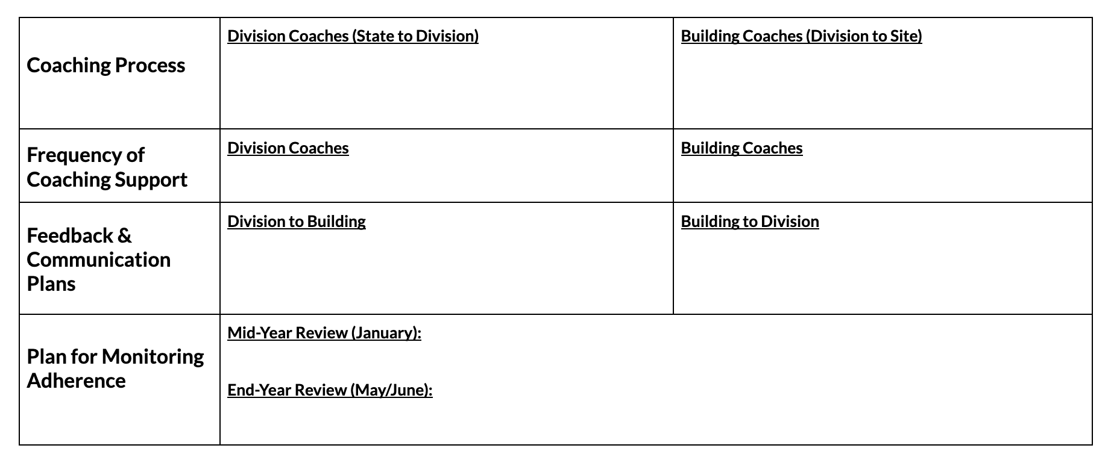
CSDP Coaching Service Delivery Plan
Notes:
https://docs.google.com/document/d/1mvR_nWeXzW87JFDm6n9Ggz0vOrcjjlYj/edit#
Talking Points: they have to automatically download since they’ll use it later in this
10 minutes to read and become familiar with this example plan on their own.
Link to Example of Division to School CSDP: https://docs.google.com/document/d/1mvR_nWeXzW87JFDm6n9Ggz0vOrcjjlYj/edit#
Read over independently - put link in chat box. This is an example of a State TO Division Plan to show you how the VTSS State Coaches support your work. You will see details for State to Division as the bottom section of this plan. We hope this example will inform your work as you prepare a Division to School(s) CSDP.

Slide 96
Purpose of Coaching Service Delivery Plan (CSDP)
a proactive approach, to purposeful and supportive coaching
The CSDP always has the goal of aligned systems, improved services, and outcomes for all.
specifies coaching elements that will promote quality service delivery and serve as the basis for continuous MTSS improvement
details the responsibilities within a continuum of coaching supports and is adjusted over time
Notes:
Talking Points:
How are these plans going to be useful to our work?
How are these plans going to be useful for your division? – strengthen the division systems work/capacity/sustainability
Connection to Implementation Matrix (and DCA)

Slide 97
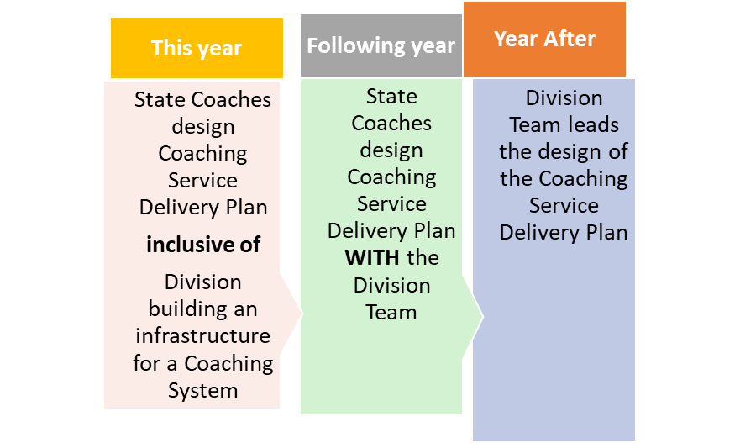
Timeline for Sustainability
Notes:
Talking point: we need to look at the data that exists and THEN choose the focus area; don’t cherry pick the data to match a selected focus area

Slide 98
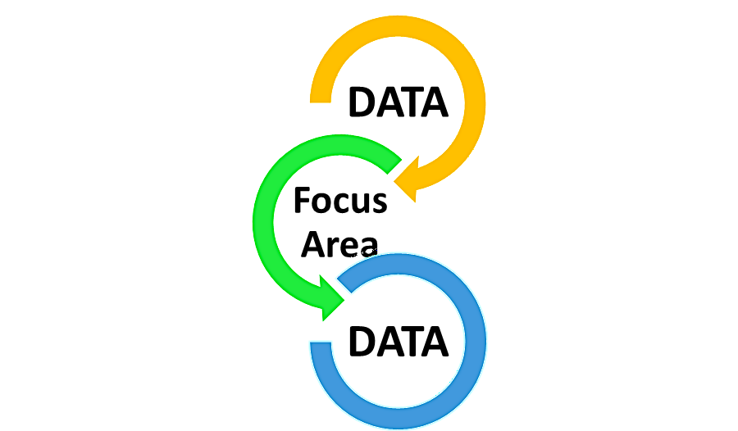
Data supports selection of the focus area
Stakeholder Engagement
Organizational Alignment
Data Systems and Decision-making Processes
Coaching
Professional Learning
Leadership/Teaming
Continuum of Evidence-based Tiered Supports/Practices
Evaluation of Process
Universal Screening
Progress Monitoring
Advanced Tiers

Slide 99
Data to Support the Need
What data sources will lead us to decide upon a given focus area?
Consider both quantitative and qualitative data.
Notes:
Talking Points:
What are your data systems that will support your work around building MTSS?
In building a MTSS framework, we can use the DCA to help guide our focus. When looking at your PBIS initiative in the schools, we can also use the aggregated data for the TFI (focus on the practices around behavior) or the ATFI (focus on the practices around academics) across the division to see where all, some or few schools need support, and then Coaches can use their school’s data to determine where additional support is needed
If you are looking at building your Academic Tiered System of Support, you may look at additional data that will help you determine focal points.

Slide 100
Quantitative
Overall Scales:
Organizational Leadership
Competency
Data System for Decision Making
DCA Scores
Drivers (subscales):
Leadership
Competency
Fidelity
Selection
Training
Coaching
Organization
Data Support Decision Making
Facilitative Administration
Systems Intervention
Notes:
Talking Points:
Always look at the 0 and 1 first. Analyse the data and ask the why the questions around the 0-`1. Or use your notes/discussion points when doing the DCA This will help you arrive at the focus areas and use this data triangulated with other data sources.

Slide 101
Questions should include (but not limited to):
How often did the district leadership team meet last year?
Are tasks assigned and completed outside monthly meetings?
Does the DLT use a data informed decision-making process at each meeting?
Qualitative
Leadership/Teaming
Notes:
Talking Points: Consider these questions around teaming.

Slide 102
Qualitative: Training
Questions should include (but not limited to):
Do we have a formal internal PD plan for strengthening staff skills that includes opportunities for practice and feedback?
How frequently have we provided PD for the division and/or school teams outside of VTSS state-wide PD?
Does someone from the division co-train (e.g., helping deliver the content) PD with school staff?
Does the division have an internal system for providing VTSS PD to on boarding schools outside of demonstration sites?
Notes:
Talking Points: Here are important questions to address training. Is training built into the calendar before school starts. We must be proactive and find times for these events!
Remember, to also connect to the DCA Training subscale.

Slide 103
Qualitative: Coaching
Questions should include (but not limited to):
Are there designated division coaches to support school implementation?
To what extent, do you facilitate DLT meetings (e.g., lead DLT meeting, create the agenda, complete follow up tasks)?
To what extent, do you you support school teams (e.g., attend monthly meetings, create the agenda)?
Has the division transitioned from external state system coach support to internal local coaching capacity (i.e., consultation)?
Notes:
Talking Points: and questions for coaching. Outlining a plan before the work begins and documenting the plan helps ensure it gets done and supports progress monitoring. Are we doing what we committed to for the success of our teachers and students?

Slide 104
Other Data to Support the Need
Key Question:
What focus area(s) will move your division forward in MTSS?
How much data?
Enough to identify a focus area
NOT too much to get lost

Slide 105
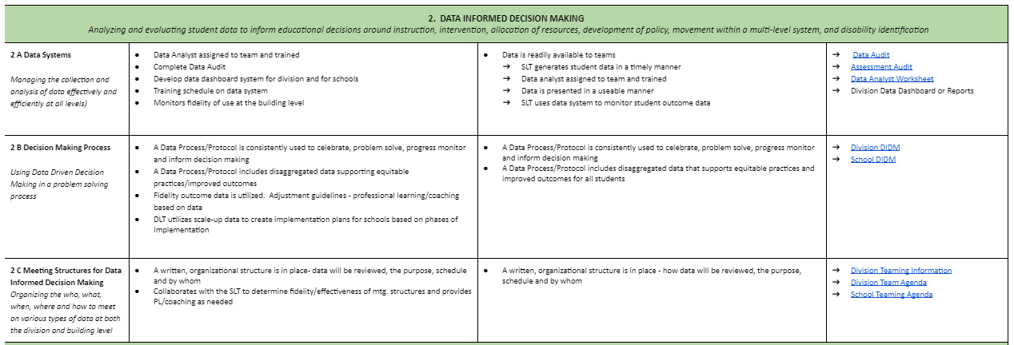
Coaching Checklist
Notes:
1.2 Coaching Checklist (revised April 2022).docx
Talking Points: Remember this great resources for DIDM.
This a a Key anchor document to support your coaching and Data Informed Decision Making is on page 3.
Analyzing and evaluating student data to inform educational decisions around instruction, intervention, allocation of resources, development of policy, movement within a multi‐level system, and disability identification
This tool supports what FULL Implementation “looks like” and “sounds like” at the division level as well as in the schools.
Column 2 - Looks like & sounds like @ Division Level
Column 3- Looks like & sounds like @ School Level
Column 4 - Coaching Tools, Resources & Prompts for Coaching Moves

Slide 106
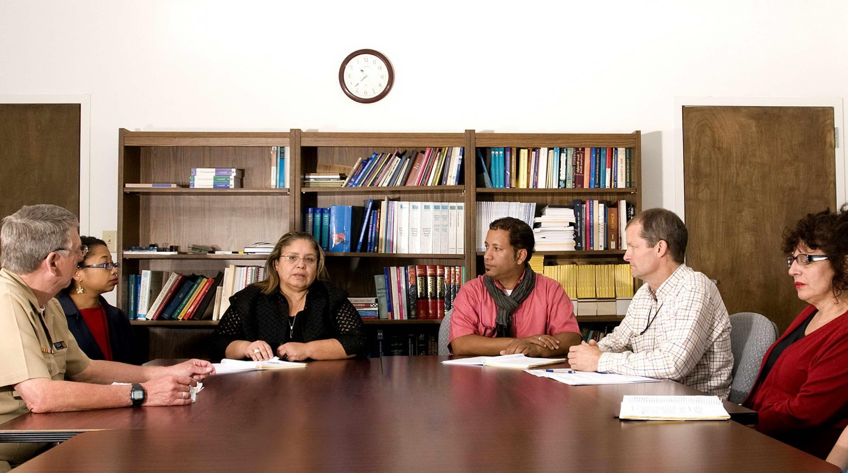
Coaching Scenario
Notes:
https://docs.google.com/document/d/1NOyAscHo4ZE8yJzCZNdHyf-ugWuxRaTp/edit?usp=share_link&ouid=102574330391338814762&rtpof=true&sd=true
Introduction: “The skit” The division coach is meeting with her VTSS Systems Coach, to continue the work on their coaching service delivery plan. This is the second meeting of three scheduled to accomplish the task. This is the first time completing the plan. We also acknowledge that divisions typically have two VTSS coaches who partner with a division. For simplicity of creating the skit, we have one VTSS Systems Coach.

Slide 107
CSDP Part 1
Notes:
Division coordinator: Hello, thank you for meeting with me today! I’m so glad we could review our state-to-division coaching service delivery plan together at our last meeting.
State coach: Not a problem. I enjoy our meetings.
State coach: I had some more time to think about the data we collected to discover a focus area for our division leadership team. I was impressed with the amount of work our division has accomplished and the use of data to set new goals. I was curious if we could focus on teaming and my role, not only with the division leadership team, but also with the school teams that I’m responsible for. Some teams have had a lot of changes in team composition, I have new schools as we scale up, and some are just struggling with many barriers around team engagement and managing conflict.
Part 1 on slide; or they can utilize the scenario example shared in the chat box
State coach: OK, so let’s review just a little bit. We looked at our quantitative data from the DCA in which we were concerned with organizational leadership, data systems for decision-making, and competency. We also discussed your qualitative observations. I’ll just pause and let you reflect on those that we worked on last time. (Pause)
Division coordinator: I see here where we truly wanted to work on including norms, following through with action items, scheduling our meetings, and making sure they’re on the calendar. I also think we need to revisit roles and responsibilities.
State coach We know that if we have that firm foundation of team structures, our work will be more efficient, and we will have meetings that are productive and fun! Yes! I said it! Fun!
Division coordinator: Laughs and says, “I would love to enjoy our meetings!” Maybe we can add some quick connections during our celebration time, too.
State coach: Hey! Good idea! We can work on some ideas—adult SEL is important.
Okay, so let’s start with one focus area in today’s meeting. Remember, our work is fluid, and we can always return to the plan.

Slide 108
CSDP Part 2

Slide 109
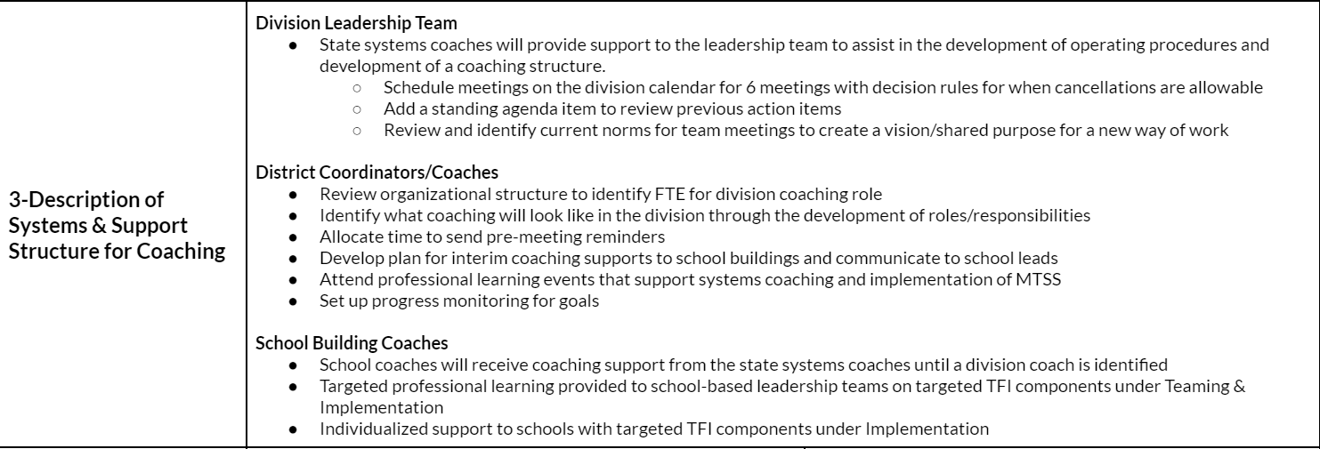
CSDP Part 3
Notes:
Division coordinator: I had a question in part 3. I know we worked through most of the items together last time, but some are confusing to me.
Slide; Part 3
State Coach: Of course!
Division coordinator: This reminds me of the cascading model of support. So, you are the state systems coach along with Pat who could not be here today, and you will both continue to help me with implementation and coaching?
State Coach: Yes, our goal is to work our way out of this role. We want to build a sustainable system in which your division can carry on the work of MTSS. This plan helps us define that support and what it looks like.
Division coordinator: The items under division coordinators/coaches are for me to accomplish with your support. I look forward to attending professional learning events to help me in my role.
Then, with my help, the school building coaches will work on the bullet items listed. I know you, and I worked on these items. Can I adjust them as I meet with my coaches? They may have ideas and comments.
State coach: YES! I’m so glad you asked that. You will want to review this plan with them and get feedback. Make sure you use the plan when you meet to review goals and respond to coaching needs. We can also review as needed between meetings.

Slide 110
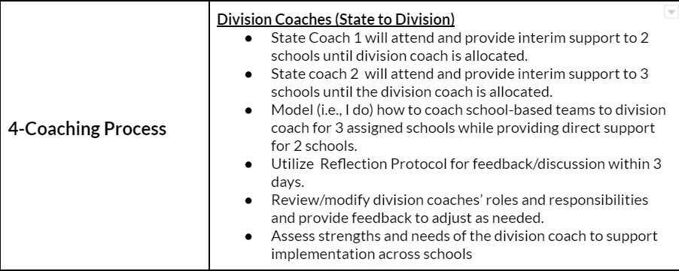
CSDP Part 4
Notes:
Talking Points:
State coach: Many of my divisions have similar goals. Teaming and teaming structures and procedures are the goals we’ve had to go back to because of the impact of the Pandemic and overall change in leadership. Would it be okay for me to show you some of the items or examples in part 4 to see if this is a good starting point?
Division coordinator: That would be great.
(State coach reviews part 4 Division Coaches (State to Division), and division coordinator interacts as she talks—adlib)
State coach review 6 bullets

Slide 111
CSDP Part 4 (continued)
Building Coaches (Division to Site)
1. Division coach will observe state coaches in 3 assigned schools
2. Assess strengths and needs of the school coach to support implementation at the building level
3. Debrief meetings using a reflection protocol monthly within 3 days of meeting
4. Support Building Teams in designing and delivering professional learning to staff focused on increasing understanding of MTSS and capacity to implement related classroom practices (TFI 1.7-1.9)
Notes:
Talking Points:
State coach: What about building coaches? What do you think we should write into the plan?
Division coordinator: What about “division coach will observe state coaches in 3 assigned schools”? I would Like to learn from you how to coach the teams.
THE FIRST BULLET FLIES IN
State coach: Great idea! Together we can assess the strengths and needs of the school coach to support implementation at the building level.
THE SECOND BULLET FLIES IN
Division coordinator: One thing I would like to develop with you is a reflection protocol or tool that others can use for reflection.
State coach: I have some ideas. Let’s put that into the plan and make it a habit to review it within 3 days after the meeting while it’s fresh on our minds.
THE THIRD BULLET FLIES IN
Division coordinator: Can we focus on professional learning this year? I would love to work on an overview of VTSS and an understanding of MTSS. I heard you say VTSS is who we are, and MTSS is what we do. I think we need more building of capacity around the work to implement in the classroom. There are a few teachers who understand and others who need that extra support.
State Coach: Absolutely, we can work on what that will look like with your division and school professional learning goals.
THE FOURTH BULLET FLIES IN
State coach: I see our time is almost up, I know you have another meeting to get to and I want to respect your time.
Division coordinator: Thank you! Yes, I need to catch my breath before the next meeting. I appreciate you sticking to our time allotted.

Slide 112
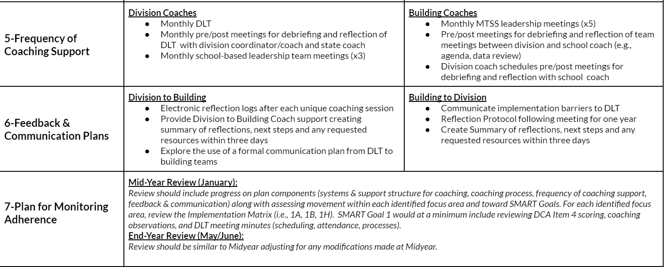
CSDP Part 5, 6, 7
Notes:
Talking Points:
State Coach: To wrap up, Part 5, 6, and 7 are an important part of the plan. This is where we will discuss the frequency of coaching support, feedback, and communication plans, and how we will monitor adherence to the plan. Between now and our next meeting look at what I’ve shared as an example and feel free to come with your ideas and any edits.
Division coordinator: I will! Thank you so much for taking the lead on this. This is all new to me and I appreciate you coming with ideas. I believe by the end of the year; I will have increased my skills on how to develop a plan. Maybe next year I can create a plan, meet with you to review, and get some feedback.
State coach: That is a wonderful idea!
Division coordinator: One last thing, as you know I’ve talked about some of the barriers with changeover, conflict, and managing group dynamics. I attended Systems Coaching Institute 102 which provided great content and tools around the very issues I’m having. Can we share this professional learning with the division leadership team members and some of the school coaches? I really want to put into practice what I’m learning and share that learning with others.
State coach: Sure, Let’s set up a time where we can look at our data again and talk about what content would support your needs at the division and schools. Sometimes it is wise to start small. For example, maybe for the first few months we work on that reflection protocol along with feedback. Then we could monitor progress, collect data, and adjust the learning based on our needs. Sound good?
Division coordinator: Yes, thank you! Okay, I’ll send you some more dates for us to meet. I really need to go. Talk to you soon. And thanks again!

Slide 113
Table Work
Spend the first 3-5 minutes silently reviewing and reading the CSDP used in the scenario.
Select a spokesperson for sharing key points discussed .
Respond to the following questions:
What were your first impressions of how the plan could support your work as a systems coach?
Using the scenario, what were similarities to your division’s ongoing coaching supports to implement MTSS?
What data and focus area would you like to discuss with your VTSS Systems Coach?
Notes:
https://docs.google.com/document/d/1NOyAscHo4ZE8yJzCZNdHyf-ugWuxRaTp/edit?usp=share_link&ouid=102574330391338814762&rtpof=true&sd=true
What were your first impressions of how the plan could support your work as a systems coach?
Using the scenario, what were similarities to your division’s ongoing coaching supports to implement MTSS?
What data and focus area would you like to discuss with your VTSS Systems Coach?

Slide 114
Large Group Share Out
Notes:
Talking Points:
5 minutes: select groups to share out depending on time.

Slide 115
True or False?
CSDPs are Flexible
CSDPs should be active documents
CSDP should NOT be data driven
CSDP are flexible as to the number of Focus Areas
CSDP are to be developed by you beginning next week?
Notes:
Talking Points:
CSDPs are Flexible - True Coaching focus area may change over the year based on progress monitoring and division data/need.
CSDPs should be living documents - True submitted annually
CSDP should NOT be data driven- False
CSDP Focus Areas are flexible in numbers - True but we are creating Smart goals and you know how having too many goals ends up.
CSDP are to be developed by you next week? False state coaches are doing this year, next year we will do with you the following year you will do them. We are building capacity to develop them and monitor them, for sustainability of MTSS in the division.

Slide 116
Summarizing Your Role
MTSS CONTENT KNOWLEDGE
COACHING KNOWLEDGE
& SKILLS
Notes:
Talking Points:
Thinking about everything that you have learning in Coaching 101 and 102, and using this bridge as a visual of coaching MTSS, write a statement that would summarize your role as a systems coach.

Slide 117
Summarize Your Role as a Systems Coach
What are you still curious about?
What are you feeling good about?
What are your questions around systems work?
What professional learning opportunities could we provide you to support implementation and systems work? Topics?

Slide 118
Congratulations!
This Photo by Unknown Author is licensed under CC BY-NC
You have hereby successfully completed the
VTSS Systems Coaching Institute
Notes:
Give them time to fill out the evaluation form!

Slide 119
Optimistic Closure
“In difficult times carry something beautiful in your heart”
-Blaise Pascal
hope
Notes:
Talking Points:
How do you define hope? Hope is active and believing and speaking aloud actions and taking small steps towards those actions.
As you move forward in your content knowledge to coaching knowledge and skills you are speaking aloud actions and making steps towards those actions. These are challenging times in education. What “beauty” do you carry in your heart as you cross the bridge? What are the small victories, acts of kindness, growth, and challenges that take you over the bridge? That is your hope! Your beauty!
Add in CTE here. When we are collectively working together for better outcomes we engage in active hopeful actions.
Please share your next steps with the mindset of “bridges of hope” and “carrying something beautiful” with your shoulder partner.
You may want to express your next steps with the mindset of hope and beauty ahead!
For example,
Conflict can be a time of growth and my beautiful is looking for opportunities to separate people from the problem and focus on shared interests.

Slide 120
Evaluation

