Slide 1
Systems Coaching Institute 102
February 19 & 20, 2025
Virtual

Slide 2
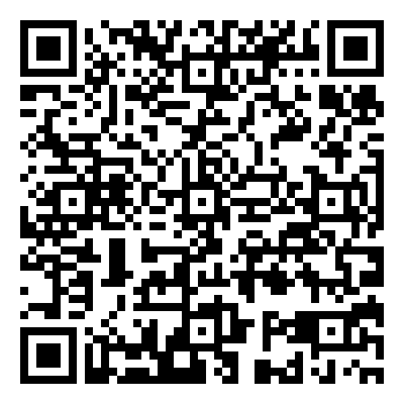
Welcome
Gathering Your Materials
Create a new folder on your desktop.
You may want to name the folder SCI 102.
You will be using the Coaching Checklist again
Download the ppt first please
Use this Link or the QR Code
to get materials as we go along.
Locate your Self assessment data for Competency 1

Slide 3
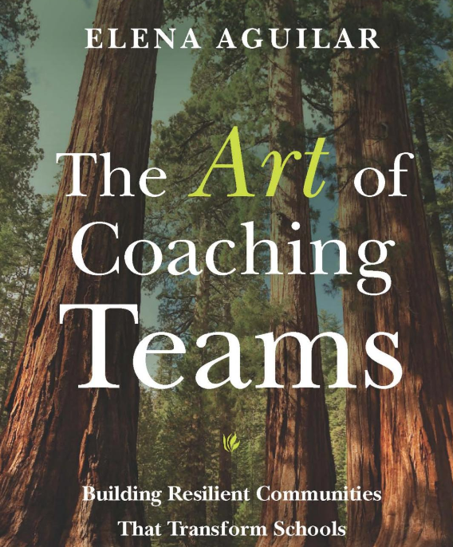
THE ART….

Slide 4
Virtual Community Agreements
Be Responsible:
Take care of your needs
Share your questions with the group
Be Respectful:
Turn volume/sound off on cell phones
Listen to others attentively
Follow up and complete assigned tasks
Be Engaged:
Please keep your video on as much as possible
Ask what you need to know to understand and contribute
Share your expertise, information and ideas
The blue star identifies activities

Slide 5
Inclusive Opener
ROSE
BUD
THORN
Signifies a success. What is working well related to your role as a Systems Coach?
What is an area of growth within your role?
What has been a barrier to your role as a systems coach?

Slide 6
Day 1 Exit Ticket Feedback
The qualitative feedback of responses were aggregated into the following themes.
What is an important takeaway? (Themes ranked ordinally)
Effective/consistent communication
Building trust
Understanding the why
Importance of teaming
What further questions do you still have?
How to expand the vision of MTSS in the school division?
How to motivate individuals within the school division?
What are other divisions doing?
What are you excited about
Growing the team within the division
Strategizing on building the capacity of the coaches throughout the division

Slide 7
SCI 101 Evaluation Data
64% strongly agree that the content aligned with their division’s standards or goals.
41% strongly agree and 56% agree that as a result of attending, their knowledge of MTSS improved.
44% strongly agree and 54% agree that as a result of attending, they have developed an awareness of Virginia’s six core components of MTSS.
28% strongly agree and 70% agree that as a result of attending, they are able to apply the lens of coaching to the Aligned Organizational Structure VTSS component.
Communication skills and active listening were highest scored as ideas that are hoped to be applied to daily practice.

Slide 9
Welcome to
Systems Coaching 102
MTSS is a systemic, data-driven approach that allows divisions and schools to provide targeted, evidence-based interventions to meet the needs of their students. This is done through a clearly defined process that is implemented to fidelity by all stakeholders within the school and/or division.

Slide 10
Big Picture of the 2 Days
Morning: Reorientation
Why you are here, your work in understanding educational systems and the impact systems have on outcomes.
Core Competencies Self assessment -pages 299-303
Completed core competency no.1-Skills and Knowledge
Core competency no.2-Emotional Intelligence
Lunch
How you show up to teams and team functioning
The impact of EI accountability, engagement and collaborative decision making in team functioning
Communication, feedback, dealing with conflict
Coaching Service Delivery Plan

Slide 11
Where we’ve been
SCI 101 Learning Intentions
Day 1
Examine educational systems and how systems change, and how to manage complex change
Understand how the MTSS framework can be applied to any initiative
Understand the Role & Responsibilities of a Division Systems Coach and 3 key principles that guide the work
Develop knowledge of VA’s MTSS 5 Core Components and their Features 2.0 and tools to support implementation

Slide 12
Where we’ve been
SCI 101 Learning Intentions cont.
Day 2
Continue to apply a systems coaching lens to Core Component 1 - Aligned organizational structures with a focus on Workforce Capacity- Features: Professional Learning, Routines and Procedures and Coaching
Develop conceptual understanding and skill acquisition of effective communication skills and their place within aligned organizational structures
Complete a Coaches Self-Assessment (from Teaming Book, Aguilar)

Slide 13
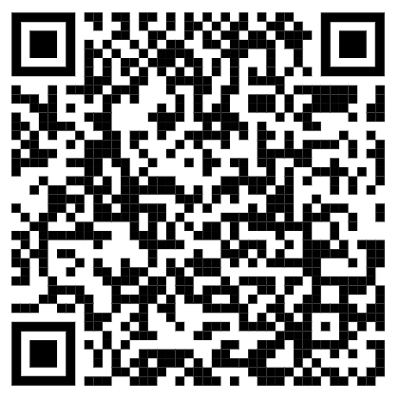
SCI 101 Review
This Photo by Unknown Author is licensed under CC BY-SA

Slide 14
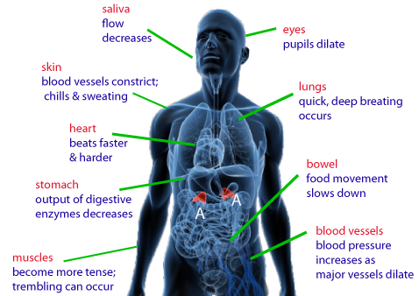
We began with a
Systems Check

Slide 15
COMPONENTS OF A SYSTEM
A constellation of parts.
HUMAN RESOURCES
MATERIAL RESOURCES
Education System
FISCAL RESOURCES
$$$$$$
PROCESSES AND PROCEDURES
POLICIES AND REGULATIONS
Adapted COACHING FOR SYSTEMS CHANGE-PIERCE AND ST.MARTIN 2023

Slide 16
Goals
Improve Division Systems & Build Local Capacity
Improve PreK-12 classroom & school Systems & Practices
Improve Student Outcomes

Slide 17
The Three Principles that Guide Systems Work
Understand the system to understand outcomes.
Systems-level change is an intentional and continuous process.
Systems-level change is an adaptive challenge.

Slide 18
2024-5 Systems Coaching Institute 102 Learning Intentions
Day 1
Utilize the 3 key principles that guide systems coaching
Understand the importance of teams in the work of systems that impact change
Understand and facilitate the development of highly effective teams
Identify, choose and implement strategies/structures for enhancing team functioning
Understand, apply and uphold concepts of emotional intelligence, accountability, engagement and collaborative decision making within a team structure
Utilize effective communication and other coaching techniques to impact systems change. Alliance strategies vs. relationship
Day 2
Understand the purpose of, practice in the development of and the ongoing utilization of a Coaching Service Delivery Plan

Slide 19
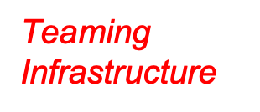
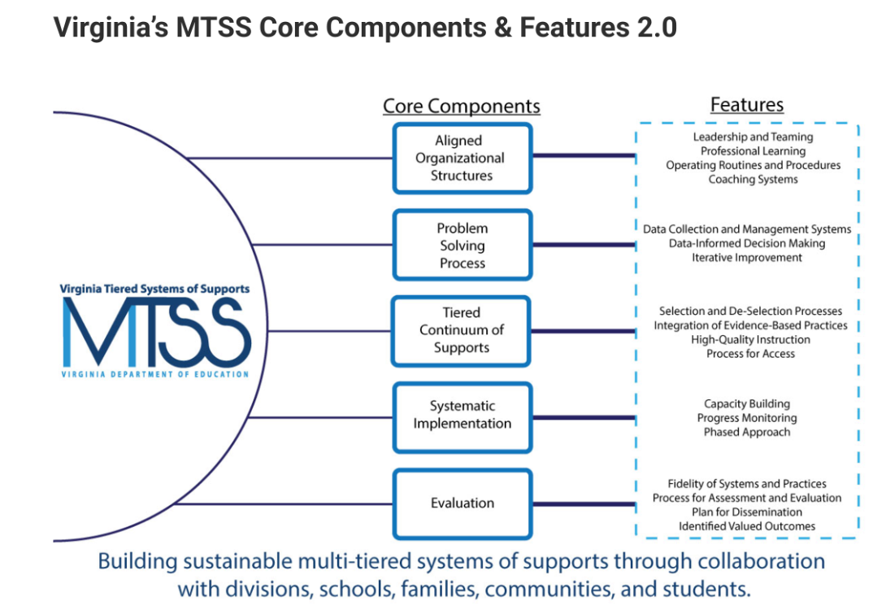
People make Systems Work!

Slide 20
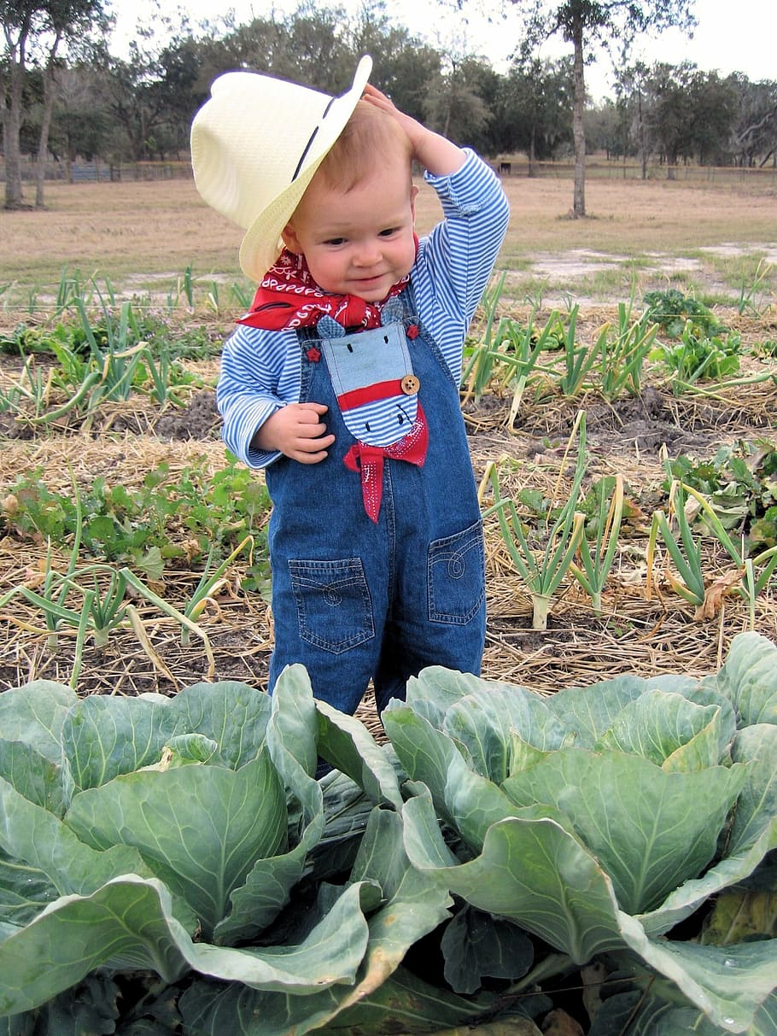
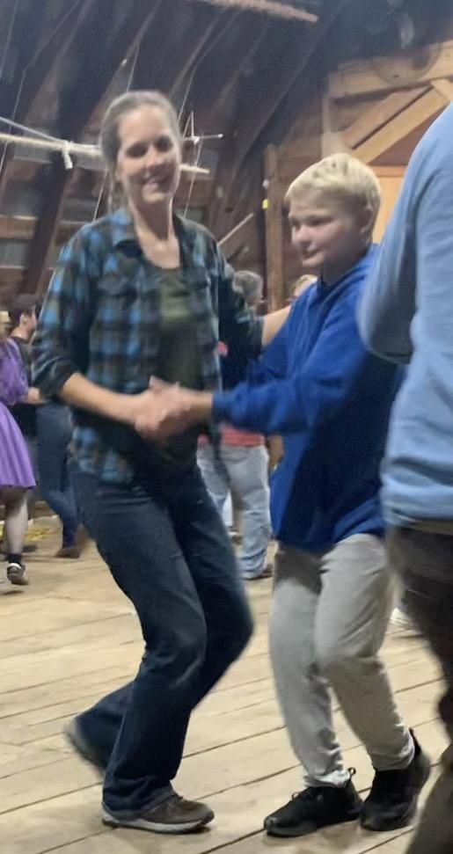
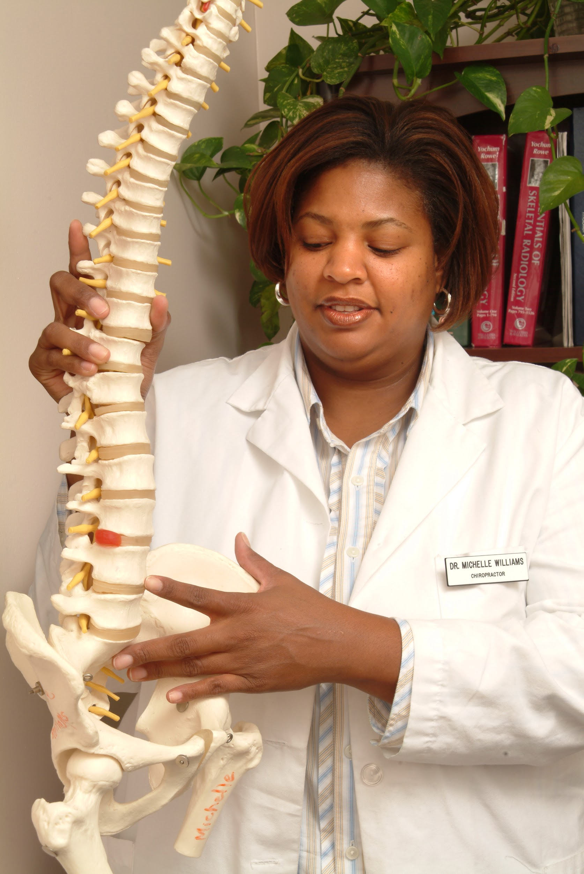
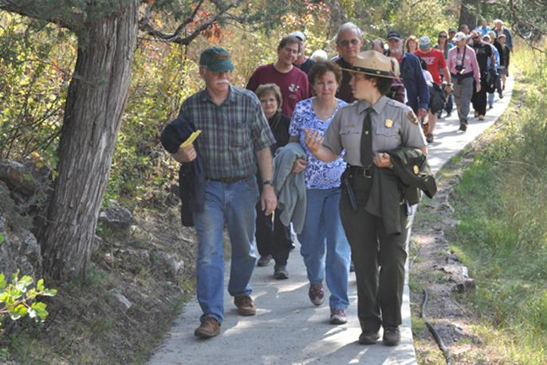
Coaching for change is like being…
a farmer because…
a chiropractor because…
a tour guide because…
a dance partner because…
the conductor of an orchestra because…

Slide 21
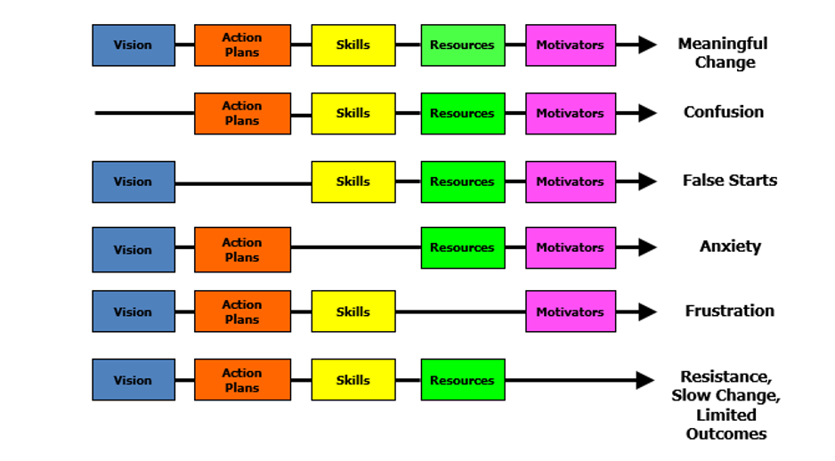
Managing Complex Change
Source: Adapted from Knoster, T., Villa R., & Thousand, J. (2000). A framework for thinking about systems change. In R. villa & J. Thousand (Eds.), Restructuring for caring and effective education: Piecing the puzzle together (pp. 93-128). Baltimore: Paul H. Brookes Publishing Co.

Slide 22
Key Role of a Division Coach is systems work!
The key role and responsibility of 'systems' coaches is to facilitate the development of and to monitor multi-tiered systems for the division. MTSS work is the result of:
VTSS Core component no 1:
Highly effective teams that use data to inform their decisions
Creating communication protocols
Aligned Professional Learning for staff, inclusive of coaching

Slide 23
Making the Shift-
From YOU to Your work with TEAMS
Day 1
Teams: are they effective, how do you know, characteristics of highly functioning teams
Day 2
Understand the purpose of, practice in the development of and ongoing utilization of a Coaching Service Delivery Plan

Slide 24
Break

Slide 25
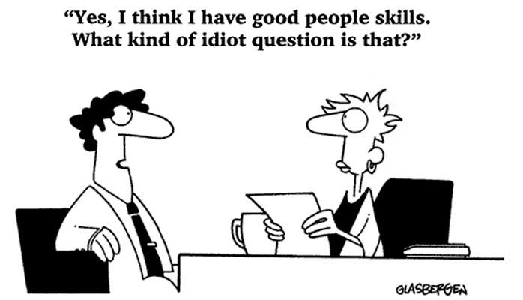
How’s your EI? √ it now

Slide 26
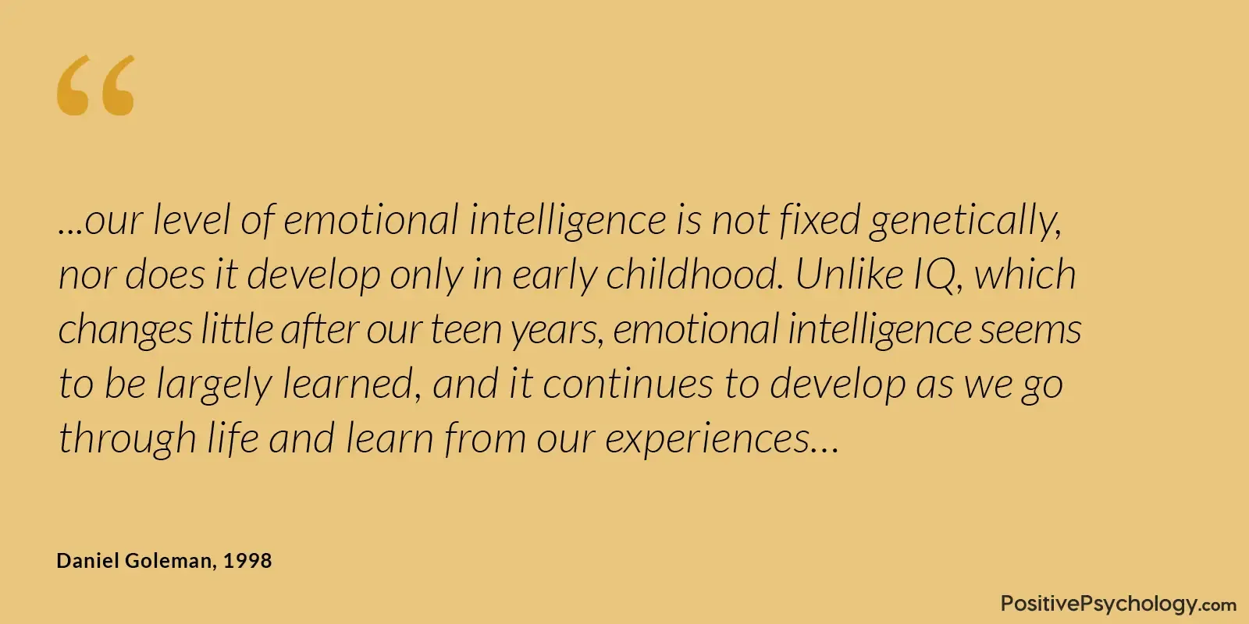
What is your
Emotional Intelligence (EI)?

Slide 27
Reflect on Emotional Intelligence
Please turn to pp. 301-303 in your Aguilar book.
Read through each element and rate your current EI using the scale of 1-5.
Highlight any areas in which you scored a 1 or 2 that you might wish to work on.

Slide 28
Emotional Intelligence
“EI is the foundation of building trusting relationships, interpersonal communication, flexibility, time management, empathy, decision making, collaboration, presentation skills, assertiveness, regulating stress, managing anger, dealing with unexpected change, and resilience.”
Aguilar, The Art of Coaching Teams, pg. 18

Slide 29
Emotional Intelligence Continued
Emotional intelligence refers to the ability to identify and manage one’s own emotions, as well as the emotions of others.
Self-Awareness
Self-Management
Social Awareness/Empathy
Social Management/Social Skills

Slide 30
Self Awareness
Self Awareness: The ability to recognize your own feelings and to name them, recognizing the impact of your emotions, and to know your strengths and limits, and to have self-confidence and the awareness of your capabilities.
Elena Aguilar, The Art of Coaching Teams: Building Resilient Communities that Transform Schools. Jossey-Bass, 2016.

Slide 31
Self Management
Self Management (Regulation): The ability to make conscious decisions on how to respond to emotions (emotional self-control, transparency, and adaptability, and initiative—the readiness to act and to anticipate the consequences, aligned with your values)
Elena Aguilar, The Art of Coaching Teams: Building Resilient Communities that Transform Schools. Jossey-Bass, 2016.

Slide 32
Social Awareness
Social Awareness (Empathy): The ability to recognize and understand the feelings that other people experience (empathy, organizational awareness, service—the needs of others and meeting them)
Elena Aguilar, The Art of Coaching Teams: Building Resilient Communities that
Transform Schools. Jossey-Bass, 2016.

Slide 33
Social Management
Social Management (Skills/ Motivation): The ability to manage conflict with others to form healthy relationships, collaboration, feedback and guidance, and to motivate and inspire others
Elena Aguilar, The Art of Coaching Teams: Building Resilient Communities that Transform
Schools. Jossey-Bass, 2016.

Slide 34
Individual Goal Setting
In the article, “50 Tips For Improving Your Emotional Intelligence,” the tips are broken down by domains.
Highlight a couple strategies you will use to improve the areas you identified.

Slide 35
Systems Change and Teams
Why are teams important in systems change?

Slide 36
WHY teams are so important
You cannot do it alone
Creating schools into places where all children get what they need each and every day, is hard work and requires solving hard problems.

Slide 37
Systems Change Requires…
Organizational Conditions for Effective Teams
Alignment
Purpose/Function/Focus
Stability
Membership
Leadership
Culture of Learning
Decision-Making
Trust
Time
Exhibit 13.4. © Elena Aguilar, The Art of Coaching Teams: Building Resilient Communities that Transform Schools. Jossey-Bass, 2016.

Slide 38
What is an Effective Team?
If you had a highly effective team, what would that look like in practice?
What role would you play as the Division Coach?
FIRESIDE CHAT

Slide 39
Does your team know its Purpose?
Reflect on purpose, pg. 64
Keeping students at the center, pg. 65
Determining a team’s mission and vision, pg. 69

Slide 41
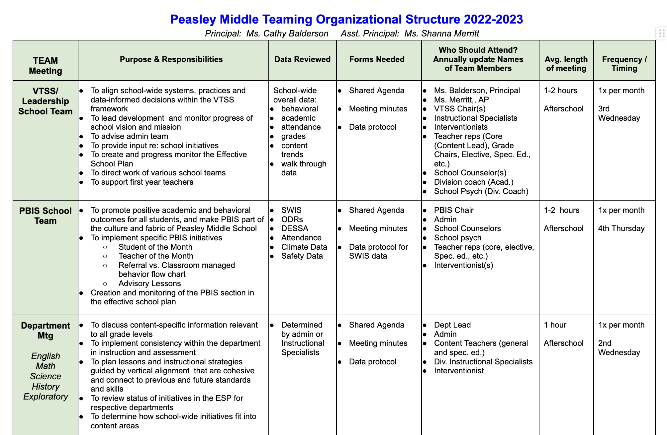
Team Alignment
What is the teaming infrastructure in the school (may also be helpful to consider at division level)?
Conducting an inventory of teams within the school (and/or division) can be helpful
What team are YOU coaching?

Slide 42
Team: Purpose/Function/Stability
What is the purpose or the role of a Tier 1 team in schools?
What is the purpose or the role of a Tier 2/Advanced tier team in schools?
How could you as a coach ‘coach’ a team to clarity of its purpose?
How could you as a coach ‘coach’ a team to value stability of the team and consistent attendance?

Slide 43
Team - Culture of Learning
Learning Organization: Read & Rate
(pp. 186-187)
Learning environment
Learning processes & practices
Leadership
Think about a team you are working with, which of these indicators are present and which ones are not?
How might you use this questionnaire?

Slide 44
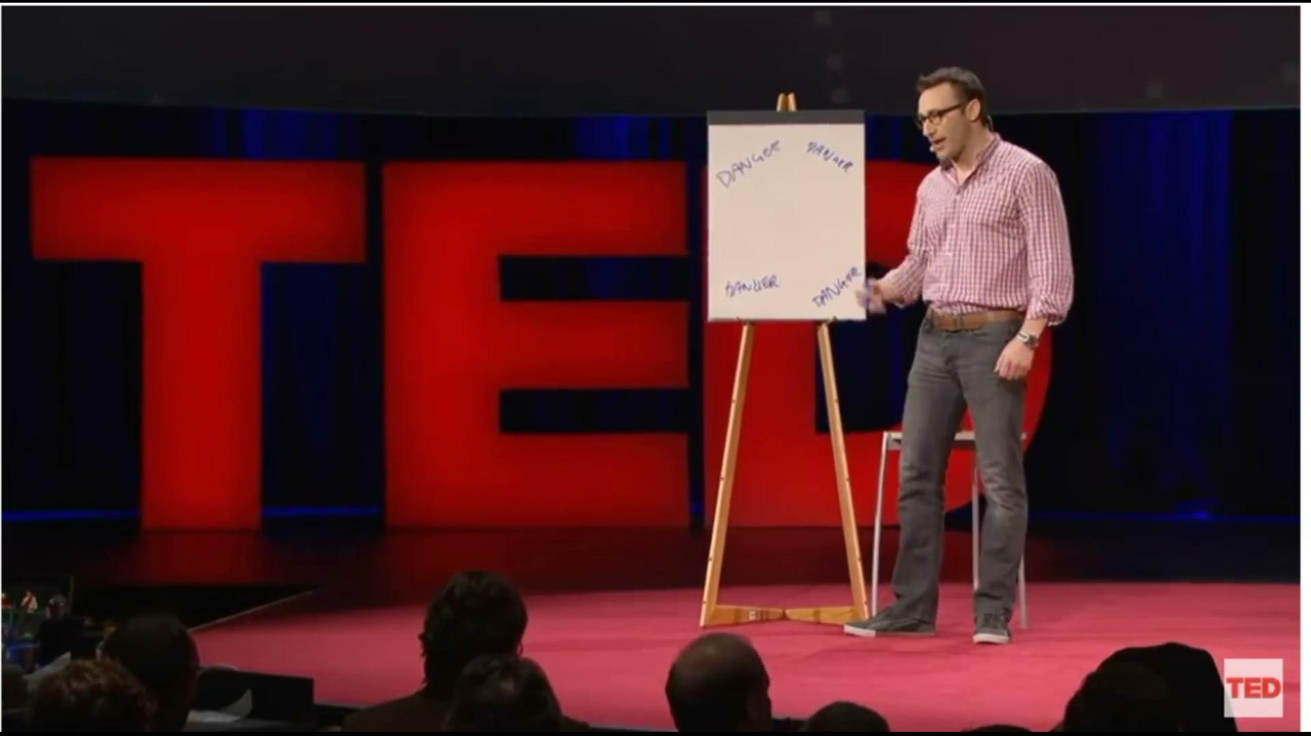
Team - Culture of Trust
Making People Feel Safe
Where does it begin?

Slide 45
Choose your favorite quote
“Trust is the glue of life. It’s the most essential ingredient in effective communication. It’s the foundational principle that holds all relationships.” – Stephen R. Covey
“The ability to establish, grow, extend, and restore trust is the key professional and personal competency of our time.” – Stephen R. Covey
“Leaders empower individuals by building trust and coaching competence...” – Kenneth Blanchard
“To be trusted is a greater compliment than being loved.”
– George MacDonald
“Trust is built when someone is vulnerable and not taken advantage of..” – Bob Vanourek

Slide 46
Indicators of Trust
Pages 282-3

Slide 47
On a scale of 1-5
My division:
Promotes a culture of ‘asking’ for coaching
Encourages risk taking
Views mistakes as learning opportunities
Ensures processes and decision making are transparent
Ensures information is shared openly

Slide 48
Building the Emotional Intelligence of Teams
It takes skill
It takes knowledge
It takes TIME
Elena Aguilar, The Art of Coaching Teams: Building Resilient Communities that Transform Schools. Jossey-Bass, pg. 130-131. 2016.

Slide 49
Foundations for Trust and Safety:
Community agreements lay the foundation for positive culture, build trust, people feel safe.
Community Agreements
Why have Community Agreements?
Effective agreements = goals achieved.
How to develop these: Together as a team!
Ideal number is 5-7. Review every meeting.
2 types:
Procedural e.g., start and end on time, keep minutes
Behavioral e.g., offer solutions, listen to understand

Slide 50
Foundations for Trust and Safety:
Norms continued
Clarify each norm: Interpretations could be different, what does it sound and feel like. e.g. assume positive intent -what does that norm mean?
Visibility: On the agenda and around the room.
Revisit them: Are they working? What can we do to make them better?
Activity: Read scenario pp. 95-96 in book. As a coach working with this team, what would be your next steps as you meet with the school coach at the end of this meeting? Is there need for another norm(s)?

Slide 51
Collaborative Decision Making
Multi-voting - used to whittle down from a lot of choices, ranking
Compromise - both sides may feel they’ve lost
Majority Voting - someone(s) lose
Unilateral Decisions - One person is designated to decide for the group
Consensus (using Fist to Five vote)
Consent-based - a proposal is made, clarified, modified and there are no objections (Fist to Five works here, too)
Art of Coaching Teams - Chapter 8

Slide 52
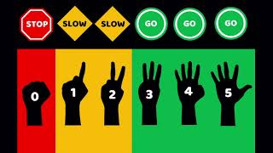
Fist to Five

Slide 53
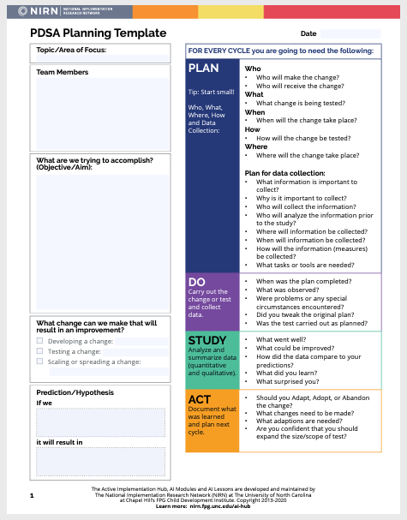
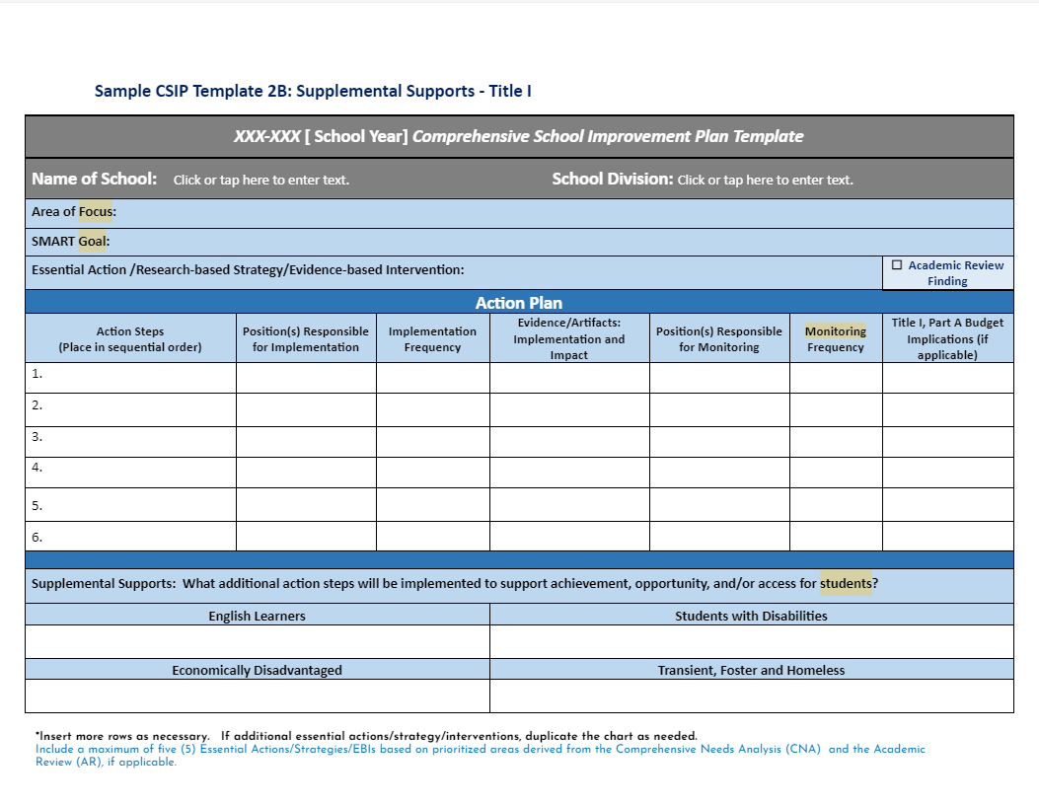
Document Your
Decision Making Process

Slide 54
Where is your Team? Typical vs. Effective Problem Solvers
Effective Problem Solvers…
Typical Problem Solvers…
Define a problem in observable and measurable terms
Collect and use multiple sources of information to validate assumptions about the problem
Create highly detailed steps to implement the intervention with fidelity including assessment procedures, decision-rules and actions to support interventionists
Use student data & intervention fidelity to identify & implement next steps through continuous cycles of problem solving
Define problems loosely or vaguely
Don’t validate assumptions before building a plan
Develop generic plans
Monitor fidelity of actions
Don’t measure or evaluate impacts
Typically abandon interventions without considering fidelity or feasibility

Slide 55
Team Temperature Check - Let’s hear from Cumberland

Slide 56
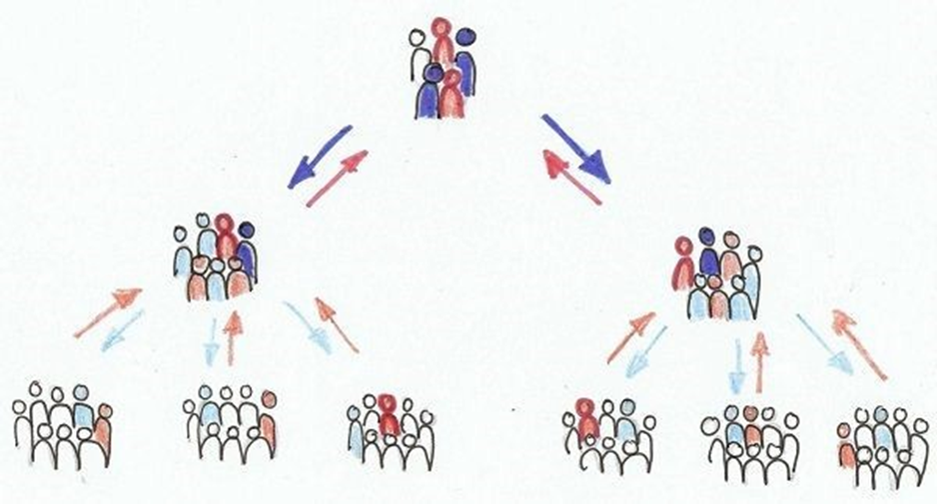
Team-What is their Level of Authority?
Decision Making Processes Matter

Slide 57
Ladder of Involvement

Slide 58
Team Assessment Possibilities:
PAUSE & consider the next four slides as opportunities for assessment
Spend a few minutes selecting one or more to consider
Spend some time thinking about next steps

Slide 59
Pause and Reflect
Does your team have norms?
Does your team meet at least monthly?
Does your team use a structured agenda that is accessible to all?
Has your team identified data points that are progress monitored regularly?
Does your team use a process/protocol for data driven decision making?

Slide 60
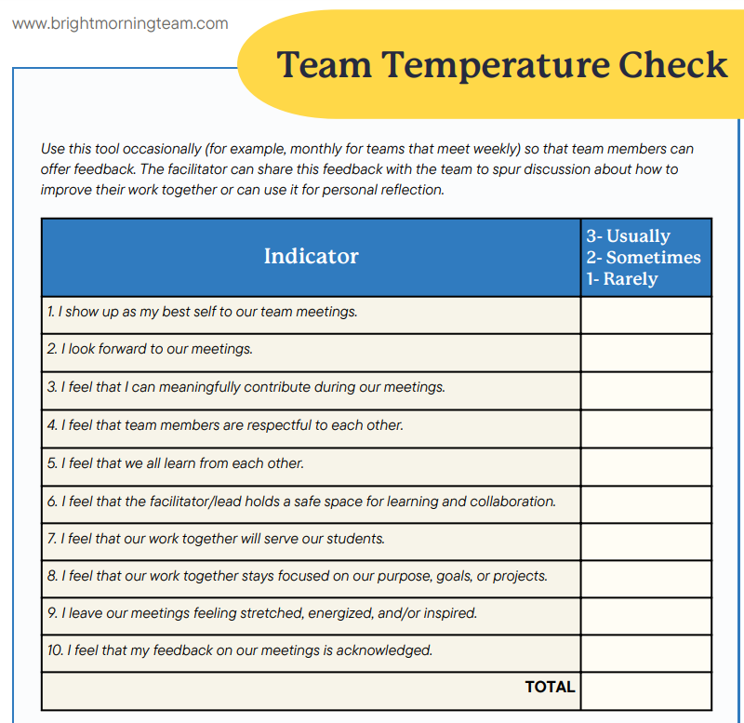
How is your team feeling?

Slide 61
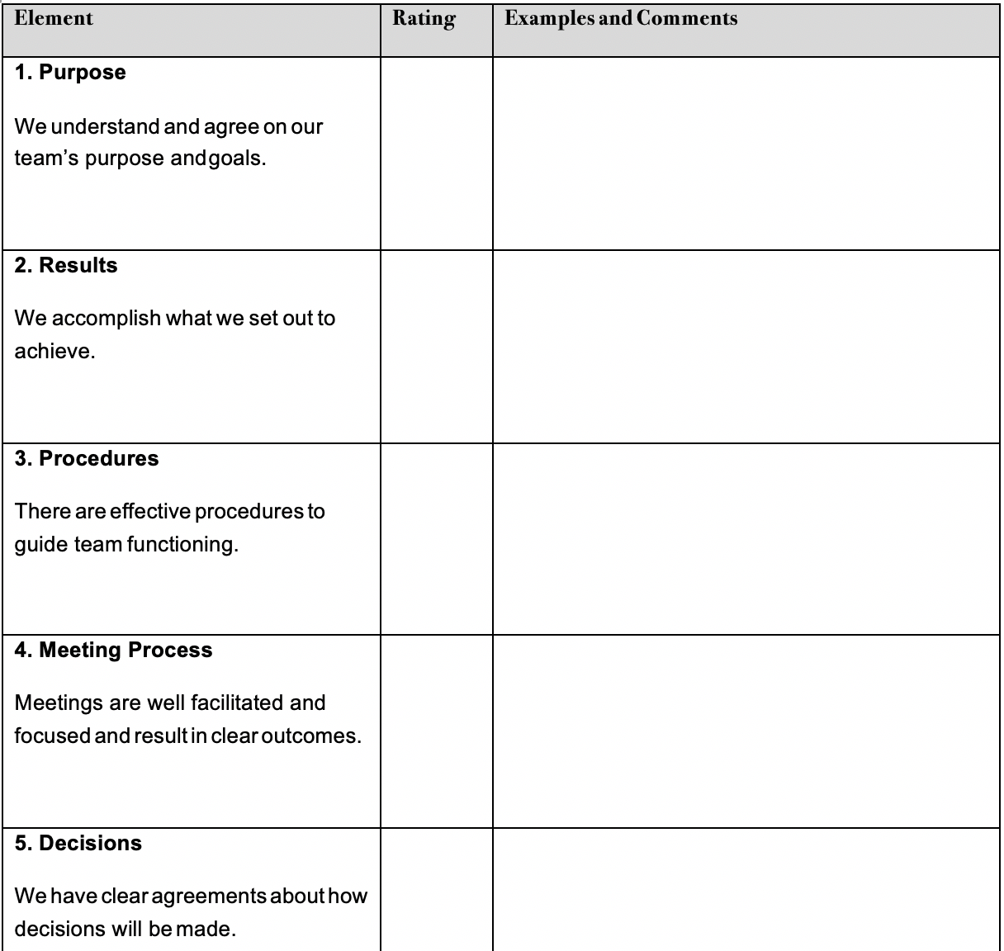
Assess Current Team Effectiveness-Page 305
TIME
Reference pages 305-306 in your Aguilar book.

Slide 62
Let’s look at your team: How will you facilitate next steps?
Brand New - We need to work on our structure, process, and procedures
Still Growing and/or Changing - We’ve accomplished a lot and just need to work on a few items due to change and/or growth
Seasoned - We’ve been doing this for awhile and love to review our structure, process, and procedures

Slide 63
Exit Ticket
http://tinyurl.com/5n6j9v54

Slide 64
Welcome back! Day 2
Be sure to have your book handy!

Slide 65
Materials
Link to materials.
VTSS website:
https://vtss-ric.vcu.edu/

Slide 66
Let’s start with the data:
Your comments from exit tickets
SCI 101 Review

Slide 67
Intent vs. Impact
“The wake is the results we leave behind. And the wake doesn’t lie and it doesn’t care about excuses. It is what it is. No matter what we try to do to explain why, or to justify what the wake is, it still remains. It is what we leave behind and is our record.” Dr. Henry Cloud
What are some team procedures and processes to help with intent vs. impact?

Slide 68
What do you bring to the table? Coaching
Systems Change Requires…
Utilize effective communication and other coaching techniques to impact systems change.
Giving and receiving feedback; navigating conflict with healthy outcomes
Aligning Communication & Coaching
Handout

Slide 69
YOU set the tone!
What do you bring to the teaming table?
Take a moment, before you go to fill out the assessment on pages 299 - 303 from your book.
If you’ve completed before, either review or feel free to take the assessment again.

Slide 70
Performance Feedback
LINK to PRACTICE PROFILE

Slide 71
Performance Feedback
Performance feedback, which can be verbal or written, highlights behaviors that were used accurately, fluently, or whose modifications maintained fidelity to the practice. In use, feedback delivered is specific (describes behavior) and aligned to the desired goals of coaching (rationale provided that also describes how or why a coaching recipient’s behaviors may need to change to meet desired outcomes of coaching).

Slide 72
Receiving and Giving Feedback
Take 4 minutes to read the article individually. While reading, highlight 1-2 points that “hit home” for both receiving and giving feedback
In your groups, 1 person shares 1 point that “hit home” for them and why. Other group members can ask up to 2 clarifying questions for the speaker to respond to.
The next person in the circle shares a different point that “hit home” for them. The process continues until each group member has been the speaker.
Adapted from National School Reform Faculty
Handout

Slide 73
Review: Feedback
Receiving Feedback
Giving Feedback
Be prepared; be mindful
Separate the strands: feeling, story, feedback
Contain the story
Change your vantage point
Appreciation: Validate and share concrete affirmation
Coaching: creating conditions for transformation through inquiry
Evaluation: letting someone know where they stand
Receiving and Giving Feedback by Elena Aguilar

Slide 74
What behaviors are perceived as resistance?
Waterfall Chat:
Answer the following question, but do not hit send until prompted:
What behaviors do you perceive as resistance on a team?

Slide 75
How do you Respond to Resistance
(p 198-99)
Read silently at explanations-what resonated with you?
Look inward
Resistance masks fear
What looks like resistance is often the need for help
Be clear
Trust reduces resistance
Confront cynicism
Reflect on team structures
Don’t focus on the resisters
Coaching Resistance Part 1: What is Resistance?
Elena Aguilar, The Art of Coaching Teams: Building Resilient Communities that Transform Schools. Jossey-Bass, 2016.

Slide 76
Engagement Strategies
for Teams to Help with Resistance
Every meeting should begin with identified outcomes!
Consider using structures or protocols for engagement:
Data Driven Dialogue (Link)
Consultancy Protocol
Discussion Protocols
Feedback Protocol
Chalk Talk
Dyads
Pages 320 - 325 in your book
Elena Aguilar, The Art of Coaching Teams: Building Resilient Communities that Transform Schools. Jossey-Bass, 2016.

Slide 77
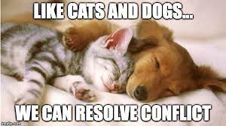
How do you feel?
1
2
3
4
5
6
7
8

Slide 78
What about conflict?
It is inevitable!

Slide 79
Task conflict vs.
Relational conflict
Different opinions about how to execute a task.
More emotional; creates disconnect between people
(Prosocial: Using Evolutionary Science To Build Productive, Equitable, and Collaborative Groups; Atkins, Wilson, and Hayes)

Slide 80
Quote
“Conflict is maintained in our heads, in the judgments of right and wrong, good and bad, justified and unjustified, and stepping into the perspective of another, seeing things from their point of view and drawing a circle that takes them in, is one of the hardest things in the world to do.”
Prosocial: Using Evolutionary Science To Build Productive, Equitable, and Collaborative Groups; Atkins, Wilson, and Hayes, pg. 177

Slide 81
Build Interpersonal Skills
Separate people from the problem
Focus on the shared interests of both parties
Develop many options that can be used to solve the problem
Evaluate the options using objective criteria
Prosocial: Using Evolutionary Science To Build Productive, Equitable, and Collaborative Groups; Atkins, Wilson, and Hayes
Link to How can We Make Conversations More Prosocial?

Slide 82
Predictions
“Your brain knew what was coming. It predicted what it was going to hear.”
https://hiddenbrain.org/

Slide 83
Enhance Personal Skills
Prosocial: Using Evolutionary Science To Build Productive, Equitable, and Collaborative Groups; Atkins, Wilson, and Hayes
Psychological flexibility skills
Psychological flexibility
The capacity to be entirely aware and connected with the present moment while behaving in ways that promote one’s values
(Biglan et al., 2013; Lloyd et al., 2013)
Perspective taking
Get up on the balcony “observing self”
Separate people from the problem (content and relationship)

Slide 84
Tools for Shifting Perspective
Imagine what others might be noticing, feeling, thinking, and wanting. (Prediction!)
Actively ask others what they are noticing, feeling, thinking, and wanting.
Listening strategies (bookmark)
Reversing roles with others, empty chair

Slide 85
Perspective Taking Activity
Think of a time when you were experiencing a conflict or a challenge with another person in the professional setting. What are your predictions or signals to be curious about?
Remember to keep the story confidential eliminating names and context.
In your pair, Partner 1 shares story, one minute.
Perspective Taking: Partner prompts the story-teller to retell the story from the other person’s perspective.
Pivot Points: Partner finds a point in the story that seems pivotal and asks, what might have gone differently? Allow them to explain what might have changed in the story.
Discuss together:
In what ways did this “perspective taking” activity open new possibilities within your coaching conversations?

Slide 86
Where is your focus?
“Play the ball, not the player.”

Slide 87
Break

Slide 88
Feature 4: Coaching Systems
Coaching for systems change involves collaborating with school and division leaders to develop, implement, and sustain an MTSS framework that emphasizes educational environments that improve student outcomes through leadership, facilitating resource allocation, fidelity of evidence-based practices, and addressing large-scale reform and whole-school organizational improvement.

Slide 89
Coaching Service Delivery Plan

Slide 90
Purpose
The Coaching Service Delivery Plan (CSDP) is a proactive approach, to purposeful and supportive coaching. It specifies the coaching elements that will promote quality service delivery and serve as the basis for continuous MTSS improvement. The CSDP details the responsibilities within a continuum of coaching supports and is adjusted over time - always with the goal of aligned systems and improved services and outcomes for all.

Slide 91
Data to Support the Need
Plan for Monitoring Adherence
Focus Areas/ Goals
Components of the CSDP
Feedback & Communication
Systems & Support Structures
Frequency
Coaching Process

Slide 92
Breaking it Down
Data to Support the Need
What data points lead us to decide upon a focus area?
Focus Areas/Goals
What are the concepts, skills, or areas that need to be coached?
Description of Systems & Support Structure for Coaching
What are the supports required at each level of the coaching infrastructure?

Slide 93
CSDP Break Down
Coaching Process
What strategies will support knowledge and skill development?
Do the strategies support the focus area(s) selected?
Frequency
How often will the coaching processes be used?
Feedback and Communication Plan
How will we ensure feedback and communication is bi-directional
Ensure feedback/communication is understandable, effective, and timely

Slide 94
And…
Plan for Monitoring Adherence
How will you adequately progress monitor and show movement?
Develop a process for reviewing progress of SMART goals within the timeline given the coaching supports outlined in the plan.
Plan a process for reviewing and making adjustments.
How will you work together to summarize progress and communicate accomplishments, barriers, and progress to the DLT?

Slide 95
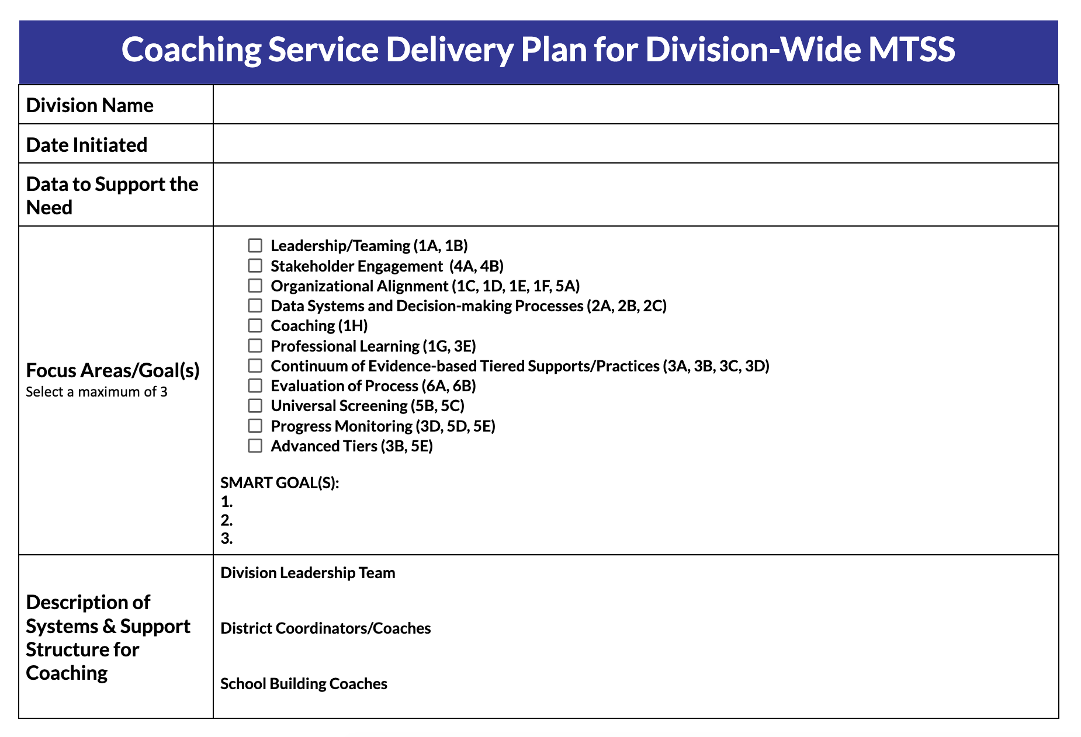
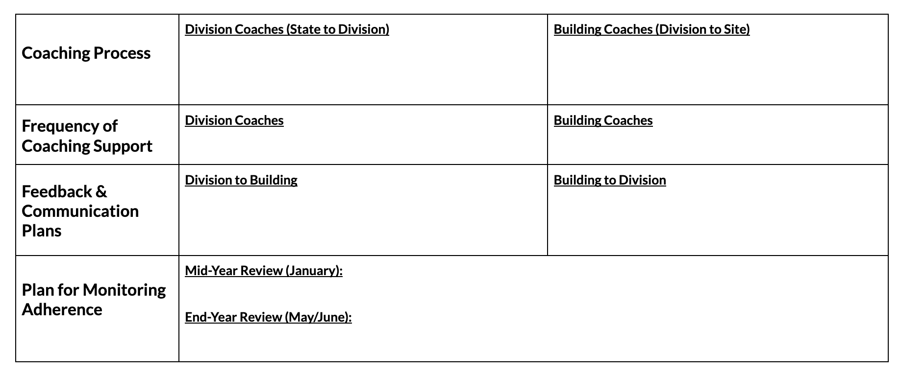
Coaching Service Delivery Plan Template

Slide 96
Purpose of Coaching Service Delivery Plan (CSDP)
a proactive approach, to purposeful and supportive coaching
The CSDP always has the goal of aligned systems, improved services, and outcomes for all.
specifies coaching elements that will promote quality service delivery and serve as the basis for continuous MTSS improvement
details the responsibilities within a continuum of coaching supports and is adjusted over time

Slide 97
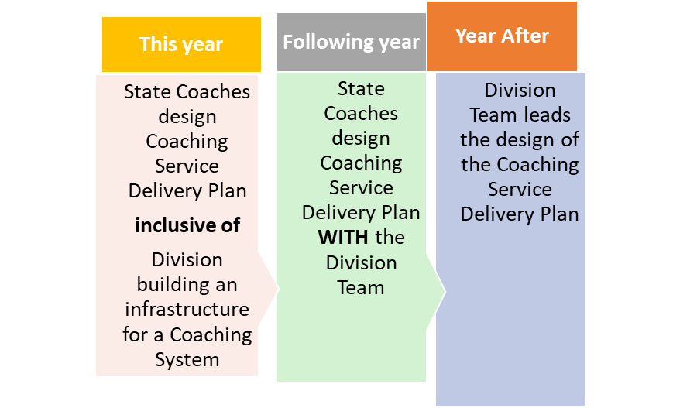
Timeline for Sustainability

Slide 98
Data to Support the Need
Plan for Monitoring Adherence
Focus Areas/ Goals
Components of the CSDP
Feedback & Communication
Systems & Support Structures
Frequency
Coaching Process

Slide 99
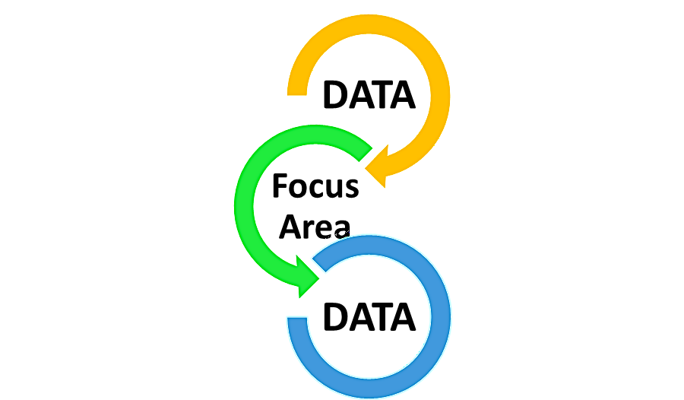
Data supports selection of the focus area
Stakeholder Engagement
Organizational Alignment
Data Systems and Decision-making Processes
Coaching
Professional Learning
Leadership/Teaming
Continuum of Evidence-based Tiered Supports/Practices
Evaluation of Process
Universal Screening
Progress Monitoring
Advanced Tiers

Slide 100
Data to Support the Need
What data sources will lead us to decide upon a given focus area?
Consider both quantitative and qualitative data.

Slide 101
Quantitative
Overall Scales:
Organizational Leadership
Competency
Data System for Decision Making
DCA Scores
Drivers (subscales):
Leadership
Competency
Fidelity
Selection
Training
Coaching
Organization
Data Support Decision Making
Facilitative Administration
Systems Intervention

Slide 102
Questions should include (but not limited to):
How often did the district leadership team meet last year?
Are tasks assigned and completed outside monthly meetings?
Does the DLT use a data informed decision-making process at each meeting?
Qualitative
Leadership/Teaming

Slide 103
Qualitative: Training
Questions should include (but not limited to):
Do we have a formal internal PD plan for strengthening staff skills that includes opportunities for practice and feedback?
How frequently have we provided PD for the division and/or school teams outside of VTSS state-wide PD?
Does someone from the division co-train (e.g., helping deliver the content) PD with school staff?
Does the division have an internal system for providing VTSS PD to on boarding schools outside of demonstration sites?

Slide 104
Qualitative: Coaching
Questions should include (but not limited to):
Are there designated division coaches to support school implementation?
To what extent, do you facilitate DLT meetings (e.g., lead DLT meeting, create the agenda, complete follow up tasks)?
To what extent, do you you support school teams (e.g., attend monthly meetings, create the agenda)?
Has the division transitioned from external state system coach support to internal local coaching capacity (i.e., consultation)?

Slide 105
Other Data to Support the Need
Key Question:
What focus area(s) will move your division forward in MTSS?
How much data?
Enough to identify a focus area
NOT too much to get lost

Slide 106
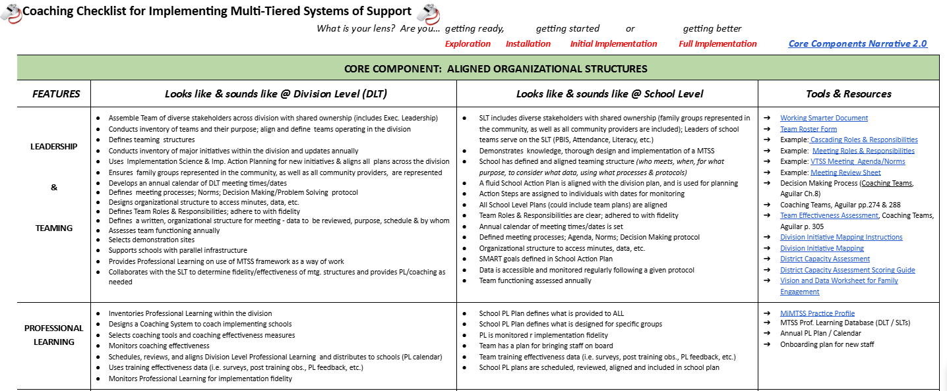
Coaching Checklist

Slide 107
Coaching Scenario
Link to Scenario CSDP

Slide 108
CSDP Part 1

Slide 109
CSDP Part 2

Slide 110
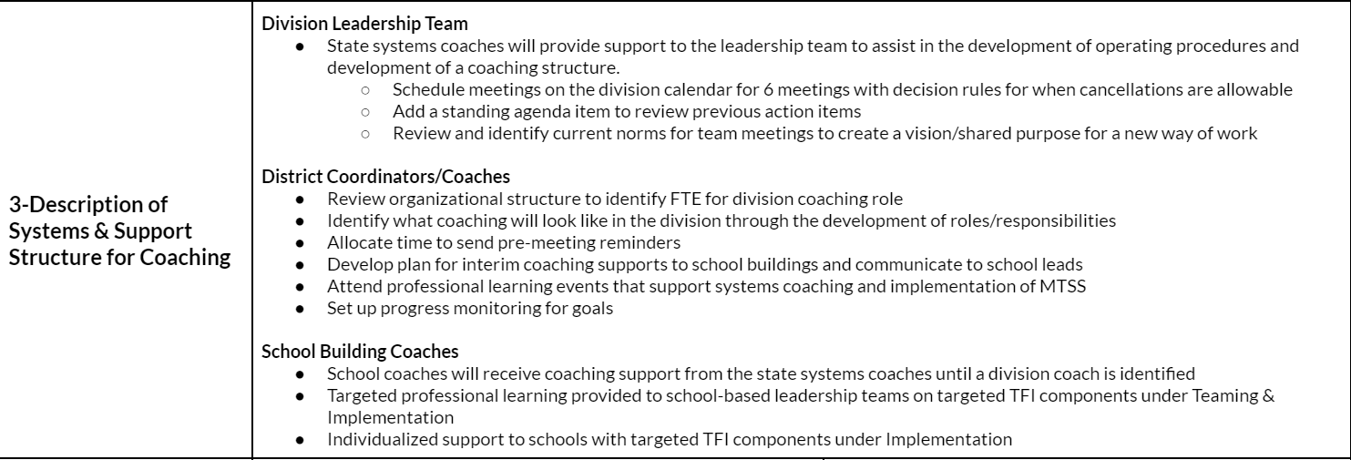
CSDP Part 3

Slide 111
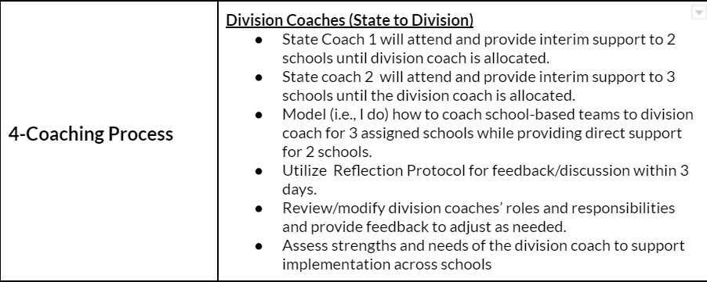
CSDP Part 4

Slide 112
CSDP Part 4 (continued)
Building Coaches (Division to Site)
1. Division coach will observe state coaches in 3 assigned schools
2. Assess strengths and needs of the school coach to support implementation at the building level
3. Debrief meetings using a reflection protocol monthly within 3 days of meeting
4. Support Building Teams in designing and delivering professional learning to staff focused on increasing understanding of MTSS and capacity to implement related classroom practices (TFI 1.7-1.9)

Slide 113
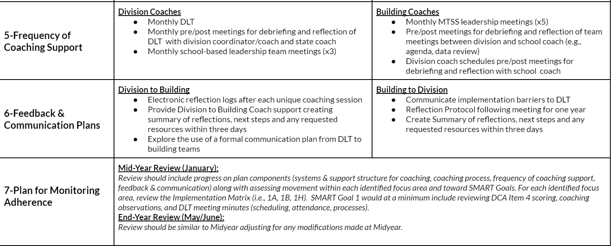
CSDP Part 5, 6, 7

Slide 114
Table Work
Silently review and read the CSDP used in the scenario.
Select a spokesperson for sharing key points discussed .
Respond to the following questions:
What were your first impressions of how the plan could support your work as a systems coach?
Using the scenario, what were similarities to your division’s ongoing coaching supports to implement MTSS?
What data and focus area would you like to discuss with your VTSS Systems Coach?

Slide 115
Large Group Share Out

Slide 116
True or False?
CSDPs are Flexible
CSDPs should be active documents
CSDP should NOT be data driven
CSDP are flexible as to the number of Focus Areas
CSDP are to be developed by you beginning next week?

Slide 117
Practice
TIME

Slide 118
Summarizing Your Role
MTSS CONTENT KNOWLEDGE
COACHING KNOWLEDGE
& SKILLS

Slide 119
Summarize Your Role as a Systems Coach
What are you still curious about?
What are you feeling good about?
What are your questions around systems work?
What professional learning opportunities could we provide you to support implementation and systems work? Topics?

Slide 120
Congratulations!
This Photo by Unknown Author is licensed under CC BY-NC
You have hereby successfully completed the
VTSS Systems Coaching Institute

Slide 121
Optimistic Closure
“In difficult times carry something beautiful in your heart”
-Blaise Pascal
hope

Slide 122
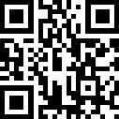
Evaluation
https://odu.co1.qualtrics.com/jfe/form/SV_ai2Ow1qZOaYcSHk

