Slide 1
Systems Coaching
Institute 102
July 16 & 23, 2026
Virtual

Slide 2
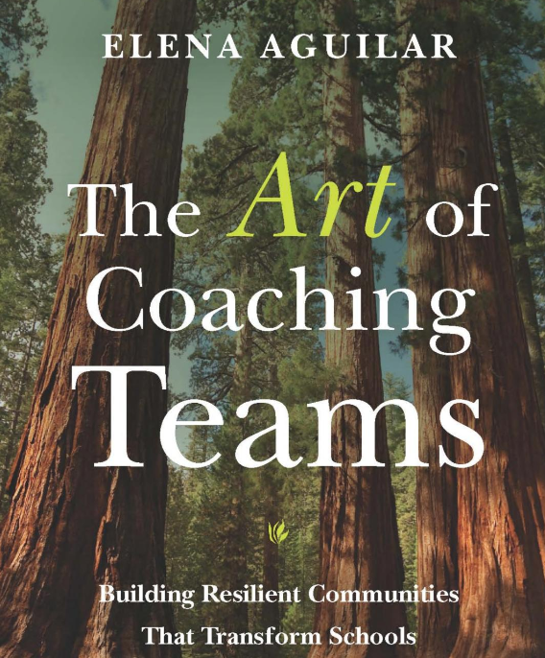
The Art….

Slide 3
Virtual Community Agreements
Be Responsible:
  Take care of your needs
  Share your questions with the group
Be Respectful:
  Turn volume/sound off on cell phones
  Listen to others attentively
  Follow up and complete assigned tasks
Be Engaged:
  Please keep your video on as much as possible
  Ask what you need to know to understand and contribute
  Share your expertise, information and ideas
The blue stars
identify activities

Slide 4



Inclusive Opener
ROSE
BUD
THORN
Signifies a success. What is working well related to your role as a Systems Coach?
What is an area of growth within your role?
What has been a barrier to your role as a systems coach?

Slide 5


Slide 6
Welcome to
Systems Coaching 102
MTSS is a systemic, data-driven approach that allows divisions and schools to provide targeted, evidence-based interventions to meet the needs of their students. This is done through a clearly defined process that is implemented to fidelity by all stakeholders within the school and/or division.

Slide 7
Big Picture of the 2 Days
Reorientation
Why you are here, your work in understanding educational systems and the impact systems have on outcomes.
Core Competencies Self assessment -pages 299-303
  Completed core competency no.1-Skills and Knowledge
  Core competency no.2-Emotional Intelligence
How you show up to teams and team functioning
The impact of EI accountability, engagement and collaborative decision making in team functioning
Communication, feedback, dealing with conflict
Coaching Service Delivery Plan

Slide 8
Where we’ve been
SCI 101 Learning Intentions
Day 1
Examine educational systems and how systems change, and how to manage complex change
Understand how the MTSS framework can be applied to any initiative
Understand the role & responsibilities of a Division Systems Coach and three key principles that guide the work
Develop knowledge of VA’s MTSS Core Components and their features and tools to support implementation

Slide 9
SCI 101 Learning Intentions cont.
Day 2
Continue to apply a systems coaching lens to Core Component 1: Aligned organizational structures these features: Professional Learning, Routines and Procedures and Coaching
Develop conceptual understanding and skill acquisition of effective communication skills and their place within aligned organizational structures
Complete a Coaches Self-Assessment (from Teaming Book, Aguilar)

Slide 10

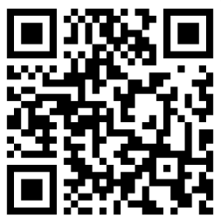
This Photo by Unknown Author is licensed under CC BY-SA

Slide 11
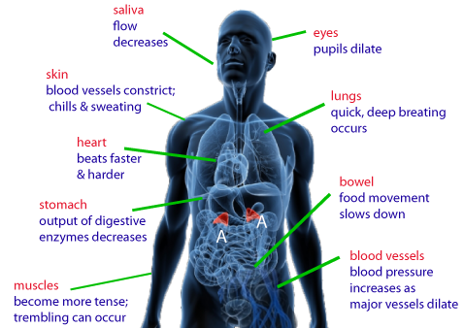
We began with a
Systems Check

Slide 12
COMPONENTS OF A SYSTEM
A constellation of parts.
HUMAN RESOURCES
MATERIAL RESOURCES
Education System
FISCAL RESOURCES
$$$$$$
PROCESSES AND PROCEDURES
POLICIES AND REGULATIONS
Adapted COACHING FOR SYSTEMS CHANGE-PIERCE AND ST.MARTIN 2023

Slide 13
Goals
Improve Division Systems & Build Local Capacity
Improve PreK-12 classroom & school Systems & Practices
Improve Student Outcomes

Slide 14
The Three Principles that Guide Systems Work
Understand the system to understand outcomes.
2. System level change is an intentional and continuous process.
3. Systems-level change is an adaptive challenge.

Slide 15
Systems Coaching Institute 102
Learning Intentions
Day 1
Utilize the three key principles that guide systems coaching
Understand the importance of teams in the work of systems that impact change
Understand and facilitate the development of highly effective teams
Identify, choose, and implement strategies/structures for enhancing team functioning
Understand, apply, and uphold concepts of emotional intelligence, accountability, engagement and collaborative decision making within a team structure
Utilize effective communication and other coaching techniques to impact systems change
Day 2
Understand the purpose of and practice the development and ongoing utilization of a Coaching Service Delivery Plan

Slide 16
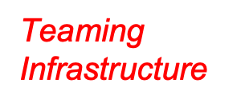

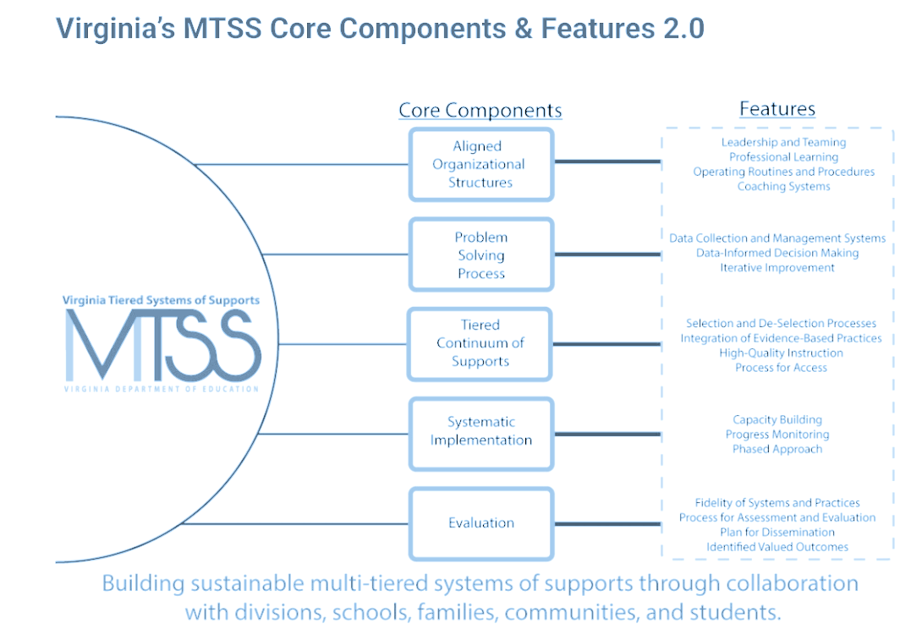




People make Systems Work!
Features:

Slide 17
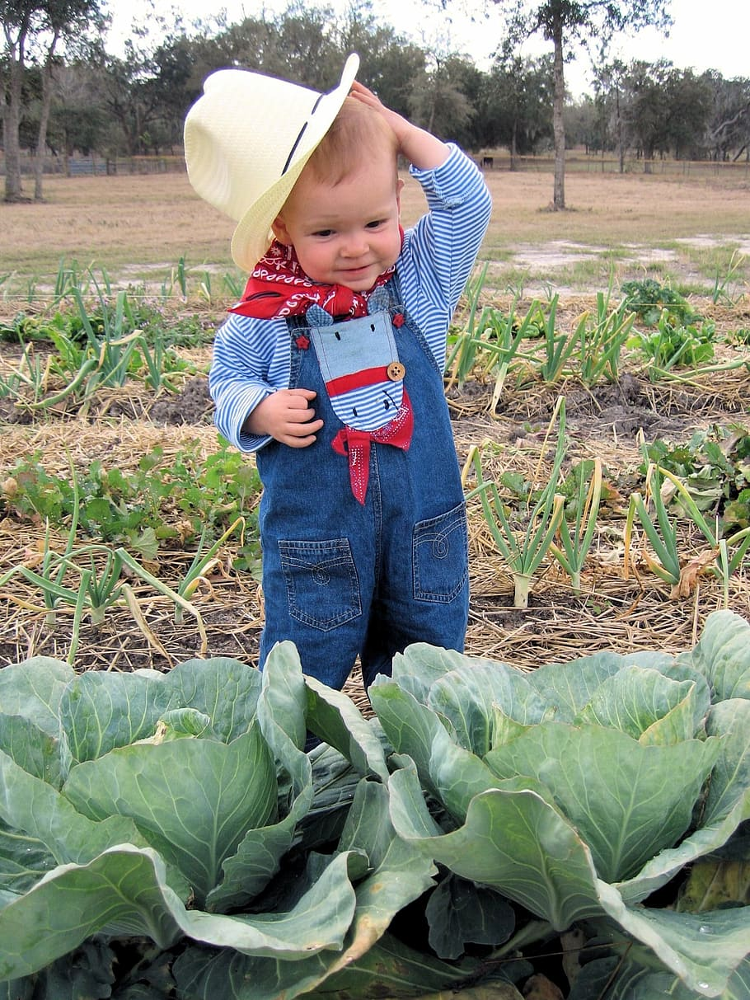
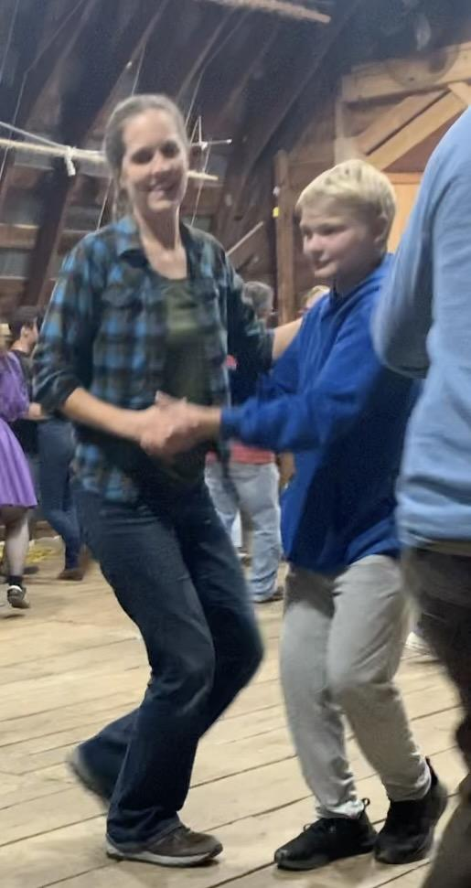
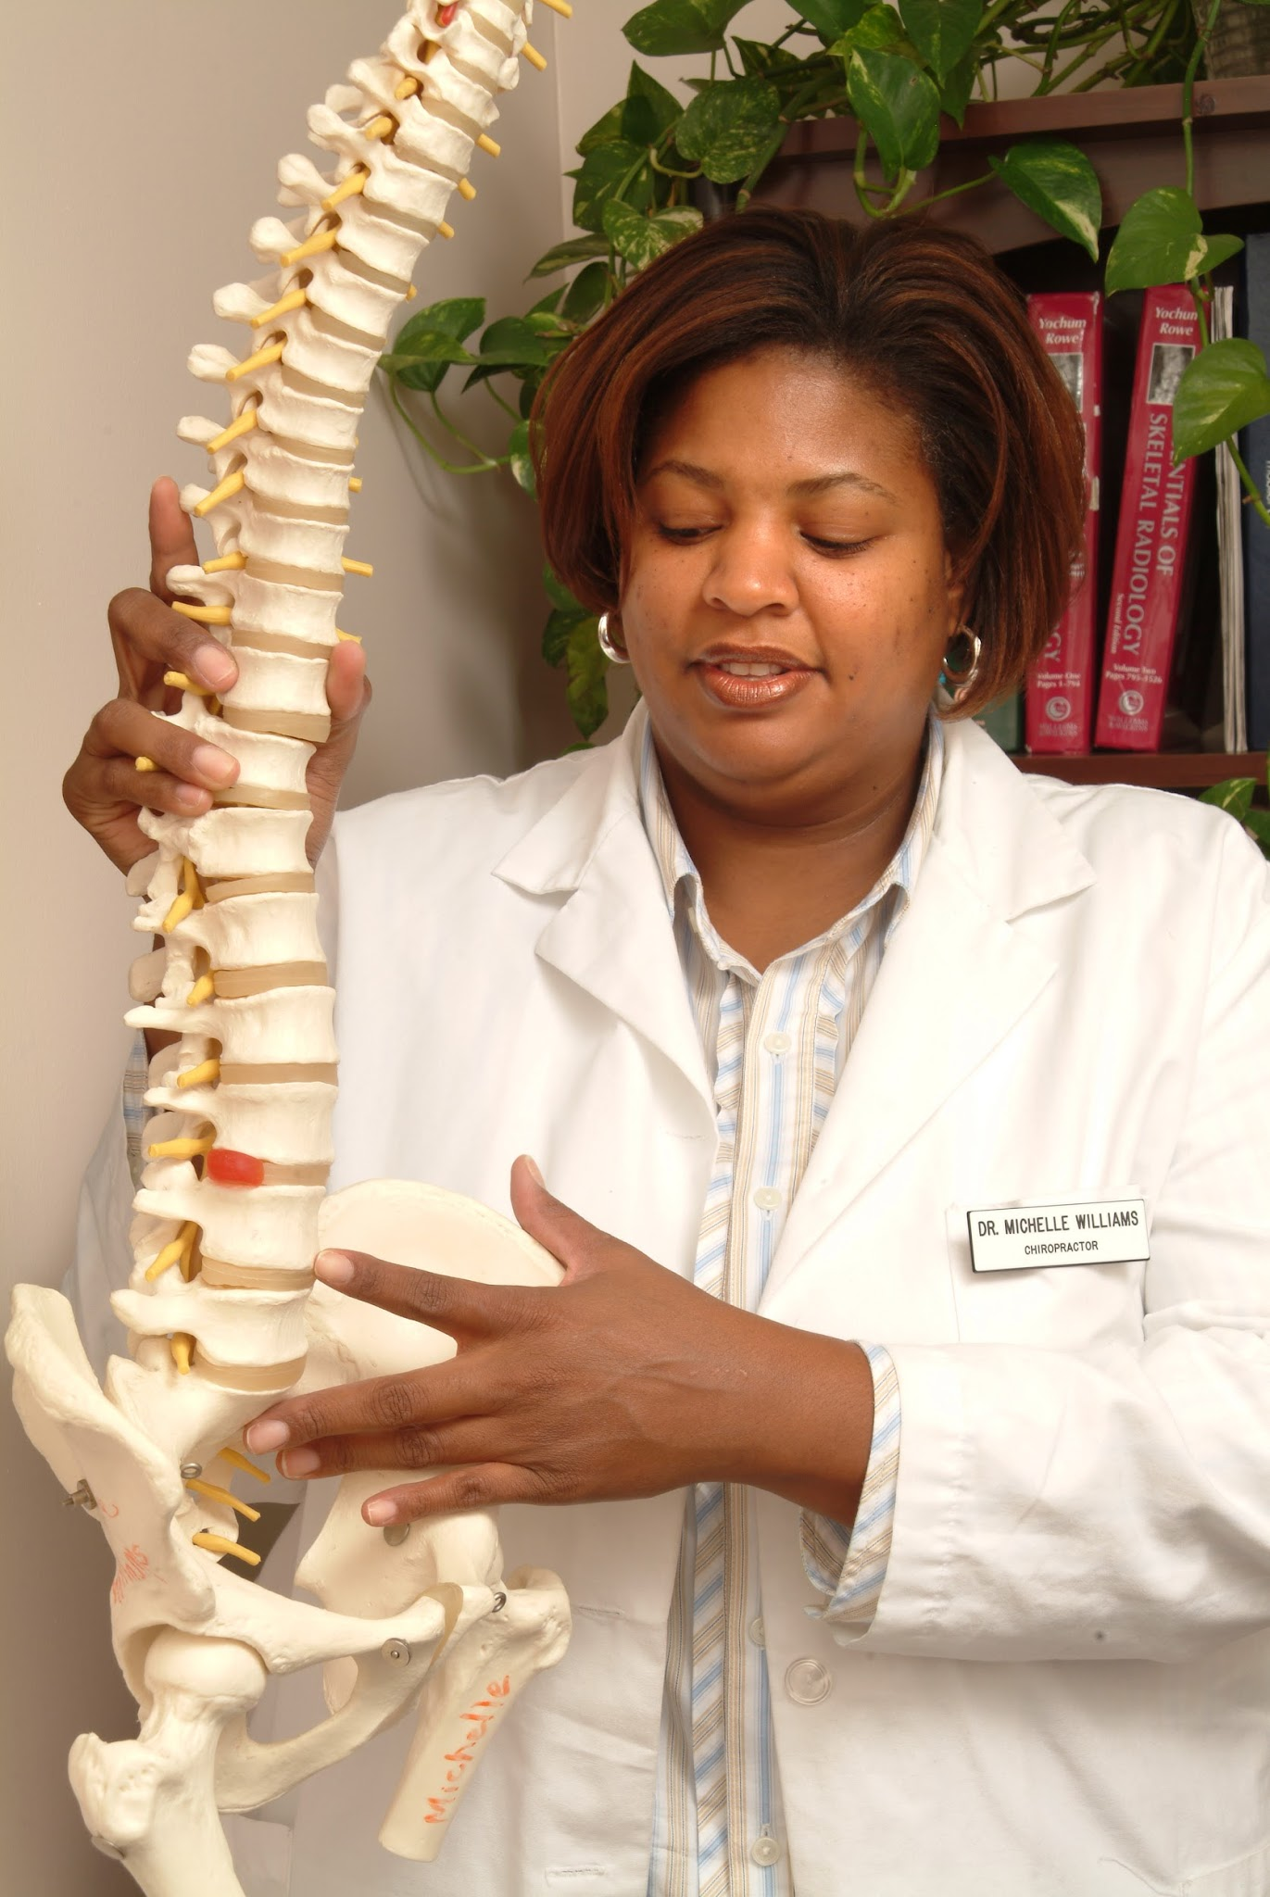
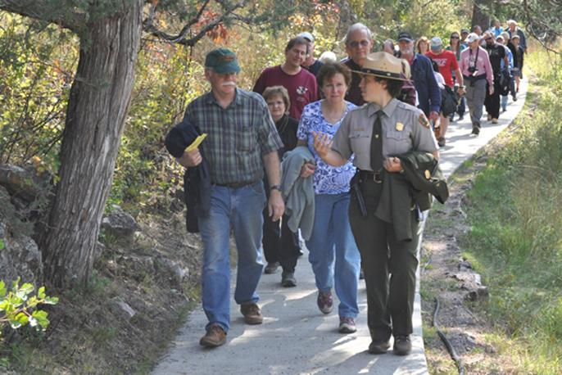

Coaching for change is like being…
a farmer because…
a chiropractor because…
a tour guide because…
a dance partner because…
the conductor of an orchestra because…

Slide 18
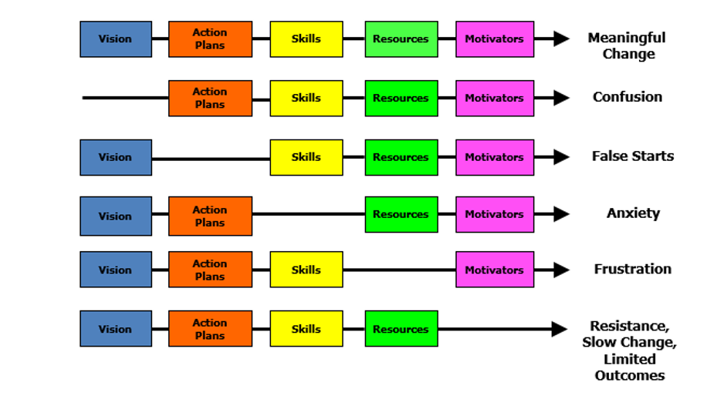
Managing Complex Change
Source: Adapted from Knoster, T., Villa R., & Thousand, J. (2000). A framework for thinking about systems change. In R. villa & J. Thousand (Eds.), Restructuring for caring and effective education: Piecing the puzzle together (pp. 93-128). Baltimore: Paul H. Brookes Publishing Co.

Slide 19

Key Role of a Division Coach is systems work!
The key role and responsibility of 'systems' coaches is to facilitate the development of and to monitor multi-tiered systems for the division. MTSS work is the result of:
VTSS Core component 1:
Highly effective teams that use data to inform their decisions
Creating communication protocols
Aligned professional learning for staff, inclusive of coaching

Slide 20
Making the Shift:
From YOU to Your work with TEAMS
Day 1
Teams: are they effective, how do you know, characteristics of highly functioning teams
Day 2
Understand the purpose of, practice in the development of and ongoing utilization of a Coaching Service Delivery Plan

Slide 21
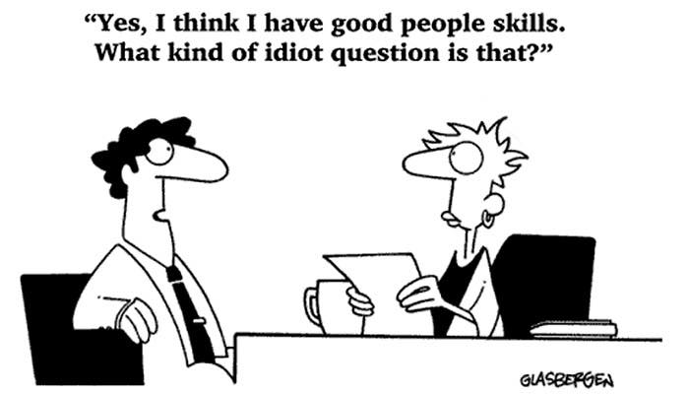
How’s your Emotional Intelligence (EI)? √ it now

Slide 22
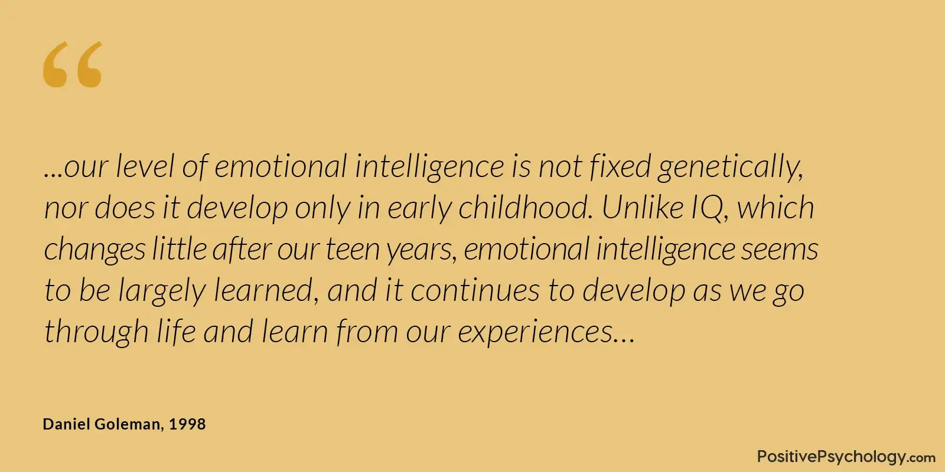
What is your
Emotional Intelligence?

Slide 23
Reflect on Emotional Intelligence
Please turn to pp. 301-303 in your Aguilar book, or use the link in the chat.
Read through each element and rate your current EI using the scale of 1-5.
Highlight any areas in which you scored a 1 or 2 that you might wish to work on.

Slide 24
Emotional Intelligence
“EI is the foundation of building trusting relationships, interpersonal communication, flexibility, time management, empathy, decision making, collaboration, presentation skills, assertiveness, regulating stress, managing anger, dealing with unexpected change, and resilience.”
Aguilar, The Art of Coaching Teams, pg. 18

Slide 25
Emotional Intelligence (Cont.)
Emotional intelligence refers to the ability to identify and manage one’s own emotions, as well as the emotions of others.
Self-Awareness
Self-Management
Social Awareness/Empathy
Social Management/Social Skills

Slide 26
Self Awareness
Self Awareness: The ability to recognize your own feelings and to name them, recognizing the impact of your emotions, and to know your strengths and limits, and to have self-confidence and the awareness of your capabilities.
Elena Aguilar, The Art of Coaching Teams: Building Resilient Communities that Transform Schools. Jossey-Bass, 2016.

Slide 27
Self Management
Self Management (Regulation): The ability to make conscious decisions on how to respond to emotions (emotional self-control, transparency, and adaptability, and initiative—the readiness to act and to anticipate the consequences, aligned with your values)
Elena Aguilar, The Art of Coaching Teams: Building Resilient Communities that Transform Schools. Jossey-Bass, 2016.

Slide 28
Social Awareness
Social Awareness (Empathy): The ability to recognize and understand the feelings that other people experience (empathy, organizational awareness, service—the needs of others and meeting them)
Elena Aguilar, The Art of Coaching Teams: Building Resilient Communities that
Transform Schools. Jossey-Bass, 2016.

Slide 29
Social Management
Social Management (Skills/ Motivation): The ability to manage conflict with others to form healthy relationships, collaboration, feedback and guidance, and to motivate and inspire others
Elena Aguilar, The Art of Coaching Teams: Building Resilient Communities that Transform
Schools. Jossey-Bass, 2016.

Slide 30
Individual Goal Setting
In the article, “50 Tips For Improving Your Emotional Intelligence,” the tips are broken down by domains.
Highlight a couple strategies you will use to improve the areas you identified.

Slide 31

Break

Slide 32

Systems Change and Teams
Why are teams important in systems change?

Slide 33

WHY teams are so important
You cannot do it alone
Creating schools into places where all children get what they need each and every day, is hard work and requires solving hard problems.

Slide 34
Systems Change Requires…
Organizational Conditions for Effective Teams
Alignment
Purpose/Function/Focus
Stability
Membership
Leadership
Culture of Learning
Decision-Making
Trust
Time
Feature 1-
Aligned Organizational Structures
Exhibit 13.4. © Elena Aguilar, The Art of Coaching Teams: Building Resilient Communities that Transform Schools. Jossey-Bass, 2016.

Slide 35

Feature 1: What is an Effective Team?
If you had a highly effective team, what would that look like in practice?
What role would you play as the Division Coach?
FIRESIDE CHAT

Slide 36




Does your team know its purpose?
Reflect on purpose
Keeping students at the center
Determining a team’s mission and vision, pp. 69

Slide 37
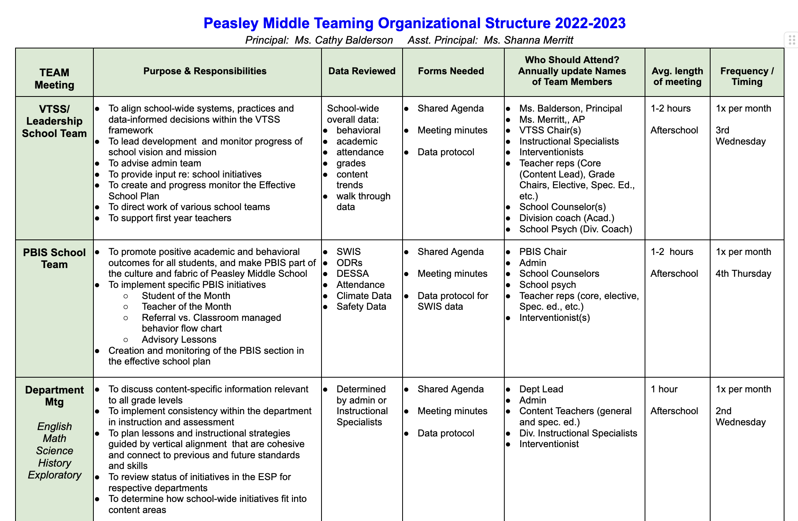
Team Alignment
What is the teaming infrastructure in the school (may also be helpful to consider at division level)?
Conducting an inventory of teams within the school (and/or division) can be helpful
What team are YOU coaching?
Working Smarter Tool

Slide 38
Team: Coaching for Purpose, Alignment & Stability
What is the purpose or the role of a Tier 1 team in schools?
  How does it support the overall school system?
  What are its key functions and responsibilities?
What is the purpose or the role of a Tier 2/Advanced tier team in schools?
  How is it different from Tier 1?
  What specific challenges or needs does it address?
As a coach, how can you help a team clarify its purpose and build stability?
  What strategies or guiding questions would you use to help teams define their role?
  How can you encourage team members to commit to consistency in attendance and engagement?
  How does clarity of purpose contribute to team stability?

Slide 39
Team - Culture of Learning
Learning Organization: Read & Rate
(pp. 186-187)
Learning environment
Learning processes & practices
Leadership
Think about a team you are working with.
Which indicators are present and which are not?
How might you use this questionnaire?

Slide 40
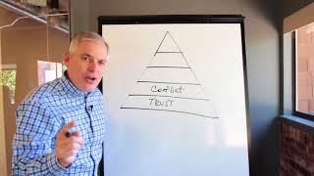
Team - Culture of Trust
Making People Feel Safe
Where does it begin?

Slide 41

Indicators of Trust
pp. 282-283

Slide 42

On a scale of 1-5
My division:
Promotes a culture of ‘asking’ for coaching
Encourages risk taking
Views mistakes as learning opportunities
Ensures processes and decision making are transparent
Ensures information is shared openly

Slide 43

Building the Emotional Intelligence of Teams
It takes skill
It takes knowledge
It takes TIME
Elena Aguilar, The Art of Coaching Teams: Building Resilient Communities that Transform Schools. Jossey-Bass, pg. 130-131. 2016.

Slide 44
Foundations for Trust and Safety:
Community agreements lay the foundation for positive culture, build trust, people feel safe.
Community Agreements
Why have Community Agreements?
Effective agreements = goals achieved.
How to develop these: Together as a team!
Ideal number is 5-7. Review every meeting.
2 types:
Procedural: e.g., start and end on time, keep minutes
Behavioral: e.g., offer solutions, listen to understand

Slide 45
Community Agreements/Norms in Practice
Clarify each norm: Interpretations could be different, what does it sound and feel like.
Visibility: On the agenda and around the room.
Revisit them: Are they working? What can we do to make them better?
Activity: Read scenario pp. 95-96 in book or from the link in the chat box.
As this team’s coach, what would be your next steps as you meet with the school coach after this meeting? Is there need for another norm(s)?

Slide 46
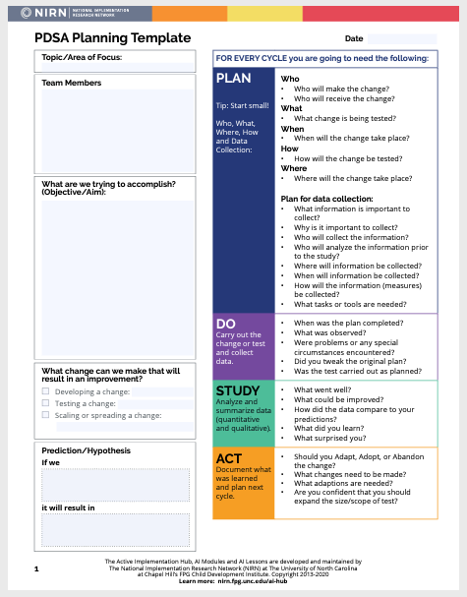
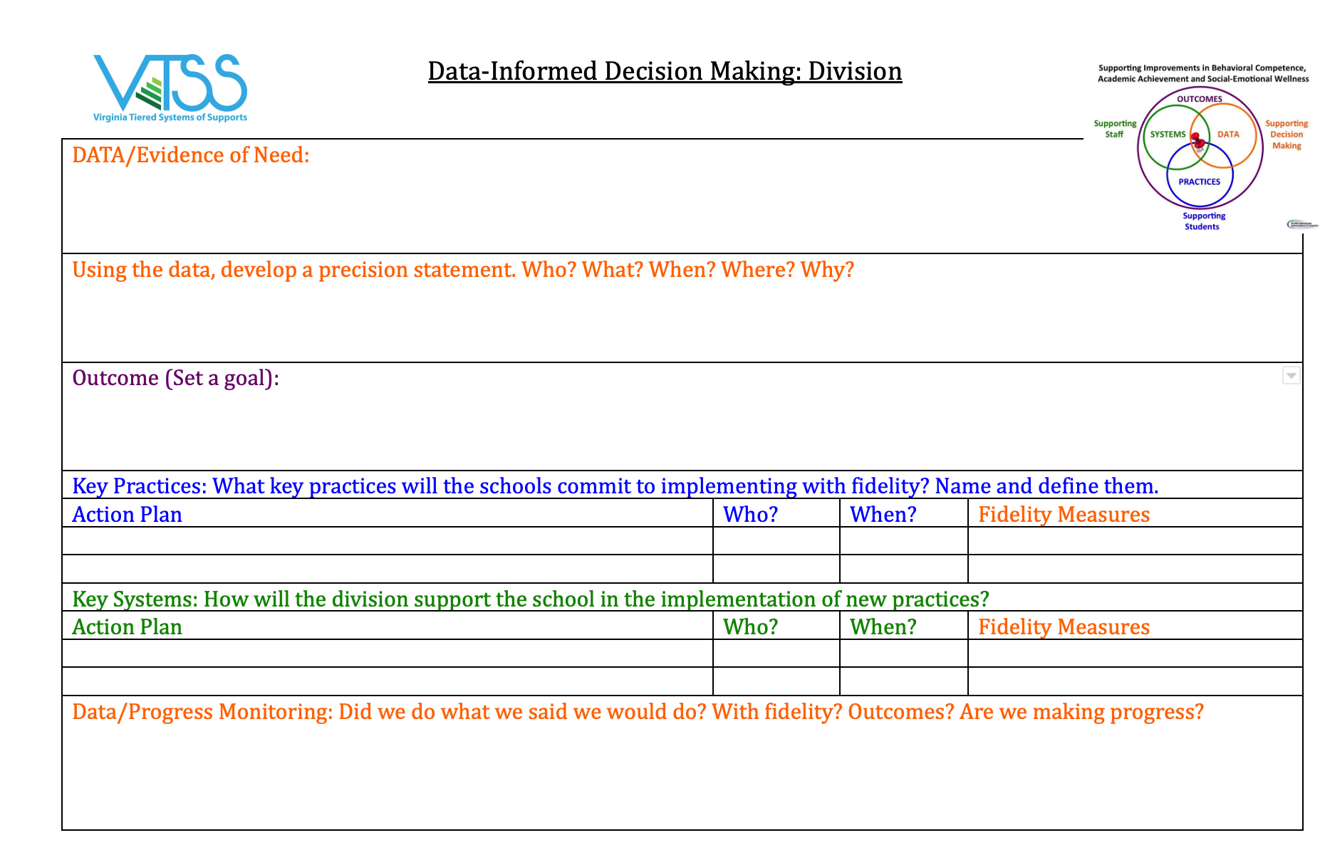
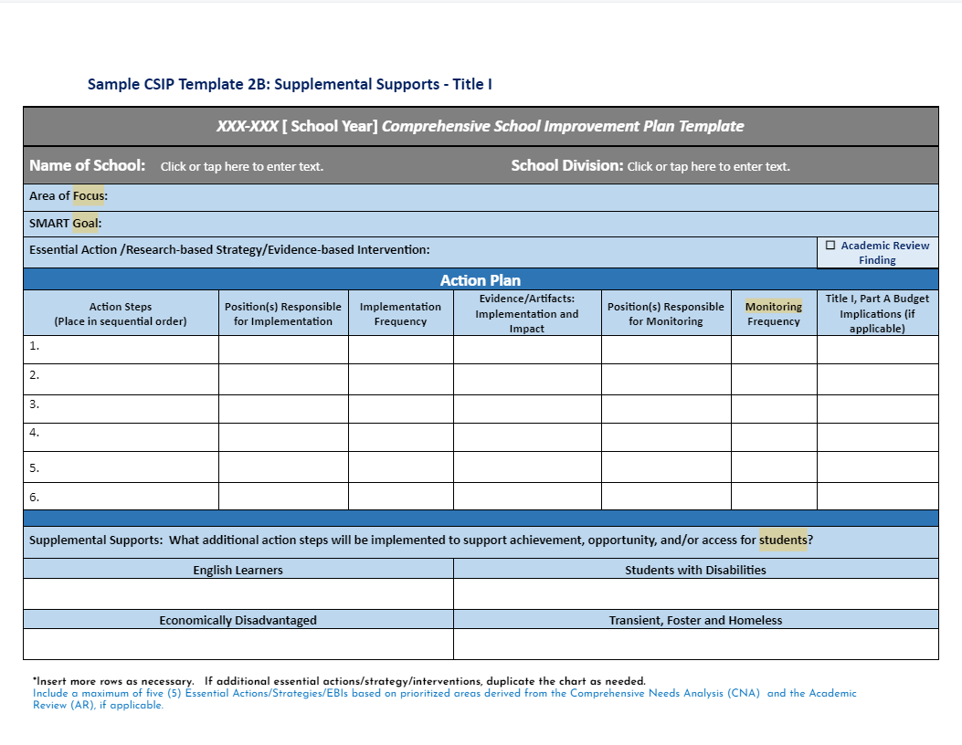
Document Your
Decision Making Process

Slide 47
Where is your Team?
Effective Problem Solvers…
Typical Problem Solvers…
Define a problem in observable and measurable terms
Collect and use multiple sources of information to validate assumptions about the problem
Create highly detailed steps to implement the intervention with fidelity including assessment procedures, decision-rules and actions to support interventionists
Use student data & intervention fidelity to identify & implement next steps through continuous cycles of problem solving
Define problems loosely or vaguely
Don’t validate assumptions before building a plan
Develop generic plans
Monitor fidelity of actions
Don’t measure or evaluate impacts
Typically abandon interventions without considering fidelity or feasibility

Slide 48
Collaborative Decision Making
Multi-voting - used to whittle down from a lot of choices, ranking
Compromise - both sides may feel they’ve lost
Majority Voting - someone(s) lose
Unilateral Decisions - One person is designated to decide for the group
Consensus (using Fist to Five vote)
Consent-based - a proposal is made, clarified, modified and there are no objections (Fist to Five works here, too)
Source: Art of Coaching Teams - Chapter 8

Slide 49
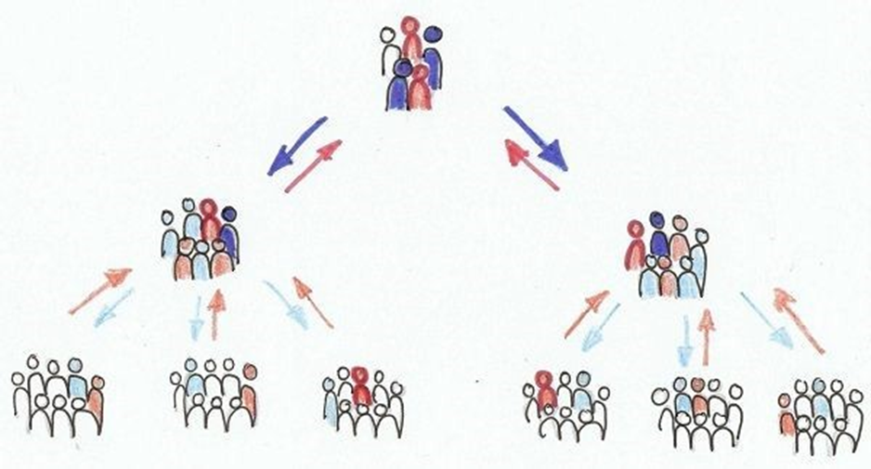

Team-What is their
Level of Authority?
Decision Making Processes Matter

Slide 50
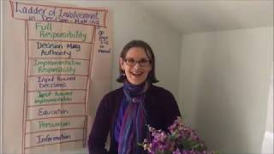
Ladder of Involvement

Slide 51

Team Assessment Possibilities:
PAUSE & consider the next three slides as growth opportunities for your team.

Slide 52
Pause and Reflect
Does your team have norms?
Does your team meet at least monthly?
Does your team use a structured agenda that is accessible to all?
Has your team identified data points that are progress monitored regularly?
Does your team use a process/protocol for data driven decision making?

Slide 53
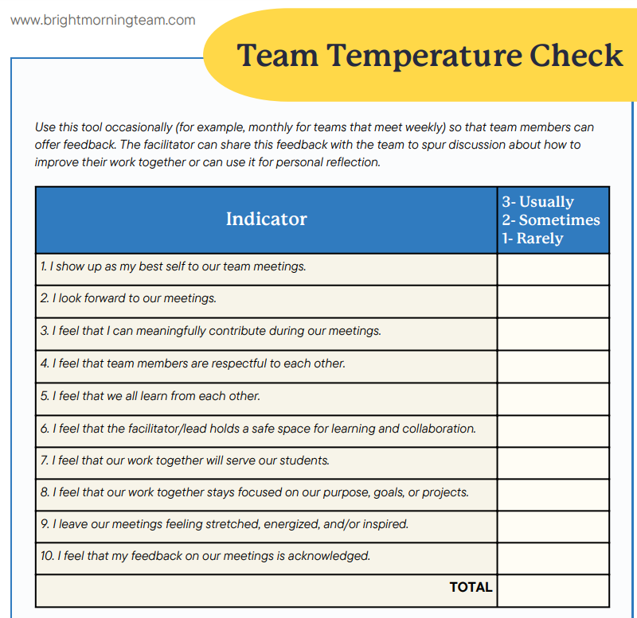
How is your team feeling?

Slide 54

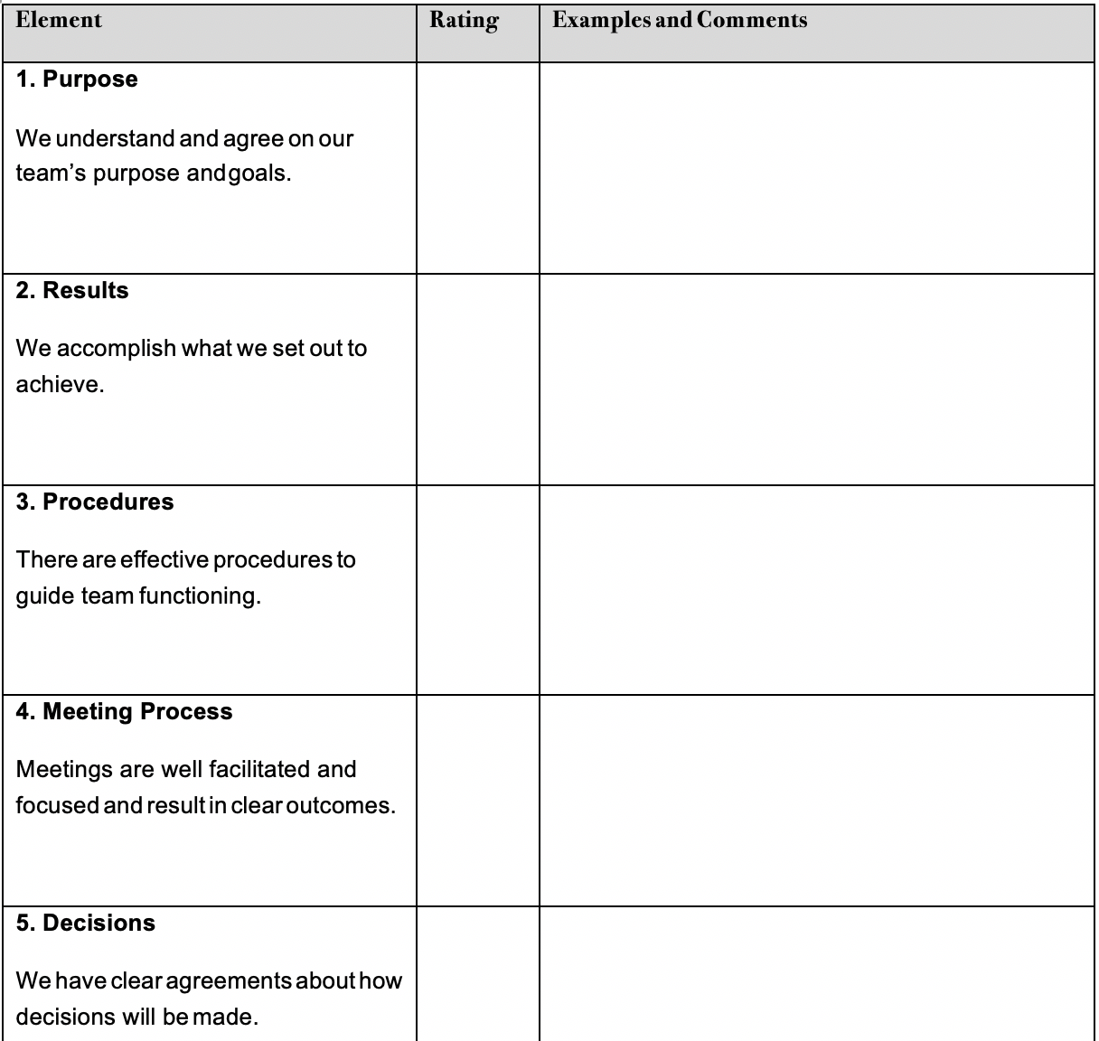
Assess Current Team Effectiveness
TIME
Reference
pp. 305-306 in the Aguilar book.

Slide 55
Let’s look at your team: How will you facilitate next steps?
Brand New - We need to work on our structure, process, and procedures
Still Growing and/or Changing - We’ve accomplished a lot and just need to work on a few items due to change and/or growth
Seasoned - We’ve been doing this for awhile and love to review our structure, process, and procedures

Slide 56

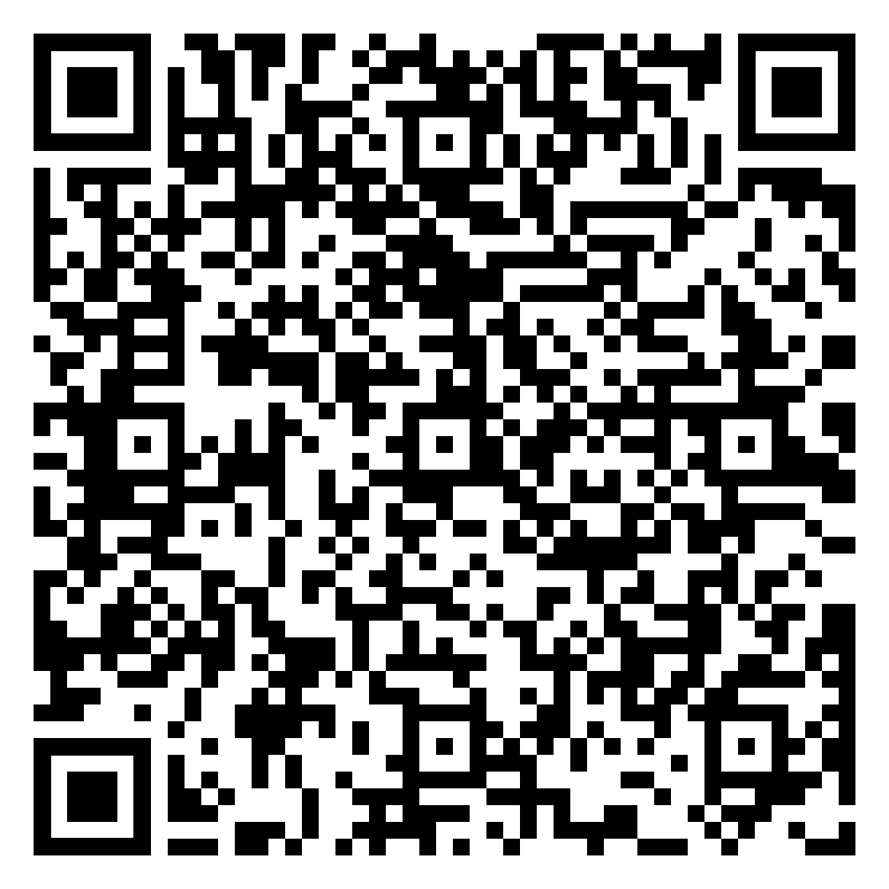
Exit Ticket
Exit Ticket Link

Slide 57

Your Role
MTSS CONTENT KNOWLEDGE
COACHING KNOWLEDGE
& SKILLS

Slide 58
People make Systems Work!
Features:

Slide 59

Intent vs. Impact
“The wake is the results we leave behind. And the wake doesn’t lie and it doesn’t care about excuses. It is what it is. No matter what we try to do to explain why, or to justify what the wake is, it still remains. It is what we leave behind and is our record.” Dr. Henry Cloud
What are some team procedures and processes to help with intent vs. impact?

Slide 60
What do you bring to the table?
Coaching
Systems Change Requires…
Utilize effective communication and other coaching techniques to impact systems change.
Giving and receiving feedback; navigating conflict with healthy outcomes.
Aligning Communication & Coaching

Slide 61
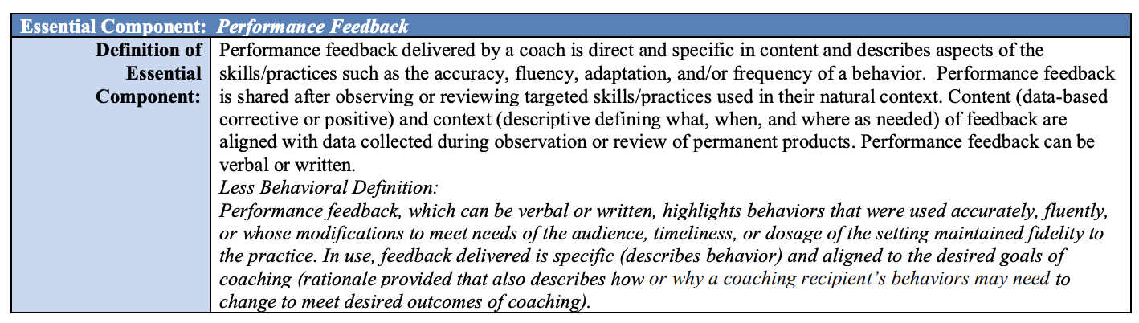
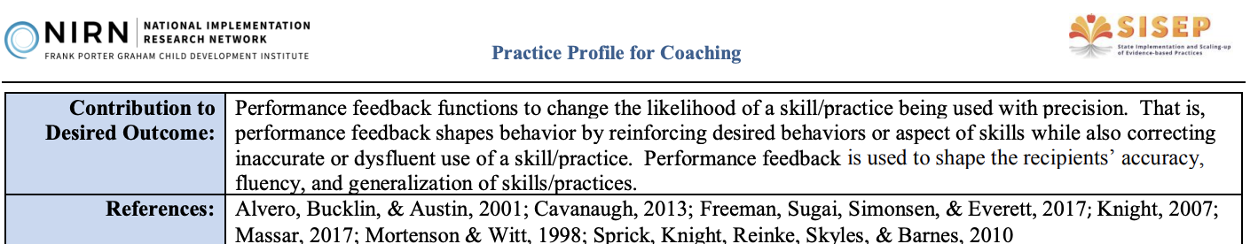
Performance Feedback
Link to Practice Profile

Slide 62

Performance Feedback
Performance feedback, which can be verbal or written, highlights behaviors that were used accurately, fluently, or whose modifications maintained fidelity to the practice. In use, feedback delivered is specific (describes behavior) and aligned to the desired goals of coaching (rationale provided that also describes how or why a coaching recipient’s behaviors may need to change to meet desired outcomes of coaching).

Slide 63
Receiving and Giving Feedback
Take 4 minutes to read the article individually. While reading, highlight 1-2 points that “hit home” for both receiving and giving feedback
In your breakout groups, each person shares 1 point that “hit home” for them.
Adapted from National School Reform Faculty
Handout

Slide 64
Review: Feedback
Receiving Feedback
Giving Feedback
Be prepared; be mindful
Separate the strands: feeling, story, feedback
Contain the story
Change your vantage point
Appreciation: Validate and share concrete affirmation
Coaching: creating conditions for transformation through inquiry
Evaluation: letting someone know where they stand
Receiving and Giving Feedback by Elena Aguilar

Slide 65

20/20 Break
Shut your camera off for 20 seconds
Look away from your computer -20 feet

Slide 66
What behaviors are perceived as resistance?
Waterfall Chat:
Answer the following question, but do not hit send until prompted:
What behaviors do you perceive as resistance on a team?

Slide 67
How do you Respond to Resistance
(pgs. 198-201)
Look inward
Resistance masks fear
What looks like resistance is often the need for help
Be clear
Trust reduces resistance
Confront cynicism
Reflect on team structures
Don’t focus on the resisters
Coaching Resistance
Part 1: What is Resistance?
Elena Aguilar, The Art of Coaching Teams: Building Resilient Communities that Transform Schools. Jossey-Bass, 2016.

Slide 68

Engagement Strategies
for Teams to Help with Resistance
Every meeting should begin with identified outcomes!
Consider using structures or protocols for engagement:
Data Driven Dialogue
Consultancy Protocol
Discussion Protocols
Feedback Protocol
Chalk Talk
Dyads
Elena Aguilar, The Art of Coaching Teams: Building Resilient Communities that Transform Schools. Jossey-Bass, 2016.
Pages 320 - 325 in the book.

Slide 69


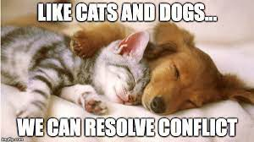





How do you feel?
1
2
3
4
5
6
7
8

Slide 70

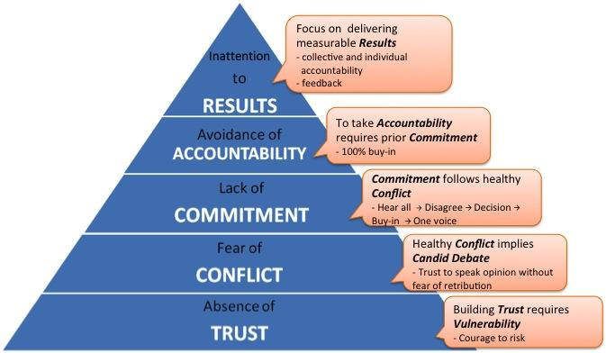
What about conflict?
“A lack of healthy conflict is a problem because it ensures the third dysfunction of a team: lack of commitment. Without having aired their opinions in the course of passionate and open debate, team members rarely, if ever, buy in and commit to decisions, though they may feign agreement during meetings.”
— Patrick Lencioni
It is inevitable!

Slide 71


Task conflict vs.
Relational conflict
Different opinions about how to execute a task.
More emotional; creates disconnect between people
(Prosocial: Using Evolutionary Science To Build Productive, Equitable, and Collaborative Groups; Atkins, Wilson, and Hayes)

Slide 72
Quote
“Conflict is maintained in our heads, in the judgments of right and wrong, good and bad, justified and unjustified, and stepping into the perspective of another, seeing things from their point of view and drawing a circle that takes them in, is one of the hardest things in the world to do.”
Source: Prosocial: Using Evolutionary Science To Build Productive, Equitable, and Collaborative Groups. Atkins, Wilson, and Hayes, pg. 177

Slide 73

Build Interpersonal Skills
Separate people from the problem
Focus on the shared interests of both parties
Develop many options that can be used to solve the problem
Evaluate the options using objective criteria
Prosocial: Using Evolutionary Science To Build Productive, Equitable, and Collaborative Groups; Atkins, Wilson, and Hayes
Link to How can We Make Conversations More Prosocial?

Slide 74

Predictions
“Your brain knew what was coming. It predicted what it was going to hear.”
https://hiddenbrain.org/

Slide 75

Enhance Personal Skills
Prosocial
Psychological Flexibility Skills
Psychological flexibility
The capacity to be entirely aware and connected with the present moment while behaving in ways that promote one’s values
(Biglan et al., 2013; Lloyd et al., 2013)
Perspective taking
Get up on the balcony “observing self”
Separate people from the problem (content and relationship)

Slide 76
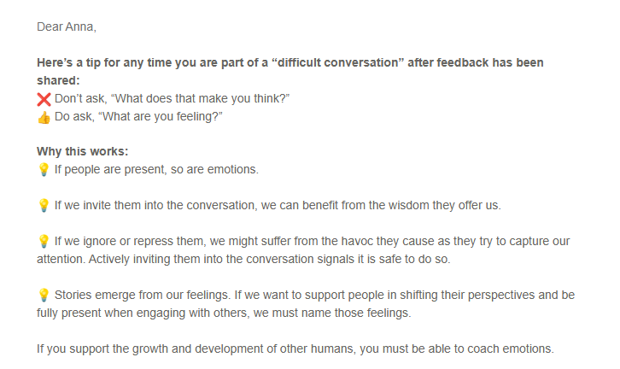
Tools for Shifting Perspective
Imagine what others might be noticing, feeling, thinking, and wanting. (Prediction!)
Actively ask others what they are noticing, feeling, thinking, and wanting.
Listening strategies (Communication Bookmark) and Sentence Stems for Healthy Conflict
Reversing roles with others, empty chair

Slide 77
Perspective Taking Activity
Think of a time when you were experiencing a conflict or a challenge with another person in the professional setting. What are your predictions or signals to be curious about?
Remember to keep the story confidential eliminating names and context.
In your pair, Partner 1 shares story, keep note of time.
Perspective Taking: Partner prompts the story-teller to retell the story from the other person’s perspective.
Pivot Points: Partner finds a point in the story that seems pivotal and asks, what might have gone differently? Allow them to explain what might have changed in the story.
Discuss together:
In what ways did this “perspective taking” activity open new possibilities within your coaching conversations?

Slide 78

Where is your focus?
“Play the ball, not the player.”

Slide 79
Feature 4: Coaching Systems
Coaching for systems change involves collaborating with school and division leaders to develop, implement, and sustain an MTSS framework that emphasizes educational environments that improve student outcomes through leadership, facilitating resource allocation, fidelity of evidence-based practices, and addressing large-scale reform and whole-school organizational improvement.

Slide 80
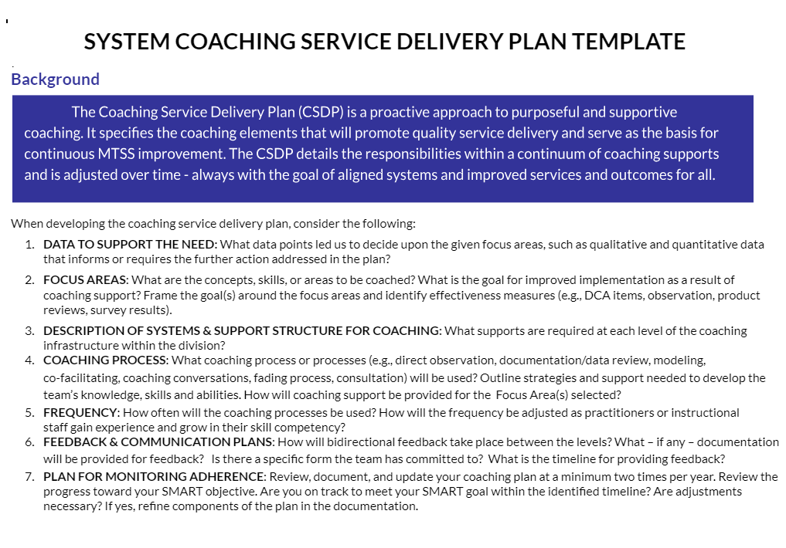
Coaching Service Delivery Plan
Feature 4

Slide 81
Purpose of the CSDP
Proactive approach, to purposeful and supportive coaching
Specifies coaching elements to promote quality service and serves as the basis for continuous MTSS improvement
Details the responsibilities within a continuum of coaching supports
Is adjusted over time - always with the goal of aligned systems and improved services and outcomes for all

Slide 82
Data to Support the Need
Plan for Monitoring Adherence
Focus Areas/ Goals
Components of the CSDP
Feedback & Communication
Systems & Support Structures
Frequency
Coaching Process

Slide 83
Breaking it Down
Data to Support the Need
  What data points lead us to decide upon a focus area?
Focus Areas/Goals
  What are the concepts, skills, or areas that need to be coached?
Description of Systems & Support Structure for Coaching
  What are the supports required at each level of the coaching infrastructure?

Slide 84
CSDP Break Down
Coaching Process
  What strategies will support knowledge and skill development?
  Do the strategies support the focus area(s) selected?
Frequency
  How often will the coaching processes be used?
Feedback and Communication Plan
  How will we ensure feedback and communication is bi-directional
  Ensure feedback/communication is understandable, effective, and timely

Slide 85
And…
Plan for Monitoring Adherence
  How will you adequately progress monitor and show movement?
  Develop a process for reviewing progress of SMART goals within the timeline given the coaching supports outlined in the plan.
  Plan a process for reviewing and making adjustments.
  How will you work together to summarize progress and communicate accomplishments, barriers, and progress to the DLT?

Slide 86
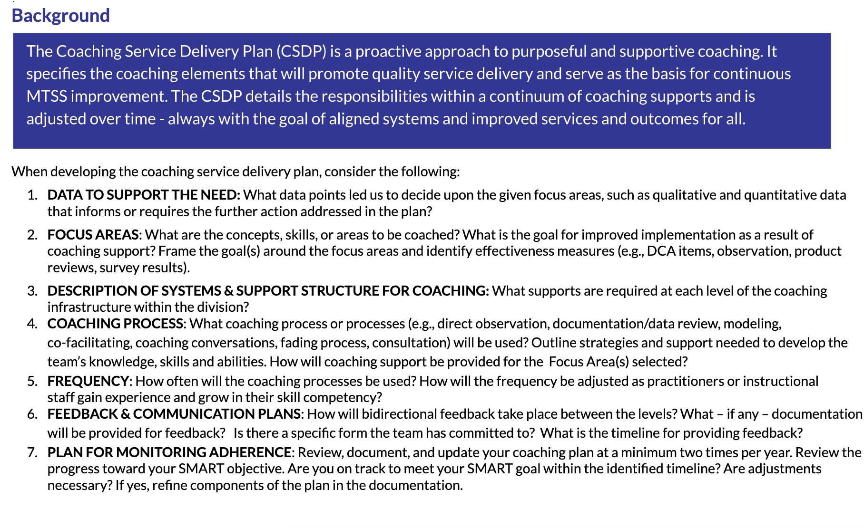
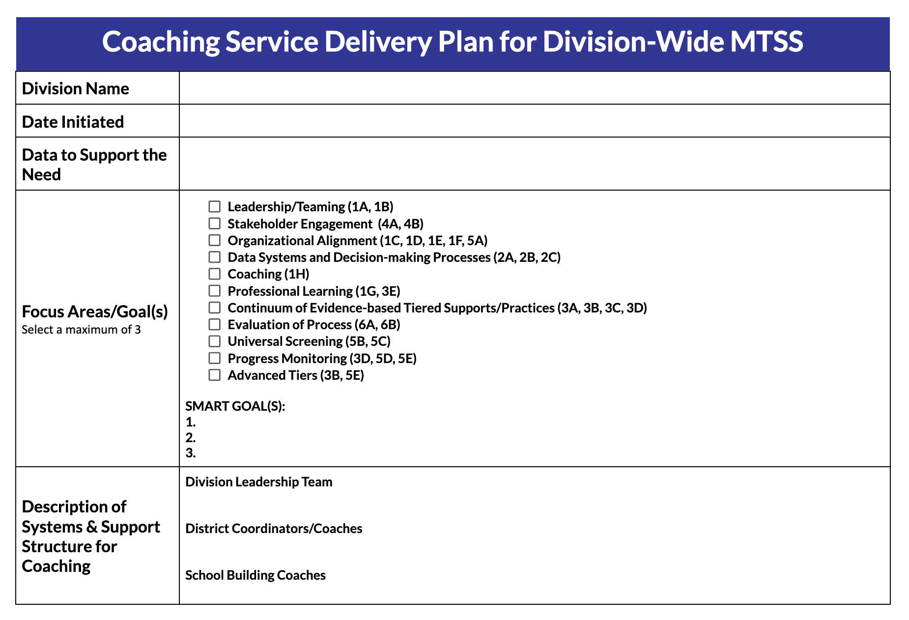
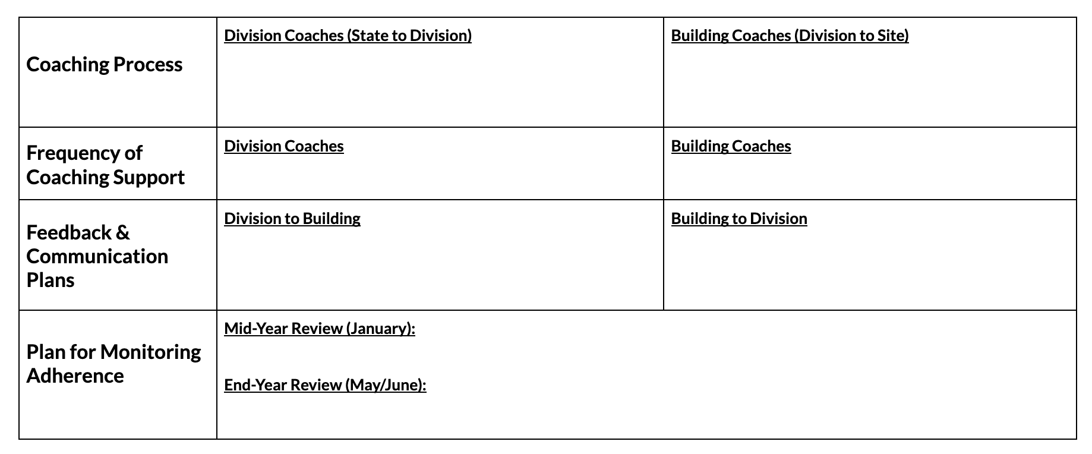
Coaching Service Delivery Plan Template

Slide 87
Break

Slide 88



a proactive approach, to purposeful and supportive coaching
The CSDP always has the goal of aligned systems, improved services, and outcomes for all.
specifies coaching elements that will promote quality service delivery and serve as the basis for continuous MTSS improvement
details the responsibilities within a continuum of coaching supports and is adjusted over time

Slide 89
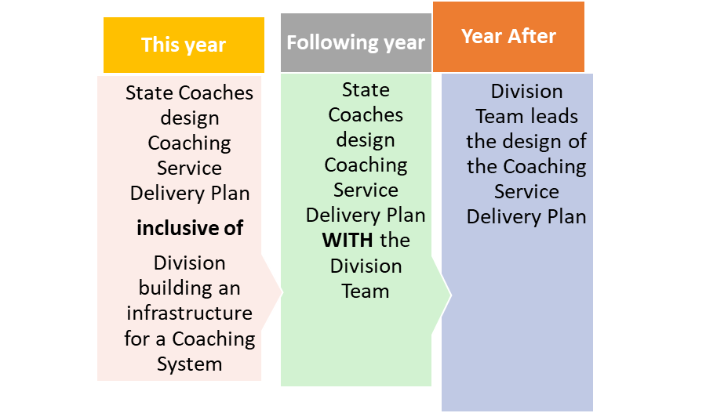
Timeline for Sustainability

Slide 90
Data to Support the Need
Plan for Monitoring Adherence
Focus Areas/ Goals
Components of the CSDP
Feedback & Communication
Systems & Support Structures
Frequency
Coaching Process

Slide 91
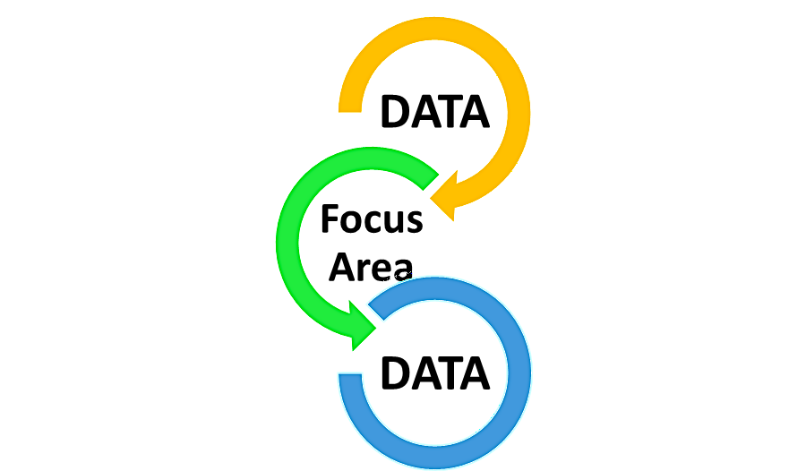
Data supports selection of the focus area
Stakeholder Engagement
Organizational Alignment
Data Systems and Decision-making Processes
Coaching
Professional Learning
Leadership/Teaming
Continuum of Evidence-based Tiered Supports/Practices
Evaluation of Process
Universal Screening
Progress Monitoring
Advanced Tiers

Slide 92
Data to Support the Need
What data sources will lead us to decide upon a given focus area?
Consider both quantitative and qualitative academic, mental, health and attendance
data.

Slide 93
Quantitative
Overall Scales:
  Organizational Leadership
  Competency
  Data System for Decision Making
DCA Scores
Drivers (subscales):
  Leadership
  Competency
    Fidelity
    Selection
    Training
    Coaching
  Organization
    Data Support Decision Making
    Facilitative Administration
    Systems Intervention

Slide 94
Questions should include (but not be limited to):
How often did the district leadership team meet last year?
Are tasks assigned and completed outside monthly meetings?
Does the DLT use a data informed decision-making process at each meeting?
Qualitative
Leadership/Teaming

Slide 95
Qualitative: Training
Questions may include:
Do we have a formal internal PD plan for strengthening staff skills that includes opportunities for practice and feedback?
How frequently have we provided PD for the division and/or school teams outside of VTSS state-wide PD?
Does someone from the division co-train (e.g., helping deliver the content) PD with school staff?
Does the division have an internal system for providing VTSS PD to on boarding schools outside of demonstration sites?

Slide 96
Qualitative: Coaching
Thoughtful Questions:
  Are there designated division coaches to support school implementation?
  To what extent, do you facilitate DLT meetings (e.g., lead DLT meeting, create the agenda, complete follow up tasks)?
  To what extent, do you you support school teams (e.g., attend monthly meetings, create the agenda)?
  Has the division transitioned from external state system coach support to internal local coaching capacity (i.e., consultation)?

Slide 97

Other Data to Support the Need
Key Question:
What focus area(s) will move your division forward in MTSS?
When reviewing data….
Enough to identify a focus area
NOT too much to get lost

Slide 98
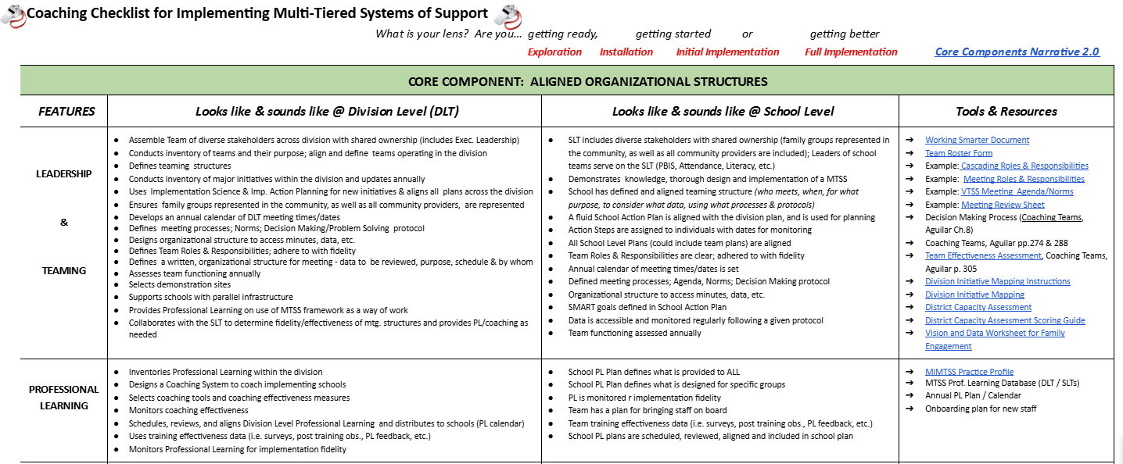
Coaching Checklist

Slide 99

Coaching Scenario

Slide 100

Breakout Room Time
Silently review and read the CSDP used in the scenario.
Select a spokesperson for sharing key points discussed.
Respond to the following questions:
What were your first impressions of how the plan could support your work as a systems coach?
Using the scenario, what were similarities to your division’s ongoing coaching supports to implement MTSS?
What data and focus area would you like to discuss with your VTSS Systems Coach?

Slide 101

True or False?
CSDPs are flexible.
CSDPs should be active documents.
CSDP should NOT be data driven.
CSDP are flexible as to the number of focus areas.
CSDP are to be developed by you beginning next week.

Slide 102
Practice
TIME

Slide 103
Summarizing Your Role
MTSS CONTENT KNOWLEDGE
COACHING KNOWLEDGE
& SKILLS

Slide 104
Summarize Your Role as a Systems Coach
What are you still curious about?
What are you feeling good about?
What are your questions around systems work?
What professional learning opportunities could we provide you to support implementation and systems work? Topics?

Slide 105

Congratulations!
This Photo by Unknown Author is licensed under CC BY-NC
You have hereby successfully completed the VTSS Systems Coaching Institute!

Slide 106

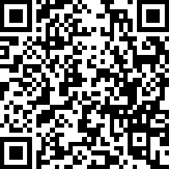
Provide Feedback
Link:
https://tinyurl.com/VTSSSCI-102

