Slide 1
WITH ALL STAKEHOLDERS
Increasing Mental Health Awareness

Slide 2
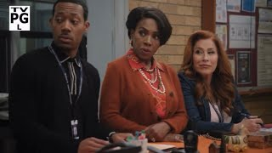
Abbott Elementary

Slide 3
What we will accomplish together.
Understand the need to increase awareness, acceptance, and understanding of mental health supports for all stakeholders/partners
Importance of self-care
Identify a quick win and short term goal for your division/school
Learn from each other

Slide 4
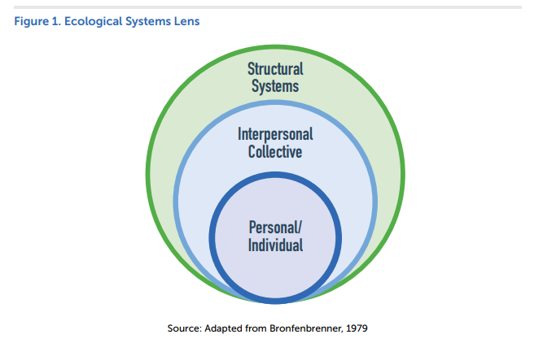
Ecological Systems

Slide 5
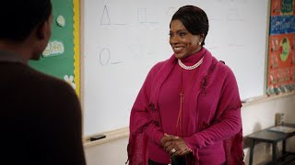
Abbott Elementary Continued

Slide 6
What is it Exactly?
“a state of well-being in which an individual realizes their own abilities, can cope with the normal stresses of life, can work productively and is able to make a contribution to her community”
Notes:
12 min.
Rhonda
According to the World Health Organization (2018) mental health is “a state of well-being in which an individual realizes their own abilities, can cope with the normal stresses of life, can work productively and is able to make a contribution to her community”.
WHAT STANDS OUT TO YOU IN THAT DEFINITION? WHAT’S MISSING?
We ALL have mental health- it’s a part of being human.
We are talking about mental health, not mental illness. Changing our language may shift the attitudes and perceptions. Mental health is something we all have an experience. It’s a continuum.
It’s like a river that ebbs and flows.

Slide 7
Mental Health
Psychological
well-being
Mental
Health
Emotional Well-being
Social Well-being
Physical Well-being
Image National Academy of Sports Medicine

Slide 8
What strategies do YOU use to achieve this?

Slide 9
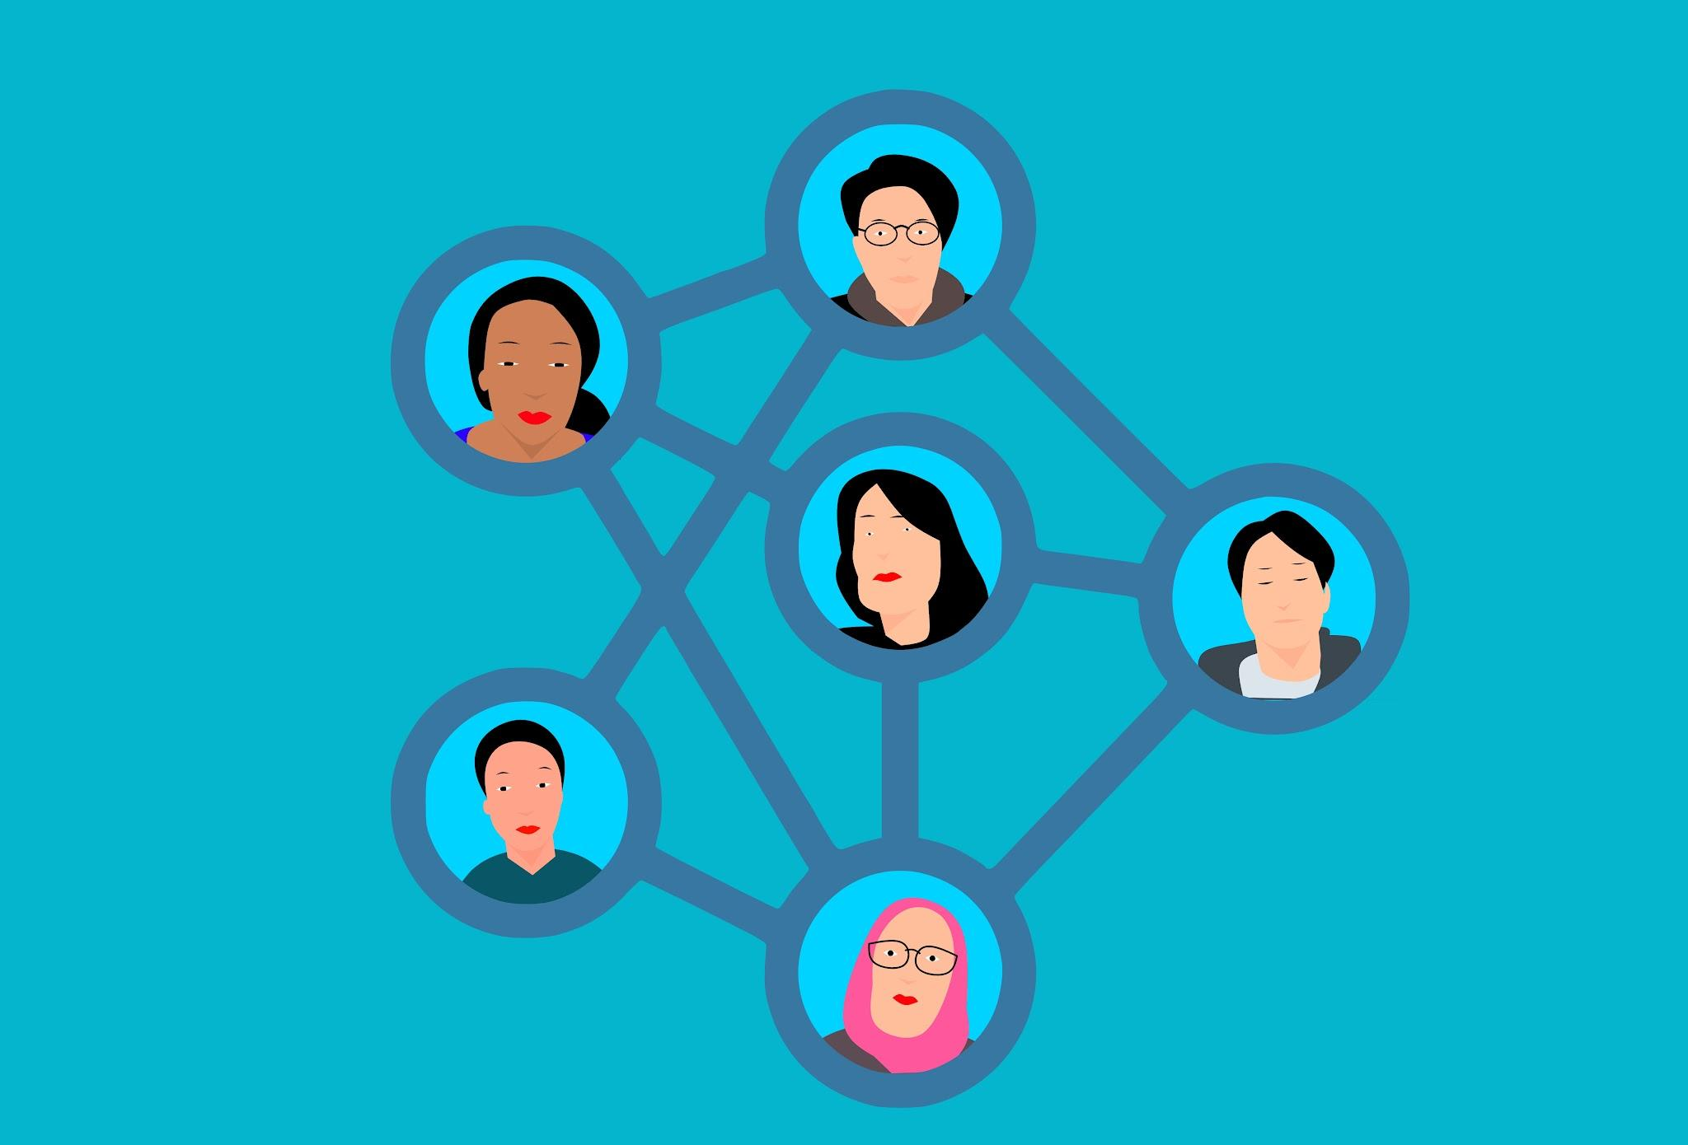
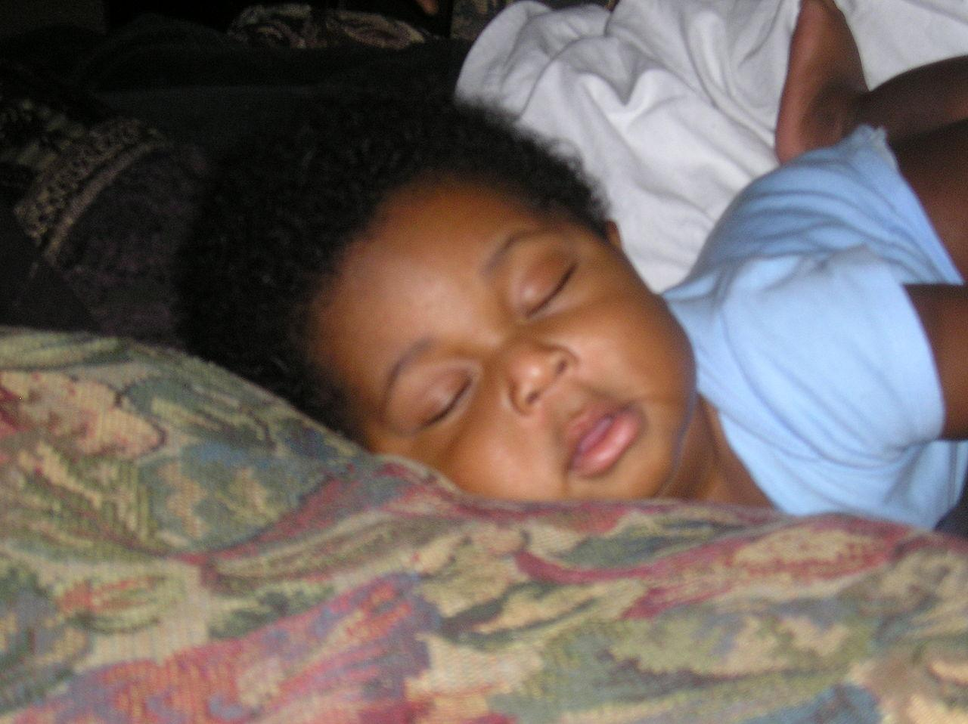
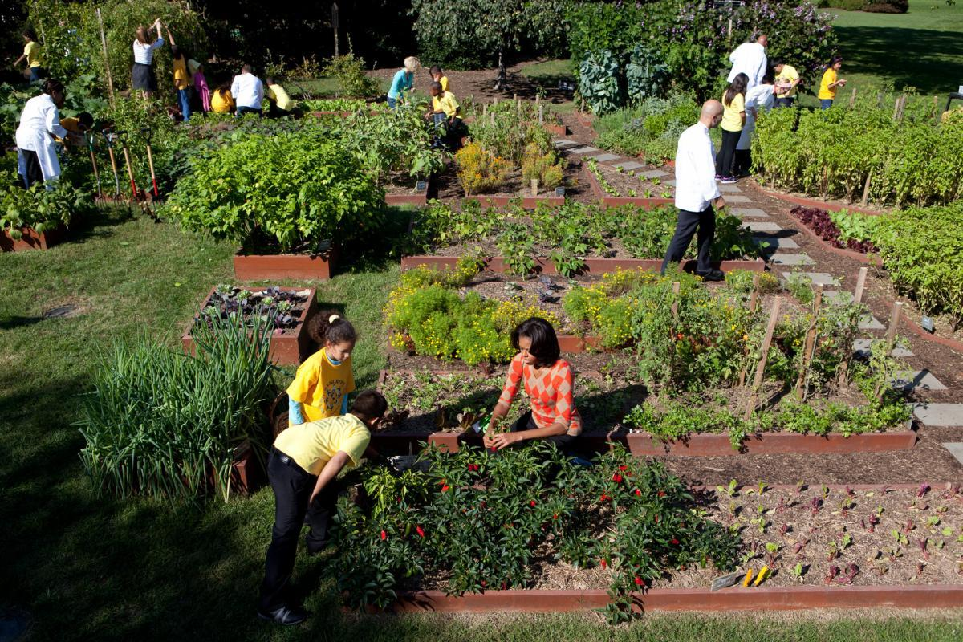
How can we reframe mental wellness?

Slide 10
Share

Slide 11
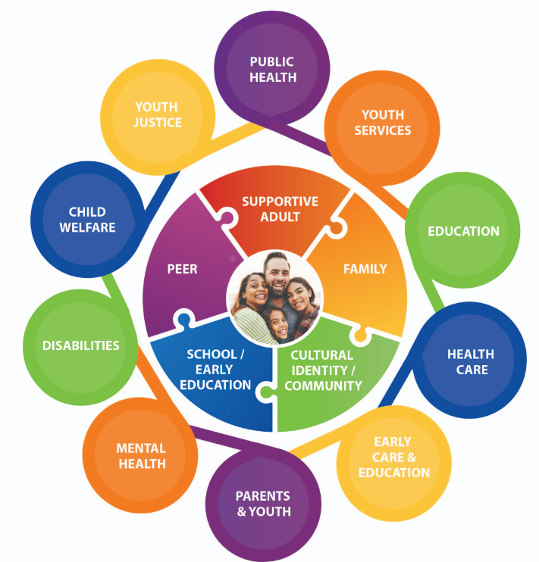
Stakeholders and Partners
Wisconsin Office of Children's Mental Health, https://children.wi.gov/Pages/AboutUs/Overview.aspx

Slide 12
Guiding Questions
What are you seeing in your schools and organizations?
What are the barriers to building time for content, reflection, space, into the school day?
Who’s voice are we missing?
How do we change the conversation and move toward increased awareness, acceptance, and understanding?
What’s one thing we should do to solve this challenge?

Slide 13
What now?
Quick Wins
Goals for 2024-25

Slide 14
Social Connection
“Social connection— the structure, function, and quality of our relationships with others—is a critical and underappreciated contributor to individual and population health, community safety, resilience, and prosperity.”
Social connection is a fundamental human need.

