Slide 1
Practices to Create a Culture of Wellness in the Classroom
Daria Lorio-Barsten, M.Ed., BCBA, LBA
Sharon Zuckerwar, M.Ed.

Slide 2
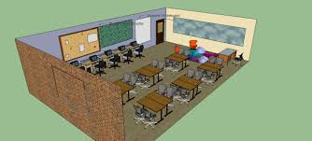
When you imagine your classroom…
What is your ideal vision of a safe, healthy, and effective learning environment?
What does it feel like, look like, sound like? What would a culture of wellness be like?

Slide 3

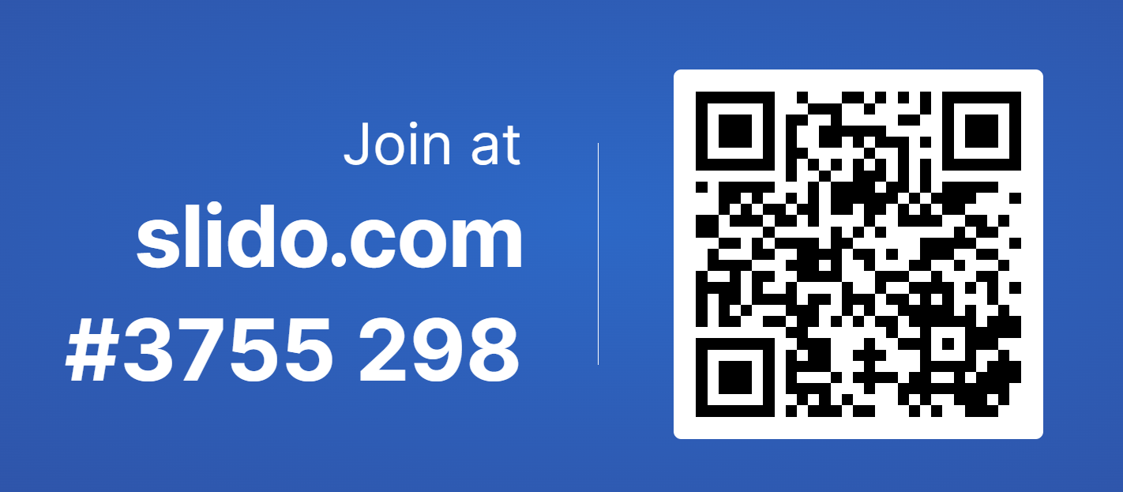
One Word Anchor
Choose one word to represent your vision for creating a culture of wellness in your classrooms and your schools.
Let’s use it as an anchor for this presentation.

Slide 4

Building relationships
Building relationships is an important foundation.
Each classroom has strong, positive classroom expectations. These are taught, reinforced, and consistently used in the classrooms.
Students understand our expectations and have skills to meet them.
Student voice and choice are used as much as possible.
We practice what we teach.

Slide 5
Let’s Start with Routines
Clearly thought out to work for you and your students/teachers, with clear steps
Need to be explicitly taught, retaught, and reinforced
Use visual supports in the environment to help teach and remind
Teach one at a time until you master the routine

Slide 6
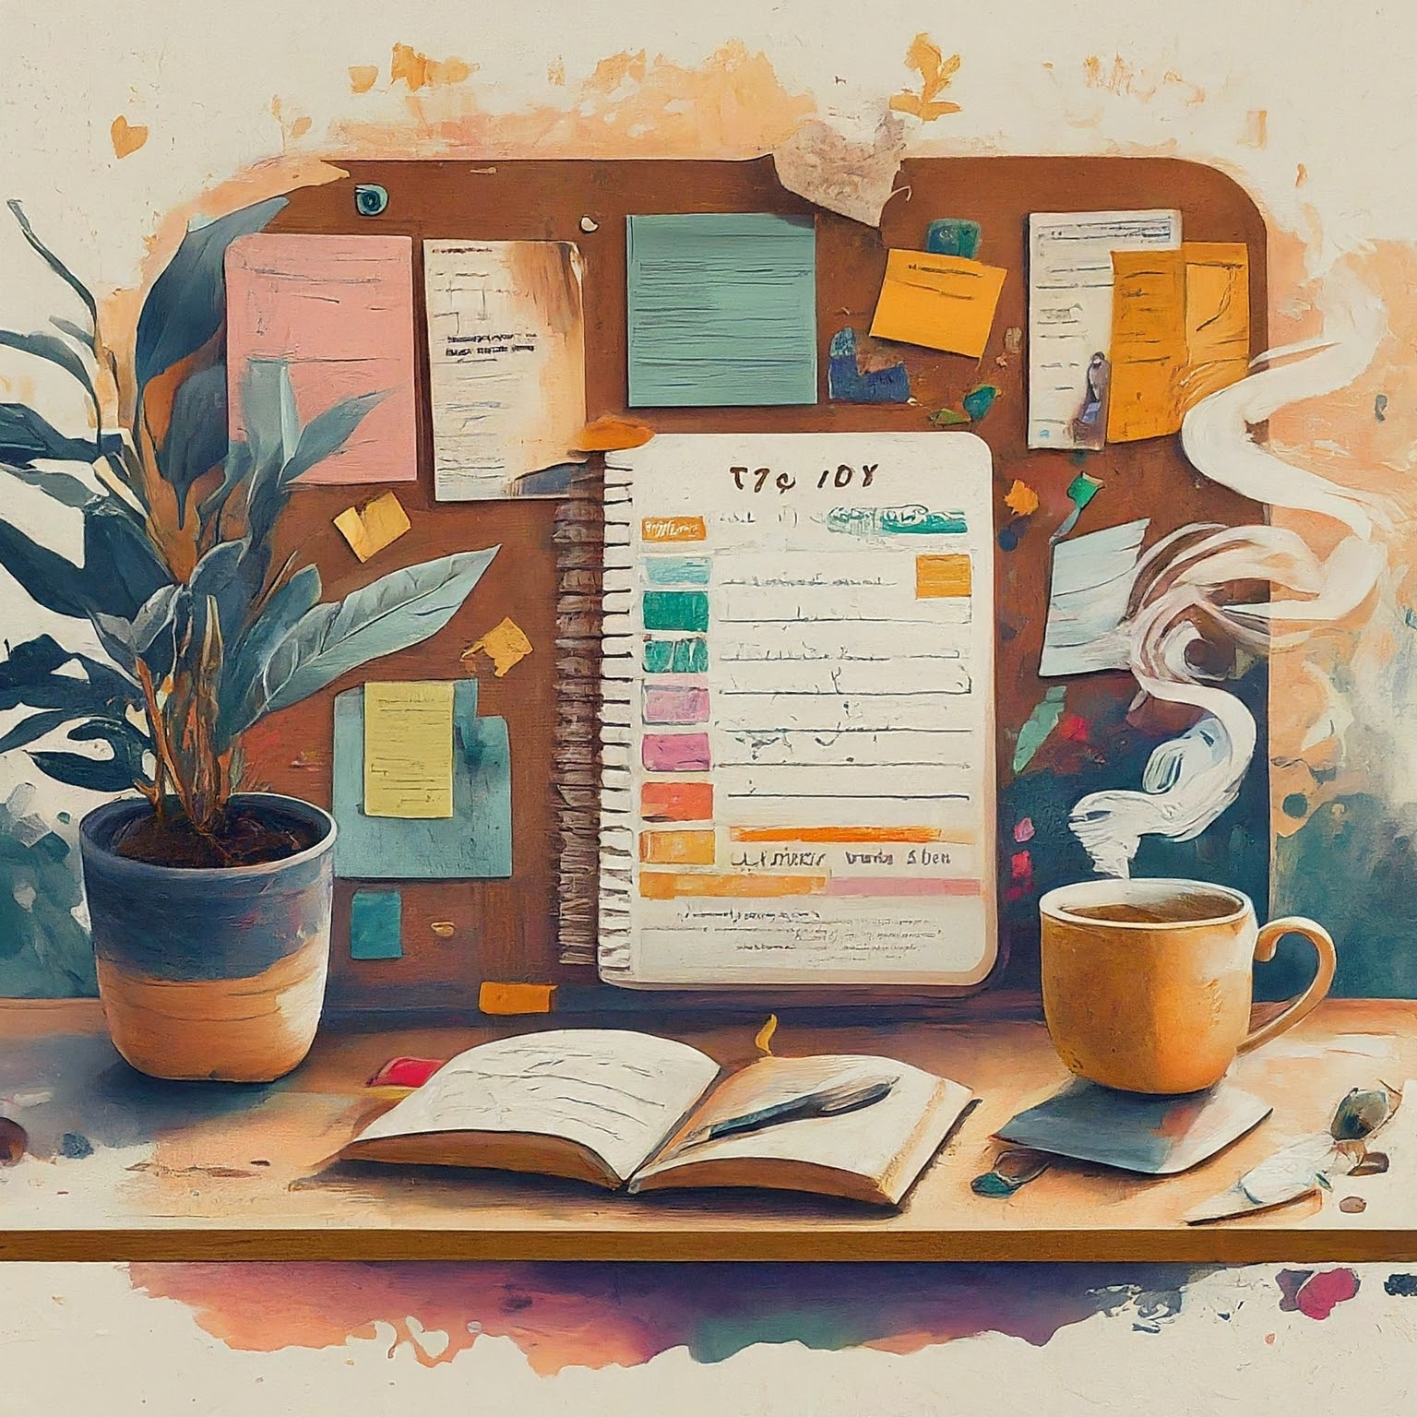
What do you already have?

Slide 7
Welcoming Routines
What’s New With You?
Morning Circles
Greetings
Back to Back
Superstar
Four Corners
Power of Kindness
Interactive Do Now

Slide 8
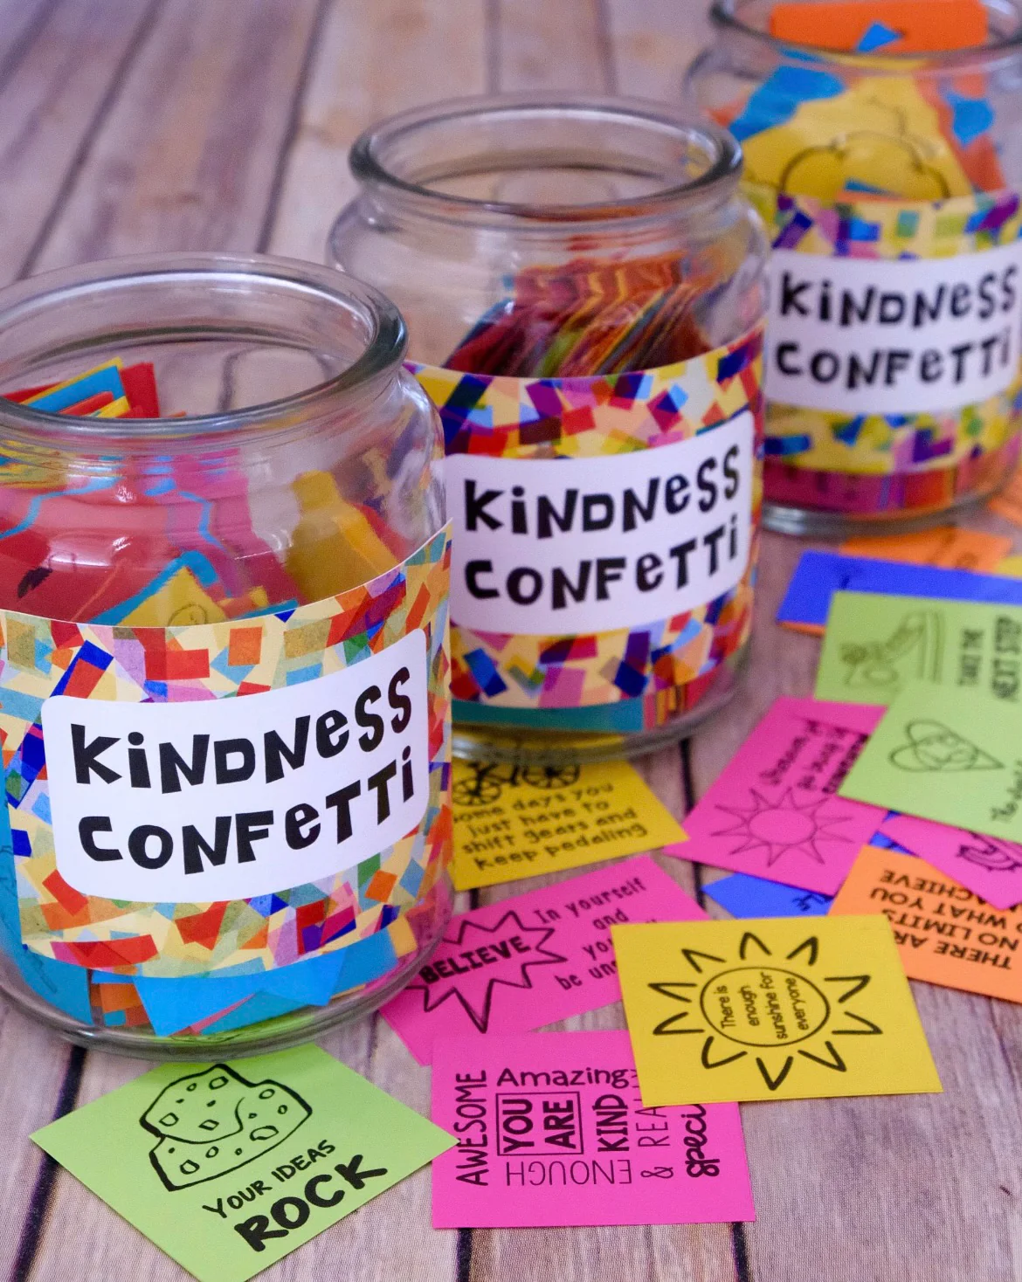
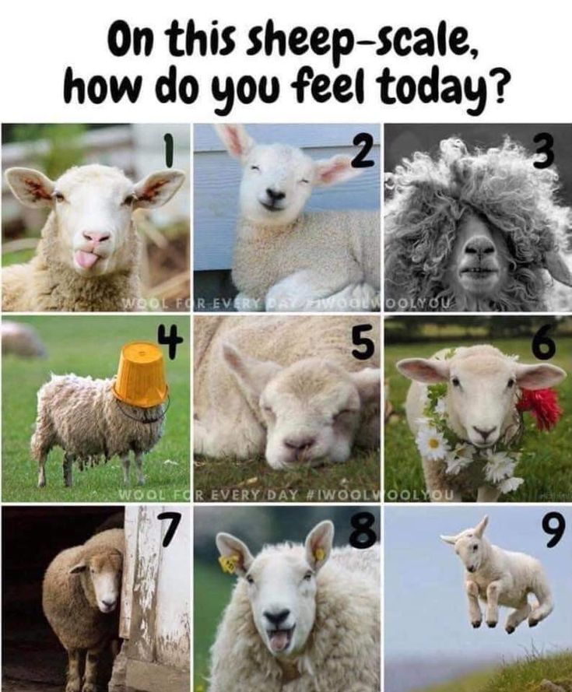
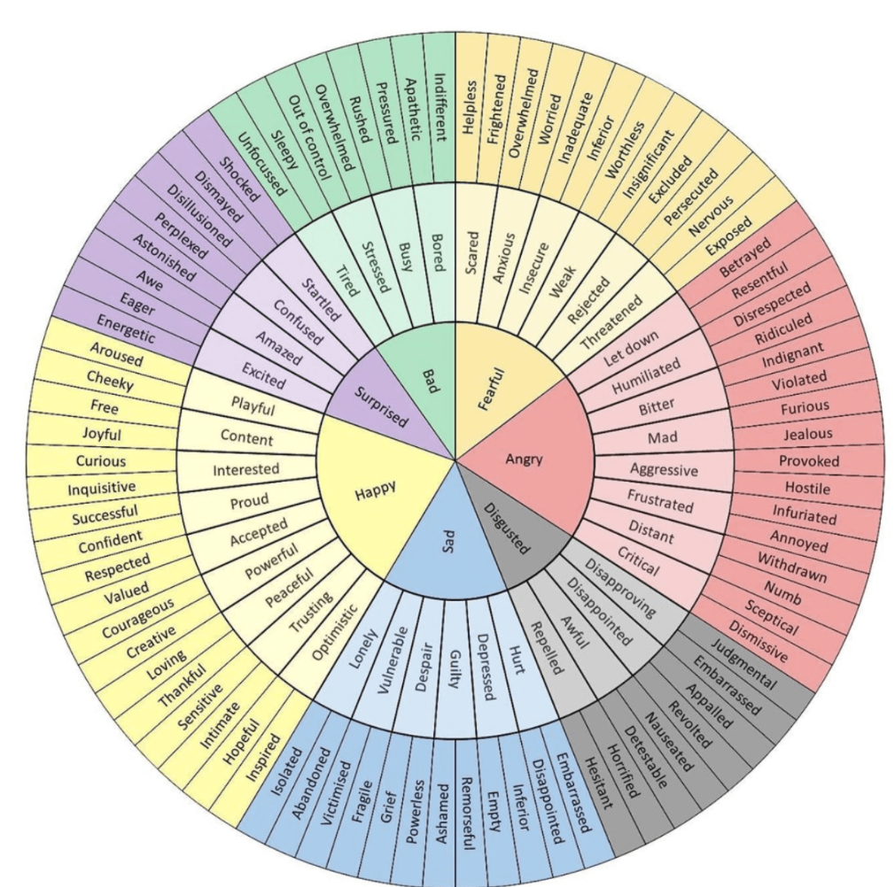
Intentionally build wellness breaks and activities into your daily schedule to refocus
Intentionally build wellness breaks and activities into your daily schedule to refocus

Slide 9

Engagement Routines
Clock Buddies
Think, Pair, Share
Numbered Heads Together
Pass It On
Group Problem Solving
Visual credit: Montgomery Schools MD

Slide 10
Wellness Engagement Routines
setting clear expectations (clear is kind)
allowing for choice and voice in assignments
teaching and practicing self-regulation and mindfulness skills (take 5, box breaths)
brain breaks and movement

Slide 11
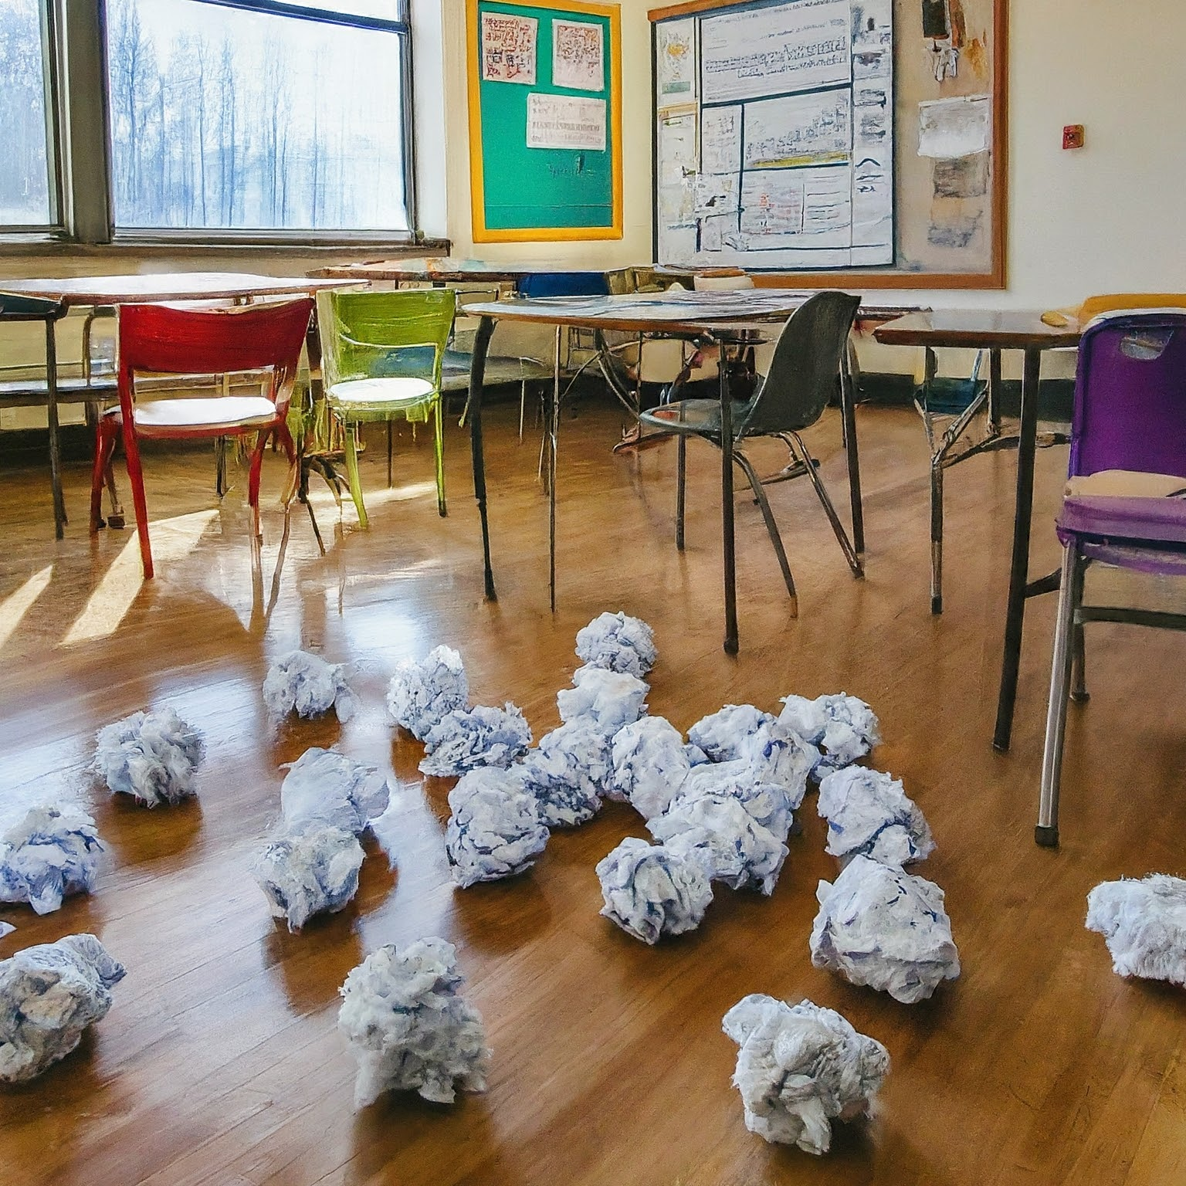
Optimistic Closure
I Am Curious
My Next Step
One Minute Accolade
Suit Yourself
One Word
Snowstorm
Two Dollar Summary

Slide 12
Wellness Closure Routines
Reflective Thinking prompts
  What are you most proud of from today’s lesson?
  How did you overcome any challenges?
  How did today’s lesson make you feel?
  What was one thing you learned from today’s lesson?
  What did you find most interesting?
  How did you help others during the lesson?

Slide 13
Think Deeper About All The Routines In Your Classroom and School
Think Deeper About All the Routines in Your Classroom and School
What about routines for re-establishing relationships?
How do we model wellness routines?
Which routines support the culture of wellness in our school community?

Slide 14
What about Schoolwide?
Start the day with a warm-welcome on the the morning announcements
Weekly check-ins with teachers
Tap In/Tap Out

Slide 15
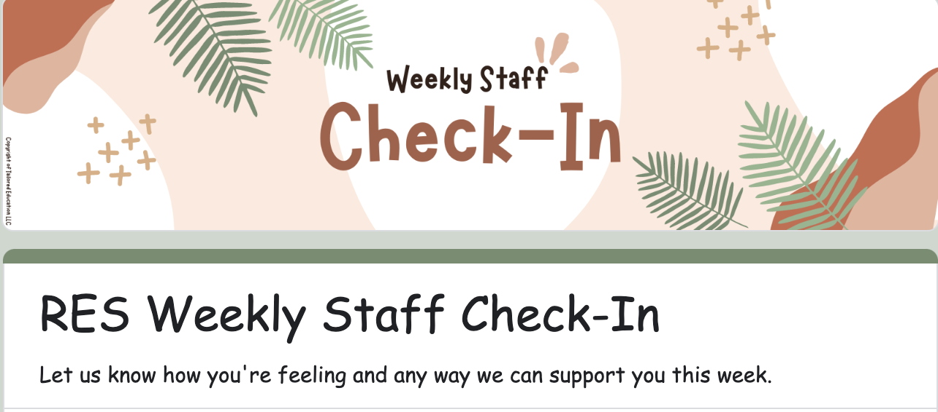
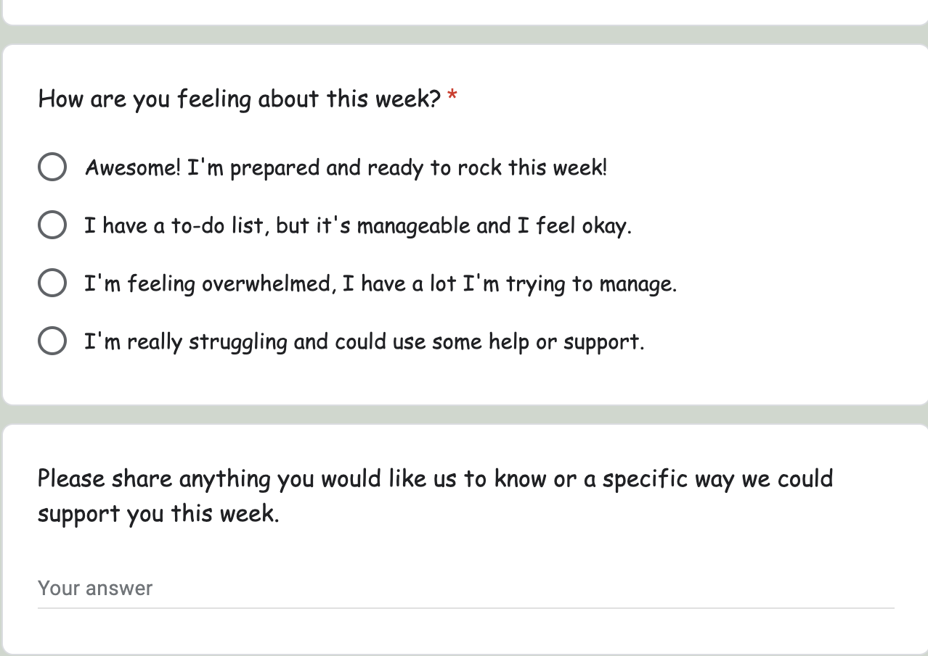
Weekly Staff Check In example

Slide 16

When things go sideways…

Slide 17
Restoration and Recovery
de-briefing *brief) discussion with the student (but not too early!)
de-briefing (brief) discussion with the classroom
Start fresh
Focus on solutions (not problems)
Separate the action from the person
For more information: https://iris.peabody.vanderbilt.edu/module/bi1-elem/cresource/q2/p09/

Slide 18
Keep. Donate. Toss.
What are you doing already that you want to keep doing?

Slide 19
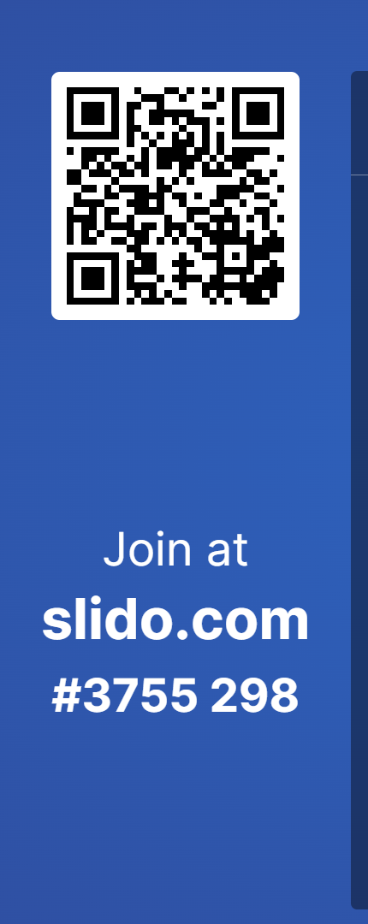
Keep. Donate. Toss.
What is a new idea that you want to donate to your colleagues?

Slide 20
Keep. Donate. Toss.
What is one idea that you want to toss and no longer use?
Why is this important to consider?

Slide 21
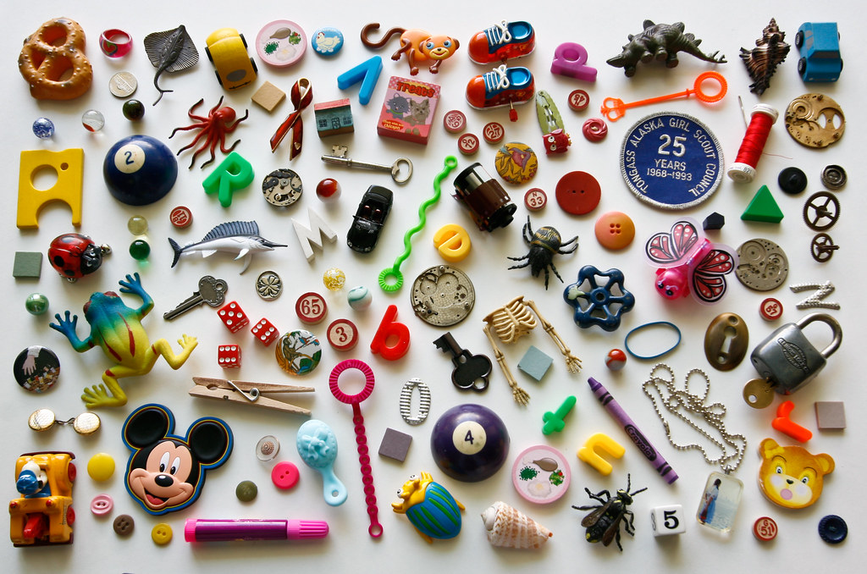
Ending summary

