Slide 1
Family & Community Partnerships
June 18, 2024

Slide 2
What we will accomplish together
Understand the components of family engagement with a mental wellness lens
Discuss a multi-tiered approach to supporting and partnering with families
Learn from each other
Identify one or more tier 1 strategies you can implement in your school/division

Slide 3
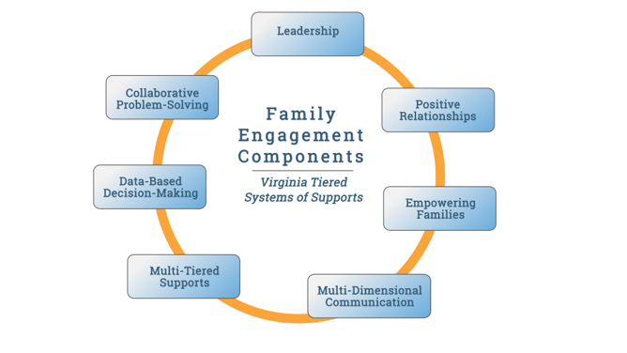
Components of Family Engagement in MTSS

Slide 4
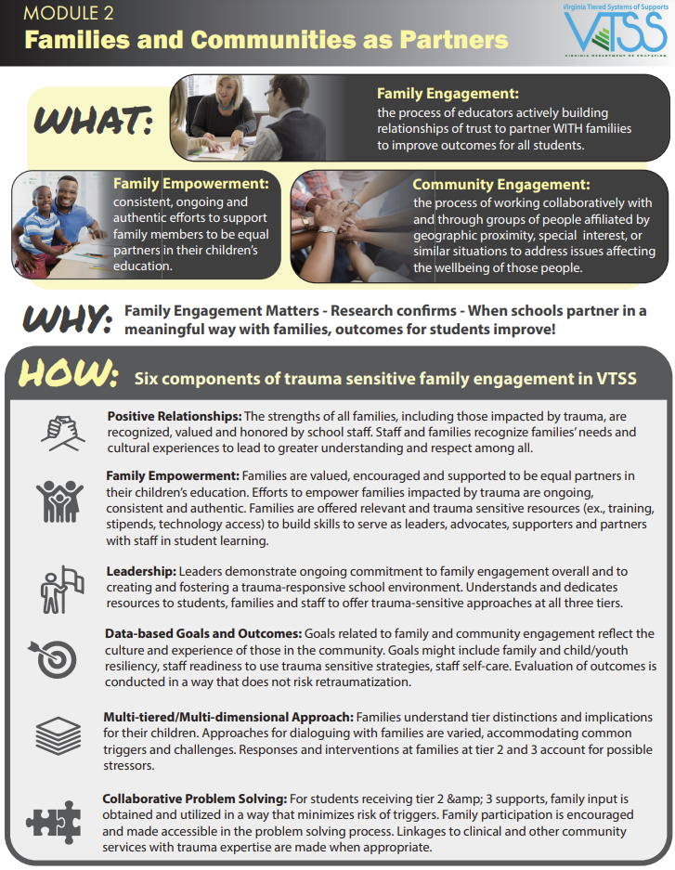
Components with mental wellness lens
Notes:
Share link in the chat to the trauma modules- https://vtss-ric.vcu.edu/trauma-learning-modules/
This graphic-
https://vtss-ric.vcu.edu/media/vtss-ric/documents/trauma-modules/Trauma-Module-2-Infographic.pdf

Slide 5
Shifting the Mindset
Data is the domain of school professionals.
Us vs. Them
Families don’t want to put in the time; school is their babysitter.
Teachers already know how to work with families.
90% of the problems with students are because of their families.
School staff as the experts.
We invite families to events at school and they don’t show.

Slide 6
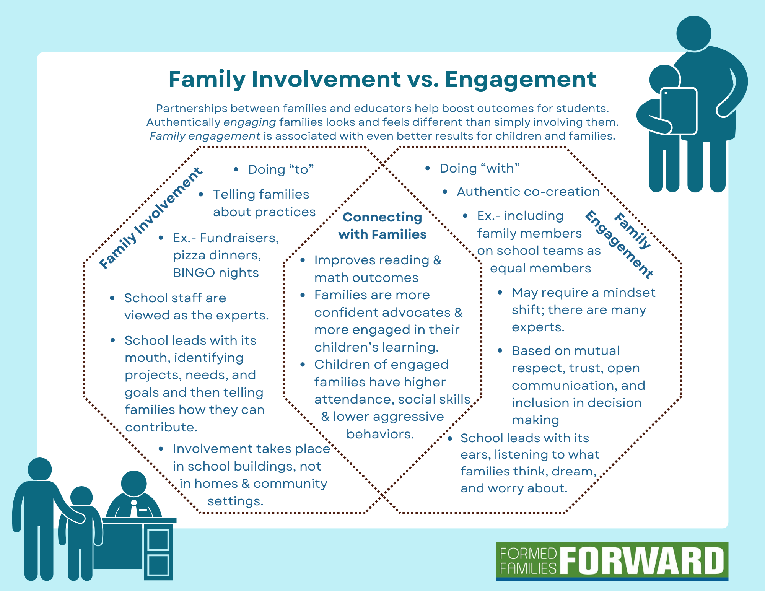
Family Involvement vs. Engagement

Slide 7
Foundations of Partnership
“Differing from positional trust, which is based on status or ranking, relational trust is built through daily interactions and exchanges that are authentic and reliant upon: listening and valuing one another, a willingness to go beyond our formally designated roles, and demonstrated consistency between what is said and done.” Herrera et al., p. 18

Slide 8
Foundations of Partnership
Equitable collaborations between families and schools fuel “...a justice-based educational change agenda can only be co-constructed by both professional educators and those with the greatest expertise on their own children, their learning priorities and needs, their languages and cultural practices, their histories and nondominant ways of knowing- that is, the families and communities of children themselves.” Ishimaru, 2020, p. 13
Simply put, authentic engagement relies more on “doing with” partnerships than us vs. them approaches where school experts are “doing to” families.

Slide 9
Activity Re: The Shift
Families are experts on their children.
Families are experts on their families’ cultures.
All families have capacity to support their children’s learning.
Families can change our assumptions and help us become better teachers.
Strong, authentic family engagement helps build educational equity.
Families can be our most powerful partners.
Cultivating and sustaining partnerships is a shared opportunity, with school staff and school leaders ultimately responsible.
(adapted from Henderson et al., 2007; Mapp, et. al, 2017; Weinzapfel, 2022)

Slide 10
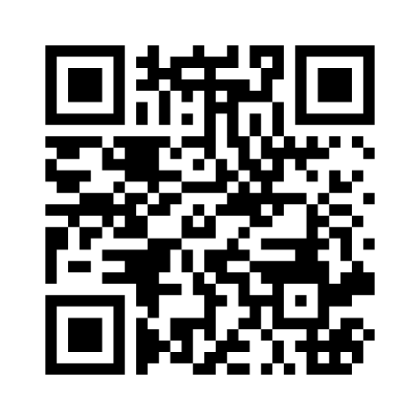
Survey
menti.com, then enter 6126 7645
Notes:
https://www.menti.com/alzjvz7yj1kd

Slide 11
Applying a Multi-Tiered Approach
Tier 1 - Universal / ALL
What universal supports can we plan for ALL families?
Tier 3- Intensive
What intensive supports can we plan for INDIVIDUAL families?
Responsive to Family and Student Needs
Aligns with & supports goals of children receiving Tier 3 support
Empowers families
Aligns with & supports the goals of children receiving Tier 2 support
Networking & leadership opportunities
Tier 2 - Targeted
What targeted supports can we plan for SOME groups of families?
Welcoming, inviting school culture
Families’ preferences are basis of communication methods
Positive relationships, awareness, and two-way communication
Notes:
NOTETAKER: https://formedfamiliesforward.org/wp-content/uploads/2024/05/fillable-multitiered-family-engagement-worksheet-MW-VTSS.pdf

Slide 12
Scenario
Billy is a new student with a history of absences at his previous school.
Parent reports significant challenges getting Billy to come to school.
Teacher reports Billy has been “fine” at school.
What reactive thinking could happen in the moment that could cause disengagement?
What proactive and supportive thinking would set this family up for successful engagement?

Slide 13
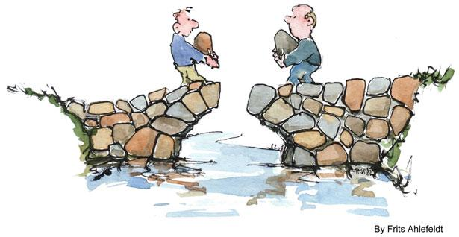
Bridging the Gap

Slide 14
Components of Family Engagement in MTSS

Slide 15
Tier 1 Strategies for ALL
from 7 Strategies for Supporting Student Mental Health via Family Engagement
Positive relationships
Begin with building caregiver trust, the foundation to partnership
Welcoming and inviting school culture
Multidimensional approaches
Two-way communication
Focus on each family’s strengths
Craft culturally responsive family engagement strategies

Slide 16
Tier 1 Strategies for ALL
from 7 Strategies for Supporting Student Mental Health via Family Engagement
Family empowerment
Emphasize self care and mental health for all adults
Prioritize key social emotional skills that boost mental health
Families preferences are basis of communication methods
Integrate protective factors into everything
Support meeting families’ basic needs that impact mental health

Slide 17
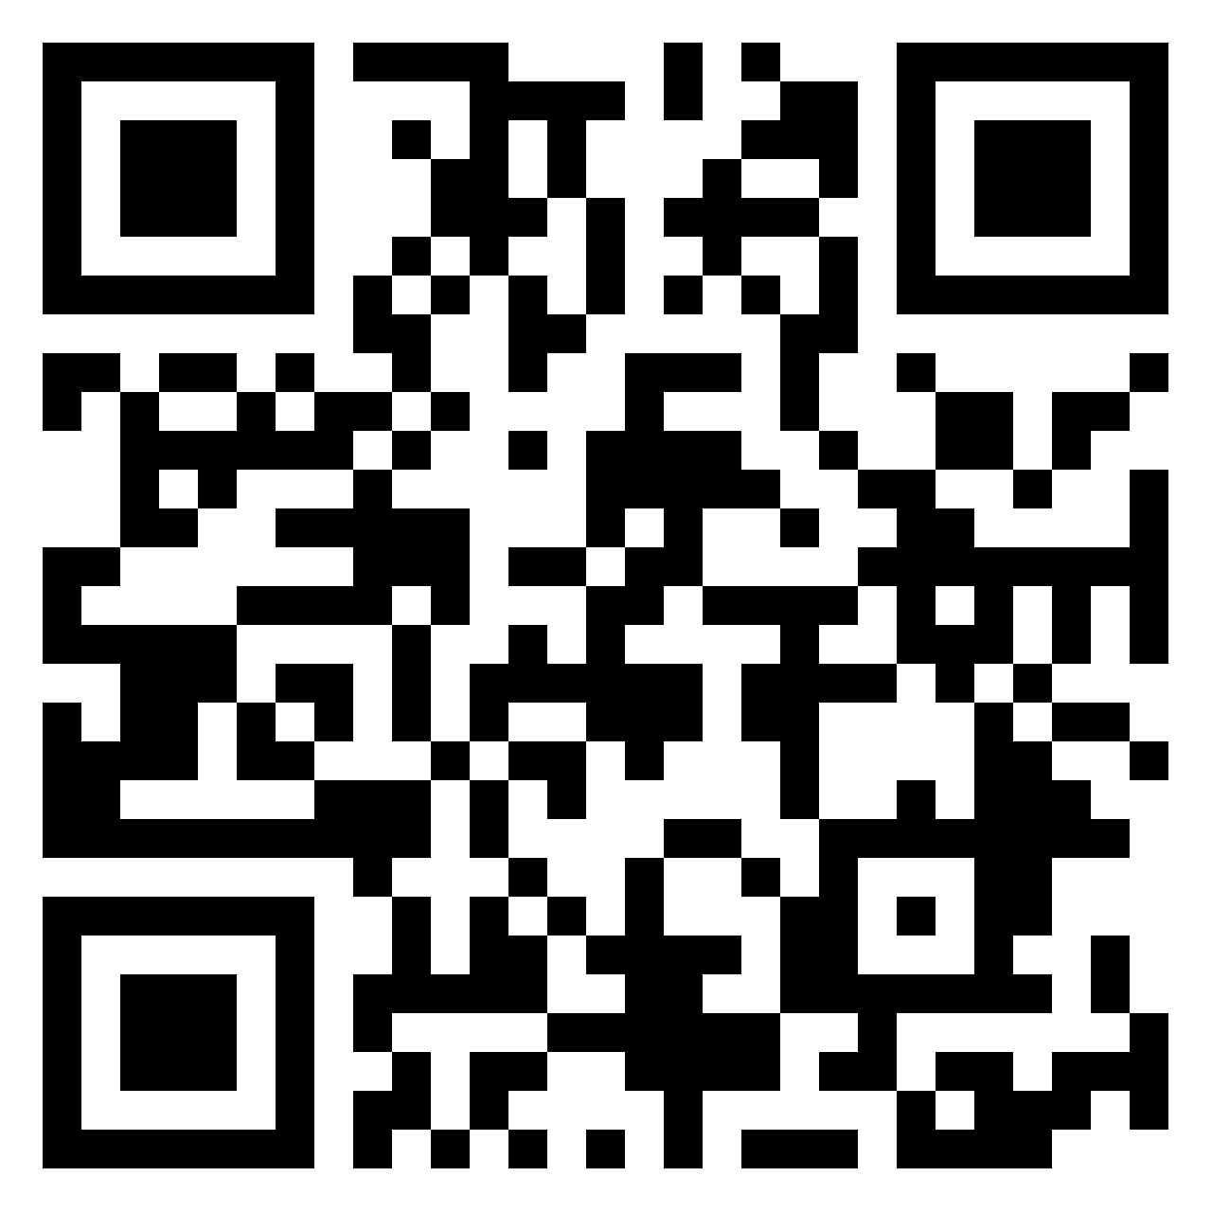
Tier 1 - Universal Strategies
LINK to Padlet
Notes:
https://padlet.com/tkwock1/family-and-community-partnerships-gk8bi5kaw8e1657c

Slide 18
What Now?
“Educators collaborate with families to co-construct programs, services, and activities that are focused on learning and development. Collaboration is an outgrowth of a shift in family and community engagement practice, a shift in which educators are not looking to transmit their own values and activities to the home, but rather are looking to build upon family knowledge as resources for learning. ... Research shows that when children and youth see their families, schools and community in authentic meaningful collaboration, it supports their learning and development, inspires motivation, cultivates critical thinking, strengthens cultural identifies, and creates safe spaces for each and every child (New America, 2020).” cited in Caspe & Hernandez, 2023

