Slide 1
Practices to Increase Teacher Retention
June 18, 2024
Stability in the teacher workforce is a factor associated with successful PK-12 schools. (Ronfeldt, Loeb, & Wyckoff, 2013)
Notes:
Emails of presenters: rathayersmith@vcu.edu or pbclark@ttacodu.org

Slide 2
Acknowledgement
Provide exemplary teaching and learning experiences.
Recruit, retain, and support our valued employees.
Provide a safe and supportive learning environment.
Engage, inform, and collaborate with the community to support our mission.

Slide 3
More Thanks
School-Based Mental Health 2 Grant (VDOE)
Focused on the recruitment and retention of school-based mental health providers: counselors, psychologists, social workers
Participating Divisions: Amelia, Fredericksburg, New Kent, Portsmouth, Prince George, Roanoke, Salem, Scott

Slide 4
Practices to Increase
Employee Retention
Learning Intentions:
to utilize the implementation logic to develop and implement a tiered system of support for all employees
to increase knowledge around practices that increase employee retention

Slide 5
Community Agreements
Be Responsible | Take care of your needs Share questions with the group
Be Respectful | Listen to others attentively Please silence cell phones
Be Engaged | Participate in activities/discussions Leave video on as much as possible Share your expertise, information and ideas

Slide 6
Inclusive Opener
Why do you stay?
ONE or TWO words

Slide 7
Idea Share
Why do you think educators are leaving?
Individually, write down the top 2 or 3 reasons you think teachers are leaving the field

Slide 8
POLL
Administrative support
Atmosphere
Salary
Student behavior
Material
Personal issues
Facilities
Student skill
Student background
“How to Retain Special Education Teachers” Principal, November/December 2008,
National Association of Elementary Principals

Slide 9
Investing in Retaining Teachers NOW-TODAY
THERE IS AN URGENCY
Investing in teachers, and providing tiered SYSTEMS of supports to teachers, to schools, to principals will assist in retaining our best teachers and keeping others from retiring early!
If you can predict it, you can prevent it

Slide 10
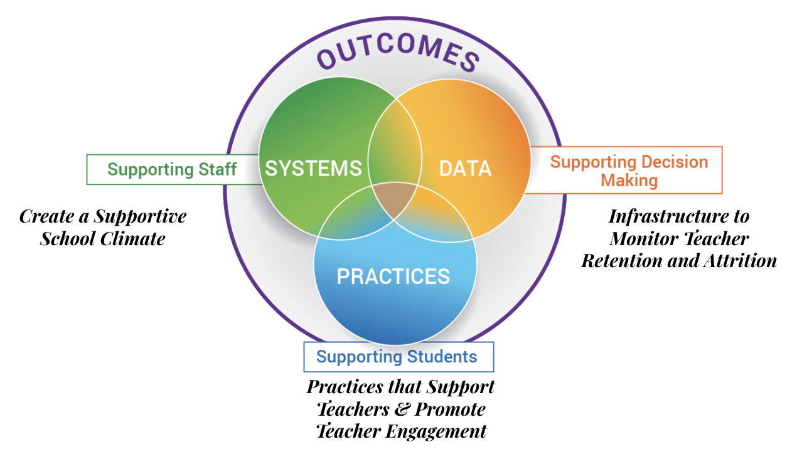
MTSS Implementation Logic
Teacher Retention

Slide 11
Decide what Data to collect
Data
Data Sources (Examples)
Process
Gather HR Data
Collect Feedback data
Surveys
Qualitative Data
Climate Data
What other data sources would match your context?
Design and maintain a Data Dashboard
Set Goals & progress monitoring schedule
Use a Data Informed Decision Making process consistently
Identify and address Barriers

Slide 12
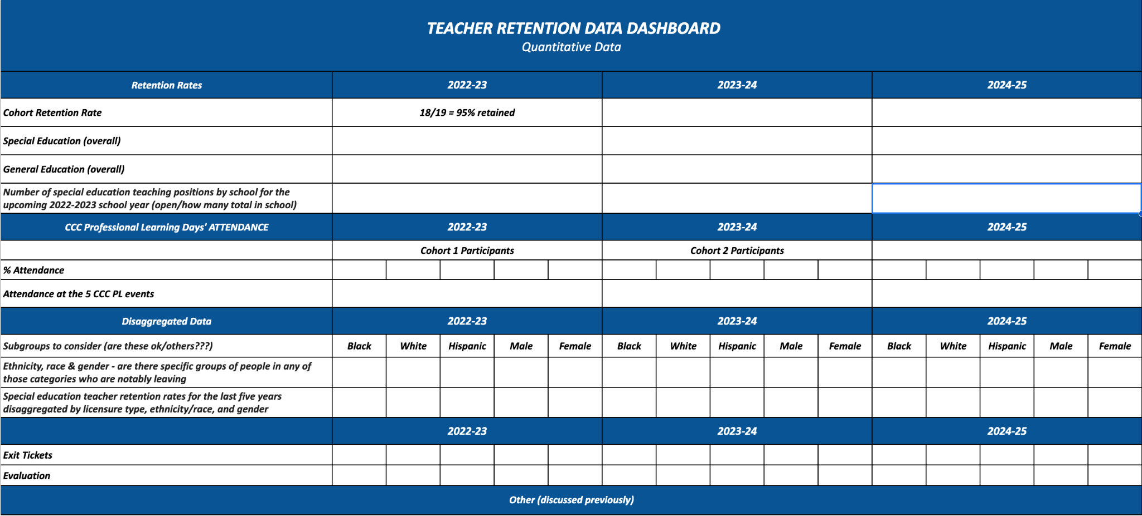
Respond to the Data

Slide 13
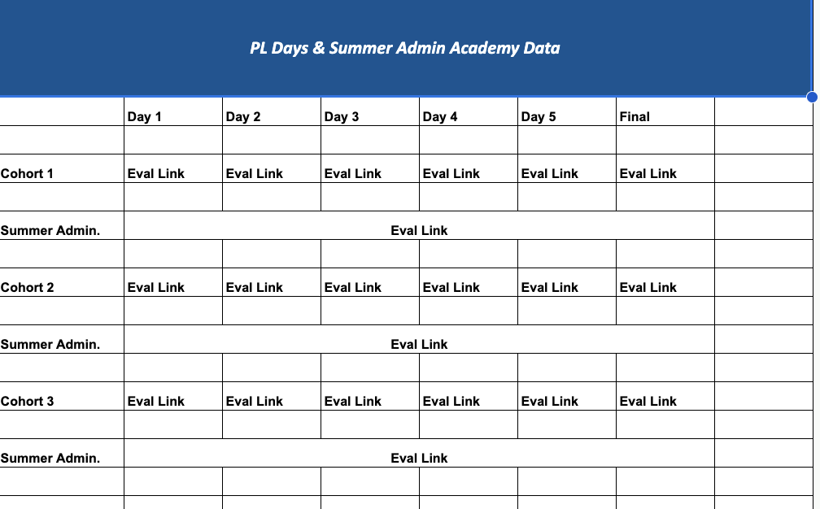
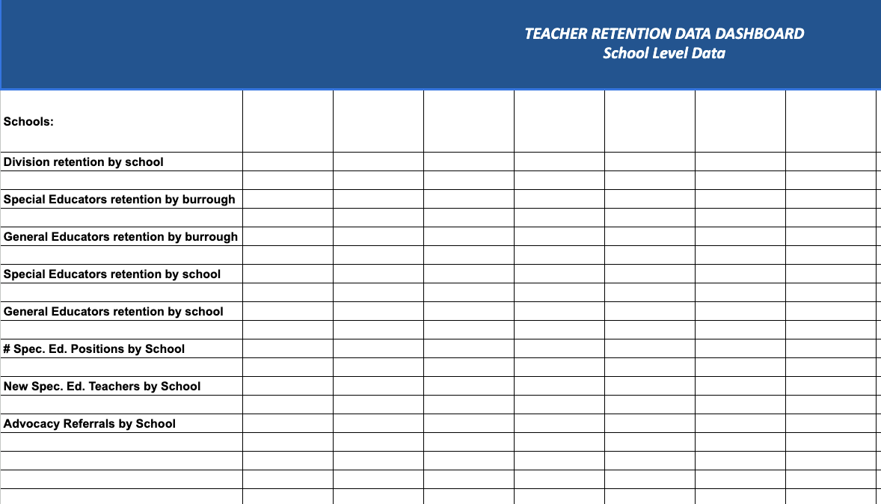
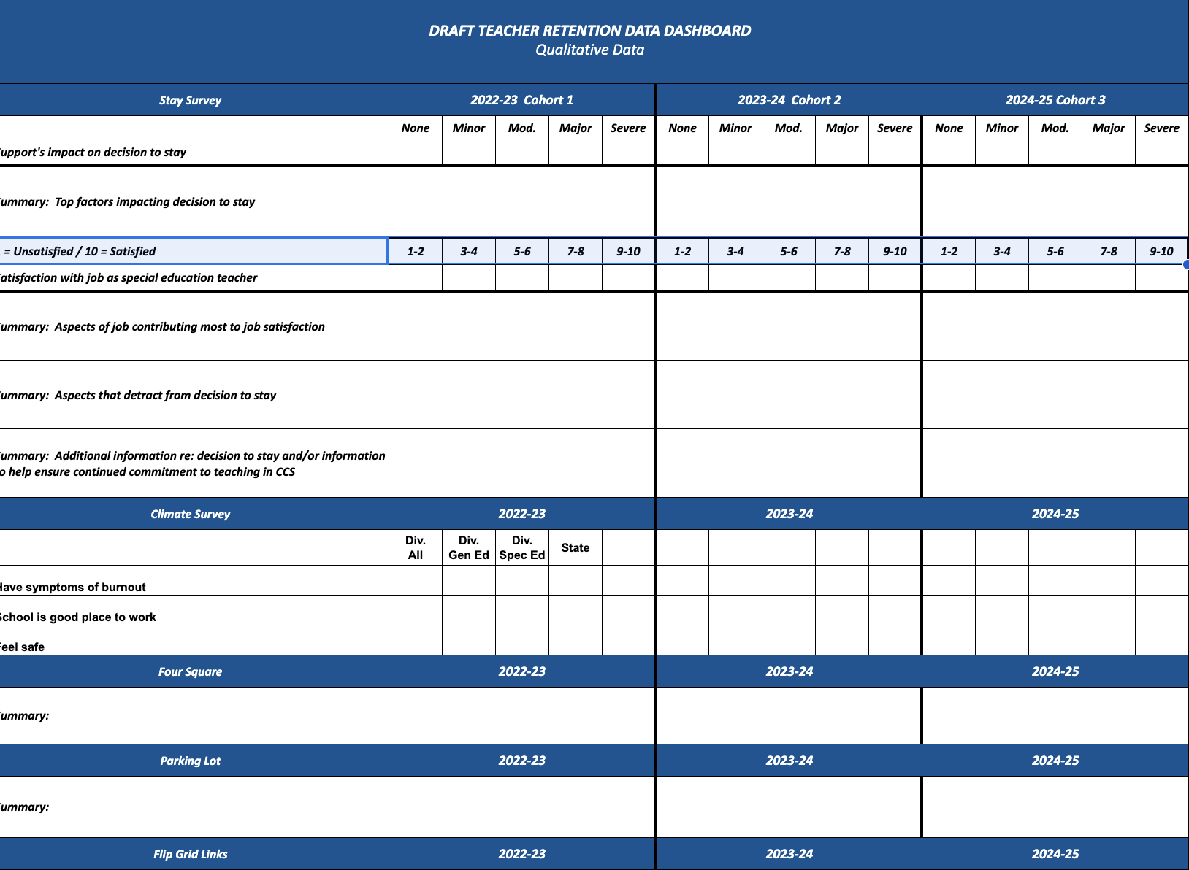
Define Barriers Precisely with DATA

Slide 14
Practices
Resource Map - Tier Supports for Staff
Ensure support roles & responsibilities are clearly defined
Provide Teacher Voice & Choice in Professional Learning
Build administrative knowledge
provide support
provide meaningful feedback
create safe, supportive learning climates
design master schedules
Attend to Staff Wellness
Honor time
Demonstrate appreciation
PRACTICES

Slide 15
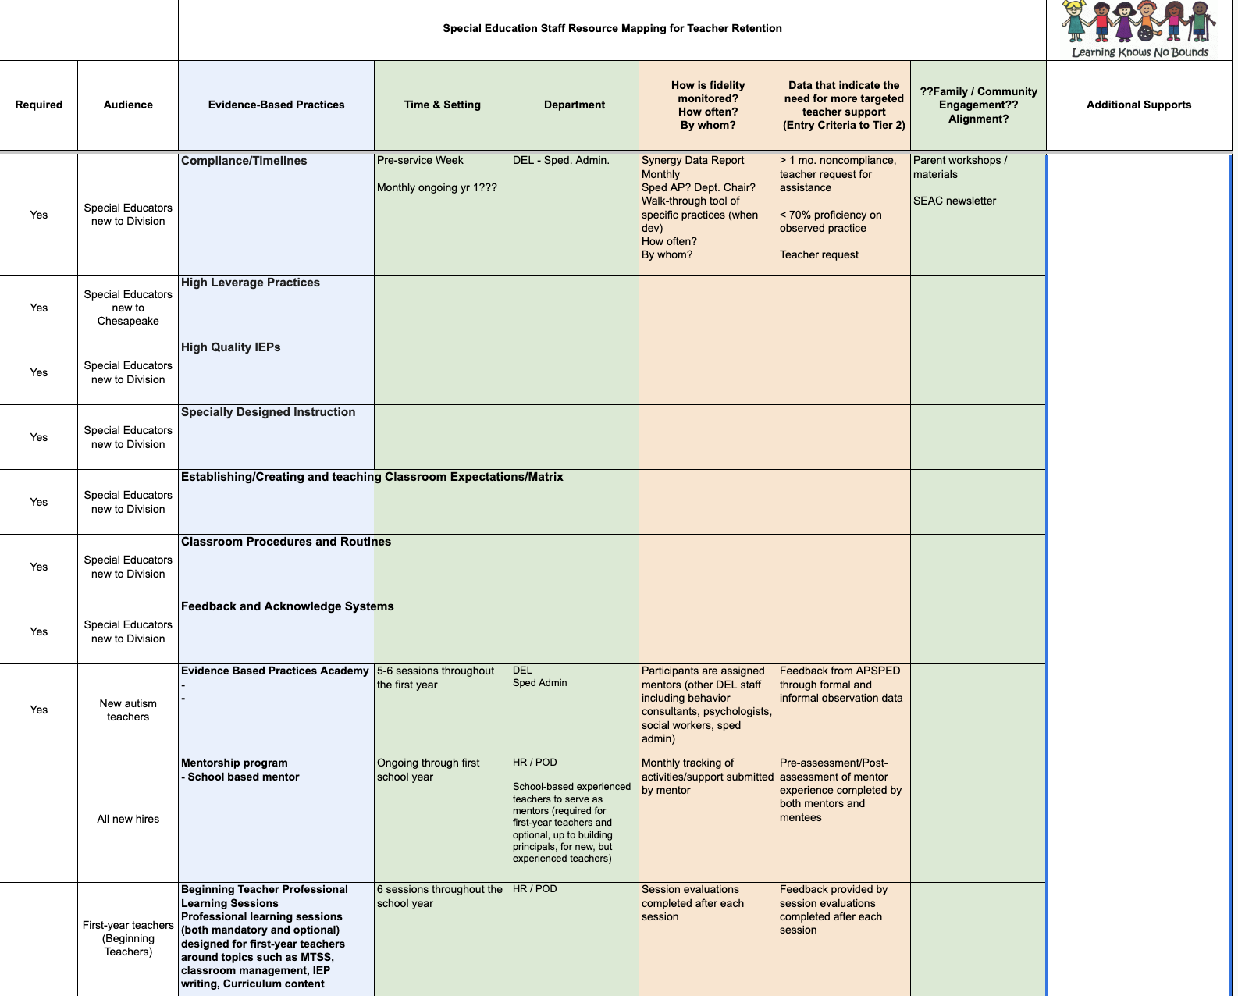
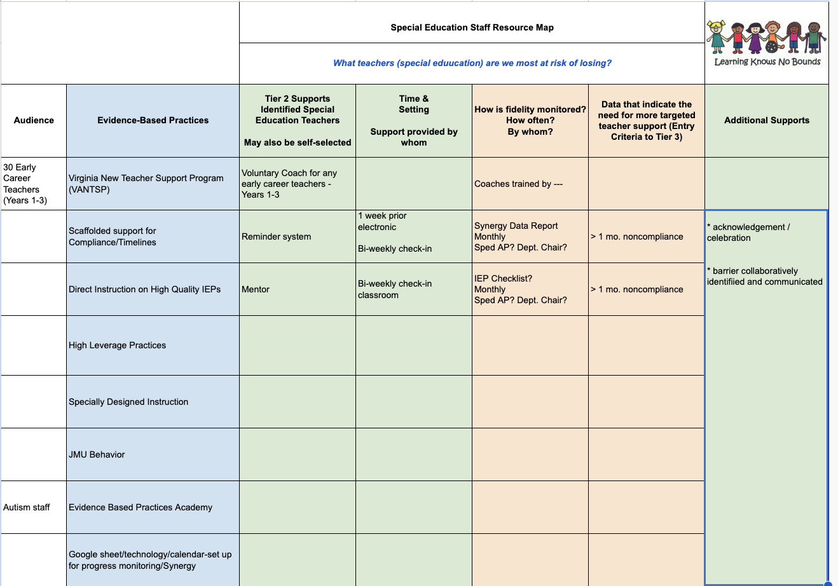
Resource Map
Tier 1 supports
Tier 2 supports

Slide 16
Supporting ALL
Teachers, Admin, Staff
Intensive
5%
Targeted
10-15%
Universal
75-80%

Slide 17
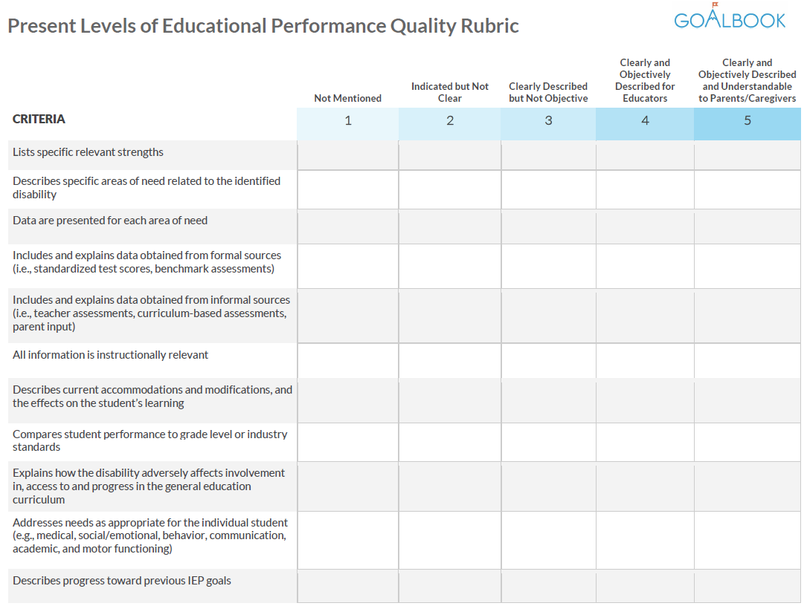
CCC Grant: What
5 Days of Professional Learning
Writing SMART Goals
High Quality IEPs
comprehensive PLAAFP
thorough PWN
SMART Goals
Services for SDI
EBPs
&
HLPs
Personal Wellness
Time Management
Calendar tools
Data collection tools
vs. Modifications
SDI
vs. accommodations
Writing a high quality PLAAFP & Prior Written Notice

Slide 18
Leadership Matters
Administrative Academy
Support teacher wellbeing
Promote teacher engagement
Create a supportive school climate
Monitor teacher retention and attrition

Slide 19
Systems = People
In your organization - teachers, administrators, parents, students, community members
SYSTEMS
Point to Ponder! Who in your organization touches teachers first?
TEAMING: Who on your team
has the most impact on teacher retention?
knows the most about PD scheduling?
will provide the communication loops?
DOCUMENTATION OF PROCESS
collects teacher performance data?
has the authority to move resources?

Slide 20
Same Logic- Different Supports
for
Mental Health Providers
Examples of Logic
Examples of Supports
Data Informed Decision Making with relevant data sets/dashboard
Defined Tiered Supports (Resource Mapping)
Practices to promote a safe, inclusive work environment
Administrative Support
Professional Learning
Teaming
Communication Plan
Stipends for professional organizations
Scheduled time for inclusion in school meetings
Re-allocation of duties to provide direct access to students
Training and coaching for SEL supports

Slide 21
Commitment to ACTION:
What WILL you do?
Waterfall
Chat
Please type your response
into the chat, but please
DO NOT hit return
until requested

Slide 22
Optimistic Closure!
We’re hopeful!
93% of Cohort 1 returned this year
Things look promising for Cohort 2
What are YOU hopeful about?

