Slide 1
How to maximize and share the load across our roles.
June 18, 2024
2:00 - 2:40

Slide 2

What do you hope to get from
this session today?
What do you hope to get from
this session today?

Slide 3
Session Purpose
What | How | Why
To effectively leverage the support provided by school mental health providers to enhance a culture of wellness in your division/school. | By gaining insight into how to foster a community of collaboration to make use of the expertise, resources, and professional learning across school mental health providers to support student wellbeing. | This provides an holistic student approach, reduces stigma, creates a positive learning environment, promotes resilience, and long-term mental health benefits. By addressing mental health issues early and effectively, we help students develop the skills and resources they need to succeed academically, thrive in their personal lives, and contribute to society.

Slide 4

Karla Allen Introduction
Hanover County Public Schools
June 18, 2024
Karla Allen - Coordinator of Counseling Services

Slide 5
Overview
The Go Green Project
The Universal Screener
Tiered Interventions of Support for Mental Health
  Classroom Lessons Tier 1
  Small groups, calming rooms, calming spaces- Tier 2
  School based mental health clinicians- Tier 3

Slide 6

The Go
Green Project
2023-2024

Slide 7

How did we decide on this project?
How did we decide on this project?
Strategy Planning- how do we track data on our relationships with students?
What’s Best for Students- 80/20
How do we know what we don’t know
Research shows that relationships are the most important indicator of student success

Slide 8
Process:
Include all of your students on a spreadsheet.
Indicate level of relationship with red, yellow or green
Subjective Criteria
Determine your own method of criteria and time frame.
Set goals to reach 100% by their transition time.
Do self-checks (yearbook photos, walking down the hall, pop ins)

Slide 9

School Counselor Project
Student: | Notes: | Green:
**** | Plays rugby, family illness
**** | Struggles w/anxiety, sees therapist
**** | Quiet, strong academic student
**** | Moved from NYC, loves the beach
**** | School anxiety, Nats fan
**** | New student
**** | Loves the outdoors, fishing

Slide 10
Tiered Interventions
Goal: All students will feel seen and heard
Tier 1
Classroom Lessons- K- 12 lessons designed to address needs from the Universal Screener
Tier 2
Small groups, Affinity Circles, Calming Rooms, Calming Spaces, Therapy Dogs
Tier 3
School Based Mental Health Clinicians

Slide 11
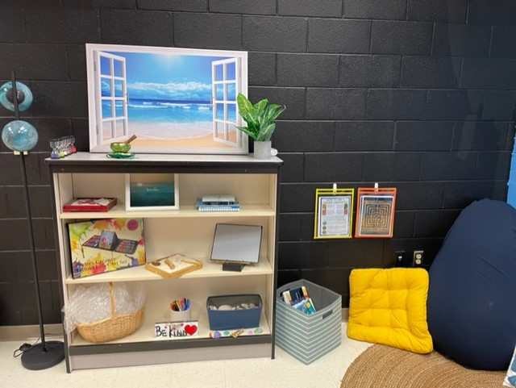
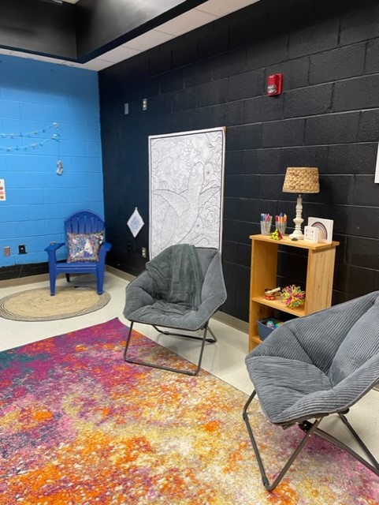
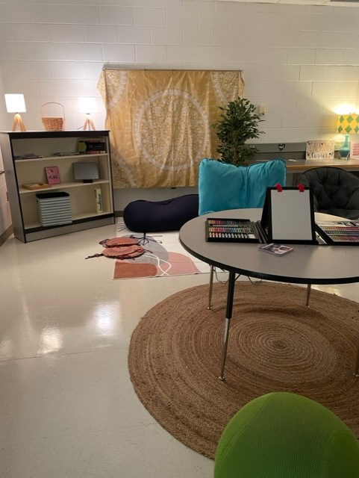
Calming Spaces

Slide 12
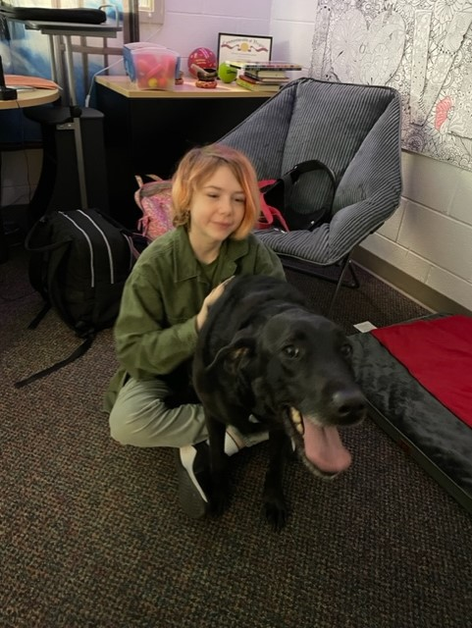

Therapy Dogs

Slide 13
Chesterfield County Public Schools
June 18, 2024
Dr. Tynisha Giles- Coordinator of School Social Work Service
Laura Early - Coordinator of Psychological Services
Audra Lancaster Boyce - Coordinator of School Counseling Services

Slide 14

Social Emotional Learning
Equity and Inclusion
Early Intervention
Prevention
Mental Health
Wellness
Community Connection and Resources
Positive School Climate

Slide 15
ESL
School Counseling
School Psychology
Special Education
Community Partners
School Improvement
Mental
Health
Support
Specialists
School
Social
Work
Mental Health Agencies
School Leadership
Chesterfield Police
Diversity, Equity, & Inclusion
Health Services
CCPS FACE

Slide 16
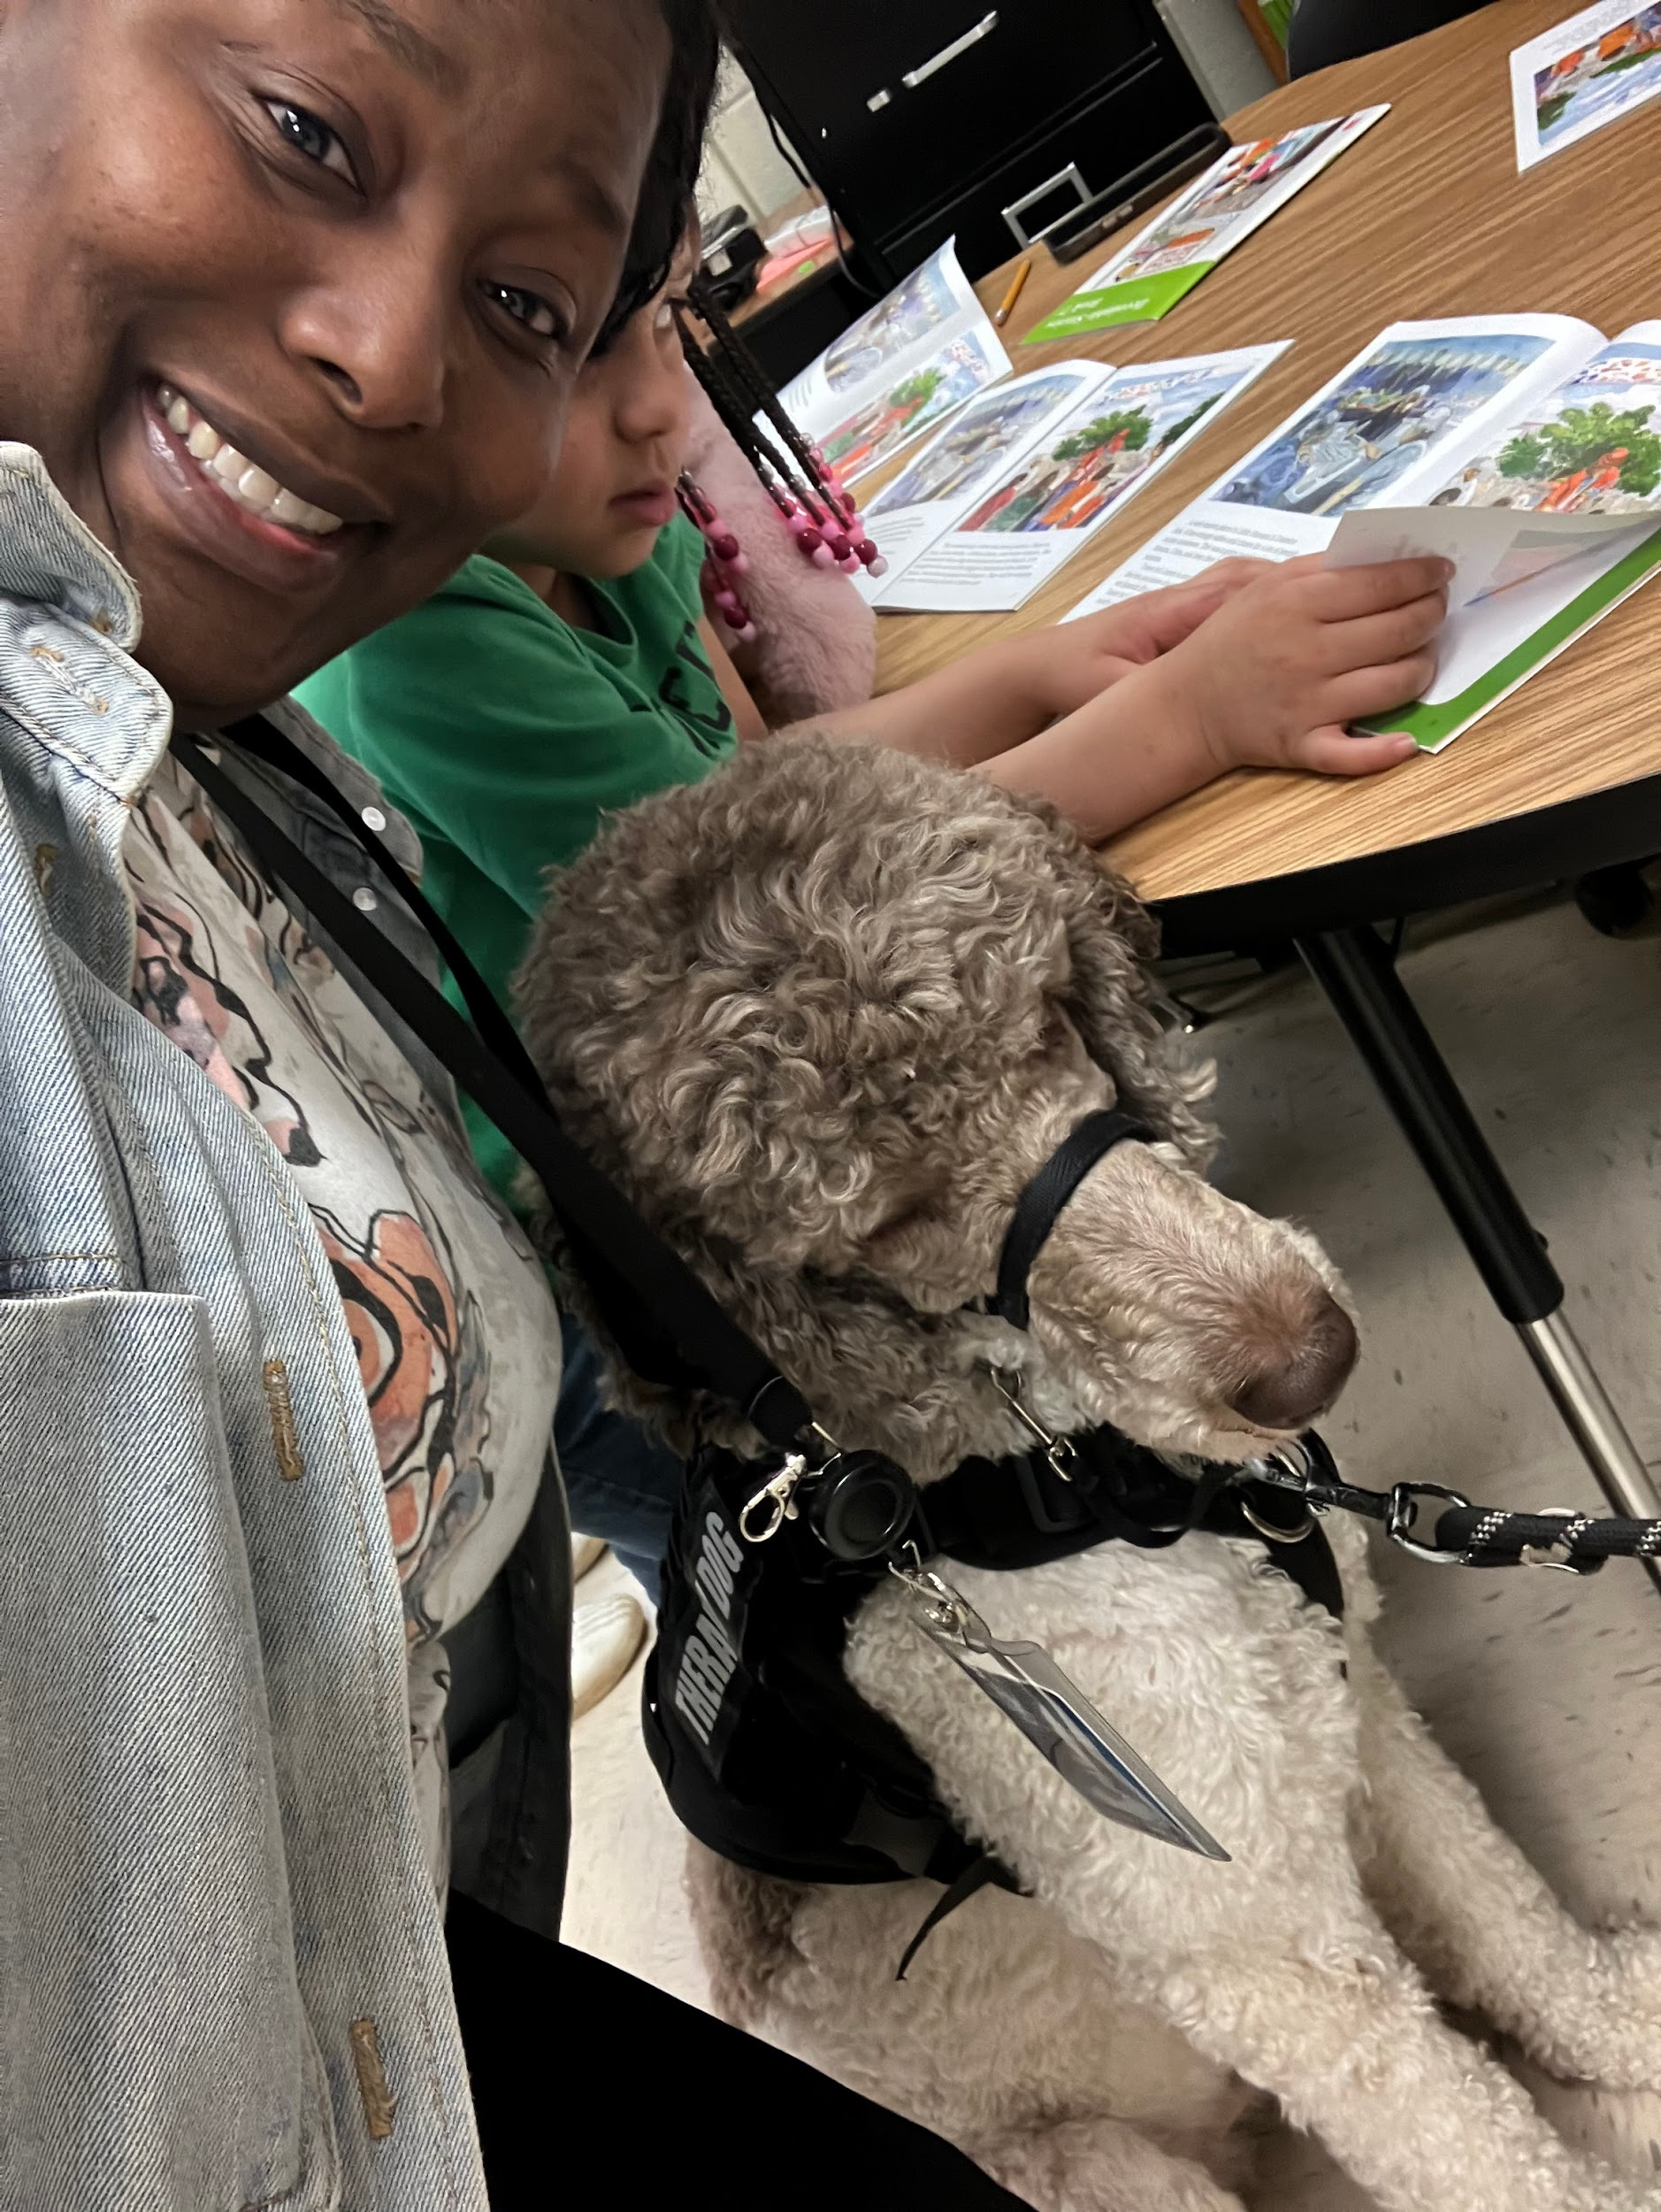
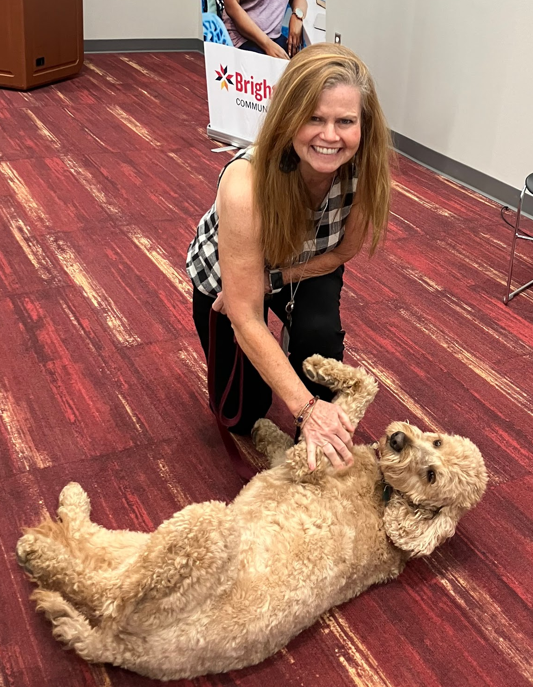
Programs
Mental Health First Aid
Sources of Strength
Signs of Suicide
Therapy Dog Partnerships
Gaggle & Safety
Mental Health Wellness Fair for Staff and Community
Professional Development
University Partnerships
Threat Assessment Training Procedures
PBIS, SEL, Behavioral Support
Specialize Populations
YMHFA
EAP

Slide 17
Identifying Student Need for Support
Through the implementation of evidence-based strategies and a
whole-school approach, these initiatives create barrier-free and inclusive
learning environments that support all student success, mental health
wellness, and long-term resilience.
SST
MTSS
Referrals
Re-entry Meetings
Safety Planning
Referrals through evidence-based programming

Slide 18

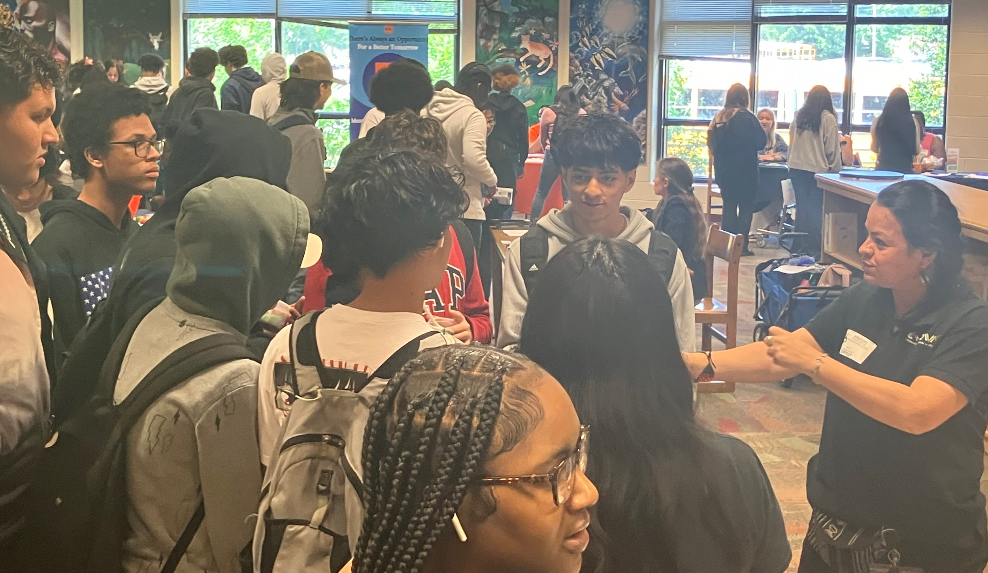
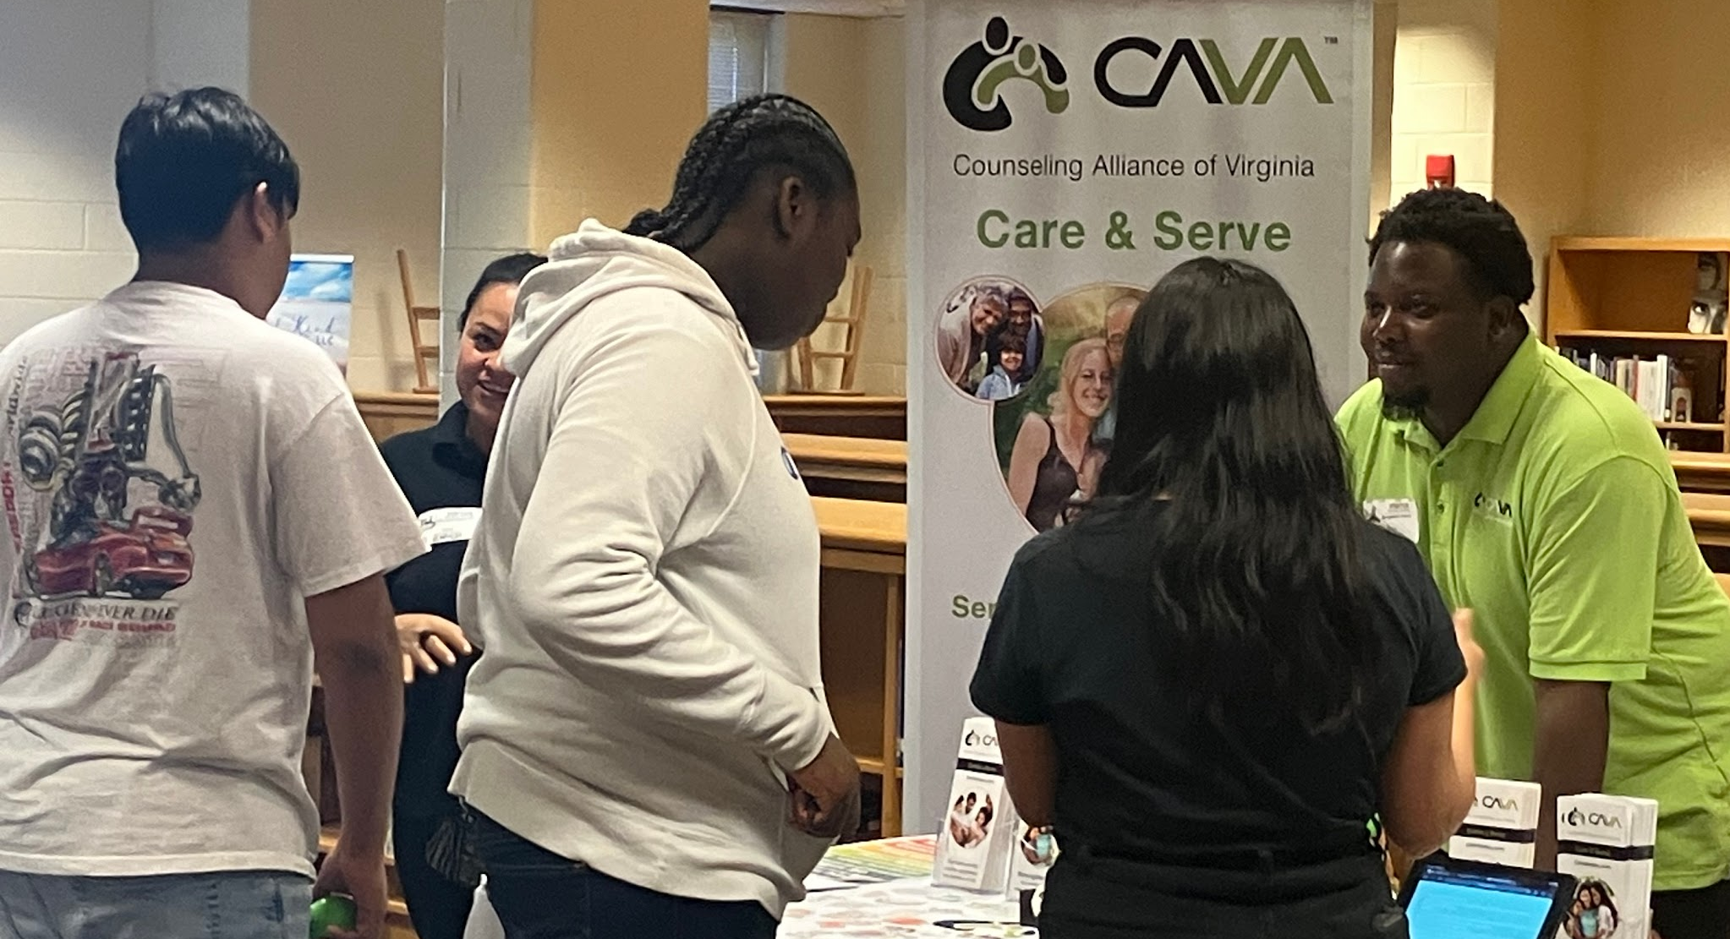

Slide 19
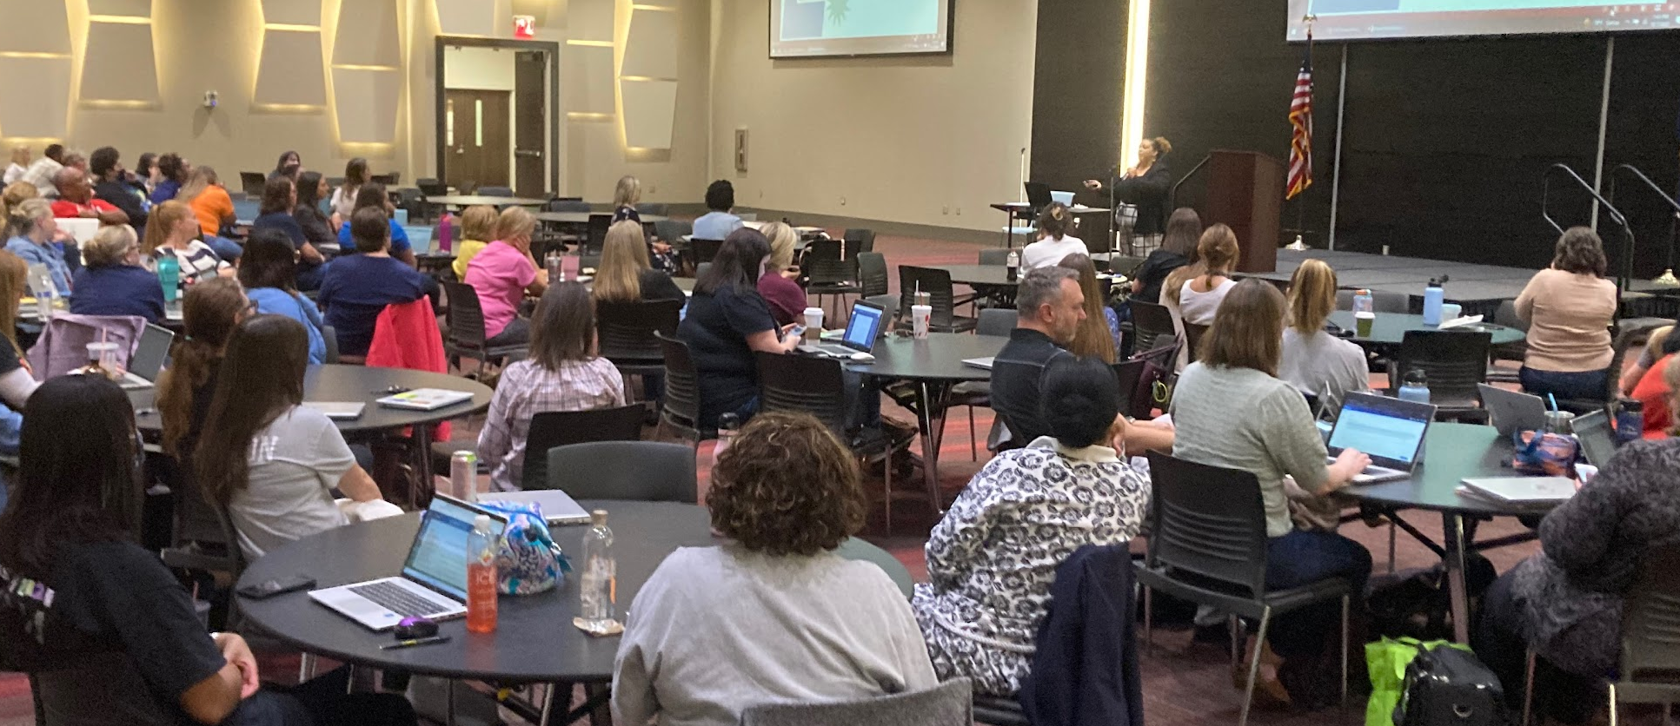
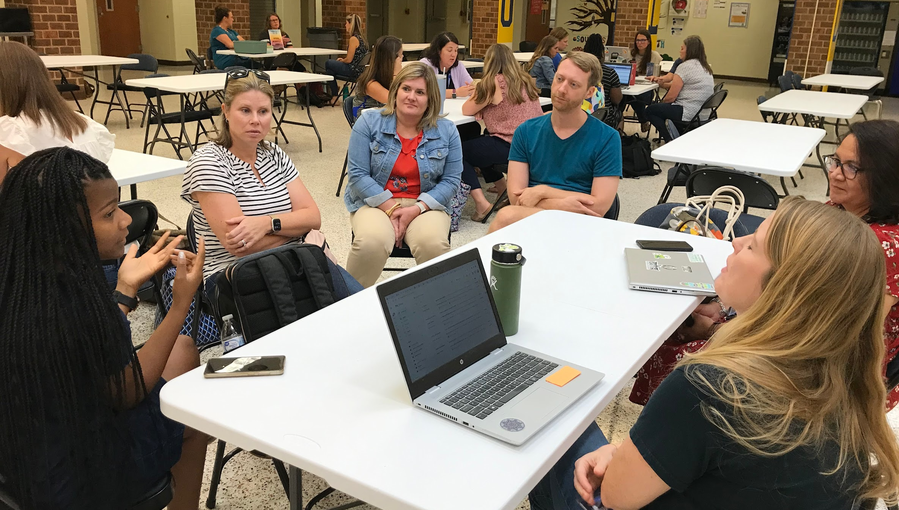


Slide 20

Questions & Answers

Slide 21
Thank you

Slide 22


