Slide 1
Recognizing & Supporting Youth with Internalizing Behaviors
Many students suffer from mental health issues, with up to 22% requiring treatment. However, 70-80% of these students do not receive adequate support, leading to severe consequences for both the individual and society. Mental health issues in schools can impact the entire educational system and community.
(He et al., 2013)

Slide 2
Learning Intentions
Learning Intentions
Increase mental wellness acceptance to reduce discrimination
Increase acceptance/understanding of internal vs. external behaviors
Align practices to improve mental wellness outcomes for youth with internalizing behaviors
Promote effective evidence based and innovative strategies to improve access and delivery of services for students with internalizing behaviors
Help divisions develop a systematic approach to improve students' social, emotional, behavioral, and academic outcomes

Slide 3
What are Internalizing Behaviors?
Youth displaying externalizing behaviors were more likely to receive mental health services (85% vs. 65%) and special education services (75%–40%) as compared with students presenting internalizing problems. (Weist et al., 2018)

Slide 4
Definition
"Internalizing behavior" refers to a child's emotional or psychological state, which is directed inward. It reflects their emotional and psychological well-being and typically includes depressive disorders, anxiety disorders, somatic complaints, and teenage suicide. These behaviors are not outwardly displayed but indicate the child's internal condition (Liu & Lewis, 2011).
Notes:
Accessed from the NIH National Library of Medicine: Liu J, Chen X, Lewis G. Childhood internalizing behaviour: analysis and implications. Journal of Psychiatric and Mental Health Nursing 2011 Dec;18(10):884-94. doi: 10.1111/j.1365-2850.2011.01743.x. Epub 2011 May 20. PMID: 22070805; PMCID: PMC5675073.

Slide 5
Prevalence & Support
Internalizing disorders are the most
prevalent chronic illness affecting children
?
?
7.5
MILLION
60%
1 in 5
?
suffer from one or more mental disorders
do NOT receive appropriate mental health services
experience MH challenges, including internalizing problems
?
?
?
15-22%
36%
22%
experience social, emotional, & mental health problems needing treatment
receive treatment, despite the prevalence of internalizing behaviors
HS students reported seriously considering suicide
Notes:
Activity

Slide 6
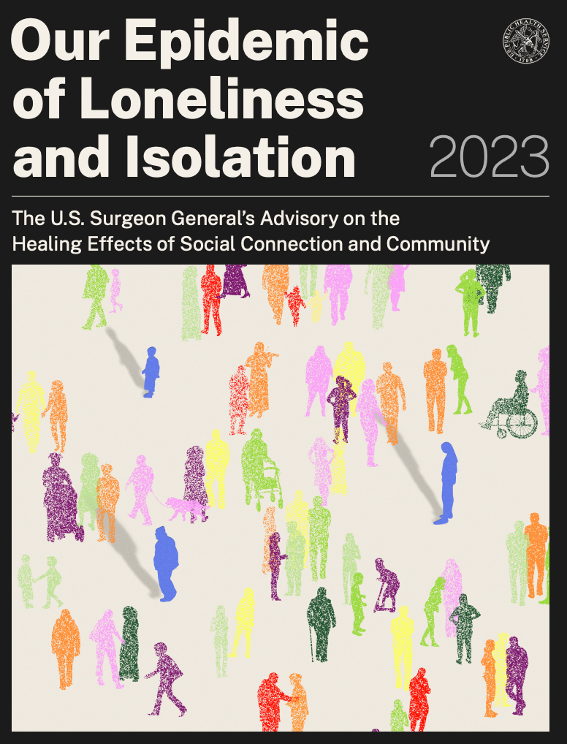
Social connection is a fundamental human need
Virginia Ranks 48th in the nation
for youth access to mental health services
“Social connection— the structure, function, and quality of our relationships with others—is a critical and underappreciated contributor to individual and population health, community safety, resilience, and prosperity.”
Youth are 21 times more likely to seek school-based mental health services than community-based services
(Guo et al., 2017; Fiat et al., 2017; U.S. Surgeon General’s Office, 2023)
Notes:
Discussed during main session

Slide 7
Vulnerable Populations
Female students
Students who identify LGBTQ+
Students who have experienced discrimination in school
Hispanic students
High-achieving students
Students from low-income households
Students living in single-parent, blended, kinship, foster/board care
Students with disabilities
(CDC, 2023; Guo et al., 2017; Kelchner et al., 2019; Lambros et al., 2016; Weist et al., 2018).
Notes:
Discussed during main session
NOTE: all students that have experienced trauma may exhibit internalizing behaviors only and go undetected and therefore they do not receive needed supports
It can be pointed out that while Black students experience mental health issues as do other groups, they are 15% less likely to seek mental health treatment. There is research about this being related to stigma within the Black community
This could be a talking point for this slide. The link to the research is below and the information sited is on page 2:
https://www.nami.org/wp-content/uploads/2023/08/Mental-Health-Facts-for-African-Americans.pdf

Slide 8
Students with Disabilities
Higher rates of depression, anxiety, and anger
Often receive inappropriate disciplinary actions rather than mental health support
Students identified ID/DD are seldom assessed for mental health disorders
Less than 1% receive school-based mental health services as a component of their IEP
Students with a disability and mental health disorders (anxiety, ADHD, and depression) that received school-based mental health services resulted in decreased school absenteeism and suspension rates
(CDC, 2023; Guo et al., 2017; Kelchner et al., 2019; Lambros et al., 2016; Santiago et al., 2014; Weist et al., 2018).
Notes:
Discussed during main session

Slide 9
Impacts of Internalizing Behaviors
Students facing mental health concerns can struggle with attendance, academic performance, and graduation risks.
(Kern et al. (2022)

Slide 10
Impacts of Internalizing Behaviors
Untreated childhood internalizing problems can evolve into diagnosable disorders during adolescence.
Youth experiencing poor mental health have an increased risk of:
School absences
Academic failure
Delayed graduation and dropout risks
Unsafe sexual behavior
Illicit substance use
Suicide attempts
(Fiat et al., 2017).

Slide 11
Academic Impact
Students with internalizing symptoms are
less likely to disrupt instruction
less likely to be identified for mental health services
less likely to receive adequate support
(Kern et al., 2022).

Slide 12
Symptoms of Internalizing Behaviors
It is particularly important that teachers recognize signs of anxiety in their students and structuring their teaching methods to minimize it such as setting achievable short-term goals and providing positive feedback for small accomplishments.
(Grills-Taquechel et al., 2013)

Slide 13
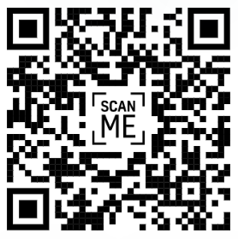
Sorting Activity
https://tinyurl.com/InternalizingSort
Notes:
Activity Chat box: https://tinyurl.com/InternalizingSort

Slide 14
Possible Symptoms
Somatic complaints
Poor attendance habits, frequent visits to clinic
Impaired problem-solving and coping skills
Excessive worrying, fear, stress, phobias
Difficulty with personal relationships
Anxiety in social settings
Low self-esteem or perfectionism
Test anxiety, poor concentration
Withdrawal/avoidance from situations that trigger anxiety
Persistent sadness, pessimism, distorted perceptions
(Hubbard et al., 2018; Hunter et al., 2014; Fiat et al., 2017; McDaniel et al., 2024)
Notes:
Somatic complaints (e.g. headaches, stomach-aches, fatigue, and irritability
Frequent requests to see the nurse
Excessive worrying or anxiety
Social anxiety (e.g. being in the cafeteria, nervousness in new situations)
Phobias (e.g. fears of storms, loss of confidence after disappointment or rejection)
Test anxiety
Difficulty with personal relationships (starting friendships or social isolation)
Withdrawal from situations that trigger anxiety symptoms
Persistent sadness or depressive symptoms
Poor attendance habits

Slide 15
Tier I
Tier 1 supports serve as the foundation for behavior and academics. Schools provide these universal supports to all students in all settings. For most students (approximately 80% of students), the core program gives them what they need to be successful and to prevent future problems.

Slide 16
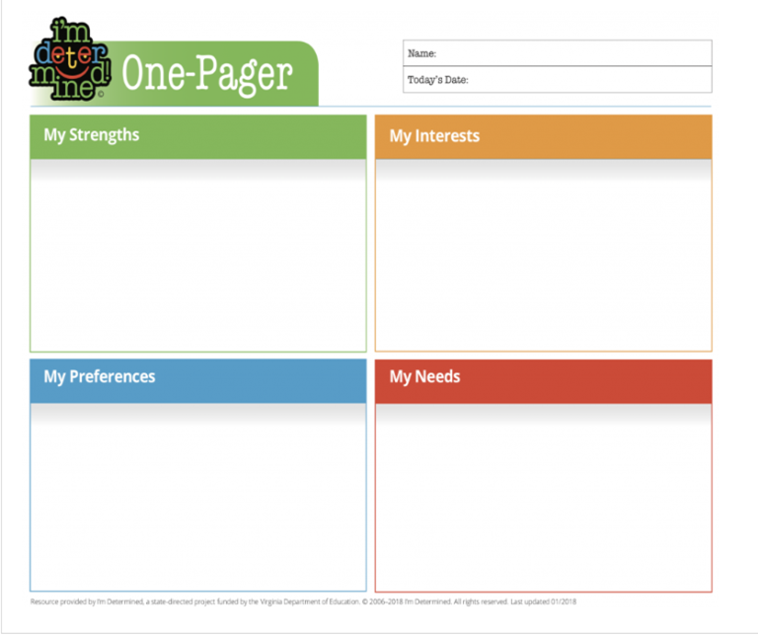
Positive Relationships
Get to know students (surveys, questionnaires, letters, projects, etc.)
Example: I’m Determined one-pager
Connect with students (circles, lunch groups, finding shared interests)
Greeting students at the door
2X10 strategy
Small acts over time
Notes:
Find references (DDB or TM?)

Slide 17
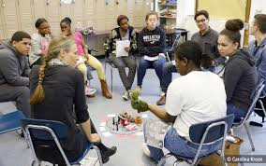
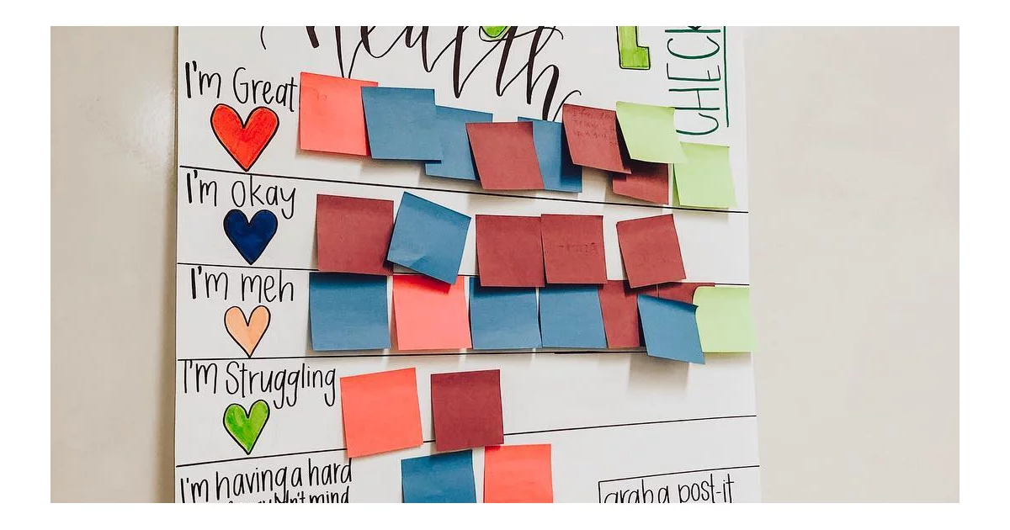
Building Community
Morning meetings
Circles
Check-ins
Community/class norms

Slide 18
Safe, Predictable, & Positive Environments
Routines and procedures are taught and practiced
Being aware of set up/lay-out of the room
Active supervision
Clear expectations
Visual supports
Acknowledging positive behavior
5:1 ratio of positive to negative

Slide 19
Mindfulness Activities
Notes:
Video from DDB 1:37
“Go through your day not feeling how your feeling.”

Slide 20
Explicit Instruction
Positive Behavior Intervention Supports (PBIS)
Teaching expectations, classroom routines & procedures
Social-emotional skills
Self-regulation strategies
Coping skills
Understanding feelings
Mental health literacy
Suicide prevention
Bullying prevention
Notes:
Resource: https://mhttcnetwork.org/ - mental health literacy https://mhttcnetwork.org/free-online-course-for-educators-on-mental-health-literacy/
For praise/attention or correction, make sure you do it in private, especially for internalizers

Slide 21
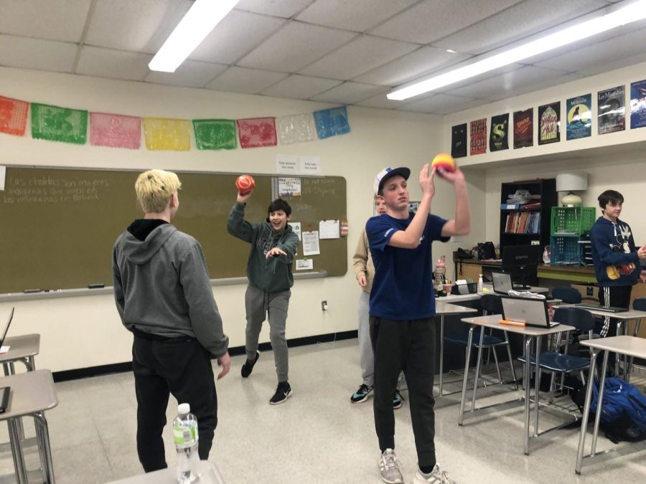
Active Engagement
Opportunities to respond
Talk in small groups
Choral responding
White boards
Choices
Opportunities for movement/brain breaks
Changes in activities
Instruction linked to interests/current events

Slide 22
Collaboration with Families

Slide 23
Tier I Share Out
In the chat box share one of the following:
#1: A tier 1 practice we have not discussed today
or
#2: A tier 1 practice introduced today that you would like to bring back to your division, building, or classroom
Notes:
Activity

Slide 24
Identification & Screening
Youth with internalizing behavior problems are more likely to be overlooked at school because they are “quiet” and thus less likely to disrupt classroom routines.
(Hartman et al., 2017)

Slide 25
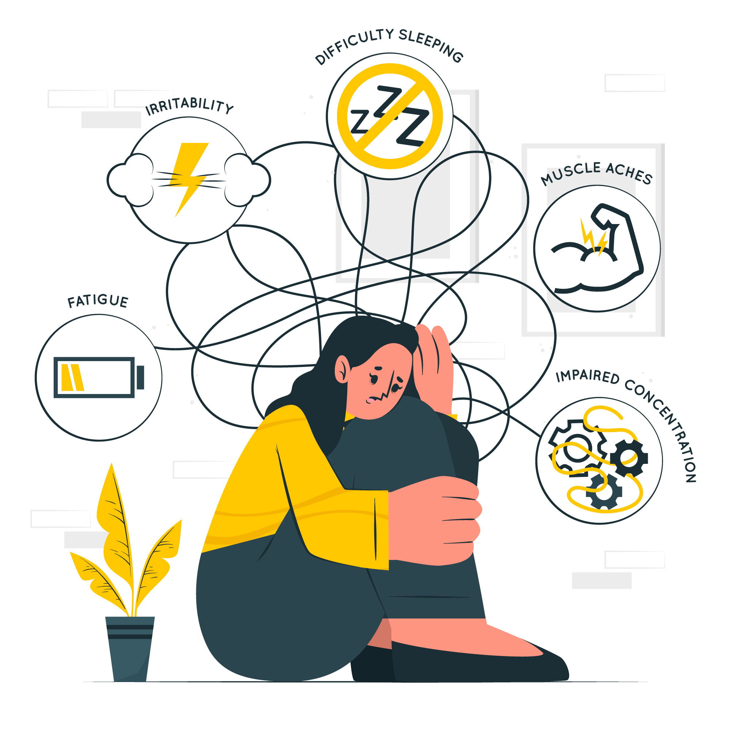
Identification and Screening
Train adults to recognize warning signs, changes in
Attendance, tardies, school refusal
Performance or demeanor
Interactions or withdrawal from peers
Distractibility and concentration
Requests to visit clinic
Participation in events and activities
(Cunningham & Suldo, 2014; Hunter et al., 2014; Kern et al., 2022; Weist et al., 2018)
Notes:
Beyond the symptoms, look for changes in
Hubbard et al. (2018) report that students were identified by the MTSS team using the Student Risk Screening Scale (SRSS) and the Student Internalizing Behavior Screening Scale (SIBSS).’’More difficult to detect than externalizing behaviors
According to Hunter et al. (2014), internalizing behaviors can be more difficult to identify, but screeners can be used, such as the SIBS Student Internalizing Behavior Screener for grades 1-5, teacher rankings identify students at risk for internalizing behavior and the SSIS-RS Social Skills Improvement System-Rating Scales multi-rater assessment of the perceived frequency and importance of social behavior.

Slide 26
Identification and Screening
Internalizing behaviors are more difficult to detect. Teachers missed 50-60% of their students who reported at-risk levels of depression and anxiety.
Universal screening tools within an MTSS framework
Parent, school personnel, peer nominations or referrals
Office Discipline Referrals and academic measures
Direct observation
(Cunningham & Suldo, 2014; Hunter et al., 2014; Kern et al., 2022; Weist et al., 2018)
Notes:
Beyond the symptoms, look for changes in
Hubbard et al. (2018) report that students were identified by the MTSS team using the Student Risk Screening Scale (SRSS) and the Student Internalizing Behavior Screening Scale (SIBSS).’’More difficult to detect than externalizing behaviors
According to Hunter et al. (2014), internalizing behaviors can be more difficult to identify, but screeners can be used, such as the SIBS Student Internalizing Behavior Screener for grades 1-5, teacher rankings identify students at risk for internalizing behavior and the SSIS-RS Social Skills Improvement System-Rating Scales multi-rater assessment of the perceived frequency and importance of social behavior.

Slide 27
School Example
How are Virginia school divisions utilizing screenings to identify students with internalizing behaviors?

Slide 28
Advanced Tier Interventions
It is crucial to consider the school environment for preventing and mitigating internalizing problems in children and young people. Comprehensive approaches like PBIS and SMH frameworks are innovative ways to improve students' social, emotional, behavioral, and academic skills and functioning.
(Weist et al., 2018)

Slide 29
Advanced Tiers
Tier 2 Interventions: Targeted support for students not successful with Tier 1 alone that is provided in addition to universal, Tier 1 instruction and aligned with student needs.
Mindfulness strategies
School-based cognitive behavioral therapy
Small group/low intensity individual support
Mentoring
Small group focused/social skills training
Low-intensity classroom-based supports
Daily report cards/teacher check-ins
Increased feedback and acknowledgement
(Bruhn & McDaniel, 2021; Guo et al., 2017; Kern et al., 2022)

Slide 30
Advanced Tiers
Tier 3 Interventions: Targeted support for students not responding to Tier 2 supports. Interventions are more frequent, intensive, and individualized. This is different than special education.
Modularized or manualized interventions
Implemented by school, community, and/or caregiver partners
Individual Focused/Social Skills Training
School-based cognitive behavioral therapy
FBA/BIP
Wraparound, holistic services
Individualized schedule/planned breaks
Individualized goal setting, feedback, and acknowledgement
(Bruhn & McDaniel, 2021; Guo et al., 2017; Kern et al., 2022)

Slide 31
SEB Needs
& Matched Interventions
CONDUCT CONCERNS
Check-in/Check-out variations (e.g. CCE)
HYPERACTIVITY/INATTENTION
Self-regulating activities: goal-setting, self-monitoring, self-graphing
SOCIAL SKILLS/PEER PROBLEMS
Social/behavioral contracts, restorative meetings & circles, problem-solving activities
EMOTIONAL SYMPTOMS
Small-group or individual therapy/counseling, CICO w/internalizing modifications
ACADEMIC CONCERNS
Supplemental explicit instruction, Breaks are Better (BrB), Homework Organization & Planning Skills (HOPS)
(McDaniel, et al., 2024).
Notes:
Examples: of manualized curriculums for all staff
Examples:
Coping Cat (anxiety)
Support for Students Exposed to Trauma (SSET)
Cognitive Behavioral Intervention for Trauma in Schools (CBITS)
Groups that focus on relationships, connectedness and belonging
Check In Check Out, Check and Connect
Peace room example (resource): https://youtu.be/HfsdoDQjAiU

Slide 32
Integrated Systems Framework
A structure and process for education and mental health systems to interact in most effective and efficient way.
Utilizes MTSS framework to guide integrated approach.
Integration of social-emotional-behavior supports, tiered systems of support, and Positive Behavioral Interventions and Supports (PBIS) to address broad range of concerns.
Guided by key partners using a single system of delivery.
Addresses concerns from a holistic vantage.
(Barrett et al., n.d.; Barrett & Yanek., 2023; Weist et al., 2018)
Notes:
Also, Kern et al. (2022) report that implementing MTSS with evidence-based mental supports embedded within the tiers can support students with internalizing behaviors. Using practices that increase intensity matching student need and responsiveness is key.

Slide 33
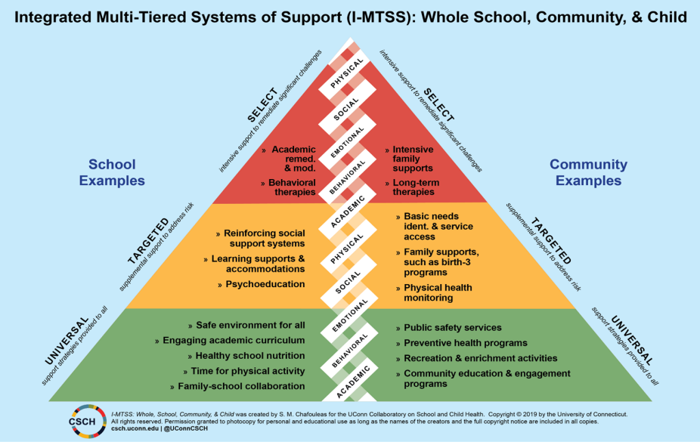
How is this approach similar or different from your current status?
(Schmitz et al., 2022)

Slide 34
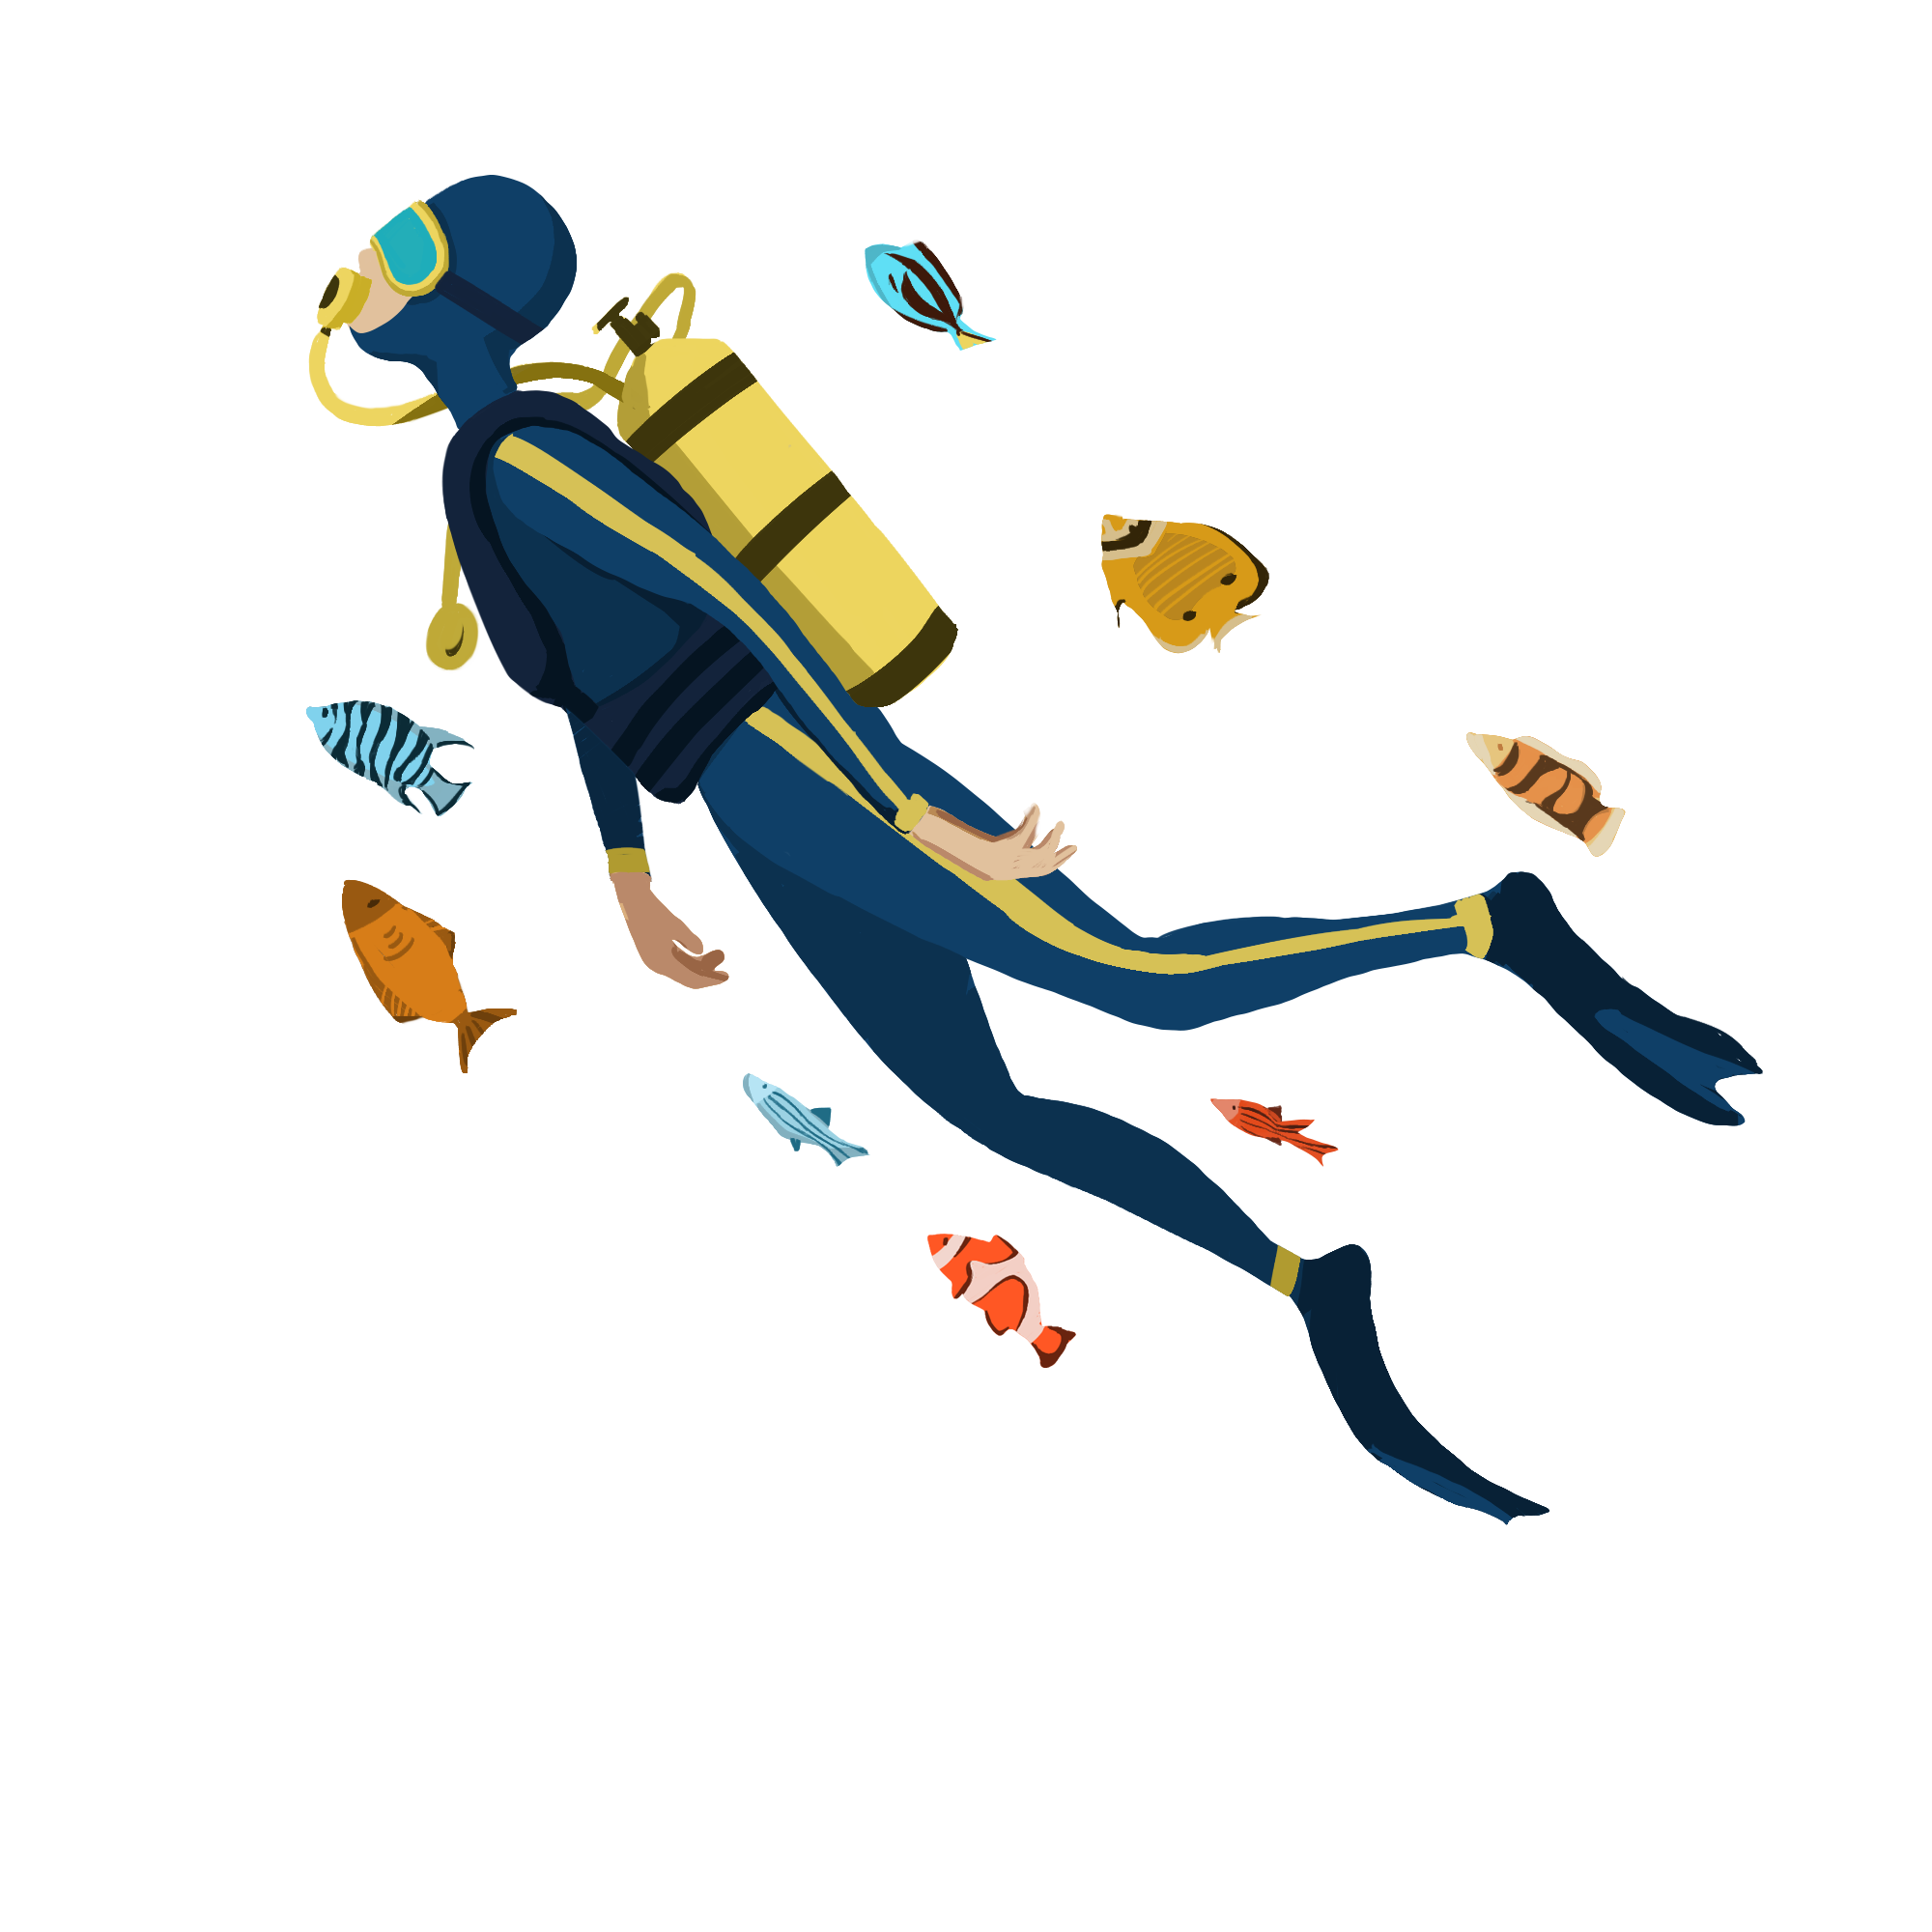
Take a Deeper Dive
Screeners | Internalizing Behaviors | Learning Modules & PL
 | Systems of Support | Wendi Jenkins wbjenkins@vcu.edu Whitney Jones wlshotwell@vcu.edu Kristen O’Sullivan osullivankj@vcu.edu
Notes:
Links to folders with resources

Slide 35
https://qrco.de/bf5hKO

Slide 36
References
Atkinson, C. (2024, May 1) Toward wellness: The status of school-based mental health initiatives In Virginia report. Voices for Virginia’s children. https://vakids.org/our-news/blog/toward-wellness-the-status-of-school-based-mental-health-initiatives-in-virginia-report
Barrett, S., Eber, L., Persale, K., & Pohlman, K. (n.d.). Fact sheet. Interconnected systems framework 101: An introduction. Center on PBIS. https://www.pbis.org/resource/fact-sheet-interconnected-systems-framework-101-an-introduction
Barrett, S., Yanek, K., (2023, November 28-29). Aligning mental health within a mtss framework: Coaching for impact [PowerPoint presentation]. VTSS State Coaching Event, Glen Allen, VA.
Bruhn, A., Bardhoshi, G. (2023, December 5-7). Tier 2 practices to support students with internalizing issues [Conference presentation]. 2023 Annual Conference on Advancing School Mental Health, New Orleans, LA, United States. https://www.schoolmentalhealth.org
Bruhn, A. L., & McDaniel, S. C. (2021). Tier 2: Critical Issues in Systems, Practices, and Data. Journal of Emotional and Behavioral Disorders, 29(1), 34–43. https://doi.org/10.1177/1063426620949859
Centers for Disease Control and Prevention. (2023). Promoting mental health and well-being in schools: An action guide for school and district leaders. https://www.cdc.gov/healthyyouth/mental-health-action-guide/pdf/DASH_MH_Action_Guide_508.pdf
Cunningham, J. M. & Suldo, S. M. (2014). Accuracy of teachers in identifying elementary school students who report at-risk levels of anxiety and depression. School Mental Health, 6, 237–250. https://doi.org/10.1007/s12310-014-9125-9
Fiat, A. E., Cook, C. R., Zhang, Y., Renshaw, T.L., DeCano, P., & Merrick, J.S. (2017). Mentoring to promote courage and confidence among elementary school students with internalizing problems: A single-case design study pilot. Journal of Applied School Psychology, 33(4), 261–287, DOI: 10.1080/15377903.2017.1292975
Guo, Y., Rousseau, J., Renno, P., Kehoe, P., Daviss, M., Flores, S., Saunders, K., Phillips, S., Chin, M., & Evangelista, L.S. (2017). Feasibility of an emotional health curriculum for elementary school students in an underserved Hispanic community. Journal of Child Adolescent Psychiatric Nursing, 30, 133–141. DOI: 10.1111/jcap.12185
Hartman, K., Gresham, F. M., & Byrd, S. (2017). Student Internalizing and Externalizing Behavior Screeners: Evidence for Reliability, Validity, and Usability in Elementary Schools. Behavioral Disorders, 42(3), 108–118. https://doi.org/10.1177/0198742916688656
He, J., Burstein, M., Schmitz, A., & Merikangas, K. R. (2013). The strengths and difficulties questionnaire (SDQ): The factor structure and scale validation in U.S. adolescents. Journal of Abnormal Child Psychology, 41(4), 583–595.
Kelchner, V. P., Perleoni, M. K., & Lambie, G. W. (2019). An investigation of change: Elementary students with an individual education program participating in a school‐based mental health counselling intervention. Journal of Research in Special Educational Needs, 19(4), 325–333. https://doi.org/10.1111/1471-3802.1245
Kern, L., Weist, M. D., Mathur, S. R., & Barber, B. R. (2022). Empowering School Staff to Implement Effective School Mental Health Services. Behavioral Disorders Journal of the Council for Children with Behavioral Disorders., 47(3), 207–219. https://doi.org/10.1177/01987429211030860

Slide 37
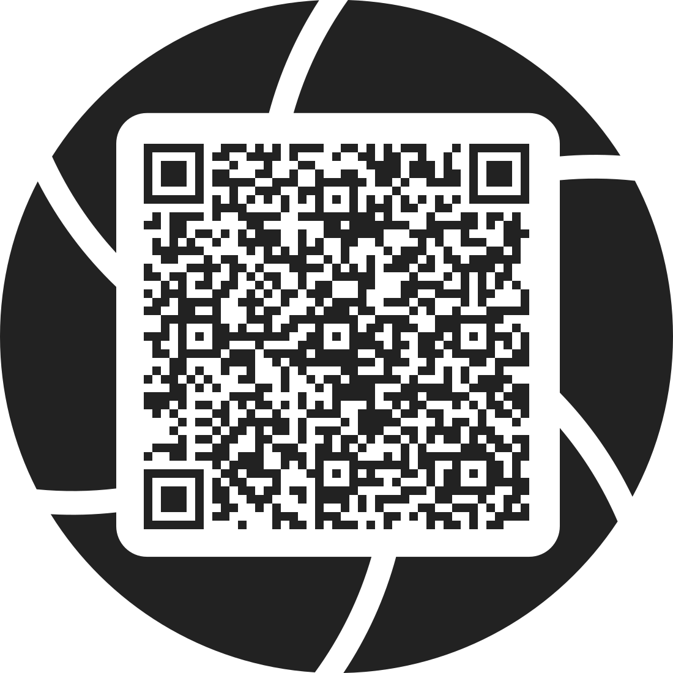
References
Lambros, K., Kraemer, B., Wager, J. D., Culver, S., Angulo, A., & Saragosa, M. (2016). Students with dual diagnosis: Can school-based mental health services play a role? Journal of Mental Health Research in Intellectual Disabilities, 9(1–2), 3–23.
Liu J, Chen X, Lewis G. (2011). Childhood internalizing behaviour: analysis and implications. Journal of Psychiatric and Mental Health Nursing 18(10):884–94. d
McDaniel, S., Bruhn, A., Estrapala, S. (2024). Social, emotional, and behavioral supports in schools: Linking assessment to tier 2 interventions. Guilford Press.
Mental Health Literacy (n.d.). Educators. Mental health literacy. http://mentalhealthliteracy.org/educators
Office of the U.S. Surgeon General. (2023). Our epidemic of loneliness and isolation: The U.S. surgeon general’s advisory on the healing effects of social connection and community (Surgeon General’s Advisory). U.S. Department of Health and Human Services., United States Public Health Service. https://www.hhs.gov/sites/default/files/surgeon-general-social-connection-advisory.pdf
Santiago, C. D., Raviv, T., Ros, A. M., Brewer, S. K., Distel, L. M. L., Torres, S. A., Fuller, A. K., Lewis, K. M., Coyne, C. A., Cicchetti, C., & Langley, A. K. (2018). Implementing the Bounce Back trauma intervention in urban elementary schools: A real-world replication trial. School Psychology Quarterly, 33(1), 1–9. https://doi.org/10.1037/spq0000229
Schmitz, K., Phu, J., Barrett, S. (2022, August 4-5). From co-located to integrated: Partnering with community mental health organizations within an interconnected systems framework [Conference Presentation]. 2022 MTSS Integrated Systems Conference. https://www.wasa-oly.org
Weist, M.D., Eber, L., Horner, R., Splett, J., Putnam, R., Barrett, S., Perales, K., Fairchild, A.J., & Hoover, S. (2018). Improving multitiered systems of support for students with “Internalizing” emotional/behavioral problems. Journal of Positive Behavior Interventions, 20(3), 172–184. https://doi.org/10.1177/1098300717753832
Scan me for link
to additional resources
https://t.ly/l7ret

