Slide 1
Strengthening Systems through Monitoring and Evaluation
June 18, 2024
Dr. Corinne Wilson, VTSS Evaluation Director at CIEES
Dr. Amanda Working, VTSS Evaluator
Dayla Brown, VTSS Systems Coach

Slide 2
Learning Intentions
Explain the role of monitoring and evaluation within implementation.
Understand the five areas of evaluation and how they guide the development of an evaluation plan.
Identify evaluation questions and measures that will support effective implementation of your division or organization’s mental health initiative, program or practice.
Strengthening Systems through Monitoring and Evaluation

Slide 3
Welcome!
How familiar are you with monitoring and evaluating systems that focus on mental wellness?
1 - I am not familiar with it, but I would like to learn!
2 - I have learned some, but I am eager to know more.
3 - I am familiar with and have observed evaluation of initiatives, programs or practices.
4 - I know quite a bit about evaluation processes and have participated in the implementation of an evaluation plan.
We invite you to share in the chat…
School Division/Organization
Your Role

Slide 4
Evaluating Systems
“Who is participating?”
Reach
“What is happening with the initiative?”
Process
“What is our ability to implement and sustain the initiative?”
Capacity
“Are the core features being implemented?”
Fidelity
“Is the initiative achieving valued outcomes and worth sustaining?”
Outcomes
(Center on Positive Behavioral Interventions and Supports, 2020)

Slide 5
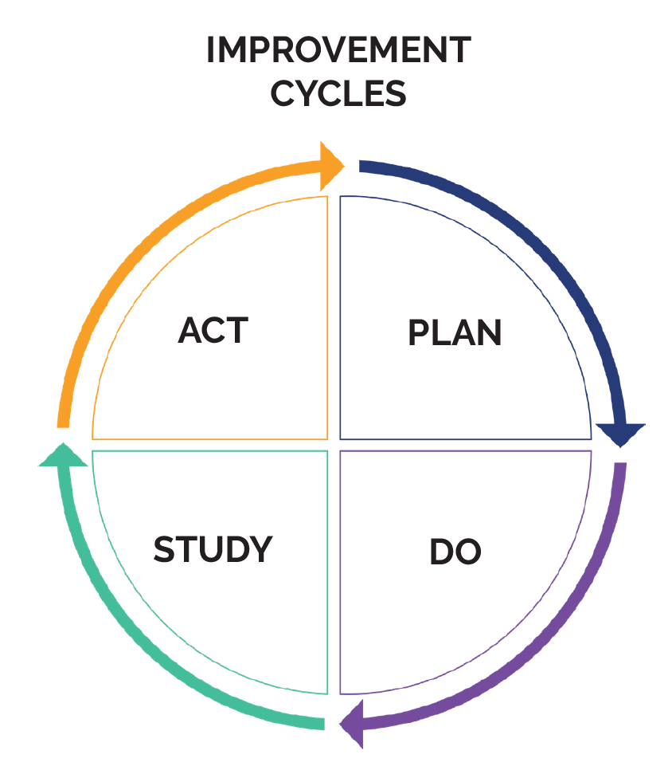
Improvement Cycles
Improvement cycles include using data from evaluation and monitoring to improve and refine implementation
PDSA (Plan, Do, Study, Act) is an example.
Data are used to help:
Choose program/practices,
Analyze to assess impact,
Use to refine implementation, and
Inform systems needed to support implementation

Slide 6
Reach
Common Questions
Sample Measures
How many students, schools, divisions, and/or community organizations are involved?
To what extent has implementation scaled across the school, division, region, and/or state?
Counts of
Students
Schools
PD participants
Implementers (e.g. teachers, school counselors)
Partnering organizations

Slide 7
Reach Example:
Tier 1 Support
(Second Step)
Questions:
How many (and which) schools are implementing Second Step as a Tier 1 support?
What student grade levels are receiving this support?
How many (and which) school staff are participating at each school?
Measures:
Implementation logs/notes
PD participant lists
A school division has decided to pilot the Second Step Curriculum with all teachers at 2 of their 5 middle schools. School Counselors and the School Psychologist will lead this initiative.

Slide 8
Process
Common Questions
Sample Measures
What implementation activities have been completed?
What PD and ongoing coaching have been delivered?
To what extent was the PD and coaching delivered with fidelity?
Tiered Fidelity Inventory action plan completion
PD Calendar
PD activity evaluations
Stakeholder Input and Satisfaction Surveys

Slide 9
Process Example:
Tier 2 Check & Connect
Questions:
How will initiative leads know how the intervention was delivered?
How will school division leaders know what PD support staff received?
A large school division has selected to implement Check and Connect at its high schools with students at risk for dropout. The School Social Workers and the Behavior Interventionists will lead this initiative.
Select the question that more closely evaluates process vs. reach.
Notes:
1. How many students were supported?
2. How was ongoing coaching provided to mentors?
3. How many high schools implemented Check & Connect?
4. Which staff attended the initial PD?

Slide 10
Process Example:
Tier 2 Check & Connect
Questions:
How will initiative leads know how the intervention was delivered?
How will school division leaders know what PD support staff received?
How was ongoing coaching provided to mentors at each high school?
A large school division has selected to implement Check and Connect at its high schools with students at risk for dropout. The School Social Workers and the Behavior Interventionists will lead this initiative.
Measures:
- Administrator and Staff PD Calendar
- Student feedback forms
- Check & Connect Core Components & Elements Self-Assessment

Slide 11
Capacity
Common Questions
Sample Measures
What is our capacity to implement and sustain this initiative?
What resources are available to support implementation?
To what extent has implementation improved capacity for the organization to replicate, sustain, or scale up?
PBIS District Systems Fidelity Inventory
NIRN District Capacity Assessment
Coaching Inventory
Resource mapping activities

Slide 12
Capacity Example:
Tier 1 Restorative Practices
Questions:
What other new initiatives are teachers/staff being asked to support this year?
How have we align our current professional learning so that staff are not confused and overburdened?
Who was available to provide PD and ongoing coaching to teachers?
What communication plan has been established to sustain this initiative?
Measures:
Coaching inventory
A division has provided PD to all staff on Restorative Practices. Schools were asked to choose 1-2 practices to implement. Division leaders recently received feedback that school staff were experiencing initiative overload.
Other measures?

Slide 13
What additional capacity measures have you used (or might you recommend for this school division)?
ⓘ
Click Present with Slido or install our Chrome extension to activate this poll while presenting.

Slide 14
Fidelity
Common Questions
Sample Measures
What percent of implementing schools have measured fidelity of implementation?
To what extent is the program or practice implemented as intended in schools?
What schools can serve as model schools for local implementation?
Tiered fidelity inventory (TFI)
Team Implementation Checklist (TIC)
Interconnected Systems Framework—Implementation Inventory (ISF-II)
Classroom observation forms

Slide 15
Fidelity Example:
Tier 2 Check-In Check-Out (CICO)
Questions:
What % of schools monitored fidelity?
What fidelity monitoring process was used?
To what level have schools implemented the intervention components with fidelity?
What were the barriers and successes?
What were the students’ experiences?
Measures:
CICO-Fidelity of Implementation Measure
Staff and Student Feedback Surveys
What barriers might this division face?
A LEA’s 13 elementary schools began implementing CICO this year after SLTs received 2 days of PD. LEA staff have received feedback from several school teams that they believe CICO is not effective and has been challenging to maintain.

Slide 16
Outcomes
rch on
Common Questions
Sample Measures
To what extent do organizations implementing the initiative with fidelity:
show desired changes in student outcomes?
show desired changes in other areas of schooling?
Attendance/chronic absenteeism
Behavior outcomes (e.g. referrals, suspensions)
Academic outcomes (e.g. state test results, graduation rates)
Social/emotional competencies
School climate

Slide 17
Outcomes Ex:
Tier 1/2 Support (Lions Quest)
Questions:
To what extent do schools implementing Lions Quest with fidelity:
show desired changes in student outcomes?
show desired changes in other areas of schooling?
Measures:
Referrals/suspensions; academic achievement; attendance/chronic absenteeism; social skills and social/emotional competencies
A LEA has decided to pilot the Lions Quest Curriculum with all teachers at 2 of their 4 elementary schools. The School Counselor will lead this initiative. He will also use this curriculum for his small groups.

Slide 18
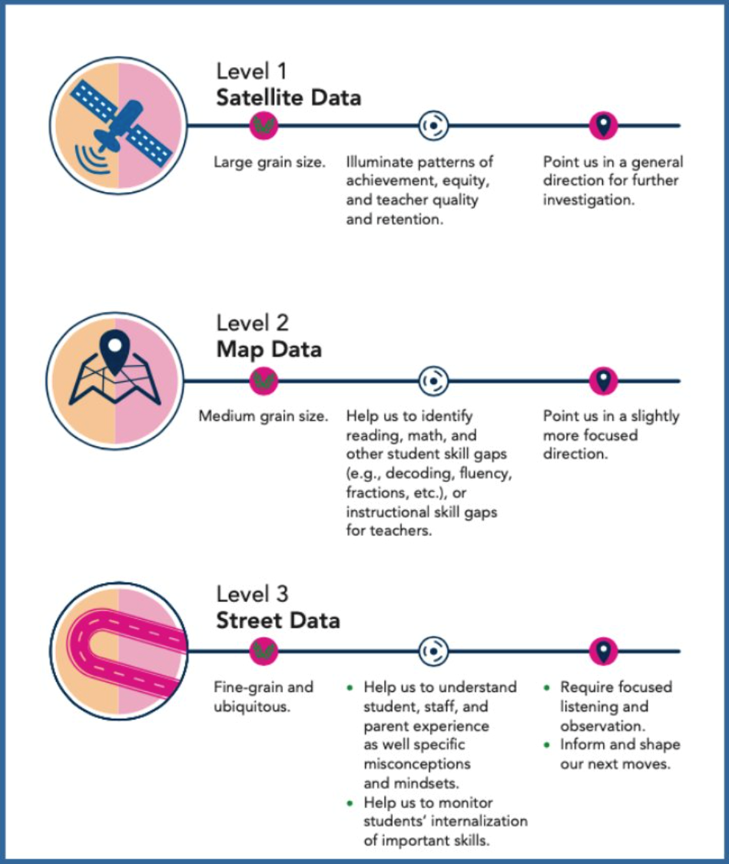
Levels of Data
(Safir & Dugan, 2021)

Slide 19
Outcome Ex:
Tier 1/2 Support (Lions Quest)
Satellite Data:
Standardized test scores/pass rates
Teacher retention/turnover rates
Attendance/chronic absenteeism data
Map Data:
Student skill gaps by both academic and social emotional competencies
Student and teacher perception data
school climate surveys
safety surveys
Street Data:
Classroom observation
What are other “street data” measures?
A LEA has decided to pilot the Lions Quest Curriculum with all teachers at 2 of their 4 elementary schools. The School Counselor will lead this initiative. He will also use this curriculum for his small groups.

Slide 20
Whew! This is a lot!
You do not have to do this all at once!
Focus on the essential components for your organization and initiative
Leverage existing systems
Utilize existing measures
A single measure can inform multiple domains
Don’t overload on data
Make it consumable

Slide 21
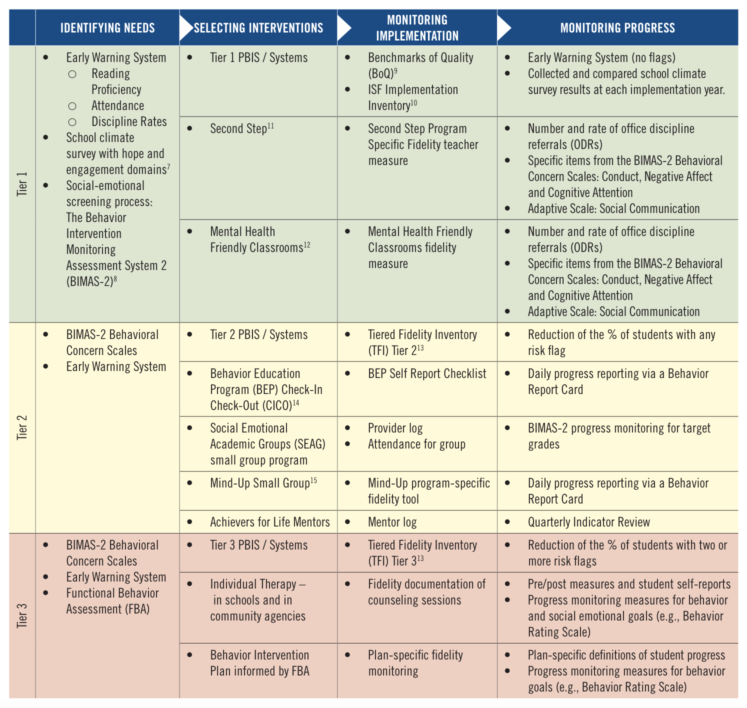
Florida District Resource
Duval County Public Schools
Data Guide for Enhancing Your PBIS Framework to Address Student Mental Health | Florida PBIS

Slide 22
Any Questions?

Slide 23
Any Questions?
Thank you for attending and please feel free to contact us:
aworking@odu.edu
ccooking@odu.edu
dbrown@ttacodu.org
Also, you will find us using our social media handles below!
X - Vtss_ric https://x.com/Vtss_ric
X - https://x.com/ODU_MTSS
Facebook - vtssric https://www.facebook.com/vtssric

Slide 24
References
Center on Positive Behavioral Interventions and Supports (December 2020). Positive Behavioral Interventions and Supports (PBIS) Evaluation Blueprint. University of Oregon. https://files.pbis.org/pub/PBIS-Evaluation-Blueprint.pdf.
Fintel, N. & Elfner, K. (2020). Data Guide for Enhancing Your PBIS Framework to Address Student Mental Health. Florida’s Positive Behavior Support Project, University of South Florida. http://flpbis.cbcs.usf.edu/other/mental_health.html.

Slide 25
References
Fintel, N. & Elfner, K. (2020). Data Guide for Enhancing Your PBIS Framework to Address Student Mental Health. Florida’s Positive Behavior Support Project, University of South Florida. http://flpbis.cbcs.usf.edu/other/mental_health.html.
Safir, S., & Dugan, J. (2021). Street data: A next-generation model for equity, pedagogy, and school transformation. Corwin.

