Slide 1
Promoting Tier 1 Mental Wellness Systems in Schools
June 18th, 2024

Slide 2
Closed Captioning
https://support.zoom.com/hc/en/article?id=zm_kb&sysparm_article=KB0059762
Notes:
Slides ahead of time for visual impairment

Slide 3
If You Need Assistance
Please send a direct chat to any of the following:
Anna Hebb
Wendi Jenkins
Kim Dupre
Kristen O’Sullivan

Slide 4
An Acknowledgement

Slide 5
Our Commitment to You

Slide 6
Who is Here?

Slide 7
Community Agreements
Practice
Self-Compassion
Extend patience, grace, and kindness
Focus on solutions to make things easier
Practice
Growth Mindset
Be open to new thoughts and ideas
Embrace learning opportunities
Practice
Presence
Focus on the here and now
Share your expertise, information and ideas
Commit to being here
Notes:
Poll: Community Agreements
Which one of these will be hardest for you?
Self-Compassion
Growth Mindset
Presence
None-I’m good to go
Activity: What do you need from us or yourself in order to honor the community agreement?

Slide 8
Let’s Chat
Take a minute to reflect on what you might need from yourself or from us to help you honor the community agreements.
Please share in the chat box so that we can build a community to foster collective care.

Slide 9
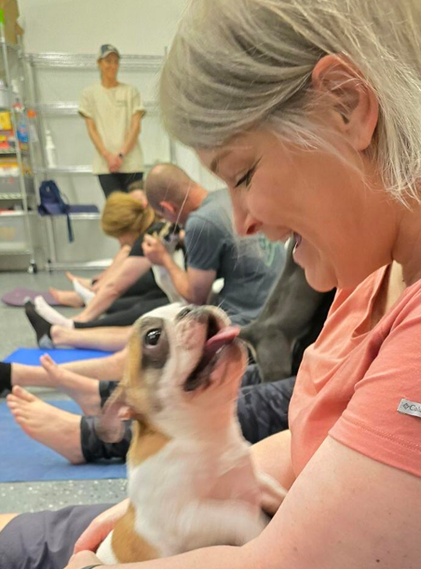
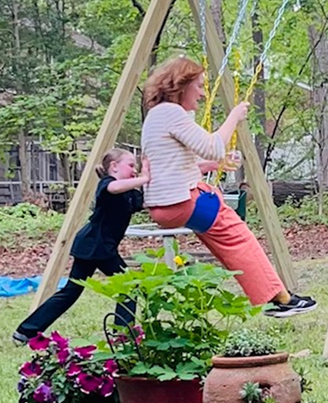
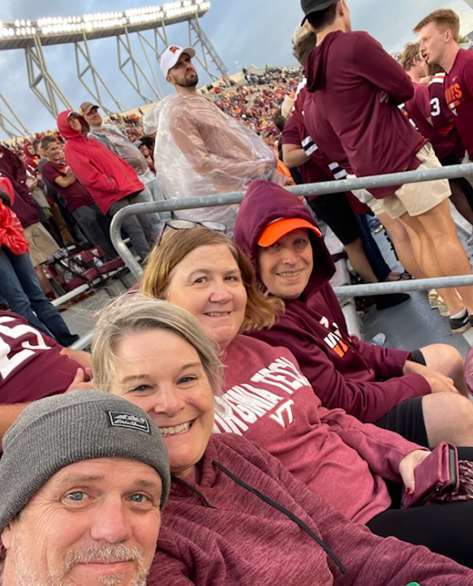
Our Team

Slide 10
Virtual Care Package
Some of our topics may be hard for you or even a trigger. If you need a little extra care today check out the links in the chat:
Coloring pages
Chair yoga
Breathing boards
Progressive Muscle Relaxation
Notes:
Please place link in chat:
Coloring pages: https://www.pblworks.org/sites/default/files/2021-04/pblworks_color-calm.pdf
Chair Yoga: https://www.youtube.com/watch?v=M-8FvC3GD8c
Breathing Boards: https://care.uci.edu/services/Breathing%20boards.pdf
Progressive Muscle Relaxation: https://psychcentral.com/lib/relaxation-exercises-and-techniques#for-everyday-relief

Slide 11
Materials and Reminders
All materials can be found in the link in the chat
You will find links for our main session as well as the breakout sessions
Please reach out if you are having difficulty
Anna Hebb
Wendi Jenkins
Kim Dupre
Kristen O’Sullivan

Slide 13
Hopes for Today
Promote a culture of wellness to improve educator retention and burnout
Increase awareness of the mental wellness crisis to reduce discrimination
Align practices to improve mental wellness outcomes
Promote effective evidence based and innovative strategies to improve access and delivery of services for students
Help divisions develop a systematic approach to improve students' social, emotional, behavioral, and academic outcomes

Slide 14
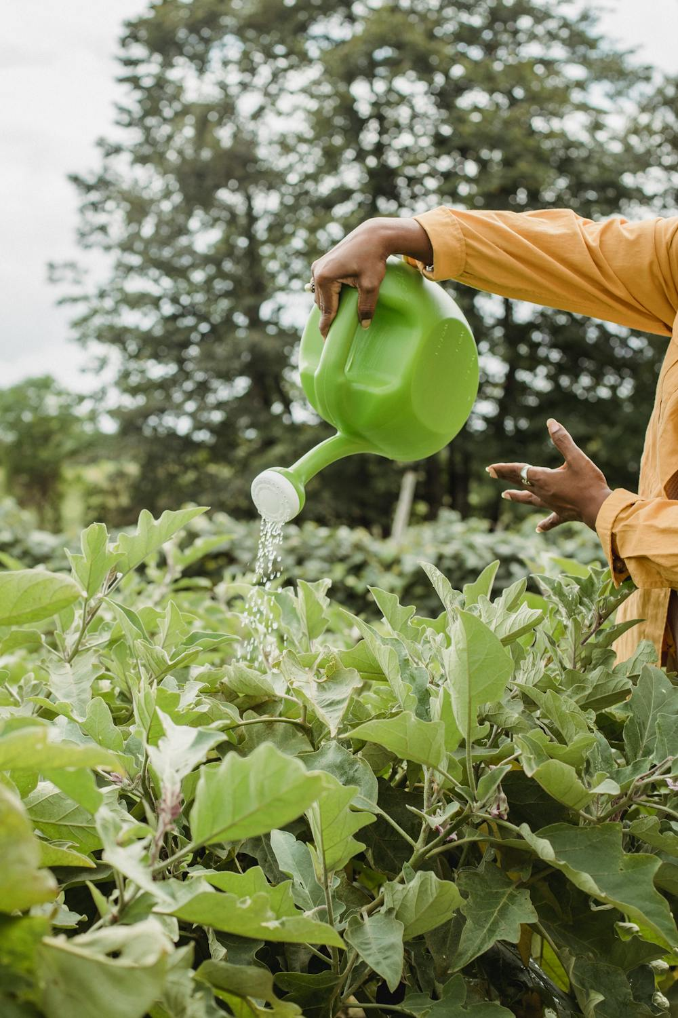
Bonus Content
Throughout the day we have embedded a sprinkling of strategies to help you create a culture of wellness in your classrooms, buildings, divisions, and homes. Keep an open mind and apply what feels appropriate for you!

Slide 15
Set a Personal Intention

Slide 16
What are you feeling today?
1 | 2 | 3 | 4 | 5
So tired I could barely get out of bed | Waiting for my coffee to kick in | Ok, but could really use a vacation | Feeling pretty good | So excited I can barely contain my enthusiasm

Slide 17
Taking Care of You!
If you were a 1, 2, or 3, what do you need to move up to a 4 or 5?
If you were a 4 or 5, what do you need to maintain that?
Is there anything we can do to support you in moving up the scale?

Slide 18
Bonus Content- Reset Strategies
Notes:
Link: https://www.youtube.com/watch?v=MqariSXiSvs

Slide 19
A Few Considerations
Creating A Culture of Wellness
Establishing a Foundation

Slide 20
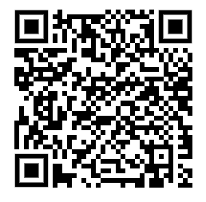
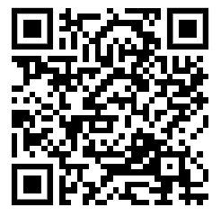
Language is Important
Check out these resources
here or at the links in the
chat
Notes:
Please place in the chat:
https://www.ffcmh.org/_files/ugd/49bf42_45b869cebad448d6a6ba48385639d427.pdf?index=true
https://www.nami.org/advocate/its-not-stigma-its-discrimination/

Slide 21
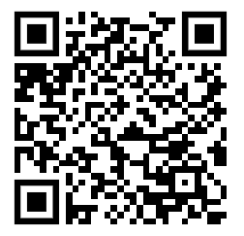
Let’s Reflect
Padlet
Use this QR code or the link in the chat to reflect on the resources we just reviewed.
Notes:
Please place link to padlet in chat: https://padlet.com/kbmcculloch1/my-epic-padlet-erpbgtjvcmr9sd2v

Slide 22
Why?
Creating A Culture of Wellness
Establishing a Foundation

Slide 23
What is Your Why?

Slide 24
Why Create a Culture of Wellness?
In your small groups discuss the following question:
Why do we need to create a culture of wellness in our schools and divisions?

Slide 25
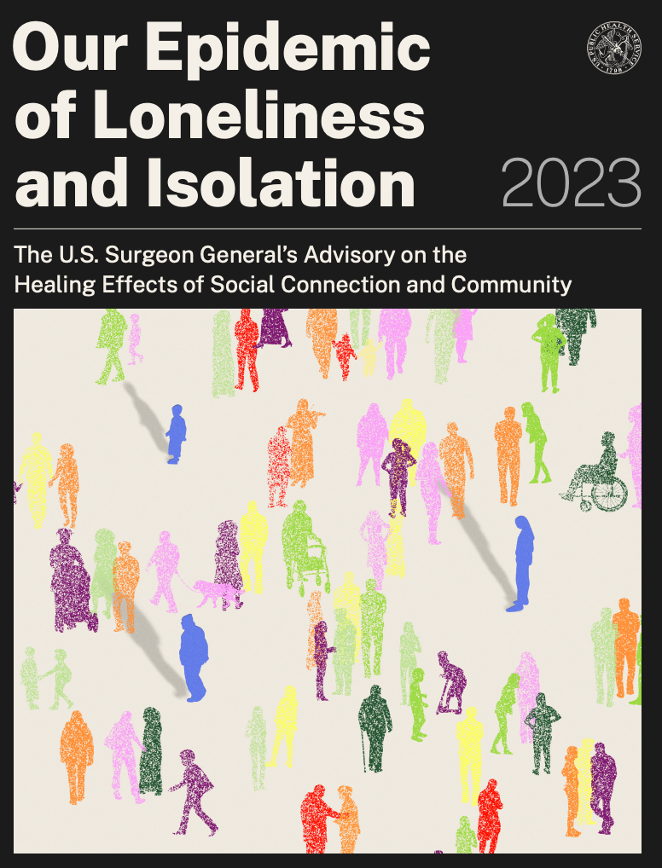
Social connection is a fundamental human need
Virginia Ranks 48th in the nation
for youth access to mental health services
“Social connection— the structure, function, and quality of our relationships with others—is a critical and underappreciated contributor to individual and population health, community safety, resilience, and prosperity.”
Youth are 21 times more likely to seek school-based mental health services than community-based services
(Guo et al., 2017; Fiat et al., 2017; U.S. Surgeon General’s Office, 2023)

Slide 26
We share stories to validate experiences and reduce discrimination. On the next slide we will share a story that has language related to self-harm and suicidal ideation. Please take care of yourself and step away if needed.

Slide 27
Sierra’s Story
Notes:
https://www.nami.org/personal-stories/sierras-story/

Slide 28
A Sense of Urgency
Suicide is the 2nd leading cause of death among high school aged youth 14-18
Nearly 1 in 3 parents (31%) shared that their child’s mental health is worse than before the pandemic
In 2019, more than 1 in 3 high school students said they experienced persistent feelings of sadness or hopelessness, 1 in 5 seriously considered suicide
In 2020, the percentage of emergency department visits increased by 24% for children ages 5-11 and by 31% for youth ages 12-17 compared to the same period in 2019
(Hopeful Futures Campaign, 2022)
Notes:
America’s School Mental Health Report Card (Feb. 2022) https://hopefulfutures.us/wp-content/uploads/2022/02/Final_Master_021522.pdf
There is more:
◦Among girls, 30 percent said they seriously considered attempting suicide, double the rate among boys and up almost 60 percent from a decade ago.
◦Almost 20 percent of girls reported experiencing rape or other sexual violence in the previous year, also an increase over previous years.
◦Almost half of LGBTQ students said they had seriously considered a suicide attempt.
◦More than a quarter of American Indians and Alaska natives said they had seriously considered a suicide attempt — higher than other races and ethnicities.

Slide 29
Youth in Crisis
Nearly 1 in 3 teen girls (30%) seriously considered attempting suicide—up nearly 60% from a decade ago.
1 in 5 (18%) teen girls experienced sexual violence in the past year—up 20% since 2017, when CDC started monitoring this measure.
More than 1 in 10 (14%) teen girls had ever been forced to have sex—up 27% since 2019 and the first increase since CDC began monitoring this measure.
More than half (52%) of LGBQ+ students had recently experienced poor mental health and, concerningly, that more than 1 in 5 (22%) attempted suicide in the past year.
CDC Youth Risk Behavior Survey, 2023
Notes:
Link in chat: https://www.cdc.gov/healthyyouth/data/yrbs/pdf/YRBS_Data-Summary-Trends_Report2023_508.pdf

Slide 30
Students with Disabilities
Higher rates of depression, anxiety, and anger (Kelchner et. al., 2019).
Often receive inappropriate disciplinary actions rather than mental health support (Kelchner et. al., 2019).
Students identified ID/DD are seldom assessed for mental health disorders (Kelchner et. al., 2019).
Less than 1% receive school-based mental health services as a component of their IEP (Santiago et al., et al., 2014).
Students with a disability and mental health disorders (anxiety, ADHD, and depression) that received school-based mental health services resulted in decreased school absenteeism and suspension rates (Lambros et al.2016).
(CDC, 2023; Guo et al., 2017; Kelchner et al., 2019; Lambros et al., 2016; Weist et al., 2018).

Slide 31
The Role of Technology
Youth who spent the most time on their digital technology were statistically more likely to exhibit higher levels of internalizing problems two years later.
Internalizing problems include depression, anxiety, social anxiety, somatic complaints, and other concerns.
Zhao, Yihong, et al. “Brain structural co-development is associated with internalizing symptoms two years later in the ABCD cohort.” Journal of Behavioral Addictions, vol. 12, no. 1, 30 Mar. 2023, pp. 80–93, https://doi.org/10.1556/2006.2023.00006.

Slide 32
Vulnerable Populations
Female students
Students who identify LGBTQ+
Students who have experienced discrimination in school
Hispanic students
High-achieving students
Students from low-income households
Students living in single-parent, blended, kinship, foster/board care
Students with disabilities
(CDC, 2023; Guo et al., 2017; Kelchner et al., 2019; Lambros et al., 2016; Weist et al., 2018).

Slide 33
Small Group Discussion
How do you see this reflected in your classrooms and schools?
Are you considering manifestations that are internal as well as those that are external?
How does this manifest differently across the variety of students you serve?
Notes:
Small Group Discussion
Place in chat:
How do you see this reflected in your classrooms and schools?
Are you considering manifestations that are internal as well as those who are external?
How does this manifest differently across the variety of students you serve?

Slide 34
Bonus Content- Zen Dens
How can you create wellness spaces or kits for your students, staff, and families?
Considerations:
How will you invite families, students, and staff to engage?
How will educators and students find time to engage with the space or kit?
How will you promote the use of and manage the resources and time to allow for that?
How will you teach appropriate use of the space for all?
Notes:
https://www.edweek.org/leadership/zen-dens-creating-mental-health-spaces-at-school/2023/02

Slide 35
The Impact in Adults

Slide 36
We share stories to validate experiences and reduce discrimination. On the next slide we will share a story that has language related to anxiety and depression. Please take care of yourself and step away if needed.

Slide 37
Maria’s Story
Notes:
https://www.nami.org/personal-stories/learning-to-prioritize-my-mental-health-2/

Slide 38
The State of the Profession
Principals and teachers report higher job stress than other workers, and educators of color are even more likely to report poorer well-being (Steiner et al., 2022a).
Job-related stress for educators has been linked to poor physical and mental health, absenteeism, and turnover, which in turn have been shown to have negative impacts on students’ academic and nonacademic outcomes (Levin & Bradley, 2019; Madigan & Kim, 2021; McLean & Connor, 2015).

Slide 39
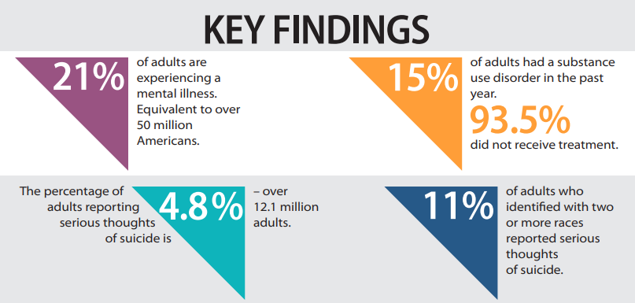
Consider our Educators and
our Families
2023 State of Mental Health in America Report, www.mhanational.org/sites/default/files/2023-State-of-Mental-Health-in-America-Report.pdf.
Notes:
https://www.mhanational.org/sites/default/files/2023-State-of-Mental-Health-in-America-Report.pdf

Slide 40
We share stories to validate experiences and reduce discrimination. On the next slide we will share a story that has language related to disordered eating. Please take care of yourself and step away if needed.

Slide 41
Tommy’s Story
Notes:
https://www.seemescotland.org/stigma-discrimination/personal-stories/personal-stories/tommys-story

Slide 42
Small Group Discussion
How do you see this reflected in your schools and divisions?
Consider all adults:
Educators
Staff
Administrators
Families
Community Partners
Notes:
Small Group Discussion:
Please place in chat:
How do you see this reflected in your schools and divisions?
Consider all adults:
Educators
Staff
Administrators
Families
Community Partners

Slide 43
Bonus Content- Tap in Tap Out
Notes:
https://www.youtube.com/watch?v=qPtsP7pBobI

Slide 44
Core Components
Aligned Organizational Structure
Evaluation of Process
Data Informed Decision Making
Whole Child
Monitoring Student Progress
Evidence Based Practices
Family, School, Community Partnerships

Slide 45
Why: A Few Considerations
Do we have data to support our why?
Are we considering all of our partners, families, and students when dreaming and designing our vision?
Are all voices captured?
Are we leading with our vision?
Personal Consideration:
How are you modeling this as a priority in your role?

Slide 46
An Expanded Use of Data to
Support your Why
School Data
Attendance
Grades
Discipline
Community Data
Poverty
Homelessness
Domestic violence
Substance use
Barrett, S., Eber, L., Perales, K., & Pohlman, K., (2019) ISF Fact Sheet Series. Retrieved from Pacific Southwest (HHS Region 9) Mental Health Training and Technology Center Funded by Substance Abuse and Mental Health Services Administration

Slide 47
Junk Room Review

Slide 48
Let’s Take a Break

Slide 49
Choice of Breakouts
1: Increasing Awareness for all Stakeholders
2: Using Data to Provide a Vision and Purpose
3: Leveraging Student Voice
4: Wellness Space: Take a break and reset
In a moment you will be prompted to choose a breakout session. Please choose between the following sessions to the right.

Slide 50
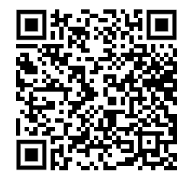
Questions?
If you have questions related to your breakouts or the main session, please fill out this quick survey and we will be in touch!
Notes:
Please place link in chat: https://docs.google.com/forms/d/1x_MVZvy4o50JVdGqnFF7-5Fb-KmkHQBdLe4UX7ogdmY/edit

Slide 51
Let’s Pause for Lunch

Slide 52
Processing, Discussion, Action Planning
What did you hear that is meaningful to your context?
What next steps will you take to implement in your divisions/schools/classrooms?
How will you share/involve all partners?
Students
Families
Community Partners

Slide 53
What?
Creating A Culture of Wellness
Practices for Implementation

Slide 54
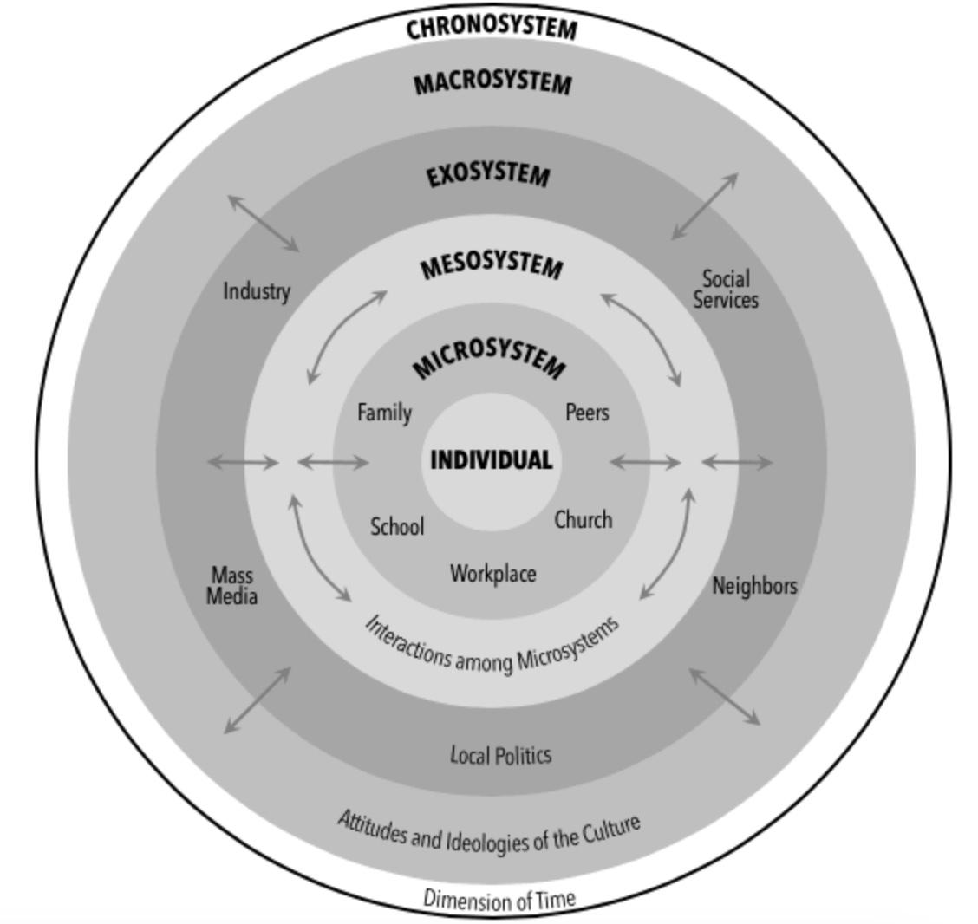
Bronfenbrenner’s Ecological Systems Theory
Discourse on Learning in Education (https://learningdiscourses.com)
Notes:
https://www.ilgateways.com/docman-docs/faculty-resources/itc-landing-pages/3101-fcr1-4-bronfenbrenner-s-ecological-systems-theory/file
B&W image Discourse on Learning in Education (https://learningdiscourses.com)

Slide 55
Now What?

Slide 56
Core Components
Aligned Organizational Structure
Evaluation of Process
Data Informed Decision Making
Whole Child
Monitoring Student Progress
Evidence Based Practices
Family, School, Community Partnerships

Slide 57
Teaming Structures Expanded
An example
Barrett, S., Eber, L., Perales, K., & Pohlman, K., (2019) ISF Fact Sheet Series. Retrieved from Pacific Southwest (HHS Region 9) Mental Health Training and Technology Center Funded by Substance Abuse and Mental Health Services Administration

Slide 58
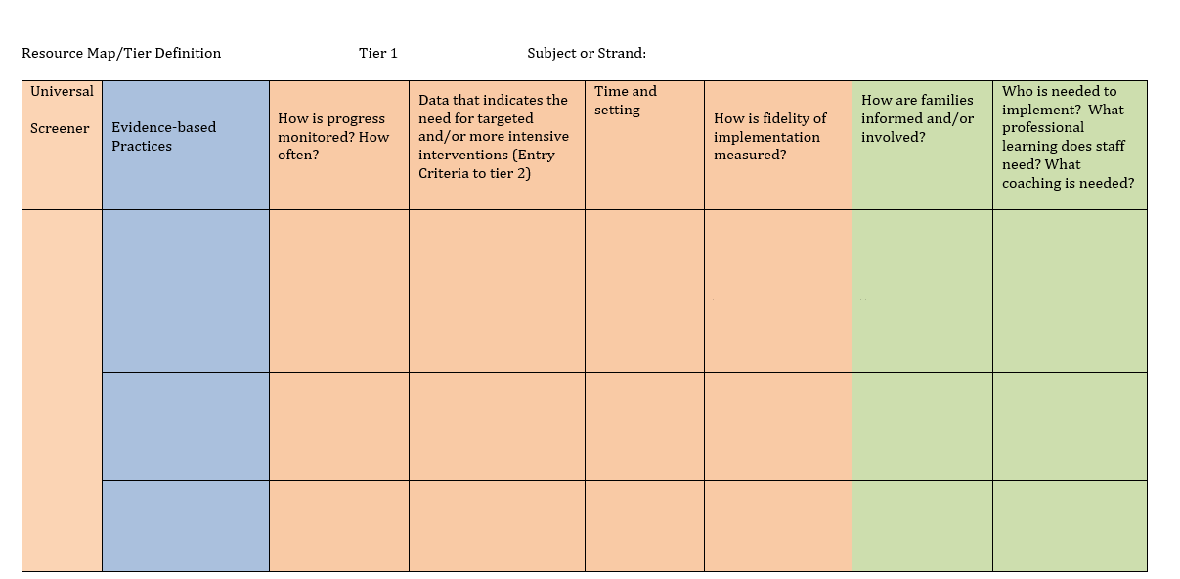
Take Inventory

Slide 59
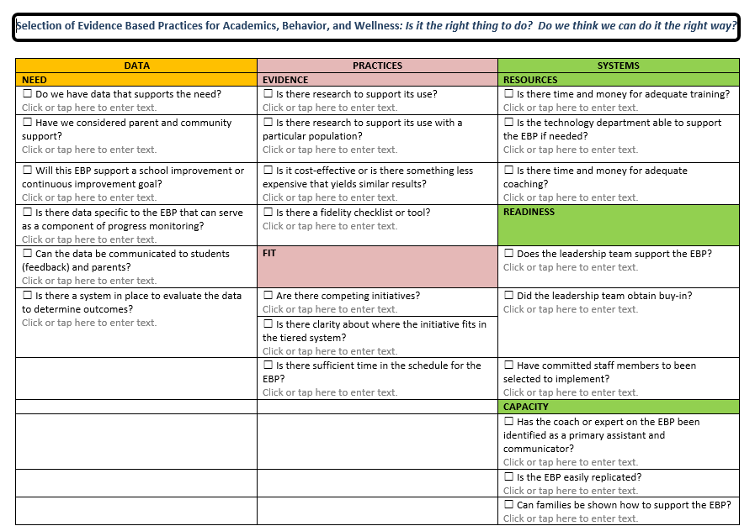
Selection of Evidence Based Practices

Slide 60
Mental Health is for All!!
Mental health wellness is a protective factor
“Within a mental health for all approach, student social, emotional, and behavioral health is addressed with the same level of attention and concern as cognitive development and academic achievement.”
Susan Barrett, Lucille Eber, Mark Weist Advancing Education Effectiveness: Interconnecting School Mental Health and School-wide PBIS Volume 2: An Implementation Guide

Slide 61
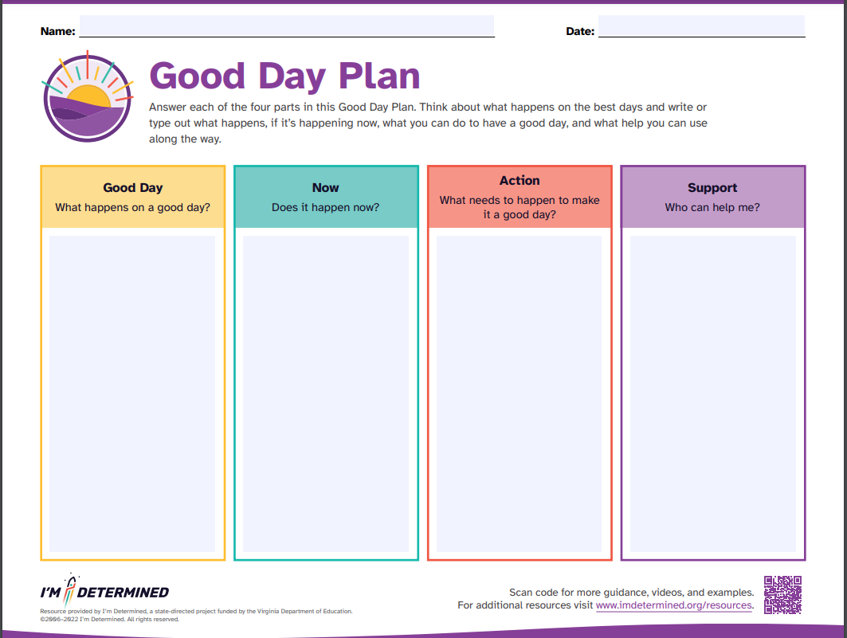
Bonus Content- Good Day Plan
Notes:
https://www.imdetermined.org/tool/good-day-plan/
Have participants complete their own
How might we use this tool to create a culture of wellness in our buildings and divisions? How can we use it with students, staff, families?

Slide 62
Choice of Breakouts
1: Practices to Increase Educator Retention
2: Practices to Create a Culture of Wellness in the Classroom
3: Recognizing and Supporting Students with Internalizing Behaviors
4: Wellness Space: Take a break and reset
In a moment you will be prompted to choose a breakout session. Please choose between the following sessions to the right.

Slide 63
Questions?
If you have questions related to your breakouts or the main session, please fill out this quick survey and we will be in touch!
Notes:
Please place link in chat: https://docs.google.com/forms/d/1x_MVZvy4o50JVdGqnFF7-5Fb-KmkHQBdLe4UX7ogdmY/edit

Slide 64
Let’s Take a Break

Slide 65
How?
Creating A Culture of Wellness
Systems to Sustain

Slide 66
Core Components
Aligned Organizational Structure
Evaluation of Process
Data Informed Decision Making
Whole Child
Monitoring Student Progress
Evidence Based Practices
Family, School, Community Partnerships

Slide 67
Integrated Systems Framework
A structure and process for education and mental health systems to interact in most effective and efficient way.
Utilizes MTSS framework to guide integrated approach.
Integration of social-emotional-behavior supports, tiered systems of support, and Positive Behavioral Interventions and Supports (PBIS) to address broad range of concerns.
Guided by key partners using a single system of delivery.
Addresses concerns from a holistic vantage.
(Barrett et al., n.d.; Barrett & Yanek., 2023; Weist et al., 2018)

Slide 68
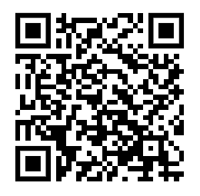
Let’s Explore Some Resources
Check out the resources provided here with this QR code or in the link in the chat.
Notes:
https://www.pbis.org/mental-health-social-emotional-well-being

Slide 69
Integration and Alignment

Slide 70
It is a Verb, Not a Noun
“ISF applies the core features of MTSS to deliberately integrate mental health, community, school, and family partners through a single system of support.”
Barrett, S., Eber, L., Perales, K., & Pohlman, K., (2019) ISF Fact Sheet Series, retrieved from Pacific Southwest (HHS Region 9) Mental Health Training and Technology Center Funded by Substance Abuse and Mental Health Services Administration
Notes:
https://www.pbis.org/mental-health-social-emotional-well-being

Slide 71
MTSS framework to guide an Integrated Approach
Integrated team-based decision making
Use of school and community data
Formal process for selecting EBPs connected across tiers
Early access through comprehensive screening
Rigorous progress monitoring for fidelity and impact
Ongoing professional learning and coaching for school and community professionals
Barrett, S., Eber, L., Perales, K., & Pohlman, K., (2019) ISF Fact Sheet Series, retrieved from Pacific Southwest (HHS Region 9) Mental Health Training and Technology Center Funded by Substance Abuse and Mental Health Services Administration

Slide 72
Bonus Content

Slide 73
Choice of Breakouts
How to Maximize/Share the Load Across a Variety of Roles
Family and Community Partnerships
Strengthening Systems through Monitoring and Evaluation
4: Wellness Space: Take a break and reset
In a moment you will be prompted to choose a breakout session. Please choose between the following sessions to the right.

Slide 74
Questions?
If you have questions related to your breakouts or the main session, please fill out this quick survey and we will be in touch!
Notes:
Please place link in chat: https://docs.google.com/forms/d/1x_MVZvy4o50JVdGqnFF7-5Fb-KmkHQBdLe4UX7ogdmY/edit

Slide 75
Processing, Discussion, Action Planning
What did you hear that is meaningful to your context?
What next steps will you take to implement in your divisions/schools/classrooms?
How will you share/involve all partners?
Students
Families
Community Partners

Slide 76
We Would Love Your Feedback!
Please complete our evaluation using the QR code here or at the link in the chat.

Slide 77
A Moment of Gratitude
Thank you for joining us today!
Take this opportunity to create a culture of wellness in our broad educational community by sending a message of gratitude!
Text
Email
Direct Message

