Slide 1
Tier 1 Team Training Behavior: Booster
TFI 1.10: Faculty Involvement
Notes:
1.10 Timing guide – 25 minutes

Slide 2
Follow VTSS
Thank you for attending. Please feel free to tag us at any of our social media handles below!
Twitter - VTSS_RIC
Facebook - VTSSRIC

Slide 3
VTSS Resource Hub
https://tinyurl.com/2bp8dhch
Notes:
To post in Chat:
Feedback for the Resource Hub: https://tinyurl.com/2bp8dhch

Slide 4
Involvement for Buy-In
PBIS implementation needs to change, grow, and evolve over time.
Think about how your colleagues experience change.
Think about how it feels when new ways of work arrive on your doorstep.
How do you want your voice heard?
How do you want to be involved in implementation decisions?
What do you look for when deciding if you are onboard with the change?
Notes:
Intent: Think about change and how it impacts buy-in
Trainer Talking Points:
We need to be proactive so we can be preventive.
How many of you have experienced a new superintendent?
We don’t want staff to feel like this is just one more program that will go away one day. How can you listen for understanding, get involvement and buy-in to ensure this proven way of work continues? We all learn differently and how can you meet the needs of all the adult learners in your building? How can you present this information account for different cultural backgrounds and internal biases?

Slide 5
Faculty Involvement means
at least 80% buy in
Collectively, staff will:
Identify focus
Identify ways to monitor progress
Identify goals
Identify ways to evaluate outcomes
Notes:
Intent: We need 80% buy-in for this way of work.
Trainer Talking Points:
Per the PBIS Handbook, we approach buy-in with prevention logic and good teaching and planning.
What brought you to the decision to implement VTSS? Was there data to support this decision?
How will you progress monitor to assess for change?
What are your goals for this year, knowing they will change over time?
How will you evaluate your outcomes?
How will you manage staff turn over?

Slide 6
Rationale
… and Implementation of PBIS involves all faculty and staff
Notes:
Intent: Bring out the best in your staff!
Trainer Talking Points:
Peter Drucker is considered the single most important thought leader in the world of management. His well known writings focuses on relationships and are filled with lessons on how organizations can bring out the best in people and find a sense of community. Who are your nay sayers? Who are your cheerleaders? Can you model a successful classroom and reward staff for building commitment?
Now organizations can bring out the best in people and find a sense of community.

Slide 7
How will you engage staff in the implementation of PBIS?
Providing professional learning/mentorship
Sharing data
Inviting input and feedback AND using it to change and grow
Notes:
Intent: What are the Systems to support your staff?
Trainer Talking Points:
How will you prepare and define your profession learning and mentorships? Looking at your data, where is there a need for PL?
How will you invite feedback and USE IT? How do you creating a safe environment for that feedback. Remember to recognize input and great ideas.
It’s so important that you have these conversations now to be proactive and prepared!

Slide 8
Share what data, when, and with whom
What and When
Who
What data do we need them to know about?
What data points does the team want to examine or move?
How regularly should we share for maximum impact?
When?
Where?
How?
With whom is data shared and examined?
Central Office
Faculty
School personnel
Family
Community
Notes:
Intent: Tell your story with data.
Trainer Talking Points: How often is data shared with your entire staff?
In being transparent with our data, it helps everyone understand your story. We help the entire school (staff and students) our families and community understand the need for this work, progress monitoring and assessing for fidelity.
Of course with family and community we need to be aware of confidentiality and respect privacy. How can you share this data without ruffling any feathers?
Ask participants to share ideas that work at their school.

Slide 9
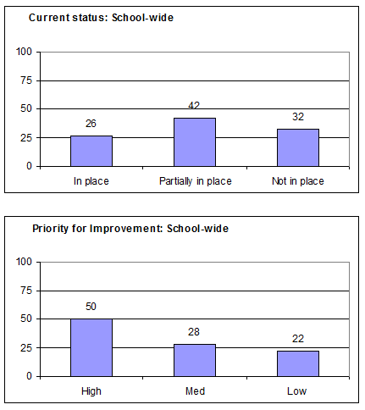
What data will you share?
Informal surveys?
TFI results?
Climate Surveys?
Discipline Data?
Notes:
Intent: Being thoughtful about what data to share and when to share.
Trainer Talking Points:
Determine what data to share with faculty- this could be part of the kick off event for staff! Tie positive outcomes to celebrations!
The class with the greatest reduced ODR’s gets extra recess or a chance to soak their teacher with water guns! Remember to recognize staff as well to build community and showcase exemplar instruction.

Slide 10
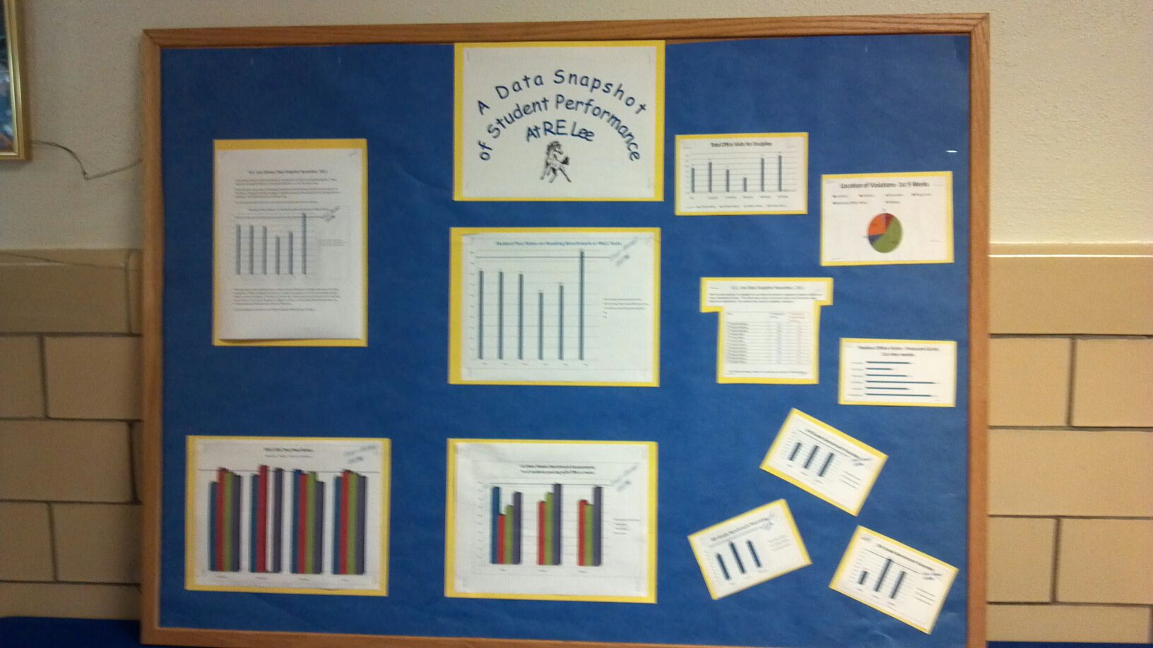
How and when will you share data?
Share visuals with staff monthly
What’s working?
What needs more focus?
Emphasize staff involvement
Notes:
Intent: Be creative with your sharing and think about the needs of your community and staff.
Trainer Talking Points:
What visual data can you share without offending or breaking trust to build moral?
Graphs, videos, newsletters, social media, etc. Think about your community and how they get their news. Will one of your local restaurants offer free dessert for performance in academics or attendance?

Slide 11
Ongoing Input and Feedback: Communication and Feedback Loops
Grade level/core/department meetings
Team meetings
Staff/Faculty Meetings
Google Docs, SharePoint, or other virtual sharing mechanisms
Newsletters
Professional development days
Communities of Learners (shared learning)
Notes:
Intent: This is more than just sharing data.
Trainer Talking Points:
You see a common theme running through the Faculty Commitment element: COMMUNICATE for understanding / trust/ safety/ transparency/ ownership.
Systems wide…do meeting structures flow in order i.e. grade level mtg then PBIS mtg, staff mtg, parent advisory---What flow works for your school?
Think about the best time to share information, then collect info, push out to the whole, etc. Admin. need to look for this structure.
Pre-plan guiding questions for each mtg that requires faculty reflection, data analysis, feedback, for developing their own conclusions and discuss.
Faculty given opportunities to provide feedback, to offer suggestions, and to make choices in every step of the PBIS process (via staff surveys, voting process, suggestion box, etc.) Nothing is implemented without the majority of faculty approval

Slide 12
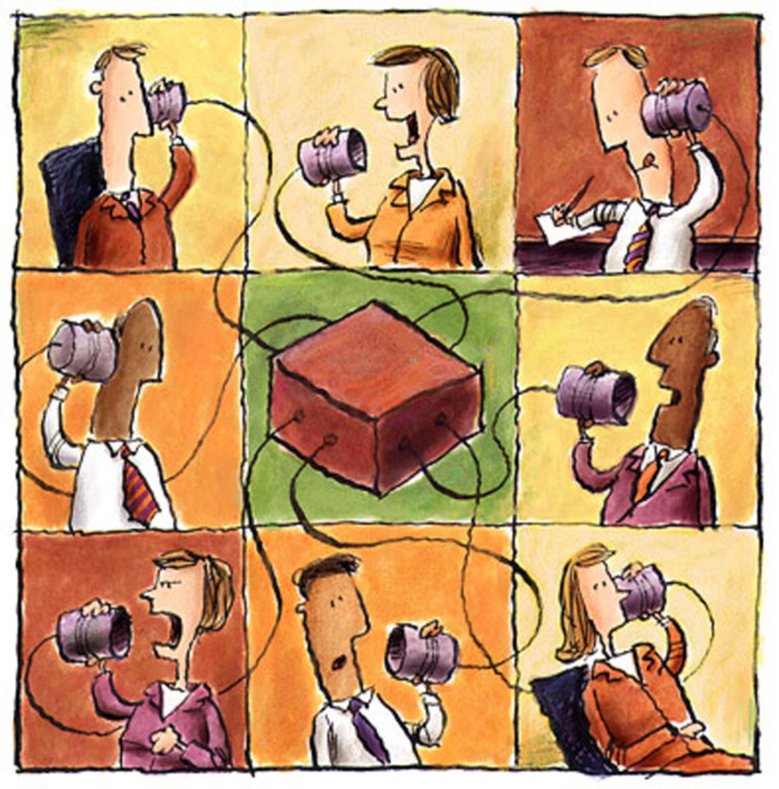
Input and Feedback: Create a Communication System
Presenting data
Sharing ongoing information
Obtaining feedback from stakeholders
Reviewing goals and action plans
Notes:
Intent: Best ways to share data and get feedback
Trainer Talking Points:
Consider how your team has decided the best way to share data. Remember it’s important for our buy-in to get feedback from all stakeholders (families, staff and the community).

Slide 13
Questions
Notes:
Intent: Thank you and address questions.

