Slide 1
Tier 1 Team
Training Behavior: Booster
TFI 1.11 Student, Family, and Community Engagement
Notes:
Intent:
Trainer Talking Points:

Slide 2


Follow VTSS
Thank you for attending. Please feel free to tag us at any of our social media handles below!
Twitter - VTSS_RIC
Facebook - VTSSRIC

Slide 3

VTSS Resource Hub
https://tinyurl.com/2bp8dhch
Notes:
To post in Chat:
Feedback for Resource Hub: https://tinyurl.com/2bp8dhch

Slide 4
Involvement and Engagement
Involve - to enfold or envelope; implies doing to
Engage - to come together and interlock; implies doing with
A school striving for family involvement often leads with its mouth.
A school striving for family engagement, on the other hand, tends to lead with its ears.
The goal of family engagement is not to serve clients, but to gain partners.
Ferlazzo, 2011
Notes:
Intent: Introduction to the idea of family engagement versus involvement
Trainer Talking Points:
A school striving for family involvement often leads with its mouth—identifying projects, needs, and goals and then telling parents how they can contribute.
A school striving for parent engagement, on the other hand, tends to lead with its ears—listening to what parents think, dream, and worry about. The goal of family engagement is not to serve clients but to gain partners.
Equitable engagement provides for a broad range of opportunities that meet the diverse needs of families in the school community.
Strong examples include: Holding a fall back-to-school open house where parents/caregivers follow their student’s daily schedule and hear about each teacher’s expectations and grading policies. Or creating content to send home that engages families with their students and reinforces instruction.

Slide 5
Involvement and Engagement
It's not that family involvement is bad.
Family engagement can produce even better results for students, families, school and the community (Ferlazzo & Hammond, 2009).
Family involvement and engagement are not mutually exclusive; most schools pursue both.
Notes:
Intent: Clarify involvement versus engagement
Trainer Talking Points:
Look at all parts of your family populations (gender, age, SES) Are opportunities accessible, meaningful? is the greater school community equitably engaged?
Do you have multiple access points to engage large swaths of your school’s population?
It's not that family involvement is bad. Almost all the research says that any kind of increased parent interest and support of students can help.
Almost all the research also says that family engagement can produce even better results—for students, for families, for schools, and for their communities (Ferlazzo & Hammond, 2009).
Family involvement and engagement are not mutually exclusive; most schools pursue both.

Slide 6
Pulse Check for Your School
Does your school tend toward doing to or doing with families?
Does the staff do more talking or more listening?
Is the emphasis on one-way communication or on two-way conversation?
Is your school's vision of its community confined to the school grounds, or does this vision encompass the entire neighborhood?
Is your school tracking which families are accessing and utilizing supports and resources?
Notes:
Intent: Pulse check
Trainer Talking Points:
Take a few minutes and allow the participants to reflect on these questions.
Training Activity:
Pulse check – where are we now?

Slide 7
Family Engagement Domains
Leadership- school level leadership (administrators and school leadership team) establish FE as a priority; FE is included in school vision, mission, goals and these are aligned with division vision & goals for FE. PD and ongoing coaching to build capacity for staff and families to work together to support student outcomes.
Data-based Goals & Outcomes- FE goals and outcomes are identified and monitored with data. Based on student outcome data and input from families and staff. Focus on knowledge, skills, practices and actions of staff and families.
Notes:
Intent: Review of Family Engagement Domains
Trainer Talking Points:
Review as time permits
Source: Minch, Kincaid, Tremaine & Thomas, 2017, in Aligning & Integrating Family Engagement in PBIS

Slide 8
Family Engagement Domains (cont.)
Positive Relationships- Relationships between educators and families are positive, educators recognize families’ needs and cultural characteristics, leading to greater understand and respect among all.
Family Empowerment- Educators use effective strategies to identify and encourage families’ knowledge, skills and efficacy for supporting students learning. Results in empowered families who serve as leaders, advocates, supports and partners in student learning.
Notes:
Intent: Review of Family Engagement Domains
Trainer Talking Points:
Review as time permits
Source: Minch, Kincaid, Tremaine & Thomas, 2017, in Aligning & Integrating Family Engagement in PBIS

Slide 9
Family Engagement Domains (cont.)
Multi-tiered Approach- Educators use multidimensional approaches to engage families in dialogue (multiple communication modes. Educators use multi-tiered approaches including tier 1 strategies for all families, more intensive tier 2 and tier 3 approaches for fewer families
Collaborative Problem-Solving- Families of children receiving Tier 2 and Tier 3 supports are effectively engaged in all steps of the problem-solving process
Notes:
Intent: Review of Family Engagement Domains
Trainer Talking Points:
Review as time permits
Source: Minch, Kincaid, Tremaine & Thomas, 2017, in Aligning & Integrating Family Engagement in PBIS

Slide 10
VTSS Family Engagement Video Resources
Family Engagement in VTSS for educator audiences (3 videos, addressing all components)
Family Engagement with Schools primarily for family and community audiences
Promoting Equity in Education Through Family Engagement for all audiences
Family Members on VTSS Teams for education leaders
All VTSS/ Formed Families Forward videos can be found at
https://formedfamiliesforward.org/vtss/
Notes:
Chat Box - https://formedfamiliesforward.org/vtss/

Slide 11
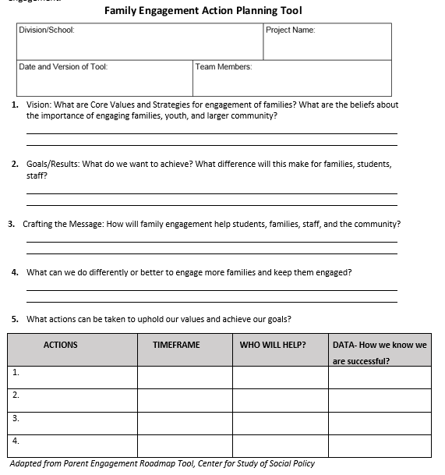
Family Engagement Action Planning Tool
Notes:
Intent: consider actions/strategies and this action planning tool to support your work.
Chat Box - VTSS Family Engagement Vision and Data Worksheet
Trainer Talking Points: What actions could immediately identify for moving the needle on family engagement? Write them in question 5. Remember to align these actions with your very rough visioning and goals discussed earlier.

Slide 12
Consider:
Does your division have a definition or model for family and community engagement? If so, what are the outcomes and expectations for schools?
How are outcomes/expectations inclusive of and responsive to family and community culture?
How do family and community members know how and when to engage?
What facilitates engagement in your division and school?
Notes:
Intent: Thoughts to consider – where is your school?
Trainer Talking Points:

Slide 13

Suggestions, Comments, Questions, Exemplars?
COMMENTS
SUGGESTIONS
QUESTIONS
EXEMPLARS

