Slide 1
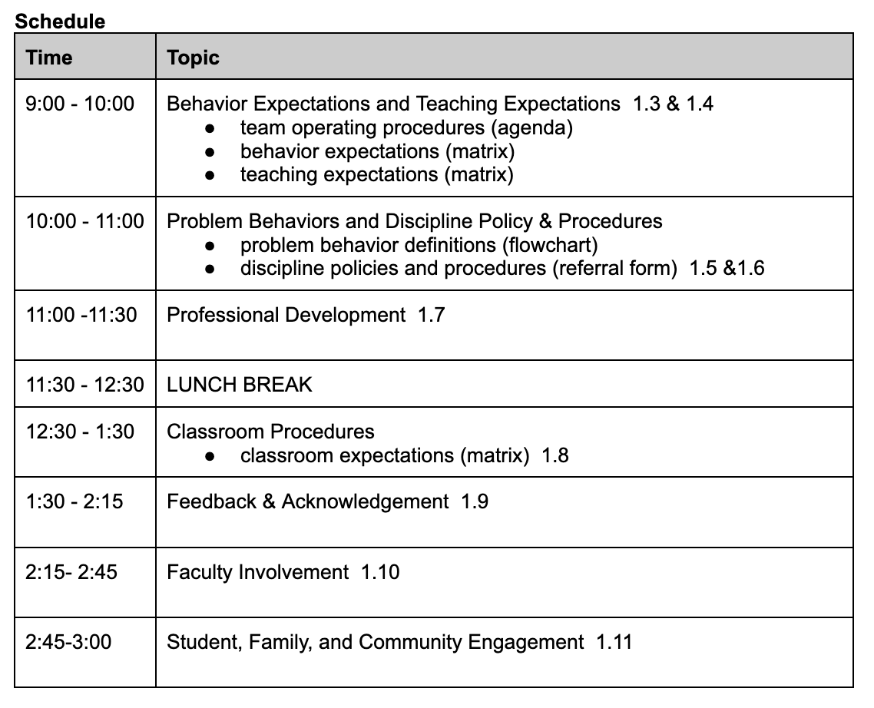
Schedule
Notes:
Schedule for today
Introduce presenters
Attendance link

Slide 2
Follow VTSS
Thank you for attending. Please feel free to tag us at any of our social media handles below!
Twitter - VTSS_RIC
Facebook - VTSSRIC

Slide 3
VTSS Resource Hub
https://tinyurl.com/2bp8dhch
Notes:
To post in Chat: https://tinyurl.com/2bp8dhch

Slide 4
Roles
Regular Education Teacher | Central Office Staff | Grandparent of a school aged child. | Superintendent | School Counselor
Parent of a school aged child. | Special Education Teacher | School Psychologist | School Social Worker | Division Coach
District Coordinator | Building Level Coach | Principal | Assistant Principal | Dean Of Students
Notes:
So that everyone has an idea of who is attending, ask participants ( if willing) to annotate their roles and mark all that may apply

Slide 5
I Am Here
Notes:
We know you all regardless of your roles may have a lot on your plates or plans that are occupying your thoughts this summer. We want to ask you to give yourself permission to put that to-do list aside so that you might be here and be present. And engage in learning around key principles you are desiring to prioritize within your schools and/or across your division.

Slide 6
Where Are We in the Triangle?
Tier 3 for a Few: Intensive, Individualized
Tier 2 for Some: Targeted for Small Groups
Tier I for All: Core/Universal
1 - 5%
5 - 15%
80 - 90%
Notes:
Most important question of the day: Can you have a tiered system of support training without a triangle visual? ...well you could. but it wouldn’t be nearly as fun :-) So the idea of a tiered system of support and the visual of a triangle is not new. In fact, we have been seeing it for years.
The idea behind the triangle is that the foundation, or the bottom, of the triangle visual represents the foundation, Tier 1 core instruction support that all students receive. That should work for approximately 80% of our students. But, just as one size fits all clothing doesn’t always fit all, the instruction and supports provided to all students does not meet the needs of all students. When students require more intensive instruction than what is provided to all, we refer this as advanced tiers, or Tier 2 or Tier 3 supports. Research suggests that about 5-15% of students will need and benefit from tier 2 supports and about 1-5% from tier 3 supports.

Slide 7
Moving In and Out of Tiers
How are students’ experiences in a multi-tiered system of supports similar to a lava lamp?
Notes:
Activity:
Invite participants to unmute or add to the chat an answer to the question: “How are students’ experiences in a multi-tiered system of supports similar to a lava lamp?” (the blue or the colors/heat)
Language matters. We do not tier students. We tier interventions and supports. As such, students will naturally ebb and flow between different tiers of support depending on the intensity of instruction they may require. Students may also require different levels of support for different skill areas.

Slide 8
Tier 1 Behavior Booster 1.3 Behavioral Expectations
Notes:
Intent: Introduction - This is our Tier 1 Behavior Booster for Behavior Expectations
Trainer Talking Points: Our focus will be on creating and teaching behavior expectations.
Including all stakeholder/different voices is REALLY important to make sure we don't say anything offense when we are unaware.

Slide 9
Proactive Teacher Supports for Classroom Managed Behaviors
Develop, teach, and maintain clearly defined classroom expectations
Build positive relationships with students and families
Model and practice expectations in the appropriate settings
Reteach expectations throughout the school year
Use pre-correction strategies
Use more positive than corrective statements
Create classroom acknowledgement system
Implement evidence based practices
Actively engage students
Teach prevention lessons that address social-emotional competencies
Flexible classroom arrangements/seating
Notes:
Intent: MTSS (PBIS) is a preventative and proactive approach at every turn. Here is a list of proactive supports for classroom managed behaviors. As you read through this list, think about which of these might be most critical for you. Which of these are you wanting to focus on or you are currently focused on?
Here you can see that The goal is to be as preventative and proactive as we can be. Foundation of PBIS are the proactive, preventative pieces we put in place. If we can think about something being predictable, then we can think about preventing it.
Examples: I know that 7th grade girls may get into drama - I can predict this, so maybe I can put things in place to prevent some of this.
Do kindergarten students get a snack time because we predict they will need a break?

Slide 10
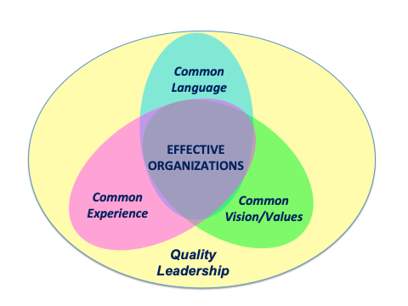
Common Expectations
Expectations (values) are broadly stated
3-5 positively stated expectations
Consistent with school’s mission statement
Expected of all faculty/students
(OSEP TAC on PBIS, 2015)
Notes:
Intent: Explain core features, rationale of expectations and importance of consistency.
Trainer Talking Points:Why do we want these to be broadly stated and easy to remember?
brain and behavior science - active memory research - our brains can typically recall patterns of 3 to 5
Repetition is critical, so the will “trip off tongue” of everyone - ALL staff and ALL students
stated in the everyday lexicon of students
Training Activities: Terry Scott Activity - the brain can remember 3-5 things.
Name:
9 supreme court justices
7 dwarfs (or 8 planets…)
3 Stooges
OR - flash up a list of grocery items, give them 10 second to read and see how many they remember.
What are some expectations you all have at your schools?

Slide 11
Building Expectations
Think about…
Utopia – the ideal school
what skills and abilities students need to be successful in their communities
the school vision statement
the school improvement plan
the team’s vision for PBIS
Alignment…
What programs and practices are you already using for behavior and emotional wellness?
What are the behavioral goals of these programs and practices?
Notes:
Intent: Introduce the process of building expectations based on ideal visions of your school. Introduce the concept of alignment...how are you aligning this to what you are already doing?
Trainer Talking Points: Think about your ideal school… the vision for your school
If you want to see/hear something, how can expectations help get us there?
Also consider: What skills/abilities students need to be...
Successful in real world.
Successful in their current community, but tied to real-world skills.
For high schools, school-wide expectations need to be aligned to academic and social success … “College and Career Ready”
This tool is your grounding document
Incorporate other tools into this, the key ideas – so language is the same
Ask where are students struggling behaviorally? Want to teach the replacement behavior
If a school team has a previously developed set of expectations or matrix – see if they align with what we’re sharing
Ask attendees to share - How many of you have observed student involvement in the development of your school’s matrix?
Trauma - if school has a SEL program/initiative we would want to reinforce that would need to align this work as building expectation; not one more thing
Diversity - remember to emphasize throughout that we don't want to just focus on the dominant culture. i.e. "the golden rule/ act like you would in a restaurant".

Slide 12
Creating Expectations
Expectation | SETTING
 | All Settings | Hallways | Playgrounds | Cafeteria | Library/ Computer Lab | Assembly | Bus
Respect Ourselves | Be on task. Give your best effort. Be prepared. | Walk. | Have a plan. | Eat all your food. Select healthy foods. | Study, read, compute. | Sit in one spot. | Watch for your stop.
Respect Others | Be kind. Hands/feet to self. Help/share with others. | Use normal voice volume. Walk to right. | Play safe. Include others. Share equipment. | Practice good table manners | Whisper. Return books. | Listen/watch. Use appropriate applause. | Use a quiet voice. Stay in your seat.
Respect Property | Recycle. Clean up after self. | Pick up litter. Maintain physical space. | Use equipment properly. Put litter in garbage can. | Replace trays & utensils. Clean up eating area. | Push in chairs. Treat books carefully. | Pick up. Treat chairs appropriately. | Wipe your feet. Sit appropriately.
Notes:
Intent: Anchor slide for the matrix.
Trainer Talking Points:
The matrix is the behavior curriculum - emphasis on this and its correlation to academic curriculum
The matrix has three components:
Expectation
Locations/Setting
Specific behaviors
Training Activities: Ask attendees to share - Do you have other locations captured on your matrix that are not captured on this one here?
Diversity - make sure to look at value laden language so we’re not focused on dominant culture. Don’t fall into deficit thinking of “other cultures” and recognize “cultural wealth”; all cultures contribute and one is not better than the other. I.E. Use a “normal” voice - what does that mean in different cultures.

Slide 13
Consistency with our language
Expectations | 3-5 overarching school-wide expectations
Behaviors | specific tasks students are to do to achieve the school-wide expectations
Routines/ Procedures | procedures are methods for accomplishing tasks in the classroom procedures form routines that help students meet classroom expectations and rules/behaviors
Notes:
Intent: Define what specific behaviors look like and sound like in various locations
Trainer Talking Points:We have looked at school-wide expectations and now we want to consider what those expectations look like and sound like in various locations around the school.
Why identify specific behaviors? We want consistency and take the guesswork out of “what do we mean by?” Gives adults the same language when we are communicating about behaviors to students and parents.
Example: If our expectation is that we want students and staff to be respectful, how might they show respect in the hallways? Would they stay to the right so others can get by? Would they refrain from talking when other classes are in session, so as not to disturb them?
We are developing consistency with our language by reframing what we want students to do.
We want to identify replacement behaviors for the behaviors that we are seeing in our data and predicting on our map.
Why? Goes back to consistency – remember this is our primary prevention tool
Teams are encouraged to consider the value of teaching social emotional skills. Example provided and discussed.
Keep specific behaviors limited. Need to honor students’ working memory.
As teams work, reminders are provided about predictable problems evidenced in data, key social emotional skills students need, specific behaviors vs. routines, and observable/measurable/positively stated/always applicable characteristics.
Trauma - remember we're teaching a behavior, but it's also teaching a "skill", how can we include this concept?
Diversity - avoid dominant culture only

Slide 14
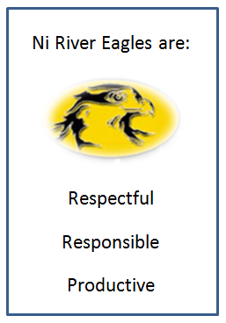
Middle School
Ni River Middle School , Spotsylvania VA
Notes:
Intent: Share success criteria
Trainer Talking Points:
Key components are referenced in examples and explained.
Ni River Middle School, Spotsylvania VA, posted their expectations on their website and throughout the building
School started with already existing pledge and pulled expectations from the pledge
Meade MS. Fort Meade, MD, Anne Arundel County used the BARK acronym to incorporate their bulldog mascot
They refer to this throughout the school and in all communications.

Slide 15
High School
South Lakes High School, Fairfax Co.
Notes:
Intent: High School examples
Trainer Talking Points:
Key components are referenced in examples and issues with non-examples are explained.
The poster on the left was a result of a student contest.
This drawing of the eagle with the expectations around it became the poster that symbolized this high school’s expectations.
It is posted at every door in the school and is visible on all school communications with the community. (South Lakes HS, Fairfax Co.)
Second picture is another HS that incorporated their mascot on all posters.

Slide 16
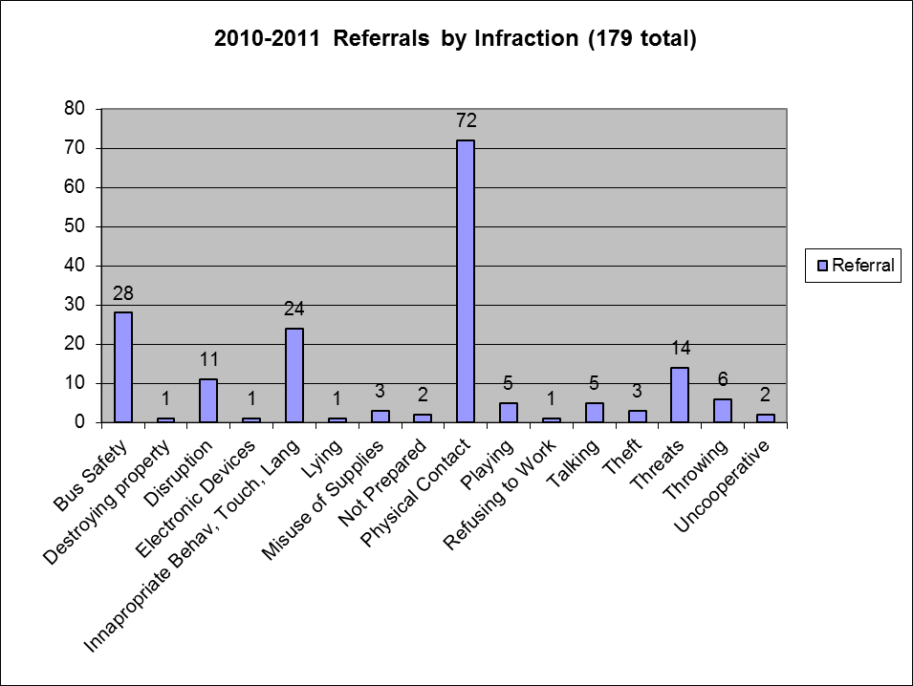
Does data corroborate your specifics?
Notes:
Intent: Use data to help us determine the specific behavior we’d like to see.
Trainer Talking Points: Data is one critical component to think about as we develop or revise school wide expectations.
Based on this data, what specific behaviors might the school need to identify that they can teach?
Definitions of these behavior issues might vary from staff member to staff member.
More discussion amongst staff might be needed to really figure out what primary source of the problem is.
This might change the specific behavior expectation needed.
Disproportionality check - who are the kids getting written up because it informs if there are culture challenges to address/ PL needed

Slide 17
View Through Different Lenses
How will students experience the matrix?
Doable?
Appropriate?
Am I learning life skills?
Examine for implicit bias to ensure that expectations are truly universal
Does this sound like a place I would want to go to school?
Notes:
Intent: Show the value of studying expectations from different points of view. Conversation pushes participants to wonder about how culture and experience impact how students (and then families) will perceive expectations.
Training Talking Points:
It is important to acknowledge how students will experience the matrix.*
There is also a need to look closer at expectations from different points of view - thinking about how culture and individual experiences impact how students (and then families) will perceive expectations.
For example:
What behaviors do Seniors need to be successful?
What do Freshmen need?
How will you account for the differences in developmental level and diverse lived experiences?

Slide 18
Assess the differences
Assess differences between school and other settings and ask:
Are the “different” school behaviors necessary for positive student development?
NO: Change the behaviors to align more with home and neighborhood
YES: Acknowledge explicitly and provide additional teaching, practice, and acknowledgment
Notes:
Intent: Awareness of school and community cultures
Trainer Talking Points: Teams actively and explicitly connect school-wide expectations to community values so that students and families are able to identify connections between school, home, and the community.
Example of “no” – if teaching kids to walk down the hall with “hand on your hip and finger on your lips” – since doesn’t work in the neighborhood, can I teach them another way to walk that will be helpful in multiple locations?
*Potential trainer talking point: Explaining differences in neighborhood playground expectations and school playground expectations. Being safe in both environments may be different; self-protection may mean interacting with each other on some neighborhood playgrounds while not at school. this is where being aware of the community served by the schools is important. I think you get the message.

Slide 19
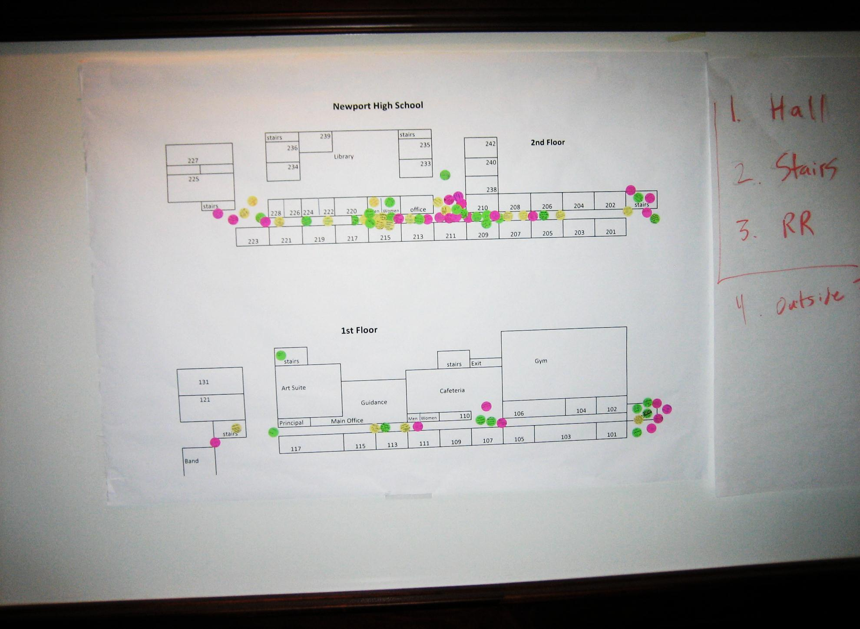
Ideas for Getting Feedback
Notes:
Intent: Planning for stakeholder involvement
Trainer Talking Points: Share ideas for replicating training activities with faculty.
Hallway activity with staff
Survey from students
Teams must be intentional about receiving feedback from the various identity groups within the school. Going beyond internal family members and members of organizations such as the PTA is important. Making sure that we are accommodating for persons who want to engage but may need a different form of engagement, such as phone, Zoom, etc., is important.

Slide 20
Questions and Answers

