Slide 1
Tier 1: Behavior Booster 1.4 Teaching Expectations
Notes:
Intent: To review teaching expectations
Trainer Talking Points:
Our focus for 1.4 will be teaching expectations.
Faculty, student and community involvement will be discussed throughout the module.
It is key that we include the voice of all stakeholders through the process.
Stakeholder involvement is ongoing and so we do not typically separate it in a module of its own.

Slide 2
Follow VTSS
Thank you for attending! Please feel free to tag us at any of our social media handles below!
Twitter - VTSS_RIC
Facebook - VTSSRIC

Slide 3
VTSS Resource Hub
https://tinyurl.com/2bp8dhch
Notes:
To post in Chat: https://tinyurl.com/2bp8dhch

Slide 4
Explicit Instruction
https://www.youtube.com/watch?v=fCVKCUB5w50
Notes:
Intent: Add some humor to highlight importance of explicit instruction
https://www.youtube.com/watch?v=fCVKCUB5w50 (1:40 minutes)
It is important to think about explicit instruction and not assume others understand what is expected. Let’s watch this video which highlights this in a fun way.
When you think about whether staff are being explicit with instruction - specifically in relation to the behavior expectations - does this spark anything for you?
Sometimes we assume a student should understand or know how to follow an expectation - and with that assumption, we are ignoring students’ context and development, and the need to ensure everyone is on the same page and are not relying on our own personal beliefs or experiences.

Slide 5
If a child doesn’t know how to…
If a child doesn’t know how to read,
If a child doesn’t know how to swim,
If a child doesn’t know how to multiply,
If a child doesn’t know how to drive,
If a child doesn’t know how to behave, we….
we teach
we teach
we teach
we teach
teach? punish?
Why can’t we finish the last sentence as automatically as we do the others?”
Notes:
Let’s all learn how we can teach ourselves to change our adult behavior so this last statement has the same outcome as the others.
Intent: Introduce core content: social behavior deficits should be viewed and responded to in the same way we view academic skill deficits - as a need for instruction.
Trainer Talking Points:
The following quote by John Herner expresses our difficulties with dealing with challenging behavior. Read quote, pausing to allow responses at the end of each line before “we teach” appears.
Do we regard behavior as a skill deficit that needs to be taught or do we perceive it as something that needs to be punished?
If we perceive it as something to be punished then it is very clear that we regard it differently than any of the other behaviors or skills that we address at school. As a result, we tend to approach it in less-effective and less-professional ways.
Appropriate behavior should be taught just like reading, swimming or driving.
Faculty/Student/Family Follow-up Engagement:
Important content for team to take back to school staff.
Consider using this slide with staff.
Consider sharing content with families.

Slide 6
The Science of Behavior Has Also Taught Us
Behavior is learned
so it can be ‘un-learned’
by explicitly teaching a replacement behavior
and providing praise and feedback
Notes:
Intent:
We also know that the science of behavior teaches us that behaviors are learned and meet some kind of need (function)…sometimes we learn behaviors that meet our individual/personal needs BUT interfere with the learning environment of the group. However, those behaviors can be replaced with time and plenty of deliberate practice.
Study the use of explicit instruction (an evidence-based practice) to teach all lessons (academic, behavior, social emotional).
Understand the reasons for teaching behaviors directly in settings and build a schedule for doing so.
Create a sample lesson based on the teaching matrix.
Brainstorm links between expectations and subject area curriculum.
Plan for training staff about lessons and their importance.
Trainer Talking Points:
Expected academic and social behaviors are taught directly to all students in classrooms and across other campus settings/locations.
Training Activities:
What would students need to be taught in order to successfully engage with their peers and participate in a lesson?
Think of this scenario. A large group of students are attempting to work together to complete a task. Ask: What are the potential problem behaviors that could occur in this situation? Work with a partner to determine the behaviors that the students might display. (Disagreeing, arguing, disengaged, distracted, etc.)
Ask: What would need to have happened to have all students fully engaged/participating? What have these students learned to do to successfully engage with their peers? What replacement behaviors would need to be explicitly taught (and reinforced)?
What are some of the social emotional skills these students need to sustain engagement through frustration? Disagreement? Shyness? Flirtation? Affection?

Slide 7
Why develop a system for teaching behavior?
Academic and social-emotional behaviors develop together.
Procedures and routines create structure.
Repetition is key to learning new skills.
Learning new skills and making them a habit takes repetition over many days (Lally, et al, 2009)
Depends on age of the learner and complexity of the skill (Lally, et al, 2009)
A break in learning can cause learning to take longer. (i.e. Not every teacher uses the same expectations) (Lally, et al, 2009)
Notes:
The research article mentioned on this slide can be found here: https://onlinelibrary.wiley.com/doi/epdf/10.1002/ejsp.674
Intent: Highlight some of the research/science supporting the need for repetition (consistency) in instruction.
Trainer Talking Points:
We can’t assume:
Students know the school/teacher’s expectations/rules and identified specific behaviors.
Students will learn appropriate behaviors quickly and effectively without consistent practice and modeling
We must assume:
We need to teach expectations and appropriate behaviors as effectively as we teach academic skills Students will require different curricula, instructional modalities, supports, etc. to learn appropriate behavior
Children, especially those most stressed or traumatized, need to have repetition to establish safety.
The study shows a what we all know as common sense, learning something new takes time. What is special about this study is it shows it can take between 15 and 254 days to learn a new skill before it becomes a “habit,” or something we do without having to think about it.
Learning new behaviors is the same as learning new habits. If we want to help students learn new ways of acting, we must provide the consistent and constant feedback that pushes the behaviors we want to see. One week, one month, and maybe even one semester won’t change anything. It’s a long-term change in adult behavior and expectations that cause the change in student behavior.
For students, knowing expectations frees up cognitive space for new (academic) learning.

Slide 8
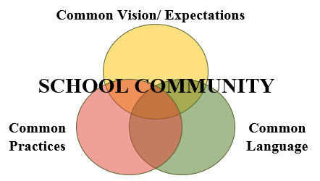
Teaching Schoolwide & Classroom-wide Lesson Plans
Once you have developed school-wide expectations,
it is not enough to just post the words on the walls…
YOU MUST TEACH (and RETEACH) THEM!
Notes:
Intent: Because behaviors and emotions are embedded with cultural norms, we should intentionally seek to understand, value, and affirm the cultural wealth of the diverse people in our buildings and communities. That’s why we considered cultural lenses when we developed the behavioral expectations.
Trainer Talking Points:
We know this may be true for the classroom: in fact, classroom teachers may find that for most of the school year they must constantly and consistently teach the behaviors they want to see in their classroom.
During the first couple weeks of school, teachers who spend more time teaching, re-teaching, pre-correcting, acknowledging and supporting implementation of classroom-wide rules for behavior, procedures and routines - who address expected behavior first - find they have more time for teaching academics.
The same holds true for schoolwide expectations and the specific behaviors tied to those expectations for all the common areas in the school.
We plan how and when to teach behaviors at the start of the year, and then also planning to re-teach after breaks or other times we predict or see behavior data increasing.

Slide 9
Alignment
The process for teaching SEL is the same process used for academics and behavior.
Notes:
It is clear that Social emotional skills, behavior and academics are intertwined. Teaching students how to share ideas in a respectful way, having empathy for academically diverse partners, pushing through challenges, and impulse control are all things that are just as important as learning to read, multiply, and write.
Data will show us what skills to teach. For these skills to be used regularly, all staff will need to model, teach, re-teach, prompt, and acknowledge across settings in the school. For that reason, it will be necessary to embed social-emotional competencies not only in the systems for teaching (i.e., expectations, matrix, lesson plans), but also in the systems for acknowledgement and responding instructionally to errors. Additionally, embedding social-emotional skills into the teaching matrix allows teams to monitor progress specific skills, thus ensuring that there is a process for measuring if the skills being taught are actually being used.

Slide 10
Why teach SEL
Increase
Decrease
Academic Performance
Self-confidence
Behavior outcomes
Positive Attitudes toward school and interactions with other
Teacher confidence
Self-efficacy
Job satisfaction and well-being
Student aggression
Emotional distress of students
Perceived stress of teachers
Durlak et al., 2011
Notes:
Research shows that explicitly teaching SEL not only improves achievement by an average of 11 percentile points, but it also increases prosocial behaviors (such as kindness, sharing, and empathy), improves student attitudes toward school, and reduces depression and stress among students (Durlak et al., 2011). Integrating SEL into the classroom can also help prepare students for the future and gain the skills employers are looking for.
Behavioral challenges are usually what we can see right in front of us but the answers to helping children are usually found below the surface of behaviors. This is where the valuable information is that helps us understand the “why” and provides us those clues for tailoring our interactions.
For example: One of your expectations might be showing respect for others, which would fit into the social awareness competency of SEL. Communication and teamwork align with relationship skills, growth mindset with self-awareness and so on.
Post pandemic - how are you all addressing SEL needs in your schools whether for students or staff?

Slide 11
Creating Behavior Lesson Plans
Teachers create lesson plans for each desired behavior
Students are taught the expectations and routines for both the school-wide system and the classroom-wide system.
Remember… If you are seeing problematic behavior, ask, “Have I taught and acknowledged the desired behavior I want to see?”
Notes:
Intent: Introduce the development of lesson plans.
As we think about creating lesson plans..
Trainer Talking Points:
we aim to explicitly teach behavior expectations, approaching lesson planning just as we would for academic instruction.
Teachers develop lesson plans for each desired behavior (based on the matrix) and then students are taught the expectations, rules and routines for both the school and the classroom.
We have to keep asking ourselves the question, “Have I taught (and acknowledged) the behavior that I want to see?”

Slide 12
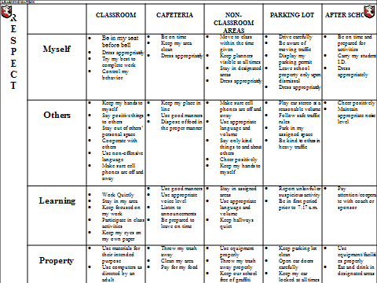
Develop an Efficient Teaching System
CAFETERIA
Be on time Keep my area clear
Keep my place in line Dispose of food in the proper manner
Use appropriate voice level Listen to announcements Be prepared to leave on time
Throw my trash away Clean my area Pay for my food
Notes:
Intent: Continue to discuss the development of lesson plans for behavior expectations.
Trainer Talking Points:
Lesson plans don’t have to be done for every single setting.
In some locations, a lesson might need to cover just one expectation - e.g. teaching how to be respectful and “use good manners” in an elementary school cafeteria
Some middle and high schools have students create the lesson plans (buy-in). Including student voice in the creation and teaching of these lesson plans is encouraged at all levels, but is even more important at the secondary level. The students often know better than the adults how to explain and support the need for certain behaviors. Student engagement will help with student buy-in, as well as showing that students’ experiences and skills are valued and supported in the school.
Training Activities: NA
Faculty/Student/Family Follow-up Engagement: NA

Slide 13
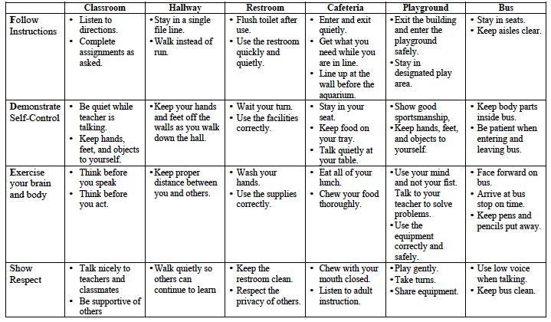
What to teach
Develop lesson plans to teach the specific behaviors identified on the matrix
Notes:
Intent: Lesson plans are built from the behavior matrix, which serves as the curriculum.
Trainer Talking Points:
The ‘WHAT’ to teach is developed directly from the behavior matrix that was developed by the team and shared/vetted with the staff.
Yout team decides how to teach and what areas or expectations to focus on based on data.

Slide 14
Pre-correct and Prompt: ALWAYS
Pre-Correction- provide a description of what the behavior looks like prior to directing student to perform a task. This includes: verbal reminders, behavioral rehearsals, or demonstrations of following the expectations or socially appropriate behaviors that are presented in or before setting where inappropriate behavior is likely. (Colvin, Sugai, Good, Lee, 1997)
Provide students with visual prompts (e.g. posters, illustrations, etc.)
Notes:
Intent: Discuss the importance of pre-corrections and prompts.
Trainer Talking Points:
Remember, if we can predict it, we can prevent it.
We naturally pre-correct for important academics (e.g. SOL testing – test taking strategies). We need to do this for expected behaviors in the same way: “Remember, we watched the video…and when we go in the hall now we’re going to walk on the right….”
Colvin, G., Sugai, G., Good, R. H. III, & Lee, Y.-Y. (1997). Using active supervision and precorrection to improve transition behaviors in an elementary school. School Psychology Quarterly, 12(4), 344-363.

Slide 15
Components of Re-teach and Adjust
Think ahead of any issues that might arise and discuss them with the class beforehand. Taking time to prepare the students before the event/activity will save you time and energy later on.
Continually embed expectations into the classroom.
Review-teacher consistently models expectations.
Students follow class expectations despite the absence of the teacher: Substitute, guest teacher, buddy teacher, volunteer.
Notes:
Intent: Discuss the importance of re-teaching and adjusting teaching.
Trainer Talking Points:
Again, if we can predict it, we can prevent it. Think ahead to any possible issues that might come up. Talk with students and ask what they see as issues.
Often we need to change our behavior in order to change student behavior.
Over time, the skill instruction may also need to be reviewed and retaught (after winter break). This also applies to the skill being generalized to different contexts and situations (substitute)
Importance of maintenance (after winter break) and generalization (with substitute)

Slide 16
How and when will we teach behavior?
Explicitly Teaching Curriculum Matrix | Embedding Curriculum Matrix in Daily Academic Instruction
Kickoff Events (start of year) | Connections to SOL
Matrix Related Lessons in Morning or Class Meetings (ongoing) | Connections to literature, historical figures and events, etc.
Booster Trainings (after breaks, based on spikes in data)
Continued Visibility
Notes:
Intent: Being intentional about the How and When will help with the consistency of implementation.
Trainer Talking Points:
The plan for teaching should include how and when the behavior curriculum (matrix) will be explicitly taught.
We also have to consider and plan for booster trainings and maintaining visibility throughout the year.
This plan should also include considerations for how and when it can be embedded into the academic curriculum.

Slide 17
When to Teach the Matrix? Schedule for Teaching
On-going Direct Instruction
Use established structures like homeroom, morning meetings, class meetings
Data-driven and scheduled lessons
Pre-correction for predictably difficult times
Re-teaching immediately after behavioral error
Notes:
Intent: Discuss other things to consider when planning the WHEN to teach lessons.
Trainer Talking Points:
Remember that you can use existing structures as opportunities to teach these lessons.
Be sure to use the data available to decide on priority lessons and reteaching needs.
Determine your schedule for initially teaching the expectations to the students and also additional times throughout the school year.

Slide 18
When to Re-teach the Matrix?
Booster Sessions
End of first grading period
Through second grading period
Review expectations once per week
Remainder of the year
Review expectations periodically as needed
Review expectations immediately after a school break
When behavior data indicates a need
Notes:
Intent: Explain the purpose of booster sessions and when they should happen.
Trainer Talking Points:
Booster sessions are really important as we mentioned, and here are some suggestions for that schedule.*
Include in your plans both the classroom and schoolwide opportunities.

Slide 19
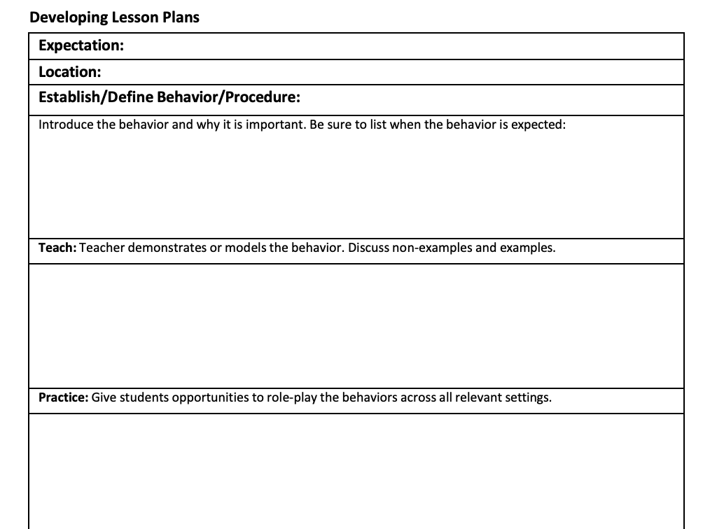
Plan for Teaching Expectations
Notes:
Intent: Consider a tool for planning for the how and when of teaching expectations. Sample lesson plan:
Post link in chat: https://docs.google.com/file/d/1rz4mRqivPsECpuYdldxXaJZe_QcZydks/edit?usp=docslist_api&filetype=msword
Trainer Talking Points:
Consider some of these tasks when creating your teaching schedule and plan.
The more that this process is documented and planned for, the more likely it will be implemented with consistency.
Training Activities: Teaching Expectations Optional Discussion
If time, allow teams the opportunity to begin to answer some of these questions.

Slide 20
Questions and Answers

