Slide 1
PBIS – Tier I Team
Behavior Booster Session
TFI 1.5 Problem Behaviors
TFI 1.6 Discipline Policy & Procedures
Notes:
Intent: Take this module very slow and give teams time to talk and address different opinions and buy-in challenges.
Remind teams that Admin. support is so important here; they need to reinforce the importance of this work and that teachers need to develop these skills in their classroom.
Trainer Talking Points:
Remind attendees that 1.5 is linked to 1.6 Discipline Policies.
Remind teams about the new Model Guidance for Positive and Preventive Code of Student Conduct Policy and Alternatives to Suspension approved by the Dept. of Education for the development of codes of student conduct and responses to student behavior.
We’ve reviewed how to engage faculty in teaching our expectations for behavior and how to provide feedback and acknowledgement. Now, we want to ensure our entire staff understands how to define and address problem behaviors. Research from our 7 Steps for Developing a Proactive Schoolwide Discipline Plan book found that the most divisive issue between staff and the administration is what behaviors warrant office referrals and what happens following an office referral. Cotton (1995) Therefore, it is crucial that staff develop an office referral system to effectively address these issues.
Include opportunities to celebrate recent accomplishments leading up to this point.
Focus on building relationships with the team from the very beginning.
Training Activities:
If time, might consider individual or team introductions.
Faculty/Student/Family Follow-up Engagement:
Be sure to emphasize that role of those attending is to engage faculty, students and families in the creation and implementation of behavior definitions and discipline process.
As they engage with the material in the module, they will want to always be thinking about how to share information and involve stakeholders.

Slide 2


Follow VTSS
Thank you for attending. Please feel free to tag us at any of our social media handles below!
Twitter - VTSS_RIC
Facebook - VTSSRIC

Slide 3

VTSS Resource Hub
https://tinyurl.com/2bp8dhch
Notes:
To post in Chat: https://tinyurl.com/2bp8dhch

Slide 4
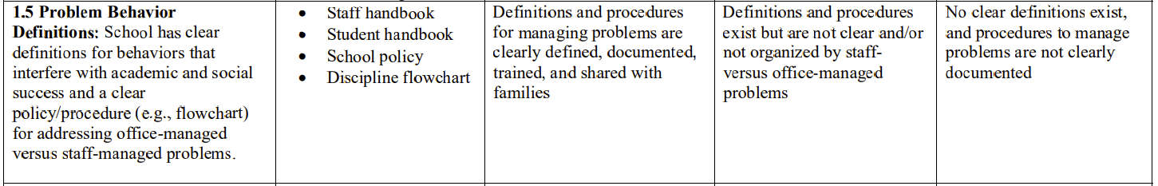
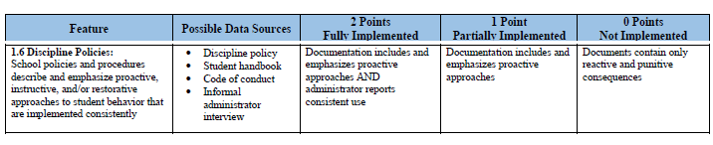
TFI Items 1.5 and 1.6
Notes:
Intent: The TFI is our Roadmap
Trainer Talking Points:
Once again, we are linking this work to our Tiered Fidelity Inventory. Schools must have clear definitions for behaviors that interfere with academic and social success and a clear policy/procedure (e.g., flowchart) for addressing office-managed versus staff-managed problems
Data Sources to assess/include: Staff and Student handbooks, School policy, Discipline flowchart

Slide 5
What will we learn?
Disciplinary policies and practices are part of a cohesive behavior support system within a school.
Discipline is a complementary system to expectations and acknowledgements.
Effective discipline includes opportunities for students to LEARN and PRACTICE appropriate behaviors through an instructional approach.
Notes:
Intent: Defines what is meant by effective discipline policies and procedures and emphasizes the importance of INSTRUCTION.
Trainer Talking Points:
“Disciplinary policies and practices are part of a cohesive behavior support system…”
Alignment to Intentions - Understand the importance of consistently implemented approaches to behavior that are proactive, instructive, and/or restorative.
Use this slide to remind participants that the discipline process is a necessary component of PBIS and aligns with other features, such as clear and consistent behavioral expectations, acknowledgement and proactive teaching of positive behavior. Though we are focusing on the discipline process in this module, it is important that participants know it is a complementary system to school-wide expectations and acknowledgement, and not an entity in itself.
The keywords in the second bullet are: Learn and Practice. As learned in module 1.3, Behavioral expectations, we cannot assume that students already know what is expected of them. If students are displaying problem behaviors, the first question to be asked is if we have given students opportunities to learn and practice our expectations. If not, we start with teaching, not discipline.
Remind participants we can’t talk about discipline unless we’re also simultaneously talking about instruction. The PBIS framework is about instruction. We have to teach and keep on re-teaching. We can’t assume because kids have demonstrated behaviors once that those behaviors will be maintained or generalized to all settings, (displayed with substitutes and so forth).
Remember: The primary feature of effective discipline is to maintain instruction!
Training Activities:
Presenter may want to highlight the words complementary system or LEARN and PRACTICE on the slide.

Slide 6
What will we do?
Define behaviors clearly and differentiate between which is office-managed and classroom-managed.
Create an array of instructional responses to behaviors that interfere with instruction.
Describe a consistent discipline process in narrative or graphic format.
Identify school policies and procedures that describe and emphasize proactive, instructive, and/or restorative approaches.
Notes:
Intent: Today’s module will focus on definitions of challenging behavior and distinguishing between classroom managed and office managed behavior.
Trainer Talking Points:
We are using the language office and classroom managed rather than major and minor. Reinforce this with new teams.
Be sure to address each bullet on slide, emphasizing that in this module, participants will consider their school’s:
Problem behavior definitions
Effective responses to challenging behaviors.
Remind participants we can’t talk about discipline unless we’re also simultaneously talking about instruction. Part of discipline is instruction. The PBIS framework is about instruction. We have to teach and keep on re-teaching. We can’t assume because kids have demonstrated behaviors once that those behaviors will be maintained or generalized to all settings, (displayed with substitutes and so forth).
Even when we use an office referral, how do we circle back when we are all calm and use it as an instructional opportunity.
Emphasize that common language and consistent procedures are the most efficient way to shape behaviors. If we are inconsistent, then we will need to work harder to change those behaviors. In this module, we will learn how to increase use of common language and consistency, particularly around problem behavior definitions and our responses to them.
Common language and consistent procedures are the most efficient way to shape behaviors. If we are inconsistent, then we will need to work harder to change those behaviors.
Training Activities:
Consider animating the highlighting of keywords in each bullet of the slide Define problem behaviors clearly and differentiate major (office-managed) and minor (classroom-managed) behavioral examples.
Faculty/Student/Family Follow-up Engagement:
Remind participants that faculty/family and student involvement are critical components of PBIS and that faculty buy-in, student voice and family representation are essential in defining the school’s discipline process and procedures.
It is important that participants know it is a complementary system to school-wide expectations and acknowledgement, and not an entity in itself.
The keywords in the second bullet are: Learn and Practice. As learned in module 1.3, Behavioral expectations, we cannot assume that students already know what is expected of them. If students are displaying problem behaviors, the first question to be asked is if we have given students opportunities to learn and practice our expectations. If not, we start with teaching, not discipline.

Slide 7
Rationale
Clearly defined procedures support consistency in responding to behavioral infractions.
Consistency creates conditions for increased structure, feelings of safety, and a positive learning environment.
Defining which behaviors are addressed within the classroom versus by administration can:
improve consistency within the classroom,
provide meaningful information for problem solving,
increase instructional minutes, and
free up administrative time spent on discipline
Notes:
Intent: Clear behavior problem definitions and discipline procedures increase consistency across the building
and result in maximized instructional time and fewer discipline problems for students
Trainer Talking Points:
Consistency provides predictability for everyone in the building and reduces behavioral errors.
If we are inconsistent, then we will need to work harder to change those behaviors.
Students who know what to expect feel safe.
Consistency helps adults and students not only know what to do, but what to expect when errors occur.
Consistent expectations and procedures increase instructional time for students and allow administrators to focus on instructional leadership as well.
Shared understanding of what are office managed versus classroom managed behaviors in a building can result in gains of instructional time.
Training Activities: Classroom vs Office Managed Discussion
With the slide in view, invite participants to read the third bullet to themselves, and pick one reason listed (a-d) to pair and share with a learning partner.
Can change letters to number and ask them to choose their favorite but holding up that number of finders. Share your “why” with someone who is holding up a different number.
After reviewing the rationale for defining classroom vs. office managed behavior through the pair and share activity, ask the group to give thumb up, sideways or down as a response to the question, “Would clearly distinguishing office vs. classroom managed behaviors be of benefit at your school?”
Faculty/Student/Family Follow-up Engagement:
Consistency is important for all students, but can be of even greater value to students who experience food or home insecurity.
Student and family engagement is essential in creating behavioral definitions, as well as the discipline process. Family involvement and student voice will assure the school’s cultural sensitivity in designing the discipline process.

Slide 8
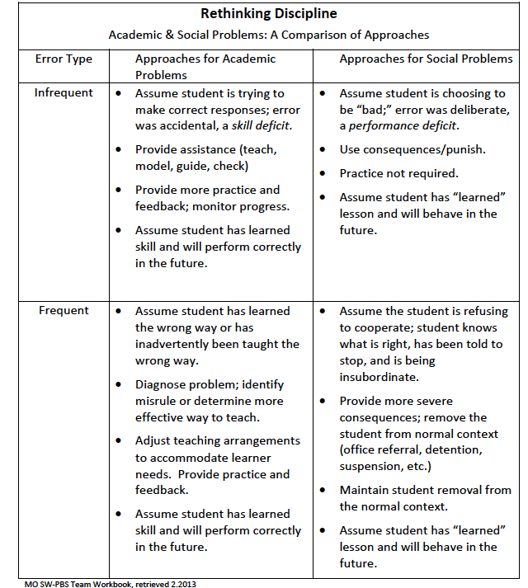
Rethinking Discipline
Notes:
Intent: Compare and contrast responses to academic vs. behavior problems.
Trainer Talking Points: Ask participants to answer this question in chat box. “What did you notice about the difference in responding to behavior and academic problems?”
Training Activities:
answer the question, “What did you notice about the difference in responding to behavior and academic problems?”
Just like with academics, when students have behavioral challenges, the first question is, “What skills can we teach?”
For example, students who rely on aggression present an instructional opportunity to teach problem-solving, coping, social-emotional regulation, interpersonal, or conflict resolution. Not only in response to problems, but in designing our curriculum and planning our instruction, we want to be sure we allocate time for teaching behavior just as we do academics.
*Possible insights that may or may not be generated in the large group share out:
If time for instruction is built into the schedule, and that instruction is effective, it frees up time that would have been spent in discipline for the small number of students who need targeted or intensive interventions, just like academics
If a school shows high numbers of students struggling with a variety of behavior challenges, the first discipline response would be to matrix identifying the expectations and building time into the schedule to teach lessons
New perspective on remediation/enrichment times – small group instruction can be for more than multiplication facts, organizational skills; it can be a means to provide more instruction and practice opportunities for behavior
Quality of instruction: Sometimes this comparison leads participants to insights about effective instruction-students who are busy and engaged have less time or opportunity for behavioral errors
Teaching skills of self-regulation: Sometimes participants have an “aha” and realize ALL students can benefit from behavior instruction and may name things like mindfulness, calming or self-regulation strategies. If this comes up, the facilitator may want to embed these points about time lapse:
When kids are really angry, how long do you think it takes to get back to effective thinking and responding? 60-90 minutes to completely calm down, for cortisol to completely be released from brain
Making time to teach students to recognize when they feeling angry or other heightened states, and a self-calming strategy can reduce that time and allow more time for instruction
Faculty/Student/Family Follow-up Engagement:
This is a good turn-around activity to use with faculty and/or families to explore beliefs about discipline.
May want to allow participants time to discuss ways they could use the activity at a grade level, faculty or PTA meeting

Slide 9
Classroom or Office Managed?
Writing on the desk versus spray painting the building
Flipping the bird versus physically harming another person
Obscene language in conversation between peers versus language as the result of an injury versus directed at a student or staff
Notes:
Intent: Practice
Training Activities: Have examples fly in and ask for waterfall responses in the chat box.

Slide 10
What evidence distinguishes each?
Classroom-Managed Data and Observations | Office-Managed Data and Observations
…or situationally appropriate…
Notes:
Intent: Apply understanding to create distinctions between classroom and office managed behaviors
Trainer Talking Points:
Now that they have begun conversations about defining the behavior, invite them to clarify distinctions between classroom vs. office-managed behavior.
Training Activities: Ask participants to share their thoughts on how these conversations will be important to have with their faculty colleagues.
Faculty/Student/Family Follow-up Engagement:
Challenge participants to create definitions and distinctions that are culturally responsive and to think of how they will include faculty and students in the process.

Slide 11
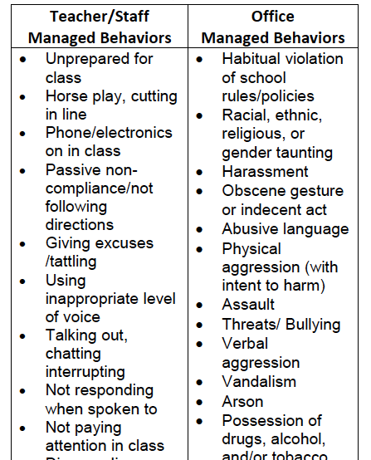
Variety of response practices - What questions do you have?
Notes:
Example from Salem, GW Carver Elementary (just part of their flowchart)
Intent: Introduce the flow chart as a way to capture the variety of responses to problem behavior in the classroom. Challenge for teams is frequently rooted in objectively screening their current practices through the lens of the content. When they were willing to engage in courageous conversations, they are more able to identify practices that are not effective and articulate why.
Trainer Talking Points:
As we move into Module 1.6 Discipline Policies and Procedures, we will begin to collect some of these various effective and instructional responses in graphic form. We learned this morning that we need to set it up so that the behaviors that are more helpful for students, work better for students than the not so helpful behaviors. Our responses are instructional first and we have a wide variety of responses. Classroom-behavior that interferes with learning-first decision point. Can we as teachers manage gum chewing, wearing a hat, desk tapping? Can we manage a physical fight or do I need help with that? Property damage? Tobacco in my room- there may be district policies in place… We will take a look at what are our rules for our building for what we expect teachers to handle and what do we want help with
This one-page type of visual display is a great guidance tool to teachers and is a way to grow consistent responses to problem behaviors across the building.
Teams will also need to develop a written policy to accompany the flowchart; but this is quick reference for teachers.
This flowchart is a prompt for the adults on what to do when they get stuck. This about verbal and visual prompts to help staff be proactive.
Flow charts are about providing a continuum of supports. Facilitate to connections to existing procedures- shared learning that behavior is learned and meets a need.
How will you handle problem behaviors that are resistant to teacher interventions?
How will you support teachers who do not try to manage classroom managed behavior or are ineffective in doing so?
Model code of Virginia also documents proactive ideas.
Training Activities:
Preview the flowchart-sample, facilitate to connections to existing procedures- shared learning that behavior is learned and meets a need.
Ask for input in the chat or to speak out about any that give them pause? For example, it would be helpful for audience to evaluate this first and see that "vandalism" may not be clear-cut without extensive conversation among faculty.

Slide 12
Completing T-charts with Staff
Share discipline data identifying the top 5 behaviors and any descriptive data
Ask staff: What do you notice?
Arrange staff in vertical teams (multiple perspectives)
Assign each team one of the top 5 behaviors and provide them with the descriptive data
Ask teams to draw a t-chart with identified behavior at the top
Ask teams to identify behavioral examples of what office and classroom managed behaviors look and sound like and connect to the VDOE behavior categories.
Notes:
Intent: Provide structure for TFI 1. 5 implementation
Trainer Talking Points:
How comfortable would you be doing this activity with staff at your school? Encourage them to complete this activity with their staff.
Develop definitions for all behaviors…or use ones like in your workbook
Consider re-directing participants back to the TFI 1.5 scoring guide to examine what a score of “2” “looks like and sounds like.”
Training Activities: T-Chart Discussion
Ask participants, “What does your team need to do to bring this activity to your school?
What data will you share and how will you get it?
Will you do it as a whole faculty, within departments, grade levels? Who will do what by when?”
Faculty/Student/Family Follow-up Engagement:
Make a plan to complete this activity with faculty, students and families.
Emphasize the importance of doing it with students.
Insight can be gained from hearing their perspective on what is office- vs classroom-managed and how they define behaviors.
May want to consider including behaviors occurring in community settings as well.
Be sure to discuss how data from community settings could be accessed and inform professional learning needs

Slide 13
Effective Responses
Planned ignoring Physical proximity Behavior specific praise - statements delivered to students engaged in expected behavior Direct eye contact – “teacher look” Re-teaching of expectations/rules | Re-direction Differential reinforcement Verbal warning- reminder Visual cue (e.g. hand signal) Private talk/problem solve with student
Notes:
Intent: Provide examples of effective responses to behaviors that interfere with learning.
Trainer Talking Points:
Summarize those that teams might want to consider providing some professional learning to increase consistency.
Spend time talking about how teachers can be proactive: use of proximity, pre-corrections, prompts, cues, etc.
Also see notes below re: response cost
Training Activities: Effective Responses Discussion
Read off various bullets on the slide and complete thumb up, thumb down, or sideways (or raise hand feature in Zoom) if this is a response strategy you feel is being used school-wide as an effective response to behaviors that interfere with learning.
Faculty/Student/Family Engagement:
Consider how to have discussions with faculty and families about existing systems in place, a means to determine if they are instructional or not, and whether they adhere to the recommended acknowledgement-to-corrections ratio.
Option to discuss: response cost (not on slide) -Response cost is the removal of a positive reinforcer contingent on a behavior and results in a decrease in the future frequency of the behavior. One common situation in which a response cost is used to decrease undesired behavior is in a token economy behavior change system. However, is the trickiest and most challenging to use effectively; yet, it is one that can be used most frequently, such as a system that involves moving clips up/down or color charts (green/yellow/red). Presenter should be prepared for participant resistance or questions and be ready to share the following in response to use of Clip Chart systems.
Remember in PBIS, the primary purpose of any behavior system is frequent and consistent acknowledgement of desired behaviors.
If the system is one in which movement on the clip chart is a means of acknowledging appropriate behavior, it is aligned and working fine.
If, however, movement is primarily occurring because of “misbehavior”, the system can be inadvertently flipping the feedback ratio, and it is primarily functioning as a corrective/punitive system. Remember in PBIS, we also look at our data. Look at the clip system’s data and ask for whom is the system working. If the same students are predictably in the yellow and red zones, then the system is not working for them.
Visibly displaying student names in an undesirable space can be a visual, rather than verbal, means of “shaming” them.
We must be watchful for unintended mental wellness ramifications of systems that primarily give corrective feedback.
Students may internalize the negative labels assigned to them due to the frequency in which their names are placed in those zones. Questions we want to ask may include:
Is there a way to respond in a private manner, rather than public display?
Is there a way to ensure movement for ALL students, or are some students forever green and some forever yellow or red?
Rather than public display, is there a means to create a private scale for individual student use with the students who need support with self-regulation? Could this be an individual self-management system rather than class-wide, and could students self-monitor as opposed to receiving external evaluation?
Be sensitive of the motivation of the behavior, the mental wellness of the child, and identifying strategies that are appropriate for that child’s needs.

Slide 14
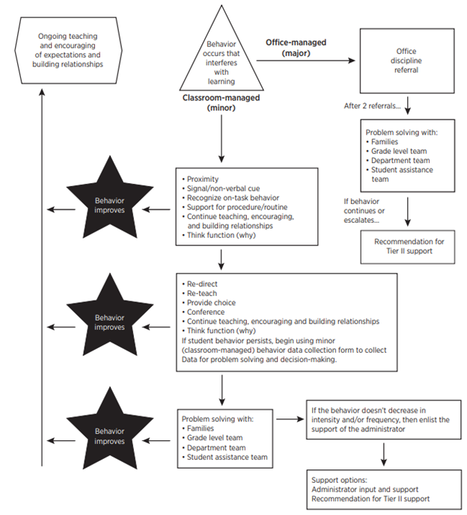
Discipline Process
Discipline Process: Continuum of Support for Discouraging Interfering Behavior
Notes:
Intent: Pg. 33 of VDOE Code of Student Conduct and page 41 of the workbook.
Trainer Talking Points:
We want to focus on being proactive and on our instructional responses!
We have to make sure we are contributing to leveling the playing field for all students.
The Virginia Model Code of Conduct also shares ideas to help teachers be proactive, corrective responses (are we practicing those), etc.
Can’t just put it on a flowchart but need to train teachers. How to pre-correct even more when you know a student is struggling with a specific interfering behavior?
Think about a policy for when kids return from a consequence (suspension) so we are supportive in their instruction and behavior.

Slide 15
Discouraging Interfering Behavior
Notes:
Intent: Maintain context of being positive, proactive and think about prevention first…teaching and acknowledging…then responding when behaviors arise.
Trainer Talking Points:
Make the point that our first response to challenging behavior is INSTRUCTION, (link to discoveries made in 1.5 about responses to academic vs. behavior problems)
This top left box contains the essence of PBIS.
We are always committed first and foremost to the ongoing teaching and encouraging of behavior expectations and building relationships.
Maintain context of prevention first…teaching and acknowledging…then responding when behaviors arise.

Slide 16
Variety of Response Practices
What effective practices are currently in place for responding to a full range of interfering student behavior? How are these vulnerable decision points effectively addressed?
Notes:
Intent: Provide examples of instructional responses to behaviors that interfere with instruction
Trainer Talking Points: Remember from Module 1.5, behavior serves a function.
Preview the sample flowchart and facilitate connections to existing procedures. We want to set it up in order for behaviors to be more helpful for students, work better for students, than the not so helpful behaviors.
The flowchart guides our responses so this occurs. refer to P 41. in New guidelines-list of proactive teacher supports in the classroom and office managed behaviors.
These are teacher responses to problem behavior, flowing from quick and easy to more involved problem solving. The thread weaving all of these responses together is effective support to increase the desired behaviors.
Discipline procedures may require participants to shift their thinking. It is important to introduce opportunities to activate knowledge/reflect on current practices and compare/contrast them to SW-PBIS.
Well documented that exclusionary discipline practices occur during classroom managed behavior.
Implicit bias is a concern in situations where teachers have to make decisions about the responses give
VDP - Vulnerable decision points lead to disproportionality.
These are places (VDP) where teacher’s responses can make all the difference.
Faculty/Student/Family Engagement:
May want to invite participants to consider how they might have faculty and families reflect on current practices and responses to behavior and ask the question, “how is that working for you?”

Slide 17
Considerations for Consequences
How we respond to behavior will have implications for whether that behavior will continue.
We need to be powerful and well-educated about how our responses can be most effective.
There are several key things to think about…
Notes:
Intent: Make distinction that consequence effectiveness is consistency, not severity.
Trainer Talking Points:
It is less important what the consequence is, than that something is reliably done.
How staff respond or what consequence is used matters less than the certainty that something will be done, even something relatively brief such as redirection or re-teaching. When students passing in the hallways see that all educators consistently stop students to address even small violations of procedures, they will quickly bring their behavior in line.
Use raise hand Zoom tool if you’ve witness staff respond inconsistently to similar scenarios.
Training Activities: Inconsistent Response Discussion
May want to give teams an opportunity to discuss a current problem to which staff respond inconsistently, or a previous problem that was decreased through consistent responding.

Slide 18
Consistency, NOT severity, is key.
It is less important what the consequence is, than that something is reliably done.
How staff respond or what consequence is used is less important than the certainty that something will be done, even something relatively brief such as redirection or re-teaching.
MO SW-PBS Team Workbook, 2012-2013
Notes:
Intent: Make distinction that consequence effectiveness is consistency, not severity.

Slide 19
Goals of Effective Responses
_________ the behavior that interferes with learning and engage the students in the expected behavior.
________ the likelihood that the interfering behavior will NOT happen again.
______ escalation of the problem behavior.
(Colvin, 2010)
Avoid Interrupt Increase
Notes:
Intent: Define and give examples of effective responses
Trainer Talking Points:
Let’s stop and think. Can you name the kids, in your head, not out loud, that are always getting in trouble? Is it the same group of kids? Then we’ve missed our instructional opportunity to teach those kids the expected behavior. You can name those kids because we’ve missed an opportunity.
Share characteristics of effective responses as shown on the slide: interrupts the behavior that interferes with learning and engages the students in the expected behavior, increases the likelihood that the interfering behavior will NOT happen again, and avoids escalation of the problem behavior.
Remember that the purpose of any response is instruction.
Trainer Activity: Fill in the blank. Answers:
Interrupt the behavior that interferes with learning and engage the students in the expected behavior.
Increase the likelihood that the interfering behavior will NOT happen again.
Avoid escalation of the problem behavior.

Slide 20
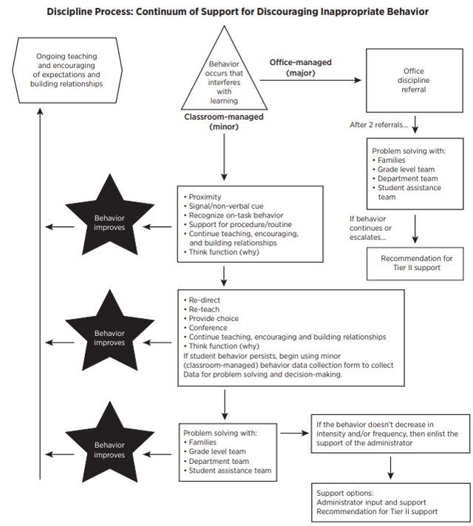
When the interfering behavior takes us here...
Notes:
Intent: Introduce office-managed behavior section of the flowchart.
Talking Points:
We know some behavior is significant enough for an office referral. We want to pay attention to our decision rules created in 1.5, which define what determines when a classroom-managed behavior becomes an office-managed behavior.
It’s important to pre-correct for how to handle classroom managed behaviors without teachers feeling like they could not ever send students out to the office when re-occurring behaviors begin to increase.
We want to avoid, “three strikes and you’re out” type thinking and instead rely on our classroom data and school-wide decision-making process, which might include decision rules for entering Tier II problem solving as opposed to an automatic office referral.
Activity:
Teams should work with their VTSS State Coach and think about how to work together with their entire staff to define behaviors; finding the time and process that would work at their school.
What systems are needed to ensure teachers can identify the motivation or function of the behavior for an office referral? Set up a system of supports/PD so teachers don’t get easily frustrated.

Slide 21
What is the system or procedure for referring a student to the office?
Do you complete an office referral electronically?
Do you complete an office referral on paper?
What is the procedure for getting a student to the office (call to office, student goes to the office)?
What’s the administrator's disposition and is it communicated to referring teachers?
Notes:
Intent: Consider the process for ODRs
Trainer Talking Points:
Beyond the form, there are other considerations regarding the process for ODRs.
Some questions to consider include how the referral will be completed, on paper or electronically; what is the procedure for getting a student to the office (call to the office, student goes unescorted); what is the principal’s disposition and how will it be communicated to referring teachers?
An interesting question to ask faculty is “What happens to students for whom you write an ODR?”
In some cases, they have no idea. The “process” ends with the submission of the referral.
In an instructional framework, it will be essential that referring teachers not only know the response of the administration, but also that they know their instructional responsibilities when the student returns.
Faculty/Student/Family Engagement:
In addition to follow up with the referring teacher, the process should include guidelines for communication with family members regarding the ODR.

Slide 22
Procedures
Discipline Process: Continuum of Support for Discouraging Inappropriate Behavior
Procedures
Notes:
Intent: Application of content; expand thinking about effective response strategies and tie to idea of providing a graphic organizer to guide adult responses
Talking Points:
Model with an example:
We have considered a lot about behaviors and responses, and we have looked at lots of examples. You will now have the opportunity to begin to create your own flowchart to guide responses to behaviors that interfere with learning at your schools. Take a few moments to examine the flowchart in your Workbook
Review restorative responses - restorative conferencing, circles - make connections to the Code. Have this context in your procedures.
Division Initiative Map can help inform the flowchart; what supports are available? What systems may need to change to provide the PD for these practices?

Slide 23
Instructional Responses for Classroom Managed Behaviors
Restructure/revise classroom practices based on student needs.
Adjust pacing of instruction to increase on-task behavior.
Actively observe and plan for ignoring low-level misbehavior.
Change student seating.
Provide immediate positive feedback when students engage in expected behavior.
Respond calmly, restating the desired behavior.
Use progress-monitoring tools (behavior charts with replacement behavior, reflection sheets, monitoring forms)
Communicate/collaborate with parents/guardians and the student’s counselor and/or case manager regarding student behavior, teacher-based actions and to problem solve.
Notes:
Intent: Code of conduct language (2021), page 52 from VDOE Code of Conduct and referenced on page 45 in the VTSS Workbook.
(This resource is also linked in the Workbook).
Trainer Talking Points:
From the Code Of Conduct document developed by the DOE. This chart has suggested responses for teachers prior to administrative involvement in student behavior issues, teachers are responsible for supporting students in acquiring the behaviors expected in the school environment. Listed are examples of proactive and instructional teacher actions to assist students in meeting behavioral expectations.
Mention Student Voice - Building relationships and conversations with students. Ask the students what would work for them. Give them choices: which do you prefer? which would work best for your learning?
Versus Student teacher conference.

Slide 24
Instructional Responses for Classroom Managed Behaviors cont...
Re-teach desired behavior.
Problem-solve the behavior during a teacher-student conference using active listening.
Establish and consistently implement corrective responses to the student misbehavior (positive practice, community service, restitution, loss of time for a valued activity, in-class timeout (<10 minutes), time out in another class under adult supervision, loss of privileges)
Facilitate restorative practices with the students and person(s) affected by the student’s behavior.
Assign a working lunch to facilitate re-teaching or making up missed work (working lunch with teacher, review a social story, reteach behavior)
Notes:
Intent: Code of conduct language (2021), page 52 from VDOE Code of Conduct
Trainer Talking Points:
From the Code Of Conduct document developed by the DOE. This chart has suggested responses for teachers prior to administrative involvement in student behavior issues, teachers are responsible for supporting students in acquiring the behaviors expected in the school environment. Listed are examples of proactive and instructional teacher actions to assist students in meeting behavioral expectations.
Mention Student Voice - Building relationships and conversations with students.
Versus student-teacher conference.

Slide 25
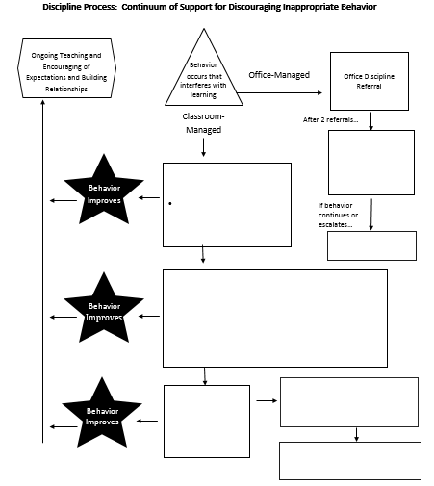
Continuum of Supports for Behavior
Continuum of Supports for Behavior
Notes:
Intent: Application of content; practice activity STARTING flowchart but will come back to finish it later. We are just getting started with with this work.
Trainer Talking Points:
Talk and work as a team to complete the middle portion of the flowchart.
Beyond listing strategies, discuss how staff will know what these practices are and how to use them. Remember our example of effective redirection. Consider how you will grow common understanding and consistency around responses.
Faculty/Student/Family Engagement:
Strategize how to involve faculty, students, and families in generating behavior response strategies and/or giving feedback on the flowchart.

Slide 26
When There is a Continued Need for Support
What do we do when responses aren’t changing behaviors?
Notes:
Intent: This is a Systems Question! Link back to behavior definitions; bridge to next section of flowchart and quality data collection tools.
Talking Points:
These are our classroom and team responses for support. The last two boxes respond to the question of “After how many minors can I send them to the office?” and “How do I get help with this students” (support options).
Spend time with this slide - when you’ve tried and tried, the next option does not need to be an office referral. The Admin. response is always a more serious behavior, but it doesn’t mean the teachers can’t get help for the kids with persistent low-level behaviors. Admin. and Div. Coaches need to be part of this conversation. What is the process for teachers, to get Admin. or other support WITHOUT a referral?
Next box is for the options: i.e. Admin. support for child and/or parents. Admin. conference with teacher - you both need a break when this happens so let’s find another teacher they can sit with (higher grade level to build connections or lower grade with teacher they already have a relationship with.) You don’t need an ODR for Tier II support. Low level behaviors can still be supported by CICO without ODR; can still refer to Tier II team.
ODR is the gateway to punishment; behavior significant enough to warrant a consequence. It’s not true that teachers can’t do ODR but, need to be clear - physical harm or interrupted classroom so much that I can’t teach and move on.
When our responses to behavior are implemented consistently and with fidelity but student behavior persists, we need data for problem solving.
Data will give more information about possible function of behavior and better inform adult responses to the behavior.
Our goal is a cultural shift. This takes time! We have to support buy-in first for those that have to wait to see their personal success. Celebrate our success to help those who are pushing back.

Slide 27
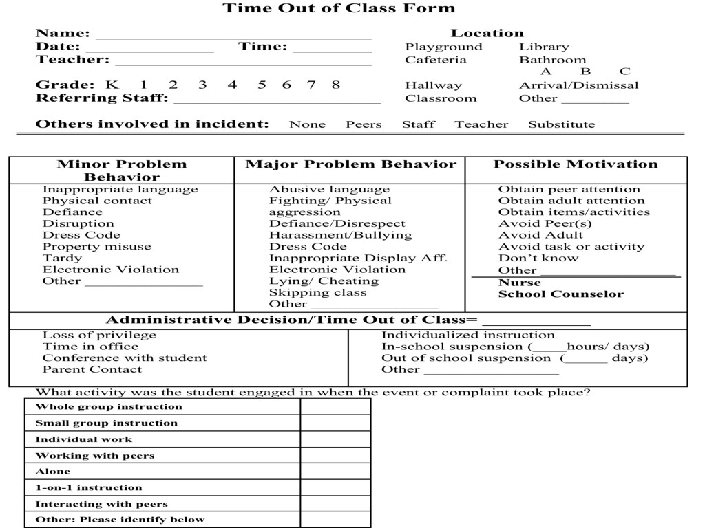
Sample Time Out of Class Form
Notes:
Intent: Introduce behavior data collection and link to previous learning: function of behavior
Trainer Talking Points:
How will we gather the data we need to problem solve? Remember the ODR form. This is a sample data collection form so that you have a chance to consider what will be critical to include in your school’s office discipline referral form. Your school may already be using a form; so, you will want to compare the fields and information on your form to the sample we review.
Notice this form contains both minor ( now classroom) and major ( now office-managed) behavior.
The purpose of this all-inclusive form is to provide accurate information from which decisions can be made to inform teacher responses/interventions. Remember all responses to behavior are instructional. Identifying the possible motivation will assist in problem solving and identifying the appropriate replacement behavior to teach.
We want to know as much about the behavior for as long as possible to make the best decisions and design the best interventions.
Notice this box on the form entitled “Possible Motivation.”
This is where the teacher records his/her hypothesis as to what function the behavior serves, based upon the consequence that follows the behavior.
As we consider function and motivation, we want our form to include fields on the form that capture students leaving their instructional environment (e.g., visits to the nurse or school counselor) so the needs of youth with internalizing as well as externalizing challenges are tracked.
A comprehensive data collection form can inform problem solving for both classroom-managed and office- managed behaviors.
Classroom data collection can be completed and maintained by the classroom teacher and will quickly provide documentation for behaviors that persist and rise to the office-managed level. In addition, the regular collection of perceived motivation information will reveal possible function of behavior, and more effectively guide responding.

Slide 28
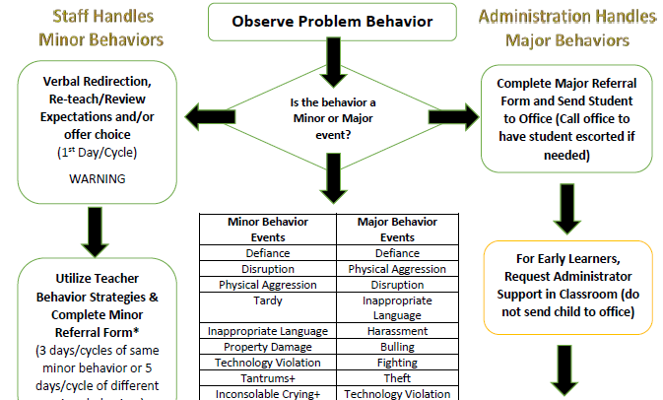
Early Childhood Behavior Flowchart
Notes:
Intent: bring in importance of this work for early childhood
Trainer Talking Points:
We know helping students understand the expected behavior in the classroom begins early. Here’s an example of an Early Childhood Flow chart. Encourage your Early Childhood programs to participate in this work as well. It’s never too early start! When we catch the students earlier, it will help the elementary schools, middle and high.
Be sure to include a clarifying statement that most of the administrator major strategies are NOT appropriate to use with young children.

Slide 29
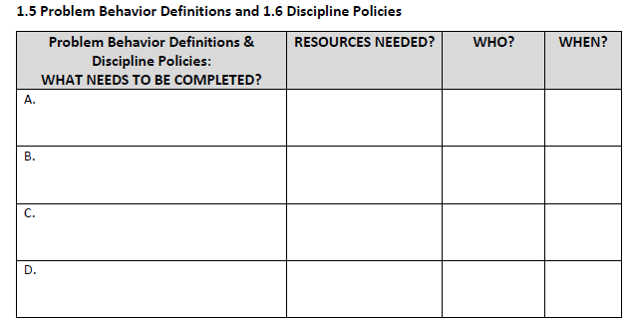
Action Planning
Notes:
Intent: Translate learning to action; teams will action plan for implementation
Trainer Talking Points:
Please note the School Wide Information System (SWIS) definitions that are included in the workbook as a resource (pp.43-45).
This listing of definitions might be useful as a launch pad for faculty discussions or as a reference as groups consider behavior definitions.
You will now have a few minutes to talk and record your team’s implementation plan for creating school-wide behavior definitions on p.76.
Ask open - ended questions that help ensure we as coaches know why teams have selected the action items for 1.5
Coaches asking clarifying questions as teams work.
Having an article about PBIS that suggests it is about not providing consequences for non desired behavior and having them develop a brief response for the naysayers who might bring these types of articles to them.
Remind teams they should follow-up with their State VTSS Coach and entire team on their plans.
Training Activities:
Highlight SWIS definition resource (which provides a strong example of the success criteria for this learning intention), give directions for action planning and circulate to hear conversations, answer questions and provide clarification as needed.
Be sure to include in summary statements that data dashboard needs to capture what schools want to know!
There may be other considerations, such as, time out of class, other health impairment..
Faculty/Student/Family Follow-up Engagement:
Remind participants to include involvement of all stakeholders in their action planning.

Slide 30
How are we doing?
Do you feel you can confidently engage
faculty in an exercise to clearly define office managed versus classroom managed behaviors?
2. Do you have a plan for creating opportunities for students to LEARN and PRACTICE appropriate behaviors through an instructional approach?
Notes:
Intent: Assess knowledge gained
Trainer Talking Points:
Use thumbs up or thumbs down on Zoom to answer the questions.
If you do not have this feature on your Zoom, use the chat box

