Slide 1
Tier 1 Team Training Behavior: Booster
TFI 1.8 Classroom Procedures
Notes:
Chat Box: Attendance Link
Intent: To introduce the TFI modules
Trainer Talking Points:
Our focus will be classroom expectations.
Faculty student and community involvement will be discussed throughout the module.
It is key that we include the voice of all stakeholders through the process.
Stakeholder involvement is ongoing and so we do not want to separate it in a module of its own.

Slide 2
Follow VTSS
Thank you for attending. Please feel free to tag us at any of our social media handles below!
Twitter - VTSS_RIC
Facebook - VTSSRIC

Slide 3
VTSS Resource Hub
https://tinyurl.com/2bp8dhch
Notes:
To post in Chat:
Feedback for VTSS Resource Hub: https://tinyurl.com/2bp8dhch

Slide 4
Learning Intentions
Create a plan for guiding staff in defining expectations with observable and measurable expectations for classrooms.
Understand options for aligning classroom behaviors and procedures to school-wide expectations
Notes:
Intent: Review outcomes.
Trainer Talking Points:
We will touch on the following key practices:
Understanding options for aligning classroom behaviors and procedures to school-wide expectation
Creation of a plan for guiding staff in defining expectations with observable and measurable rules for classrooms
We spend SO much time in the classroom, the matrix is foundational for success
Additional sessions will be provided that focus specifically on classroom practices at later date

Slide 5
Consistency With Our Language
Expectations | 3-5 overarching school-wide expectations
Behaviors | specific tasks students are to do to achieve the school-wide expectations
Routines/ Procedures | procedures are methods for accomplishing tasks in the classroom procedures form routines that help students meet classroom expectations and rules/behaviors
Notes:
Intent: Spiraling back to consistency of language.
Trainer Talking Notes:
We have looked at school-wide expectations and defined what those expectations look like and sound like in the classroom.
Now we want to organize the procedures and routines that will ensure students meet the expectations
Training Activities: NA
Faculty/Student/Family Follow-up Engagement: NA

Slide 6
School Wide Expectations
School-wide Expectations | Classroom Procedures (behaviors aligned with expectations)
Be Respectful | Raise your hand before speaking & when you need help Listen when others are talking Use inside voice
Be Responsible | Have materials ready before activities begin
Be Safe | Follow directions the first time Keep hands, feet, and objects to yourself
Anchor Classroom to School-wide Expectations
Consider: department, grade level, core team, co-teaching teams
Notes:
Intent: To provide specific examples of anchoring classroom to school-wide expectations.
Trainer Talking Notes:
Some schools want classroom specific behaviors to be the same for all classrooms, and include it as a location on the matrix. Other schools decide each teacher will develop classroom specific behaviors for their classroom to align with school-wide expectations.
Think about the culture of your building and how you might present this alignment of expectations to your peers.
Trainer Talking Notes:
The key is that all classroom expectations are anchored to the school-wide expectations.
How might you do this? by grade level, department, teams?
It depends on the culture of your school.
Getting feedback from all stakeholders is key to consistency and addressing “tolerance levels” of staff.
Trainer Talking Notes:
How will you get input and feedback from students, families, and the community?
Getting feedback from all stakeholders is key to consistency and addressing “tolerance levels” of staff.
Additional high school input from Patti Hershfeldt:
Incorporate student voice when developing and teaching expectations. Adolescents want to be “heard” and feel they have a voice/control over their own lives.
If students are heavily involved in creating and implementing the PBIS framework, they will help to hold faculty responsible for consistent implementation.
Training Activities: TFI 1.3/1.8: Activity 7 | p. 30 - Short Breakout with teams to discuss 1) schoolwide or teacher specific and 2) how to get student voice
Keep in mind our earlier discussions surrounding cultural sensitivity.
Check for understanding/opportunity to process: Activity #7
Share out some examples.
Faculty/Student/Family Follow-up Engagement:
Student engagement: Provide blank matrices or portions of the classroom matrix as “Bellwork” or “Warm-up” activities in classrooms during the first few days of school. Gather and use student input to create classroom expectations, procedures and routines.

Slide 7
What Are Procedures & Routines?
Procedures should be succinct, positively stated and in age-appropriate terms
keep “who, what, when, where, why, and how” in mind
taught and consistently enforced
patterns for accomplishing classroom tasks
Procedures form routines when practiced and help students meet expectations stated in the expectations
Notes:
Intent:
Clarification of the language that is often interchanged ; procedures versus routines
Procedures and routines are defined.
Examples are provided that are appropriate to those present.
Trainer Talking Notes:
taught and consistently enforced are the most critical tool to create a functional and productive learning environment
Keep in mind procedures should be positively stated and in age-appropriate terms
Research tells us that we get time back to teach!
Classroom procedures are patterns for accomplishing classroom tasks
Clear procedures are taught and consistently enforced
They are critical to creating a functional and productive learning environment
Procedures form routines when practiced and help students meet expectations and the desired behaviors
Making sure students have the ability to do the classroom routine is critical. This is as simple as recognizing that some students can't afford school supplies and taking care of that need so all have the ability to do what is expected; being ready to learn may be required
Training Activities: Ask how participants would delineate between procedures and routines.

Slide 8
Research Studies Found…
Effective teaching includes teaching functional routines and procedures to students at the beginning of the year and using these routines to efficiently move through the school day. (Simonsen and Myers, 2015)
As students become more familiar with classroom routines and procedures, additional instructional formats and more challenging work can be incorporated (Evertson, Emmer, & Worsham, 2003; Good & Brophy, 2003)
Having Procedures and Routines in place will:
Increase instructional time by preventing problem behavior
Free teachers from correcting misbehavior
Improve classroom climate
Create shared ownership of the classroom
Develop self-discipline
Notes:
Intent: Provide background and research for those wanting further information.
Trainer Talking Notes:
Having Procedures and Routines in place will:
Increase instructional time by preventing problem behavior
Free teachers from correcting misbehavior
Improve classroom climate
Create shared ownership of the classroom
Develop self-discipline
Training Activities: Classroom Procedures Optional Activity
After sharing this slide - Give participants 30 seconds to write down everything they need a procedure for in their classroom.
CALL TIME.
Call out increments of 5’s or 10’s and have them stand if they listed that many.
Person with the most reads their list.

Slide 9
Example of a Classroom Procedures Matrix
Settings ➔ Expectations ↓ | Starting the Day Procedures | Independent Work Procedures | Transitions Procedures | Small Group Work Procedures | When I feel Upset/Frustrated
Be Responsible | Turn in homework Put instructional materials in desk Begin morning work | Have materials ready Check your work before turning it in Begin next activity when finished | Put materials away on my signal Get materials ready for next activity | Assign roles for group work (include a timekeeper) | Identify the emotion
Be Respectful | Talk in soft voices | Move quietly around room when necessary | Listen for directions to move | Listen to your peers and speak when it is your turn Support your peers and let them do their role | Communicate with teacher/adult Use kind words
Be Safe | Put personal belongings in designated areas | Select area to work and walk to selected spot quickly and quietly | Always walk quietly to new location | Clean up area when group work is finished for the day | Use coping strategies you know
Notes:
Intent: Procedures and routines should be anchored to school-wide expectations, just as classroom expectations are anchored to school-wide expectations.
Trainer Talking Notes:
This is an Elementary sample
Remember they should be …
Positively stated
Age appropriate
Observable and measurable
Culturally responsive
Set the conditions for learning
Make note of the last column - routines and procedures lend a sense of consistency and structure making it a trauma informed practice, and also for vulnerable students it is important to address needs as your data shows, and it integrates with social-emotional learning.
Faculty/Student/Family Follow-up Engagement: NA

Slide 10
Classroom Procedures and Routines to Create the Conditions for Learning
School-wide Expectations | Norms | I need help | Lining up for Lunch | Circle Time | Going Home
Be Respectful | Raise your hand before speaking & when you need help Listen when others are talking Use inside voice | Raise hand if you have a teacher question Wait your turn quietly | Look for teacher signal and listen | Take turns Listen to others talking | Listen to announcements Wait for your turn to get your stuff
Be Responsible | Have materials ready before activities begin | Continue working while waiting for help | Follow teacher directions to line-up | Get materials to begin Return materials to their home | Follow teacher directions Be sure you have everything
Be Safe | Follow directions the first time Keep hands, feet, and objects to yourself | Stay in your seat | Line up on blue line at door Walk quietly | Stay in your space Hands and feet to self | Line up on blue line at door Wait quietly
Notes:
Intent: Procedures and routines should be anchored to school-wide expectations, just as classroom expectations
are anchored to school-wide expectations.
Trainer Talking Notes:
Example of a procedures matrix
Teachers change the blocks of time on the columns to match their schedules.
Examples: Library might be - Arrival, Instruction, Computer lab, Book Check
Science might be - Arrival, Whole class Instruction, Small Groups, Independent work, lab.
An important note is that the routines should also be in place to help students - what can they do if they forgot the materials, or didn’t finish the work - we have to keep in mind that students from trauma or vulnerable situations are doing all they can do to even get to school; need to offer support to make them want to come to class rather than avoid
SEL - Some school include a column for social emotional to teach self management of behaviors
Notes - speak explicitly to being aware of inclusive practices during development
Training Activities: Conditional Learning-Partner Share Optional Activity
Share your favorite successful lesson with your partner.
Tell why you like the lesson, what makes it so successful?
What were the conditions for learning that you created?
Tables share out “Conditions for Learning” they created.
Chart them. Think about adding those conditions to your procedures matrix.
Faculty/Student/Family Follow-up Engagement: NA

Slide 11
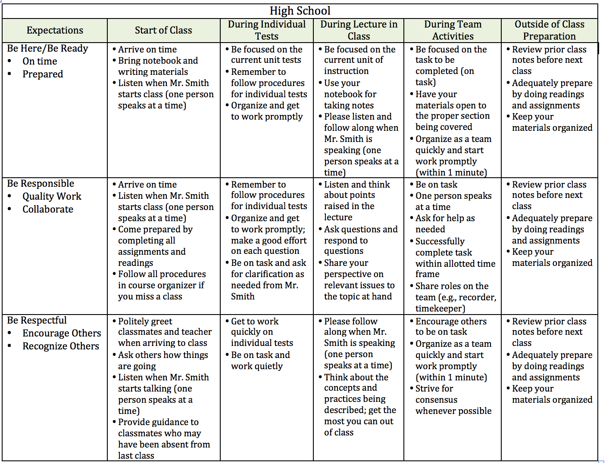
High School Procedures Matrix
Notes:
Intent: Procedures and routines should be anchored to school-wide expectations, just as classroom expectations are anchored to school-wide expectations.
Trainer Talking Notes:
This is an Secondary sample. Procedures may be very different depending on the grade level or content area.
Make sure to get input from students around appropriateness and effectiveness of procedures
Remember they should be …
Positively stated
Age appropriate
Observable and measurable
Culturally responsive
Set the conditions for learning
There is a lot here. It’s even more important to provide feedback when procedures and routines are being followed, and to re-teach when they aren’t
When re-teaching it’s not personal it is a general statement about procedures/routines
Training Activities: NA
Faculty/Student/Family Follow-up Engagement: NA

Slide 12
Routines for Supporting
Emotional Safety
When students can predict what will happen in the classroom, there is a sense of safety and security.
Routines create predictable environments where students know what to expect and how to act/react.
Notes:
Intent: Knowing what to expect provides safety and security
Trainer talking notes:
Can use example of self and first day on new job: what is expected, where are things located, who are your colleagues like, is this something you can do! Then compare to 6 months later
Students are the same: the difference can be in apprehension
The routines may not just be about how to get a pencil or go to the bathroom; think about what to do if you don’t have materials, feeling a need to calm down

Slide 13
Routines and Procedures:
Lesson Design Considerations
Conversation
Can students engage in conversation during this activity? If yes, about what? With whom?
Help
How do students get your attention to ask a question? What do they do while they wait?
Movement
Can students get out of their seats for this activity? If so, for what reasons?
Participation
What does it look like and sound like?
Notes:
Intent: Things to consider when creating routines and procedures.
Trainer Talking Notes:
What are some key routines and procedures considerations?
Think through anything that can and “will” happen and how can you be proactive and prevent it.
Training Activities:
If the optional conditional learning partner share activity was completed - were these procedures in place when you facilitate your favorite lesson?
Are any of these considerations on the chart?
Faculty/Student/Family Follow-up Engagement:
Share your procedures and routines with families during open house or in newsletters
Include it in your syllabus

Slide 14
If routines are disrupted...
Think about the last time your morning routine got disrupted and how it impacted your emotional response to students/others.
What happens when routines are disrupted for students?
Notes:
Intent: Engagement and practice. (explain sole refers to their shoes)
Trainer Talking Points for Activity: After they partner share - return to seats and presenter make these points so they apply this to student routines:
-students are equally disrupted by changes in routines; however, they are limited in their ability to control situations.
-often times students are unable to regroup and move forward positively following a disruption to their routine, which can lead to spiraling negative behaviors.
-students with disabilities are more susceptible to negative reactions to changes in routines and conversely respond positively to consistent, predictable environments.

Slide 15
If routines are disrupted in the classroom...
Notice and acknowledge when routines have been disrupted
Revisit the need for the routine
Re-teach routine
Create opportunities to practice routine
Provide feedback
Notes:
Trainer Talking Points for Activity:
This wraps up the activity on previous slide
Acknowledge the difficulties that can occur when routines disrupted
We always go back to what we know - use our data to determine a need to revisit the routine, and then we follow our same teaching routine: Teach (if new routine), re-teach, practice, provide feedback

Slide 16
Using a Classroom Matrix to Target Procedures
Settings ➔ Expectations ↓ | Start of Day | Independent Work | Transitions | Small Group
Be Responsible
Be Respectful
Be Safe
Notes:
Intent: Thinking about behavior that needs to be addressed as specific times of the day
Trainer Talking Notes: Turn and talk to your team-Give examples of these times in the day when teachers may need to think about specific procedures and teaching to address behaviors.

Slide 17
Complete your Action Plan
WHAT NEEDS TO BE COMPLETED? | RESOURCES NEEDED? | WHO? | WHEN?
A.
B.
C.
Notes:
Intent: Begin creating a Team Action Plan anchored to the TFI.
Trainer Talking Notes:
It is time to begin the work and action plan how you will share this information with your staff.
Check what is already in place, what needs to be implemented and when will it happen.
Work to prioritize. For example - you may work only on school-wide expectations now and add classroom
procedures and routines next year.
Training Activities: TFI 1.3 and 1.8 | p. 71
Turn to your workbook and plan as a team.
Check what you have in place and what will be your starting point.
Faculty/Student/Family Follow-up Engagement:

