Slide 1
Tier 1 Team
Training Behavior: Booster
TFI 1.9 Feedback and Acknowledgement
Notes:
45 minutes for this module.
Intent: To introduce the TFI modules
Trainer Talking Points: Our focus will be feedback and acknowledgement. John Hattie’s research shows that feedback has a .7 effect size BUT ⅓ of teacher feedback is negative. Feedback should be about helping students know where to go next, not negative.
It’s critical to explore the belief of your staff regarding acknowledgement systems because their beliefs drive their behavior.
Be intentional about the importance of “voice” in creating acknowledgement systems in order to be culturally responsive to what motivates others.

Slide 2


Follow VTSS
Thank you for attending. Please feel free to tag us at any of our social media handles below!
Twitter - VTSS_RIC
Facebook - VTSSRIC

Slide 3

VTSS Resource Hub
https://tinyurl.com/2bp8dhch
Notes:
To post in Chat:
Feedback for Resource Hub: https://tinyurl.com/2bp8dhch

Slide 4
Learning Intentions
Understand frequency and characteristics of effective acknowledgment for increasing behaviors we expect from students.
Understand the components of Behavior-Specific Praise Statements (BSPS) and increase the ratio of positive-to-negative and acknowledgement-to-corrective statements.
Link acknowledgements to the expectations
Notes:
Intent: To understand the importance of an acknowledgement system and how it is an essential component of PBIS. We have discussed clear and consistent behavioral expectations, defining behaviors on a matrix, teaching desired behaviors and now we will discuss how to acknowledge the desired behaviors to increase the likelihood they will continue to occur.
Trainer Talking Notes: Remember that some students need help interpreting feedback. Our goal is for students to eventually look for and maye even ask for feedback.
●In this module we will:
○Understand frequency - ratios of positive feedback to corrective feedback, and characteristics of effective forms of acknowledgment for increasing behaviors we expect from students.
○Understand the components of Behavior-Specific Praise Statements (BSPS) and increase the ratio of positive-to-negative and acknowledgement-to-corrective statements.
○Link acknowledgements to the expectations and behaviors on your matrix. Always keep in mind the matrix is your social skills curriculum.
Notes - be careful with this work and do not devalue other cultures - should be inclusive and goes to all students that earn it - temp. check that not just acknowledging the same kids consistently

Slide 5
An Acknowledgement System is….
A system that provides immediate, intermittent, and long-term reinforcements, given by adults in the building, to any students displaying desired school-wide expectations or behaviors.
(SBCUSD Positive Behavior Support Initiative)
Notes:
Intent: continue to introduced shared language and definitions.
Trainer Talking Notes: Let participants read this to themselves.
●Stress and define the highlighted words on the slide.
Everytime we spend being intentional up front is time saved on the backend.
●A system that provides immediate (immediately follows behavior), intermittent (unexpected such as drawings or scheduled intervals), and long-term reinforcements (everyone celebrates meeting of goals) given by adults in the building, to any students displaying desired school-wide expectations, behaviors, or associated rules.
●Reinforcement is the presentation of something pleasant or rewarding immediately following a behavior.
●Reinforcement increases the likelihood the specific behavior will occur in the future, and is used for shaping or changing behavior.
●We are going to build a system to support staff to use feedback and acknowledgement. How do we build a system where all students get all of the different types of acknowledgements - immediate, intermittent, long term? These things happen naturally in our environment and we are going to plan for it to increase the likelihood of it happening. Every time we spend this intentional moment up front is a moment saved on the back end.
Notes- avoid falling into your preferences and comfort areas, remember to acknowledge all students; not consistently the same students. We tend to reinforce kids who are like us more often.

Slide 6

Rationale
Every time any adult interacts with any student, it is an instructional moment.
(Cameron, 2002; Cameron & Pierce, 1994, 2001;
Cameron, Banko, & Pierce, 2001)
Notes:
Intent: Go slow to go fast. Building skills intentionally up front and taking time to acknowledge prosocial behaviors will gain back time for academics in the long run..
Trainer Talking Notes: Use the chat box to share creative ways you interact with students.
●Time needed is often a concern…
○Building an acknowledgment system, taking the time to acknowledge students when they’re on the right track, may seem like a lot of time on the front end, but the time we spend now teaching and ensuring students have proactive, prosocial behaviors will result in less time spent on the “discipline end”.
○We gain back time for instruction when we build skills that create a positive classroom environment and help all students get/stay on track
●If we refer back to Hattie’s list of evidence based practices we discussed in module 1.4 teaching expectations, feedback has a .73 effect size.
●We want to reemphasize is the purpose of the system is to make sure students are exhibiting the behaviors we want to see.
●When we use positive acknowledgment / reinforcement - mostly in the form of language/attention - we increase the likelihood behavior will continue to occur in the future.
●If something we do following the occurrence of behavior doesn’t result in more of the behavior, it’s not reinforcing to the student(s) (or not reinforcing enough).

Slide 7
Why Do We Acknowledge
Desired Behavior?
Reinforce the teaching of new behaviors
Form habits that are likely recur in the future
Harness the influence of students who are showing expected behaviors to encourage the students who are not
Strengthen positive behaviors that can compete with problem behavior
Improve school climate
Create positive interactions and rapport with students
Notes:
Intent: Rationale for the “why” we acknowledge behavior
Trainer Talking Notes: Ask participants how they would answer this question. Discuss which items they mentioned and which ones them missed.
●Explanation of the “why” we acknowledge behavior - include power of negative attention as reinforcement.
●We want productive/helpful behaviors to become habits for our students so they don’t need the other behaviors continue to work for them
Build those 21st Century skills like self-discipline and being a team player.
●Adult attention, even if it is negative, is a powerful reinforcer--especially for students with the most challenging behaviors who typically receive very little positive attention.” (Maag, 2001)
●What Great Teachers do to create environments where students:
○Know what is expected. With acknowledgement comes an expectation of accountability
○Receive recognition each week for good behavior.
○Have a teacher who cares, and pays attention.
○Receive encouragement to contribute and improve.
○Have the opportunity to do the right thing.

Slide 8
Zooming In On The Definition
  A system that provides
  immediate,
  intermittent, and
  long-term reinforcements,
  given by adults in the building, to any students displaying desired school-wide expectations, behaviors, or associated rules.
Notes:
Intent: Use of common language, definitions.
Trainer Talking Notes: Which one do you find most challenging for your teachers? Which one would you like to spend more time on today?
●An effective acknowledgment system includes varied kinds of reinforcement - immediate, intermittent and long-term.
●We’ll be focusing first on immediate feedback, and then think about ways to add intermittent and long-term reinforcement, too.
●Immediate feedback closely follows the desired behavior.

Slide 9

The quickest way to change behavior…
Experience has shown that you
can improve behavior
just by pointing out
what someone is doing
correctly.
Notes:
Intent: value the of positive reinforcement.
Trainer Talking Notes: Ask for a volunteer to read or read silently. How many of you agree with this data?

Slide 10
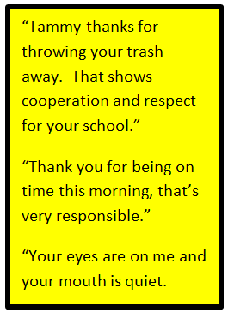
Use Immediate & Specific Praise
Specific
Contingent upon student demonstration of expected behavior
Use more frequently when teaching new behaviors
Student and age appropriate-know your students
Attributes success to effort
Think Growth Mindset
Notes:
Intent: Definition of behavior specific praise and Building common language.
Trainer Talking Notes:
●Define behavior specific praise, focusing on the words immediate and specific.
●Use it more frequently when we are teaching new behaviors
●Once we see that they are forming habits with it, then we can fade the immediate and move to intermittent for maintenance.
●Focus equally on effort and outcome.
●Connect to growth mindset.
●We give equal focus on successive approximations to the behavioral outcome and effort towards the behavioral outcomes.
●Deliver BSP that lets them know they tried and maybe didn’t get it yet, but they are closer.
●By focusing primarily on growth and effort, adults communicate to students that achievement isn’t about who’s “smart” and who isn’t, whether they’re “good” at math, or not, etc. Those are indicators of a fixed mindset. Instead, a growth mindset is based on the belief that setting hard goals and working hard to reach those goals - “grit” - are the important factors.

Slide 11
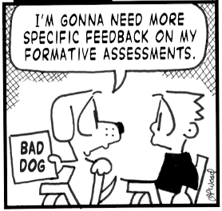
What does it sound like?
Specific
  Names the behavior demonstrated
  Connects to specific behavior/expectation on matrix
Genuine
Student friendly language
Notes:
Intent: Process of Behavior Specific Praise Statements
Trainer Talking Notes:
●Use the student’s name
●Recognize the behavior
●Connect the behavior to expectation on the matrix

Slide 12
How Does 5 to 1 Happen?
Interact in a friendly, supportive manner with students, parents, guests and colleagues
Initiate positive interactions by:
    Making eye contact
    Smiling nodding, winking
    Welcoming
    Offering a greeting
    Asking if assistance is required
    Providing positive feedback regarding appropriate student behavior
    Maintaining an attitude of respect and support, even when correcting student behavior
Notes:
Intent: To share an example practice and additional ways to provide positive interactions and acknowledgement
Trainer Talking Notes: Would anyone like to volunteer their experience with 5 to 1?
●Staff commitment: Some staff might have difficulty with reinforcing student behaviors
●Provide adults examples of how adults are reinforced for doing what they are expected to be doing (DISCOVER card, Allstate)
●To meet the 5:1 ratio, not all acknowledgment needs to be behavior specific praise;
●Key factor is how we’re connecting positively with students, versus the ways we have negative connections.
●Review slide - Be aware of culturally responsive behaviors - eye contact?
●What additional ways do you acknowledge students? (Thumbs up, Claps, The Teacher Look)
Faculty/Student/Family Follow-up Engagement:
●Have students and or parents list ways they acknowledge behavior at home
●Survey for culturally responsive behaviors - eye contact?

Slide 13
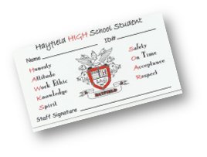
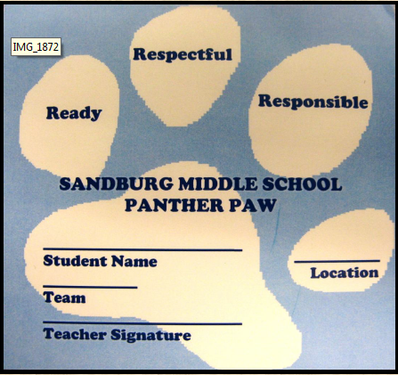
Linking Praise to Acknowledgement System
Name behavior and expectation observed
  (Teaching Matrix)
Tie-in recognition to school-wide recognition system
Given with high frequency when teaching new expectations
"Thank you for being
on time this morning, that's very responsible."
!
Notes:
Intent: To stress the importance of pairing specific praise statements with the acknowledgement system.
●Link rewards to social curriculum (matrix).
Trainer Talking Notes:
●It is imperative that students hear the language of the praise statement when receiving a token representation to go with it (e.g., cards, stars, paws, bucks, etc.).
●Without the specific praise statements, students may not understand how they were earned or what they did that was valuable to their learning or their school community.

Slide 14
Providing Acknowledgement
1. Acknowledge specific behavior
2. Tie back to school-wide expectations
Giving ticket without saying anything
Only giving for “above and beyond” behavior
Nice job being in your seat when the bell rang to start our day. Way to be there, be ready. That earns a tiger paw.
Notes:
Intent: To emphasize the importance of the language tied to the acknowledgement.
Trainer Talking Notes: Review example and non-example.
Trainer Activity: Ask participants to vote which are examples and which are non-examples with waterfall chat box responses or using the annotate check and “x” tools.

Slide 15
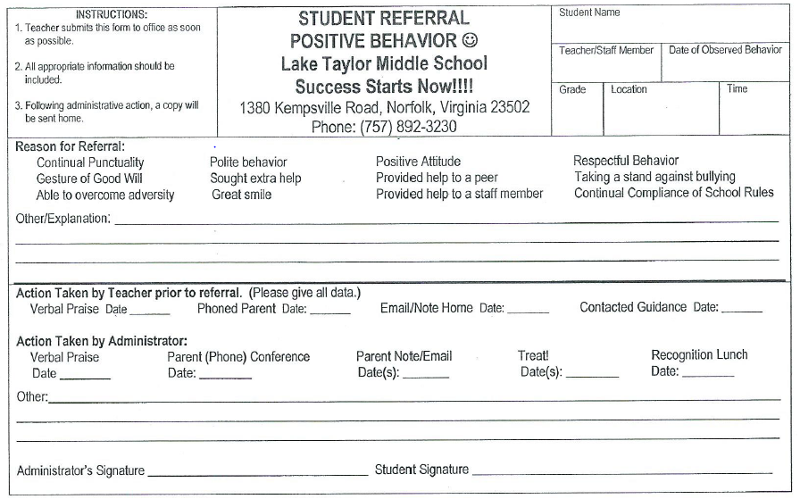
Sample Student Referral for Positive Behavior
Notes:
Intent: Examples
Trainer Talking Notes:
●How many administrators in the room would like to see students for positive behavior?
●This is a positive office referral.
●It notes action teacher has taken so principal can do something different.

Slide 16
Zooming In On Definition
  A system that provides
  immediate,
  intermittent, and
  long-term reinforcements,
  given by adults in the building, to any students displaying desired school-wide expectations, behaviors, or associated rules.
Notes:
Intent: To establish common language and define different forms of reinforcement systems.
Trainer Talking Notes: We’ve talked a lot about immediate reinforcement.
●Now we’re going to move to a second category of acknowledgment - reinforcement that is given on an intermittent basis
●Intermittent - occurring at irregular intervals, random, periodic, occasional
Notes - periodically highlight inclusivity

Slide 17
Affirmations and Mantras
Increased activity in the regions of the brain associated with reward and self
Improved academic performance and improved grades
Problem solving abilities increase
Notes:
Intent: strategies to support self-awareness
Trainer Talking Notes:Today we are going to share some strategies to support self-awareness and provide a way to intervene and support students who may not respond to praise. The most important aspect of this work is relationship. Relationship is always key. As you spend time with your students you began to notice what potential thoughts or feelings they are having through their conversations, and your desire to understand the why behind their behaviors. As you notice what works and doesn’t work with your students you adapt and learn from them.
Self-affirmations, Value-Based Affirmations, and Classroom Mantras can potentially increase activity in the student’s brain associated with reward and self, improve academic performance and improve grades, and help with problem solving.
DO NOT READ BELOW (ONLY THERE AS A RESOURCE)The research to support self affirmations, value-based affirmations, and mantras (can be seen as classroom affirmations)
Increased activity in the regions of the brain associated with reward and self
(Christopher N. Cascio Matthew Brook O’Donnell Francis J. Tinney Matthew D. Lieberman Shelley E. Taylor Victor J. Strecher Emily B. Falk)
Improved academic performance and improved grades
(Valerie Purdie-Vaughns, Geoffrey L. Cohen, Julio Garcia, Rachel Sumner, Jonathan C. Cook & Nancy Apfel — September 23, 2009)
Problem solving abilities increase
(Carnegie Mellon University’s David Creswell)
A brain-scan study confirmed that participants who practiced self-affirmations showed increased activity in the regions of the brain associated with reward and self. This was especially true when participants were given self-affirmation prompts that were future-oriented. An additional review of this study can be found here. In addition, utilizing self-affirmations, also called values-based affirmations, was also shown to improve academic performance, narrow the achievement gap, and improve grades in this study.
Students’ problem-solving abilities increase as a result of utilizing positive self-affirmations. Carnegie Mellon University’s David Creswell conducted research that found people who are under pressure can boost their problem-solving abilities by using positive affirmations. Thus, the negative effects of stress on problem solving can be minimized. This has important implications for high stakes testing. Students under stress prior to taking an exam can think about values important to them (self-affirmations) in order to mitigate the negative impact of the pressure they feel.

Slide 18
Zooming In On Definition
  A system that provides
  immediate,
  intermittent, and
  long-term reinforcements,
  given by adults in the building, to any students displaying desired school-wide expectations, behaviors, or associated rules.
Notes:
Intent: To establish common language and define different forms of acknowledgement systems.
Trainer Talking Notes: The final category in the acknowledgment system are long-term reinforcers
●The goal of long-term reinforcement, typically, is to help shape/create a positive school culture and work toward larger school-wide goals (i.e. attendance), NOT to change individual student behavior.
Remember that not including all students in a school-wide event and actually can increase poor behavior for those students.

Slide 19
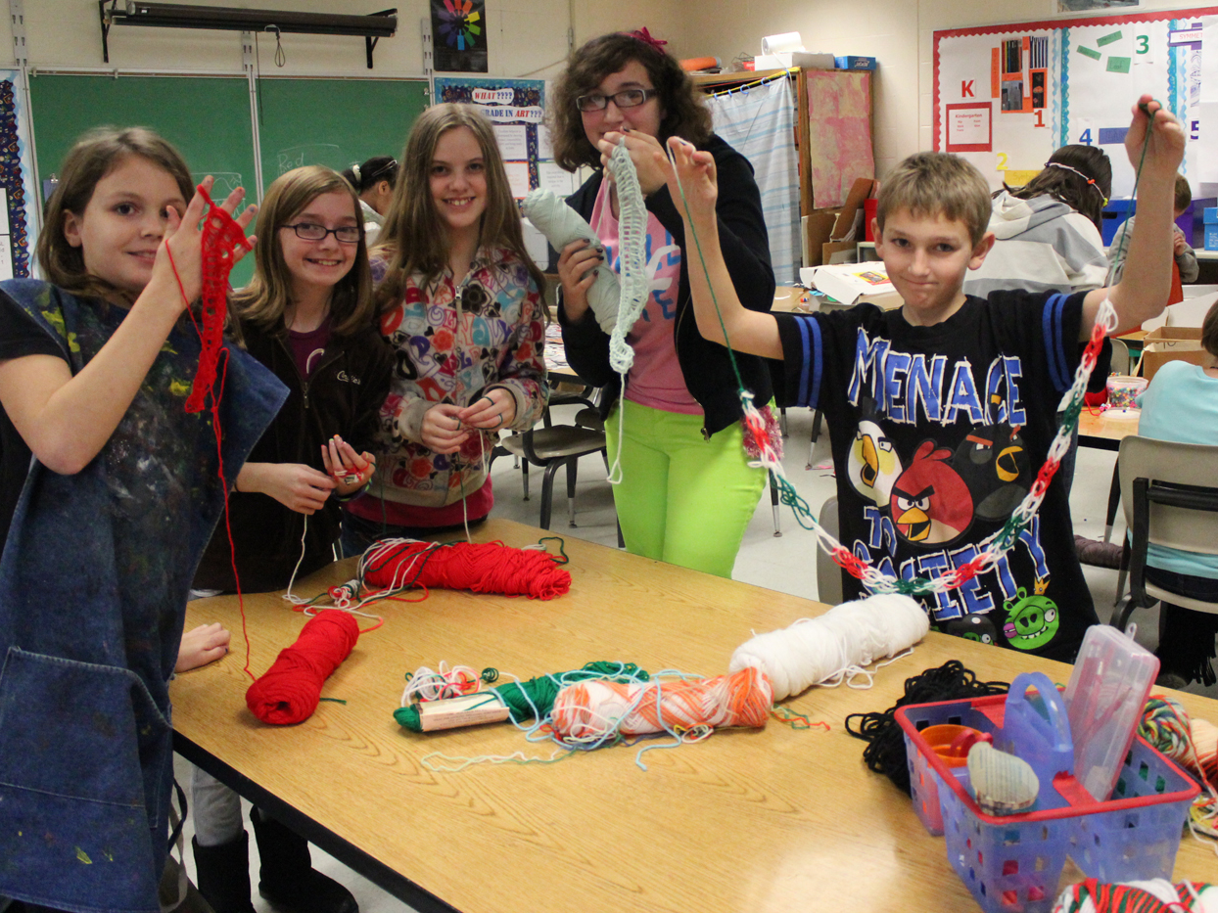
School-wide PBIS Celebration – Include Everyone
Students choose from options like learning to knit, fitness fun, board games, movie viewing, etc. for their school celebration.
Notes:
Intent: To share examples of long-term reinforcements
Trainer Talking Notes: Schoolwide celebrations should be just that - schoolwide; they are opportunities for all students and adults to celebrate and build community.
●Everyone participates
●Meeting school goal
●These students got to choose from options of activities to participate in
Faculty/Student/Family Follow-up Engagement:
●Solicit community/family support and participation in celebrations.
●Business partners like to participate
●Publicize

Slide 20
How about secondary schools?
Create a positive culture in your school.
Ask the students what they want!!!
Led by administrators
Common Language
Student acknowledge each other’s behavior
Notes:
CHAT BOX - PBIS High School Acknowledgement System
High School Acknowledgement Systems: https://assets-global.website-files.com/5d3725188825e071f1670246/5f3abce24c49c792dfa9f360_High%20School%20Acknowledgement%20Systems.pdf
An effective recognition system in high schools is led by the building administration.
Helping faculty and staff see the importance and draw a parallel between academics and behavioral acknowledgment systems can help
them realize it is not a unique practice.
“I just spent my last couple hours cutting grass, so we should have pizza for dinner”
Provide teachers with some lead-ins (sentence starters) that are contextual and adolescent relevant. They can use such as, “You showed responsibility when…”, and “I could tell you were frustrated but you used a respectful tone when sharing with me.”
Examples - Assemblies and Pancake breakfast

Slide 21
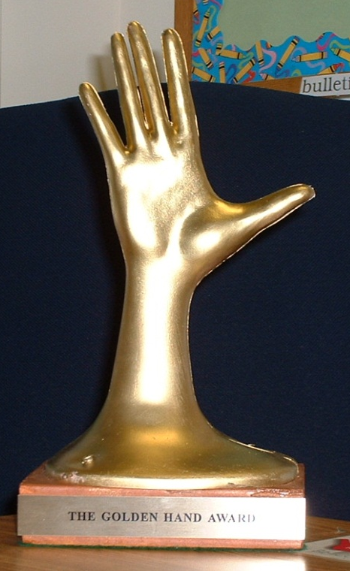

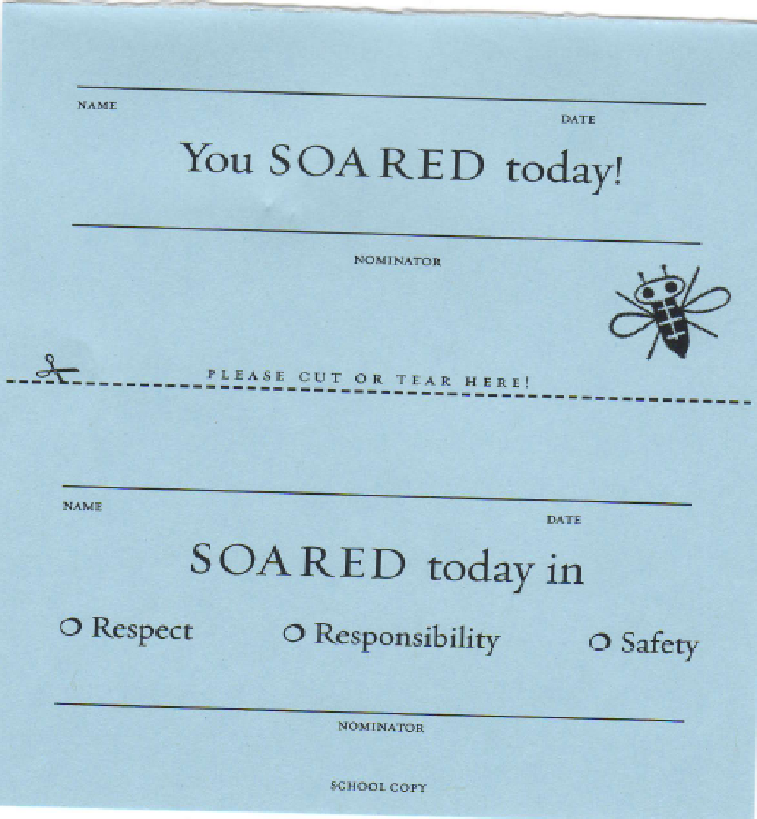
Recognizing Staff
Keep staff motivated and appreciated!
Use community resources and local businesses
Incentives for staff could include:
  Tangibles
  Tokens
  Symbolic
  Celebrations
Notes:
Intent: To acknowledge staff in order to keep them motivated and appreciated and provide examples to participants.
Trainer Talking Notes: As you’re building your acknowledgment system, developing ways to celebrate and acknowledge the hard work of the adults in your building is critical.
Variety is important - and it’s important to identify ways to give acknowledgment that work for the adults in your school - all schools are different.
Incentives for staff:
Golden hand award
Raffles
Huskies - school mat
Teachers nominated each other.
Earned mat to put in front of door of classroom
Faculty/Student/Family Follow-up Engagement:
Solicit community/family support and participation in staff acknowledgement.
Business partners like to donate gifts
Publicize

Slide 22
Quick Review
School and classroom-wide acknowledgements are for __________
Acknowledge the behavior __________
Acknowledge students __________ in common areas
Keep it __________
Include the students in identifying possible __________
__________ for students needing greater support systems
individualize every student immediately
acknowledgements other than your own novel
Notes:
Intent: To review acknowledgement systems and assess for understanding
Trainer Talking Notes: From the selections, fill in the blanks using the waterfall chat box method.
Answers:
School and classroom-wide acknowledgements are for every student
Acknowledge the behavior immediately
Acknowledge students other than your own in common areas
Keep it novel
Include the students in identifying possible acknowledgements
Individualize for students needing greater support systems

Slide 23
What could your acknowledgement system include?
TYPE | WHAT | WHEN | WHERE | WHO
Immediate/High Frequency In the moment, predictable, Delivered at a high rate for a short period (e.g., Gotchas, Paws, High Fives) | STUDENTS ADULTS: | High frequency for a short time when first teaching desired behavior or re-teaching identified problem behavior from data |  | ALL STUDENTS, ALL ADULTS
Redemption of high frequency (scheduled intermittent) (e.g., school store, drawings) | STUDENTS ADULTS: | At least monthly |  | ALL STUDENTS, ALL ADULTS
Intermittent/Unpredictable (e.g., surprise homework completion treat, random use of gotchas in hallway) | STUDENTS ADULTS: | Maintaining a taught behavior (fading) |  | ALL STUDENTS, ALL ADULTS
Long-term School-wide Celebrations (school-wide not individually based) FOR: Ex: ODR reduction, school-wide target met for certain setting/behavior area ACTIVITY: (e.g., ice cream social, dance, game day) | BOTH TOGETHER | At least quarterly |  | ALL STUDENTS, ALL ADULTS
Notes:
23
Intent: Begin the process of developing a plan for an acknowledgement system.
Trainer Talking Notes: Share sample plan

Slide 24
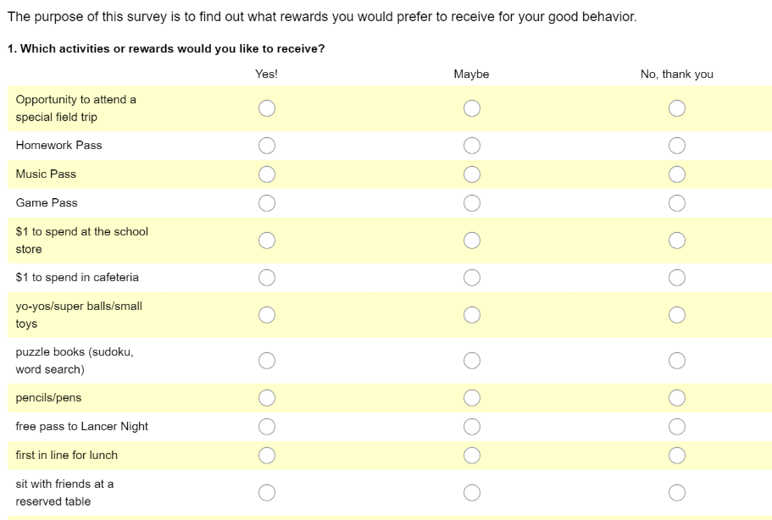
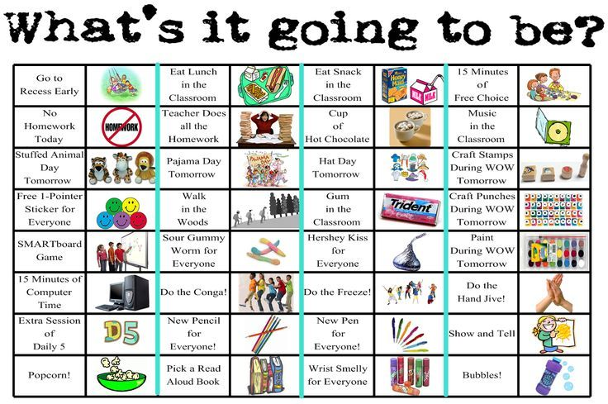
Staff and Student Input
Notes:
Intent: Provide samples for team planning.
Trainer Talking Notes: How will you include staff and students in the process.
What are the ways you will get feedback from the school community?
Surveys? Inventories?
Consider developmental level of students when determining feedback and acknowledgement systems. High school students can tell you what is reinforcing to them.
If students are heavily involved in creating and implementing the PBIS framework, they will help to hold faculty responsible for consistent implementation.

Slide 25
Using Acknowledgement
System Data Guide…
Implementation
Continuous Improvement
Acknowledgement Inventory at all 3 tiers (build on what is place)
Staff and student surveys
Staff and student incentive inventories
5:1 ratios
Classroom anchored to school-wide system
Who?
Where?
Why?
What?
When?
Climate survey results
ODRs
Minor behavior data
Increased instructional time
Notes:
Intent: Data-driven decision making
Trainer Talking Notes:
Remind teams of the Cool Tool in the workbook.
●Multiple forms of data can be used to make decisions.
●Influences faculty commitment.

