Slide 1
Academics - Tier 1:
New Team Professional Learning
Instructional Delivery
Teaming
1.6a, 1.6b, 1.8, and 1.9
1.1, 1.2a, 1.2b

Slide 2
ATFI Roadmap
Academic Tiered Fidelity Inventory Roadmap
Implementation
1.3 | Aligned Curricula
1.4a | Evidence-Based Practices
1.4b | Lesson Plans
1.4c | Relevant Objectives
1.5 | Performance Measures
1.6a | Formative Assessment
1.6b | Instructional Adjustment
1.7a | Professional Learning
1.7b | Coaching
1.7c | Collaborative Planning
1.8 | Instructional Practices
1.9 | Student Involvement
1.10 | Collective Teacher Efficacy
1.11 | Family and Community Engagement
Teaming
1.1 | Team Composition
1.2a | Team Alignment
1.2b | Team Operating Procedures
Our Focus:
Instructional Delivery

Slide 3
Academic TFI 1.6a
Formative Assessment (item description)
Teachers utilize formative assessment to inform teaching, lesson plan adjustment, and remediation.
Evidence:
Examples of formative assessment
Examples of lesson plans with adjustments
Examples of plans for remediation
Walkthrough observations

Slide 4
Academic TFI 1.6a
Formative Assessment
Learning Intention
Success Criteria
Know and apply knowledge of five strategies of formative assessment
I can give examples of using the five strategies of formative assessment and/or guide others in the process

Slide 5
Definition of Formative Assessment
Formative assessment is a process used by students and teachers during instruction to elicit and use evidence to improve understanding of intended learning outcomes and support students to become more self-directed learners.

Slide 6
Five Formative Assessment Strategies #1 and #2
Clarifying, understanding, and sharing learning intentions and success criteria
Eliciting evidence of learners’ achievement
Providing feedback that moves learning forward
Activating students as instructional resources for one another
Activating students as owners of their own learning
Source: Wiliam, D. (2011). Embedded Formative Assessment.

Slide 7
Strategy #2. Eliciting evidence of learners’ achievement
Just Say No to Calling on Volunteers
Response Systems
Choral response (with think time and clear signal)
White boards
Popsicle sticks
Partners (teacher selected, job for both)
Discussion groups
Exit tickets

Slide 8
Tools for Formative Assessment
29 Ideas Tool!
60 Formative Assessment Tips!

Slide 9
They Respond - We Respond
What adaptations can be made to the current lesson?
immediate reteaching
more practice
What adaptations should be made in future lessons?
Facts, concepts, skills, opportunities for critical thinking
Additional practice

Slide 10
Process Time
Question
Activity
1.Which type of response system do you see most frequently in your building? Share any good ideas!
OR
2. Moving away from calling on raised hands can be challenging. Share any tips or frustrations in your breakout.

Slide 11
Five Formative Assessment Strategies #3
Clarifying, understanding, and sharing learning intentions and success criteria
Eliciting evidence of learners’ achievement
Providing feedback that moves learning forward
Activating students as instructional resources for one another
Activating students as owners of their own learning
Source: Wiliam, D. (2011). Embedded Formative Assessment.

Slide 12
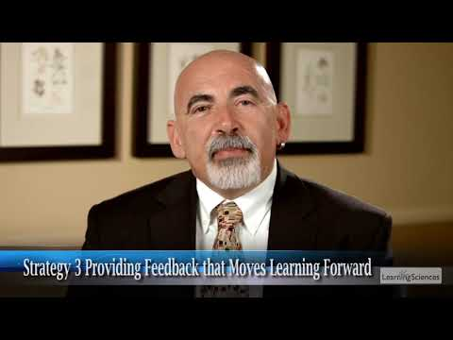
Strategy #3: Provide feedback that moves learning forward

Slide 13
Effective Classroom Feedback:
The Work of the Recipient
Feedback should be more work for the recipient than the donor.

Slide 14
Effective Classroom Feedback:
Focused and Specific
Feedback should be focused.

Slide 15
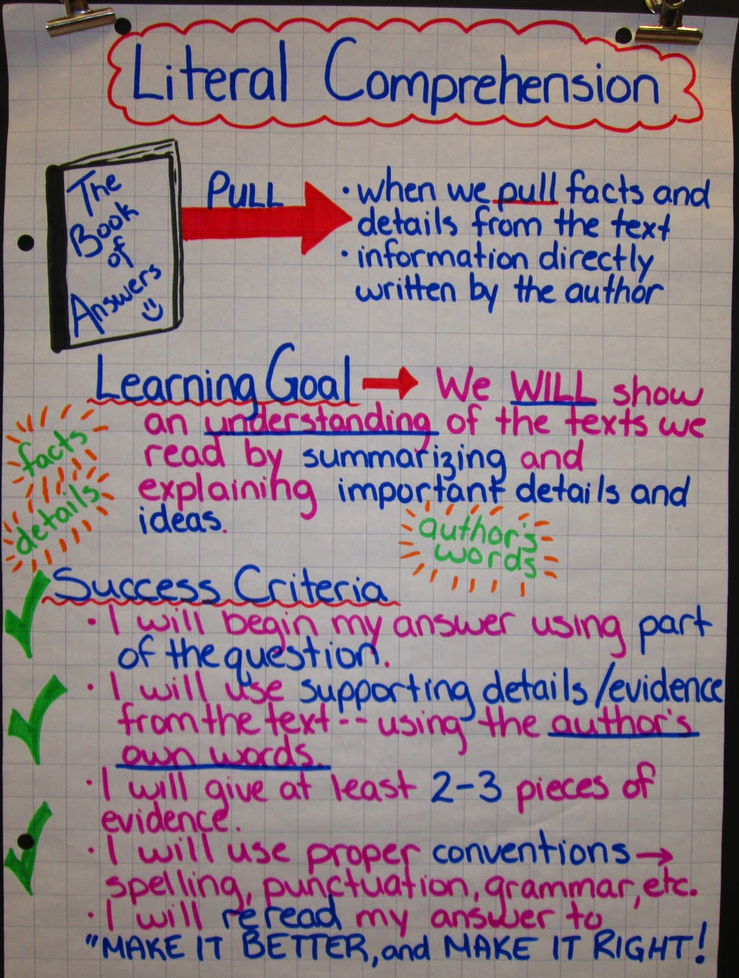
Effective Classroom Feedback: Related to Learning Goals
Feedback should relate to the learning goals that have been shared with students.

Slide 16
Teacher-Student relationships and feedback
The relationship between the teacher and student needs to be a positive one.
The teacher needs to be seen as credible in the eyes of the student.
The climate of the classroom needs to be such that errors are not viewed with shame, but as part of the learning process.
The Distance Learning Playbook p. 151

Slide 17
Is it a medical or a post mortem?
Annotate M or P:
“Let’s look at the last paragraph. Can you add more detail?”
“You forgot footnotes. That lowered your grade to a C.”
“Look again at the success criteria. Can you rewrite this section in your own words?”
“You followed all instructions but there are too many spelling errors so your grade is a D.”

Slide 18
Team Reflection
How is a school culture created that celebrates mistakes as a part of learning?

Slide 19
Five Formative Assessment Strategies
Clarifying, understanding, and sharing learning intentions and success criteria
Eliciting evidence of learners’ achievement
Providing feedback that moves learning forward
Activating students as instructional resources for one another
Activating students as owners of their own learning
Source: Wiliam, D. (2011). Embedded Formative Assessment.

Slide 20
Strategy #4. Having students help each other learn
Cooperative learning (as long as there is a group goal and individual accountability)
Discussion
Partner work
Collaborating
Peer tutoring
Turn and talk

Slide 21
A goal for peer interactions
“Classroom discussion has an effect size of…, double the average impact on student learning…A reasonable goal is that, on average, 50 percent of the instructional minutes are spent in student-to-student
interactions..”
Fisher D, Frey N, Smith D, Hattie J Rebound:A playbook for bebuilding agency, accelerating learning recovery, and rethinking schools, 2021,pp.88-89

Slide 22
Peer Critiques
https://players.brightcove.net/268012963001/rJenILPQx_default/index.html?videoId=5518311215001

Slide 23
Reflect a Moment
What skills do you need to teach students so they can help each other learn?

Slide 24
Team Time 1.6
Team Time
Refer to ATFI feature 1.6a. How might your team score your school?
Discuss: What are additional ways to use formative assessment in this school?
Record next steps for this feature in the ATFI Action Planner.

Slide 25
Five Formative Assessment Strategies #5
Clarifying, understanding, and sharing learning intentions and success criteria
Eliciting evidence of learners’ achievement
Providing feedback that moves learning forward
Activating students as instructional resources for one another
Activating students as owners of their own learning
Source: Wiliam, D. (2011). Embedded Formative Assessment.

Slide 26
Academic TFI 1.9
Student Involvement (Strategy #5)
Instruction includes opportunities for students to participate in (a) the process of setting learning goals; (b) tracking of progress toward the learning goals; and (c) metacognitive reflection on learning.
Evidence:
Self-monitoring performance charts
Student goal statements
Aim lines
Lesson plans
Instructional observation data
Notes:
Jot down for yourself: How would you score your school?

Slide 27
Academic TFI 1.9
Student Involvement
Learning Intention
Success Criteria
Enable the use of student goal setting and metacognitive learning in classrooms
I have strategies to use in working with students to set and monitor goals and/or share with others.
I have strategies to use in working with students on reflecting on their own learning and/or sharing with others.

Slide 28
1.9 a) Students setting learning goals
Co-constructing a rubric or checklist based on learning criteria (not necessarily individual)
Setting personal, individual goals based on current performance
Notes:
Goal setting is related to success criteria.
The importance of involving students in the Co constructing of success criteria on rubrics and checklist was discussed in the planning section. We will talk briefly about the impact of having students set individual goals.
The importance here is two things: Setting personal goals allows students to experience success even when their actual achievement is below that of their peers. We know that each small step toward success is a path to greater success . If teacher or student focus on deficits, low expectations take hold.
Secondly, growth toward a goal is motivating. We want to continue on a path, even if it’s difficult, if we can see that we’re making progress.

Slide 29
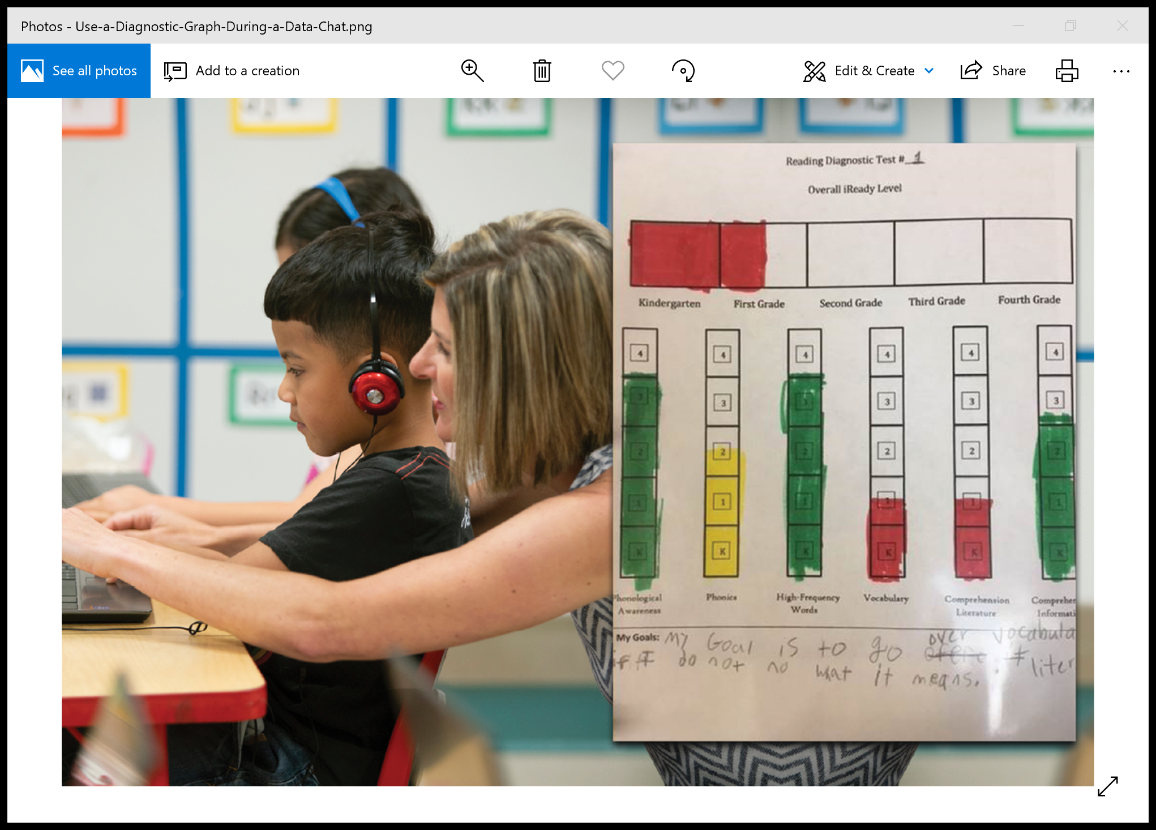
1.9 b) Tracking Learning Goals
Notes:
notes - self management for SEL, and tracking goals is not just academic but also behavior
Next, let’s look at ways for students to track their goals.
All of us are encouraged by seeing a visual representation of our progress toward a goal, a star, a checkmarl, a graph.
Now let’s look at ways for students to track their progress toward goals.
An added incentive is students graphing their own progress in various formats depending on grade levels. Think about your fitbit or phone that shows what you’ve accomplished!
These are in the resource folder.
These tools may also help families monitor their student’s progress.

Slide 30
1.9 b) Clarity on tracking goals
Individual Tracking
Individual Understanding
Graphs
Stars on rubrics (video)
Project checklists
Red/Green Disks or Cups
Videos of a lesson for students to watch and rewatch.
Notes:
One goal of teaching is to develop self directed learners. Not only are they clear about what they are learning, they are able to know when their learning has gone off track. And they are confident enough to express a need for more clarity to the teacher. That confidence is often the result of the learning environment fostered by the teacher.
Having a method of signaling to the teacher that he or she is confused or having trouble is also a strategy for avoiding behavior issues related to frustration
This example also leads us into the next part of this item...students reflecting on their own learning.
In the second example, students start out with green cups coving red cups on their desks. If they become confused or lost during the lesson, they can put the red cup on top, a silent signal to the teacher. The teacher can scan the room to determine how many students need help and either revise the lesson to clarify or provide assistance to a few.
Students showing green discs or cups can be called on to help others. How would this work remotely?
Blended learning often involves short explanatory videos created by teachers. Students can watch and rewatch as they feel the need.

Slide 31
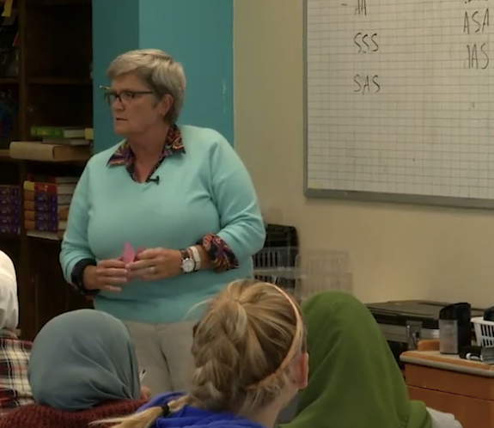
1.9 b&c) Looks like, sounds like...
http://players.brightcove.net/268012963001/default_default/index.html?videoId=5117777016001
Notes:
In this clip the students use the rubric to decide their own level of understanding. This shows the natural progress from 1.9b (tracking goals) to 1.9c (reflecting on learning)
Good examples of:Sharing the success criteria with students
Having kids track and assess their learning
Using the student assessment as an exit slip to revise lesson

Slide 32
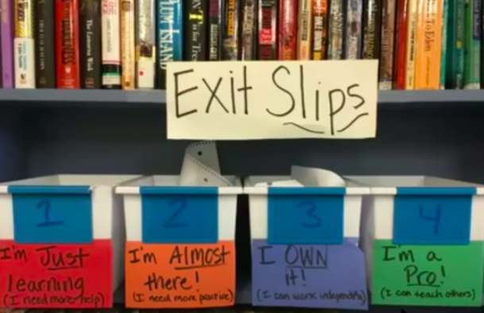
Self Directed Learners
https://youtu.be/pqAHh3pZ57M
Notes:
Almarode Minute 27.48-28.37.
This video clip is from a webinar presented by John Almarode and Doug Fisher. Here are elementary students monitoring their own learning.

Slide 33
Metacognition is what exactly???
“Often described as ‘thinking about thinking’.
We teach students to monitor their understanding as they read, to take notes….A student with a higher degree of metacognition will notice what is confusing, ask questions, and mentally summarize what they are learning.”
Rebound, p.45

Slide 34
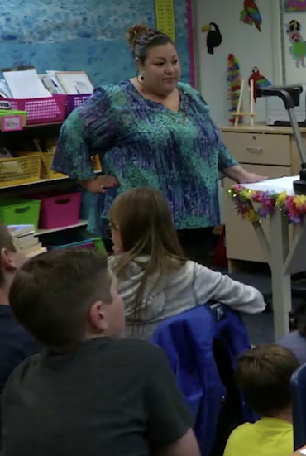
1.9 c) Example: Metacognition
http://players.brightcove.net/268012963001/default_default/index.html?videoId=5117489250001
Notes:
Now we move from setting and tracking goals to students actually reflecting on their learning. They start to better understand themselves as learners. What comes easily for me, what challenges me and requires more effort?
For this example of metacognition, queue the video to 4.25
In the video the students have played battleship to practice using x and y axis language . After the game, the teacher leads them to discuss what strategies didn’t work for them.

Slide 35
Team Time 1.9
Team Time
Refer to ATFI feature 1.9. How might your team score your school?
Discuss: What are some ways to increase student involvement in their own learning? How could good practices be shared?
Record next steps for this feature in the ATFI Action Planner.
Notes:
Have the ATFI available. Assign a recorder for the ATFI action planner.

Slide 36
Academic TFI 1.8
Instructional Practices(item description)
Evidence-based practices and routines are implemented with fidelity and consistency across all classrooms (e.g., activating prior knowledge, explicit instruction, engagement, feedback, scaffolding).
Evidence:
Walkthrough data
Data collection tools
Administrator observation data
Peer observation data
Notes:
mention collective teacher efficacy

Slide 37
Academic TFI 1.8
Instructional Practices
Learning Intention
Success Criteria
Determine school-wide practices that are equitable and impactful for ALL students
I can share the data to engage others in committing to impactful practices
Notes:
We are going to have to talk about systems here -

Slide 38
Stop, Jot, and Break
What are common instructional practices you see in your building that are school-wide, expected, and monitored for fidelity?

Slide 39
Yes/No/Somewhat
Assessing Our Current Practices
Expectations for use of evidence-based instructional practices have been defined in my division.
Evidence based practices are used in my school consistently.
We communicated and shared practices during periods of remote learning.
I am familiar with the practices and routines of my colleagues (Collective Teacher Efficacy!!)
Notes:
True/False annotate
We are going to do a quick activity. Remember, that the practices we are discussing need to be school wide and embedded in your systems. So even if you are familiar with high impact processes, the question is if it is clear for your division and school. So lets see...

Slide 40
VTSS Instructional Practices
Notes:
For this section, rather than present all of it here, since it is so critical, we have this in another training. It is called Effective Classroom Systems. There is quite a lot of alignment and agreement in using educational leaders such as Hattie, Marzano, Archer, etc.

Slide 41
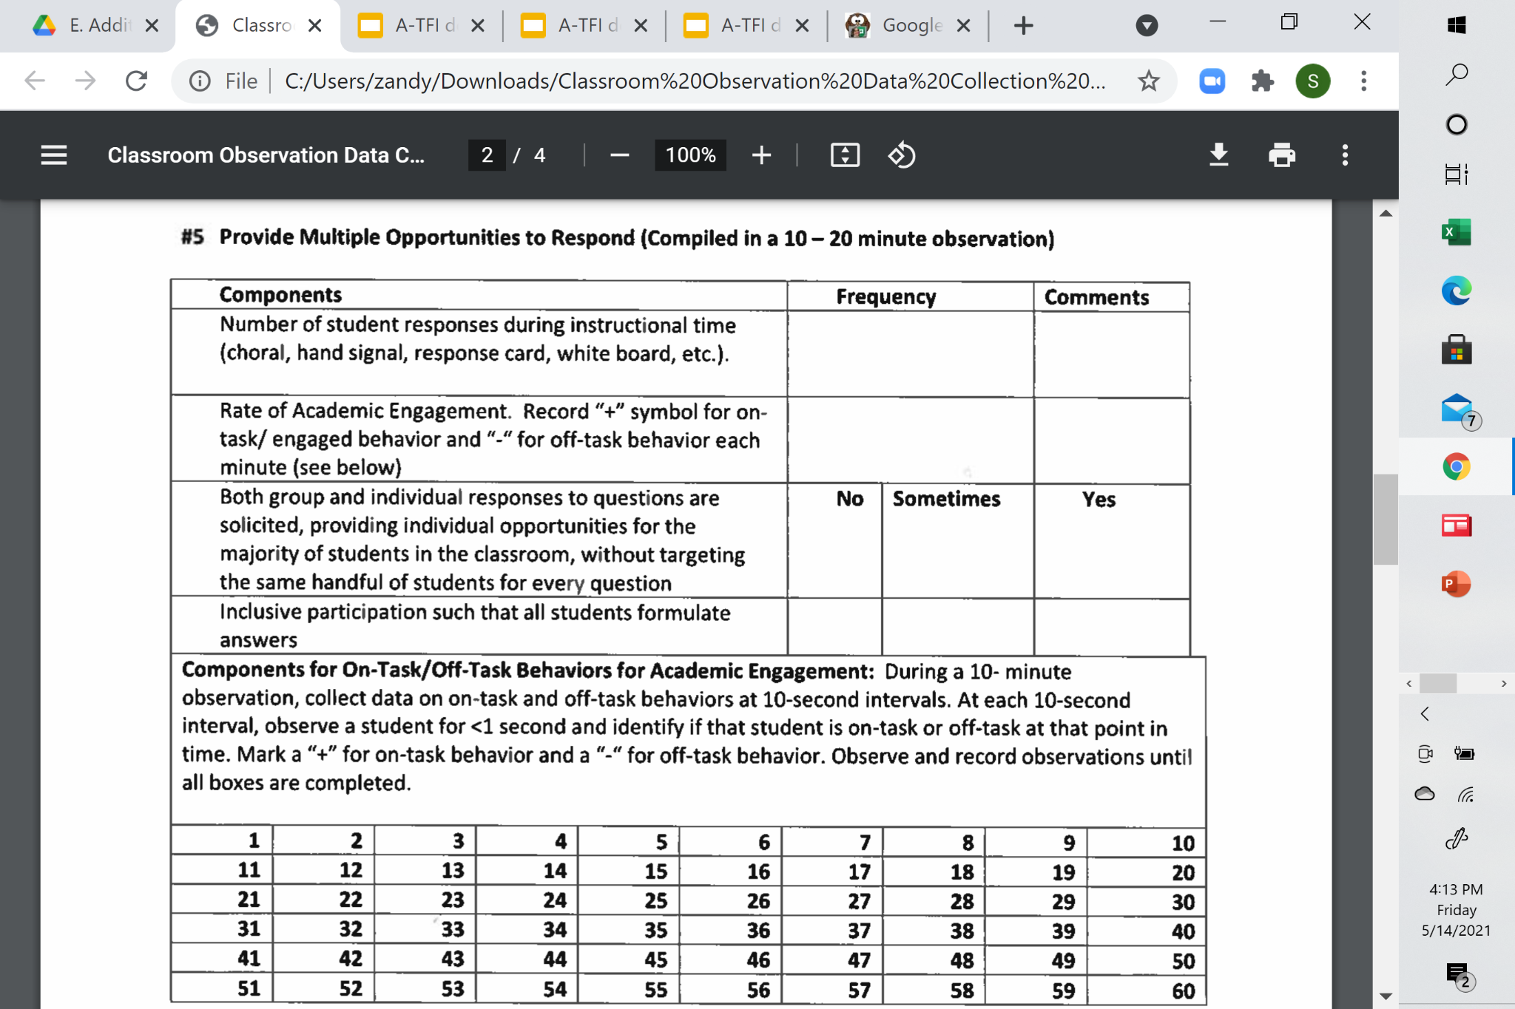
Data observation tools

Slide 42
Fidelity:
Did We Do What We Said?
What Are the Practices?
Do We Implement With Fidelity?
Once we decide on the universal practices, we need to make sure that they are implemented across the building. Example:
#6 Formative Assessment
Components
Teacher monitors student responses in order to determine at least 80% of students’ responses are accurate
0 = evidence-based practices and routines are implemented inconsistently
1 = Practices are implemented in lessons but are not implemented with fidelity across 80% of classrooms.
2 = 80% of staff utilize documented routines and evidence-based practices with fidelity
No | Sometimes | Frequently
Notes:
In simple terms, fidelity just means that we do what we said we would do in the manner in which it was intended to be done. Once we decide as a school or division on the tier 1 practices we expect to see in classrooms we need to ensure that they are delivered schoolwide. This is also an equity issue - each student has access to quality instruction. On the left is one example of the first part of a simple data collection tool that you find in Effective Classroom systems. On the right, you see that in the scoring criteria on the A-TFI we document the extent to which fidelity of instruction occurs.
goes back to culture of the classroom

Slide 43
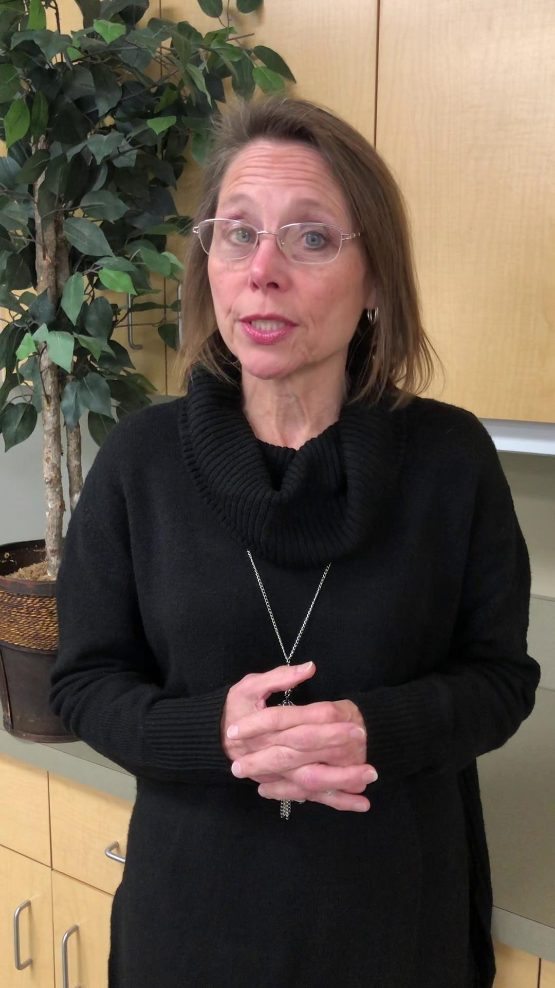
A System for Data Collection
Notes:
Let’s watch how one of our divisions, Frederick County, has a system in place to support teachers as they implement evidence based practices from Effective Classroom Systems.

Slide 44
Team Time 1.8
Team Time
Refer to ATFI features 1.8. How might your team score your school?
Discuss: What are your thoughts on how to collect the data that suggests that evidence based practices are used school wide?
Record next steps on the ATFI Action Planner.

Slide 45
Academic TFI 1.1
Team Composition
Each team in the school includes staff with expertise to support the function of the team and represents the diversity of the building.
Evidence
Meeting structure flow chart
Meeting agendas with team members
List of team members and their roles
Notes:
Explain that we cover teaming in all of our trainings so we will go a little quickly to this part so we can get to where we can dive deeper around how the teams impact instruction
2 big ideas: one is that in the ATFI we are inclusive of all teams working on a similar framework as that will improve academic performance - all teams need the required expertise; two is that the diversity of the building doesn’t just mean race or gender - people from the community or other staff, new vs. veteran teachers, etc.
We generally know that need expertise to support what they are doing, but it was intentionally included in this feature that the teams represent the diversity of the building. And by diversity, we don’t just mean race and gender - we mean level of experience - newer and experienced teachers, community connection, varied departments in the building...

Slide 46
Academic TFI 1.2a
Team Alignment
All school teams (e.g., grade level, content, department, leadership)have
a)defined goals that support the strategic plan and/or continuous improvement plan;(b) defined communication loops among all teams and faculty; and 9c) regularly scheduled meetings.
Evidence:
Meeting structure flow chart with team goals
Team action plans
Meeting agenda
“Working Smarter Not Harder” document
Communication plan
Notes:
Now that you have the teams you need – everyone in the school understands the purpose of the team, the intended outcomes of the team, who benefits from the work of the team and who serves on the team and why – it is time to build the capacity of the team.

Slide 47
Self-Reflect
Think of a team on which you are currently serving and reflect on these two questions.
Does the team reflect the diversity of the building.
2. Does that team have defined goals (clearly stated) and is there an understanding of how those goals support the plan for improvement.
Notes:
you don’t have to answer - just think
Are you on the left, or are you on the right? :)

Slide 48
Academic TFI 1.2b
Team Operating Procedures
All schools have operating procedures that include (a) agenda; (b) minutes and (c) defined roles and responsibilities
Evidence:
Meeting agenda and notes
Roles and responsibility documentation
Notes:
We are going to be quick on this slide - if you’ve participated in our training, you certainly know some of this… the roles are particularly important so one person isn’t doing all the work!!

Slide 49
(b) defined communication loops
Suggestions for communication:
All teams maintain meeting minutes in Drive folder using common agenda.
All teams present 5 minute update at bi-monthly faculty meeting.
Each team has minimally one member on leadership for two-way communication.
Each team shares their data with all staff.
Notes:
Put suggestions in the chat box for how your teams communicate; what your communication loops
Communication is frequently an issue as no matter what part of a system we are in, it is easy to get siloed, which we can’t afford to do

Slide 50
(c) regularly scheduled meetings
Teams identify when they will meet and it is communicated to school staff.
This document is monitored by leadership as evidenced by agenda minutes.
Hint: Consider adding some specific agenda items, such as January 1st meeting looks at universal screening, or 2nd grade level meeting of month reviews benchmark assessments, etc.
Notes:
provide the days and times at the beginning of the year. This gives all faculty members advanced notice of days and times and enables them to plan ahead and have families, etc. scheduled.

Slide 51
Why Teams?
“No individual alone can transform our schools into places where all children get what they need every day.”
*Elena Aguilar, The Art of Coaching Teams, 2016. p. 7
Team Effectiveness Self-Assessment
TEAM:________________________ DATE:____________
TEAM MEMBER: _________________________________
Rate the following elements on a scale of 1-5, with 1 = strongly disagree, 2 = disagree, 3 = neutral,
4 = agree, 5 = strongly agree. Wherever possible, offer examples that illustrate each element.
Element | Rating | Examples and Comments
Purpose We understand and agree on our team’s purpose and goals
2. Results We accomplish what we set out to achieve
3. Procedures There are effective procedures to guide team functioning
Notes:
Add that there are 15 in all...
So why the emphasis on teams? You can read the quote…
Note about pandemic -
The other important factor about teams is that you are heading in to a section tomorrow on instructional adjustment. This is setting you up for how to have the discussions around the data and practices so that you are able to let the formative assessments we’ve discussed actually inform teaching.
We are going to wrap up our day thinking about our teams. 15 items on this
Let’s dig down more into why these teams are so critical
WB- it is on p. 305 - 306 in book
Go back to change begins at the school level so the way we work together is imperative to successful outcomes.
These meetings may look a bit different when work on reopening of schools. Our data will help us focus on learning gaps and how we fold in learning not covered last year.
We have so much content to cover, why are we starting with teams. Teams complete the work of the school - no matter what level or what school you work in teams of teachers and admin, teams of students and teachers get the work done.
Teams work on planning, delivery, aligning the taught curriculum to the tested curriculum
Think about this - whenever you reflect back on something that went really well, you almost always hear “we had a great team.” Think about a team that you were a part of and you really felt good about what that team accomplished. What are 3 qualities of that team - write down 3 words used to describe that team. Go around the table until you’ve repeated them all.

Slide 52
Team Effectiveness
We understand and agree on our team’s purpose and goals.
Team members hold each other accountable.
We have clear agreements about how decisions will be made.
I feel valued as an individual. member in this group. People treat all individuals with respect.
Members engage in unfiltered debate around ideas and issues related to work.
Notes:
Annotate: Which do you think your team needs to work on the most? (Hint - this might be reflected in your action planning)

Slide 53
Team Time 1.1, 1.2a, 1.2b
Team Time
Refer to ATFI features 1.1, 1.2a, and 1.2b. How might your team score your school?
Discuss: How will we use our teaming structures to improve learning?
Record next steps for this feature in the ATFI Action Planner.
Notes:
Do if we have time. Otherwise, ask them to look at this tomorrow.
Have the ATFI available. Assign a recorder for the ATFI action planner.
A point is in Va Learns that we want to take advantage of some of what we’ve learned…

Slide 54
Academic TFI 1.6b
Instructional Adjustment(item description)
A procedure is in place for teams to evaluate Tier 1 data that results in instructional adjustment.
Evidence:
Grade level/content team, professional learning community, and/or data meeting agendas
Unit plans
Lesson plans that reflect adjustment
Data meeting reflection sheets
Programmatic data
Documentation of a data meeting process used by teams

Slide 55
Academic TFI 1.6b
Instructional Adjustment
Learning Intention
Success Criteria
Promote effective teaming structures with systems for utilizing data to make instructional adjustments
I can lead a discussion of grade or team level data in order to impact instruction

Slide 56
Where are you?
Teams in my school meet regularly to review Tier 1 data.
Our teams follow an agenda/procedure for discussing Tier 1 data.
Our teams regularly make instructional adjustments based on a review of Tier 1 data.
Notes:
Get ready to chat partner. Think about each question and answer as best you can about the teams in your school, or if you’re really unsure about many of them, just your team. Division and school leaders, answer about the teams you supervise, to the best of your knowledge. All anonymous.

Slide 57
Helping Teams Interpret Results
John Hattie notes that the “most successful method” involved small teams of teachers meeting every 2 to 3 weeks using an “explicit, data driven structure to disaggregate data, analyze student performance, set incremental goals, engage in dialogue around explicit and deliberate instruction, and create a plan to monitor student learning and teacher instruction.”
Hmmm… Does this sound like systems work to you?
Notes:
Introduce how DIDMworks and that training
Take a minute to read John Hattie’s statement about the work of teacher teams. This is from the Collective Teacher Efficacy work that Kandy was sharing in our first session.
Look at team success analysis protocol in Efficacy book, p.94
Look at resources in National School Reform Faculty
Www.nsrf.org/system/files/protocols/atlas_looking-data

Slide 58
Common agenda items
Identify the problem using data which has been disaggregated.
Set a goal for a measurable level of improvement.
Discuss possible root causes for the problem.
Consider a range of instructional adjustments.
Commit, as a group, to making one or two instructional adjustments during the next 4-6 weeks.
Notes:
This is the systems piece. link to folder - let them know you are going to show a few examples but they are going to get 10 minutes to consider on their own

Slide 59
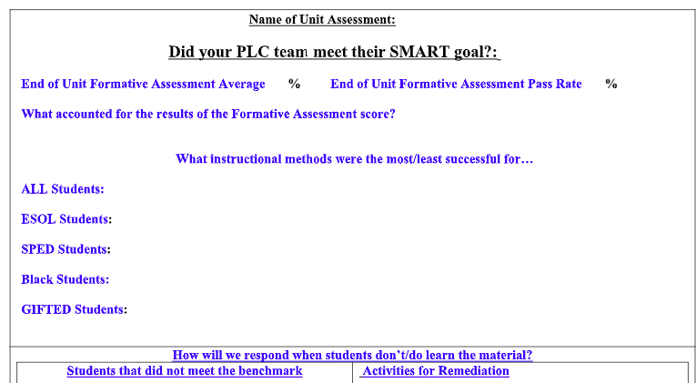
Data collection and problem identification
Notes:
These three sample agendas are in your folder. One is specific to elementary reading, one is for secondary schools looking for students at Risk in a number of different categories, and the last one is a general post benchmark review agenda.

Slide 60
Why is this happening(possible root causes)?
Notes:
In the two examples from Oregon, there is a section for problem analysis.

Slide 61
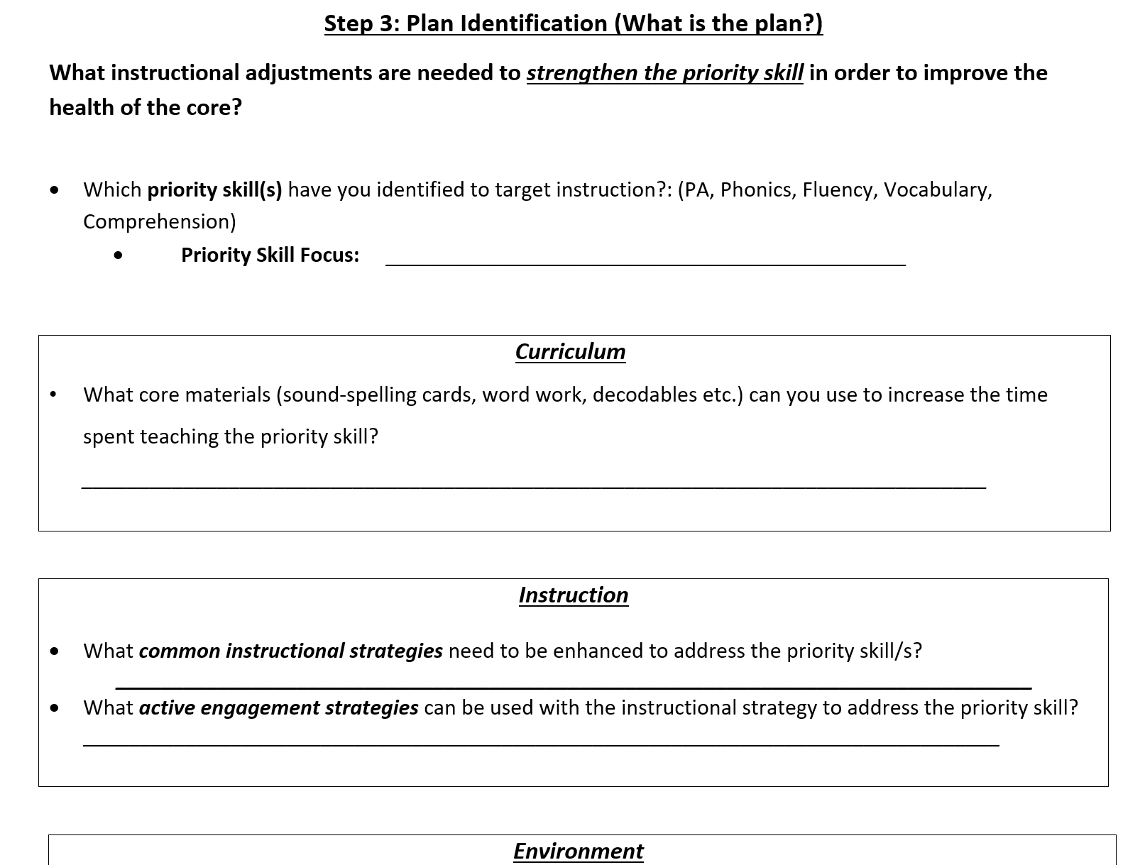
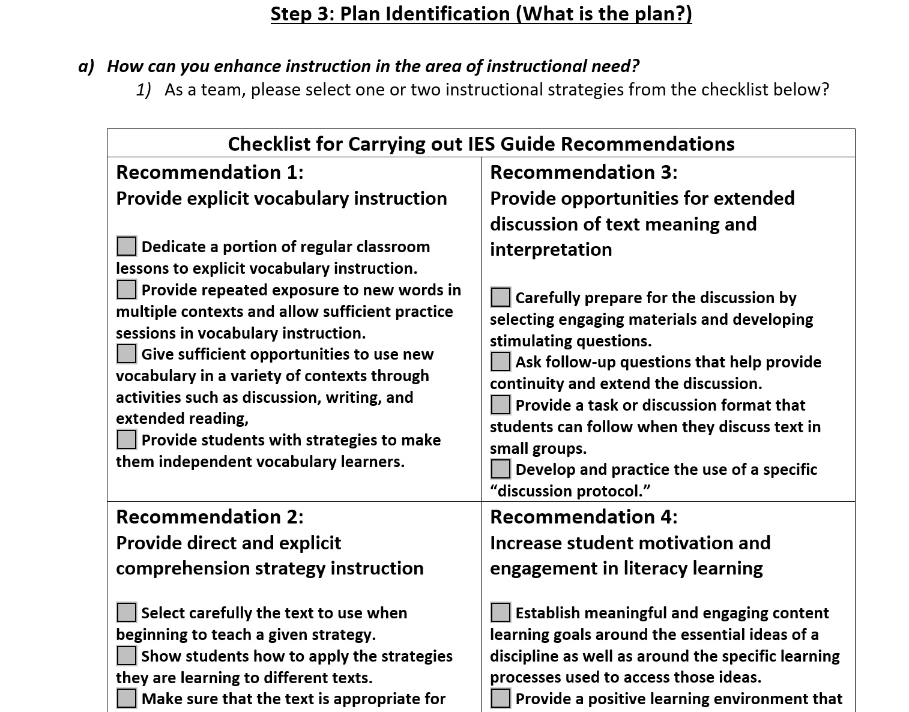
Instructional Adjustments
Notes:
And, for elementary and secondary, sections to prompt instructional adjustment based on evidence based practices.

Slide 62
Lesson Adjustment Considerations
Sharing examples of successful strategies
Increasing focus on vocabulary work
Identifying opportunities for scaffolding
Chunking information
Increasing use of high leverage instructional strategies
Increasing student engagement
Notes:
Sometimes it is easy to identify a priority skill to focus on in the future. If not, looking at adding more student engagement strategies is always useful.

Slide 63
Make a commitment to the adjustment
Identify the goal
Commit to one or two instructional adjustments as a group
Hold one another accountable
Celebrate success!
Notes:
Teams can decide whether to make an adjustment as a group, or for individuals to decide on a personal adjustment. Either way, it’s important to report out and share during the next meeting.

Slide 64
Team Time 1.6b
Team Time
Refer to ATFI feature 1.6b. How might your team score your school?
Discuss: What is your current process for instructional adjustment and how might it be improved? Does our data lead to modifications in teaching?
Record next steps for this feature in the ATFI Action Planner.
Notes:
Do on Thursday if there is time.Have the ATFI available. Assign a recorder for the ATFI action planner.

Slide 65
References
Archer, A. L., & Hughes, C. A. (2011). Explicit instruction: Effective and efficient teaching. New York: Guilford Press.
Fisher, D., Frey, N., & Hattie, J. A. (2016). Visible learning for literacy: Implementing the practices that work best to accelerate student learning: Grades K-12. Thousand Oaks (California): Corwin.
Hattie, J., Fisher, D., Frey, N., Gojak, L. M., Moore, S. D., & Mellman, W. (2017). Visible learning for mathematics: What works best to optimize student learning, grades K-12. Thousand Oaks, CA: Corwin Mathematics.

Slide 66
References (cont.)
Wiliam, D. (2018). Embedded formative assessment. Bloomington, IN: Solution Tree Press.
Wiliam, D. (2018). Creating the schools our children need: Why what were doing now won’t help much (and what we can do instead). West Palm Beach, FL: Learning Sciences International.
http://www.oregonrti.org/teamingdecisionmaking

