Slide 1
Academics - Tier 1:
New Team Professional Learning
Instructional Planning Module
1.3, 1.4a, 1.4b, 1.4c, 1.5, 1.7c

Slide 2
Tier 1 Academics Roadmap
Implementation
1.3 | Aligned Curricula
1.4a | Evidence-Based Practices
1.4b | Lesson Plans
1.4c | Relevant Objectives
1.5 | Performance Measures
1.6a | Formative Assessment
1.6b | Instructional Adjustment
1.7a | Professional Learning
1.7b | Coaching
1.7c | Collaborative Planning
1.8 | Instructional Practices
1.9 | Student Involvement
1.10 | Collective Teacher Efficacy
1.11 | Family and Community Engagement
Tier 1 Team: Academics Roadmap
Teaming
1.1 | Team Composition
1.2a | Team Alignment
1.2b | Team Operating Procedures
Our Focus:
Instructional Planning

Slide 3

Learning Intention
We are learning the Tier 1 features essential for instructional planning.

Slide 4
I will be successful if
I can explain the importance of aligned curricula.
I can describe a process for lesson plan development.
I can explain the relationship between clarity, learning intentions, and success criteria.

Slide 5
Feature 1.3
Aligned Curricula
Evidence-based curricula are organized into clearly defined learning objectives and progressions that are aligned to state standards.

Slide 6

Alignment
We’ve all heard the term “curriculum/curricula alignment.”
Why is it important?

Slide 7
Alignment of curricula
“...the degree to which expectations and assessments are in agreement and service in conjunction with one another to guide the system toward students learning what they are expected to know and do.”
Written Curriculum
Taught Curriculum
Tested
Curriculum
Source: Virginia Department of Education

Slide 8


Research tells us...
An aligned curriculum is strongly correlated to increased or high student achievement for all students.
The impact is more powerful with low achieving students.
Source: Virginia Department of Education

Slide 9
What it looks like
Evidence-based curricula
Align with the SOL
Are grounded in sufficient quantity and quality of research
Provide multiple opportunities for responding
Include opportunities for confirming and corrective feedback
Provide a scope and sequence that leads to increasing levels of difficulty
Require mastery-based instruction
Include formative assessment
Source: https://www.winginstitute.org/effective-base-instruction-evidence-curriculum

Slide 10
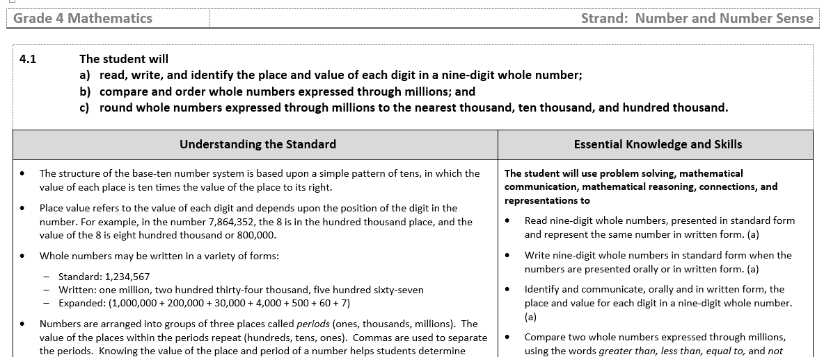
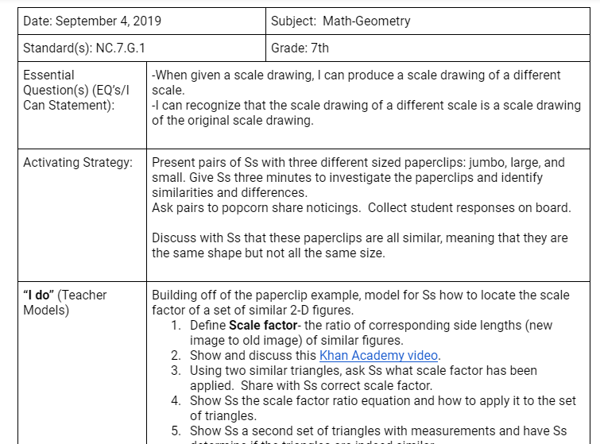
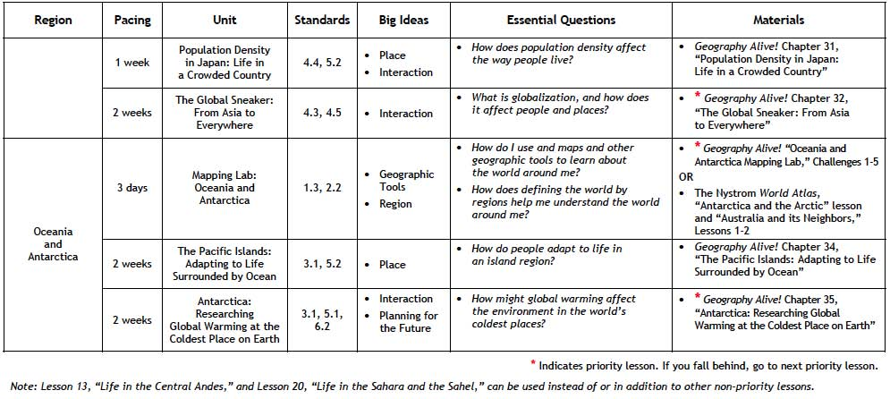
Evidence of the feature
Curriculum guides
Lesson plans
Pacing guides

Slide 11
J. Hattie Quote
“Planning can be done in many ways, but the most powerful is when teachers work together to develop plans, develop common understandings of what is worth teaching, collaborate on understanding their beliefs of challenge and progress, and work together to evaluate the impact of their planning on student outcomes (p. 41).”
Hattie, J. (2012). Visible Learning for Teachers: Maximizing Impact on Learning

Slide 12
Feature 1.7c
Collaborative Planning
Time for collaborative planning is in the schedule (including special education and resource staff) with accountability for the resulting instructional plan.

Slide 13
It's important
“When teachers engage in high-quality collaboration that they perceive is extensive and helpful, there is both an individual and collective benefit. High-quality collaboration...is associated with increases in their students’ achievement, their performance, and their peers’ students’ achievement (p.62).” (Killion, 2015)

Slide 14
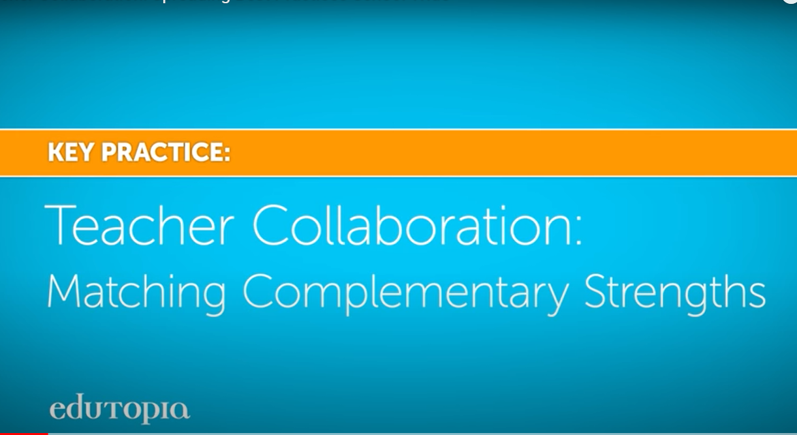
What it looks like

Slide 15
Considerations
Do we have common planning time and/or protected planning time?
Building administrators create the schedules to accommodate collaborative planning.
Expectations and a structure for what collaborative planning time looks like and sounds are communicated.
Are all staff members provided time to collaboratively plan?

Slide 16
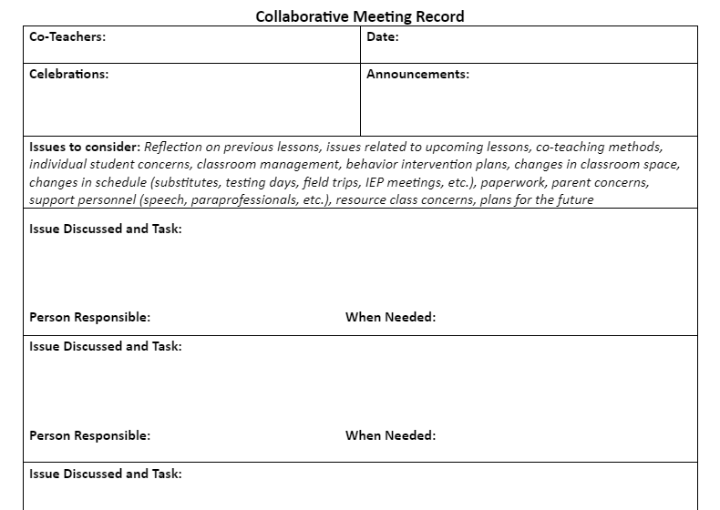
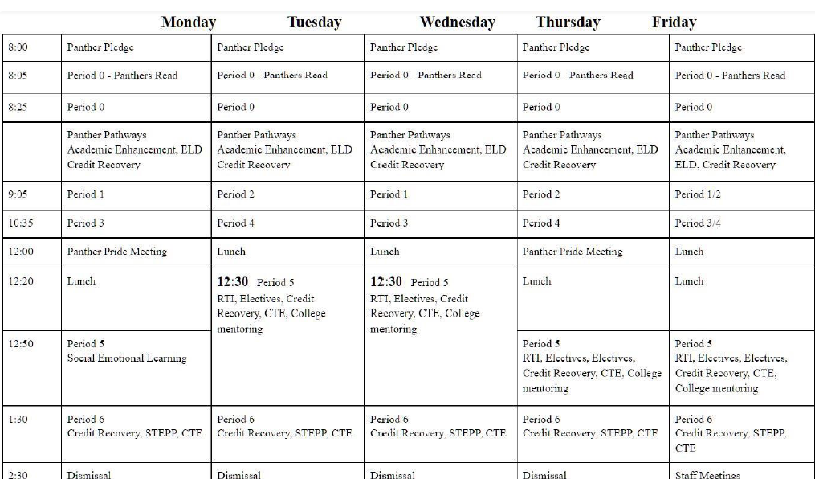
Evidence of the feature
Collaborative planning meeting minutes
Lesson plans
School schedule

Slide 17
Feature 1.4b
Lesson Plans
A process for lesson plan development includes knowledge, skills, and cognitive levels matched to the success criteria of the objectives in the curriculum.

Slide 18
Why it’s important
The written curriculum aligns with the taught curriculum, which aligns with the tested curriculum.
Source: Virginia Department of Education
Written Curriculum
Written Curriculum
Taught Curriculum
Tested
Curriculum

Slide 19
S. Milkova Quote
“A lesson plan is the instructor’s road map of what students need to learn and how it will be done effectively during the class time (para 1).”
Milkova, S. University of Michigan Center for Research on Learning and Teaching

Slide 20

Ensuring alignment

Slide 21
A lesson plan
What do I want students to learn?
What teaching and learning activities will I use?
How will I check for understanding?
Visual source: Milkova, S. University of Michigan Center for Research on Learning and Teaching

Slide 22
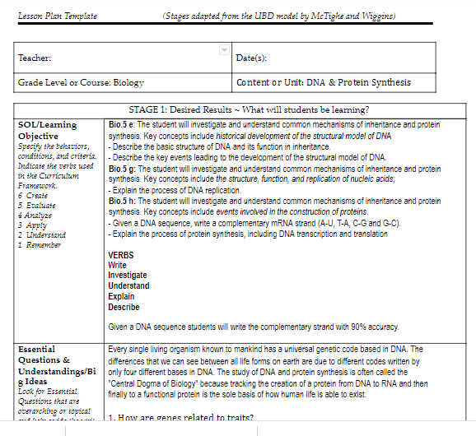
Evidence of the feature
Collaborative planning meeting minutes
Lesson plans

Slide 23

Teacher Clarity
Teachers communicate the learning intentions and success criteria for the learning intentions.
Students know where they are going with their learning, how they are progressing, and where they will go next.

Slide 24
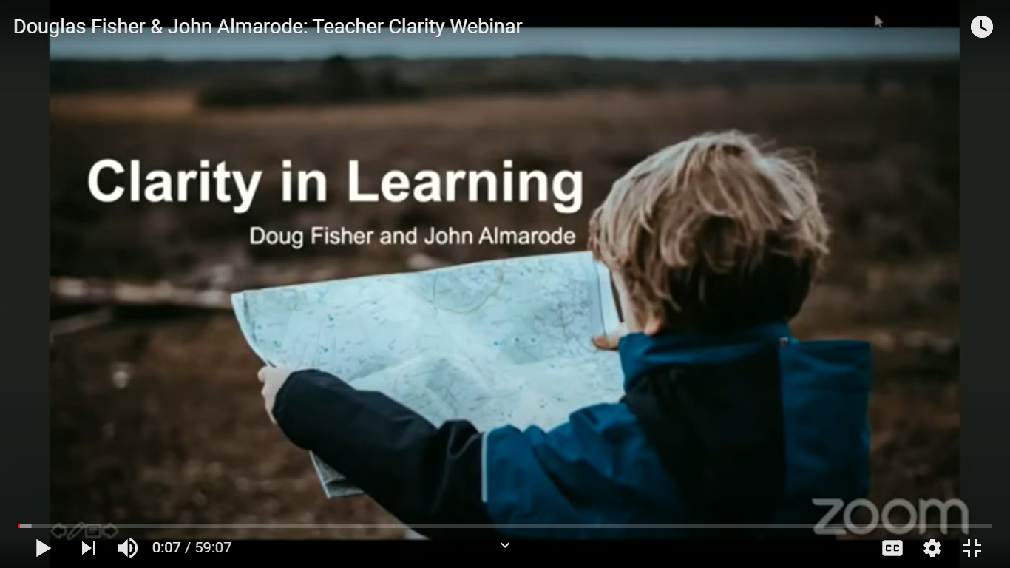
A word about clarity

Slide 25

Teachers with clarity know...
Where am I going?
How am I doing?
Where to next?

Slide 26

Students with clarity can answer these questions...
What am I learning today?
Why am I learning it?
How do I know I have learned it?

Slide 27
Feature 1.4c
Relevant Objectives
Learning objectives are matched to real world relevance and student experiences.

Slide 28

Why they are important
Learning intentions “explicitly focus instruction on guiding students toward proficiency with the content knowledge and skills expressed in the standards document.”
Source: Dean, C.B., Hubbell, E.R., Pitler, H., & Stone, H. (2012)

Slide 29
What it looks like
A learning intention
describes what students must know, understand, and/or do in lesson-sized chunks.
is aligned to the standards.
focuses on student learning, not what they will do.
is age appropriate, using kid friendly language.
is shared throughout daily lessons to guide student learning.
Sources: Almarode, J. & K. Vandas, (2019); Fisher, D. & Almarode, J. (2018)

Slide 30

Learning intentions
Learning intentions
match to students’ experiences;
match to students’ background; and
provide real world relevance

Slide 31

Include social learning intentions
I am learning to work collaboratively with my peers in critically analyzing our ideas.
I am learning to work collaboratively with my peers in making observations about animal habitats.

Slide 32
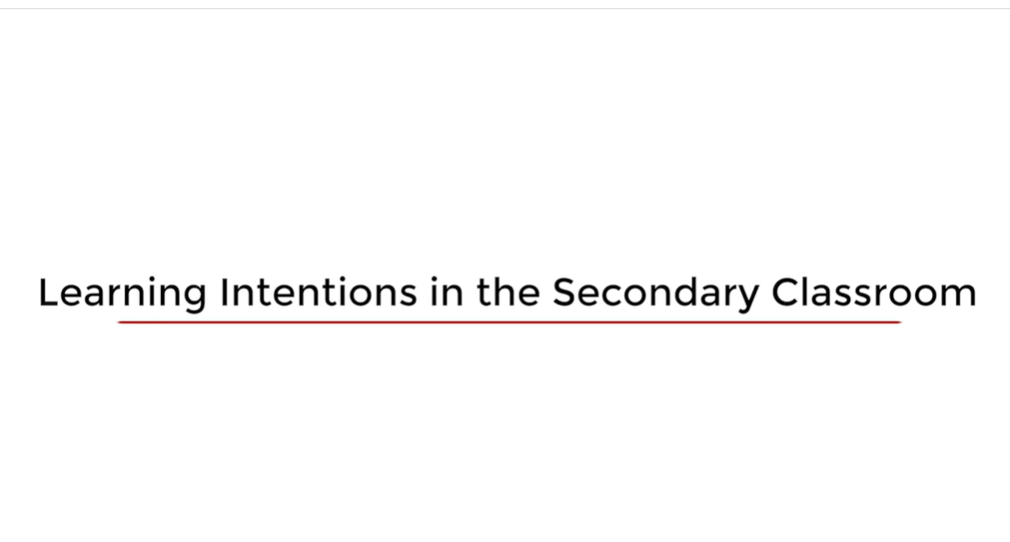
Teacher explanation

Slide 33
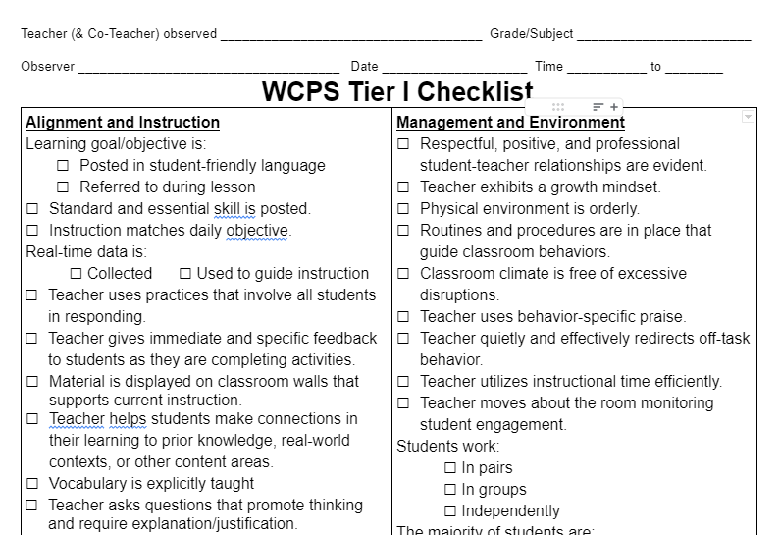
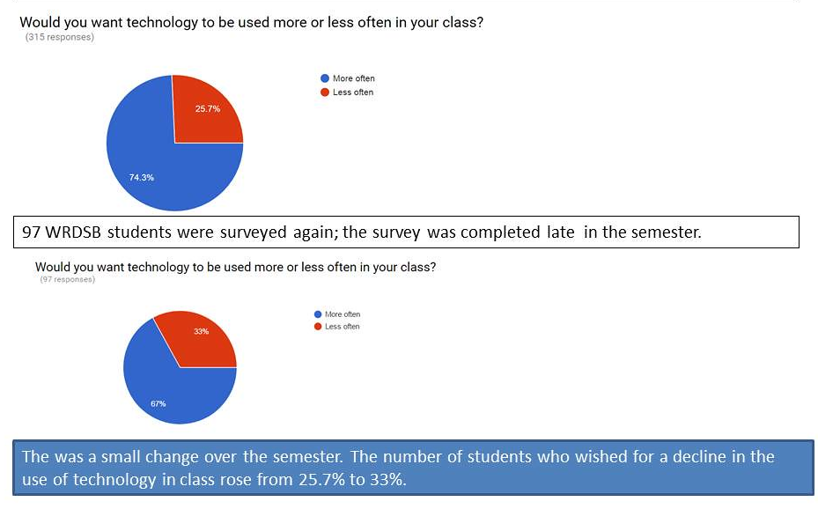
Evidence of the feature
Walkthrough data
Lesson plans
Student survey data

Slide 34
Feature 1.5
Performance Measures
Measures of student performance include goals with success feature criteria and are communicated to students.

Slide 35

Why it’s important

Slide 36

The box puzzle analogy

Slide 37
Success criteria…
Specify what students are to do Provide a “map” to the learning destination
Identify the details needed to achieve the learning intention
Use terms from the standard(s) and maintain the rigor of the standard(s)
Include objective wording
Source: Almarode, J. & K. Vandas, (2019) (p. 39)

Slide 38

Defining success criteria
Defining success criteria is an equitable practice.

Slide 39
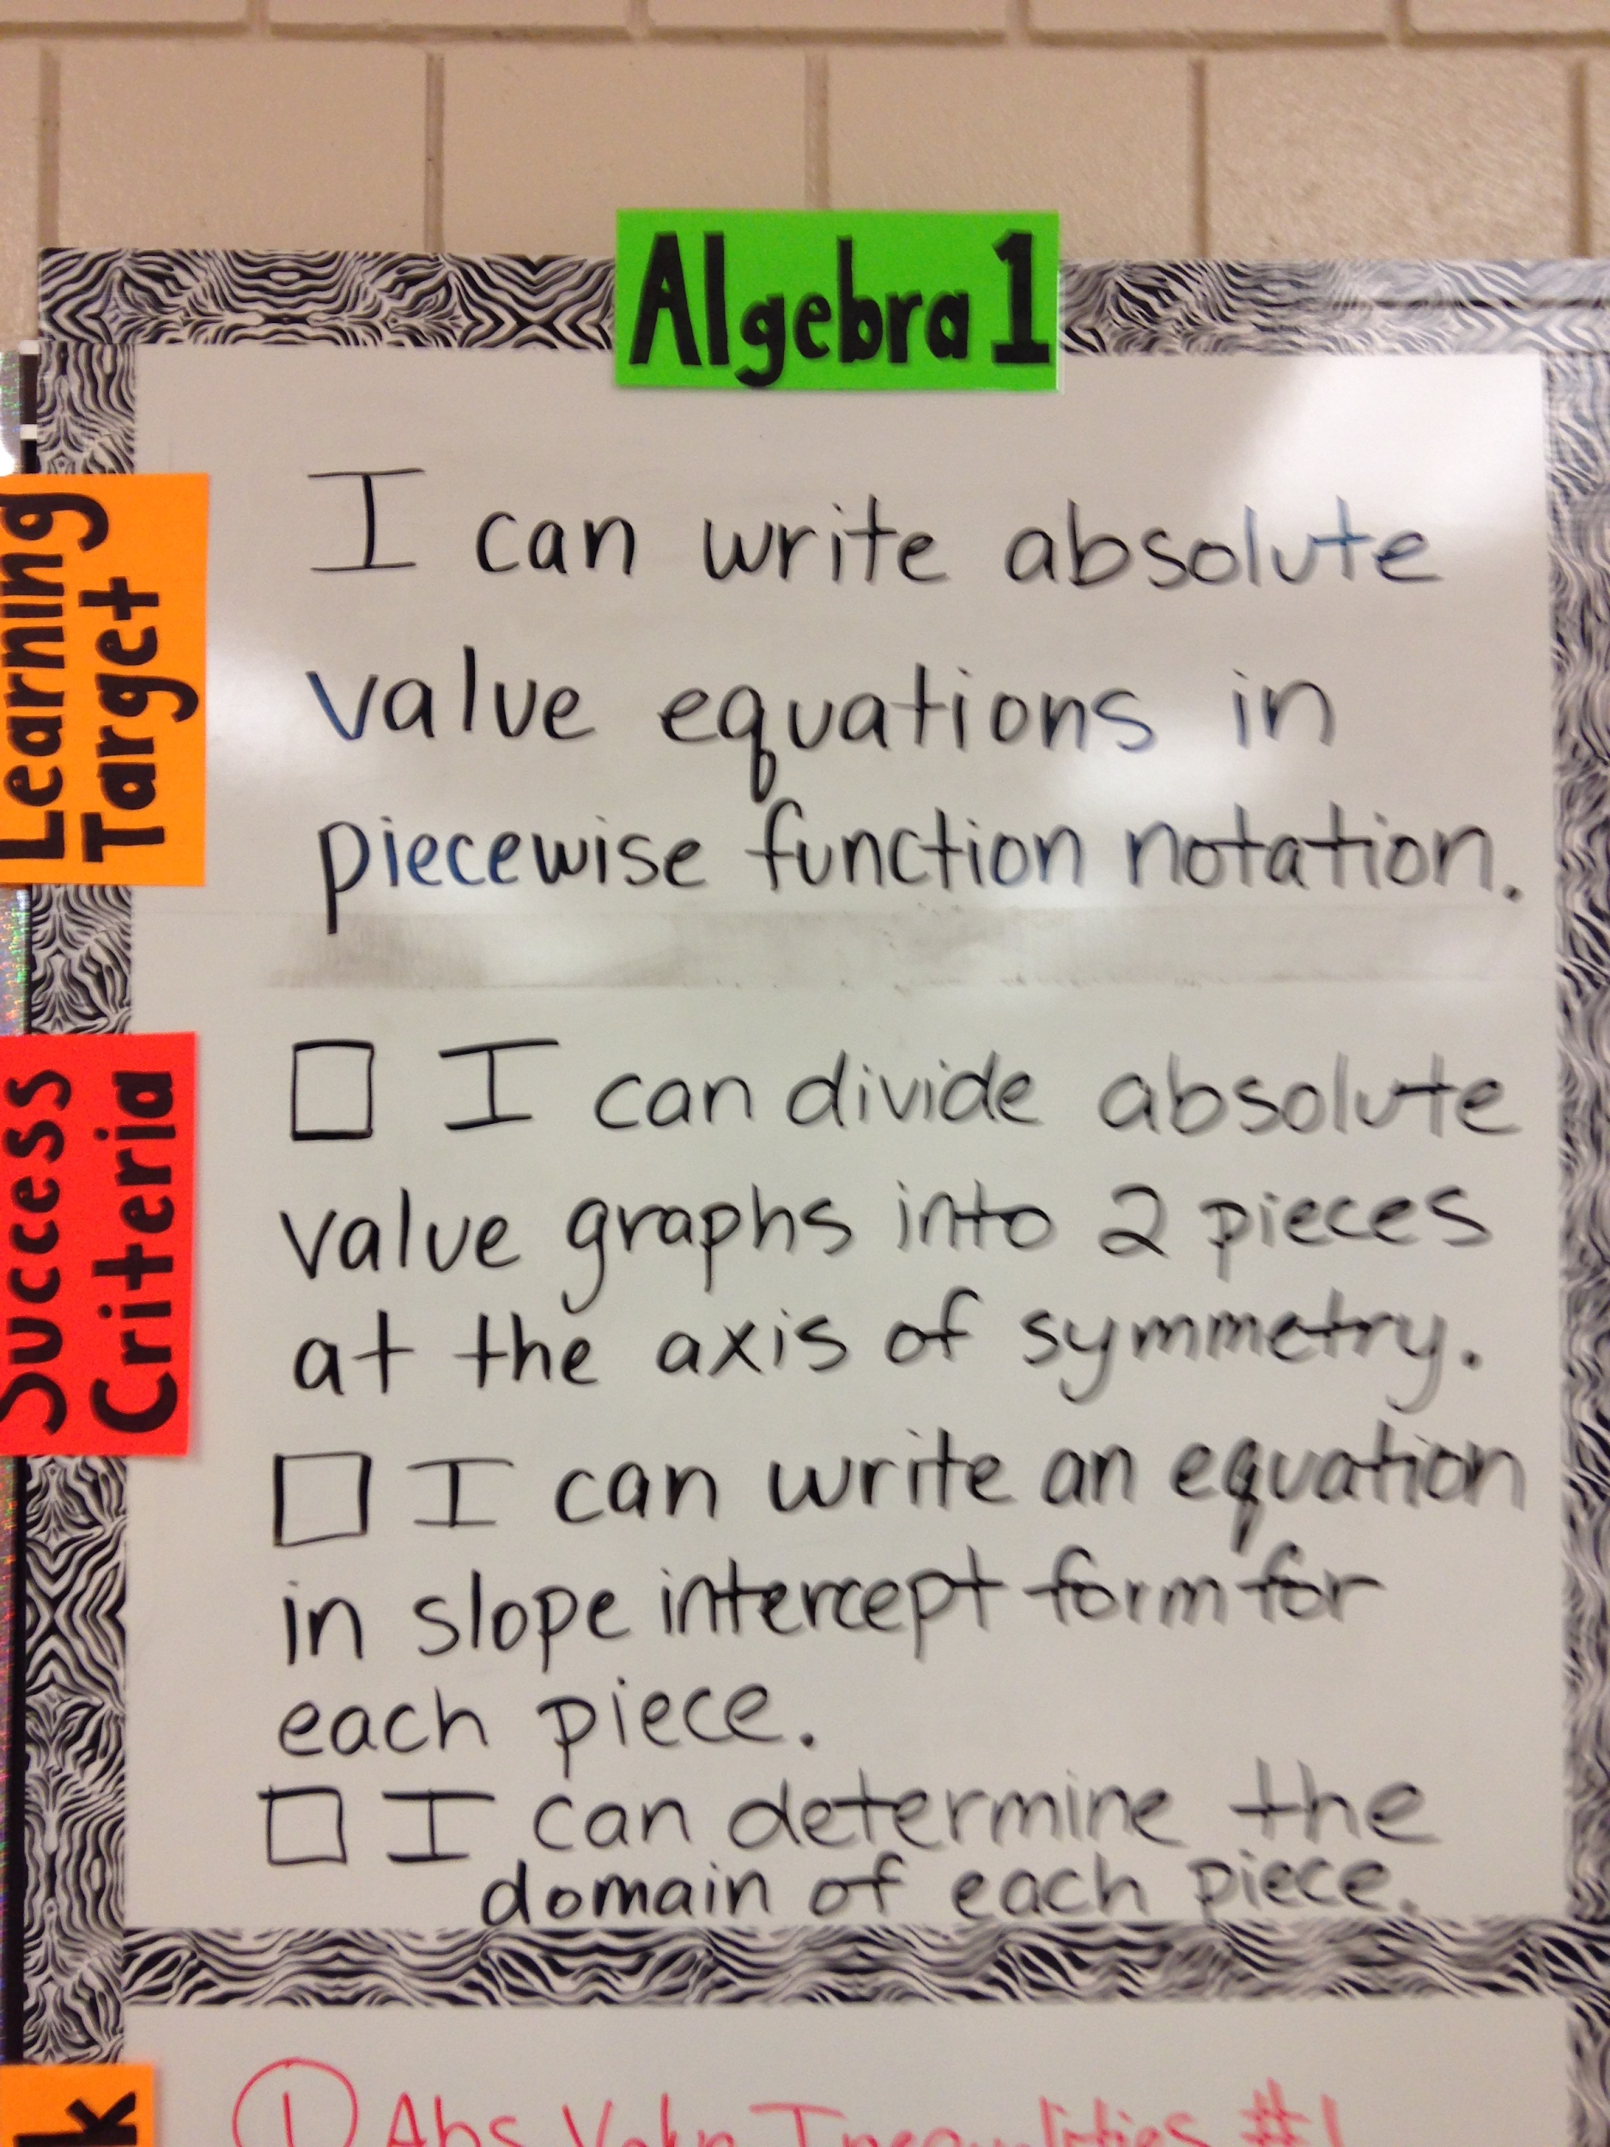
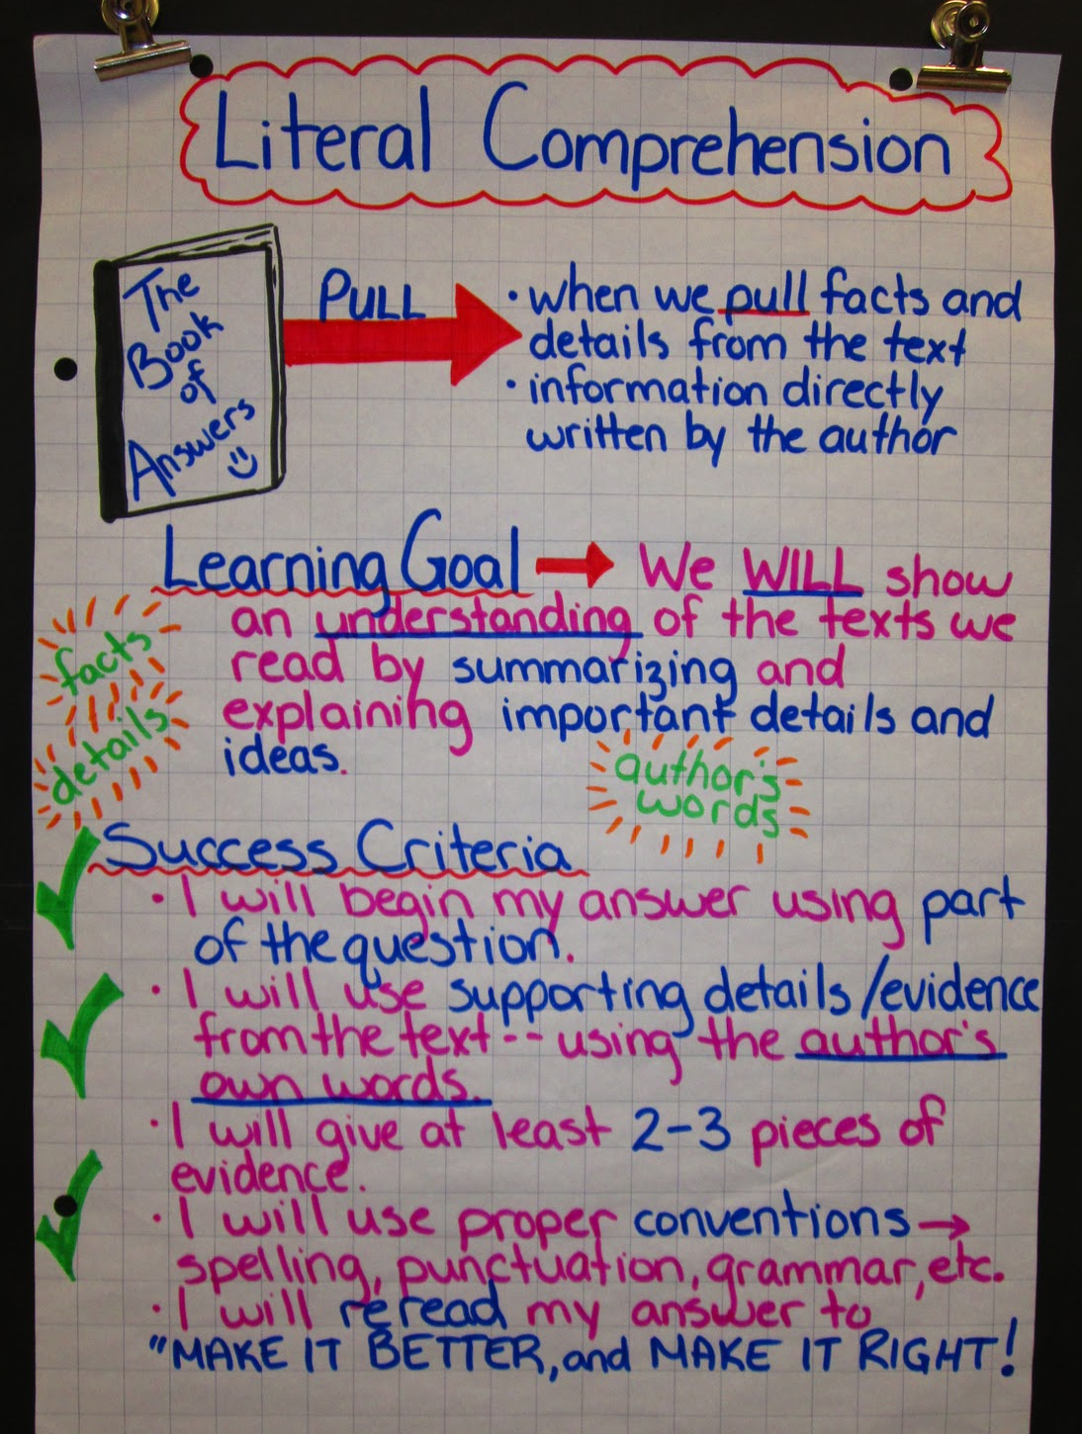
Classroom examples

Slide 40
Single Point Rubric
Instructor: Mrs. Pereira Course: Design Technology – Digital Design Learning Target: Powerful presentations effectively communicate information
Concerns Areas that Need Work | Criteria Standards for this Performance | Advanced Evidence of Exceeding Standards
 | Criteria 1: Planning (storyboard/graphic organizer) Detailed planning (storyboard/graphic organizer) is evident. The storyboard was followed closely during animation.
 | Criteria 2: TEXT Text supports the information being communicated and is appropriate in at least 3 of the following: -Size -Color -Font -# of lines and words
 | Criteria 3: Content Content is in author’s own words with 1-3 errors in: spelling and grammar

Slide 41
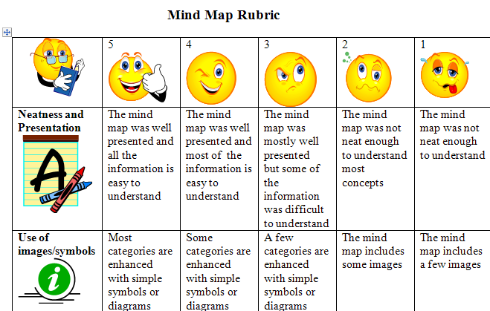
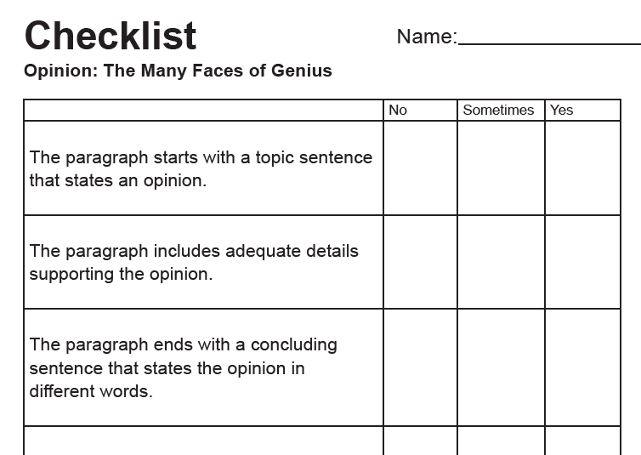
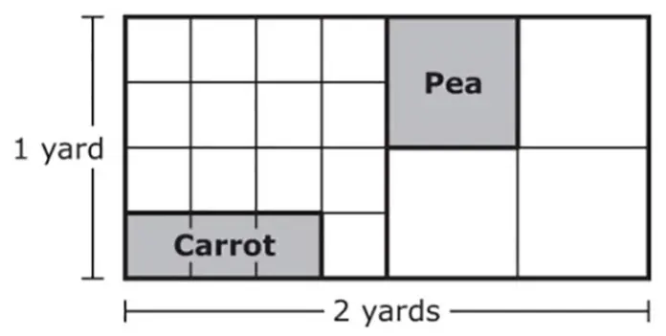
Evidence of the feature
Student rubrics
Student checklists
Performance based assessment

Slide 42
Feature 1.4a
Evidence-Based Practices
Teachers strategically select and use evidence-based practices that are supported by the division/school and matched to learner needs.

Slide 43

Why it’s important
Evidence-based practices are skills, techniques, and strategies that are supported by research that shows the practice or program works (McIntosh & Goodman, 2016; IRIS Center, n.d).
Photo by Julia M Cameron

Slide 44




What it looks like

Slide 45
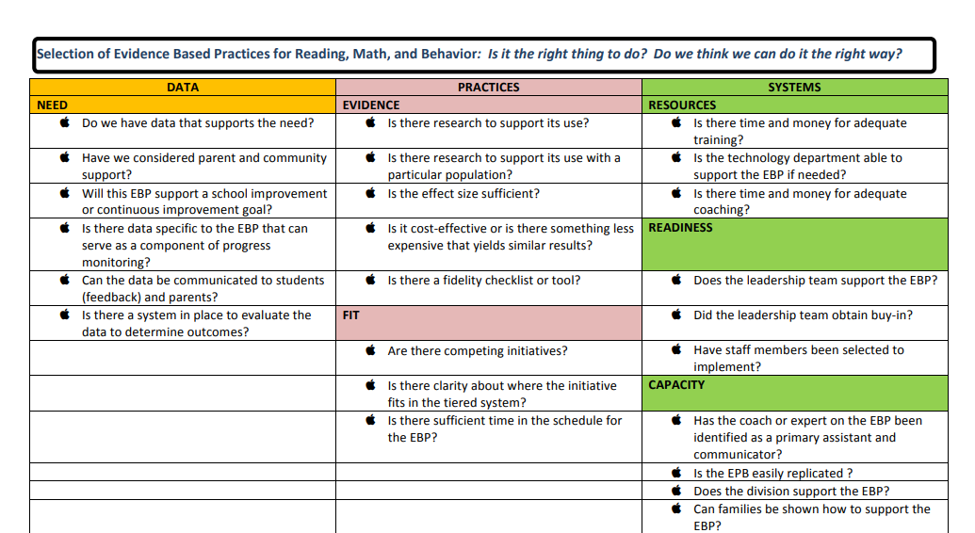
What it looks like
VTSS Selection of Evidence-based Practices Tool
Is it the right thing to do?
Do we think we can do it the right way?

Slide 46
Side 2
Evaluation of Evidence Based Practices: Did we do it the right way? Did it work the way we planned?
DATA | PRACTICES | SYSTEMS
NEED | EVIDENCE | RESOURCES
Does the data suggest this EBP was successful? | Is there evidence of an instructional match between student need and the EBP? | Are the materials organized and categorized by an assigned person?
Has the data been mined to determine the subgroups for whom the EBP was successful | Has fidelity of implementation been measured? | Is on-going assistance available in terms of coaching and professional learning?
Does the data suggest that this EBP is still needed? | FIT | CAPACITY
 | Does the use of the EBP continue to align with school or division priorities? | Are there a sufficient number of trained implementers?
 |  | Is the EBP incorporated into a long-range plan to support outcomes?
Step One: Consider all of the resources from the resource mapping. Is it complete?
Step Two: Evaluate current EBPs (Evaluation of Evidence Based Practices) and select new EPBs as needed (Selection of Evidence Based Practices).
Step Three: Complete a Continuum of Supports document (aka resource map or resources menu, outline of practices, etc.) that outlines the EBPs that will be supported by the school and division.

Slide 47
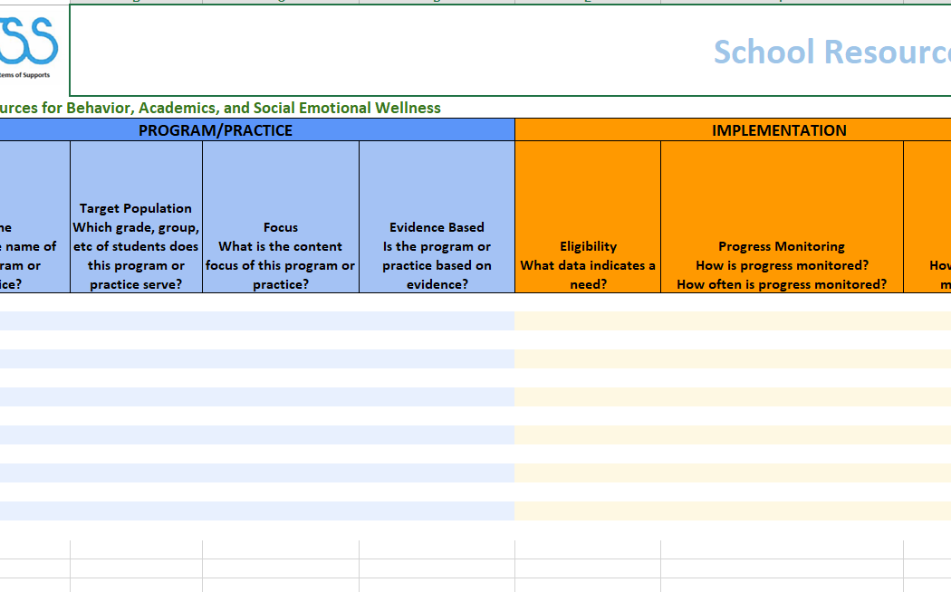
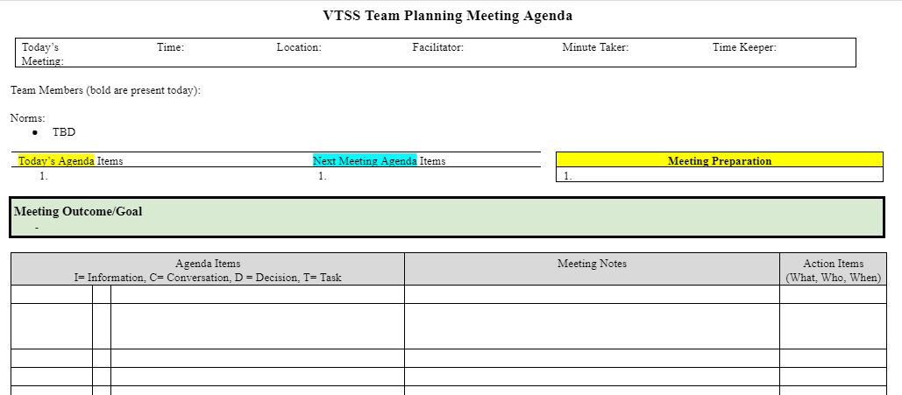
Evidence of the feature
School Resource Map
Walkthrough data
Team meeting minutes

Slide 48
References
Almarode, J. & K. Vandas, (2019). Clarity for Learning. Corwin.
Corwin. (2018, November 14). Douglas Fisher & John Almarode: Teacher Clarity Webinar [Video]. YouTube. https://www.youtube.com/watch?v=pqAHh3pZ57M&t=2813s.
Dean, C.B., Hubbell, E.R., Pitler, H., & Stone, H. (2012). Classroom Instruction that Works. Association for Supervision and Curriculum Development.
Hattie, J. (2012). Visible Learning for Teachers: Maximizing Impact on Learning. Routledge.

Slide 49
References
Killion, J. (2015). High-Quality Collaboration Benefits Teachers and Students. Lessons from Research. Journal of Staff Development, 36(5), 62-65.
Milkova, S. (n.d.). Strategies for Effective Lesson Planning. University of Michigan Center for Research on Learning and Teaching. https://crlt.umich.edu/gsis/p2_5
The Wing Institute at Morningside Academy. (n.d.). Evidence-Based Curriculum. The Wing Institute at Morningside Academy. https://www.winginstitute.org/effective-base-instruction-evidence-curriculum

Slide 50
References
Virginia Department of Education (2014). Unpacking standards, planning lessons. Richmond, VA.
Virginia Department of Education (2015). Aligning academic review and performance evaluation. Richmond, VA.

Slide 51

Day 1: Exit Ticket

Slide 52

Sentence Stems
Complete one of these sentence stems in the Chat Box:
Something I appreciated about today was...
Something I want to thank someone for is…
Something that went well was...

