Slide 1
Academic TFI Community of Practice
January 2020

Slide 2
Reflections: Your Life as a Song in 2020
No headers on this table; the entries below are song titles.
I Will Survive | Don’t Stand So Close To Me | All By Myself | Stayin’ Alive | Waiting on the World to Change
Livin’ on a Prayer | Level of Concern | Better Days | Dancing with Myself | Bright Side of the Road

Slide 3
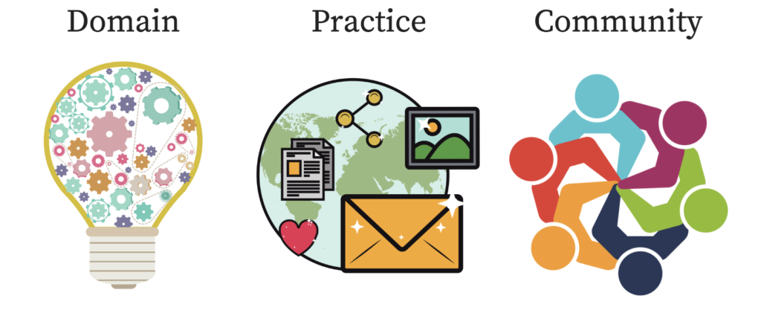
What is a Community of Practice?
“Communities of practice are groups of people who share a concern or a passion for something they do and learn how to do it better as they interact regularly (p.1).”
Source: Wenger-Traynor, E. & B. (2015). Introduction to communities of practice: A brief overview of the concept and its uses.

Slide 4
Meet Your Hosts:
Wanda Vaughan
Regina Pierce
Sandy Hart
Kandy Grant
Chris Frawley
Sharon Zuckerwar

Slide 5
Using Zoom
A VTSS Coach will continually monitor the chat box.
If we lose connectivity, we will notify everyone via email.
We love to hear from you but, to prevent background noise, please stay muted when not speaking.
Use the “raise hand” or chat feature if you have questions or comments .
Watch for the flashing orange alert which notifies you of a new chat.
Closed captions are available.
If you don’t see a full screen; some of the slide is cut off, choose “display options” to change your screen display.

Slide 6
The Art of Conversation
adapted from Margaret Wheatley
Behaviors that help take conversation to a deeper realm:
We acknowledge one another as equals.
We try to stay curious about each other.
We recognize that we need each other's help to become better listeners.
We slow down so we have time to think and reflect.
We remember that conversation is the natural way humans think together.
We expect it to get messy sometimes.

Slide 7
Who’s in the Room?
District Administrators | Building Administrators | School Counselors
District Administrators | Building Administrators | School Counselors
Elementary Classroom Teachers | Secondary Classroom Teachers | Other…Tell us!
What is your role in your division?

Slide 8
Who’s in the Room?
No headers on this table, just categories in the boxes in the rows below
FIRST YEAR! 2020 Style! | 1 – 5 years | 6-10 years
11-15 years | 16 – 20 years | 21 years and beyond…
How long have you been in education?

Slide 9
Meet Your Chat Partner
Pay attention to the room number you are assigned to, then RENAME yourself: 4-Sharon;
(Also, VTSS Coach- Sharon) Introduce yourselves and then discuss: How is your semester going? In your current reality.
Why are you engaging in this work? Why are you choosing to learn with us?

Slide 10
our reasons for learning
No headers; cells contain reasons for learning
Can help me solve a problem that feels very real to me | Gives me greater freedom in my life as I live it right now | Creates an opportunity for me to do something that I want to do soon
Feels like a worthy challenge to me | Helps me to do something good for people that I care about | Connects me to people that I want to know
Is fun or cool (as I define it) | Allows me to survive something or someone that threatens my well-being | What else?

Slide 11
Academic TFI
1.6a Formative Assessment
Feature | Possible Data Sources | Scoring Criteria
1.6a Formative Assessment Teachers utilize formative assessment to inform teaching, lesson plan adjustment, and remediation. | Examples of formative assessment Examples of lesson plans with adjustments Examples of plans for remediation Walkthrough observations | 0 = Evidence of formative assessment is not present. 1 = Evidence of formative assessment is present but not utilized to impact instruction. 2 = Evidence of formative assessment is present and utilized to impact teaching, lesson plan adjustment, and remediation.

Slide 12
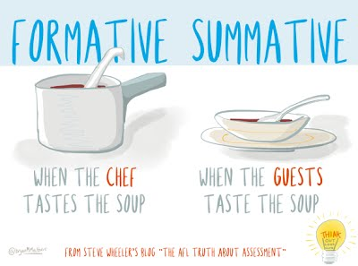
What is Formative Assessment?

Slide 13
What is Formative Assessment?
No headers; several examples of formative assessment
“...encompassing all those activities undertaken by teachers, and/ or by their students, which provide information to be used as feedback to modify the teaching and learning activities in which they are engaged” (Wiliam, 2011, p. 37).” | “Assessment carried out during the instructional process for the purpose of improving teaching and learning (Wiliam, 2011, p. 37, p 37).”
“...frequent interactive assessments of students’ progress and understanding to identify learning needs and adjust teaching appropriately (Wiliam, 2011, p. 38).” | “...the process used by teachers and students to recognise and respond to the student learning in order to enhance that learning, during the learning (Wiliam, 2011, p.37).”

Slide 14
Formative Assessment
“Rather, assessment is a process of data collection that is ongoing, formative, and low or no-stakes. Consider a combination/balance of broader diagnostics with “just-in-time” formative assessments that inform immediate instructional needs. (p.60).”
It should be used daily.
VDOE. (2020). Recover, redesign, restart.

Slide 15
Five Formative Assessment Strategies
Clarifying, understanding, and sharing learning intentions and success criteria
Eliciting evidence of learners’ achievement
Providing feedback that moves learning forward
Activating students as instructional resources for one another
Activating students as owners of their own learning
Source: Wiliam, D. (2011). Embedded Formative Assessment.

Slide 16
Intentions:
We can be really clear about what we want students to learn, understand and do. (teacher clarity)
We can provide multiple opportunities for students to show what they learn. (evidence of learning)

Slide 17
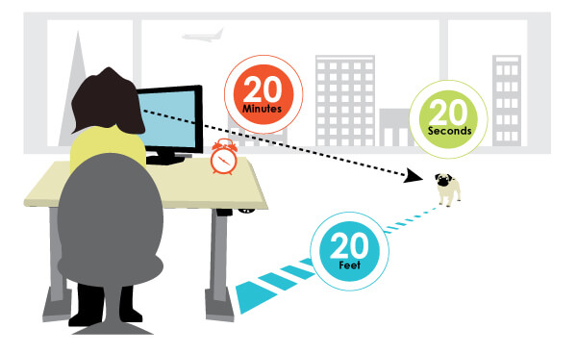
20-20-20

Slide 18
1. Clarifying, Sharing, and Understanding Learning Intentions: Teacher Clarity
Teachers identify the most critical parts of instruction: learning intentions, success criteria, and learning progressions.

Slide 19
Teachers with clarity know...
Where am I going?
How am I doing?
Where to next?
Students know...
What am I learning
today?
Why am I learning it?
How do I know I have learned it?
Source: Corwin. (2018). Clarity in learning [Video].

Slide 20
How do you….?

Slide 21
Virtual High Five

Slide 22
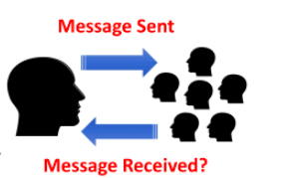
2. Eliciting Evidence of Learners’ Achievement
Source: Hanover Research. (2014). The impact of formative assessment and learning intentions on student achievement.

Slide 23
Good Questioning Routines
“The challenge for teachers is to involve as many students as possible which leads to the need for good questioning routines and good knowledge-check routines where the ratio of student involvement is high and the information received has a good diagnostic component (para 11).”
Source: Sherrington, T. (2019). Revisiting Dylan Wiliam’s five brilliant formative assessment strategies.

Slide 24
Examples
Questioning
Cold Call
No Opt Out
Check for Understanding
Probing Questioning
Think Pair Share
Say It Again-but say it better!
Whole Class Response
Knowledge check
Response Cards
Virtual Exit Slips/Checks
Voice recorded comments
Polling
Break out Discussion Groups
Source: Sherrington, T. (2019). Revisiting Dylan Wiliam’s five brilliant formative assessment strategies.

Slide 25
Evidence Gathering Routines

Slide 26
CoP Problem of Practice
Identify something that you’d like to do better related to formative assessments.
What would make life easier/more likely to use formative assessments?
What is something you’d like to learn or develop for your students?
The end goal is to work on this and be able to share your ideas with others by the end of the CoP.

Slide 27
Create a System of Support
Reconnect with your Chat Partner.
Make a commitment to try something.
Share contact information to connect and share how it is going.
Make a plan!

Slide 28
Questions/Feedback
Exit Ticket

Slide 29
20-20-20

Slide 30
Resources
Formative Assessment Resources

