Slide 1
Please access the VTSS Website for all
Tier I New Team Training materials
vtss-ric.org
Professional Learning->
Tier I Forum->
Tier 1 Forum Materials->
Materials->Session Materials->
PASSWORD: “VTSS”

Slide 2
Virtual Networking
Throughout the school year, VTSS offers networking sessions on a variety of topics.
We would like your feedback on future networking sessions so we can better serve you!
Here is the link:
forms.gle/g7HwCdJaJDd588dM9

Slide 3
PBIS - Tier 1 New Team Professional Learning
TFI 1.4 Teaching Expectations
TFI 1.10 Faculty Involvement
TFI 1.11 Student/Family/Community Involvement

Slide 4
Professional Learning Outcomes

Slide 5
TFI Roadmap: Where are we headed?
Where We’ve Been
1.1 Team Composition
1.2 Team Operating Procedures
1.3 Behavioral Expectations
1.8 Classroom Expectations
1.10 Faculty Involvement (Embedded)
1.11 Student/Family/Community Involvement (Embedded)
Our Focus in this Module
1.4 Teaching Expectations

Slide 6
Learning Intentions
Understand the use of explicit instruction (an evidence-based practice) to teach all lessons, behavioral as well as academic.
Understand the reasons for teaching behaviors and routines directly in settings and build a schedule for doing so.
Create a sample lesson based on the teaching matrix.
Brainstorm links between expectations and subject area curriculum.
Plan for training staff about lessons and their importance.

Slide 7
TFI: 1.4 Teaching Expectations
Explicitly Teaching the Behavior Curriculum

Slide 8
On Teaching Students Behavior
If a child doesn’t know how to read, we teach
If a child doesn’t know how to swim, we teach
If a child doesn’t know how to multiply, we teach
If a child doesn’t know how to drive, we teach
If a child doesn’t know how to behave, we…teach? punish?
Why can’t we finish the last sentence as automatically as we do the others?

Slide 9
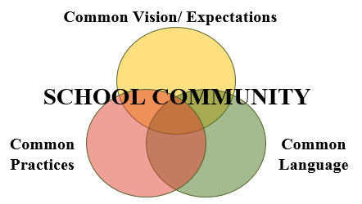
Teaching Appropriate School-wide & Classroom-wide Lesson Plans
Once you have developed school-wide expectations,
it is not enough to just post the words on the walls…
YOU MUST TEACH (and RETEACH) THEM!

Slide 10
Why develop a system for teaching behavior?
Academic and social-emotional behaviors develop together.
Procedures and routines create structure.
Repetition is key to learning new skills.
Learning new skills and making them a habit takes repetition over many days (Lally, et al, 2009)
Depends on age of the learner and complexity of the skill (Lally, et al, 2009)
A break in learning can cause learning to take longer. (i.e. Not every teacher uses the same expectations) (Lally, et al, 2009)

Slide 11
The Science of Behavior Has Taught Us
There is no mis-behavior!
The behavior is feedback for us
A trigger for us to think
Where is the mis-match?
What instruction needs to happen?

Slide 12
There is only Behavior
That meets a need (function)
And works (is reinforced)!

Slide 13
The Science of Behavior Has Also Taught Us
Behavior is learned so it can be ‘un-learned’ by explicitly teaching a replacement behavior and providing praise and feedback

Slide 14
Behavior Change
Reframe change as an instructional process
We change STUDENT behavior
by changing
ADULT behavior
Interventions = changes in staff procedures & practices

Slide 15
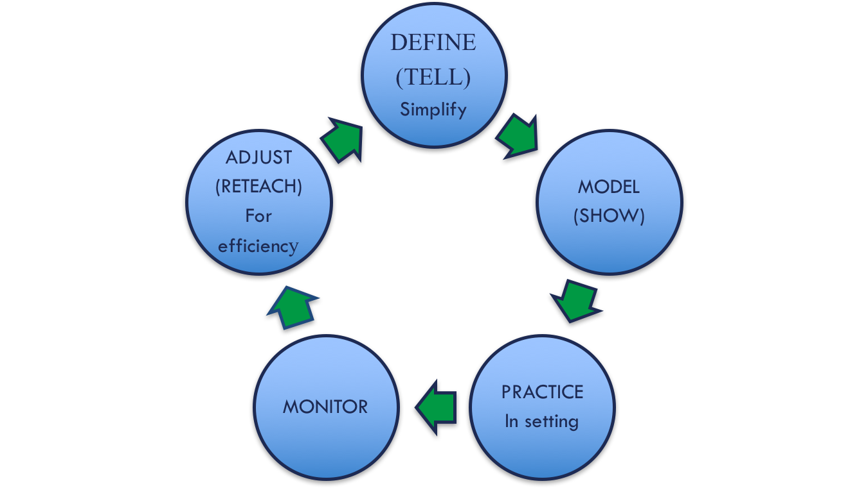
An Instruction Process for Academics AND Behavior
BE CONSISTENT

Slide 16
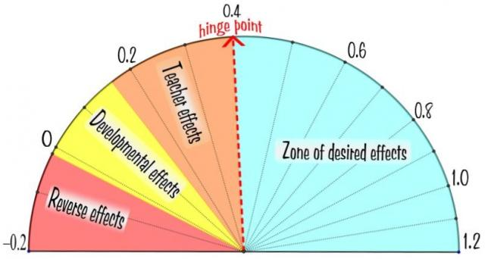
This works!
Direct Instruction
(0.6)
Feedback
(0.7)
Teacher
Clarity
(0.75)

Slide 17
Creating Behavior Lesson Plans
Teachers create lesson plans for each desired behavior - with student involvement for secondary schools
Students are taught the expectations and routines for both the school-wide system and the classroom-wide system
Remember… If you are seeing problematic behavior, ask, “Have I taught and acknowledged the desired behavior I want to see?”

Slide 18
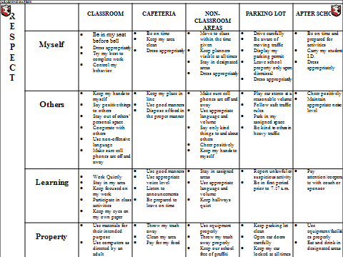
Develop an Efficient Teaching System
CAFETERIA
Be on time Keep my area clear
Keep my place in line Dispose of food in the proper manner
Use appropriate voice level Listen to announcements Be prepared to leave on time
Throw my trash away Clean my area Pay for my food

Slide 19
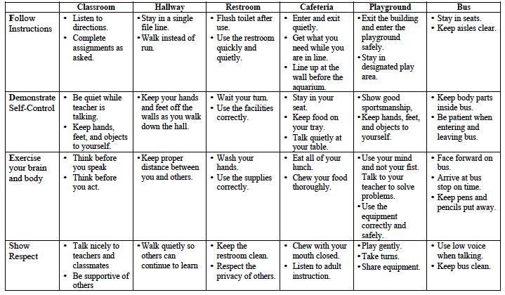
What to teach
Develop lesson plans to teach the specific behaviors identified on the matrix

Slide 20
TFI 1.4 Teaching Expectations
Activities for Developing Understanding

Slide 21
Teach and Practice Expected Behaviors
I do (explain/show/model)
We do (gradually release responsibility – may have several ‘we do’s’)
You do (practice with feedback)
You all do (independent practice)

Slide 22
Going Deeper into Explicit Instruction
Think back to our matrix
Expectation | Specific Behavior or Social Emotional Skill
Be Safe | Keep hands and feet to self I tell an adult when I am worried about a friend.
Be Respectful | Use the signal to ask a public or private question. Make sure everyone gets a turn.

Slide 23
Anita Archer Teaches The Signal
Please see your VTSS Systems Coach for a link to this YouTube video

Slide 24
Observations
BE CONSISTENT

Slide 25
Components of an Effective Model
Provides explicit model of expectation done well
Videos can be great options for the model or “I Do” because
They can include peers who look and sound like they do
They are entertaining when done well
Non-examples should be clearly identifiable.

Slide 26
Components of Effective Practice
Practice is carefully and closely guided.
It happens in the setting wherever possible.
Includes opportunities for feedback.

Slide 27
Components of Effective Feedback
Focuses on desired behaviors
Names the skill/behavior the student demonstrates
Explains why it’s valuable to the community or student

Slide 28
Components of Effective Monitoring
Move, scan, and interact with students
Observation and data collection
Formatively assess the lesson – For whom was the lesson successful? How do we know?
Who needs additional instruction? Practice? How will that happen?
Are skills crossing settings?
Is this occurring in classrooms and in schoolwide settings?

Slide 29
Pre-correct and Prompt: ALWAYS
Pre-Correction - provide a description of what the behavior looks like prior to directing student to perform a task. This includes: verbal reminders, behavioral rehearsals, or demonstrations of following the expectations or socially appropriate behaviors that are presented in or before setting where inappropriate behavior is likely. (Colvin, Sugai, Good, Lee, 1997)
Provide students with visual prompts (e.g. posters, illustrations, etc.)

Slide 30
Components of Re-teach and Adjust
Think ahead of any issues that might arise and discuss them with the class beforehand. Taking time to prepare the students before the event/ activity will save you time and energy later on.
Continually embed expectations into the classroom
Review - teacher consistently models expectations
Students follow class expectations despite the absence of the teacher: Substitute, guest teacher, buddy teacher, volunteer

Slide 31
Sample Lesson
Read through the lesson plan for Activity 1 on pages 35-38 of your workbook. Note where the lesson:
Defines the behaviors
Models the behaviors
Practices the behaviors (in the setting)
Monitors for understanding and effectiveness
Provides opportunities for adjusting and re-teaching

Slide 32
Involving Students and Staff in the Development of Lessons
Students
Involve students in planning assemblies
Student developed lessons
Role plays developed by students
Music and video clips
Staff
Skits
Morning announcements
Staff/parent/student collaboration on lesson plans for families (PTA, PTO, Parent Resource Centers)

Slide 33
Honoring ALL students!
When creating lessons…
Think VABB – Validate, affirm, build & bridge
Identify similarities between home and school – use real life experiences to make connections
Discuss with students the differences between home and school (Remember Matrix 2.0?)
Examine the matrix for reflection of dominant culture only – what needs explicit teaching? Explain why those skills are necessary to students.
Teach code-switching

Slide 34
Honoring ALL students! 2
Seek input…
Always seek family and community input…
On efficacy and relevance
How can they help to teach and reinforce?
Use within families
What are effective communication loops?
Please see your VTSS Systems Coach for article links

Slide 35
TFI 1.4: Teaching Expectations – Lesson Plans
Activities for Developing Understanding

Slide 36
Lesson Plan Activity
Choose a routine from the school-wide or classroom-wide matrix.
Work with team and complete the behavior lesson plan template found in the workbook.
Be ready to describe your lesson to the group and possibly role play the example and non-example.

Slide 37
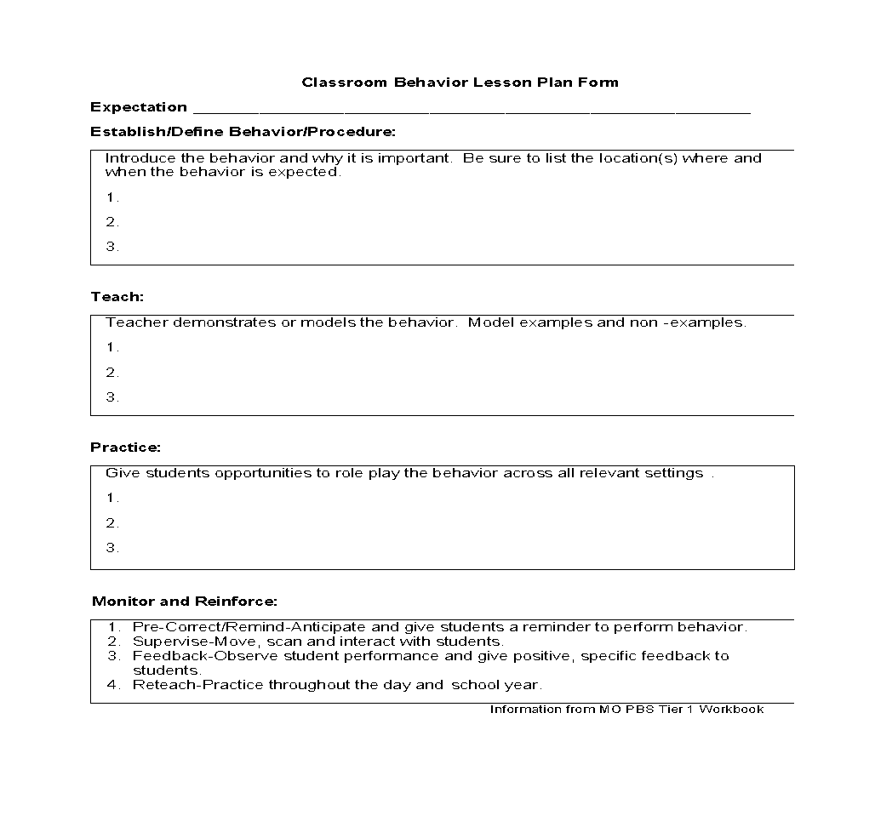
Behavior Lesson Plan

Slide 38
TFI 1.4: Teaching Expectations – Make a Plan
When and How to Teach Behavior

Slide 39
Creating a Plan for Teaching Desired Behaviors
Once the behavior lesson plans are created it is important to take time to decide how the lessons will be taught, not only at the beginning of the year, but throughout the year.
There should be a written plan documenting how and when expectations will be taught.
ALL TEACHERS TEACH THE EXPECTATION AND ALL STUDENTS RECEIVE THE INSTRUCTION!

Slide 40
How and when will we teach behavior?
Explicitly Teaching Curriculum Matrix | Embedding Curriculum Matrix in Daily Academic Instruction
Kickoff Events (start of year) | Connections to SOL
Matrix Related Lessons in Morning or Class Meetings (ongoing) | Connections to literature, historical figures and events, etc.
Booster Trainings (after breaks, based on spikes in data)
Continued Visibility

Slide 41
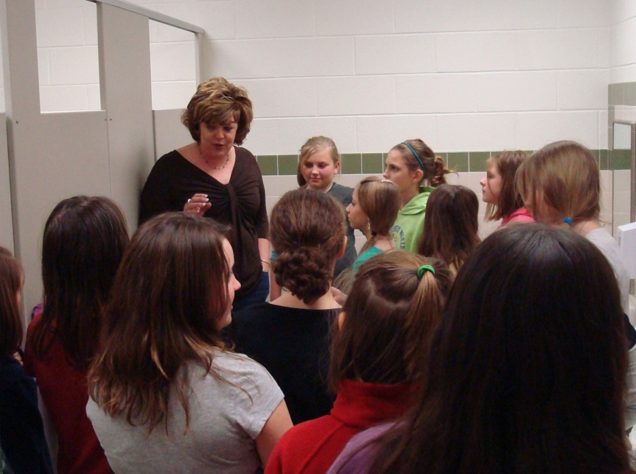
When to Teach the Matrix?
Beginning of school year
Kickoff: Teach expectations for all areas of school, including individual classrooms, during first week of school
After first week, review expectations 2 or 3 times/week
…in the cafeteria
…in the restroom

Slide 42
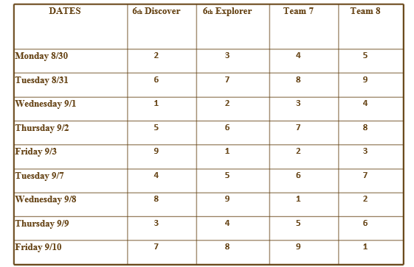
McCombs Middle School Teaching Schedule
Teaching Areas: 1-Cafeteria 2-Hallway 3-Outside
4-Restroom 5-Auditorium 6-Before/After 7-Bus
8-Office 9-Rewards

Slide 43
When to Teach the Matrix? 2 Schedule for Teaching
On-going Direct Instruction
Use established structures like homeroom, morning meetings, class meetings
Data-driven and scheduled lessons
Pre-correction for predictably difficult times
Re-teaching immediately after behavioral error

Slide 44
Booster Session - Predictable Problems
Booster sessions are planned and delivered to re-teach staff/students at least once in the year and additionally at times when the data suggest problems by an increase in discipline referrals per day per month or a high number of referrals in a specified area.

Slide 45
When to Teach the Matrix? Schedule for Teaching
Booster Sessions
End of first grading period
Through second grading period
Review expectations once per week
Remainder of the year
Review expectations periodically as needed
Review expectations immediately after a school break
When behavior data indicates a need

Slide 46
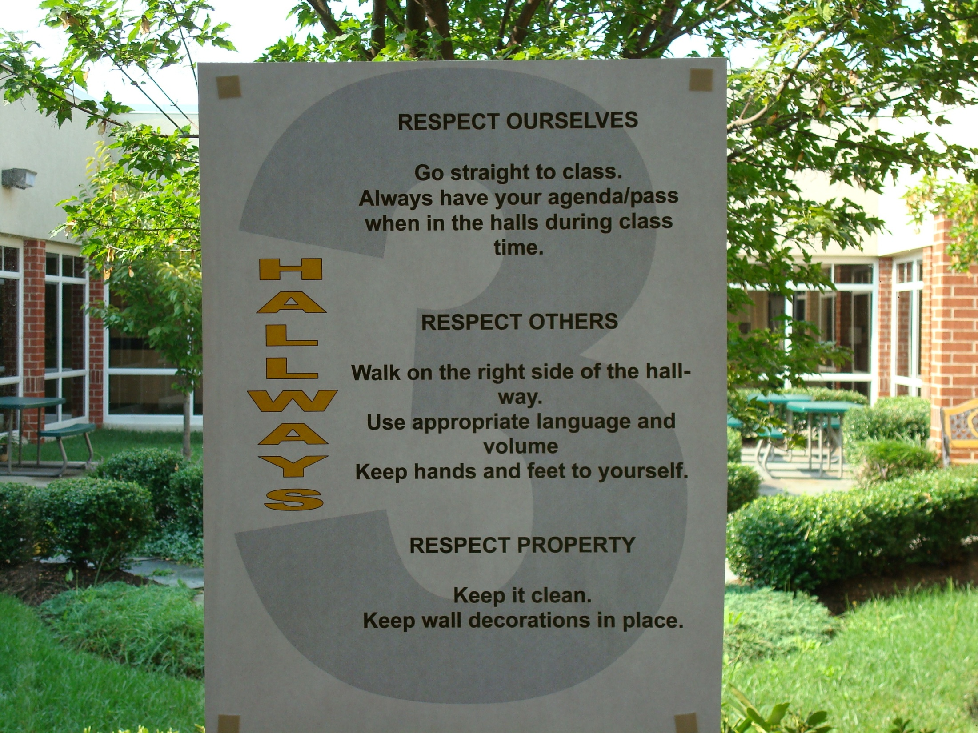
Continued Visibility

Slide 47
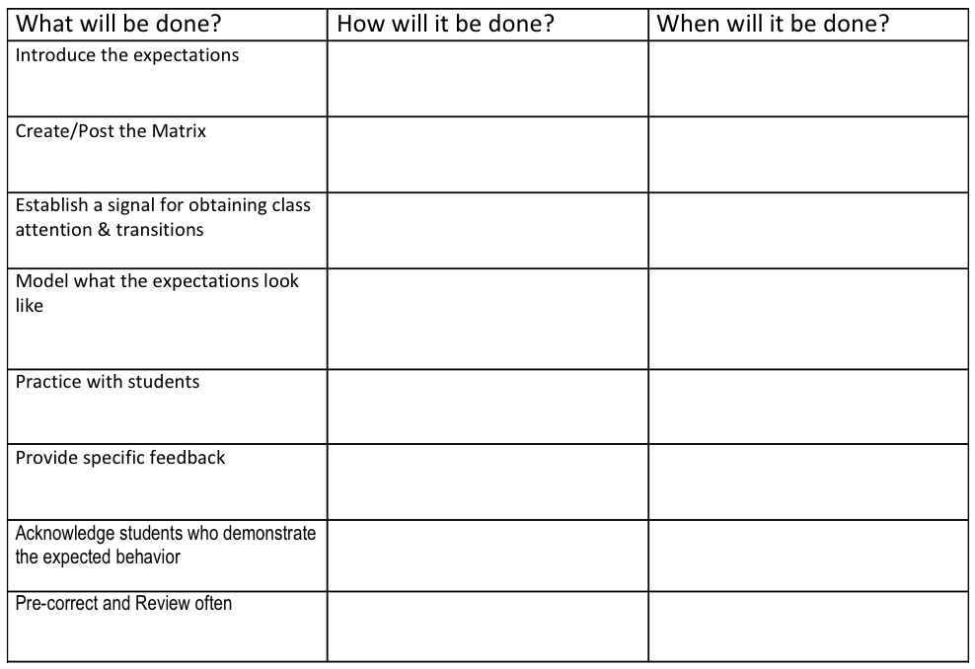
Plan for Teaching Expectations

Slide 48
How and when to teach behavior?
Explicitly Teaching Curriculum Matrix | Embedding Curriculum Matrix in Daily Academic Instruction
Kickoff Events (start of year) | Connections to SOL
Matrix Related Lessons in Morning or Class Meetings (ongoing) | Connections to literature, historical figures and events, etc.
Booster Trainings (after breaks, based on spikes in data)
Continued Visibility

Slide 49
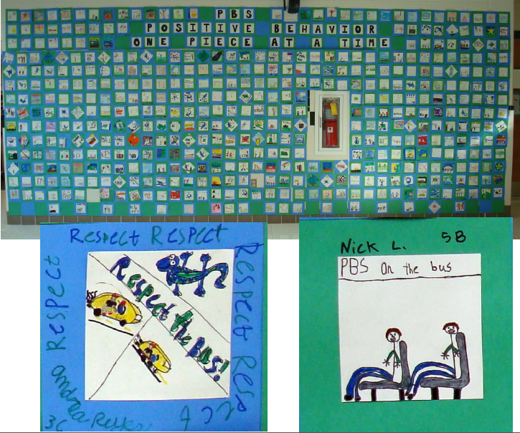
Embedded into the curriculum

Slide 50
TFI 1.4: Teaching Expectations – Action Planning

Slide 51
Complete Your Action Plan
WHAT NEEDS TO BE COMPLETED? | RESOURCES NEEDED? | WHO? | WHEN?
A.
B.
C.

Slide 52
Bibliography
Colvin, G., Sugai, G., Good, R. H. III, & Lee, Y.-Y. (1997). Using active supervision and precorrection to improve transition behaviors in an elementary school. School Psychology Quarterly, 12(4), 344-363.
Lally, P. , van Jaarsveld, C. H., Potts, H. W. and Wardle, J. (2010), How are habits formed: Modelling habit formation in the real world. Eur. J. Soc. Psychol., 40: 998-1009. doi:10.1002/ejsp.674

