Slide 1
PBIS – Tier I Behavior Professional Learning
TFI 1.10: Faculty Involvement

Slide 2
Learning Intentions
Understand the importance of involving faculty meaningfully in every step of PBIS implementation: to provide feedback, offer suggestions, and make choices.
Involve faculty in establishing PBIS goals on at least an annual basis based on inclusive sharing and analysis of data.

Slide 3
Professional Learning Roadmap
Where We’ve Been
1.1 Team Composition
1.2 Team Operating Procedures
1.3 Behavioral Expectations
1.4 Teaching Expectations
1.5 Problem Behavior Definitions
1.6 Discipline Policies and Procedures
1.7 Professional Development
1.8 Classroom Expectations
1.9 Feedback & Acknowledgement
Our Focus in this Module
1.10 Faculty Involvement

Slide 4
Professional Learning Roadmap
Feature | Possible Data Sources | 2 Points Fully Implemented | 1 Point Partially Implemented | 0 Points Not Implemented
1.10 Faculty Involvement: Faculty are shown school-wide data regularly and provide input on universal foundations (e.g., expectations, acknowledgments, definitions, consequences) at least every 12 months. | PBIS Self-Assessment Survey Informal surveys Staff meeting minutes Team meeting minutes | Faculty are shown data at least 4 times per year AND have provided feedback on Tier I practices within the past 12 months. | Faculty have been shown data more than yearly OR have provided feedback on Tier I foundations within the past 12 months but not both. | Faculty are not shown data at least yearly and do no provide input.
4

Slide 5
Healthy Faculty Involvement
Open and honest communication is established among stakeholders to secure input, buy-in and commitment to change

Slide 6
Involvement for Buy-In
Your PBIS implementation will need to change, grow, and evolve over time.
Think about how your colleagues experience change.
Think about how it feels when new ways of working arrive on your doorstep.
How do all of you want to be involved in implementation decisions?
How do you want your voice heard?
What do you look for when deciding if you are onboard with the change?
1.10 Activity 1

Slide 7
Faculty Involvement means
at least 80% buy in
Collectively, staff will:
Identify focus
Identify ways to monitor progress
Identify goals
Identify ways to evaluate outcomes

Slide 8
Rationale
“Unless commitment is made, there are only promises and hopes...but no plans.”
(Peter Drucker)
… and Implementation of PBIS involves all faculty and staff

Slide 9
How will you engage staff in the implementation of PBIS?
Providing professional learning/mentorship
Sharing data
Inviting input and feedback AND using it to change and grow

Slide 10
Share what data, when, and with whom
What and When
Who
What data do we need them to know about?
What data points does the team want to examine or move?
How regularly should we share for maximum impact?
When?
Where?
How?
With whom is data shared and examined?
Central Office
Faculty
School personnel
Family
Community

Slide 11
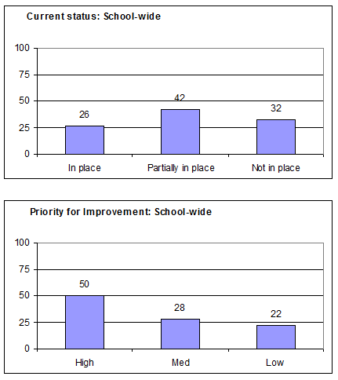
What data will you share?
Informal surveys?
TFI results?
Climate Surveys?
Discipline Data?

Slide 12
How and when will you share data?
Share visuals with staff monthly
What’s working?
What needs more focus?
Emphasize staff involvement

Slide 13
Ongoing Input and Feedback: Communication and Feedback Loops
Grade level/core/department meetings
Team meetings
Staff/Faculty Meetings
Google Docs, SharePoint, or other virtual sharing mechanisms
Newsletters
Professional development days
Communities of Learners (shared learning)

Slide 14
Breakout Room:
Communication Systems
Directions:
Assign a Facilitator, each person share out a time/opportunity your school could share important school data/PBIS information.
Think about what structures you have in place now and think “outside” the box of opportunities you haven’t explored yet.
Minute Taker, please be sure to document the team’s discussions.
Encourager, please prepare to share out after the activity with the large group.
TFI 1.10 Activity 2

Slide 15
Time to Share

Slide 16
Input and Feedback: Create a Communication System
Presenting data
Sharing ongoing information
Obtaining feedback from stakeholders
Reviewing goals and action plans
TFI 1.10 Activity 3

Slide 17
Action Planning
1.10 &1.11 Student/Family/Community Involvement
Student/Family/Community Involvement: WHAT NEEDS TO BE COMPLETED? | RESOURCES NEEDED? | WHO? | WHEN?
A.
B.
C.
D.

Slide 18
Thank you!
Thank you for your time and dedication!

