Slide 1
PBIS Tier I: Behavior Professional Learning
TFI 1.1 Team Composition

Slide 2
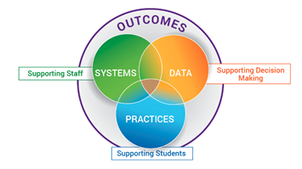
What is VTSS?
Virginia Tiered Systems of Supports (VTSS) integrates academics, behavior, AND mental wellness into a framework for establishing the supports needed for a school to be an effective learning environment for all students.
This systemic approach allows divisions, schools, and communities to provide multiple levels of support to students in a more effective and efficient, clearly defined process (VTSS, 2016).

Slide 3
Professional Learning Roadmap
Our Focus in this Module
1.1 Team Composition
Where We’ll Go
1.2 Team Operating Procedures
1.3 Behavioral Expectations
1.4 Teaching Expectations
1.5 Problem Behavior Definitions
1.6 Discipline Policy and Procedures
1.7 Professional Development
1.8 Classroom Expectations
1.9 Feedback & Acknowledgement
1.10 Faculty Involvement
1.11 Student/Family/Community Involvement

Slide 4
Learning Intentions
Understand what human resources are essential to team success
Build a representative leadership team

Slide 5
Change is Good

Slide 6
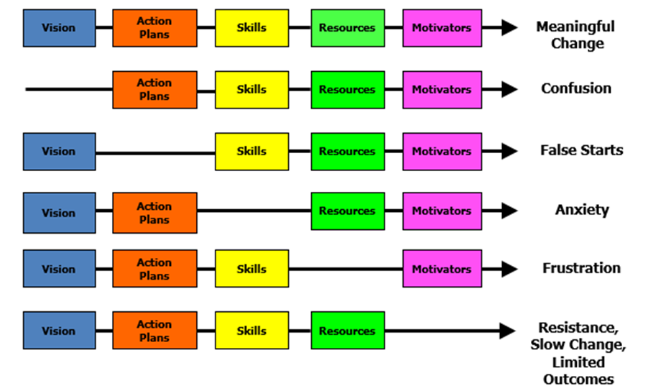
Managing Complex Change
Source: Knoster, T., Villa R., & Thousand, J. (2000). A framework for thinking about systems change.

Slide 7
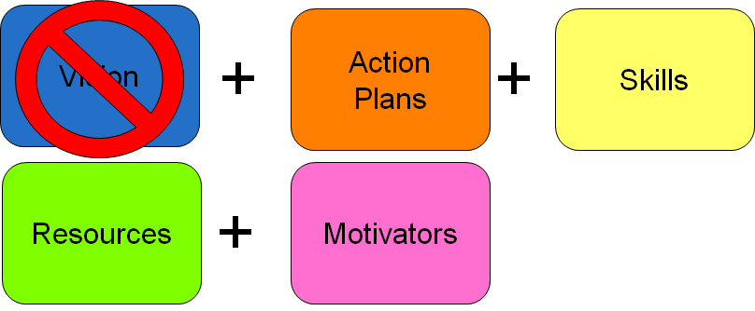
Confusion

Slide 8
Why do we need a team?
Please contact your VTSS Systems Coach
for this video.

Slide 9
Who should be on the team?
Building Level Coach or Co-coaches
Administrator
Individuals able to provide:
Applied behavioral expertise
Knowledge of student academic and behavior patterns
Data Analyst
Knowledge of operations of the school across grade levels and programs
Youth representation
Family and Community representation

Slide 10
Other Service Providers
Is your School Psychologist, School Social Worker, School Counselor and/or School Nurse on the team?
Can community mental health providers be a member of the Tier 1 team?
Memorandum of Understanding (MOU)
Provide Tier 1 Instruction/Skills training for all students, staff, and families

Slide 11
Youth, Family, and Community
Why include youth, family, and community?
Students have higher math and reading achievement when schools engage parents and caregivers.
Children of school-engaged parents have higher academic & social skills and lower aggressive behaviors.
Empowering families in school leadership matters!
Reference
Reference

Slide 12
How do we recruit and retain family voice.
Please contact your VTSS Systems Coach for this video.

Slide 13
What does it look like
This video can be found at
https://www.youtube.com/watch?v=fD1iLZy3dl0

Slide 14
What are the roles of families?
Representatives of diverse family perspectives
Liaisons with all families
Providers and receivers of supports
Initiators of ideas and providers of feedback

Slide 15
Who is family on your team?
Family member(s) should be independent (not a staff member who is also a parent) and has reach to other families
Family member(s) commits to learning about VTSS.
For secondary school teams, also consider a student who can offer a youth voice.
Consider and clarify time commitment and access to meetings.

Slide 16
Social Identity Wheel
Adapted from “Voices of Discovery”, Intergroup Relations Center, Arizona State University

Slide 17
Pause and Practice
How do we ensure our team has…
Representatives from all grade levels, departments
Administrator is an active member of the team
Team should form around the data points you want to move and your
Student representatives/voice, especially with high school
Representative/voice of families
Representative/voice of your school community

Slide 18
Administrators are Crucial!
An Administrator’s role in VTSS implementation:
Visibility
Collaboration
Accountability
Sustainability
Activity #1
Colvin, G. (2007). 7 Steps for developing a proactive schoolwide discipline plan, 17

Slide 19
Visibility
Raising Community Awareness
Creating a culture of implementation fidelity

Slide 20
Collaboration
Families and Community as Partners
Shared Leadership with Teacher Leaders

Slide 21
Accountability
Being accountable to each other for implementation fidelity.

Slide 22
Sustainability
Plan from the beginning.
Do not put anything in place that you don’t plan to keep in place for at least a decade!

Slide 23
Coaches are Crucial!
A Coach’s role in VTSS implementation:
Coordination
Collaboration
Technical Assistance
Evaluation
Activity #2, pg. 8
Colvin, G. (2007). 7 Steps for developing a proactive schoolwide discipline plan, 17

Slide 24
Coordination
Organized coaches with strong social capital have the ability to lead faculties to high fidelity of implementation!

Slide 25
Coaching Collaboration
External Coaches and Division Team Members as Partners
Peer Coaching and Support for Implementation

Slide 26
Technical Assistance
Training
Modeling
Providing growth oriented feedback
Providing resources and information
Sharing ideas

Slide 27
Evaluation
Assessing fidelity of implementation
Assessing outcomes of implementation
Data analysis

Slide 28
Outcomes of Coaching
Provide support to team and faculty for:
PBIS Fluency
Rapid redirection from misapplications
Fidelity of overall implementation
Sustainability over time

Slide 29
The Role of the Team is Essential
Align
Align VTSS (PBIS) goals, school mission, and vision
Establish multi-year action plans
Share
Capture voice and choice from the school community
Communicate and disseminate information among stakeholders
Guide
Ensure that student social behavior is a priority
Develop coaching supports
Facilitate data-based decision-making
You are AGENTS for SYSTEMS CHANGE!

Slide 30
Commitment
All team members (including the administrator) commit to attending
80% or more
of team meetings.

Slide 31
Can you repurpose a team?
Is there:
an existing leadership team?
an existing school improvement team?
a team that problem solves around issues of school climate? Trauma? Mental Wellness?
a team that engages faculty in social-emotional programming, skills or implementation?

Slide 32
Working Smarter
Committee/Group-Self Assessment Document,
Activity #3 in the Tier I Behavior Workbook
Activity #3

Slide 33
Are we working efficiently?
Eliminate teams that do NOT have a defined purpose and measurable outcome.
Combine teams that have the same measurable outcomes and/or same target group.
Combine teams that have 75% of the same staff.
Eliminate teams that are not tied to School Improvement Goals.

Slide 34
Prepare for Tier I Behavior Training
Make sure you have all team members including school administration
Bring your data: (discipline, academic and attendance)
Bring your computer

Slide 35
Time to Action Plan With Your Team!
Composition and Operating Procedures WHAT NEEDS TO BE COMPLETED? | RESOURCES NEEDED? | WHO? | WHEN?
A.
B.
C.
D.
See Workbook for Action Planning documents.

Slide 36
References
Simple Truths video - https://vimeo.com/99086742
Penguins vs. Shark video -
https://www.youtube.com/watch?v=H-JMD8FcdVM
The Art of Coaching Teams E. Aguilar (2016)
Social Identity Wheel - Adapted from “Voices of Discovery”, Intergroup Relations Center, Arizona State University
Colvin, G. (2007). 7 Steps for developing a proactive schoolwide discipline plan, 17
Wood, L. & Bauman, E. (2017, February). How Family, School, and Community Engagement Can Improve Student Achievement and Influence School Reform: Literature Review. Washington, DC: AIR and Quincy, MA: Nellie Mae Education Foundation.
U.S. Department of Education, Office of the Deputy Secretary, Planning and Evaluation Service, The Longitudinal Evaluation of School Change and Performance in Title I Schools, Volume 1: Executive Summary, Washington, D.C., 2001.
Families and Schools Together (2006) Milwaukee program, reported in Wood & Bauman, 2017

