Slide 1
PBIS – Tier I Behavior Professional Learning
TFI 1.2 Team Operating Procedures

Slide 2
Virtual Norms
Expectations | What does that look like?
Be Engaged | Unmute to share ideas/questions. Participate in virtual activities.
Be Respectful | Eliminate distractions like cell phones, email, social media, and background noise. Give others time to talk and share. Be committed to attend all three days.
Be Prepared | Download materials prior to the session. Set dates/times with your team to continue action planning after professional learning.

Slide 3
Professional Learning Roadmap
Where We’ve Been
1.1 Team Composition
Our Focus in this Module
1.2 Team Operating Procedures
Feature | Possible Data Sources | 2 Points Fully Implemented | 1 Point Partially Implemented | 0 Points Not Implemented
1.2 Team Operating Procedures: Tier I team meets at least monthly and has (a) regular meeting format/agenda, (b) minutes, (c) defined meeting roles, and (d) a current action plan. | Tier I team meeting agendas and minutes Tier I meeting roles and descriptions Tier I action plan | Tier I team meets at least monthly and uses regular meeting format/agenda, minutes, defined roles, and has a current action plan. | Tier I team has at least 2 but not all 4 features. | Tier I team does not use regular meeting format/agenda, minutes, defined roles, or a current action plan.

Slide 4
What will we know and do?
Understand and communicate the importance of a vision for implementing VTSS
Establish a relevant and clear mission statement that includes input and feedback from all stakeholders
Develop effective and efficient meeting foundations with roles and responsibilities

Slide 5
What is the most generous act you’re seen recently?

Slide 6
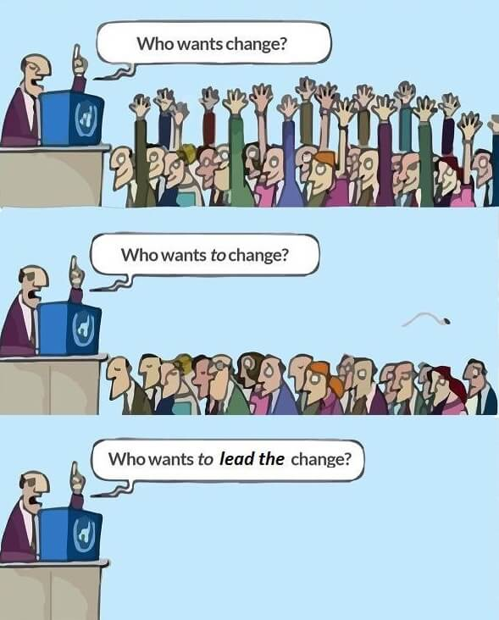
The Trouble with Change

Slide 7
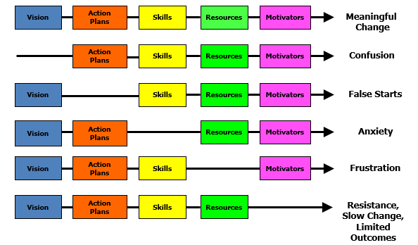
The Team’s Work is Managing Change
Source: Knoster, T., Villa R., & Thousand, J. (2000). A framework for thinking about systems change. In R. villa & J. Thousand (Eds.), Restructuring for caring and effective education: Piecing the puzzle together (pp. 93-128). Baltimore: Paul H. Brookes Publishing Co.Original Model: Dr. Mary Lippitt (1987) Enterprise Group Ltd.

Slide 8
The Team’s Work is Managing Change
Source: Knoster, T., Villa R., & Thousand, J. (2000). A framework for thinking about systems change. In R. villa & J. Thousand (Eds.), Restructuring for caring and effective education: Piecing the puzzle together (pp. 93-128). Baltimore: Paul H. Brookes Publishing Co.Original Model: Dr. Mary Lippitt (1987) Enterprise Group Ltd.

Slide 9
The Value of Why
This video can be found at
https://www.youtube.com/watch?v=OVnN4S52F3k

Slide 10
The Golden Circle
Outside-in/Conventional
Why
Inside-out/Remarkable
How
What

Slide 11
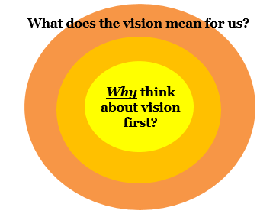
Implications for the Team
Does your current vision/mission statement align with VTSS?
Teams must have a clear understanding of “why” in order to:
share information with the school community
coach professional learning
articulate the value to school climate and student success

Slide 12
The Golden Circle
Have a Super Bowl Party.
Invite people. Order wings.
Catch-up with friends.
Inside-out/Remarkable
Outside-in/Conventional
Why
How
What

Slide 13
The Golden Circle
Host a dinner party.
Cook a meal for an intimate group.
Quality time with friends
Inside-out/Remarkable
Outside-in/Conventional
Why
How
What

Slide 14
Envision Possibilities
Dream School
Looks like: What will we see?
Sounds like: What will we hear?
Feels like: What will we feel?

Slide 15
Thinking about our Team Vision, what does your Dream School...
Look like...What will we see?
Sound like...What will we hear?

Slide 16
Outcomes
What are the intended OUTCOMES for your school?

Slide 17
Where do you want to go?
This video can be found at
https://www.youtube.com/watch?v=LJhG3HZ7b4o&t=2s

Slide 18
What does alignment look like?
As teams:
Review Mission Statement Examples: PBIS Teams, Schools or Divisions (workbook pg. 16)
Choose one to read based on grade level context OR most intriguing.
Answer Analysis Questions
(workbook pg. 17)

Slide 19
Align YOUR Vision
Mission & Vision Statements
School Improvement Plan
Your Vision
+
+
Consider - Does your current vision/mission statement align with VTSS?
Activity #1

Slide 20
Now, Let’s Think About Effective Meetings
Team members are present and on time
Roles and responsibilities are defined
Honor all working agreements
Produce agenda, notes/minutes, and data
Team meeting information is shared with all stakeholders

Slide 21
Are your meetings inclusive?
How are you supporting families, youth and community members to understand the work of this team?
invite participation during the meetings
scheduling dates and times so family, youth and the community members can attend
participation in VTSS training
access to all materials

Slide 22
Define Roles for Effective Meetings
Core roles during team meetings
Facilitator (typically not the administrator)
Minute taker (typically not the administrator)
Data Planner/Analyst (typically not the administrator)
Additional team member(s)
Administrator
Meeting Observer
Encourager
Assign backup for each role.
Can one person serve multiple roles?
Are other roles needed?
Activity #2

Slide 23
Roles and Responsibilities Defined
Coach | Is an active participant and provides technical support on implementation on PBIS
Facilitator (if not coach) | Starts meeting on time Determines date, time, and location of next meeting Manages the “flow” of meeting by adhering to the agenda Prompts team members Is active participant in meeting Ask questions (75% of what a facilitator says should be in question form) Implement group norms/agreements Keep people on track (back on track)
Minute Taker/Recorder | Asks for clarification of tasks/decisions to be recorded on meeting minutes form, as necessary Is active participant in meeting
Data Planner/Analyst | Leads discussion of potential new problems Responds to team members’ questions concerning content of the Data Analyst’s Report; produces additional data on request (e.g., additional Custom Reports) Is active participant in meeting
Process Observer | Notes what is working well in the meeting and what may need improvement
Administrator | Listen to understand Engage in team dialogue Address policy questions if necessary
Team Member(s) | Listen to understand Engage in team dialogue Engage in problem-solving process – pose questions about data and potential solution actions Family member on the team contributes to meeting dialogue
What is your role and responsibility on the team?

Slide 24
Plan for Roles and Responsibilities
Name | Role | Email | Phone #
Day to meet: |  | Time:
Location:
Dates to present to faculty

Slide 25
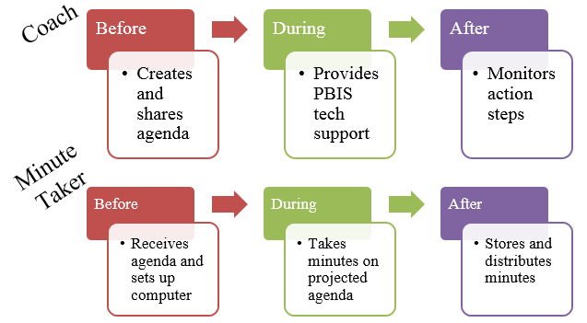
The Importance of Meeting Roles

Slide 26
Care Values
SAFETY
EMPOWERMENT
COLLABORATION
TRUST
CHOICE

Slide 27
Creating Team Agreements/Norms
Sample Agreements/Norms:
Start on time, end on time
Listen to understand, not reply
Use the team meeting process
Actively participate
Assume best intentions

Slide 28
Working Team Agreements/Norms
Each person takes 5 post-it notes.
Record ideal behaviors for a group on each post-it note.
Put all of the notes together.
Read each aloud.
Group similar ideas together.
Write a norm for each group of sorted cards.
What norms did your group identify?
Star the one that is most useful for your team.
Activity 3

Slide 29
Example: Care Values
SAFETY
Norm: Assume Good Intentions
Operating Procedure: Agenda ahead of time
EMPOWERMENT
Norm: We will support the team with our individual strengths
Operating Procedure: We will select team members based on their individual expertise and validate work
COLLABORATION
Norm: We encourage building positive team relationships and support those who are experiencing trauma
Operating Procedure: Roles/Responsibilities are assigned and adhered to

Slide 30
Example: Care Values Continued
TRUST
Norm: Start and end on time
Operating Procedure: Action items are completed prior to meeting
CHOICE
Norm: We value each other’s input
Operating Procedure: Selecting a meeting time that is convenient for team members

Slide 31
A Blended Model

Slide 32
Activity
Using the care value handout, match your norm to the care value that best describes the norm.
Do you need to develop a norm that supports a care value?

Slide 33
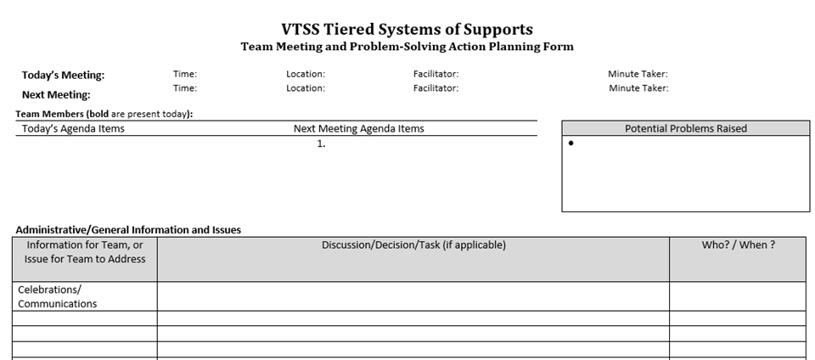
Team Meeting Agenda Template

Slide 34
Scope of Practice
This video can be found at
https://www.youtube.com/watch?v=bewrXPdwhYE&t=200s

Slide 35
Teamwork Time
Activity 1: Creating a Vision and Mission
Step 1: Envision Possibilities
Step 2: Collaborate
Step 3: Align
Activity 2: Plan for Roles and Responsibilities
Activity 3: Working Agreements = Norms
Everyone share your ideas.
Write a norm for each group of sorted cards.
Star the one that is most useful for your team.
** Develop a Meeting Agenda Template**

Slide 36
Complete your Action Plan
Identify:
What needs to be completed?
What resources are needed?
Who is responsible for leading it?
When is it to be completed?

