Slide 1
PBIS –Tier I
Behavior Professional Learning
TFI 1.3 Behavioral Expectations
Involvement

Slide 2
Meet your Presenters

Slide 3
Please Rename Yourself on Zoom
Please rename yourself as follows:
School Name, First Name, Last Name
Example: Joyful School, Ryan, Best
WELCOME!!
Please Rename Yourself on Zoom

Slide 4
Professional Learning Outcomes
Feature | Possible Data Sources | 2 Points Fully Implemented | 1 Point Partially Implemented | 0 Points Not Implemented
1.3. Behavioral Expectations School has five or fewer positively stated behavioral expectations and examples by setting/location for student and staff behaviors (i.e. school teaching matrix) defined and in place. | TFI Walkthrough Tool Staff Handbook Student Handbook | Five or fewer behavioral expectations exist that are positive, posted, and identified for specific settings (i.e. matrix) AND at least 90% of staff can list at least 67% of the expectations. | Behavioral expectations identified but may not include a matrix or be posted | Behavioral expectations have not been identified, are not all positive, or are more than 5 in number

Slide 5
PBIS Field Guide
This document can be found at
https://www.pbis.org/resource/pbis-cultural-responsiveness-field-guide-resources-for-trainers-and-coaches

Slide 6
Professional Learning Roadmap
Where We’ve Been
1.1 Team Composition
1.2 Team Operating Procedures
Our Focus in this Module
1.3 Behavioral Expectations

Slide 7
What we will learn and do.
Understand the criteria for effectively framed school-wide expectations and define teaching matrix
Organize a practice draft of expectations and rules in a teaching matrix
Create a plan for guiding staff in the development of 3-5 positively stated school-wide expectations
Create a plan for guiding staff in defining expectations with observable and measurable rules for specific locations
Understand options for aligning classroom behaviors and procedures to school-wide expectations
Examine expectations to make sure they are working for all students.

Slide 8
Primary Prevention
Primary prevention is the focus of PBIS.
If we can think about
something being predictable,
then we can think about preventing it.

Slide 9
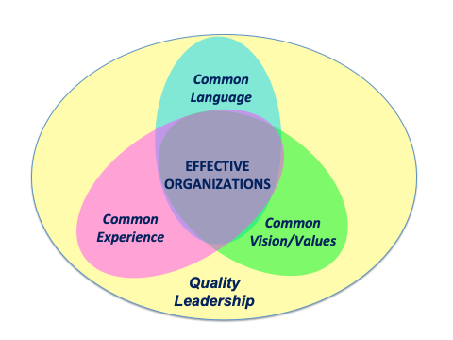
Why? Consistency Matters!
(OSEP TAC on PBIS, 2015)
Notes:
9

Slide 10
Teaching Matrix
Teaching Matrix |  | SETTING
 |  | All Settings | Hallways | Playgrounds | Cafeteria | Library/ Computer Lab | Assembly | Bus
 | Respect Ourselves | Be on task. Give your best effort. Be prepared. | Walk. | Have a plan. | Eat all your food. Select healthy foods. | Study, read, compute. | Sit in one spot. | Watch for your stop.
 | Respect Others | Be kind. Hands/feet to self. Help/share with others. | Use normal voice volume. Walk to right. | Play safe. Include others. Share equipment. | Practice good table manners | Whisper. Return books. | Listen/watch. Use appropriate applause. | Use a quiet voice. Stay in your seat.
 | Respect Property | Recycle. Clean up after self. | Pick up litter. Maintain physical space. | Use equipment properly. Put litter in garbage can. | Replace trays & utensils. Clean up eating area. | Push in chairs. Treat books carefully. | Pick up. Treat chairs appropriately. | Wipe your feet. Sit appropriately.
1. Expectations
Expectations

Slide 11
Common Expectations
Expectations (values) are broadly stated
3-5 positively stated expectations
Consistent with school’s mission statement
Expected of all faculty/students
(OSEP TAC on PBIS, 2015)

Slide 12
Common Language
Expectations | 3-5 overarching school-wide expectations
Behaviors/ Skills | specific tasks students are to do to achieve the school-wide expectations
Routines/ Procedures | procedures are methods for accomplishing tasks in the classroom procedures form routines that help students meet classroom expectations and skills/behaviors

Slide 13
Building Expectations
Think about…
  Utopia – the ideal school
  what skills and abilities students need to be successful in their communities
  the school vision statement
  the school improvement plan
  the team’s vision for PBIS
Alignment…
  What programs and practices are you already using for behavior and emotional wellness?
  What are the behavioral goals of these programs and practices?

Slide 14
Proactive Teacher Supports for Classroom Managed Behaviors
Develop, teach, and maintain clearly defined classroom expectations
Build positive relationships with students and families
Model and practice expectations in the appropriate settings
Reteach expectations throughout the school year
Use pre-correction strategies
Use more positive than corrective statements
Create classroom acknowledgement system
Implement evidence based practices
Actively engage students
Teach prevention lessons that address social-emotional competencies
Flexible classroom arrangements/seating

Slide 15
Let’s try it!
Independent Activity:
Read through the list of valued behaviors and attitudes in the workbook on p. 23. Circle or place a checkmark by approximately 5 expectations or attitudes that are essential for the success of your students. Feel free to add any important but missing values.
Narrow those 5 expectations to 3. Enter those 3 expectations in the box on the left on page 22 of your workbook.
Group Activity:
Share your list with your team, noting similarities and differences. Can some be grouped together?
As a team come to consensus on the TOP 3-5 most important for students’ success.
TFI 1.3: Activity 1 |

Slide 16
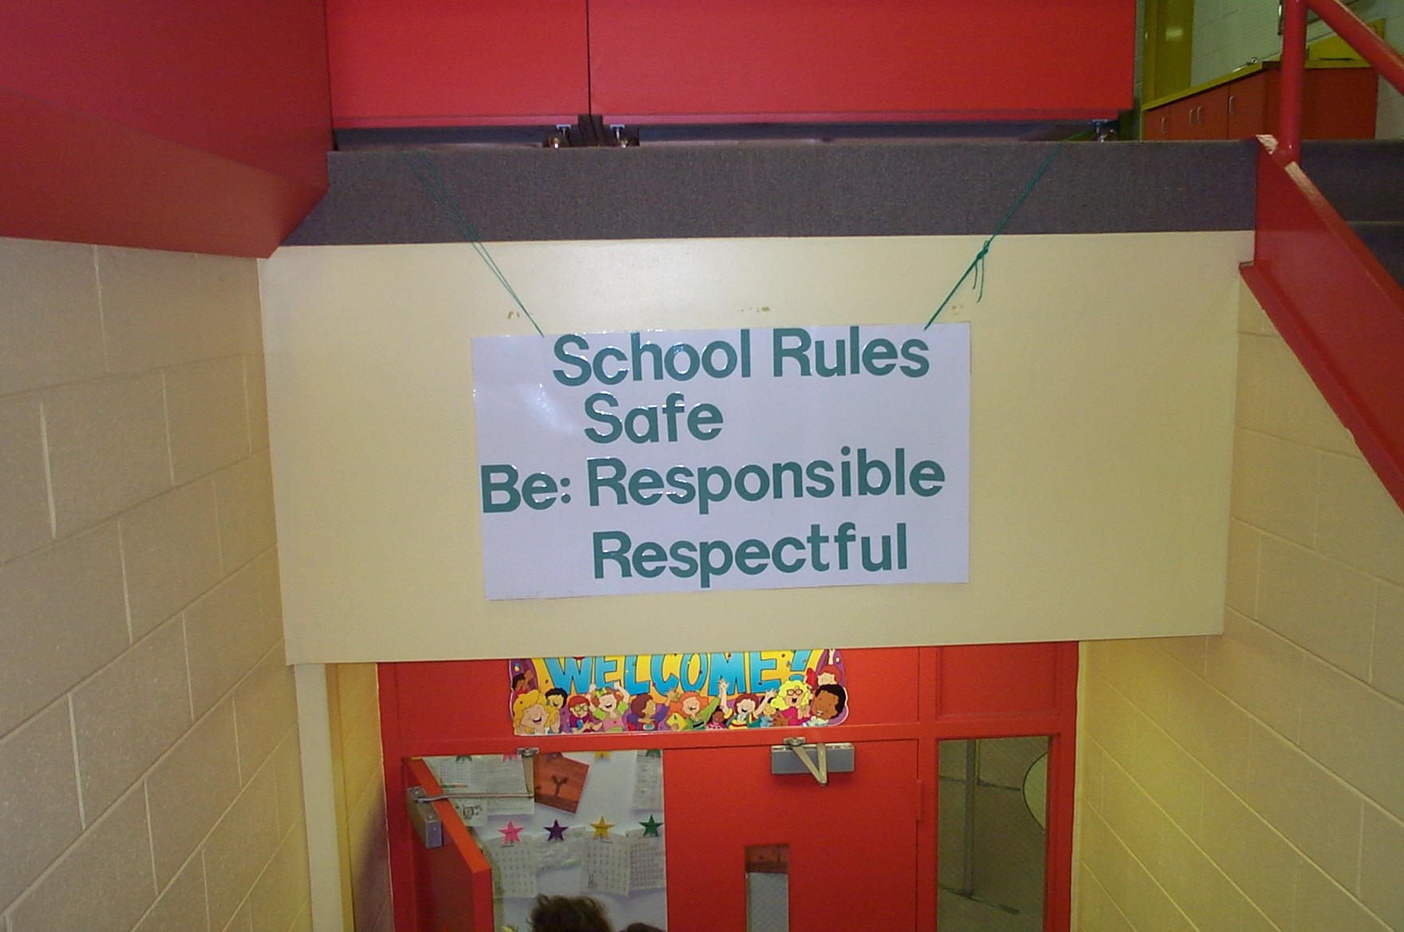
Redesign the Learning Environment
School Rules
NO Food
NO Weapons
NO Backpacks
NO Drugs/Smoking
NO Bullying
Notes:
16

Slide 17
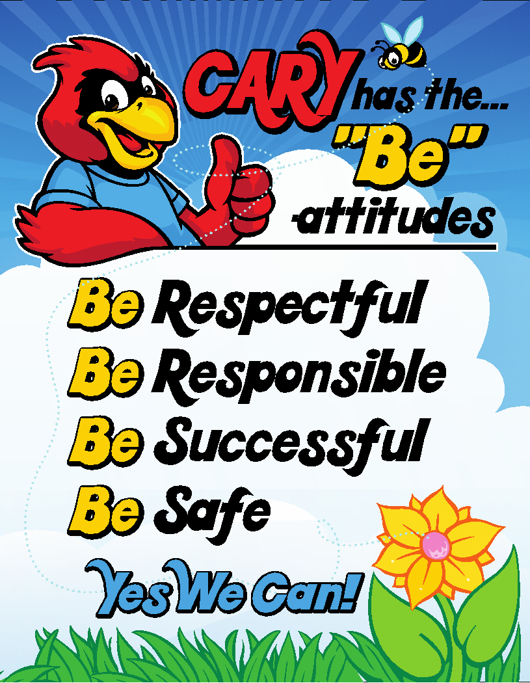

Elementary School Examples

Slide 18
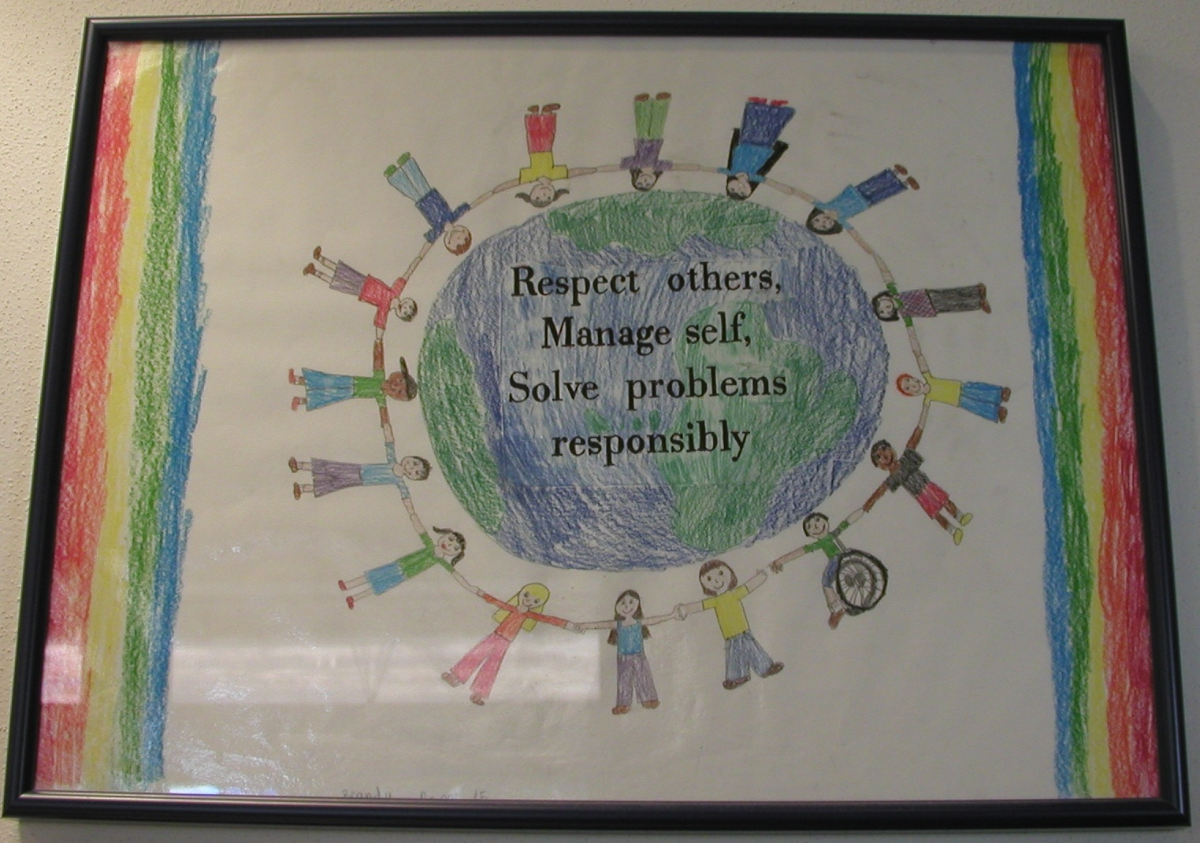
Elementary School Example #2
Student Created PBIS Poster

Slide 19
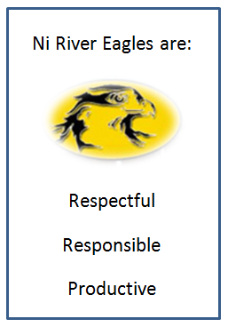

Middle School
Ni River Middle School , Spotsylvania VA

Slide 20

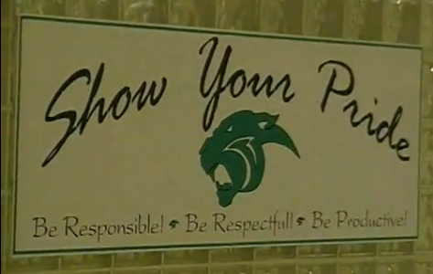
High School
South Lakes High School, Fairfax Co.

Slide 21
School-wide Behavior Expectations
Non-example
Exhibit respect for yourself and others.
Accept responsibility.
Give your best effort.
Look, listen, and learn to
Exceed expectations and
Soar to success.

Slide 22
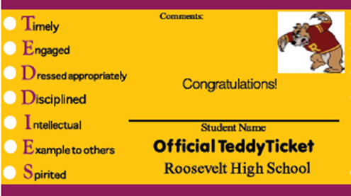
School-wide Behavior Expectations
Non-example

Slide 23
One More Look!
Take 5 minutes and discuss the examples and non-examples you just saw.
  Look over the 3-5 expectations your team chose.
  Do you want to change any?
  Add some, remove some?
TFI 1.3: Activity 1

Slide 24
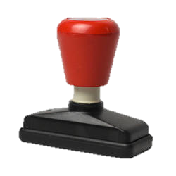

Creating a Matrix
Creating a Matrix
Expectations | SETTINGS
?
?
?
TFI 1.3: Activity 2

Slide 25
Take a Breath

Slide 26
Teaching Matrix
Teaching Matrix |  | SETTING
 |  | All Settings | Hallways | Playgrounds | Cafeteria | Library/ Computer Lab | Assembly | Bus
 | Respect Ourselves | Be on task. Give your best effort. Be prepared. | Walk. | Have a plan. | Eat all your food. Select healthy foods. | Study, read, compute. | Sit in one spot. | Watch for your stop.
 | Respect Others | Be kind. Hands/feet to self. Help/share with others. | Use normal voice volume. Walk to right. | Play safe. Include others. Share equipment. | Practice good table manners | Whisper. Return books. | Listen/watch. Use appropriate applause. | Use a quiet voice. Stay in your seat.
 | Respect Property | Recycle. Clean up after self. | Pick up litter. Maintain physical space. | Use equipment properly. Put litter in garbage can. | Replace trays & utensils. Clean up eating area. | Push in chairs. Treat books carefully. | Pick up. Treat chairs appropriately. | Wipe your feet. Sit appropriately.
2. NATURAL CONTEXT (Locations)
Expectations

Slide 27
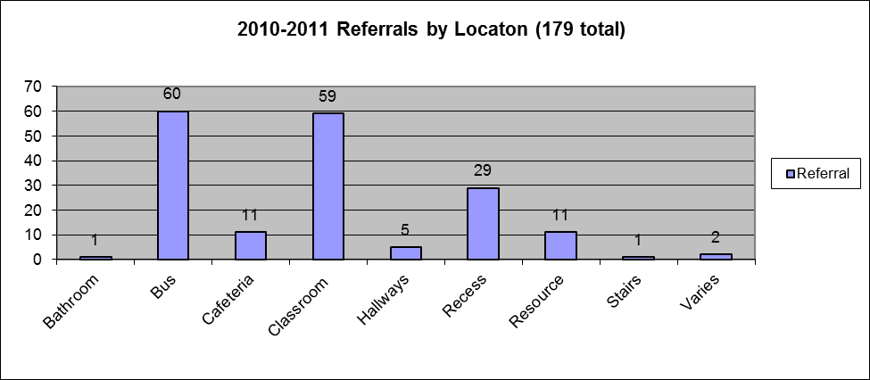
What locations should we target?
What locations should we target?

Slide 28
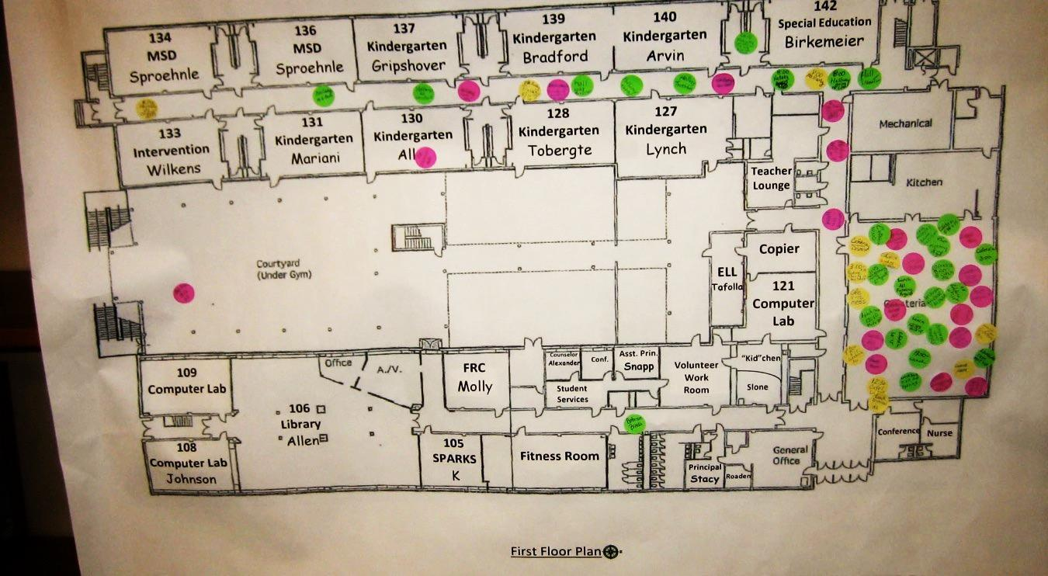
Sample Elementary School Map

Slide 29
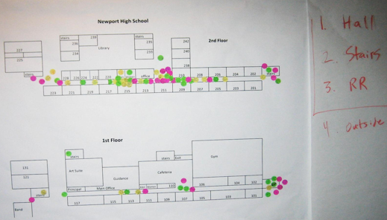
Secondary Map

Slide 30
Time to determine locations
Time to Determine Locations
Teaching Matrix |  | SETTINGS
 |  | All Settings
EXP ECTA T I ONS | 1
 | 2
 | 3
2. Add locations

Slide 31
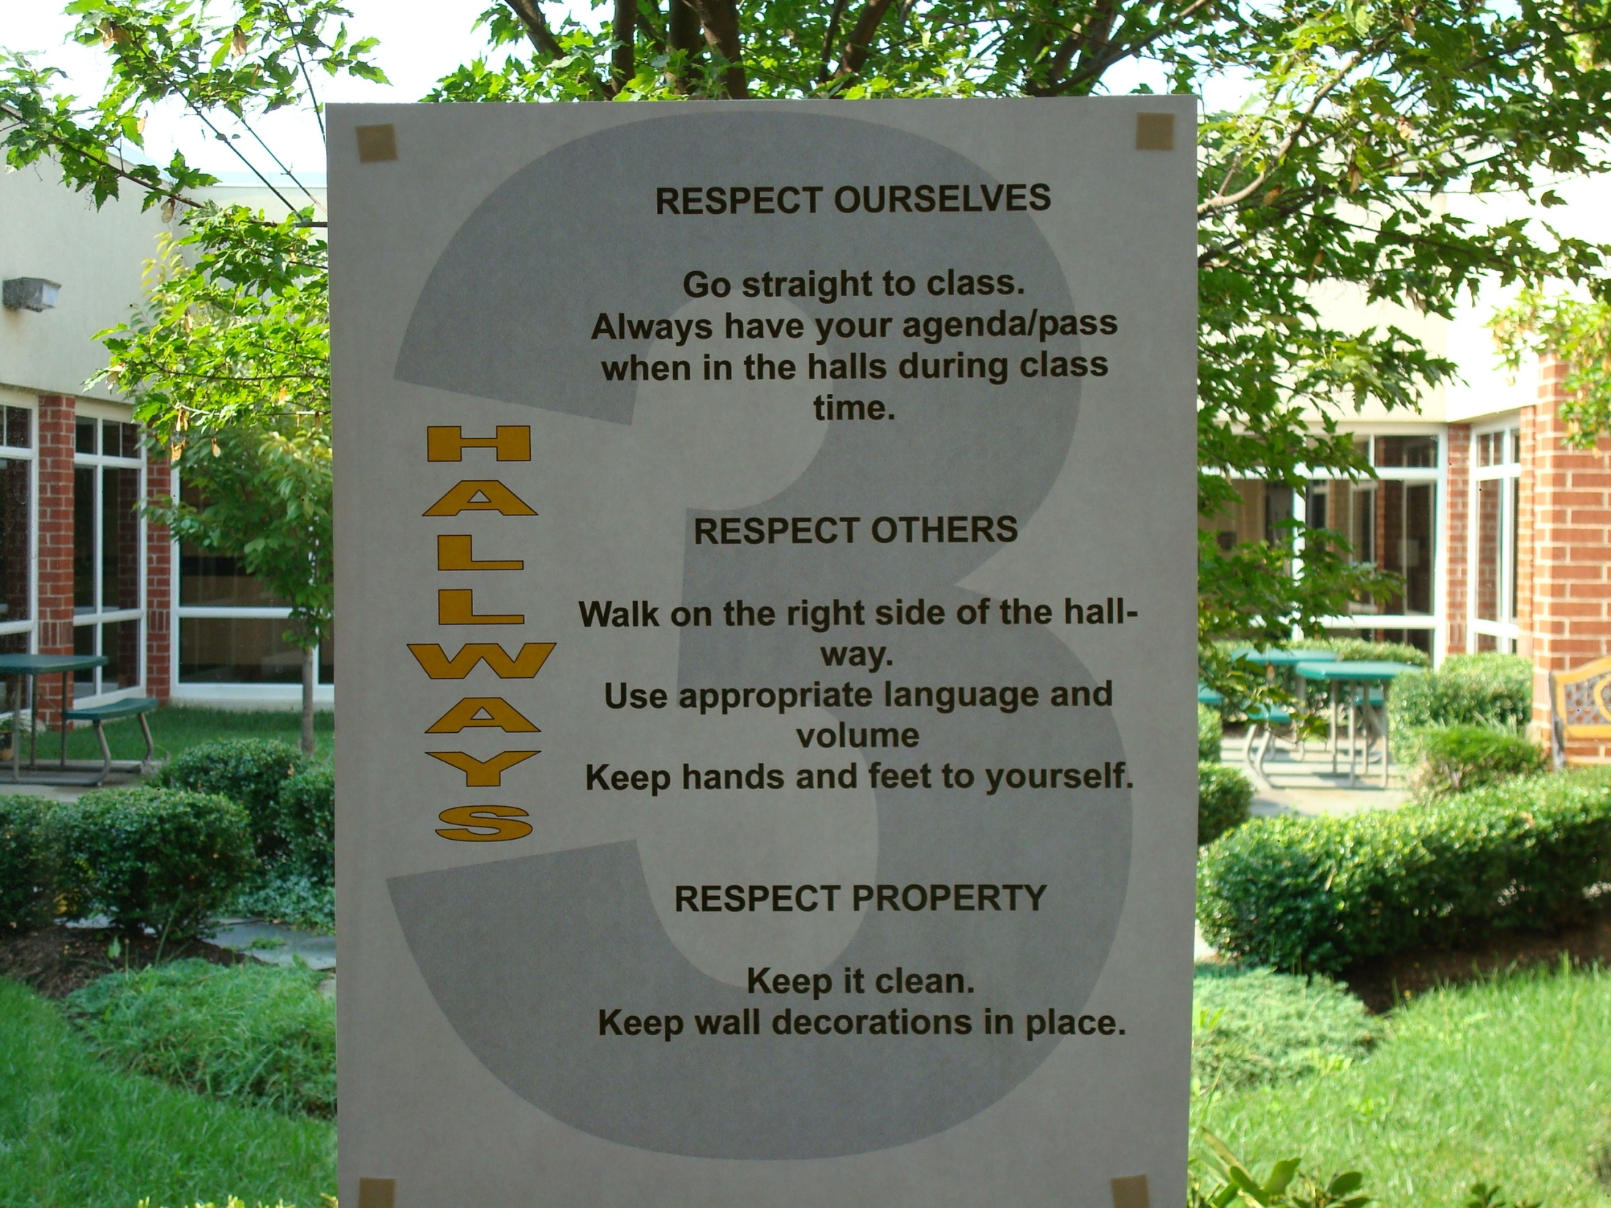
Location behaviors example
Eagle Ridge Middle School , Ashburn, VA

Slide 32
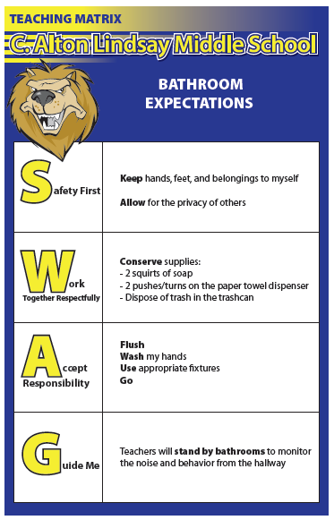
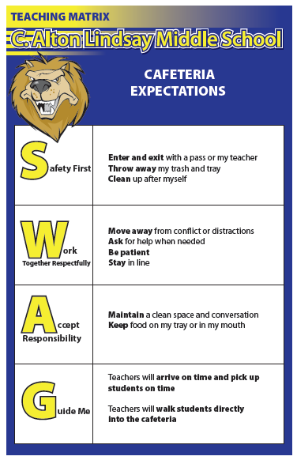
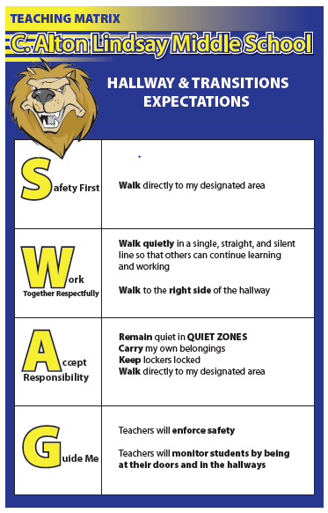
More location behavior examples

Slide 33
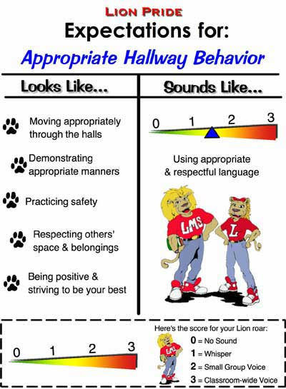
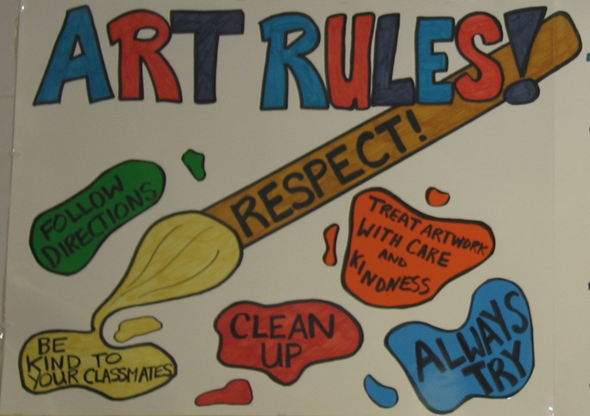
Middle School

Slide 34
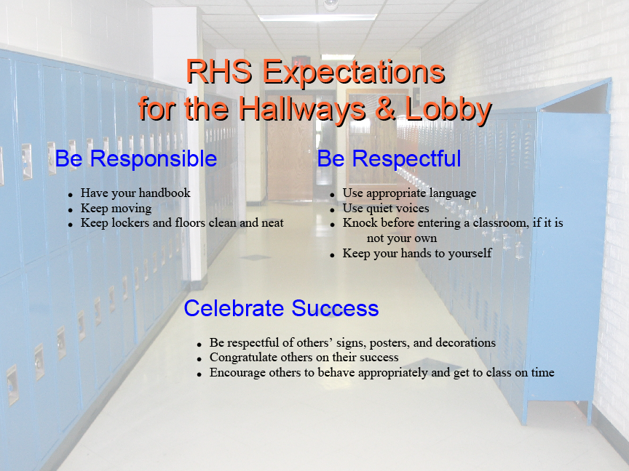
RHS Hallways and Lobby Expectations
Riverton HS

Slide 35
Teaching Matrix Draft
Teaching Matrix
Expectations | SETTINGS
?
?
?
TFI 1.3: Activity 2

Slide 36
Consider Challenging Locations
Where? | What? | When? | Who is involved? | Why is it happening?
TFI 1.3: Activity 3

Slide 37
Teaching Matrix - Behaviors
Teaching Matrix |  | SETTING
 |  | All Settings | Hallways | Playgrounds | Cafeteria | Library/ Computer Lab | Assembly | Bus
 | Respect Ourselves | Be on task. Give your best effort. Be prepared. | Walk. | Have a plan. | Eat all your food. Select healthy foods. | Study, read, compute. | Sit in one spot. | Watch for your stop.
 | Respect Others | Be kind. Hands/feet to self. Help/share with others. | Use normal voice volume. Walk to right. | Play safe. Include others. Share equipment. | Practice good table manners | Whisper. Return books. | Listen/watch. Use appropriate applause. | Use a quiet voice. Stay in your seat.
 | Respect Property | Recycle. Clean up after self. | Pick up litter. Maintain physical space. | Use equipment properly. Put litter in garbage can. | Replace trays & utensils. Clean up eating area. | Push in chairs. Treat books carefully. | Pick up. Treat chairs appropriately. | Wipe your feet. Sit appropriately.
Expectations
3. Specific Behaviors

Slide 38
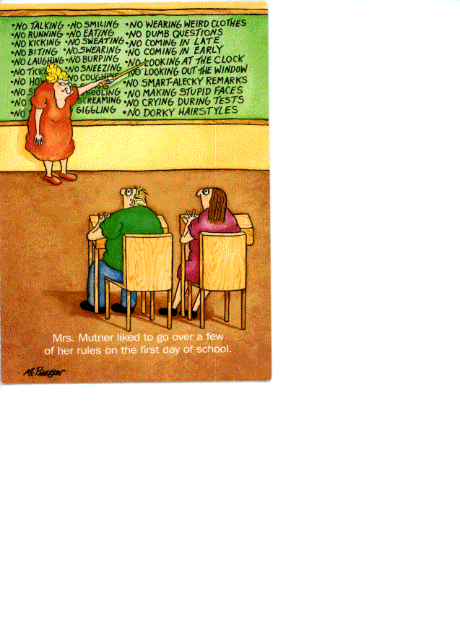
The Do Nots – Non-Examples
T H E DO NOTs
Non-Example

Slide 39
Consistency with our language
Expectations | 3-5 overarching school-wide expectations
Behaviors | specific tasks students are to do to achieve the school-wide expectations
Routines/ Procedures | procedures are methods for accomplishing tasks in the classroom procedures form routines that help students meet classroom expectations and rules/behaviors

Slide 40
Why identify Specific Behaviors?
Consistent instruction across multiple programs and settings within the school
Communication among staff members and students
Students know what to expect and what is expected in all areas
Consistent communication with parents
Makes the “hidden curriculum” visible

Slide 41
Expectations or
Specific Behaviors?
Expectation | Specific Behavior
Respect self and others
Walk in the hallways
Turn in completed assignment
One trip through the lunch line
Be Here, Be Ready
Keep hands and feet to self
Be Safe
They must be…
Observable
Measurable
Positively Stated
Understandable
Applicable
TFI 1.3: Activity 4

Slide 42
Specific behaviors should be...
____________that we can see
b. ____________we could actually count the occurrence of the behavior
c. ____________what to do to be successful
d. ____________student-friendly language
e. ____________able to accomplish in all settings in the school
Understandable Measurable Applicable
Positively State Observable

Slide 43
Use the DATA!
Infraction | Notes
Disruption | Refusal to do work, throw paper
Disruption | Refusal to do work, cry, pout, stomp
Disruption | Off task, refusal
Disruption | Arguing with teacher
Disruption | Prohibited teaching and learning
Disruption | Playing, throwing water
Disruption | Off task
Disruption | Throwing paper, yelling, hitting, crawling
Disruption | Not following directions, playing, off task
Disruption | Not following directions

Slide 44
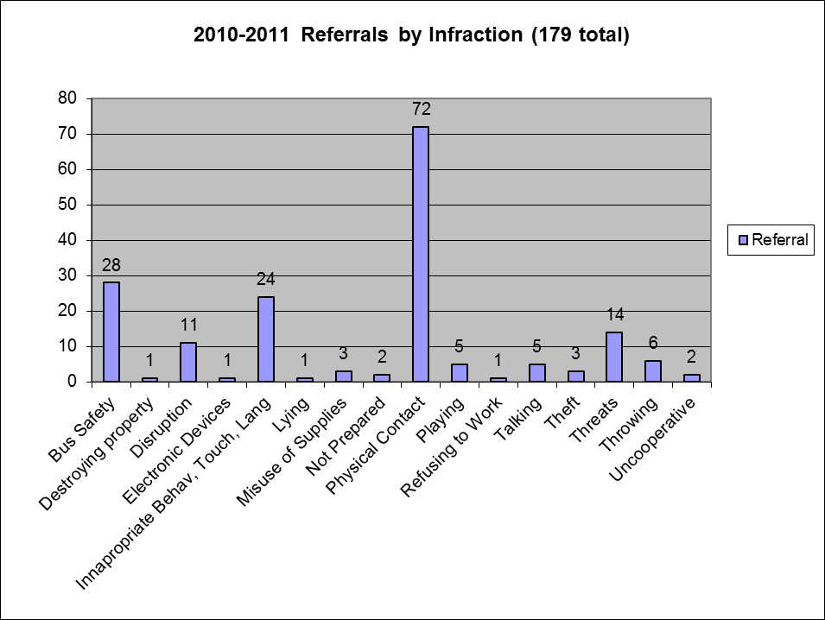
Does data corroborate your specifics?
Does data corroborate your specifics?

Slide 45

Identifying Behaviors
As a team, look at your discipline data.
What are the most common behaviors students are disciplined for in your school?
Student Discipline Referrals
What other life skills might we teach as a replacement for the behaviors you are seeing?

Slide 46
Let’s practice…RESPECT
Respect
Looks like | Sounds like

Slide 47
Teaching Matrix
Teaching Matrix |  | SETTINGS
 |  | All Settings
EXP ECTA T I ONS | 1
 | 2
 | 3
How will you operationally define your expectations?
Add behaviors/rules

Slide 48
View Through Different Lenses
How will students experience the matrix?
  Doable?
  Appropriate?
  Am I learning life skills?
  Examine to ensure that expectations are truly universal
  Does this sound like a place I would want to go to school?

Slide 49
Specific Behaviors + Social-Emotional Skills
Expectation | Specific Behavior or Social Emotional Skill
Be Safe | Keep hands and feet to self
 | I tell an adult when I am worried about a friend.
Be Respectful | Use the signal to ask a public or private question.
 | Make sure everyone gets a turn.
Be Responsible | Turn in all work on time
 | Check in with my feelings during the day

Slide 50
Matrix that includes Social Emotional Learning
TEACHING MATRIX |  | SETTINGS
 |  | All Settings | Classrooms | Hallways | Cafeteria
 | RESPECT | Be kind Hands/feet to self Help/share with others | Give your best effort USE POSITIVE SELF-TALK | Use normal voice volume | Practice good table manners
 | RESPONSIBLE | Recycle Clean up after self USE CALMING STRATEGIES | Participate in activities MONITOR FEELINGS/ EMOTIONS | Walk | Replace trays & utensils
 | SAFE | Be alert to your surrounding | Follow adult instructions ASK FOR HELP | Maintain physical space | Clean up eating area

Slide 51
Teaching Matrix with specifics
Teaching Matrix |  | INCORPORATE BULLY PREVENTION / INTERVENTION
 |  | All Settings | Halls | Playgrounds | If you see Disrespect | Library/ Computer Lab | Assembly | Bus
 | Respectful | Be on task. Give your best effort. Be prepared. | Walk. | Have a plan. |  | Study, read, compute. | Sit in one spot. | Watch for your stop.
 | Achieving & Organized | Be kind. Hands/feet to self. Help/share with others. | Use normal voice volume. Walk to right. | Share equipment. Include others. |  | Whisper. Return books. | Listen/watch. Use appropriate applause. | Use a quiet voice. Stay in your seat.
 | Responsible | Recycle. Clean up after self. | Pick up litter. Maintain physical space. | Use equipment properly. Put litter in garbage can. |  | Push in chairs. Treat books carefully. | Pick up. Treat chairs carefully. | Wipe your feet.
STOP: Interrupt & model respect, rather than watch or join in
WALK: Invite people
who are being disrespected to
to join you and move away.
Invite those who are
alone to
join in.
Expectations
Stop: Interrupt,
Say “that’s not ok.”
Walk: Walk away Don’t be an audience
Talk:
REPORT to an adult

Slide 52
High School Matrix
Hoopeston Area High School – PBIS Matrix
 | Cafeteria | Gym | Classroom | Bathrooms
Show Responsibility | Have lunch card ready. Keep area clean. Dispose of your garbage. | Pick up after yourself. | Arrive on time with materials and planner. Turn in work on time. | Wash your hands. Flush stool. Report problems.
Show Integrity | Eat your own food. Use your own lunch card. | Act safely. | Do your own work. Give best effort. Stay on task. | Keep restrooms clean.
Show Respect | Wait your turn Use appropriate tone and language Food in cafeteria only. | Leave equipment alone. Respect others’ space and property. | Wait your turn to speak. Value others and their opinion. Respect others’ property. | Respect others’ property.
 | Computer Lab | Hallways/Lockers | Library | Parking Lot/Outside
Show Responsibility | Use appropriate websites. Report problems to staff. | Keep moving. Use your own lockers. Put trash in trash cans. Walk to your right. | Speak quietly. Return materials on time. Have signed pass/planner. Ask for help. | Wait your turn. Put trash in trash cans. Use safety rules both on foot and in cars.
Show Integrity | Use only your password and user name. Do your own work. Stay on task. Print only necessary paper. | Use appropriate language. Carry pass/planner at all times. Use cell phone only before 7.15 and after 3.25. | Check out books with staff. Pay fines on time. Return directly to class. | Be courteous. Report problems.
Show Respect | Use all equipment properly. | Respect others’ personal space and property. Move quietly during class time. | Treat materials with care. | Use appropriate language. Be careful.

Slide 53

RAH – Athletics
RAH | Practice | Competitions | Eligibility | Lettering | Team Travel
Respect | Listen to coaches directions; push yourself and encourage teammates to excel. | Show positive sportsmanship; Solve problems in mature manner; Positive inter-actions with refs, umps, etc. | Show up on time for every practice and competition. | Show up on time for every practice and competition; Compete x%. | Take care of your own possessions and litter; be where you are directed to be.
Achievement | Set example in the classroom and in the playing field as a true achiever. | Set and reach for both individual and team goals; encourage your teammates. | Earn passing grades; Attend school regularly; only excused absences | Demonstrate academic excellence. | Complete your assignments missed for team travel.
Honor | Demonstrate good sportsmanship and team spirit. | Suit up in clean uniforms; Win with honor and integrity; Represent your school with good conduct. | Show team pride in and out of the school. Stay out of trouble – set a good example for others. | Suit up for any competitions you are not playing. Show team honor. Cheer for teammates. | Remember you are acting on behalf of the school at all times and demonstrate team honor/pride.
Notes:
53

Slide 54

Teaching Matrix Development
Teaching Matrix Development

Slide 55
Teaching Matrix highlights
Teaching Matrix |  | SETTING
 |  | Hallways | Cafeteria | Library/ Computer Lab | Bus | Classroom
 | Be Respectful | Keep hands feet and other objects to self | Eat only your food | Study, read, compute | Talk quietly so driver can focus
 | Be Responsible | Use quiet voice | Replace trays & utensils | Push in chairs. Treat books carefully. | Wipe your feet Sit appropriately
 | Be Safe | Maintain your own physical space Stay to the right | Clean up your eating area | Whisper. Return books | Use a quiet voice Stay in your seat
 | Conditions for Learning
Expectations

Slide 56
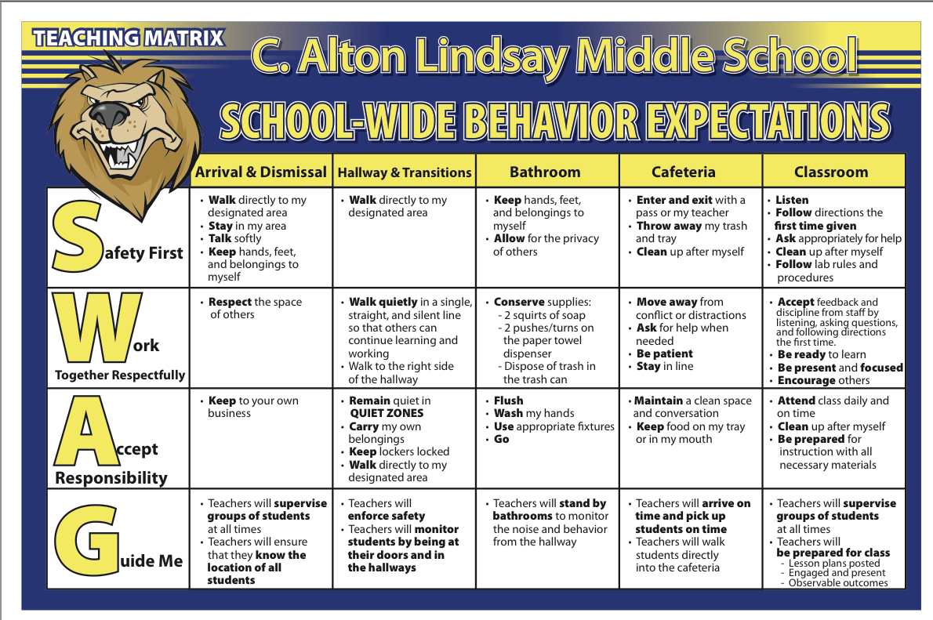
Middle School Teaching Matrix Example

Slide 57
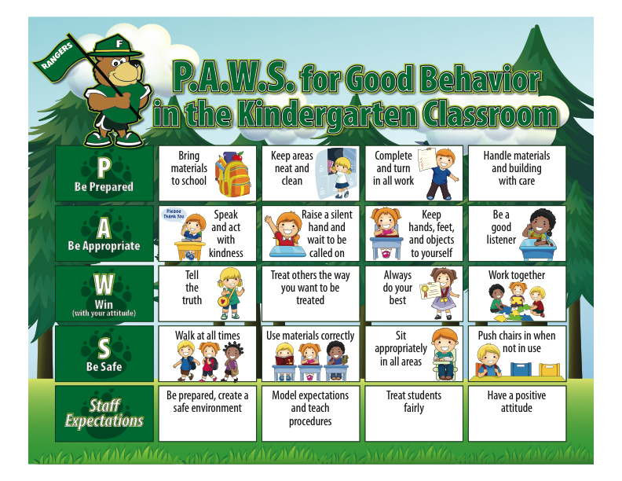
Elementary school Teaching Matrix Example

Slide 58
Teaching Matrix 2.0
Expectations | Self | Home | Neighborhood | Classroom
Be Safe | -Use a breathing strategy if stressed or angry | -Protect your friends and family | -Stand up for yourself | -Keeps hands and feet to self -Tell an adult when I am worried about a friend
Be Respectful | -Use positive self talk when I make a mistake | -Do what adults tell you to do -Keep family business at home | -Text back within 30 seconds -Use kind words to friends’ parents | -Use the signal to ask a public or private question. -Make sure everyone gets a turn.
Be Responsible | -Recognize and name my feelings during the day | -Own your mistakes -Help out your family first | -Stay with your friends -Have each other’s backs | -Turn in all work on time.
Add Behaviors

Slide 59
Validation, Affirmation, Building, and Bridging
Validation, Affirmation, Building and Bridging
Appendix I: VABB and a Sample Bridging Behavior Cool Tool
Validation, Affirmation, Building, and Bridging (VABB; Hollie, 2011) is a set of strategies that can be used by staff to facilitate learning about expectations across settings by their students in relation to the students and families served by the school. VABB includes the following actions:
Validation is legitimizing aspects of students’ cultures that have historically been seen as illegitimate by the dominant culture, including intentionally allowing time and space for cultural aspects within the school day. These cultural aspects include language, teachings, and rites of passage. As a system, the school must acknowledge that these cultural aspects play a prominent role in students’ lives. Rap music, for example, sometimes has a negative connotation in dominant society due to language or themes. However, rap music can also be seen as an effective form of communication that requires creativity and spontaneity. Strategies for validation include displaying aspects of students’ culture in the classroom and around the school, asking students to share their experiences, and listening non-judgmentally.
Affirmation is explicitly acknowledging the worth of students’ cultures and learning histories. If rap music is an aspect of student culture at a school, affirmation requires harnessing and capitalizing on the communication, creativity, and spontaneity of the music. Strategies for affirmation include accepting a wider range of acceptable behavior than the dominant culture often allows, stating the positive intent of students’ behaviors when trying to shape them for situational appropriateness, and holding high expectations for each student.

Slide 60
Family Teaching Matrix
Family Teaching Matrix |  | SETTING
 |  | At home | Morning Routine | Homework | Meal Times | In Car | Play | Bedtime
 | Respect
 | Responsible
 | Safe
Expectations

Slide 61
Assess the differences
Assess differences between school and other settings and ask:
Are the “different” school behaviors necessary for positive student development?
  NO: Change the behaviors to align more with home and neighborhood
  YES: Acknowledge explicitly and provide additional teaching, practice, and acknowledgment
PBIS Resources for Equity

Slide 62
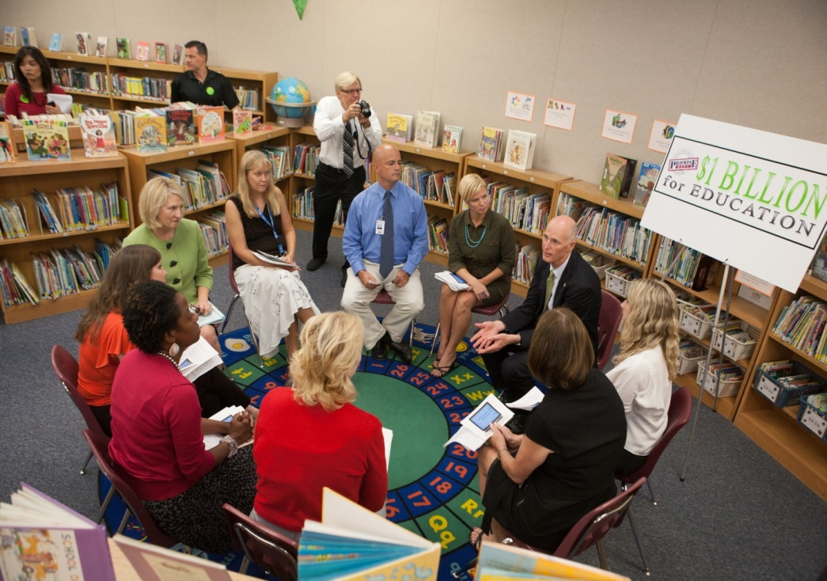
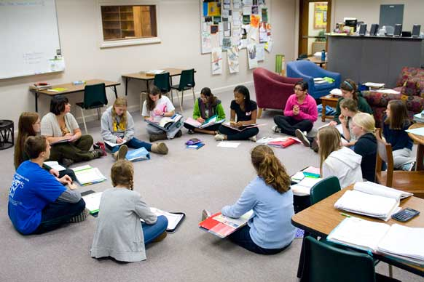
Gather Feedback from all Stakeholders
What about community
service providers?

Slide 63
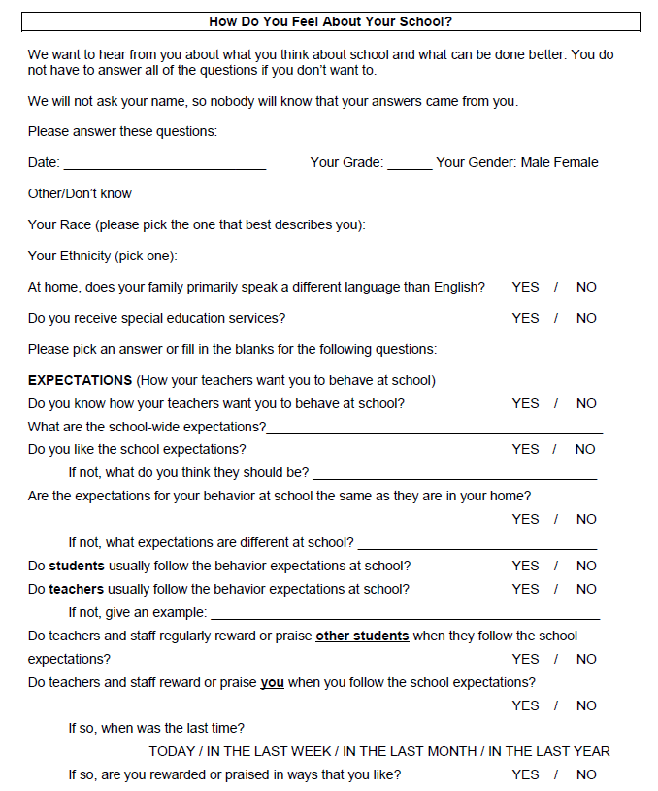
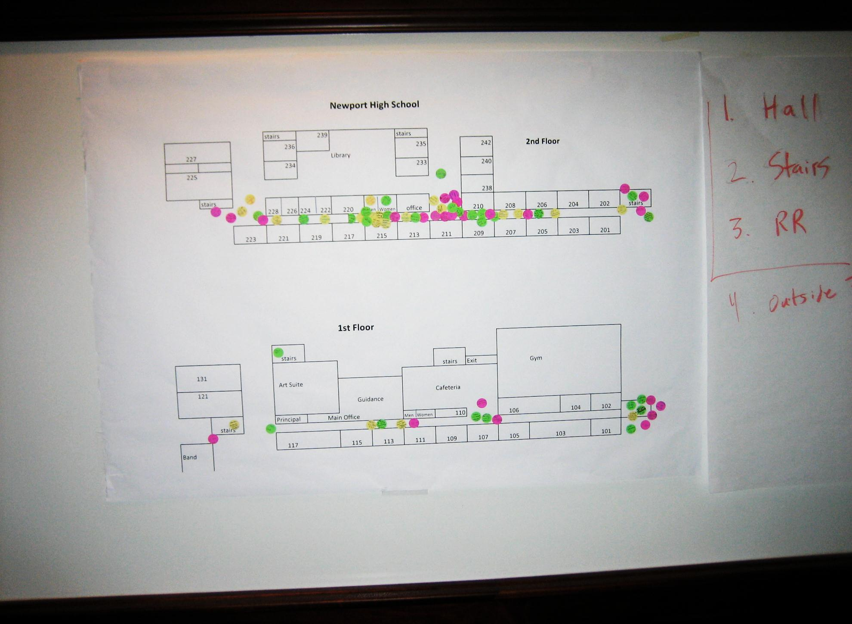
Stakeholder Involvement
TFI 1.3: Activity 6

Slide 64
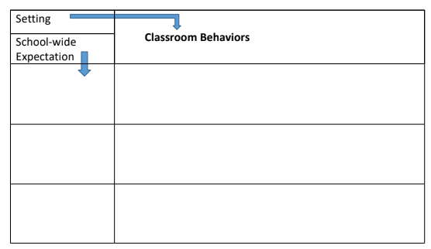
Classroom Behaviors Aligned with School-wide Expectations
TFI 1.3: Activity 7

Slide 65
Action Planning
What needs to be completed? | Resources needed? | Who? | When?
A.
B.
C.

Slide 66
How are you?
Your three key take-a-ways.
What squares with your thinking?
What ideas make you wiggle in your seat?
What questions are still circling in your mind?

Slide 67
Bibliography
OSEP Technical Assistance Center on Positive Behavioral Interventions and Supports (October 2015). Positive behavioral interventions and supports (PBIS) implementation blueprint: Part 1 – Foundations and supporting information. Eugene, OR: University of Oregon. Retrieved from www.pbis.org.
PBIS Resources for Equity [Web log post]. (2019, March 25). Retrieved March 25, 2019, from https://www.pbis.org/school/equity-PBIS

