Slide 1
PBIS - Tier 1 Behavior Professional Learning
TFI 1.4 Teaching Expectations

Slide 2
How are you showing up today? (Slido)
Some examples, it’s okay to be honest and add some humor :)
I’m here but distracted.
I’m ready to learn and assume our time will be valuable.
Wait. What? I thought I signed on to a division meeting.
I’m looking forward to learning more about VTSS/PBIS!
CASEL RESOURCE

Slide 3
Professional Learning Outcomes

Slide 4
TFI Roadmap: Where are we headed?
Where We’ve Been
1.1 Team Composition
1.2 Team Operating Procedures
1.3 Behavioral Expectations
1.8 Classroom Expectations
Our Focus in this Module
1.4 Teaching Expectations
Feature | Possible Data Sources | 2 Points Fully Implemented | 1 Point Partially Implemented | 0 Points Not Implemented
1.4 Teaching Expectations: Expected academic and social behaviors are taught directly to all students in classrooms and across other campus settings/locations | TFI Walkthrough Tool Professional Development Calendar Lesson Plans Informal walkthroughs | Formal systems with written schedules is sued to teach expected behaviors directly to students across classroom and campus settings AND at least 70% of students can list at least 67% of expectations | Expected behaviors are taught informally or inconsistently | Expected behaviors are not taught

Slide 5
Learning Intentions
Study the use of explicit instruction (an evidence-based practice) to teach all lessons (academic, behavior, and social emotional).
Understand the reasons for teaching behaviors and routines directly in settings and build a schedule for doing so.
Create a sample lesson based on the teaching matrix.
Brainstorm links between expectations and subject area curriculum.
Plan for training staff about lessons and their importance.

Slide 6
Explicit Instruction
This video can be found at
https://www.youtube.com/watch?v=fCVKCUB5w50

Slide 7
Teaching Behavior
If a child doesn’t know how to read,
If a child doesn’t know how to swim,
If a child doesn’t know how to multiply,
If a child doesn’t know how to drive,
If a child doesn’t know how to behave, we….
we teach
we teach
we teach
we teach
teach? punish?
Why can’t we finish the last sentence as automatically as we do the others?”

Slide 8
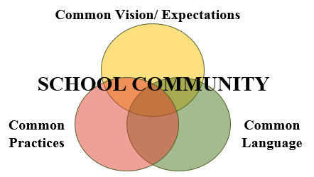
Teaching Schoolwide & Classroom-wide Lesson Plans
Once you have developed school-wide expectations,
it is not enough to just post the words on the walls…
YOU MUST TEACH (and RETEACH) THEM!

Slide 9
Why develop a system for teaching behavior?
Academic and social-emotional behaviors develop together.
Procedures and routines create structure.
Repetition is key to learning new skills.
Learning new skills and making them a habit takes repetition over many days (Lally, et al, 2009)
Depends on age of the learner and complexity of the skill (Lally, et al, 2009)
A break in learning can cause learning to take longer. (i.e. Not every teacher uses the same expectations) (Lally, et al, 2009)

Slide 10
Why teach SEL
Increase
Decrease
Academic Performance
Self-confidence
Behavior outcomes
Positive Attitudes toward school and interactions with other
Teacher confidence
Self-efficacy
Job satisfaction and well-being
Student aggression
Emotional distress of students
Perceived stress of teachers
Durlak et al., 2011

Slide 11
The Science of Behavior Has Taught Us
There is no mis-behavior!
The Behavior is Feedback for us...
A trigger for us to think...
Where is the mismatch?...
What instruction needs to happen?

Slide 12
There is only….
behavior
that meets a need (function)
and works (is reinforced)!

Slide 13
ABC’s of Behavior
Antecedent/
Trigger:
When _____ happens…
Behavior:
the student does (what)__
Consequence/
Outcome
..because (why) ______
(Loman & Borgmeier)

Slide 14
The Science of Behavior Has Also Taught Us
Behavior is learned
so it can be ‘un-learned’
by explicitly teaching a replacement behavior
and providing praise and feedback

Slide 15
The Fun Theory
This video can be found at https://www.youtube.com/watch?v=SByymar3bds

Slide 16
Behavior Change
Reframe change as an instructional process
We change STUDENT behavior
by changing
ADULT behavior
Interventions = changes in staff procedures & practices

Slide 17
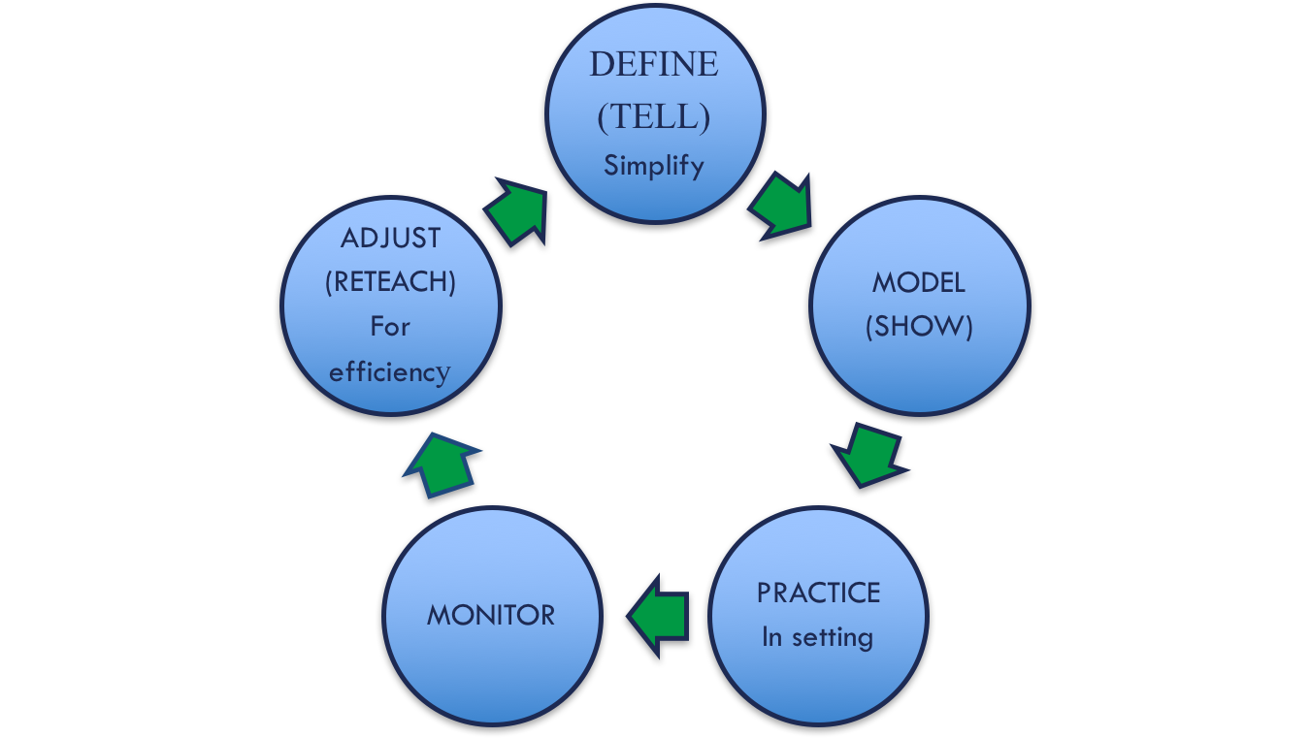
An Instruction Process for Academics
BE CONSISTENT

Slide 18
The Same Process for Behavior
BE CONSISTENT

Slide 19
Alignment
The process for teaching SEL is the same process used for academics and behavior.

Slide 20
SEL Approaches
SEL Approaches | Short Term Outcomes | Behavioral/Academic Outcome
Explicit SEL Skills Instruction Teacher Instructional Practices Integration with Curriculum Areas Organizational, Culture, and Climate Strategies | SEL Skill Acquisition: Five Competence Areas | Positive Social Behavior
 | Improved Attitudes: Self, Others, Learning, and Schools | Fewer Conduct Problems
 |  | Less Emotional Distress
 | Enhanced Learning Environment: Supportive, Engaging, and Participatory | Improved Academic Performance

Slide 21
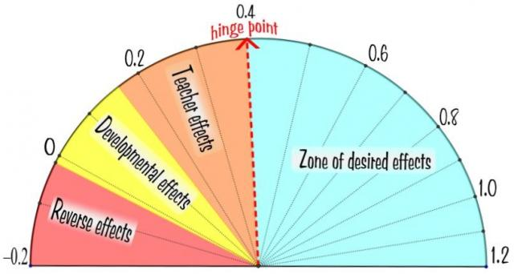
This works!
Direct Instruction
Feedback
Teacher
Clarity

Slide 22
Creating Behavior Lesson Plans
Teachers create lesson plans for each desired behavior
Students are taught the expectations and routines for both the school-wide system and the classroom-wide system.
Remember… If you are seeing problematic behavior, ask, “Have I taught and acknowledged the desired behavior I want to see?”

Slide 23
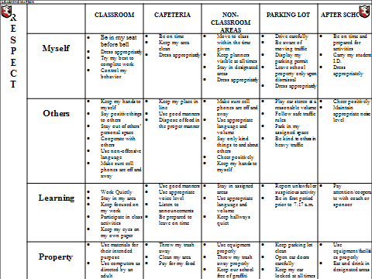
Develop an Efficient Teaching System
CAFETERIA
Be on time Keep my area clear
eep my place in line Dispose of food in the proper manner
Use appropriate voice level Listen to announcements Be prepared to leave on time
Throw my trash away Clean my area Pay for my food

Slide 24
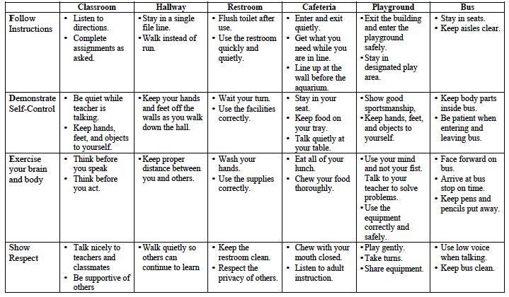
What to teach
Develop lesson plans to teach the specific behaviors identified on the matrix

Slide 25
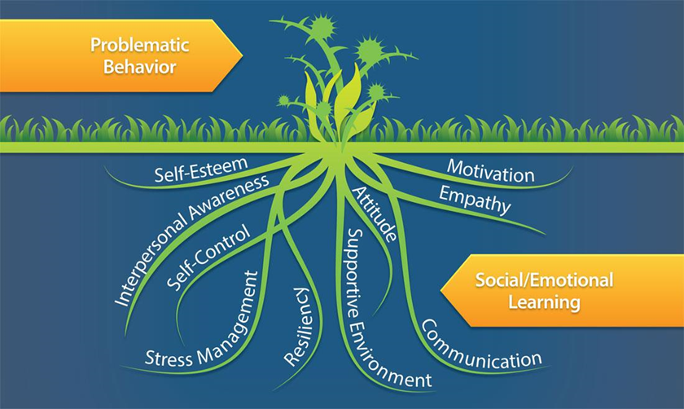
Deeper Dive

Slide 26
Teach and Practice Expected Behaviors
I do (explain/show/model)
We do (gradually release responsibility – may have several ‘we do’s’)
You do (practice with feedback)
You all do (independent practice)

Slide 27
Going Deeper into Explicit Instruction
Think back to our matrix
Expectation | Specific Behavior or Social Emotional Skill
Be Safe | Keep hands and feet to self
 | I tell an adult when I am worried about a friend.
Be Respectful | Use the signal to ask a public or private question.
 | Make sure everyone gets a turn.

Slide 28
Anita Archer Teaches The Signal
This video can be found at
https://www.youtube.com/watch?v=XAsi5ykgJg0&feature=youtu.be

Slide 29
Observations
BE CONSISTENT

Slide 30
Components of an Effective Model
Provides explicit model of expectation done well
Videos can be great options for the model or “I Do” because
They can include peers who look and sound like they do
They are entertaining when done well
Non-examples should be clearly identifiable.

Slide 31
Components of Effective Practice
Practice is carefully and closely guided.
It happens in the setting of the desired behavior when possible.
Includes opportunities for feedback.

Slide 32
Components of Effective Feedback
Focuses on desired behaviors
Names the skill/behavior the student demonstrates
Explains why it is valuable to the school/classroom community or supports student success

Slide 33
Components of Effective Monitoring
Move, scan, and interact with students
Observation and data collection
Formatively assess the lesson – For whom was the lesson successful? How do we know?
Who needs extra teaching practice? How will that happen?
Are skills crossing settings?

Slide 34
Pre-correct and Prompt: ALWAYS
Pre-Correction- provide a description of what the behavior looks like prior to directing student to perform a task. This includes: verbal reminders, behavioral rehearsals, or demonstrations of following the expectations or socially appropriate behaviors that are presented in or before setting where inappropriate behavior is likely. (Colvin, Sugai, Good, Lee, 1997)
Provide students with visual prompts (e.g. posters, illustrations, etc.)

Slide 35
Components of Re-teach and Adjust
Think ahead of any issues that might arise and discuss them with the class beforehand. Taking time to prepare the students before the event/activity will save you time and energy later on.
Continually embed expectations into the classroom.
Review-teacher consistently models expectations.
Students follow class expectations despite the absence of the teacher: Substitute, guest teacher, buddy teacher, volunteer.

Slide 36
Sample Lesson
Read through the lesson plan for Activity 1 on pages 35-38 of your workbook. Note where the lesson:
Defines the behaviors
Models the behaviors
Practices the behaviors (in the setting)
Monitors for understanding and effectiveness
Provides opportunities for adjusting and re-teaching
TFI 1.4: Activity 1

Slide 37
Involving Students and Staff in the Development of Lessons
Students
Involve students in planning assemblies
Student developed lessons
Role plays developed by students
Music and video clips
Staff
Skits
Morning announcements
Staff/parent/student collaboration on lesson plans for families (PTA, PTO, Parent Resource Centers)

Slide 38
Honoring ALL students!
When creating lessons…
Think Validate, Affirm, Build, & Bridge (VABB)
Identify similarities between home and school – use real life experiences to make connections
Discuss with students the differences between home and school (Remember Matrix 2.0?)
Examine the matrix for reflection of dominant culture only – what needs explicit teaching? Explain why those skills are necessary to students.
Teach Situational Appropriateness

Slide 39
Honoring ALL students!
Seek input…
Always seek family and community input…
On efficacy and relevance
How can they help to teach and reinforce?
Use within families
What are effective communication loops?

Slide 40
Lesson Plan Activity
Choose a routine from the school-wide or classroom-wide matrix.
Work with team and complete the behavior lesson plan template found in the workbook.
Be ready to potentially describe your lesson to the group.
TFI 1.4: Activity 2

Slide 41
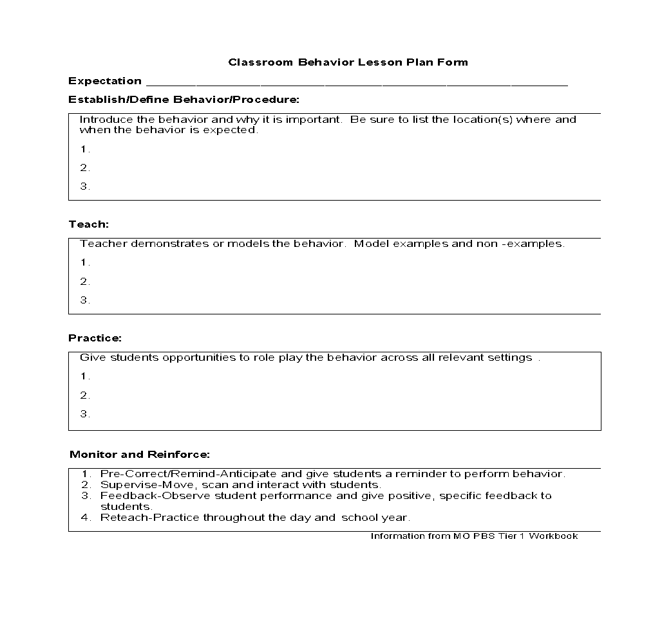
Behavior Lesson Plan
TFI 1.4: Activity 2

Slide 42
Creating a Plan for Teaching Desired Behaviors
Once the behavior lesson plans are created it is important to take time to decide how the lessons will be taught, not only at the beginning of the year, but throughout the year.
There should be a written plan documenting how and when expectations will be taught.
ALL TEACHERS TEACH THE EXPECTATION AND ALL STUDENTS RECEIVE THE INSTRUCTION!

Slide 43
How and when will we teach behavior?
Explicitly Teaching Curriculum Matrix | Embedding Curriculum Matrix in Daily Academic Instruction
Kickoff Events (start of year) | Connections to SOL
Matrix Related Lessons in Morning or Class Meetings (ongoing) | Connections to literature, historical figures and events, etc.
Booster Trainings (after breaks, based on spikes in data)
Continued Visibility

Slide 44
When to Teach the Matrix?
Beginning of school year
Kickoff: Teach expectations for all areas of school, including individual classrooms, during first week of school
After first week, review expectations 2 or 3 times/week
…in the cafeteria
…in the restroom

Slide 45
When to Teach the Matrix? Schedule for Teaching
On-going Direct Instruction
Use established structures like homeroom, morning meetings, class meetings
Data-driven and scheduled lessons
Pre-correction for predictably difficult times
Re-teaching immediately after behavioral error

Slide 46
Booster Session - Predictable Problems
Booster sessions are planned and delivered to re-teach staff/students at least once in the year and additionally at times when the data suggest problems by an increase
in discipline referrals per
day per month or a high number of referrals in a specified area.

Slide 47
When to Teach the Matrix? Schedule for Teaching
Booster Sessions
End of first grading period
Through second grading period
Review expectations once per week
Remainder of the year
Review expectations periodically as needed
Review expectations immediately after a school break
When behavior data indicates a need

Slide 48
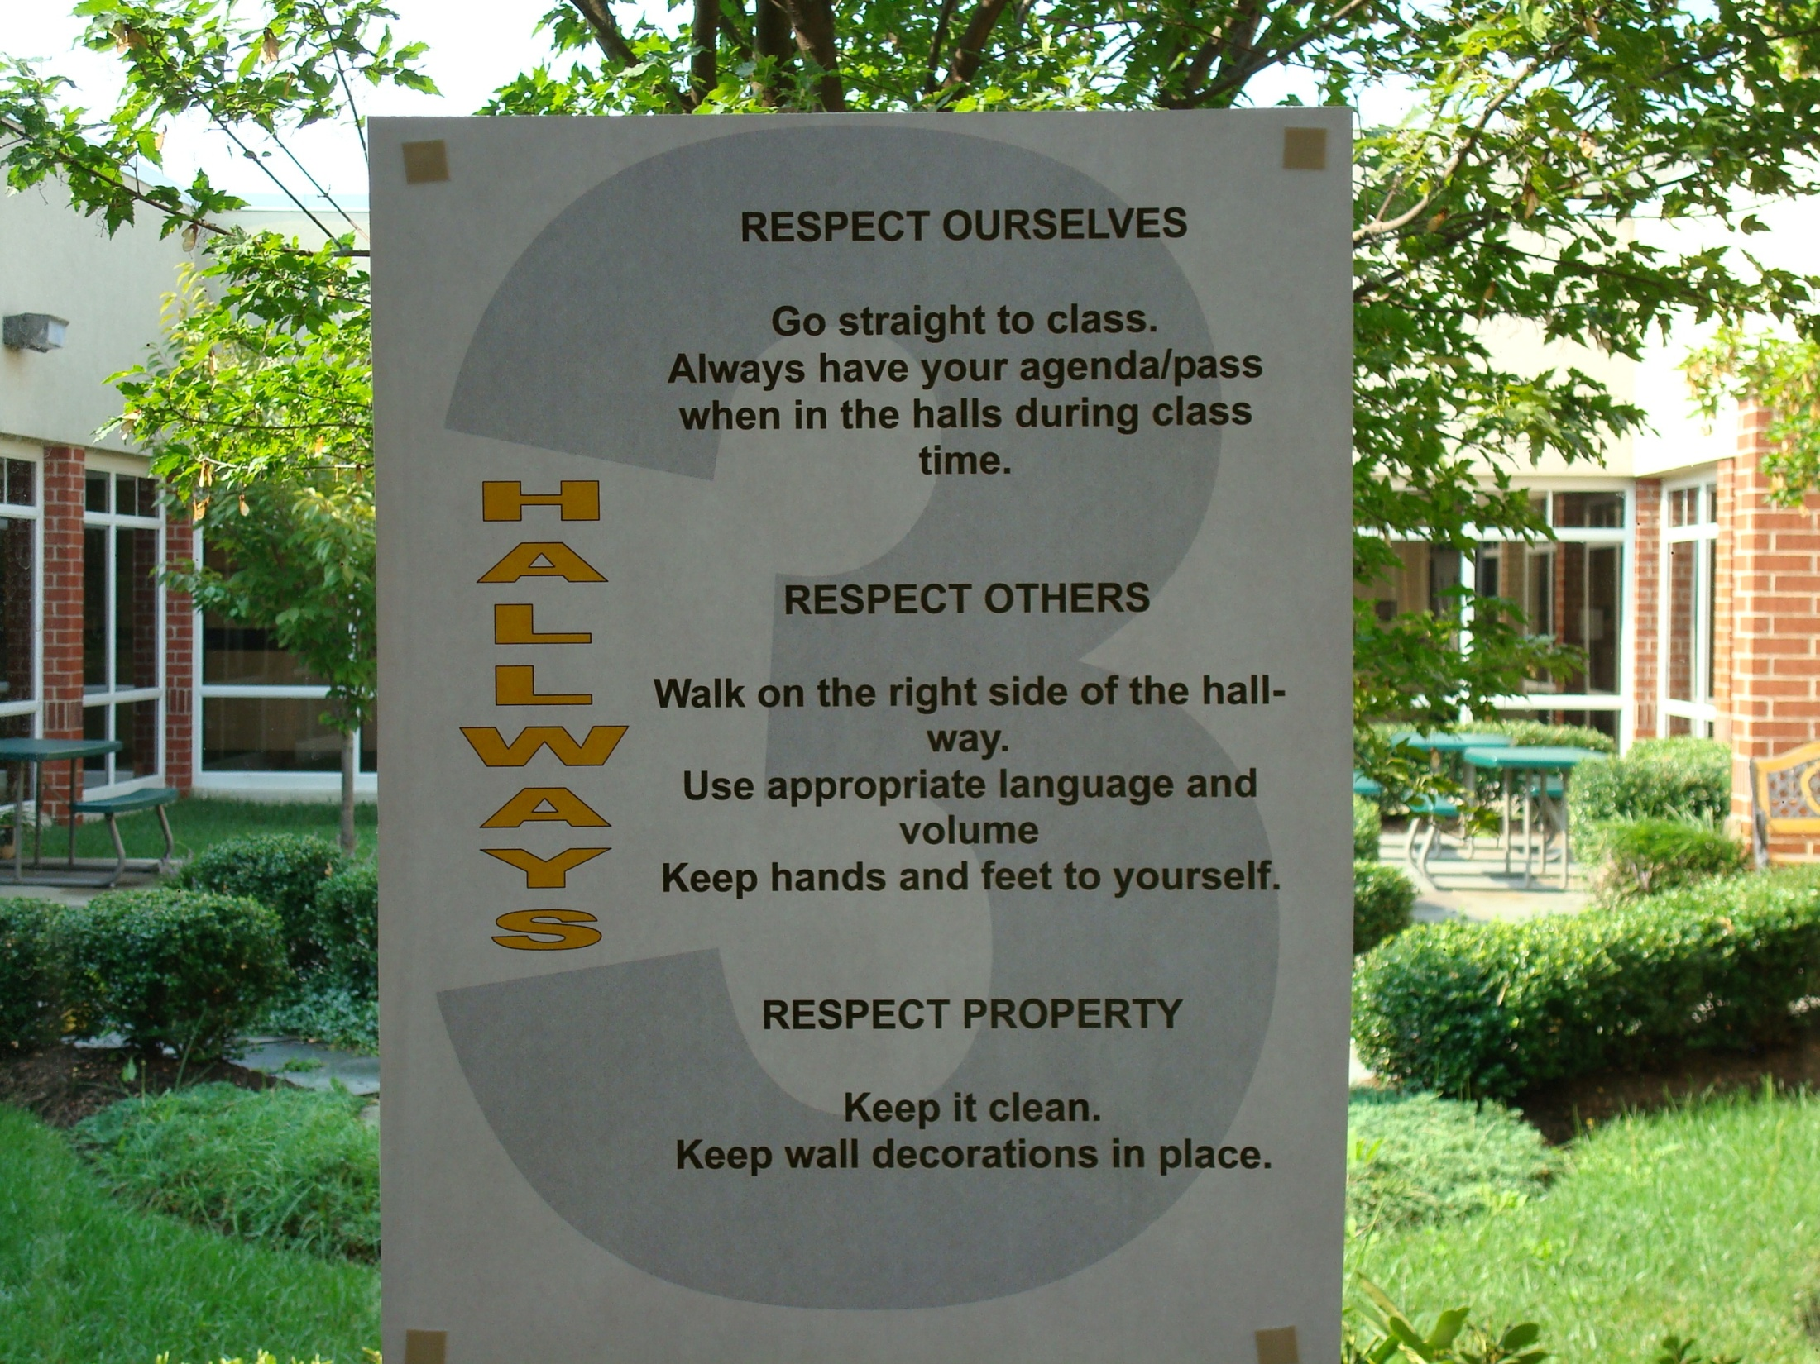
Continued Visibility

Slide 49
Plan for Teaching Expectations
What will be done? | How will it be done? | When will it be done?
Introduce the expectations
Create/Post the Matrix
Establish a signal for obtaining class attention & transitions
Model what the expectations look like
Practice with students
Provide specific feedback
Acknowledge students who demonstrate the expected behavior
Pre-correct and Review often

Slide 50
How and when to teach behavior?
Explicitly Teaching Curriculum Matrix | Embedding Curriculum Matrix in Daily Academic Instruction
Kickoff Events (start of year) | Connections to SOL
Matrix Related Lessons in Morning or Class Meetings (ongoing) | Connections to literature, historical figures and events, etc.
Booster Trainings (after breaks, based on spikes in data)
Continued Visibility

Slide 51
Complete Your Action Plan
WHAT NEEDS TO BE COMPLETED? | RESOURCES NEEDED? | WHO? | WHEN?
A.
B.
C.

Slide 52
Bibliography
Colvin, G., Sugai, G., Good, R. H. III, & Lee, Y.-Y. (1997). Using active supervision and precorrection to improve transition behaviors in an elementary school. School Psychology Quarterly, 12(4), 344-363.
Lally, P. , van Jaarsveld, C. H., Potts, H. W. and Wardle, J. (2010), How are habits formed: Modelling habit formation in the real world. European Journal Social Psychology, 40(6), 998-1009. doi:10.1002/ejsp.674

