Slide 1
Please rename yourself as follows:
School Name, First Name, Last Name
Example: Joyful School, Ryan, Best
WELCOME!!
Please Rename Yourself on Zoom

Slide 2
PBIS – Tier I Behavior Professional Learning
TFI 1.5 Problem Behaviors
TFI 1.6 Discipline Policy & Procedures

Slide 3
Professional Learning Roadmap
Our Focus in this Module
1.5 Problem Behavior Definitions
1.6 Discipline Policy and Procedures
Where We’ve Been
1.1 Team Composition
1.2 Team Operating Procedures
1.3 Behavioral Expectations
1.8 Classroom Procedures
1.10 Faculty Involvement
1.4 Teaching Expectations

Slide 4
TFI Items 1.5 and 1.6
Feature | Possible Data Sources | 2 Points Fully Implemented | 1 Point Partially Implemented | 0 Points Not Implemented
1.5 Problem Behavior Definitions: School has clear definitions for behaviors that interfere with academic and social success and a clear policy/procedure (e.g., flowchart) for addressing office-managed versus self-managed problems. | Staff handbook Student handbook School policy Discipline flowchart | Definitions and procedures for managing problems are clearly, defined, documented, trained, and shared with families. | Definitions and procedures exist but are not clear and/or not organized by staff versus office managed problems. | No clear definitions exist, and procedures to manage problems are not clearly documented.
Feature | Possible Data Sources | 2 Points Fully Implemented | 1 Point Partially Implemented | 0 Points Not Implemented
1.6 Discipline Policies: School policies and procedures describe and emphasize proactive, instructive, and/or restorative approaches to student behavior that are implemented consistently. | Discipline policy Student handbook Code of conduct Informal administrator interview | Documentation includes and emphasizes proactive approaches AND administrator reports consistent use | Documentation includes and emphasizes proactive approaches | Documents contain only reactive and punitive consequences

Slide 5
What will we learn?
Disciplinary policies and practices are part of a cohesive behavior support system within a school.
Discipline is a complementary system to expectations and acknowledgements.
Effective discipline includes opportunities for students to LEARN and PRACTICE appropriate behaviors through an instructional approach.

Slide 6
What will we do?
Define behaviors clearly and differentiate between which is office-managed and classroom-managed.
Create an array of instructional responses to behaviors that interfere with instruction.
Describe a consistent discipline process in narrative or graphic format.
Identify school policies and procedures that describe and emphasize proactive, instructive, and/or restorative approaches.

Slide 7
What more will we do?
Identify documentation procedures to track office-managed and classroom-managed behavior incidents.
Review current office discipline referral form to ensure data collection fields exist for meaningful decision-making.

Slide 8
Rationale
Clearly defined procedures support consistency in responding to behavioral infractions.
Consistency creates conditions for increased structure, feelings of safety, and a positive learning environment.
Defining which behaviors are addressed within the classroom versus by administration can:
improve consistency within the classroom,
provide meaningful information for problem solving,
increase instructional minutes, and
free up administrative time spent on discipline

Slide 9
As we begin to talk about policy and process…
Key Elements of Policies to Address Discipline Disproportionality:
A Guide for District and School Teams

Slide 10
Rethinking Discipline Academic & Social Problems: A Comparison of Approaches
Error Type | Approaches for Academic Problems | Approaches for Social Problems
Infrequent | Assume student is trying to make correct responses; error was accidental, a skill deficit. Provide assistance (teach, model, guide, check) Provide more practice and feedback; monitor progress. Assume student has learned skill and will perform correctly in the future | Assume student is choosing to “bad;” error was deliberate, a performance deficit. Use consequence/punish. Practice not required. Assume student has “learned” lesson and will behave in the future.
Frequent | Assume student has learned the wrong way or has inadvertently been taught the wrong way. Diagnose problem; identify misrule or determine more effective way to teach. Adjust teaching arrangements to accommodate learner needs. Provide practice and feedback. Assume student has learned skill and will perform correctly in the future | Assume the student is refusing to cooperate; student knows what is right, has been told to stop, and is being insubordinate. Provide more severe consequences; remove the student from normal context (officer referral, detention, suspension, etc.) Maintain student removal from the normal context. Assume the student has “learned: lesson and will behave in the future.
MO SW-PBS Team Workbook, retrieved 2.2013
TFI 1.5 and 1.6: Activity 1

Slide 11
How We Used to Define Behavior
Classroom-managed | Office-managed
tardiness running in hallway missing materials gum chewing wearing hat Incomplete work disrespect disruption defiance | physical fights property damage drugs, tobacco weapons leaving school grounds without permission disrespect disruption defiance

Slide 12
Take a 20/20/20 Break

Slide 13
Classroom or Office
Classroom Managed Behavior | Office Managed Behavior
Inappropriate language Physical contact Defiance Disruption Dress code Property misuse Tardy Electronic violation Other __________________ | Abusive language Fighting/physical aggression Defiance/disrespect Harassment/bullying Dress code Inappropriate display aff. Electronic violation Lying/cheating Skipping class Other___________________

Slide 14
Classroom or Office Managed?
Writing on the desk versus spray painting the building
Flipping the bird versus physically harming another person
Obscene language in conversation between peers versus language as the result of an injury versus directed at a student or staff

Slide 15
What evidence distinguishes each?
Classroom-Managed Data and Observations | Office-Managed Data and Observations
…or situationally appropriate…
TFI 1.5 and 1.6: Activity 2

Slide 16
Variety of response practices - What questions do you have?
Teacher/Staff Managed Behavior | Office Managed Behaviors
Unprepared for class Horseplay, cutting in line Phones/electronics on in class Passive non-compliance/ not following directions Giving excuses/tattling Using inappropriate level of voice Talking out, chatting, interrupting Not responding when spoken to Not paying attention in class | Habitual violation of school rules/policies Racial, ethnic, religious, or gender taunting Harassment Obscene gesture or indecent act Abusive language Physical aggression (with intent to harm) Assault Threats/bullying Verbal aggression Vandalism Arson Possession of drugs, alcohol, and/or tobacco

Slide 17
Completing T-charts with Staff
Share discipline data identifying the top 5 behaviors and any descriptive data
Ask staff: What do you notice?
Arrange staff in vertical teams (multiple perspectives)
Assign each team one of the top 5 behaviors and provide them with the descriptive data
Ask teams to draw a t-chart with identified behavior at the top
Ask teams to identify behavioral examples of what office and classroom managed behaviors look and sound like and connect to the VDOE behavior categories.

Slide 18
Effective Responses
Planned ignoring Physical proximity Behavior specific praise - statements delivered to students engaged in expected behavior Direct eye contact – “teacher look” Re-teaching of expectations/rules | Re-direction Differential reinforcement Verbal warning- reminder Visual cue (e.g. hand signal) Private talk/problem solve with student

Slide 19
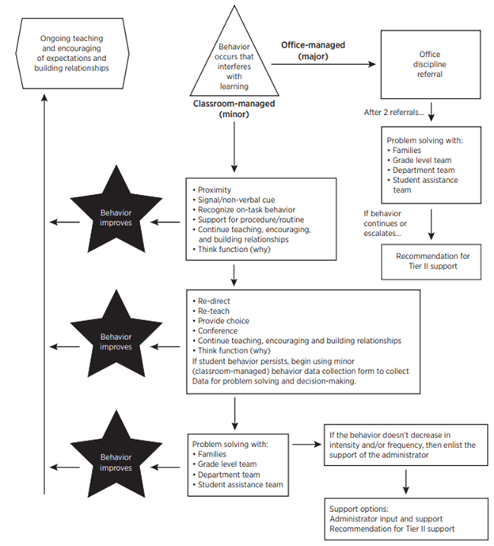
Discipline Process: Continuum of Support for Discouraging Interfering Behavior

Slide 20
Response Strategies
What is the single most commonly used but least effective method for addressing undesirable behavior?
The single most commonly used but least effective method for addressing undesirable behavior is to verbally scold and berate a student (Albetro & Troutman, Revised 2012).

Slide 21
Discouraging Interfering Behavior

Slide 22
Variety of Response Practices
What effective practices are currently in place for responding to a full range of interfering student behavior? How are these vulnerable decision points effectively addressed?

Slide 23
How do you respond?
This video can be found at
http://www.youtube.com/watch?v=VTbbYLvhDSM

Slide 24
Considerations for Consequences
How we respond to behavior will have implications for whether that behavior will continue.
We need to be powerful and well-educated about how our responses can be most effective.
There are several key things to think about…

Slide 25
Consistency, NOT severity, is key.
It is less important what the consequence is, than that something is reliably done.
How staff respond or what consequence is used is less important than the certainty that something will be done, even something relatively brief such as redirection or re-teaching.
MO SW-PBS Team Workbook, 2012-2013

Slide 26
What do you think?

Slide 27
Goals of Effective Responses
_________ the behavior that interferes with learning and engage the students in the expected behavior.
________ the likelihood that the interfering behavior will NOT happen again.
______ escalation of the problem behavior.
(Colvin, 2010)
Avoid Interrupt Increase

Slide 28
Take a Break and Consider….
Avoid Acronyms!
- Tip from National Association of Family & Community Engagement

Slide 29
Classroom-Managed
If interfering student behavior persists, begin using classroom-managed behavior data collection tools to collect data for problem solving and informed decision-making.

Slide 30
Data Collection Fields
Student’s name
Date
Time of incident
Location of incident
Student’s teacher
Student’s grade level
Referring staff
Others involved
Problem behavior
Possible motivation
What was happening before the behavior (antecedent)?
Possible consequences
Administrative decision
Follow up communication
Other comments
TFI 1.5 and 1.6:Activity 3

Slide 31
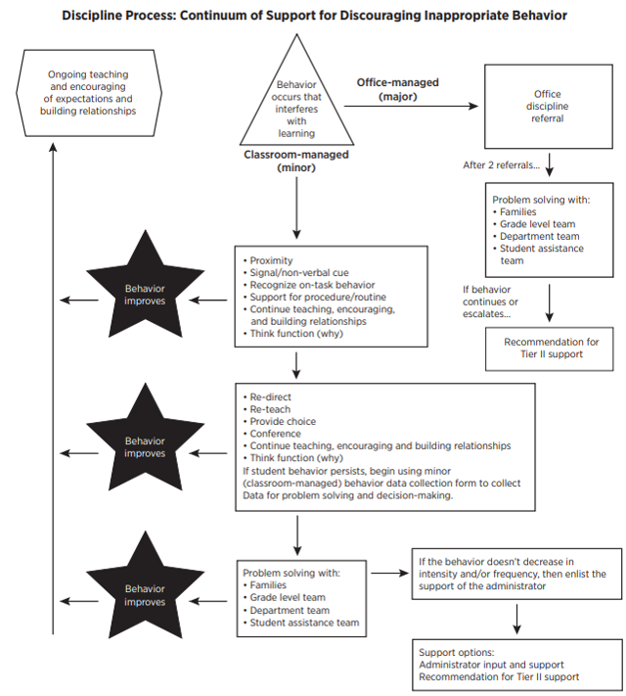
When the interfering behavior takes us here...

Slide 32
What is the system or procedure for referring a student to the office?
Do you complete an office referral electronically?
Do you complete an office referral on paper?
What is the procedure for getting a student to the office (call to office, student goes to the office)?
What’s the administrator's disposition and is it communicated to referring teachers?

Slide 33
What is the purpose of the office discipline referral form?
Is it used as an intervention?
Is it used to collect data?
TFI 1.5 and 1.6: Activity 4

Slide 34
Discipline Process: Continuum of Support for Discouraging Inappropriate Behavior
Procedures

Slide 35
Instructional Responses for Classroom Managed Behaviors
Restructure/revise classroom practices based on student needs.
Adjust pacing of instruction to increase on-task behavior.
Actively observe and plan for ignoring low-level misbehavior.
Change student seating.
Provide immediate positive feedback when students engage in expected behavior.
Respond calmly, restating the desired behavior.
Use progress-monitoring tools (behavior charts with replacement behavior, reflection sheets, monitoring forms)
Communicate/collaborate with parents/guardians and the student’s counselor and/or case manager regarding student behavior, teacher-based actions and to problem solve.

Slide 36
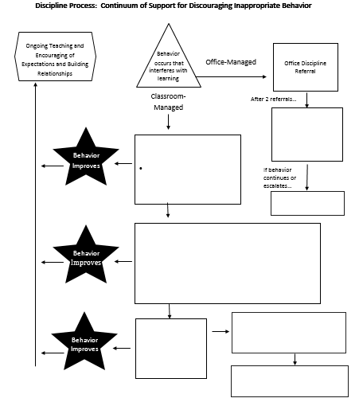
Continuum of Supports for Behavior
TFI 1.5 and 1.6, Activity #4

Slide 37
When There is a Continued Need for Support
What do we do when responses aren’t changing behaviors?

Slide 38
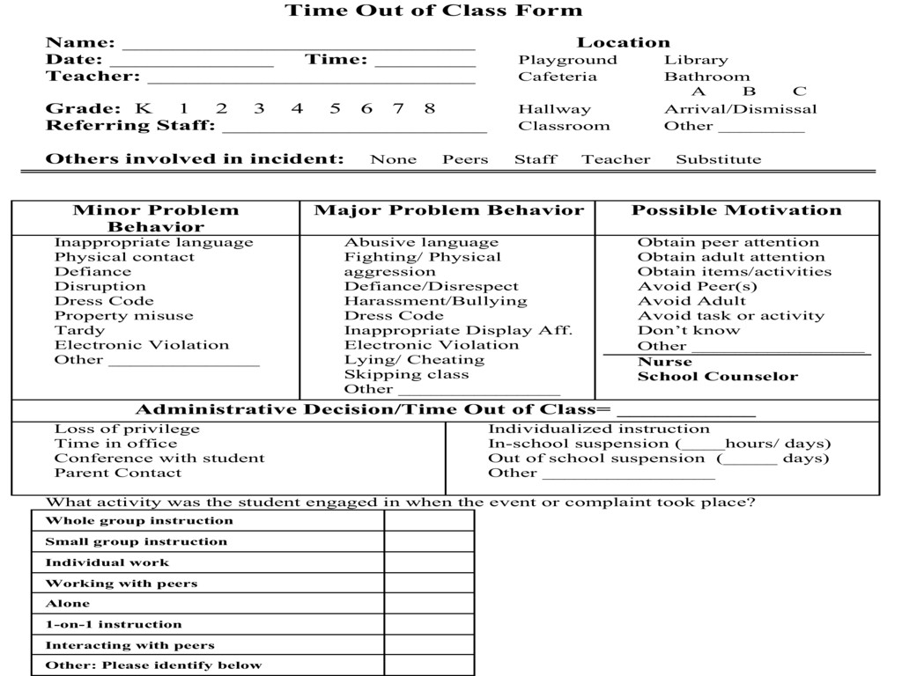

Slide 39
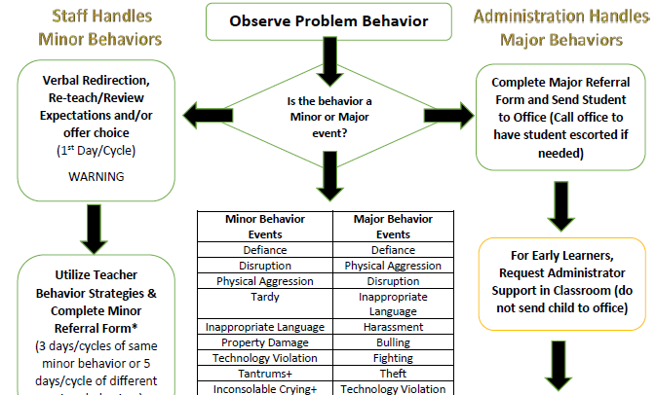
Early Childhood Behavior Flowchart

Slide 40
Action Planning
Problem Behaviors Definitions & Discipline Policies: WHAT NEEDS TO BE COMPLETED? | RESOURCES NEEDED? | WHO? | WHEN?
A.
B.
C.
D.

Slide 41
How are we doing?
Do you feel you can confidently engage
faculty in an exercise to clearly define office managed versus classroom managed behaviors?
2. Do you have a plan for creating opportunities for students to LEARN and PRACTICE appropriate behaviors through an instructional approach?

