Slide 1
PBIS - Tier 1 Behavior Professional Learning
TFI 1.7 Professional Development

Slide 2
Professional Learning Roadmap
Feature | Possible Data Sources | 2 Points Fully Implemented | 1 Point Partially Implemented | 0 Points Not Implemented
1.7 Professional Development: A written process is used for orienting all faculty/staff on 4 core Tier I SWPBIS practices: (a) teaching school-wide expectations, (b) acknowledging appropriate behavior, (c) correcting errors, and (d) requesting assistance. | Professional development calendar Staff handbook | Formal process for teaching all staff all aspects of Tier I system, including all 4 core Tier I practices. | Process is informal/ unwritten, not part of professional development calendar, and/or does not include all staff or all 4 core Tier I practices. | No process for teaching staff is in place.

Slide 3
What will we know and do?
Understand Learning Forward’s seven key components for effective adult learning.
Plan for effective professional learning for staff to support VTSS implementation.
Learning Forward Standards

Slide 4
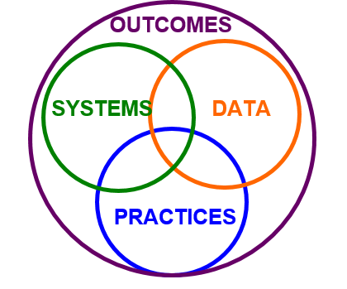
Implementation with Fidelity
Implementation with fidelity is better achieved when…

Slide 5
Effective Professional Learning: Learning Forward Standards
Standard | Qualities | Team’s Role
Learning Communities | occurs within learning communities committed to continuous improvement, collective responsibility, and goal alignment. | creates a network of ongoing learning for evidence based practices embedded in PBIS
Resources | requires prioritizing, monitoring, and coordinating resources for educator learning. | identifies resource needs and determine how to meet them

Slide 6
Standards Part 2
Learning Designs | integrates theories, research, and models of human learning to achieve its intended outcomes. | brings the learning design to the faculty provides well designed training and time to discuss
Leadership | requires skillful leaders who develop capacity, advocate, and create support systems for professional learning.

Slide 7
Standards Part 3
Standard | Qualities | Team’s Role
Data | uses a variety of sources: student, educator, and system data to plan, assess, and evaluate professional learning. | shares and analyzes data
Implementation | applies change research and sustains support for implementation of professional learning for long term change. | makes implementation plans

Slide 8
Standards Part 4
Outcomes | aligns its outcomes with educator performance and student curriculum standards. | measures fidelity and outcomes.

Slide 9
Identify Expertise and Support
Who in our division could we talk to about our plans?
Who on the team enjoys
facilitating learning for adults?
Who in our building provides great professional learning?

Slide 10
When Planning Professional Learning Consider:
What key content do we need to teach?
What resources will make these practices easier for staff to adopt or deepen in their daily routines?
Are there any changes or shifts that might create confusion/resistance?
How will we respond in a supportive way that maintains fidelity of implementation?
TFI 1.7 Activity #1 and # 2

Slide 11
Develop a Training Plan
Booster Sessions: When will we hold these sessions?
New Adults: Who do we train first?
Incoming Staff and Students: How will you share your VTSS plan with staff after your school’s kick-off and with students starting after your school’s kick off?
Substitutes: How will you share your school-wide VTSS plan with short- and long-term subs?
Guest Teachers: How will you share your school-wide VTSS plan with presenters and volunteers?
TFI 1.7 Activity #3 and #4

Slide 12
Cycle of Growth and Learning
As we accomplish our implementation goals, we celebrate and then create new ones, all for the improvement of outcomes for our students and staff.
Celebrate Growth!

Slide 13
Remember the Golden Circle?
Stakeholders may ask,
“Why are we doing this VTSS thing?”
How will you concisely answer this question?
Create an Elevator Pitch to share your vision and hard work!
Why
How
What
TFI 1.7 Activity #5 -Elevator Pitch

Slide 14
What will we know and do?
Understand Learning Forward’s seven key components for effective adult learning.
Plan for effective professional learning for staff to support VTSS implementation.
Learning Forward Standards

Slide 15
Action Plan
What needs to be completed? | Resources needed? | Who? | When?
A.
B.
C.

