Slide 1
Tier 1 Team
Training Behavior
TFI 1.8 Classroom Procedures

Slide 2
Professional Learning Roadmap
Our Focus in this Module
1.8 Classroom Expectations
Feature | Possible Data Sources | 2 Points Fully Implemented | 1 Point Partially Implemented | 0 Points Not Implemented
1.8 Classroom Procedures: Tier I features (school-wide expectations, routines, acknowledgments, in-class continuum of consequences) are implemented within classrooms and consistent with school-wide systems. | Staff handbook Informal walkthroughs Progress monitoring Individual classroom data | Classrooms are formally implementing all core Tier I features, consistent with school-wide expectations. | Classrooms are informally implementing Tier I but no formal system exists. | Classrooms are not implementing Tier I.

Slide 3
Learning Intentions
Create a plan for guiding staff in defining expectations with observable and measurable expectations for classrooms.
Understand options for aligning classroom behaviors and procedures to school-wide expectations

Slide 4
Teaching Matrix
Teaching Matrix |  | SETTING
 |  | Hallways | Cafeteria | Library/ Computer Lab | Bus | Classroom
 | Be Respectful | Keep hands feet and other objects to self | Eat only your food | Study, read, compute | Watch for your stop
 | Be Responsible | Use quiet voice | Replace trays & utensils | Push in chairs. Treat books carefully. | Wipe your feet Sit appropriately
 | Be Safe | Maintain your own physical space Stay to the right | Clean up your eating area | Whisper. Return books | Use a quiet voice Stay in your seat
 | Conditions for Learning
What about the classroom?
Expectations

Slide 5
School Wide Expectations
School-wide Expectations | Class-wide Expectations (rules/behaviors aligned with expectations)
Be Respectful | Raise your hand before speaking & when you need help Listen when others are talking Use inside voice
Be Responsible | Have materials ready before activities begin
Be Safe | Follow directions the first time Keep hands, feet, and objects to yourself
Anchor Classroom to School-wide Expectations
Consider: department, grade level, core team, co-teaching teams
TFI 1.3/1.8: Activity 7

Slide 6
Student Voice
 | All Areas | Classroom | Hallways | Bathroom | Cafeteria | Bus Ramp
Be Respectful | Value other student’s opinions and needs | Do not punish the whole class for the actions of one student | Say excuse me when bumping into someone Pick up trash & hazardous materials | Discard of any trash Clean up after oneself | Join the end of the line Keep noise to a minimum | Keep moving so students can board the bus on time
Activity #7

Slide 7
Activity #7
Practice defining classroom behaviors aligned with your expectations.
Discuss pros and cons of having individual teachers create their own aligned classroom behavior definitions vs. having consistency across the school/grade levels/teams.
Discuss how your team will get stakeholder involvement in defining classroom expectations.

Slide 8
Consistency With Our Language
Expectations | 3-5 overarching school-wide expectations
Behaviors | specific tasks students are to do to achieve the school-wide expectations
Routines/ Procedures | procedures are methods for accomplishing tasks in the classroom procedures form routines that help students meet classroom expectations and rules/behaviors

Slide 9
The Power of Language
Traditional Reactors | Helpful Responses
“It’s not that difficult.” | “I need to know how hard this is for you.”
“Go to the principal’s office.” | “I’m here. You’re not in trouble.”
“You need to take ownership of this.” | “I’m sorry this is so hard.”
“Stop crying.” | “It’s okay to feel.”
“You’re old enough to handle this.” | “Let’s handle this one together.”

Slide 10
What Are Procedures & Routines?
Procedures should be succinct, positively stated and in age-appropriate terms
  keep “who, what, when, where, why, and how” in mind
  taught and consistently enforced
  patterns for accomplishing classroom tasks
Procedures form routines when practiced and help students meet expectations stated in the expectations

Slide 11
Research Studies Found…
Effective teaching includes teaching functional routines and procedures to students at the beginning of the year and using these routines to efficiently move through the school day. (Simonsen and Myers, 2015)
As students become more familiar with classroom routines and procedures, additional instructional formats and more challenging work can be incorporated
(Evertson, Emmer, & Worsham, 2003; Good & Brophy, 2003)
Having Procedures and Routines in place will:
  Increase instructional time by preventing problem behavior
  Free teachers from correcting misbehavior
  Improve classroom climate
  Create shared ownership of the classroom
  Develop self-discipline

Slide 12
Procedures and Routines Examples
Elementary
Secondary
Times you may need a routine
  Entering the classroom
  What do when finished with work
  How to get teacher’s attention
  In-class transitions
  Dismissal
  How to let teacher know when you need to take a break (i.e. Calming Corner)
When a student is late for class
  Knock on door if closed
  Put tardy slip on teacher’s desk
  Get out materials for class
  Wait for teacher and/or student partner to give directions
When a student needs to take a break from the classroom
For procedures to become routines it is every teacher’s responsibility to
teach each one directly, practice them regularly, and reinforce students for following them correctly.

Slide 13
Procedures Become Routine
1.______ the procedures directly through behavior lessons and role play
2._________ procedures regularly so they become routinely used
3._____ students of procedures by providing pre-corrects before they need to use the procedure for an activity
4._________ students when they have followed a procedure correctly so that there will be the likelihood of it continuing to be repeated.
A. Practice B. Acknowledge C. Teach D. Remind

Slide 14
Break

Slide 15
Example of a Classroom Procedures Matrix
Settings ➔ Expectations ↓ | Starting the Day Procedures | Independent Work Procedures | Transitions Procedures | Small Group Work Procedures | When I feel Upset/Frustrated
Be Responsible | Turn in homework Put instructional materials in desk Begin morning work | Have materials ready Check your work before turning it in Begin next activity when finished | Put materials away on my signal Get materials ready for next activity | Assign roles for group work (include a timekeeper) | Identify the emotion
Be Respectful | Talk in soft voices | Move quietly around room when necessary | Listen for directions to move | Listen to your peers and speak when it is your turn Support your peers and let them do their role | Communicate with teacher/adult Use kind words
Be Safe | Put personal belongings in designated areas | Select area to work and walk to selected spot quickly and quietly | Always walk quietly to new location | Clean up area when group work is finished for the day | Use coping strategies you know

Slide 16
Classroom Procedures and Routines to Create the Conditions for Learning
School-wide Expectations | Rules/Norms | I need help | Lining up for Lunch | Circle Time | Going Home
Be Respectful | Raise your hand before speaking & when you need help Listen when others are talking Use inside voice | Raise hand if you have a teacher question Wait your turn quietly | Look for teacher signal and listen | Take turns Listen to others talking | Listen to announcements Wait for your turn to get your stuff
Be Responsible | Have materials ready before activities begin | Continue working while waiting for help | Follow teacher directions to line-up | Get materials to begin Return materials to their home | Follow teacher directions Be sure you have everything
Be Safe | Follow directions the first time Keep hands, feet, and objects to yourself | Stay in your seat | Line up on blue line at door Walk quietly | Stay in your space Hands and feet to self | Line up on blue line at door Wait quietly

Slide 17
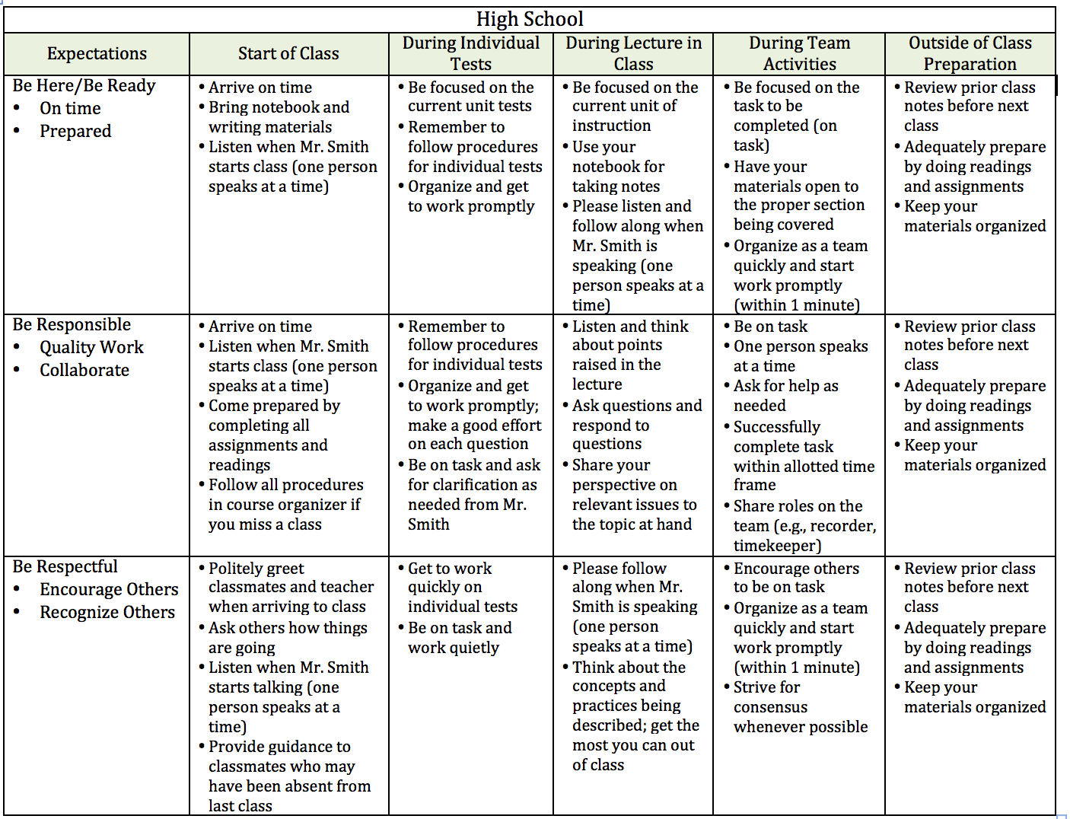
High School Procedures Matrix

Slide 18
Routines for Supporting
Emotional Safety
When students can predict what will happen in the classroom, there is a sense of safety and security.
Routines create predictable environments where students know what to expect and how to act/react.

Slide 19
How Teachers Honor Students
If someone says or does something that is rude, nasty or inappropriate, I just want to let you know that I will not always be stopping the lesson to deal with it. It doesn’t mean I’m not going to do something about it. It just means I think teaching is more important in that moment.
EdWeb, Trauma-Informed Motivation and Managing in the Classroom, April 2021

Slide 20
Routines and Procedures:
Lesson Design Considerations
Conversation
  Can students engage in conversation during this activity? If yes, about what? With whom?
Help
  How do students get your attention to ask a question? What do they do while they wait?
Movement
  Can students get out of their seats for this activity? If so, for what reasons?
Participation
  What does it look like and sound like?

Slide 21
If routines are disrupted...
Think about the last time your morning routine got disrupted and how it impacted your emotional response to students/others.
What happens when routines are disrupted for students?

Slide 22
If routines are disrupted in the classroom...
Notice and acknowledge when routines have been disrupted
Revisit the need for the routine
Re-teach routine
Create opportunities to practice routine
Provide feedback

Slide 23
Using a Classroom Matrix to Target Procedures
Settings ➔ Expectations ↓ | Start of Day | Independent Work | Transitions | Small Group
Be Responsible
Be Respectful
Be Safe

Slide 24
Complete your Action Plan
WHAT NEEDS TO BE COMPLETED? | RESOURCES NEEDED? | WHO? | WHEN?
A.
B.
C.

