Slide 1
PBIS – Tier I
New Team Professional Learning

Slide 2

VTSS social media
Vtss_ric

Slide 3







Atrributions
Appreciation is given to the following
for their contributions to this New Team Professional Learning:
Center for Social Behavior Support
Mid-Atlantic PBIS Network
Midwest PBIS Network

Slide 4
What to expect these three days….
begin each day at 9:00 a.m.
frequent breaks and time for team work
one hour for lunch
Zoom tools for feedback and engagement
breakout rooms for activities
action planning to continue work after this event

Slide 5
Prepare for the webinar
            1. Download the VTSS Tier I New Team Workbook materials https://vtss-ric.vcu.edu/
            Implementers->
            Tier I Resources->
            More About Tier 1 Forum->
            New Team Training->
            Materials and Zoom link
2. Create a shared folder for all materials
3. Review Zoom basic tools if you are new to this platform
Annotation tools: https://www.youtube.com/watch?v=Dyv6KRsurno ( 6 min.)

Slide 6
Grid Greetings
If it’s true for you, type your name in the box.
I have been with my division for more than 5 years. | I have children. | I love to read.
I have worn pajama pants during a Zoom. | I have binged watched something on Netflix, Amazon, etc. | I have a pet.

Slide 7
Virtual Norms
Expectations | What does that look like?
Be Engaged | Unmute to share ideas/questions. Participate in virtual activities.
Be Respectful | Eliminate distractions like cell phones, email, social media, and background noise. Give others time to talk and share. Be committed to attend all three days.
Be Prepared | Download materials prior to the session. Set dates/times with your team to continue action planning after professional learning.

Slide 8
What we will accomplish in these three days.
During our Time Together
Future Work Back at Your School
Review key features of the VTSS Framework and our Roadmap for this work
Begin creating a Behavior Matrix
Begin Action Planning
Complete your Behavior Matrix
Complete your Action Planning

Slide 9
Did you work from home and teach kids this past year?
YES
NO

Slide 10
Professional Learning Roadmap
SWISPBIS Tiered Fidelity Inventory

Slide 11
Change is Constant
INDIVIDUAL
How does it feel when new ways of working arrive on your doorstep?
How do you want your voice heard?
What do you look for when deciding if you are on board with the change?
TEAMS
How do your colleagues experience change?
How do all of you want to be involved in implementation decisions?

Slide 12
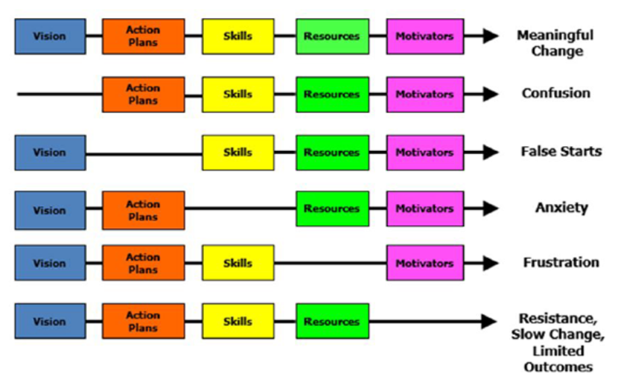
Managing Complex Change
Knoster, Villa and Thousand, 2000.

Slide 13


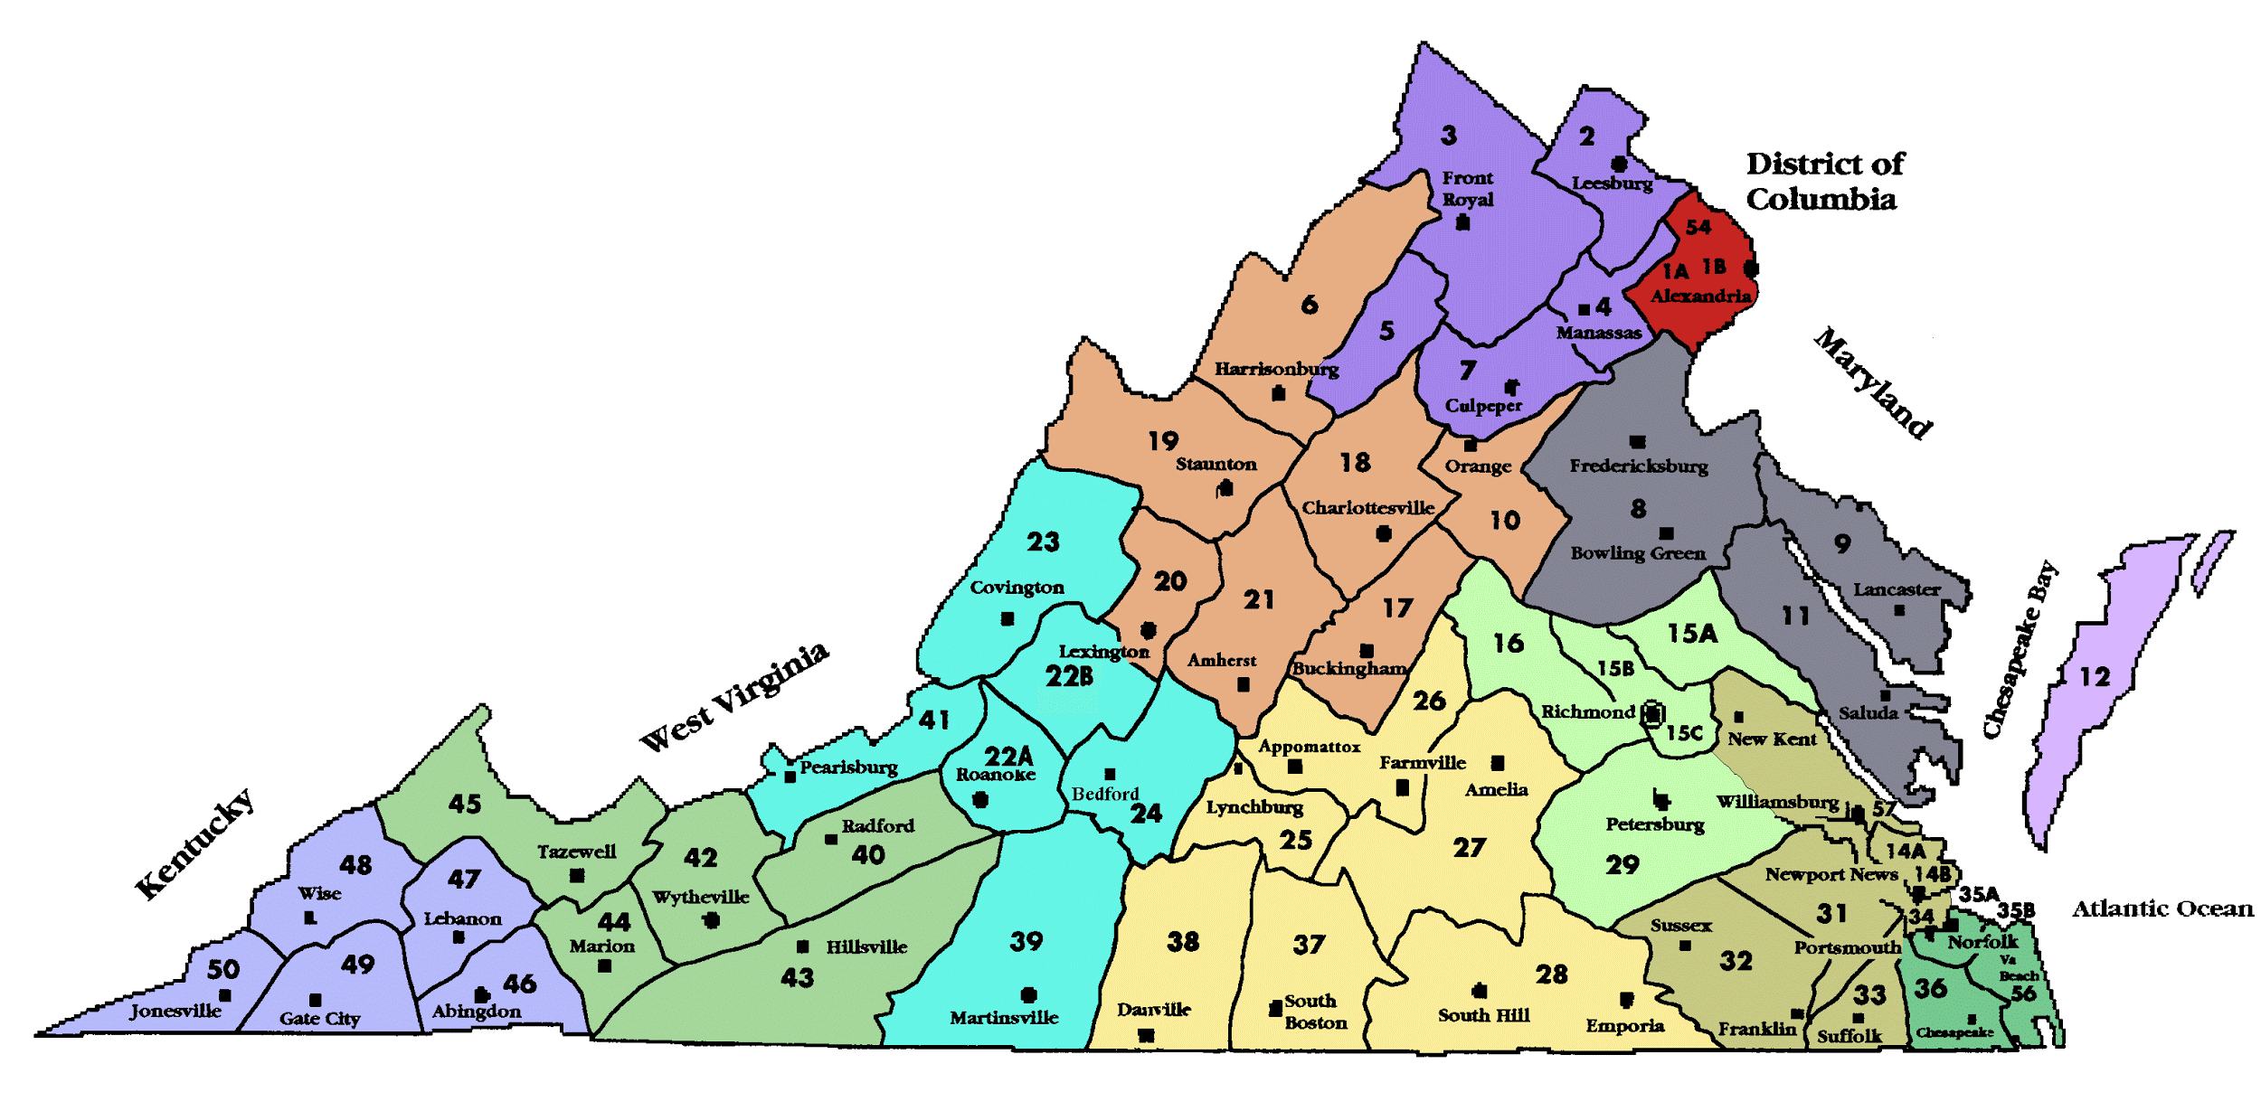

Consistency Matters:
Common Language
School Based Coaching
guides faculty
supports implementation of PBIS
Division Based Coaching
support to schools
liaison to the system coach
provided by VTSS to develop capacity among implementers
Systems Coaching

Slide 14
What is VTSS?
The Virginia Tiered Systems of Supports (VTSS) integrates academics, behavior and mental health into a single decision-making framework for establishing the supports needed for a school to be an effective learning environment for all students.
The VTSS systemic approach allows divisions, schools, and communities to provide multiple levels of support to students in a more effective and efficient, clearly defined process.

Slide 15
Understanding VTSS
VTSS is not a new initiative, it is a way of doing work!
VTSS is a Multi-Tier System of Support (MTSS) framework
What is a Multi-Tier System of Support?

Slide 16
Features of MTSS
Academic RTI
PBIS
•Specific academic assessments and interventions
•Use of published curricula selected by school or district
•Use of direct assessment of skills
•Periodic assessment through benchmarking periods
•Focus on grade-level teaming
•Described in IDEA as SPED eligibility determination approach
•Scientifically-based interventions
•Instruction as prevention
•Tiered continuum of supports with increasing intensity based on need
•Regular screening for early intervention
•Use of a problem-solving model and data-based decision rules
•Focus on teaming
•Emphasis on improving quality of implementation
•Embedded into school improvement plan
•Specific social behavior assessments and interventions
•Use of free materials that are adapted to fit the school’s context
•Use of indirect assessment of behavior
•Continuous assessment of social behavior with existing data sources
•Focus on school-wide teaming
•Described in IDEA as school-wide prevention and individual intervention approach
McIntosh & Goodman, 2015

Slide 17
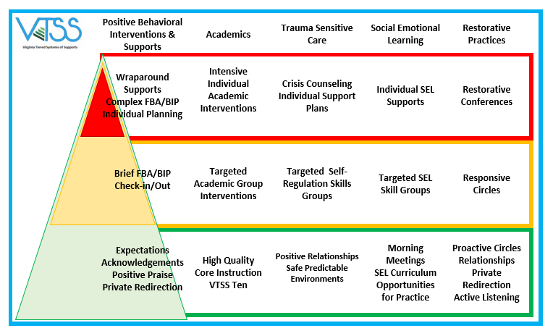
VTSS Can Support All Efforts

Slide 18
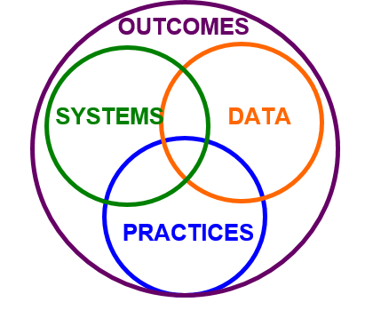
Implementation Logic
Teams and schools will use their learning to…develop data driven systems that support adults in efficient acquisition of preventive and restorative practices for teaching prosocial skills and responding to behavior incidents.
Supporting
Decision
Making
Supporting
Staff
Supporting
Students

Slide 19
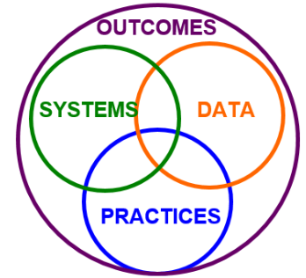

Let’s practice the
Implementation Logic
With your team, choose a current example in your school that reflects the implementation logic of data, practices, and systems.
This example will help your faculty understand the value of each element and the importance of this logic.
Activity #1, pg. 5

Slide 20
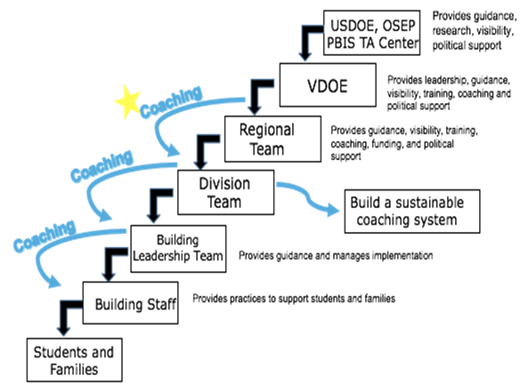
Division Leaders Support the SYSTEM

Slide 21
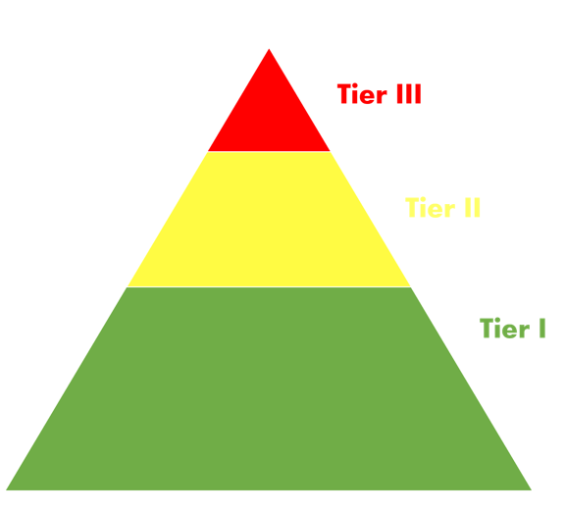
Tiered Instruction and Intervention
Knowing the culture in your building, what is the best way to explain tiered instruction and intervention to your faculty?
Activity #2, pg. 6

Slide 22

Layers of Support
Students receiving Tier II and Tier III supports ALSO receive Tier I supports
Tier III: No more than 5% of students needing intensive, individualized instruction in addition to core and supplemental instruction
Tier II: No more than approximately 20% of students needing supplemental instruction in addition to core instruction
Tier I: Goal – 100% of students achieve at high levels

Slide 23
Tier Summary
Tier I
- Universal, core, primary level of prevention
- School-wide research-based systems, practices, & data
- Available to all students from all adults at all times
Tier II
- Supplemental, targeted, secondary level of prevention
- Small group research-based interventions available to some students in order to access core curriculum
- Tier 2 services provided in addition to core instruction
Tier III
- Intensive, tertiary level of prevention
- Individualized research-based interventions provided to the few highest need students and designed by individualized student teams

Slide 24
Example:
Tiered Behavioral Supports
Tier I: School wide expectations matrix, teaching expectations, lesson plans, reviewing expectations, acknowledgement system, classroom based strategies
Tier II: Check in Check Out (CICO) with specific targets and skill instruction
Tier III: Functional Behavior Assessment (FBA) and Behavior Intervention Plan (BIP)

Slide 25
Example:
Tiered Social Emotional Learning Supports
Tier I (Core curriculum): Social Emotional Learning, relationship building, behavior as communication, classroom routines for self-regulation, staff self-care plan, restorative practices
Tier II: Student mentoring programs, partnering with community organizations, small groups and classes for specialized instruction
Tier III: Individual student plans, wrap-around and individual counseling

Slide 26
Example:
Tiered Math Supports
Tier I (Core curriculum): Explicit instructional sequence (I do, we do, you do), student goal setting, use of dry erase boards, response cards, and other techniques to increase student engagement, working through the CONCRETE – REPRESENTATIONAL – ABSTRACT sequence
Tier II: Small group intervention focused on a research-based problem solving method
Tier III: One on one tutoring driven by student mastery data

Slide 27
Example:
Tiered Attendance Supports
Tier I: Engaging school climate, positive relationships with students and families, recognition of improved attendance, chronic absence data monitored
Tier II: Personalized early outreach, caring mentors
Tier III: Coordinated school and interagency response, legal intervention (last resort)

Slide 28

Why are we here?
Universal Evidenced Based Practices
Schools and teams will use their learning to….
Adopt, organize,
and implement
evidence-based practices
for teaching and
reinforcing behaviors
Social-Emotional
Behavior
that promote academic and social success for ALL students.

Slide 29
Six Core Components of VTSS
Aligned Organizational Culture and Structure
Data Informed Decision-Making
Monitoring Student Progress
See Workbook pg. 3

Slide 30
Six Core Components (cont.)
4. Evidence-Based Practices
5. Family, School, and Community Partnership
6. Evaluation
See Workbook pg. 3

Slide 31
VTSS is not a new initiative, it is a way of doing work!
The focus is on behavior for Tier I supports.
The various tasks we cover during this training will take time to implement (1-2 years).
Your VTSS coaches will be there to support you every step of the way.

Slide 32
Critical Tasks of
Tier I New Team Training
Begin to build a behavior expectation matrix
Plan for creating lesson plans for the behavior matrix
Begin to create an acknowledgement system
Plan for communications with staff

Slide 33
Action Planning for each TFI Module.
Behavioral & Classroom Expectations: WHAT NEEDS TO BE COMPLETED? | RESOURCES NEEDED? | WHO? | WHEN?
A.
B.
C.
D.

Slide 34
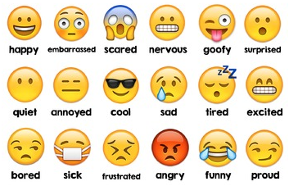
How are you feeling after learning more about VTSS?

Slide 35
How do you eat an elephant?
One bite at a time!
Let’s get your VTSS journey started!

Slide 36
BEFORE Tier I Training
Download the VTSS Tier I New Team training materials at vtss-ric.vcu.edu/
Complete the TFI 1.1 and TFI 1.2 with your VTSS State Coaches or view the recorded webinar with your team.
Discuss any comments or questions with your VTSS State Coaches or Division Lead.

