Slide 1
Trauma Sensitive Schools
within VTSS
TFI 1.11 - Student, Family and Community Engagement

Slide 2
What Will We Know and Do
Explore current approaches to engaging families in schools, particularly those families impacted by trauma
Understand why family and community engagement is key to developing and fostering trauma-sensitive schools within a multi-tiered systems of supports
Identify strategies for implementation of empowering, trauma-sensitive strategies to foster positive school – family – community partnership
Create a plan to include and engage families impacted by trauma and traumatic stress within the VTSS framework and measure it

Slide 3
Roadmap
TFI | Mental Health Planning Tool | A-TFI
1.11 Student/Family & Community Involvement: Stakeholders (students, families, and community members) provide input on universal foundations (e.g., expectations, consequences, acknowledgments) at least every 12 months. | 1.11 Student/Family & Community Involvement: School/staff engage students, families, and community in wellness practices. | 1.11 Family and Community Engagement: School provides a system for diverse opportunities to authentically engage family and community stakeholders in instruction.

Slide 4
Why Engage Families?
School reach out to families and the community, and building strong parent-school relationships have positive impact on students.
When schools and families partner:
reading and math and other academic outcomes increase;
student attendance improves.
Families’ high expectations matter:
Parental expectations are positively associated with students’ emotional engagement and more strongly associated for low-SES groups.
(literature review by Wood & Bauman, 2017)

Slide 5
The VTSS Framework
Aligned Organizational Structure
Data Informed Decision Making
Evidence-Based Practices
Family, School, and Community Partnerships
Monitoring Student Progress
Evaluation

Slide 6
Schools and Families as Partners
“The key to creating family engagement that supports better learning outcomes is to ensure that there is a plan in place that engages every family… Every family, in this case, does truly mean every family. And the engagement has as an outcome better achievement for children…all children.” -Dr. Steve Constantino, 2016

Slide 7
Confronting the Family Role in Trauma
Educators AND families keeping focus on the student
Our Goal: Build safe, collaborative and non-judgmental relationships with families and communities so that outcomes for children and youth will improve.

Slide 8
Consider
Does your division have a definition or model for family and community engagement? If so, what are the outcomes and expectations for schools?
How are outcomes and expectations inclusive of & responsive to family & community culture?
How do family and community members know how and when to engage?
What facilitates engagement in your division and school?
Are your efforts to engage families trauma-sensitive? How do you know?

Slide 9
Trauma: A Factor in Family Engagement
Parents/caregivers who are affected by trauma may have their own triggers related to their experiences. Potential trauma triggers:
Feeling disrespected by the school staff
Being called into a meeting to address their child’s behaviors
Uncertainty about what is happening
Concerns about safety of their children
Lack of control over decisions being made about their child
History of negative experiences with the education system

Slide 10
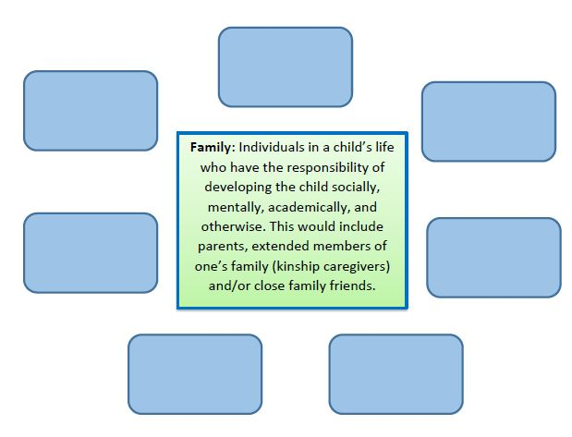
Who is Family?

Slide 11
Six Components of (trauma sensitive) Family Engagement
Positive Relationships: The strengths of all families, including those impacted by trauma, are recognized, valued and honored by school staff. Staff and families recognize families’ needs and cultural experiences to lead to greater understanding and respect among all.
Family Empowerment: Families are valued, encouraged and supported to be equal partners in their children’s education. Efforts to empower families impacted by trauma are ongoing, consistent and authentic. Families are offered relevant and trauma-sensitive resources (ex., training, stipends, technology access) to build skills to serve as leaders, advocates, supporters and partners with staff in student learning.

Slide 12
Six Components of (trauma sensitive) Family Engagement
Leadership: Leaders demonstrate ongoing commitment to family engagement overall and to creating and fostering a trauma-responsive school environment. Understands and dedicates resources to students, families and staff to offer trauma-sensitive approaches at all three tiers.
Data-based Goals and Outcomes: Goals related to family and community engagement reflect the culture and experience of those in the community. Goals might include family and child/youth resiliency, staff readiness to use trauma sensitive strategies, staff self-care. Evaluation of outcomes is conducted in a way that does not risk retraumatization.

Slide 13
Six Components of (trauma sensitive) Family Engagement
Multi‐tiered/Multi-dimensional Approach: Approaches for dialoguing with families are varied, accommodating common triggers and challenges. Responses to and interventions across tiers with families account for traumatic stressors. Families understand tiers and implications for their children.
Collaborative Problem Solving: For students receiving tier 2 & 3 services, family input is obtained and utilized in a way that minimizes risk of triggers. Family participation is accessible and encouraged in the problem solving process. Links to clinical and other community services with trauma expertise are made when appropriate.

Slide 14
Videos: VTSS Trauma Sensitive Approaches for Home & School
Series of three videos: Understanding Trauma; Addressing Trauma; Building Trauma Sensitive Schools
Feature family, educator and clinician voices
Fact sheets to accompany each
Valuable tools for PD and family outreach and building connection
Workbook

Slide 15
Video 1
Please see you VTSS Systems Coach for a copy of this video

Slide 16
Activity- The Data
2 in 3 Virginia children who have had major depressive episode did not receive mental health treatment due to a lack of MH professionals.
31% of Virginia children are in homes with low income. 29% of Virginia children live in households with high housing cost burden (spend more than 30% of income on housing).
Parents with ACEs are more likely to have children with developmental delays. There is an 18% increase in suspected risk of delay for each maternal or paternal ACE.

Slide 17
Activity- in Teams
What are implications of these data for your daily work in serving students and families?
How do or can these data shape your efforts to provide your services in a trauma-sensitive way?
Where could collaboration with other sectors improve your services to families and improve family and child outcomes?

Slide 18
First Steps a School or Agency Might Take
Assess using facilities checklist or other measure
Survey families
Revisit discipline procedures and code of conduct for trauma responsiveness
Consider communication protocols to proactively connect about students and families ‘in hard places’

Slide 19
Choosing a Measure
Workforce development involves promoting knowledge of trauma (for instance, through staff trainings and a healthy workforce).
Trauma-focused services include screening and access to trauma-focused interventions.
Organizational environment & practices include policies and practices that promote trauma-related communication and collaboration.

Slide 20
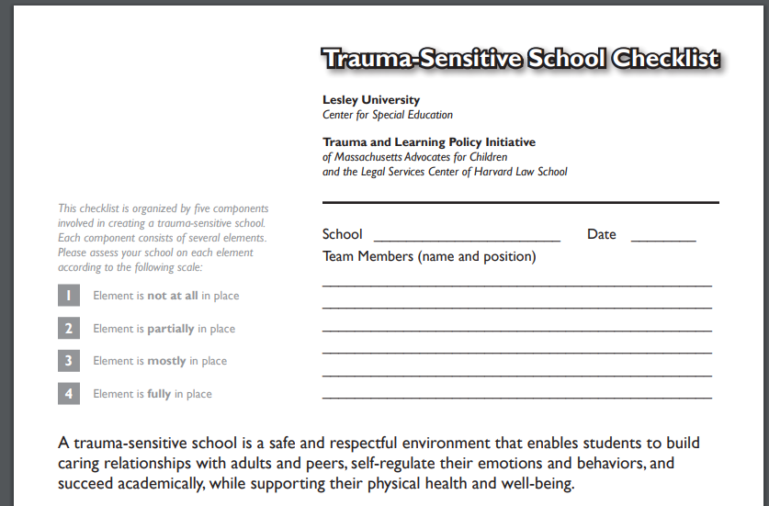
Trauma-Sensitive School Checklist
Workbook

Slide 21
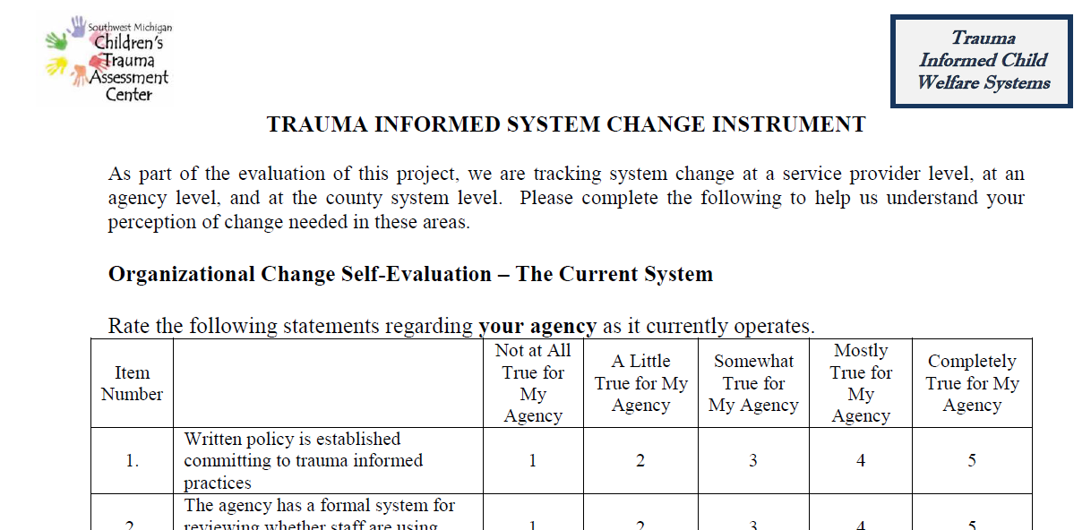
Trauma-Informed System Change Instrument
Workbook

Slide 22
Trauma-Informed System Change Instrument

Slide 23
Ideas for Engagement
Family kick-off event
Encourage families to share information with the school about culture, background, children's talents and needs
Student engagement opportunities, ex. student ambassador and leadership opportunities
Hold neighborhood meetings to help families understand schools & schools understand families
Service opportunities for staff, families, youth, community members to work for common goal
Plan for data-informed decisions through feedback from families and students (e.g. formal and informal surveys, focus groups)

Slide 24
Drilling Down Example
Family kick-off:
Letter to families
VTSS overview
Explanation of school expectations
Explanation of acknowledgement system
Brochure
Back to school activities

Slide 25
Bringing It to the Community
What is your community doing to:
Realize trauma impact & understand paths to recovery?
Recognize the signs/symptoms of trauma in students, families, staff?
Respond by integrating policies, procedures, practices?
Resist retraumatization?

Slide 26
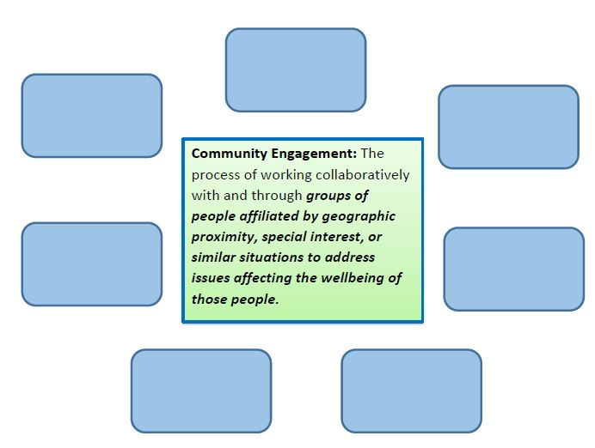
Who is Community?
Workbook

Slide 27
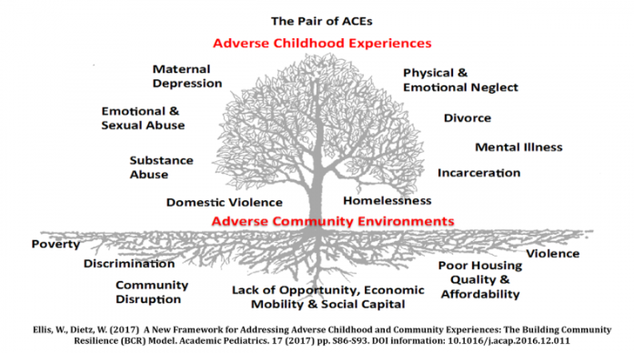
Trauma-Focused
Community Tools
Building Community Resilience from GW University
Virginia HEALS Toolkit
Workbook

Slide 28
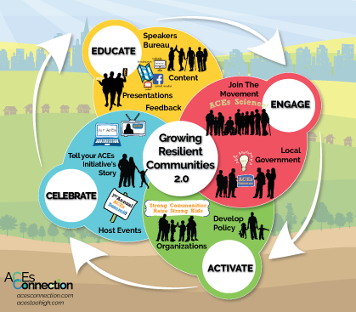
Growing Resilient Communities
Workbook

Slide 29
Planning for Authentic Family Engagement
An action plan should:
guide agencies in laying out basic beliefs, goals and practices on how the team will work together to support family, community and youth engagement in PBIS/VTSS;
be agreed upon by families and other partners.
Workbook

Slide 30
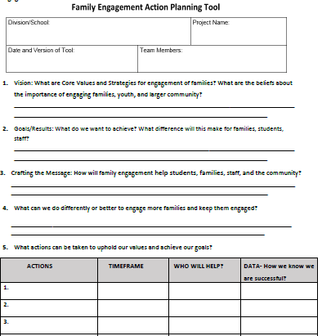
Family Engagement Action Plan
Workbook

Slide 31
Action Plan
Workbook

